Slide 1
APL Bootcamp
Tacit Programming

Slide 2
Tacit Programming
Explicit code mentions arguments:
Expression (⌈/N)-⌊/N←3 1 4 1 5
Tradfn ∇ R←Range Y …
Dfn {(⌈/⍵)-(⌊/⍵)}
Tacit code implies arguments:
Tacit (⌈/-⌊/)

Slide 3
You already know some
f/ f¨ ∘.g f\ A∘g f⌸ f⍠B
Operators derive tacit functions

Slide 4
Function composition
f⍥g f⍤g f⍨ fgh f∘g
Function composition is plumbing that guides arguments to functions

Slide 5
Benefits
Memorable (like ≠⊆⊢ and +⌿÷≢)
Adjacency (like ×- and ∨/⍷)
Brevity (like F⍥⎕C)
DRY (Don’t Repeat Yourself; like ≡⍥⍴)
Just a general feeling of superiority and awesomeness

Slide 6
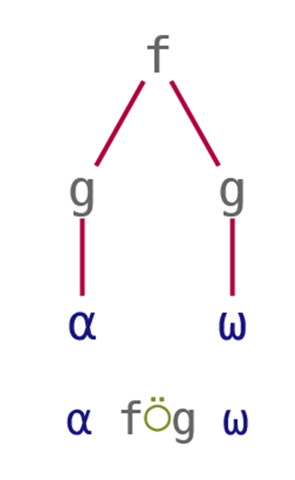
⍥ Over
The shape of an outer product ⍺ ∘.f ⍵ is (⍴⍺) , (⍴⍵)
We can write this as ⍺ ,⍥⍴ ⍵
“pre-process both”

Slide 7
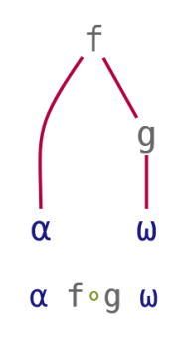
∘ Beside
Location of ⍺^{th} 1 in each element of ⍵ is ⍺ ⊃¨ ⍸¨ ⍵
We can write this as ⍺ ⊃∘⍸¨ ⍵
“pre-process right”

Slide 8
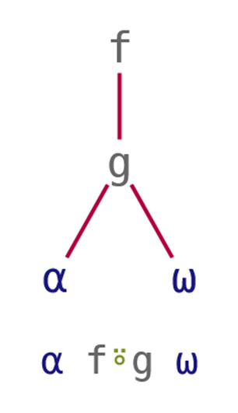
⍤ Atop
Any-presence of ⍺ in ⍵ is ∨/ ⍺ ⍷ ⍵
We can write this as ⍺ ∨/⍤⍷ ⍵
“post-process result”

Slide 9
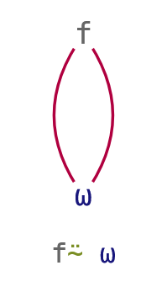
⍨ Commute
A multiplication table of N is (⍳⍵) ∘.× (⍳⍵)
We can write this as ∘.×⍨ ⍳⍵
“selfie”
Notes:
After this slide, handout "function compositions" cheat sheet

Slide 10
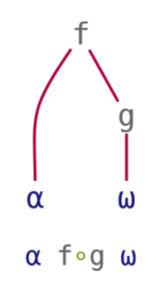
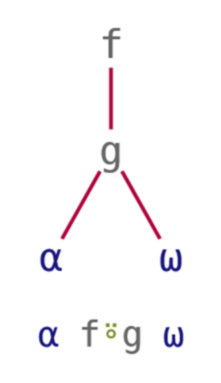
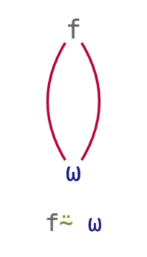
Tacit Techniques Function Compositions
Over | Beside | Atop | Commute
pre-process both | pre-process right | post-process result | selfie

Slide 11
Train Introduction
Also a type of composition
Sequence of functions in isolation
Parenthesised: (+⌿÷≢) 3 1 4 1 5
Assigned Avg←+⌿÷≢ Avg 3 1 4 1 5
+⌿÷≢ 3 1 4 1 5
0.2
(+⌿÷≢)3 1 4 1 5
2.8
Most common mistake

Slide 12
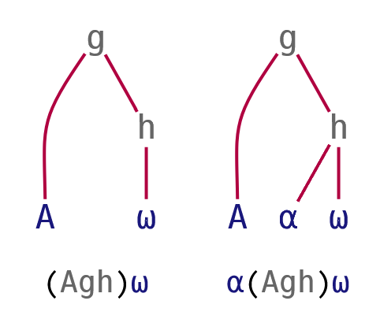
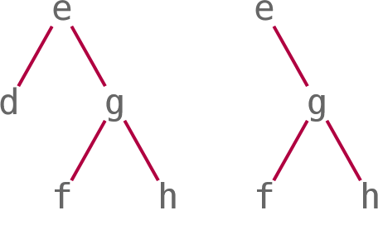
Train Details
Some parts can be arrays:
A g h is {A} g h
Two sub-types of trains:
Fork: f g h and A g h
Atop: f g
Longer trains:
(d e f g h) is (d e (f g h))
(e f g h) is (e (f g h))
Notes:
After this slide, handout "trains" cheat sheet

Slide 13
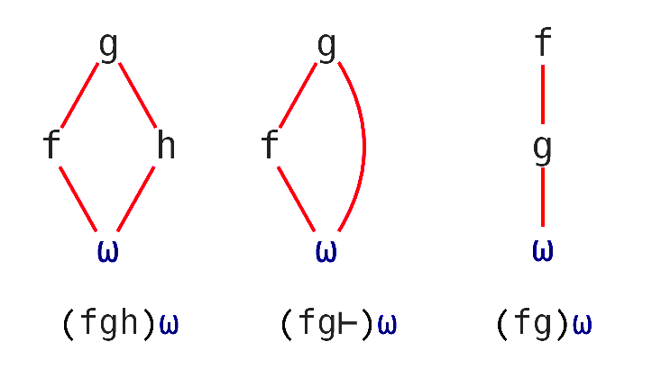
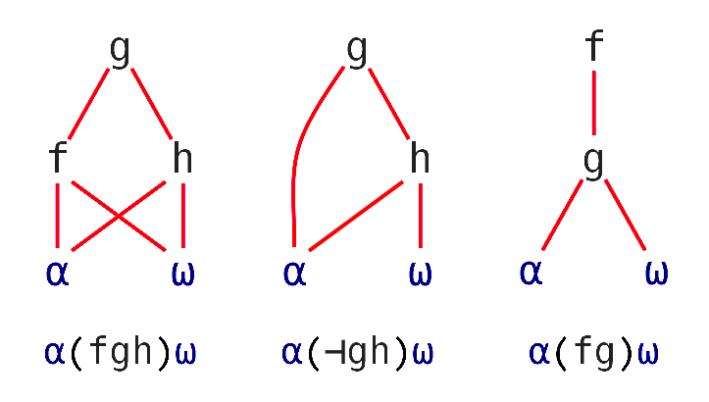
Tacit Techniques Trains
Monadic
(f Y) g (h Y) ↔ (f g h) Y
(f Y) g ( Y) ↔ (f g ⊢) Y
g (h Y) ↔ ( g h) Y
Dyadic
(X f Y) g (X h Y) ↔ X (f g h) Y
(X ) g (X h Y) ↔ X (⊣ g h) Y
g (X h Y) ↔ X ( g h) Y

Slide 14
]box on |⊢÷+/⍣≡
┌─┬─────────────────┐ │|│┌─┬─┬───────────┐│ │ ││⊢│÷│┌─────┬─┬─┐││ │ ││ │ ││┌─┬─┐│⍣│≡│││ │ ││ │ │││+│/││ │ │││ │ ││ │ ││└─┴─┘│ │ │││ │ ││ │ │└─────┴─┴─┘││ │ │└─┴─┴───────────┘│ └─┴─────────────────┘

Slide 15
]box on –t=… |⊢÷+/⍣≡
-t=box
┌─┬─────────────────┐ │|│┌─┬─┬───────────┐│ │ ││⊢│÷│┌─────┬─┬─┐││ │ ││ │ ││┌─┬─┐│⍣│≡│││ │ ││ │ │││+│/││ │ │││ │ ││ │ ││└─┴─┘│ │ │││ │ ││ │ │└─────┴─┴─┘││ │ │└─┴─┴───────────┘│ └─┴─────────────────┘

Slide 16
]box on –t=… |⊢÷+/⍣≡
-t=box | -t=tree
┌─┬─────────────────┐ │|│┌─┬─┬───────────┐│ │ ││⊢│÷│┌─────┬─┬─┐││ │ ││ │ ││┌─┬─┐│⍣│≡│││ │ ││ │ │││+│/││ │ │││ │ ││ │ ││└─┴─┘│ │ │││ │ ││ │ │└─────┴─┴─┘││ │ │└─┴─┴───────────┘│ └─┴─────────────────┘ | ┌─┴─┐ . | ┌─┼─┐ . ⊢ ÷ ⍣ . ┌┴┐. / ≡. ┌─┘ . + .

Slide 17
]box on –t=… |⊢÷+/⍣≡
-t=box | -t=tree | -t=parens
┌─┬─────────────────┐ │|│┌─┬─┬───────────┐│ │ ││⊢│÷│┌─────┬─┬─┐││ │ ││ │ ││┌─┬─┐│⍣│≡│││ │ ││ │ │││+│/││ │ │││ │ ││ │ ││└─┴─┘│ │ │││ │ ││ │ │└─────┴─┴─┘││ │ │└─┴─┴───────────┘│ └─┴─────────────────┘ | ┌─┴─┐ . | ┌─┼─┐ . ⊢ ÷ ⍣ . ┌┴┐. / ≡. ┌─┘ . + . | |(⊢÷((+/)⍣≡))

Slide 18
Reading Tacit: operator scope
=∘⌽⍤0 1⍨∘⍳5

Slide 19
Reading Tacit: operator scope
=∘⌽⍤0 1⍨∘⍳5

Slide 20
Reading Tacit: operator scope
=∘⌽⍤0 1⍨∘⍳5

Slide 21
Reading Tacit: operator scope
=∘⌽⍤0 1⍨∘⍳5

Slide 22
Reading Tacit: operator scope
=∘⌽⍤0 1⍨∘⍳5

Slide 23
Reading Tacit: operator scope
=∘⌽⍤0 1⍨∘⍳5

Slide 24
Reading Tacit: operator scope
=∘⌽⍤0 1⍨∘⍳5

Slide 25
Reading Tacit: operator scope
=∘⌽⍤0 1⍨∘⍳5

Slide 26
Reading Tacit: operator scope
=∘⌽⍤0 1⍨∘⍳5
((((=∘⌽)⍤0 1)⍨)∘⍳)5

Slide 27
Reading Tacit: operator scope
=∘⌽⍤0 1⍨∘⍳5
((((=∘⌽)⍤0 1)⍨)∘⍳)5

Slide 28
Reading Tacit: operator scope
=∘⌽⍤0 1⍨∘⍳5
((((=∘⌽)⍤0 1)⍨)∘⍳)5

Slide 29
Reading Tacit: operator scope
=∘⌽⍤0 1⍨∘⍳5
((((=∘⌽)⍤0 1)⍨)∘⍳)5

Slide 30
Reading Tacit: operator scope
=∘⌽⍤0 1⍨∘⍳5
((((=∘⌽)⍤0 1)⍨)∘⍳)5

Slide 31
My Favourite Trains
(≠⊆⊢) ⍝ Split on delimiter
((≤\≠)⊆⊢) ⍝ Split on first delimiter
(⊢~⌊) ⍝ Remove whole numbers
(⊢∩⌊) ⍝ Keep whole numbers
(⊢~+) ⍝ Keep complex numbers
(⌊∘≢↑⊢) ⍝ Truncate ⍵ if longer than ⍺
(⌈∘≢↑⊢) ⍝ Expand ⍵ if shorter than ⍺
(⊃⍷) ⍝ Is ⍺ a prefix of ⍵? Does ⍵ start with ⍺?
(∨/∊) ⍝ Are any elements of ⍵ found in ⍺?
(?∘≢⊂⍛⌷⊢) ⍝ Select one or deal ⍺ from ⍵
(+⌿÷1⌈⊣∘≢) ⍝ Mean average or moving average

Slide 32
My Favourite Trains
' '(≠⊆⊢)'split up these words'
┌─────┬──┬─────┬─────┐
│split│up│these│words│
└─────┴──┴─────┴─────┘
' '((≤\≠)⊆⊢)'split up these words'
┌─────┬──────────────┐
│split│up these words│
└─────┴──────────────┘

Slide 33
My Favourite Trains
(⊢~⌊)3 0.2 5 0.7
0.2 0.7
(⊢∩⌊)3 0.2 5 0.7
3 5
(⊢~+)3 0.2 5 0.7 4j7
4J7

Slide 34
My Favourite Trains
5(⌊∘≢↑⊢)¨'keep' 'everything' 'short'
┌────┬─────┬─────┐
│keep│every│short│
└────┴─────┴─────┘
7(⌈∘≢↑⊢)¨'make' 'everything' 'long'
┌───────┬──────────┬───────┐
│make │everything│long │
└───────┴──────────┴───────┘

Slide 35
My Favourite Trains
're'∘(⊃⍷)¨'refill' 'reimagine' 'alligator'
1 1 0
'has' 'vowels' 'cd'(∨/∊)¨⊂'aeiou'
1 1 0

Slide 36
My Favourite Trains
(?∘≢⊂⍛⌷⊢)⎕A
C
⎕RL←2711
3(?∘≢⊂⍛⌷⊢)⎕A
APL

Slide 37
My Favourite Trains
(+⌿÷1⌈⊣∘≢) 3 1 4 1 5
2.8
2 (+⌿÷1⌈⊣∘≢) 3 1 4 1 5
2 2.5 2.5 3

Slide 38
Tacit Programming
Memorable (like ≠⊆⊢ and +⌿÷≢)
Adjacency (like ×- and ∨/⍷)
Brevity (like F⍥⎕C)
DRY (Don’t Repeat Yourself; like ≡⍥⍴)
Just a general feeling of superiority and awesomeness

