Slide 1
APL Bootcamp – Part 3
Introduction to the Workspace and IDE

Slide 2
The Workspace
APL maintains the variables and functions that you define in a memory area called the active workspace.
It is like an Excel Spreadsheet containing data and macros.
A copy of your active workspace can be saved and retrieved later.
The file name will have an extension of .dws (Dyalog Work Space).

Slide 3
Workspace ID
On startup your active workspace has no name (CLEAR WS)
To give your active workspace a name use the system command )WSID as in
)WSID mywork
was CLEAR WS

Slide 4
)SAVE
To save your active workspace enter
)SAVE [name]
Where name, if present, is a name of your choice.
Name can include a path (full or relative)
This also has the effect of (re)naming your active workspace.
If you change the name and the name already exists, you will get an error. Use )WSID to change the name and then )SAVE with no name.
From version 16.0 )SAVE NewName -force

Slide 5
)SAVE
)SAVE xyz
)SAVE changes the name of the current workspace and overwrites the file on disk with the same name
Use ]CD to view or change current directory
Active
workspace
xyz.dws
)SAVE xyz

Slide 6
)LOAD
To bring back a workspace from file enter
)LOAD name
Where name is a name of an existing workspace.
Name can include a path (full or relative), and you can also include the .dws extension.
The )loaded workspace becomes your active workspace.

Slide 7
)LOAD
)LOAD xyz
)LOAD overwrites the active workspace with the contents of the file on disk.
All functions and variables will be deleted and replaced by whatever is in the file.
Active
workspace
xyz.dws
)LOAD xyz

Slide 8
)COPY
Merge a workspace file into the active workspace
)copy isolate
C:\Program Files\Dyalog\Dyalog APL-64 20.0 Unicode\ws\isolate.dws ⍝ saved Wed Jul 2 19:23:18 2025
]names
II IIÐ IIö IÏ isolate ll o_II ø

Slide 9
)COPY
Merge a workspace file into the active workspace
)copy isolate
C:\Program Files\Dyalog\Dyalog APL-64 20.0 Unicode\ws\isolate.dws ⍝ saved Wed Jul 2 19:23:18 2025
]names
II IIÐ IIö IÏ isolate ll o_II ø
File path or workspace in WSPATH
Existing names are OVERWRITTEN!

Slide 10
)COPY
Copy names from a workspace file
)copy dfns days date cal
C:\Program Files\Dyalog\Dyalog APL-64 20.0 Unicode\ws\dfns.dws ⍝ saved Wed Jul 2 19:23:00 2025
cal 2024 02
February 2024
Su Mo Tu We Th Fr Sa
1 2 3
4 5 6 7 8 9 10
11 12 13 14 15 16 17
18 19 20 21 22 23 24
25 26 27 28 29

Slide 11
Protected )COPY
To protect your workspace when merging with the active workspace enter
)PCOPY name
Where name is a name of an existing workspace.
Name can include a path (full or relative)

Slide 12
)DROP
To erase a file on disk use )DROP:
)DROP xyz
Wed Dec 26 12:04:14 2012
Alternatively, use Windows Explorer or any other tool to delete the file.
Take a backup first!

Slide 13
)CLEAR
To start with a clean slate use
)CLEAR
All items in the workspace will be deleted and defaults will apply.
The name of the active workspace will become CLEAR WS

Slide 14
)LIB
To show workspaces in the workspace search path
See ]TOOLS.Config WSPATH
(Options → Configure → Workspace)
Includes tools, samples and some system utilities
Notable examples include:
dfns
sharpplot
conga
isolate

Slide 15
System Commands Overview
Command | Description
)CLASSES | List classes
)CLEAR | Clear the workspace
)CMD Y | Execute a Windows Command
)CONTINUE | Save a Continue workspace and terminate APL
)COPY {Y} | Copy objects from another workspace
)CS {Y} | Change current namespace
)DROP {Y} | Drop named workspace
)ED Y | Edit object(s)
)ERASE Y | Erase object(s)
)EVENTS | List events of GUI namespace or object
)FNS {Y} | List user defined Functions
)HOLDS | Display Held tokens
)LIB {Y} | List workspaces in a directory
)LOAD {Y} | Load a workspace
)METHODS | List methods in GUI namespace or object
)NS {Y} | Create a global Namespace
)OBJECTS {Y} | List global namespaces
)OBS {Y} | List global namespaces (alternative form)
)OFF | Terminate the APL session
)OPS {Y} | List user defined Operators
)PCOPY {Y} | Perform Protected Copy of objects
)PROPS | List properties of GUI namespace or object
)RESET | Reset the state indicator
)SAVE {Y} | Save the workspace
)SH {Y} | Execute a (UNIX) Shell command
)SI | State Indicator
)SIC | Clear State Indicator
)SINL | State Indicator with local Name Lists
)TID {Y} | Switch current Thread Identity
)VARS {Y} | List user defined global Variables
)WSID {Y} | Workspace Identification
)XLOAD Y | Load a workspace; do not execute ⎕LX

Slide 16
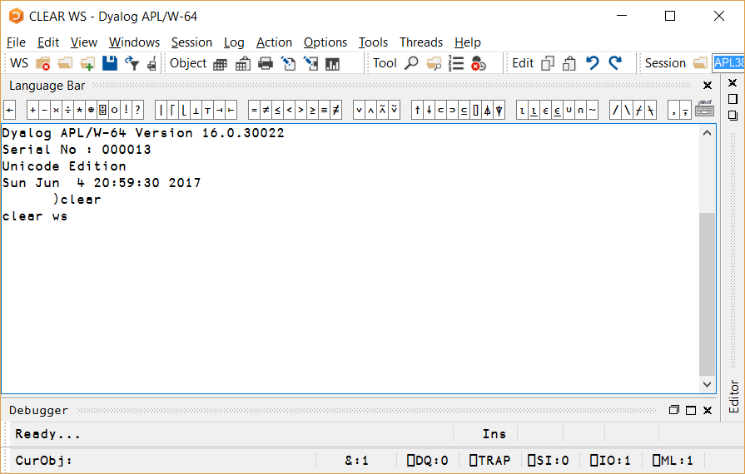
The Session
Menus
And
Toolbars
Input indented
Session Log

Slide 17
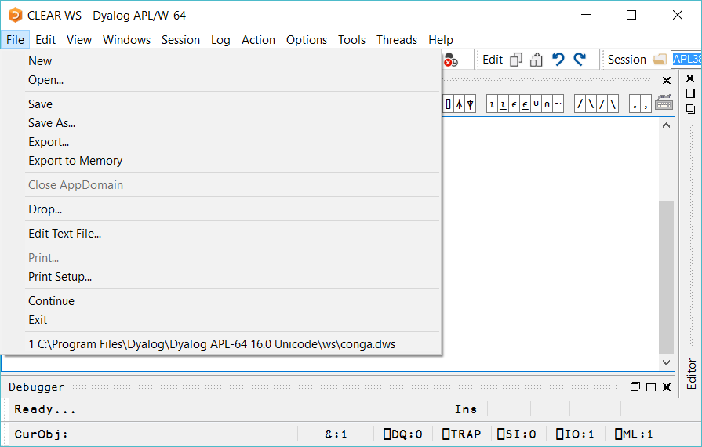

Slide 18
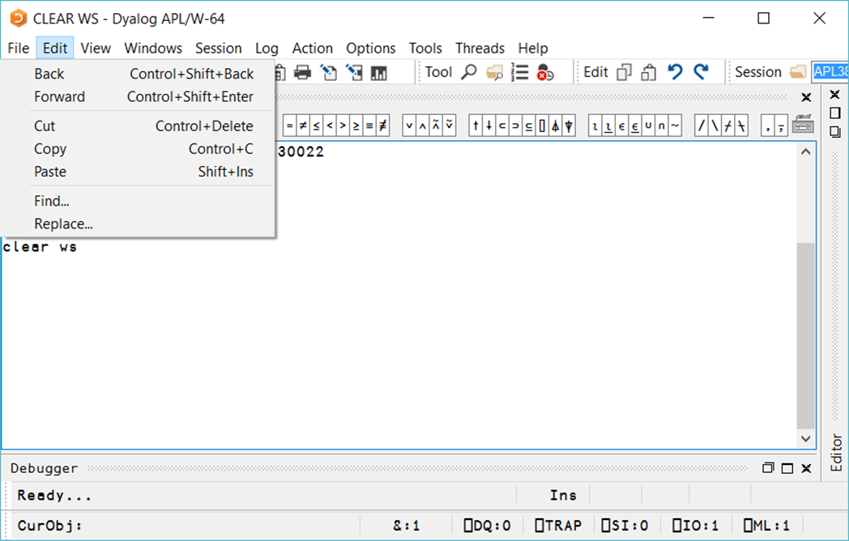

Slide 19
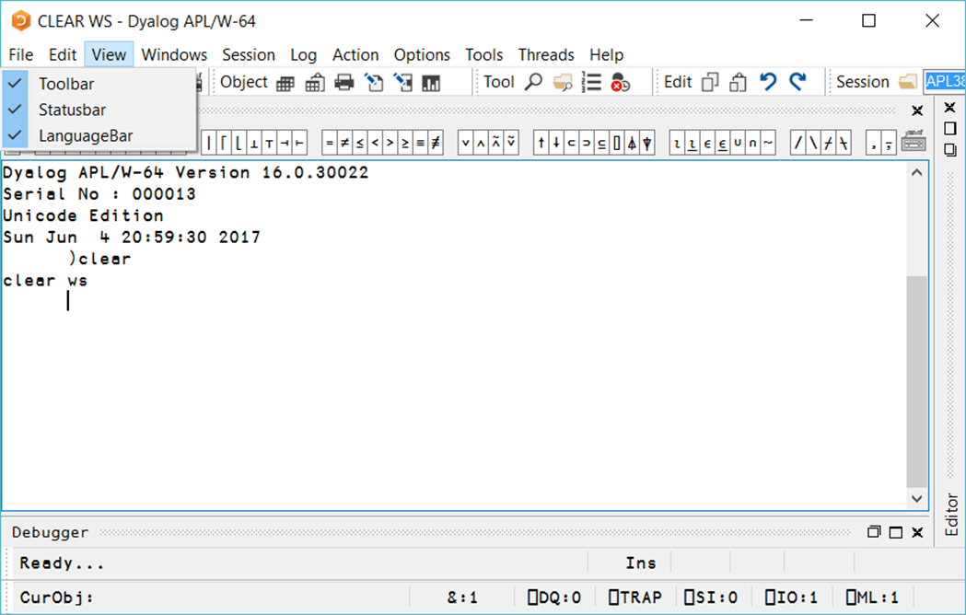

Slide 20
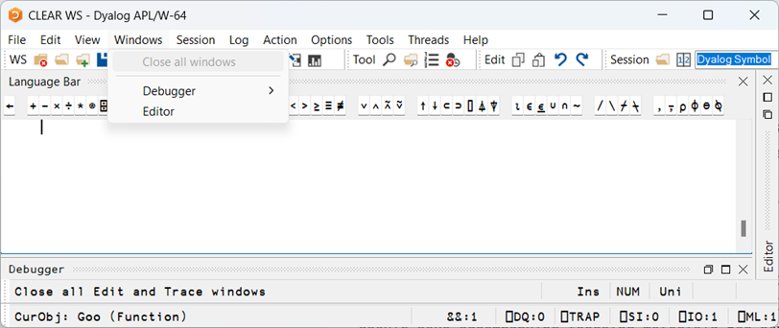

Slide 21
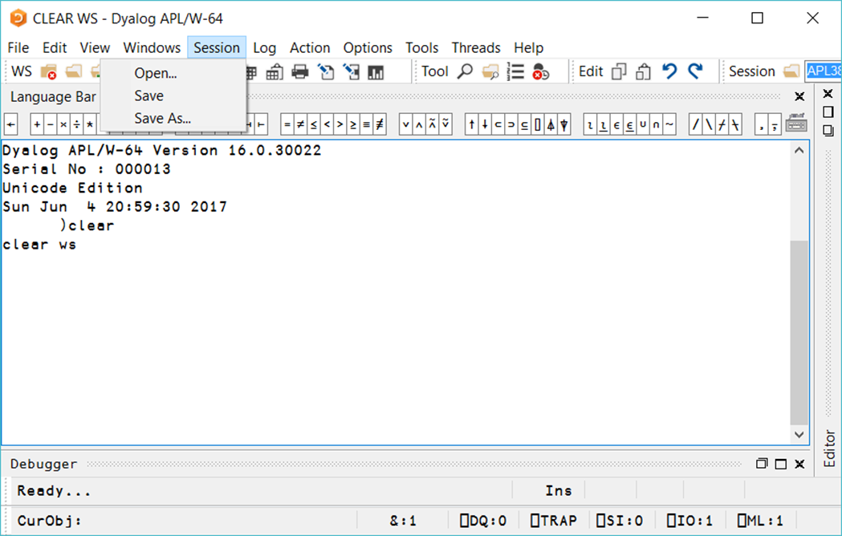

Slide 22
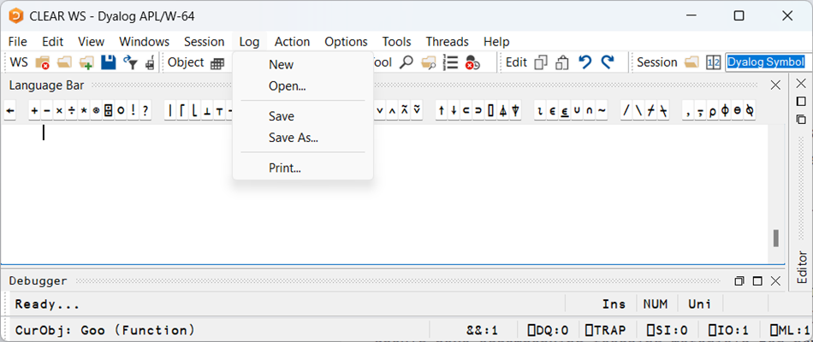

Slide 23
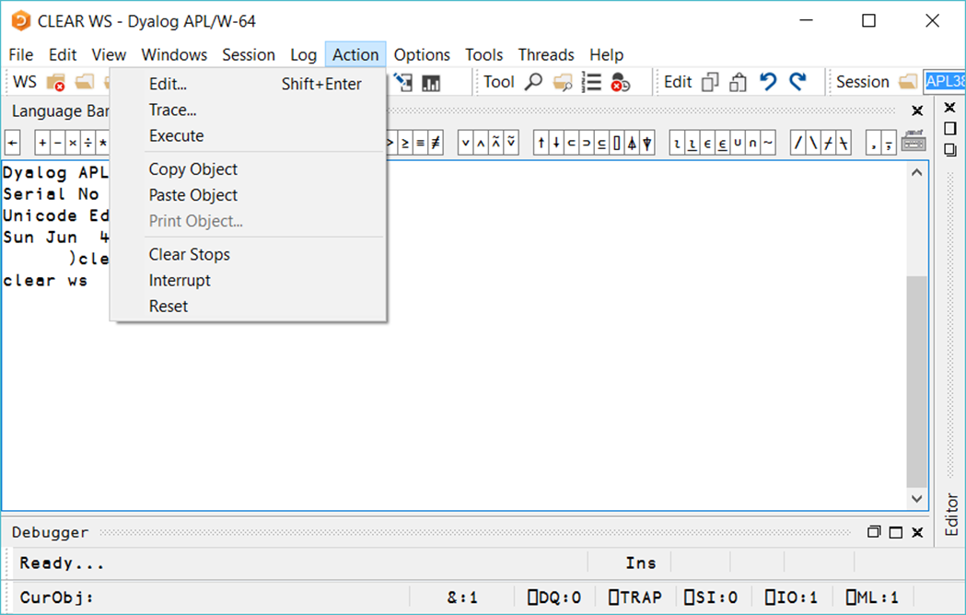

Slide 24
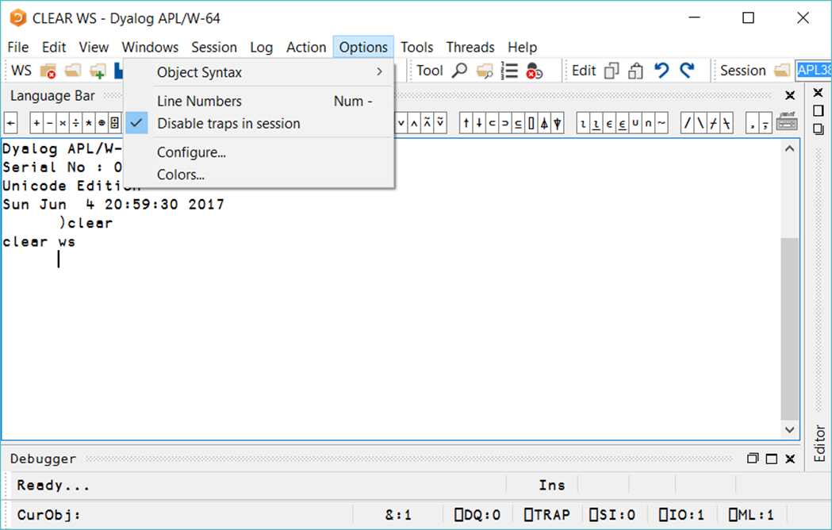

Slide 25
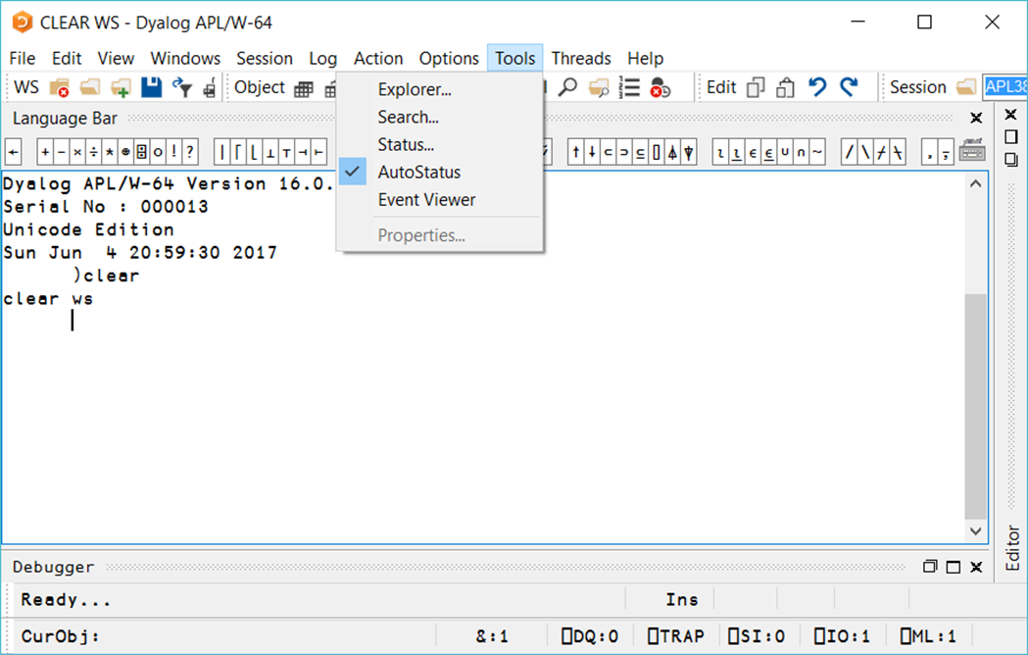

Slide 26
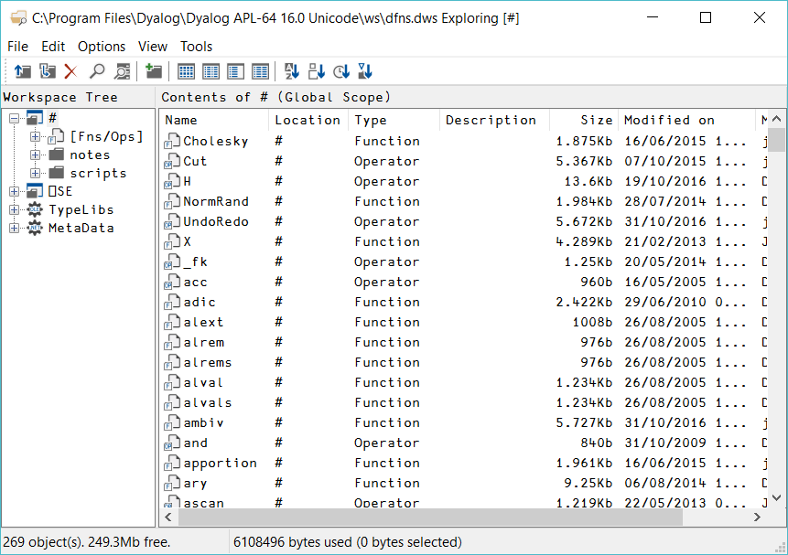

Slide 27
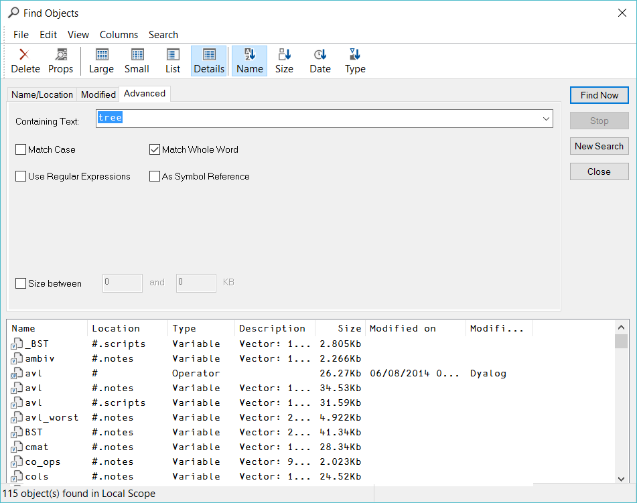

Slide 28
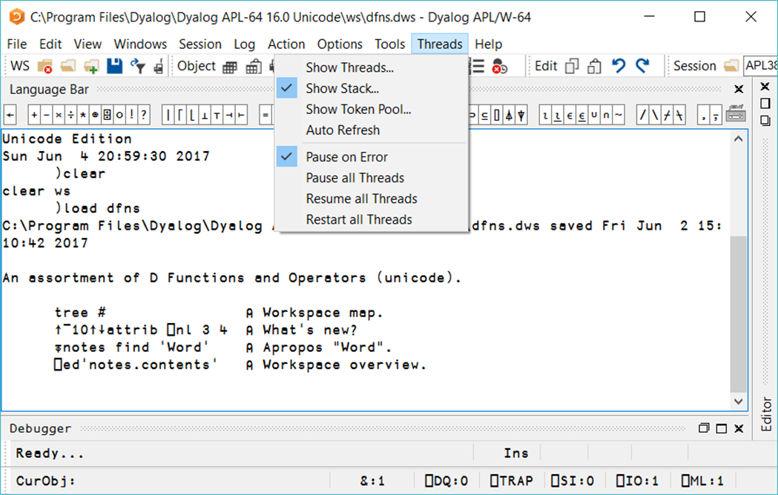

Slide 29
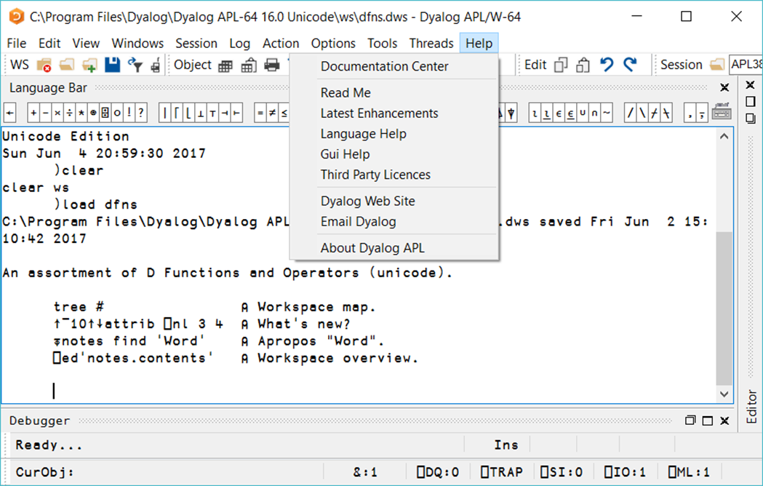

Slide 30
Options → Configure
Unicode Input
Keyboard Shortcuts
Auto Complete
User Commands

Slide 31
Important Shortcuts
Edit object: Shift+Enter
Exit edit/debugger: Esc
Abandon edit: Shift+Esc
Localize name: Ctrl+UpArrow
Toggle line numbers: NumPad-
Reformat program: NumPad/

Slide 32
Important Shortcuts
Recall last statement: Ctrl+Shift+BS
Recall next statement: Ctrl+Shift+Enter
Switch between windows: Ctrl(+Shift)+Tab
Start Tracer: Ctrl+Enter
Within the Tracer:
Execute line: Enter
Go back one line in code: Ctrl+Shift+BS
Go forward: Ctrl+Shift+Enter

Slide 33
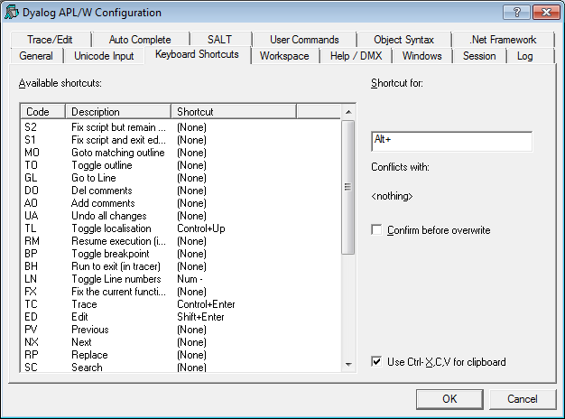
Keyboard Shortcuts
Notes:
Not in Classic – see Windows UI Guide p.13

Slide 34
Keyboard Shorcuts
Using an alternative input method allows regaining standard Ctrl-based shortcuts
FX Ctrl+S
CP Ctrl+C
CT Ctrl+X
PT Ctrl+V
SA Ctrl+A

Slide 35
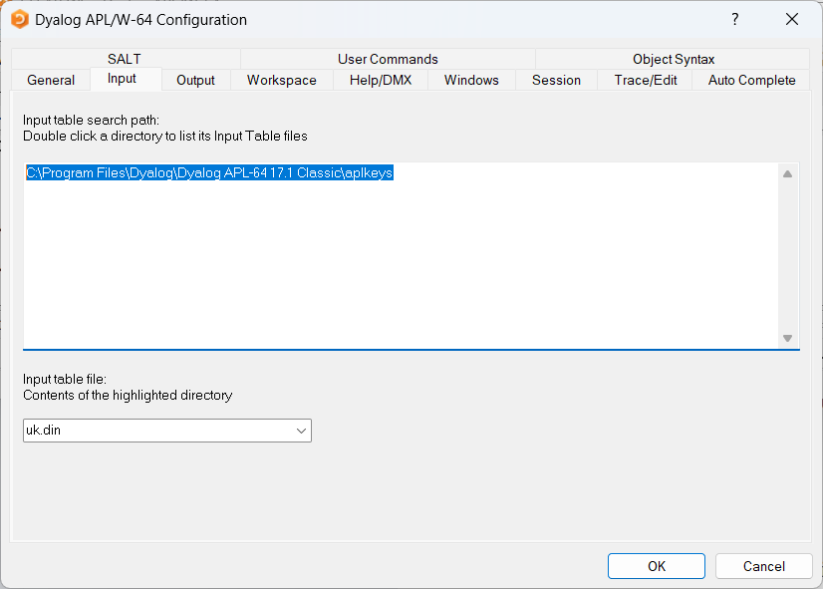
Keyboard Shortcuts
For Classic users
Location of .din file is in input tab
The .din file can be modified to, for example,
add a shortcut to save editor changes (FX)
FX=Ctrl+Shift+S: 3 83 * + Fix Definition

Slide 36

Toolbar
The WS toolbar
This toolbar has icons for 6 of the File menu items:
)CLEAR
)Load
)Copy
)Save
Export (application as .exe, .dll etc.)
Print Functions
v17.1

Slide 37

Toolbar
The Object toolbar
This toolbar needs the cursor to be positioned over a name:
Copy object to clipboard
Paste to object FROM clipboard
Print object (source code)
Edit object (general)
Edit numeric object
Chart wizard
Excel / HTML demo copy / paste object
v17.1

Slide 38

Toolbar
The Object toolbar
This toolbar needs the cursor to be positioned over a name:
Copy object to clipboard
Paste to object FROM clipboard
Print object (source code)
Edit object (general)
Edit with array notation
Chart wizard
Excel / HTML demo copy / paste object
v20.0

Slide 39

Toolbar
The Tool toolbar
This toolbar is for the developer:
Search the workspace for strings
Open workspace Explorer
Toggle line numbers in functions
Remove all stops/trace/monitor points
v17.1

Slide 40

Toolbar
The Edit toolbar
This toolbar mimics the shortcuts for:
Copy (Ctrl+C)
Paste (Ctrl+V)
Undo (Ctrl+Shift+Backspace)
Redo (Ctrl+Shift+Enter)
v17.1

Slide 41

Toolbar
The Session toolbar
This toolbar deals with the session:
You can load a new session file
Select a new font
Change the font size
v17.1

Slide 42
Questions?
🤔

Slide 43
Exercises
Save your workspace, exit and re-enter APL, verify you can load it
Save your log file under a different name
Modify your log
Retrieve your log file
)LOAD a workspace, for example "dfns".
Open explorer to look at the functions and variables in the newly loaded workspace

Slide 44
Workspace Links
Modern development encourages source code in text files
Enables use of Source Code Management (SCM) tools like Git or SVN
Many Dyalog tools open source on GitHub

Slide 45
Workspace Links
]create # /tmp/myproj
Linked: # ←→ "C:\tmp\myproj" [directory was created]

Slide 46
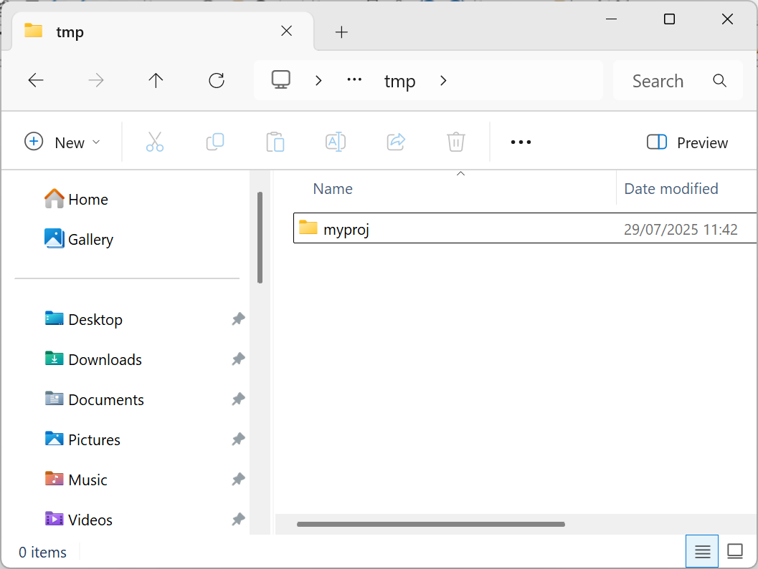
Workspace Links
]create # /tmp/myproj
Linked: # ←→ "C:\tmp\myproj" [directory was created]

Slide 47
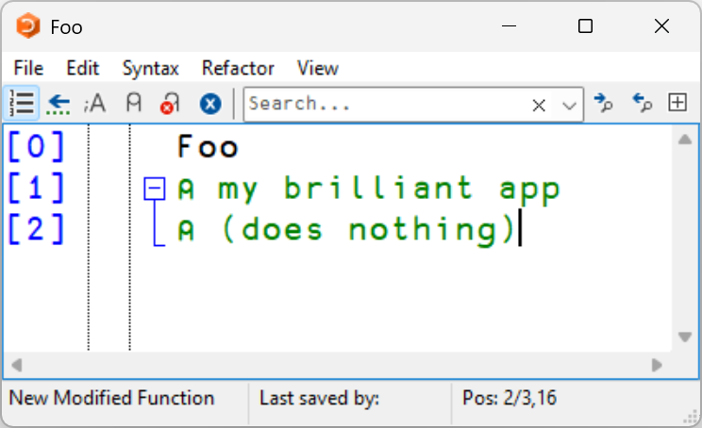
Workspace Links
]create # /tmp/myproj
Linked: # ←→ "C:\tmp\myproj" [directory was created]

Slide 48
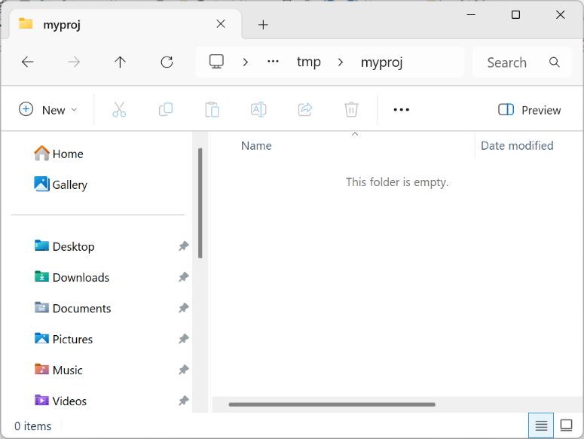
Workspace Links
]create # /tmp/myproj
Linked: # ←→ "C:\tmp\myproj" [directory was created]

Slide 49
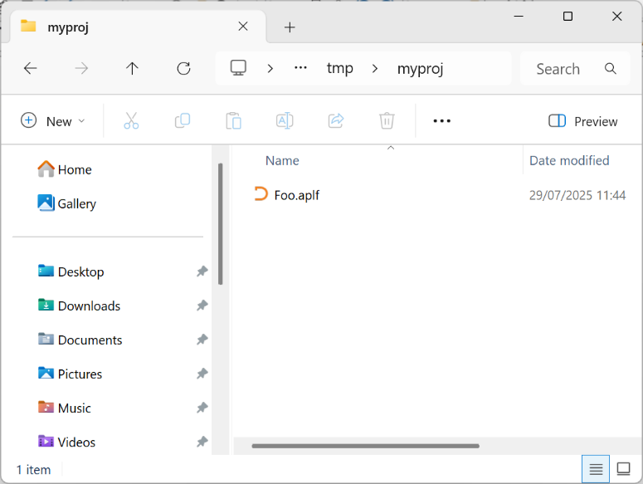
Workspace Links
]create # /tmp/myproj
Linked: # ←→ "C:\tmp\myproj" [directory was created]

Slide 50
Workspace Links
Array values are not saved to files by default.
Can be explicitly added for configuration.
Typically, data is read from files.

Slide 51
Questions?
🤔

Slide 52
Exercises
Create a link between your active workspace and a folder on the file system
Create a function in the Dyalog editor and find the newly created file in the folder
Open the function file in a text editor, modify the source and check that it has been updated in your workspace

