Slide 1
APL Bootcamp – Part 2
Tables; shape;

Slide 2
Tables (matrices)
A table (or matrix) is an array of data organized into rows and columns.
For example, 3 rows, 4 columns:
11 12 13 14
21 22 23 24
31 32 33 34

Slide 3
Tables (matrices)
Tables can be created using reshape (⍴)
The list to the left of ⍴ specifies the number of rows and columns desired:
3 4 ⍴ 1 2 3 4 5 6 7 8 9 10 11 12
1 2 3 4
5 6 7 8
9 10 11 12
3 rows and 4 columns

Slide 4
Shape and Reshape (⍴)
Reshape can be used to create arrays of any dimensionality, using data from any (non-empty) array:
4 ⍴ 2 ⍝ repeat 2 four times
2 2 2 2
A ← ¯2 4 8
10 ⍴ A ⍝ reuse the values in A
¯2 4 8 ¯2 4 8 ¯2 4 8 ¯2
1 4 ⍴ dates ⍝ 1 row, 4 columns from dates
1956 5 6 2006
When there is no left argument, ⍴ is Shape and returns the shape of the right argument:
⍴ dates ⍝ has 2 rows, 3 columns
2 3

Slide 5
Rank
The number of dimensions of an array is known as the rank of the array:

Slide 6
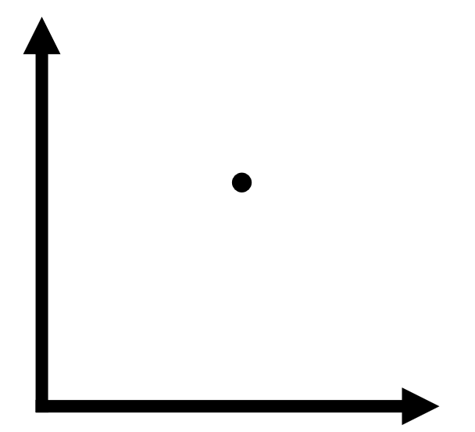
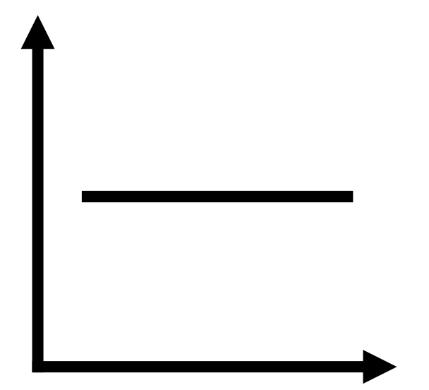

Rank
The number of dimensions of an array is known as the rank of the array:
Rank 0 1 2
Name scalar vector or list matrix or table

Slide 7
Rank
The rank is the shape of the shape:
ρρ table ⍝ 2 dimensions: rows & columns
2
ρρ 1 ¯3 77 21.1 ⍝ only 1 dimension
1
ρρ 12.2 ⍝ ZERO dimensions
0

Slide 8
Rank
The rank is the tally of the shape:
≢ρ table ⍝ 2 dimensions: rows & columns
2
≢ρ 1 ¯3 77 21.1 ⍝ only 1 dimension
1
≢ρ 12.2 ⍝ ZERO dimensions
0

Slide 9
Quad (⎕)
This is a system variable.
It represents the session.
It can be used to display results or request input:
⎕←2+2
4
Aways write an explicit ⎕← in a function that produces output, rather than relying on the default display. You can then search for print statements.

Slide 10
Quad (⎕)
Quad can be used to insert output in statements when debugging:
⎕← a←2+⍳5 ⎕← b←3!a ⎕← c←0.5×b This is equivalent (to the interpreter ☺)
⎕←c←.5×⎕←b←3!⎕←a←2+⍳5
Note that the result of an assignment is the assigned value.

Slide 11
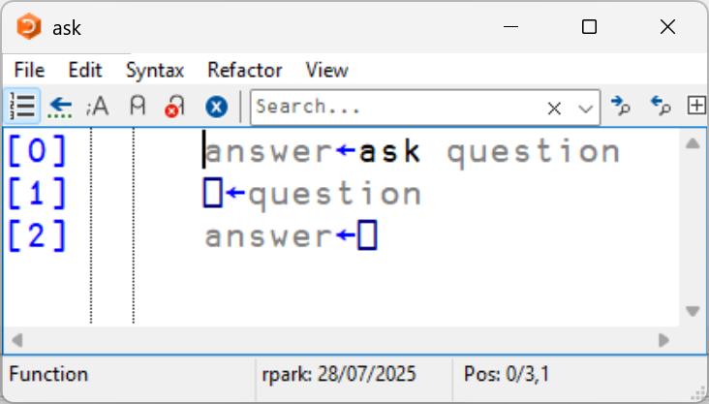
Quad (⎕)
age ← ask 'What is your age?'
What is your age?
⎕:
29+25
age + 1
55
Note: You can enter ANY expression in response to the ⎕:
This makes ⎕ input inappropriate for deployed applications, but useful for internal models.

Slide 12
Quote-quad (⍞)
This is a similar system variable.
It is intended for character input/output.
It can be used to display results or request input:
⍞←2+2
4

Slide 13
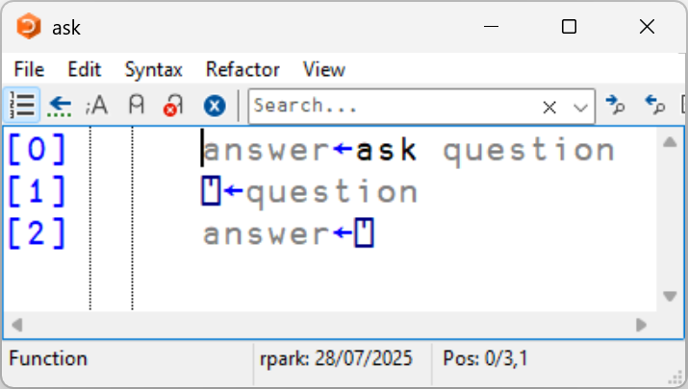
Quote-quad (⍞)
⍞ merges the input with the prompt that was issued:
name ← ask 'What is your name?'
What is your name?Carlos
⍴⎕←name
What is your name?Carlos
24

Slide 14

Ravel
Monadic comma is the function ravel ,⍵ and it lays out the elements of an array as a vector, one row at a time — a bit like pulling thread from a spool.
mat ← 3 3⍴⎕A
mat
ABC
DEF
GHI
,mat
ABCDEFGHI

Slide 15
Catenate (⍺,⍵)
Catenate joins the arguments into a single array:
A←⍳3 ⋄ B←33 ⋄ D←'-rules' ⋄ C←'APL'
⍴⎕←A,B 1 2 3 33
4 C,D
APL-rules

Slide 16
Table (⍪⍵)
Ravel always returns an array of rank 1 (vector)
Table always returns table / Matrix (rank =2)
⍴⎕←⍪'ABC' A B C
3 1

Slide 17
Table (⍪⍵)
⍴⎕←⍪99 ⍝ works with scalars
99
1 1
⍴⍪2 3⍴⍳6 ⍝ no change for matrices
2 3
⍴⎕←⍪2 3 4⍴⍳24 ⍝ preserve 1st dimension
1 2 3 4 5 6 7 8 9 10 11 12
13 14 15 16 17 18 19 20 21 22 23 24 2 12

Slide 18
]Rows User Command
Sometimes you will produce very long output, intentionally or by accident
]rows on -fold=2
Was OFF -fold=3
⍪⍳100
1
2
···
99
100

Slide 19
Catenate First (⍺⍪⍵)
Catenates on the leading dimension:
A←2 4 ⍴ ⍳ 8 B←'APL*' ⍴A⍪B
3 4
A⍪B
1 2 3 4
5 6 7 8
A P L *
Note: B is a vector and A is a matrix!
Notes:
Note how B is a vector and A is a matrix!

Slide 20
Outer Product (∘.F)
F ← {⍺+⍵}
1 2 3 ∘.F 10 20 30
11 21 31
12 22 32
13 23 33

Slide 21
Outer Product (∘.F)
1 4 9 , 6 5 4
1 4 9 6 5 4
'joined up' , 'text vectors'
joined uptext vectors
'chicken' 'pork' 'vegetable' ∘., ' chow mein' ' with cashew nuts'
┌───────────────────┬──────────────────────────┐
│chicken chow mein │chicken with cashew nuts │
├───────────────────┼──────────────────────────┤
│pork chow mein │pork with cashew nuts │
├───────────────────┼──────────────────────────┤
│vegetable chow mein│vegetable with cashew nuts│
└───────────────────┴──────────────────────────┘

Slide 22
Boxing
We have just created a nested array. These are arrays in which each element contains another array more complex than a single number or character.
]box on
Was OFF
⍳2 3
┌───┬───┬───┐
│1 1│1 2│1 3│
├───┼───┼───┤
│2 1│2 2│2 3│
└───┴───┴───┘

Slide 23
Boxing
We have just created a nested array. These are arrays in which each element contains another array more complex than a single number or character.
We will learn more about nested arrays later…

Slide 24
Diamond (⋄)
This is not a function, it is a statement separator, similar to ; in many languages.
Its sole purpose is to separate statements on a single line. Examples:
V←⍳3 ⋄ B←33 ⋄ A←'APL' V+B ⋄ ⍴ A
34 35 36
3
Note that the separated statements are executed from left to right. Diamond acts as a NewLine.

Slide 25
Complex Numbers
APL supports complex numbers
Complex numbers are entered using J between the real and imaginary parts.
For example, the number 3J4.
¯7 * 0.3
1.0537J1.4503

Slide 26
Engineering Notation
When numbers are too big (or too small) to display “comfortably”, APL uses exponential or engineering notation.
For example, the number 1,000,000,000 can be written in APL as 1E9, that is 1x10⁹.
The display form is not necessarily the same as that used to enter a number: 1E6 1E¯1 1000000 0.1

Slide 27
Questions?
🤔

Slide 28
Exercises
Create an addition table for the numbers 1 to 9
Add 0 and 100 to the table in one expression
How many dimensions does the result have (what is its shape)?
Calculate 1000000 x 1000000 x 1000000
Write Avogadro’s number (6.02x10²³) in E notation

Slide 29
Relational Functions
These functions compare items of arrays.
There are 6 relational functions:
= ≠ < > ≤ ≥
They are scalar functions:
3 5 3 < 5 3 3
1 0 0
The result is 1 for TRUE or 0 for FALSE

Slide 30
Character Data
Arrays can also contain character data.
Character arrays are enclosed in quotes as in 'Z'.

Slide 31
Character Data
A list of characters is also possible:
'A' 'P' 'L' (a list of 3 “scalar” characters)
A list of characters does not require each individual character to be quoted:
'APL is easy' (11 characters).

Slide 32
Character Data
The character '9' and the number 9 are NOT considered equal:
9 = '9'
0
APL does not distinguish between numeric types: 9 = 9.0 1

Slide 33
Character Data
Quotes are used to delimit a string as in 'ABC⍋_ (耆耇)'
What about quote itself?
You double it inside the string:
S←'I am what I''m'
S ⍝ 13 characters
I am what I'm

Slide 34
Empty Vectors
A character vector, just like a numeric vector may be empty.
An empty character vector has no characters between the quotes:
''
The literal character “zilde” (zero+tilde) represents the empty numeric vector
⍬
You can also create empty vectors using reshape:
0⍴'A' 0⍴0

Slide 35
Relational Functions
Relational functions like < and > can only be applied to numbers but = and ≠ can also be applied to characters:
A←'APL is easy'
A='s'
0 0 0 0 0 1 0 0 0 1 0
Here the 1’s denote where A contains an ‘s’

Slide 36
Relational Functions
Outer product is a good tool for exploring relational functions:
n1 2 3 4
n∘.<n
0 1 1 1
0 0 1 1
0 0 0 1
0 0 0 0

Slide 37
Boolean Logic
Booleans are the values true and false. A Boolean array consists entirely of 1s and 0s.
APL is very efficient when used with Booleans.

Slide 38
Boolean Logic
Booleans are the values true and false. A Boolean array consists entirely of 1s and 0s.
APL is very efficient when used with Booleans.

Slide 39
Boolean Logic
There are 16 Boolean logical functions for two inputs.
1⍨
0⍨
⊣
⊢
~⍤⊣
~⍤⊢
∧
⍲
True
False
Left
Right
Not left
Not right
AND
NAND
∨
⍱
>
<
≥
≤
≠
=
OR
NOR
Left but not right
Right but not left
Left OR not right
Right OR not left
Exclusive OR
Exclusive NOR

Slide 40
Boolean Logic
There are 16 Boolean logical functions for two inputs.
1⍨
0⍨
⊣
⊢
~⍤⊣
~⍤⊢
∧
⍲
True
False
Left
Right
Not left
Not right
AND
NAND
∨
⍱
>
<
≥
≤
≠
=
OR
NOR
Left but not right
Right but not left
Left OR not right
Right OR not left
Exclusive OR
Exclusive NOR

Slide 41
Scan (F\⍵)
Scan applies reduction to successive prefixes
,\⍳5
┌─┬───┬─────┬───────┬─────────┐
│1│1 2│1 2 3│1 2 3 4│1 2 3 4 5│
└─┴───┴─────┴───────┴─────────┘

Slide 42
Scan (F\⍵)
Scan applies reduction to successive prefixes
,\⍳5
┌─┬───┬─────┬───────┬─────────┐
│1│1,2│1,2,3│1,2,3,4│1,2,3,4,5│
└─┴───┴─────┴───────┴─────────┘

Slide 43
Scan (F\⍵)
Scan applies reduction to successive prefixes
+\⍳5
┌─┬───┬─────┬───────┬─────────┐
│1│1+2│1+2+3│1+2+3+4│1+2+3+4+5│
└─┴───┴─────┴───────┴─────────┘

Slide 44
Scan (F\⍵)
Scan applies reduction to successive prefixes
+\⍳5
1 3 6 10 15

Slide 45
Scan (F\⍵)
Scan applies reduction to successive prefixes
1 2 3 4
5 6 7 8
9 10 11 12
+\
1 3 6 10
5 11 18 26
9 19 30 42
+⍀
1 2 3 4
6 8 10 12
15 18 21 24

Slide 46
Scan (F\⍵)
Scan applies reduction to successive prefixes
1 2 3 4
5 6 7 8
9 10 11 12
+\
1 3 6 10
5 11 18 26
9 19 30 42
+⍀
1 2 3 4
6 8 10 12
15 18 21 24

Slide 47
Scan (F\⍵)
Scan applies reduction to successive prefixes
1 2 3 4
5 6 7 8
9 10 11 12
+\
1 3 6 10
5 11 18 26
9 19 30 42
+⍀
1 2 3 4
6 8 10 12
15 18 21 24

Slide 48
Useful Scans and Reductions
Maximum of a list
Minimum of a list
Are ALL true?
Are ANY true?
⌈/
⌊/
∧/
∨/

Slide 49
Useful Scans and Reductions
Maximum of a list
Minimum of a list
Are ALL true?
Are ANY true?
⌈\
⌊\
∧\
∨\

Slide 50
Useful Scans and Reductions
⌈\ 2 4 3 5 3 2 8 1 ⍝ Highest so far
2 4 4 5 5 5 8 8
⌊\ 2 4 3 5 3 2 8 1 ⍝ Lowest so far
2 2 2 2 2 2 2 1
∨\ 0 0 1 1 0 1 ⍝ Keep after first 1
0 0 1 1 1 1
∧\ 1 1 1 0 0 1 ⍝ Keep only leading 1s
1 1 1 0 0 0

Slide 51
Useful Scans and Reductions
{⍵⌿⍨~∧\'-'=⍵}'---some text---'
some text---
{⍵⌿⍨~⌽∧\⌽'-'=⍵}'---some text---'
---some text

Slide 52
Questions?
🤔

Slide 53
Exercises
Define a variable containing the characters A, P and L
Compare it (using =) to another 3 character string containing a, p and l
Explain why 321='321' yields 3 results

Slide 54
Replicate / Compress
The replicate function ⍺/⍵
(some symbols have multiple meanings)
repeats elements of an array along rows.

Slide 55
Replicate / Compress
1 2 3/'ABC'
ABBCCC
1 2 3/2 3⍴'DYALOG'
DYYAAA
LOOGGG
1 ¯2 3/2 3⍴'DYALOG'
D AAA
L GGG

Slide 56
Replicate / Compress
When used with a Boolean array, the function ⍺/⍵ is called compress.
2 3⍴'DYALOG'
DYA
LOG
0 1 0/2 3⍴'DYALOG'
Y
O

Slide 57
Indexing
Select from arrays with square brackets
'APPLE'[4]
L

Slide 58
Indexing
Select from arrays with other arrays
'APPLE'[1 3 4]
APL

Slide 59
Indexing
Select from arrays with other arrays
'APPLE'[1 3 5]
APE

Slide 60
Indexing
Select from arrays with other arrays
'APPLE'[1 3 5 5 5 5 5 5 5]
APEEEEEEE

Slide 61
Index Of (⍺⍳⍵)
APL provides an easy way to find where an element is located in a vector (list).
The primitive dyadic ⍳ (iota) finds where the scalar to its right is found in the vector to its left:
'ABCDEFG' ⍳ 'E'
5
'ABCDEFG'[5]
E

Slide 62
Index Of (⍺⍳⍵)
If an element is not found, 1+≢ left argument is returned:
'ABCDEFG' ⍳ 'SAGE'
8 1 7 5
'ABCDEFG' [8 1 7 5]
INDEX ERROR
'ABCDEFG'[8 1 7 5]
^
'ABCDEFG*' [8 1 7 5]
*AGE

Slide 63
Where (⍸⍵)
Converts between replications and indices
1 0 0 0 3 1 / 'DYALOG'
DOOOG
'DYALOG'[⍸1 0 0 0 3 1]
DOOOG

Slide 64
Where (⍸⍵)
Converts between replications and indices
[1 0 0
0 3 1] /⍥, ['DYA'
'LOG']
DOOOG
(2 3⍴'DYALOG')[⍸2 3⍴1 0 0 0 3 1]
DOOOG
Array notation in v20.0

Slide 65
Questions?
🤔

Slide 66
Exercises
https://rikedyp.uk/APLBootcamp
Part 2

