Slide 1
APL Bootcamp – Part 4
User-defined Functions; Using the IDE

Slide 2
User-defined Functions
Often, you don’t need a program to perform calculations.
E.g.: Find the range of some values
(⌈/Values)-⌊/Values
But sometimes you need to write a program.

Slide 3
User-defined Functions
Often, you don’t need a program to perform calculations.
E.g.: Return 42 when values are inside of the range Max-Min, return 50 otherwise.
50-8×(N>Min)∧(N<Max)
But sometimes you need to write a program.

Slide 4
User-defined Functions
Dyalog APL supports three styles of writing functions:
TradFns, available since the first APL interpreters saw the light of day (1966)
dfns, a functional style of coding introduced around 1990
Tacit definition, in which functions are composed without explicit reference to arguments
In this section we will look at TradFns, which are still by far the most widely used in existing applications.

Slide 5
User-defined Functions
Example Problem Statement:
Given a price and a tax rate in percent, compute the price including tax.
APL does not have a primitive to calculate the tax (and the tax changes from one place to another)

Slide 6
User-defined Functions
A user defined function consists of a series of statements usually written by a human.
It normally has more than one line of code:
The first line is the header, and declares the name and syntax of the function.
Any additional lines are the body, consisting of APL expressions which will be executed.

Slide 7
User-defined Functions
To create your own function, let’s say called plusTax, you use the system command )ED:
)ED plusTax
APL brings up a new window:

Slide 8
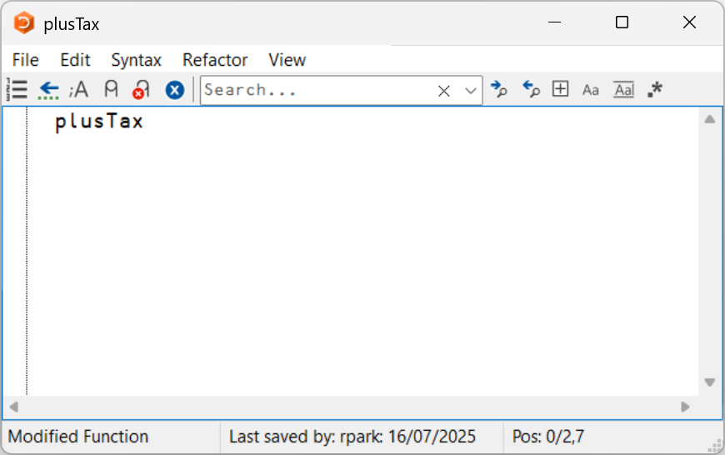
User-defined Functions
To create your own function, let’s say called plusTax, you use the system command )ED:
)ED plusTax
APL brings up a new window:

Slide 9
User-defined Functions
We want plusTax to take 2 arguments: price on the left and tax on the right and returns the value in amount:

Slide 10
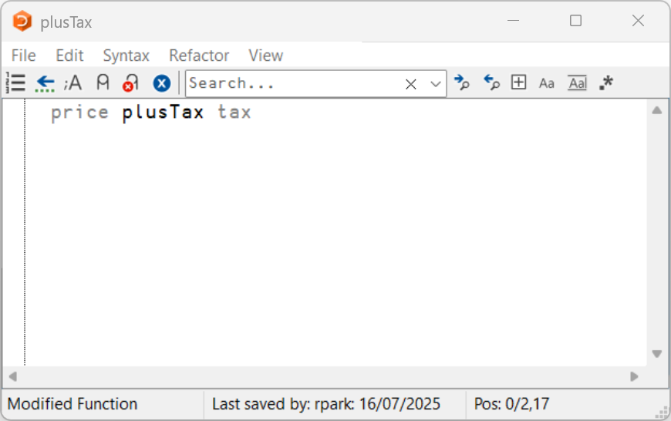
User-defined Functions
We want plusTax to take 2 arguments: price on the left and tax on the right and returns the value in amount:

Slide 11
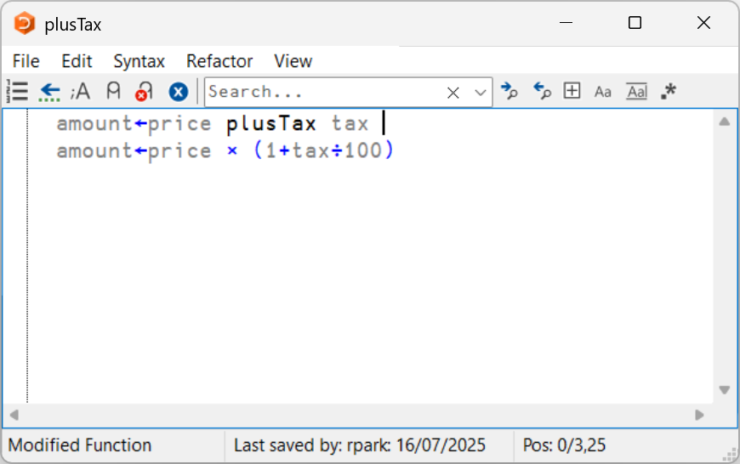
User-defined Functions
We want plusTax to take 2 arguments: price on the left and tax on the right and returns the value in amount:

Slide 12
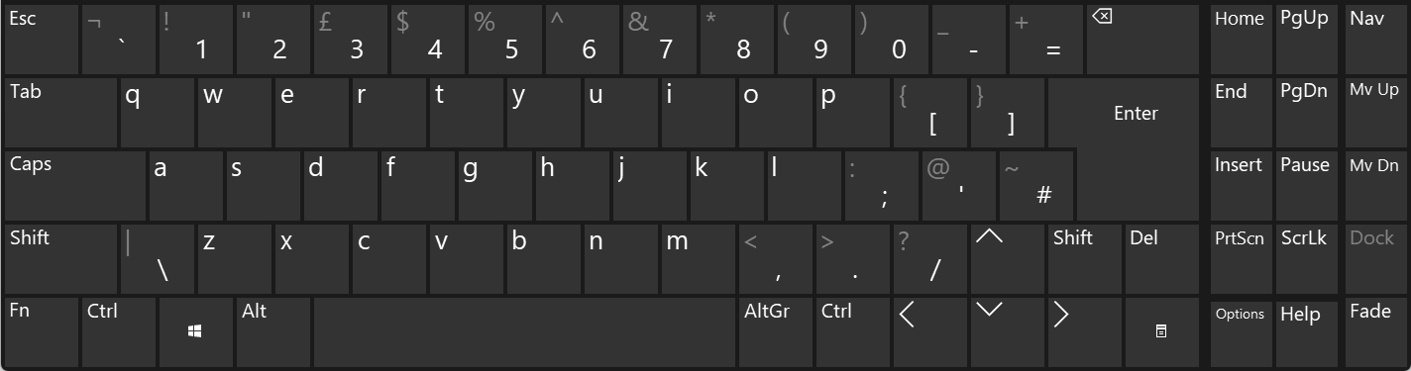
User-defined Functions
When we hit Esc APL creates the function for us.
We can now use it like any other primitive:
100 plusTax 15
115

Slide 13
Operator Application
Even if your function only works on a scalar at a time, you can use operators to do things like:
100 300 1000 ∘.plusTax 15 12 8.5
115 112 108.5
345 336 325.5
1150 1120 1085

Slide 14
User-defined Functions
A primitive function accepts one or two arguments, returns a result and has no side effects* (like updating a database, or making operating system calls, etc.)
A user-defined function can also take one or two arguments and return a result. It may have side effects, depending on the code.
*except roll/deal ?

Slide 15
Programs
User-defined functions are sometimes called "programs". Program can also refer to an entire application consisting of user-defined code and data.

Slide 16
User-defined Functions
[0] header
User-defined functions can have as many lines as necessary (but are limited to 4096 lines)
[1]
[2]
[3]
[4]
[5] body
[6]
[7]
[...]

Slide 17
Types of Programs
If a program takes one or two arguments and returns a result, it is a proper function.
If a program takes no arguments (niladic), or does not return a result (non-explicit), it is sometimes still referred to as a function, but cannot be used as an operand. Avoid writing these if at all possible.
It is also possible to define user operators, which take operands in addition to arguments, in the same way as primitive operators

Slide 18
Dyadic Functions
A program/function may take 2 arguments,
like the primitive function +
2 + 3 ⍝ 2 and 3 are the arguments
If MyFn is a function which takes 2 arguments:
4 MyFn 78 ⍝ 4 & 78 are the arguments
This is a dyadic function.

Slide 19
Monadic Functions
A program may take 1 argument,
like ! (factorial, Gamma function)
!7 ⍝ 7 is the argument
If YourFn is a function which takes one argument:
YourFn 78 ⍝ 78 is the argument
This is called a monadic program or function.

Slide 20
Niladic Functions
A program may take 0 arguments,
ex: HisFn is a program
HisFn
This is called a niladic function or a procedure.
There are no niladic primitives.
You might need such functions for special tasks like starting an application, and you will encounter functions named Boot, Clean or Finish in existing applications. Within an application, they should be avoided.

Slide 21
Returning a Result
If a program returns a result, it (the result) can be assigned and/or used for further calculations
For example, + returns a result that can be assigned to a variable
All primitives return a result.
Not all programs return a result.
Note that a program which does not return a result, or does not take an argument, cannot be used with operators.
3+4
7
seven←3+4
2×seven
14
2×3+4
14

Slide 22
Tradfn Headers
The header specifies names
The function itself, and optionally:
Fn

Slide 23
Tradfn Headers
The header specifies names
The function itself, and optionally:
Arguments
larg Fn rarg

Slide 24
Tradfn Headers
The header specifies names
The function itself, and optionally:
Arguments
Result
r ← larg Fn rarg

Slide 25
Tradfn Headers
The header specifies names
The function itself, and optionally:
Arguments
Result
Local names
r ← larg Fn rarg;var

Slide 26
Tradfn Headers (no result)
Niladic (0 argument) program, no result:
fnname
Monadic (1 argument) program, no result:
fnname rargname
Dyadic (2 arguments) program, no result:
largname fnname rargname

Slide 27
Tradfn Headers
[0] hyp←height pythagoras base
[1] hyp←((height*2)+base*2)*0.5

Slide 28
Tradfn Headers
[0] hyp←height pythagoras base
[1] hyp←((height*2)+base*2)*0.5
hyp is the result

Slide 29
Tradfn Headers
[0] hyp←height pythagoras base
[1] hyp←((height*2)+base*2)*0.5
hyp is the result
height is the left argument

Slide 30
Tradfn Headers
[0] hyp←height pythagoras base
[1] hyp←((height*2)+base*2)*0.5
hyp is the result
height is the left argument
pythagoras is the function name

Slide 31
Tradfn Headers
[0] hyp←height pythagoras base
[1] hyp←((height*2)+base*2)*0.5
hyp is the result
height is the left argument
pythagoras is the function name
base is the right argument

Slide 32
Tradfn Headers
[0] root←sqrt numbers
[1] ⍝ This function computes the square root
[2] root←numbers*0.5
root is the result
sqrt is the function name
numbers is the right argument

Slide 33
Local Names
If a program uses temporary names it can list them in the header, after the program name or the right argument, separated by semicolons:
r←larg foo rarg;local1;local2;…
;local3;local4;…
NB: Any name not localised is shared with the calling environment. Such "globals" should only be used with care and intent.

Slide 34
Local Names
The names of the result variable, the left and the right argument only exist INSIDE the program (they are always local).
result ← left Function right
Names revert to previous state (undefined or previous value) after the program/function completes.
Note that local names are GLOBAL to any functions that the program calls (unless sub-functions localise the same names)

Slide 35
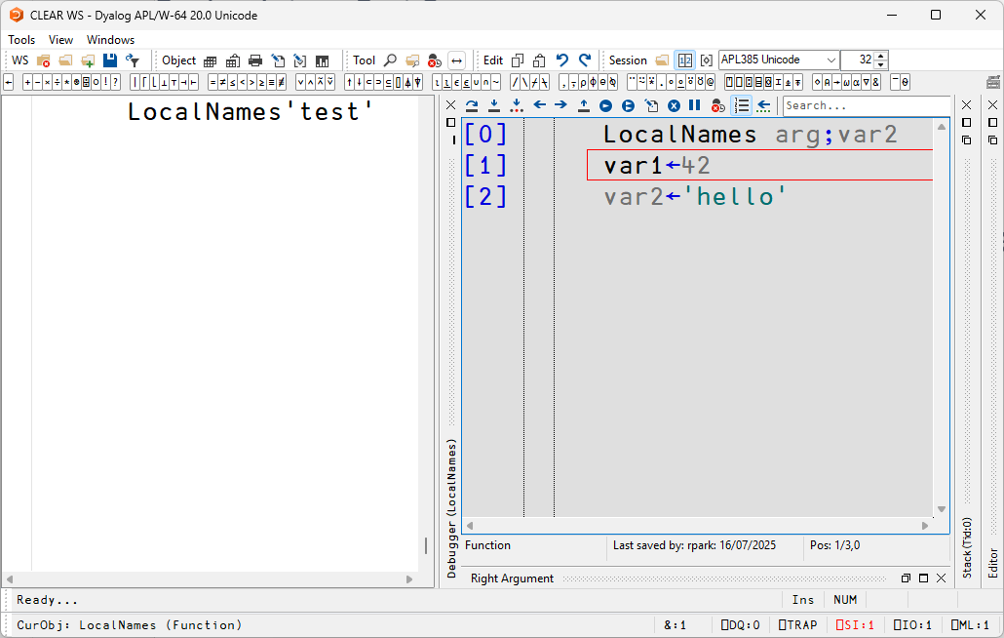
Local Names

Slide 36
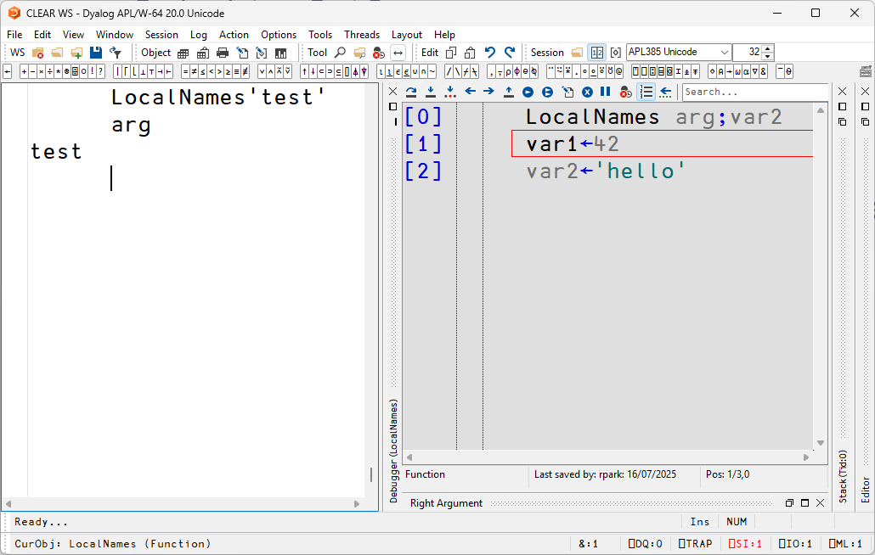
Local Names

Slide 37
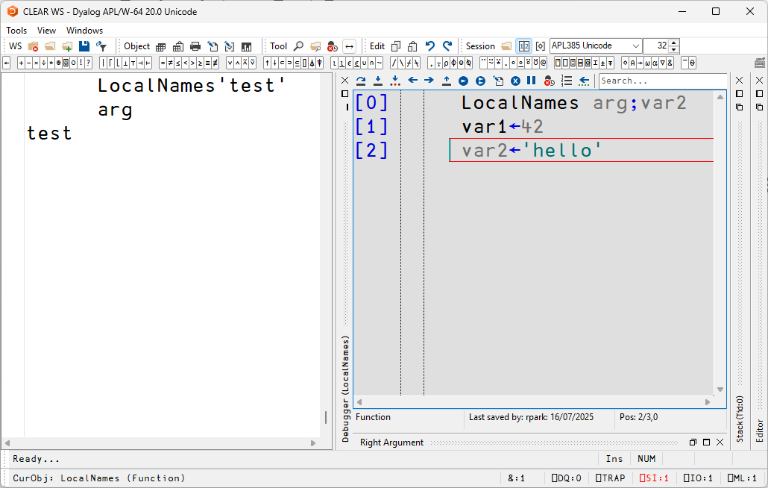
Local Names

Slide 38
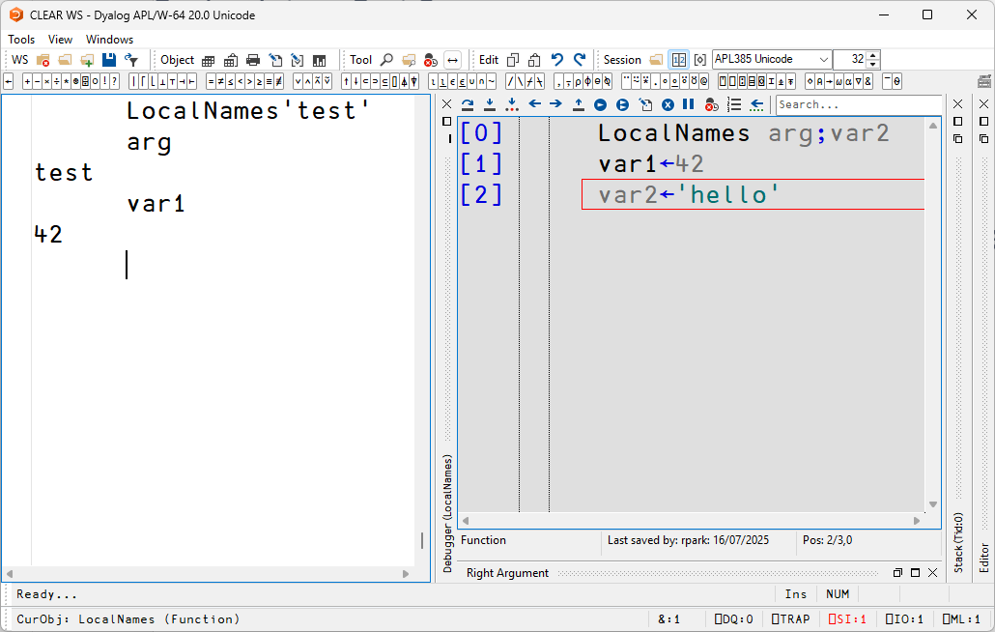
Local Names

Slide 39
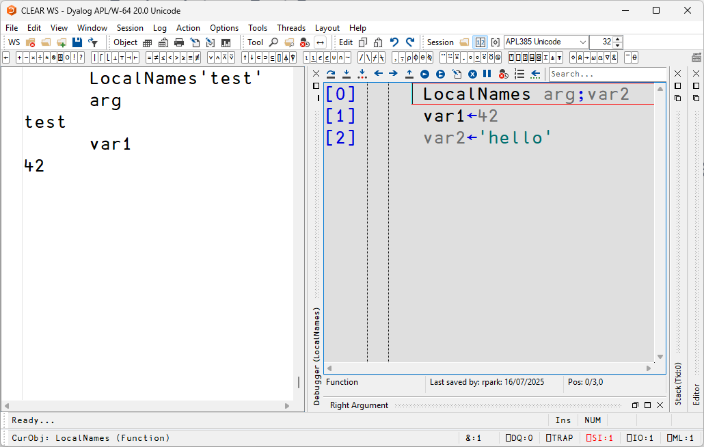
Local Names

Slide 40
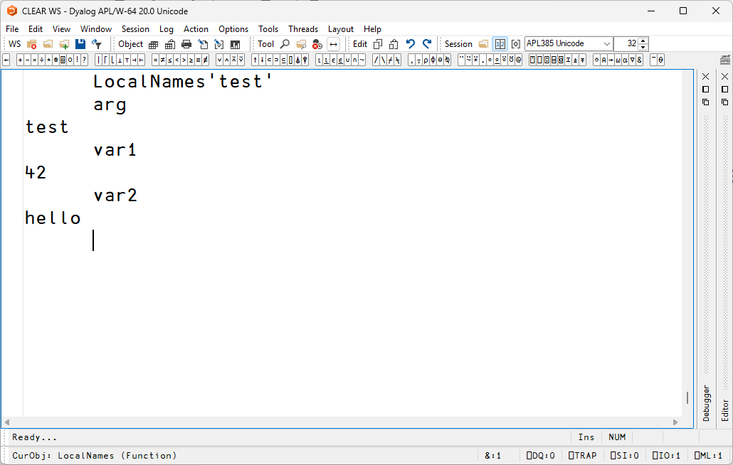
Local Names

Slide 41
Local Names

Slide 42
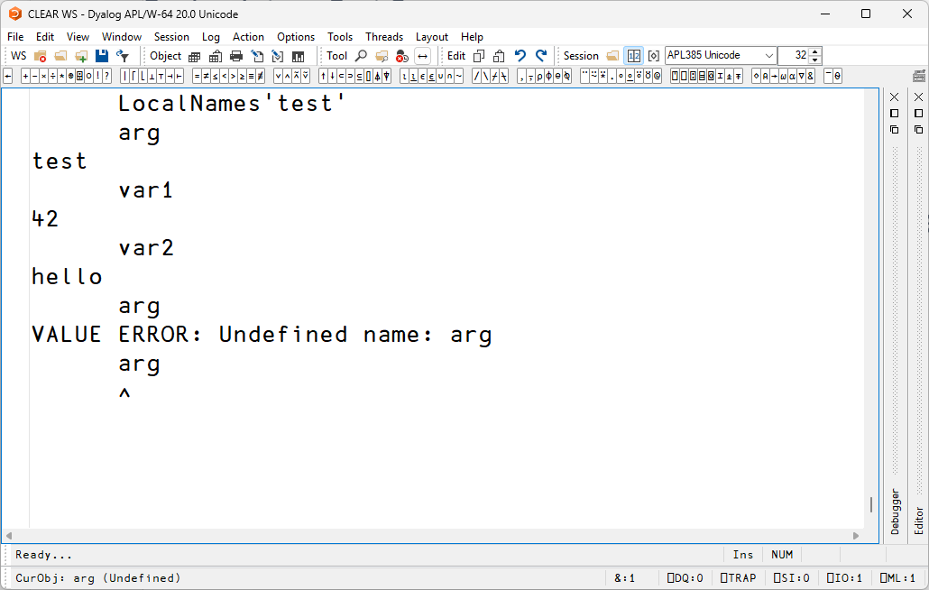
Local Names

Slide 43
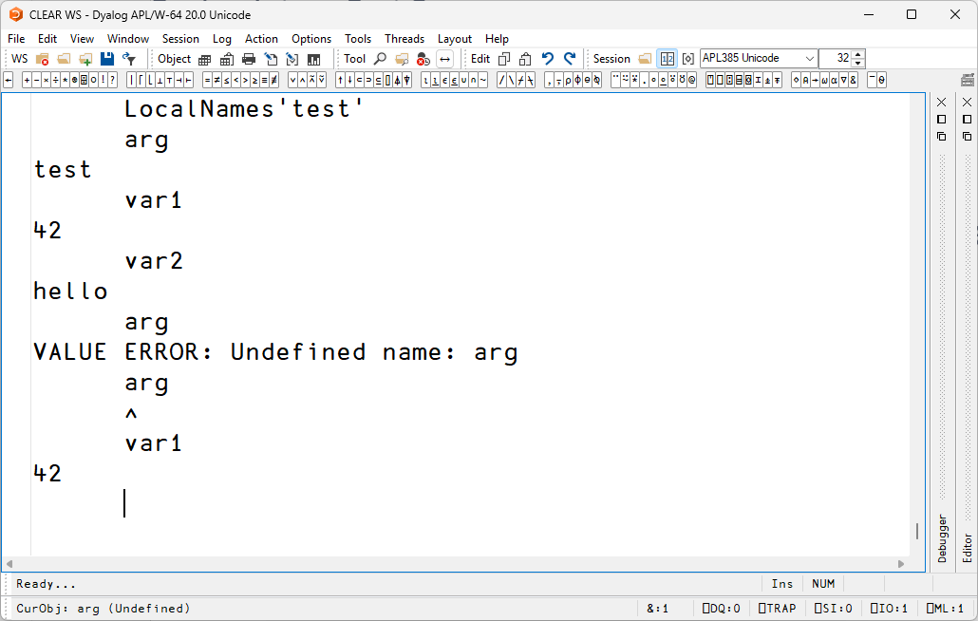
Local Names

Slide 44
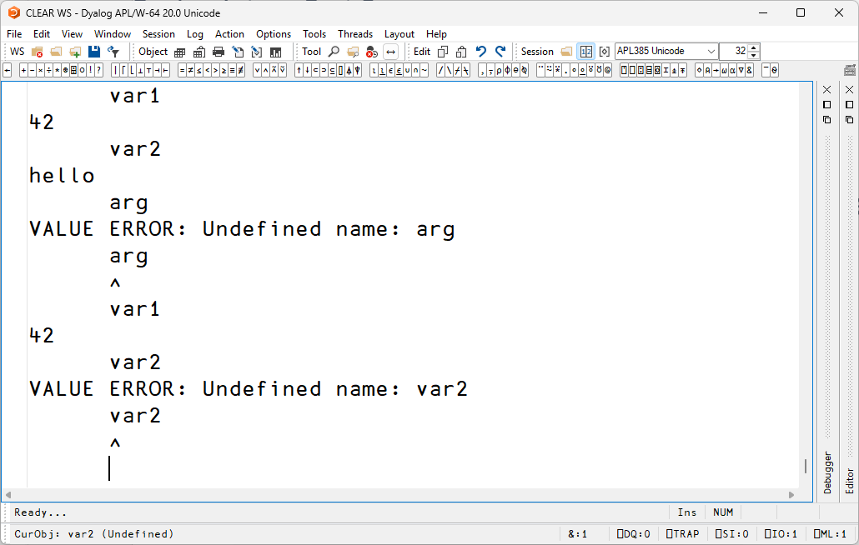
Local Names

Slide 45
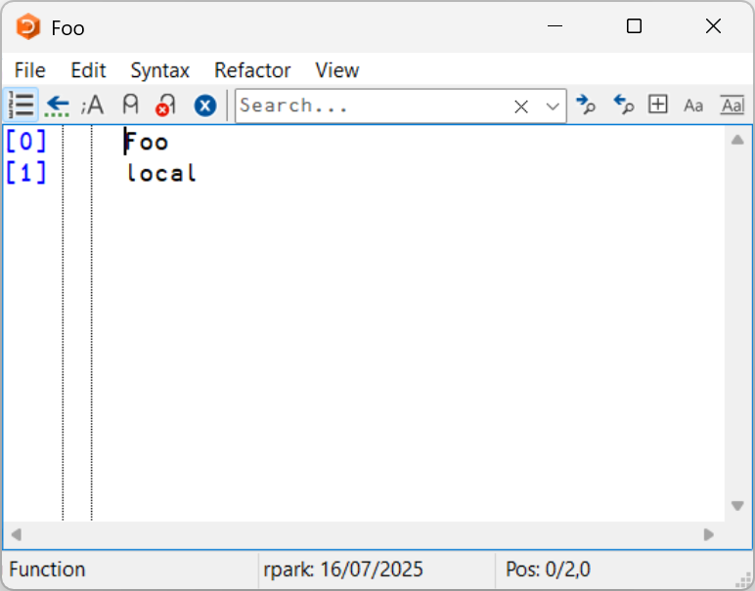
Local Names
Toggle local:
Ctrl
↑

Slide 46
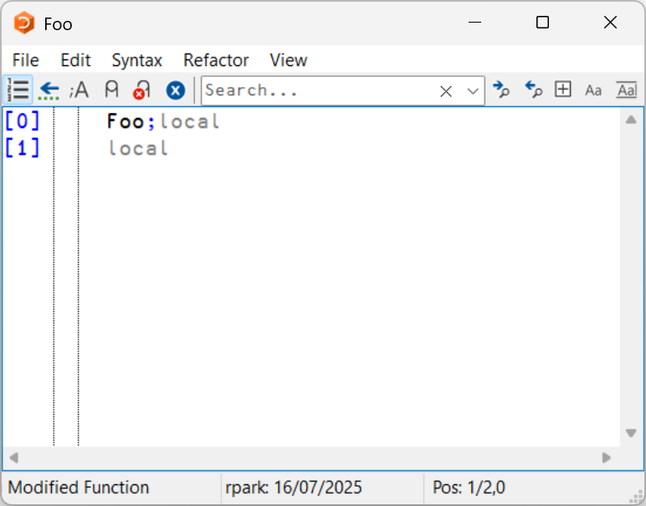
Local Names
Toggle local:
Ctrl
↑

Slide 47

Local Names
Toggle local:
Ctrl
↑

Slide 48
Display Forms of Programs
In APL literature you will often see decorators when displaying functions with a del (∇) starting and ending the program and line numbers:
∇ r←pgm_name args
[1] ⍝ …
[2] …
∇

Slide 49
Shy Results
By default, APL displays the result of any expression if it is not assigned to a name.
It is sometimes desirable to make a result available to an interested caller, but NOT display the result in the session if it is not used.
We can achieve this with a SHY result.

Slide 50
Shy Results
The result is shy if it is surrounded by curly braces:
∇ {time}← WaitFor Nseconds
[1] … ⍝ spend N seconds here
[2] time←Nseconds
∇
WaitFor 9 ⍝ nothing displayed
⎕←WaitFor 3
3
[NB. Morten thinks shy results are “too clever”]

Slide 51
Questions?
🤔

Slide 52
Exercises
Explain the role of each name in these tradfn headers:
la myPgm ra
alpha←omega;Zeta0;∆
W X Y ;Z
Are these headers valid?
LeftArg myFn
{why}←not this?
Hum

Slide 53
Exercises
Write TradFn versions of functions from previous exercises:
CtoF ← {32+⍵×9÷5}
Eggs ← {⌈⍵×4÷3}
To ← {⍺+s×¯1+⍳1+d×s←×d←⍵-⍺}
Use )ED, double-click or Shift+Enter to open the editor

Slide 54
Comparing Arrays
Comparison functions are scalar functions
['ABC'
'DEF'] = ['AAC'
'EEF']
1 0 1
0 1 1

Slide 55
Match (⍺≡⍵)
Compare the shape and contents of two arrays
['ABC'
'DEF'] ≡ ['AAC'
'EEF']
0

Slide 56
Match (⍺≡⍵)
Compare the shape and contents of two arrays
['AAC'
'EEF'] ≡ ['AAC'
'EEF']
1

Slide 57
Natch (⍺≢⍵)
Compare the shape and contents of two arrays
['AAC'
'EEF'] ≢ ['AAC'
'EEF']
0

Slide 58

Structural Functions
Structural functions are functions that allow you to select or rearrange elements from an array
… as opposed to functions that "compute" things from the elements of arrays

Slide 59
Structural Functions
Take: n↑A
Take takes the first n elements of an array:
A ← 2 7 9 ¯2 12 ¯33
2↑A
2 7
If n is negative it takes from the end:
¯3↑A
¯2 12 ¯33

Slide 60
Structural Functions
If n is greater than the length of V it is padded with the prototypical element of the array.
A← 2 ¯7 1.2
5↑A ⍝ ask for 5
2 ¯7 1.2 0 0

Slide 61
Structural Functions
For character arrays, APL fills with spaces:
A←'abc' ⍝ only 3 elements
⍴⎕←5↑A ⍝ ask for 5
abc
5
(5↑A),'!'
abc !

Slide 62
Structural Functions
Drop: n↓A
Drop drops the first n elements of an array:
A ← 2 7 9 ¯2 12 ¯33
2↓A
9 ¯2 12 ¯33
If n is negative it drops from the end:
¯3↓A
2 7 9

Slide 63
Structural Functions
Find the difference between each pair of numbers in a vector – without writing a loop:
A← 2 7 9 ¯2 12 ¯33
¯1↓A
2 7 9 ¯2 12
1↓A
7 9 ¯2 12 ¯33
(¯1↓A)-(1↓A)
¯5 ¯2 11 ¯14 45
Note: this is also 2-/A

Slide 64
Structural Functions
Compress: s / A
Keep each item of A if the corresponding item of the Boolean array is 1:
s← 0 1 0 1 0
A← 2 3 5 7 11
s / A
3 7

Slide 65
Structural Functions
Replicate: s / A
If s contains numbers <0 or >1. Ex:
s←2
A←2 3 5 7 11
s/A
2 2 3 3 5 5 7 7 11 11
Discuss: Is / a scalar function?

Slide 66
Structural Functions
Replicate: s / A
s← 0 1 0 4 0
A← 2 3 5 7 11
s/A
3 7 7 7 7
The shape of s and A must conform.
The length of the result is +/s

Slide 67
Structural Functions
Replicate: s / A
Negative numbers REPLACE with prototypes.
s← 3 1 ¯2 4 0
A← 2 3 5 7 11
s/A
2 2 2 3 0 0 7 7 7 7
The length of the result is +/|s

Slide 68
Structural Functions
Expand: s \ A
s is a vector where 1s correspond to elements of A and 0s insert a prototype:
s← 0 1 0 1 0
A← 3 7
s\A
0 3 0 7 0

Slide 69
Structural Functions
Expand: s \ A
The number of positive numbers in s must match the number of elements in A.
The length of the result is +/1⌈|s

Slide 70
Structural Functions
Compress example: find the accounts with balances greater than $1,000
balance←100 2000 500 5000
account←123 4321 2345 666
s←balance > 1000
s / account
4321 666

Slide 71
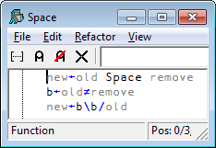
Structural Functions
Here we want to replace each occurrence of a specific character by space.
'APL;is;great' Space ';'
APL is great
Oops! Spot something
Unfortunate about that
function?
Let's trace / fix it…

Slide 72
Selection from High Rank Arrays
A matrix A with elements whose digits identify its row and column
⎕←A←10 20 30 ∘.+ 1 2 3 4
11 12 13 14
21 22 23 24
31 32 33 34

Slide 73
Selection from High Rank Arrays
Take: n is 2 elements for rows and columns
2 2 ↑ A
11 12
21 22
If n is negative it takes from the end:
¯1 3↑A
31 32 33
2
2
11 12 13 14
21 22 23 24
31 32 33 34
3
11 12 13 14
21 22 23 24
31 32 33 34
¯1

Slide 74
Selection from High Rank Arrays
Drop: drops the first rows and columns:
2 2 ↓ A
33 34
If n is negative it drops from the end:
¯1 3↓A
14
24
11 12 13 14
21 22 23 24
31 32 33 34
11 12 13 14
21 22 23 24
31 32 33 34

Slide 75
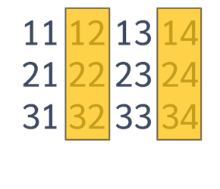
Selection from High Rank Arrays
Compress (/): selects columns in matrices
s is a vector of the same width as A. Ex:
s← 0 1 0 1
s / A
12 14
22 24
32 34

Slide 76
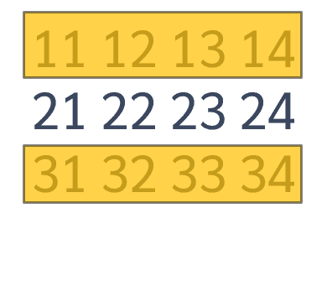
Selection from High Rank Arrays
Compress First (⌿): selects rows in matrices
s is a vector corresponding to rows A:
s← 1 0 1
s ⌿ A
11 12 13 14
31 32 33 34

Slide 77
Selection from High Rank Arrays
Indexing: A[r;c]
r represents the rows(s) and c the column(s) to be selected.
A[1;3]
13
A[1 3;4 1]
14 11
34 31
11 12 13 14
21 22 23 24
31 32 33 34
11 12 13 14
21 22 23 24
31 32 33 34

Slide 78
Selection from High Rank Arrays
Indexing: A[r;c]
There is a very simple rule for the shape of the result: it is (⍴r),⍴c – regardless of the ranks of r and c.
THIS IS WORTH TAKING SOME TIME TO UNDERSTAND
If ⍴r is 2 and ⍴c is 3 the shape of the result is 2 3
NB: A 1-element vector is NOT the same as a scalar!

Slide 79
Selection from High Rank Arrays
Note: A 1-element vector is not the same as a scalar
⍴42
⍴,42
1
42≡,42
0

Slide 80
Questions?
🤔

Slide 81
Exercises
https://rikedyp.uk/APLBootcamp
Part 3

