Slide 1
APL Bootcamp – Files

Slide 2
Files
Dyalog APL contains system functions to deal with two types of files:
Operating System files (aka "Native" files)
APL Component files

Slide 3
Native Files
Native (OS) files are files made available directly by the Operating System (OS).
Dyalog APL allows you to create, fill, read, lock, destroy files, within OS limitations.

Slide 4
Native Files
All the files on an external or internal storage medium to which the OS can reach are available to you as long as you have access to them.
System functions to access native files have names beginning with ⎕N as in ⎕NREAD

Slide 5
Text Files
Read a file with ⎕NGET (data encoding eol)←⎕NGET 'filename'
data is the contents of the file, with all line endings replaced by Line Feeds (⎕UCS 10)
encoding is the name of an encoduing, typically UTF-8
eol is a numeric vector of the end-of-line sequence actually found.

Slide 6
Text Files
Write a file with ⎕NPUT
(data [encoding eol])⎕NPUT 'filename'
data encoding and eol are the same as in the result of ⎕NGET.
encoding and eol are optional.
Options on ⎕NGET and ⎕NPUT allow
Representing data as a vector of vectors
Overwriting an existing file

Slide 7
Native Files
A set of system functions allow access to a file via a tie number or handle:
You tie a file with a negative integer, e.g.
'myfile' ⎕NTIE ¯33
Use a right argument of 0 to use the first free tie number (returned as the result).

Slide 8
Native Files
Once a file is tied you can manipulate it always using the tie number chosen, e.g.
⎕NSIZE tieno ⍝ size in bytes
⎕NREAD tieno,datatype,length[,startpos]
data ⎕NAPPEND tieno datatype data ⎕NREPLACE tieno startbyte datatype
datatype is an internal type number, for example 82 for 8 bit Classic character data, 160 for 16-bit Unicode text, or 323 for 32-bit integers
See the documentation for other ⎕N* functions (start by typing ⎕N and examining the autocomplete list)

Slide 9
APL Component Files
APL component files are an "object store" for APL arrays. Any APL array can be stored in a component file.
Components are numbered, starting with 1.
Component files can be shared and have a "hold" mechanism for implementing transactions.
The default extension is .dcf (recently changed from .DCF).
Data in component files can be shared across different platforms without conversion (Windows Linux etc).
Simple and nested arrays can be shared between different versions of Dyalog APL (but not namespaces or object representations returned by ⎕OR).

Slide 10
APL Component Files
Just like Native files, APL files need to be tied - but to a positive tie number. First you may need to create a file:
'myAPLfile' ⎕FCREATE 21
If the file already existed, you could just "tie" it:
'myAPLfile' ⎕FTIE 21
You can also let APL pick a tie number for you.
tieno←'myAPLfile' ⎕FTIE 0
APL will pick the lowest unused tie number.
If the extension is .dcf it does not need to be provided.

Slide 11
APL Component Files
A tied file can be appended to:
cn←myData ⎕FAPPEND tieno
Data is appended into a “component” of the file.
The result is the number of the new component. A new file has zero components; the first appended component will be number 1.

Slide 12
APL Component Files
To find out the range of components use
⎕FSIZE tieno
1 3 271 4294967295
Element | Description
1 | the number of the first component
2 | 1 + the number of the last component, (i.e. the result of the next ⎕FAPPEND)
3 | the current size of the file in bytes
4 | the file size limit in bytes

Slide 13
APL Component Files
Existing components can be replaced, even by bigger components:
⎕←(10×⍳5)⎕FAPPEND ¨ tieno
3 4 5 6 7
Make component 5 much bigger:
(9 9⍴⍳99)⎕FREPLACE tieno 5
⎕FSIZE tieno
1 8 21271 4294967295

Slide 14
APL Component Files
Components can be dropped from the file:
⎕FSIZE tieno
1 8 21271 4294967295
1 ⎕FDROP tieno ⍝ Drop 1st component
¯2 ⎕FDROP tieno ⍝ Drop last two (#6 & #7) ⎕FSIZE tieno
2 6 21271 4294967295
After the two drops, the first component is #2 and next is #6.

Slide 15
APL Component Files
Component files can be shared:
⎕FUNTIE tieno ⍝ Close myAPLFile
'ourAPLFile' ⎕FSTIE tieno
1 8 21271 4294967295
1 ⎕FDROP tieno ⍝ Drop 1st component
¯2 ⎕FDROP tieno ⍝ Drop last two (#6 & #7) ⎕FSIZE tieno
2 6 21271 4294967295
After the two drops, the first component is #2 and next is #6.

Slide 16
APL Component Files
The file can be erased. This requires you to provide the name for confirmation:
'myAPLfile' ⎕FERASE 21

Slide 17
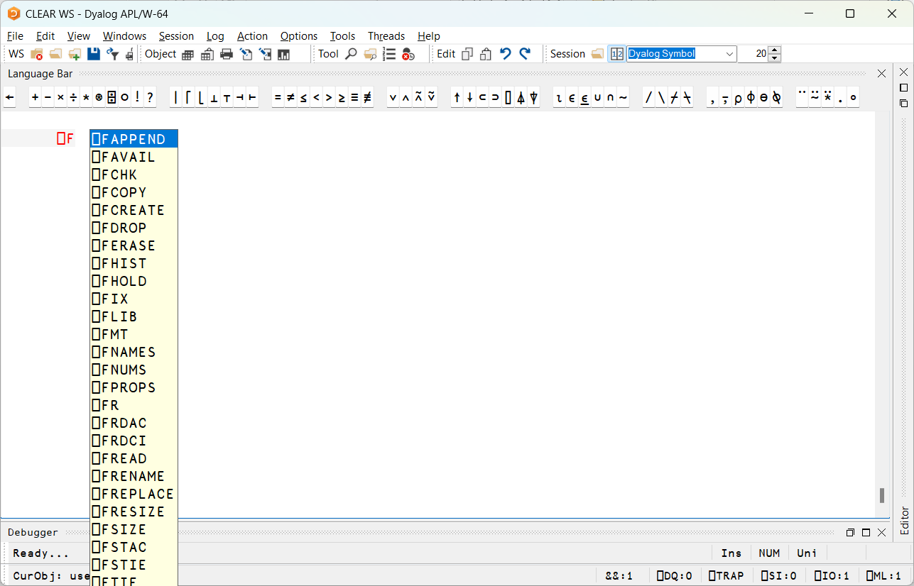

Slide 18
CSV Files
Import and Export Comma Separated Value files. The file Demos\Demo.csv contains:
Place,Name,Score London, Joe Bloggs ,89 "Bramley, Hampshire", Björn Bloggs ,67.5
We can import it using ⎕CSV:
⎕CSV 'Demos\Demo.csv' Place Name Score London Joe Bloggs 89 Bramley, Hampshire Björn Bloggs 67.5

Slide 19
CSV Files
Read data from and write data to files directly
data ← ⎕CSV '/path/to/file.csv' ⍝ Read from file.csv
data ⎕CSV '/path/to/file.csv' ⍝ Write to file.csv

Slide 20
CSV Files
Separate the header (first row) from the rest of the data
(data header) ← ⎕CSV '/path/to/file.csv' ⍬ ⍬ 1

Slide 21
CSV Files
Import specific columns as numbers or characters, depending on the options provided.
numeric_if_possible ← ⎕CSV '/path/to/file.csv' ⍬ 4
The 4 in this example indicates to convert numeric values if possible, else keep the value as text.

Slide 22
CSV Files
Use a separator other than commas, using the "Separator" variant option, for example using tabs (⎕UCS 9) for Tab Separated Values (.tsv).
tsv ← ⎕CSV⍠'Separator' (⎕UCS 9)⊢'/path/to/file.csv'

Slide 23
CSV Files
Read data chunks at a time to not fill the workspace, using the "Records" variant option.
path ← '/path/to/file.csv'
A function to read CSV 10 records at a time
ReadCSV10←⎕CSV⍠'Records' 10
Tie the file - this locks it from use by other applications
tn←path ⎕NTIE 0
first10 ← ReadCSV10 tn ⍝ Read the first 10 records (rows)
second10 ← ReadCSV10 tn ⍝ Read the next 10
⎕NUNTIE tn ⍝ Don't forget to untie the file after use!

Slide 24
JSON
A common data interchange format
We must read text before converting
⎕←namespace←0⎕JSON⊃⎕NGET'/tmp/demo.json'
#.[JSON object]
1(⎕JSON⍠('Dialect' 'JSON5'))namespace
{list:[3,1,4,1,5],name:"Dave",number:42}

Slide 25
JSON
Getting values with defaults
opts←0⎕JSON⊃⎕NGET'/tmp/opts.json'
(id name opt)←opts ⎕VGET(name 'John Doe')(opt:'Default')
From Dyalog v20.0

Slide 26
Review
Dyalog APL contains system functions to deal with two types of files:
Operating System files (aka "Native" files)
APL Component files, containing APL arrays

Slide 27
Questions?
🤔

Slide 28
Exercises
Bootcamp Part 6

