Slide 1
Task 1
Define:
text←'three short words'
Write an expression to count the number of "r"s ('r') in text
rs
3
Write an expression to count the number of spaces (' ') in text
spaces
2
Put the expressions into your submission:
rs ← …
spaces ← …

Slide 2
Task 2
Write a function AgeInMonths to convert years into months
AgeInMonths 33
396
AgeInMonths 26 35 12 17 65
312 420 144 204 780
Put the function definition into your submission:
AgeInMonths ← {…}

Slide 3
Task 3
Write a function NumberIn which counts the number of occurrences of the single letter left argument that appear in the right argument.
3 NumberIn 1 3 3 4 7 2 3 4 3 1
4
3 NumberIn 8 17 3 4 5 3 6
2
'i' NumberIn 'mississippi'
4
'i' NumberIn 'applesauce'
0
'p' NumberIn 'applesauce'
2
Put the function definition into your submission:
NumberIn ← {…}

Slide 4
Task 4
Two variables give the order prices and quantities of five products.
prices ← 5 7.99 12.99 3.5 16
quantities ← 3 6 12 5 3
Write an expression which uses prices and quantities to compute the total cost of the order across all products.
order_total
284.32
Put the expression into your submission:
order_total ← …

Slide 5
Task 5
Two variables give the distances travelled (m) and mean average speeds (m/s) of four runners.
distances ← 325 412 290 150
speeds ← 6 7 5 3
Write an expression which uses speeds and distances to compute the total time taken by all runners.
total_time ⍝ Rounded to nearest millisecond
221.024
Put the expression into your submission:
total_time ← …

Slide 6
Task 6
Write an function Multiples to count the number of elements in its right argument ⍵ which are exact multiples of its left argument ⍺
3 Multiples 12 3 5 2 7 9
3
5 Multiples 5 3 25 6 15 7 9 10
4
7 Multiples ⍳30
4
Put the function definition into your submission:
Multiples ← {…}

Slide 7
Task 7
A recipe serving 4 uses 3 eggs. Write a function Eggs which computes the number of eggs which need cracking to serve ⍵ people. A fraction of an egg requires that a whole egg is cracked.
Eggs 1
1
Eggs 0
0
Eggs 3
3
Eggs 4
3
Eggs ⍳10
1 2 3 3 4 5 6 6 7 8
Put the function definition into your submission:
Eggs ← {…}

Slide 8
Task 8
Write an function To that generates integers from ⍺ to ⍵ inclusive. You may assume that ⍺<⍵.
1 To 10
1 2 3 4 5 6 7 8 9 10
4 To 10
4 5 6 7 8 9 10
¯3 To 5
¯3 ¯2 ¯1 0 1 2 3 4 5
Put the function definition into your submission:
To ← {…}

Slide 9
Task 9
These are the temperatures for 7 days, Sunday through Saturday:
t_allweek←11.7 8.6 9.7 14.2 6.7 11.8 9.2
Compute the average temperature for the week:
t_mean
10.27142857
Round t_allweek:
12 9 10 14 7 12 9
Round t_mean to 1 decimal:
10.3
Put the expressions into your submission:
t_mean ← …
APL expression which rounds t_allweek to nearest whole number
APL expression which rounds t_allweek to 1 decimal place

Slide 10
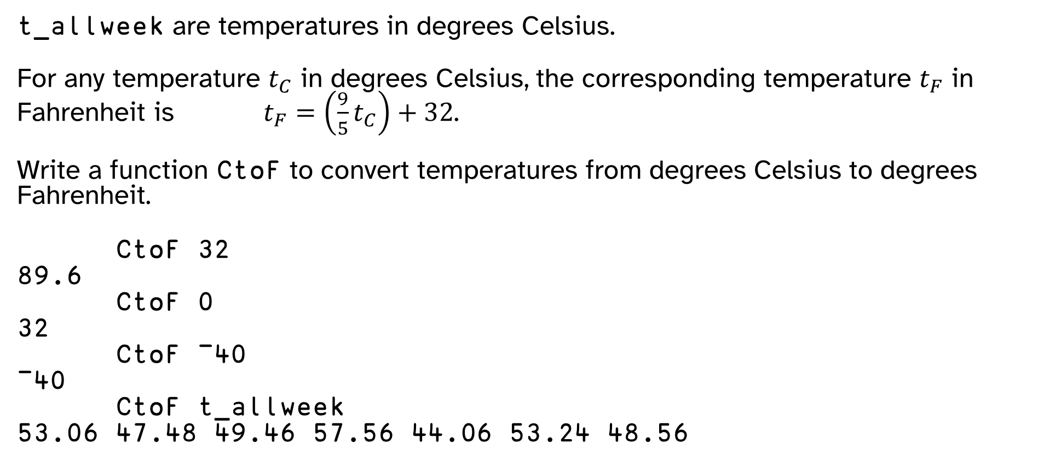
Task 10
t_allweek are temperatures in degrees Celsius.
For any temperature $t_{C}$ in degrees Celsius, the corresponding temperature $t_{F}$ in Fahrenheit is $t_{F}=\left(\frac{9}{5}t_{C}\right)+32$.
Write a function CtoF to convert temperatures from degrees Celsius to degrees Fahrenheit.
CtoF 32
89.6
CtoF 0
32
CtoF ¯40
¯40
CtoF t_allweek
53.06 47.48 49.46 57.56 44.06 53.24 48.56
Put the function definition into your submission:
CtoF ← {…}

Slide 11
Task 11 (Bonus)
How many days in t_allweek had a temperature between 8.0 and 10.0 degrees exclusive? You will need to use logical functions < and >
temperate_days
3
Put the expression into your submission:
temperate_days ← …

Slide 12
Task 12 (Bonus)
Write a function CountVowels that counts instances of the letters 'aeiou' in its right argument.
CountVowels 'how many vowels?'
4
CountVowels 'here there are sixteen vowels in this sentence'
16
Put the function definition into your submission:
CountVowels ← {…}

