Slide 1
Task 1
Define the following:
tall ← 5 3⍴'T'
wide ← 3 5⍴'W'
long ← 1 5⍴'L'
short ← 1 3⍴'S'

Slide 2
Task 2
Using tall and short, create:
short_tall SSS TTT
TTT
TTT
TTT
TTT

Slide 3
Task 3
Using tall and short, create:
tall_short TTTSSS
TTTSSS
TTTSSS
TTTSSS
TTTSSS

Slide 4
Task 4
Using long, wide, and tall, create:
tall_long_wide
TTTLLLLL
TTTLLLLL
TTTWWWWW
TTTWWWWW
TTTWWWWW

Slide 5
Task 5
Using short, long, wide, and tall, create:
all
TTTLLLLL
TTTLLLLL
TTTWWWWW
TTTWWWWW
TTTWWWWW
SSSLLLLL

Slide 6
Task 6
Create this list of temperatures in degrees Celsius:
t_C
¯40 0 37.78 100 ¯10 20 ¯273.15
How many temperatures are negative?
cold
3

Slide 7
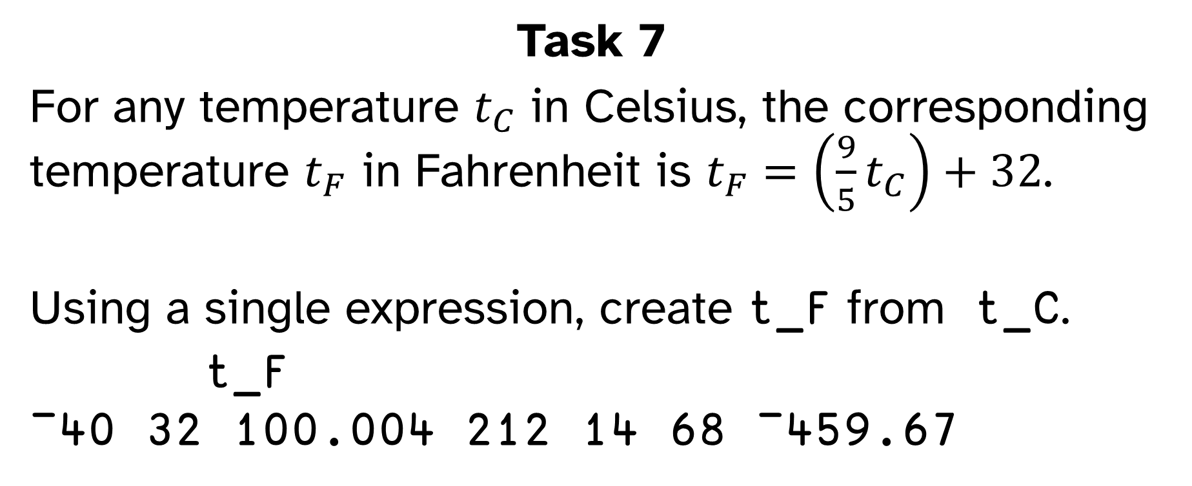
Task 7
For any temperature $t_{C}$ in Celsius, the corresponding temperature $t_{F}$ in Fahrenheit is $t_{F}=\left(\frac{9}{5}t_{C}\right)+32$.
Using a single expression, create t_F from t_C.
t_F
¯40 32 100.004 212 14 68 ¯459.67

Slide 8
Task 8
Define the array prices to hold the prices of 3 products:
prices
3.50 7.99 4.25
⍴prices
3
Define quantities as a table that tells how many of each product was ordered on each of 5 days:
quantities ← 5 3⍴3 1 0 7

Slide 9
Task 9
Using quantities, how many products were ordered on each day?
quantity_per_day
4 11 10 8 4
Using quantity_per_day, how many products have been ordered, all in total?
total_quantity
37

Slide 10
Task 10
For each product how many did we sell in total?
quantity_per_product
14 12 11
Using quantity_per_product, how many did we sell of the product that we sold the most of?
most_sold
14

Slide 11
Task 11
For each day, how many products sold at least 1?
varieties
2 3 2 2 2
On which days were 10 or more items sold?
super_days
0 1 1 0 0

Slide 12
Task 12
Using prices and quantities, compute the income per product per day:
incomes
10.5 7.99 0
24.5 23.97 4.25
0 55.93 12.75
3.5 0 29.75
10.5 7.99 0

Slide 13
Task 13
Using incomes, compute the total income for each day:
total_per_day
50.45 69.72 68.68 47.25 50.45
Using total_per_day, compute the grand total:
grand_total
286.55

Slide 14
Task 14 (bonus task)
Recompute grand_total with a single expression that only uses prices and quantities:
grand_total
286.55

Slide 15
Task 15 (bonus task)
Create this pattern:
pattern
zzzzzzHHHHzzzzzzHHHH
HHHHzzzzzzHHHHzzzzzz
zzzzzzHHHHzzzzzzHHHH
HHHHzzzzzzHHHHzzzzzz
Try to make your code as short as possible!

