Slide 1
Dyalog APL in Non-Windows Environments
Miscellaneous features etc which you might come across when using Dyalog APL on non-Windows platforms
Andy Shiers, COO Dyalog Ltd

Slide 2
Supported Platforms
Windows: 32- and 64-bit, Classic and Unicode
Linux: 64-bit, Classic and Unicode
macOS: 64-bit Unicode
Raspberry Pi: 32-bit Unicode on 32-bit Raspbian
AIX: 32- and 64-bit, Classic and Unicode
64-bit Unicode for Windows, Linux and macOS, and 32-bit Unicode for Raspberry Pi can be downloaded from www.dyalog.com

Slide 3
Major differences
32-/64-bit: size of array/workspace, interaction with O/S
Classic/Unicode: Number of supported characters, font limitations etc
Windows vs the rest: full IDE vs tty interface
RIDE can be used to drive recent Dyalogs on any platform
AIX vs the rest: Big Endian vs Little Endian
Not a huge difference between AIX/Linux&Pi/macOS
But don't assume that they are always the same !

Slide 4
Major differences – workspace
Workspaces and component files should be compatible across all platforms
Within the same version
Are upwardly compatible
Classic generates TRANSLATION ERRORs if a workspace contains characters which are not in ⎕AVU
Watch out for such characters in ⎕DM and ⎕DMX !
GUI features will be deleted when loading a Windows workspace into a non-Windows version
Will get warning messages .. ignore them!
WSEXT/CFEXT control what extensions workspace and component file have (if any)

Slide 5
Major differences – workspace and array size
Workspace size (MAXWS)
Maximum size to allow; must be contiguous in the process space
32-bit .. Maximum is between 1.2 to <2.0GB
64-bit .. "unlimited" .. biggest we know of is 2.1TB
Don't make too big or O/S will start to swap which really slows things down
Consider size of workspace × number of concurrent instances
An array must fit in workspace:
32-bit can have up to ¯1+2*32 elements
64-bit "unlimited"

Slide 6
Major differences – Classic/Unicode
Classic has at most 256 characters
Limited further by font considerations
Much more flexibility with keyboard setup (APLK/APLKEYS etc)
Unicode has considerably more
1, 2 or 4 byte values
Even in Classic better to use ⎕UCS, not ⎕AV/⎕TC

Slide 7
Big Endian/Little Endian
AIX runs on POWER CPU in big-endian mode (the original mode)
All other supported platforms are little-endian
Be aware that you may have to consider byte ordering
Intel/AMD/ARM: Little endian – 1 2 3 4
POWER (AIX): Big endian – 4 3 2 1
eg 11 ⎕DR 123456
Dyalog APL does most of the work for you
Always )SAVEs in current endianness (!)
Components written in local endianness

Slide 8
Major differences – IDE vs tty
Windows IDE
GUI based, floating resizable windows
tty interface
Assumes fixed sized, character based output
Responds to some resize requests – might need screen refresh
RIDE
Client for all but AIX
Can talk to any Dyalog after 16.0
Zero-footprint RIDE (runs in browser)
included with all non-Windows versions of Dyalog

Slide 9
Auxillary Processors
Example: 'xutils'⎕sh''
Separate process which contains user-written c-code
Appears in workspace as locked functions
Erasing all the functions terminates the AP
Benefit: if an AP crashes, it doesn't bring the APL down too
But: data has to be passed to and from the AP .. Slow
xutils
nfiles
unixfiles
Customer written APs

Slide 10
⎕SM
A screen manager
Available on Windows, but only to support existing applications
Available on non-Windows, tty interface only, only for existing applications
Assign/change ⎕SM to update the screen
A complex nested array which can contain sub-screen manager arrays
Use ⎕SR to pass control to user (and make ⎕SM screen visible)
Use HK keystroke to toggle ⎕SM screen when developing

Slide 11
UNIX cheat sheet
Big difference with Windows:
Windows: erase *.*
The erase command sees "*.*" so can ask if you really meant to do it.
UNIX: rm *
The command shell expands "*" to all that matches it (ie everything). So rm has no idea that it's everything, so won't check
But: rm –i
Similar for all commands. Few have the interactive option.

Slide 12
UNIX cheat sheet - directories
cd
cd go home
cd - go to previous directory
cd adir cd to adir
mkdir adir
rmdir adir delete iff it's empty
rm –r adir recursively delete (be careful!)
rm –rf adir forcibly delete recursively (be exceedingly careful!)

Slide 13
UNIX cheat sheet –dealing with files
ls
ls –lrt long listing in reverse time order – current directory
ls f1 f2
ls *
ls adir
rm
rm f1 delete f1
rm * delete all files in current directory

Slide 14
UNIX cheat sheet – dealing with file content
cat file
cat * concatenate all files
cat andy* > out concatenate all files whose name starts with andy into a file called out
wc –l file report number of lines
grep andys /etc/passwd report all lines which contain "andys" in the file /etc/passwd
vi myfile Use the standard UNIX editor to edit/look at myfile

Slide 15
UNIX cheat sheet – the file command
file myfile
Attempt to describe the contents of the file
file –m /opt/mdyalog/17.1/64/classic/p9/magic myfile
As above, but try to identify details of Dyalog files (the –m only needed on AIX)
andys@p9-72qa:/devt/tmp/andys$ file -m /opt/mdyalog/17.1/64/classic/p9/magic *
182.dws: Dyalog APL workspace type 18 subtype 33 64-bit unicode little-endian
big.dws: Dyalog APL workspace type 17 subtype 16 64-bit classic big-endian
isfile: Dyalog APL workspace type 12 subtype 5 64-bit classic big-endian
isfile121: Dyalog APL workspace type 12 subtype 5 64-bit classic big-endian
runall: c program text File contains 8 bit characters.
types.dws: Dyalog APL workspace type 18 subtype 4 64-bit unicode big-endian
xx.dcf: Dyalog APL component file 64-bit level 1 journaled checksummed

Slide 16
UNIX cheat sheet – filesystems
Windows "sees" separate drives, each with its own filesystem
UNIX "sees" a single directory structure, made up of one or more filesystems
df # report space available in each filesystem
df –m # report in MB
du myfile # report space used by myfile
du –ms * # report space used by each object in current directory
du and df both based on number of blocks used. df is more precise

Slide 17
UNIX cheat sheet – pipes, redirection, exit codes
mycmd <infile >outfile 2>errfile
0: stdin (usually the keyboard)
1: stdout – where output goes (usually the terminal)
2: stderr – where error messages go (usually the terminal)
mycmd <infile >outfile 2>&1
Redirect stderr to wherever stdout is currently redirected to
grep dyalog /etc/passwd | wc –l
identify all lines in /etc/passwd which have dyalog in them, and return how many that is
echo $?
Print the exit code from the last command run. 0 indicates success, anything else failure of some sort

Slide 18
UNIX cheat sheet – processes
ps
ps –ef list all processes with useful information about each
ps –elf list full information about all processes
ps –fu andys list all the processes belonging to andys
top/topas/nmon (AIX)
Show most active processes. Ctrl-c stops this
kill
kill -2 pid signal a weak interrupt to process with process id pid
kill -3 pid signal a strong interrupt to process with process id pid
kill -9 pid unconditionally and immediately kill process with process id pid
This should be a last resort, not a first resort !

Slide 19
UNIX cheat sheet – shell/environment variables
ANDY=1 # defines a shell variable, only visible to this shell
export ANDY # is now available to all commands started from this # shell. An Environment Variable
export ANDY=1 # both the above in one command
echo $ANDY # Must put a $ in front of a variable to reference it
1

Slide 20
UNIX cheat sheet – watch out for quotes
echo "echo $ANDY" # Substitute value of variable
echo 1
echo 'echo $ANDY' # exactly as was typed
echo $ANDY
echo `echo $ANDY` # treat as though a command
1

Slide 21
UNIX cheat sheet – common environment vars
$HOME # my home directory
$PATH # list of directories to look for commands in
$LANG # defines your language environment
$TZ # defines your time zone
$TERM # defines what terminal type you are using
Normally has the value xterm
Get this wrong and you may have an unusable terminal session

Slide 22
⎕sh and )sh
Run a command from within APL
AIX: !!! time taken to call ⎕SH proportional to size of calling process !!!
Avoid using ⎕SH whereever possible
)sh echo $PPID
123456
⎕sh 'grep 620 /etc/passwd'
jenkins:!:6203:6116::/home/jenkins:/usr/bin/bash
nicolas:!:6204:6116::/home/nicolas:/usr/bin/bash
+⎕sh 'grep 620 /etc/passwd'
jenkins:!:6203:6116::/home/jenkins:/usr/bin/bash nicolas:!:6204:6116:: /home/nicolas:/usr/bin/bash
Quite intentional !

Slide 23
When it goes horribly wrong
Dyalog APL can "crash"
Be careful when using the word crash
Do you mean the APL code has errored, but you're still in APL ?
Do you mean the APL interpreter has crashed ?
Types of abnormal termination
Syserror - generates an aplcore
Core dump - generates a core file if O/S is configured to do so
Process dump - need to configure Windows to do so
Silently disappears
Are you sure the APL code didn't call ⎕OFF ?

Slide 24
When it goes horribly wrong
Your tty session may be unusable
Close it down and open a new one
Ctrl-j stty sane ctrl-j may get control back
With a syserror you may be able to see where the problem lies with
sed -n '/======== Interesting Information/,$p' aplcore
You may be able to )copy or ⎕cy from an aplcore
)copy copies global value, ⎕CY the most local

Slide 25
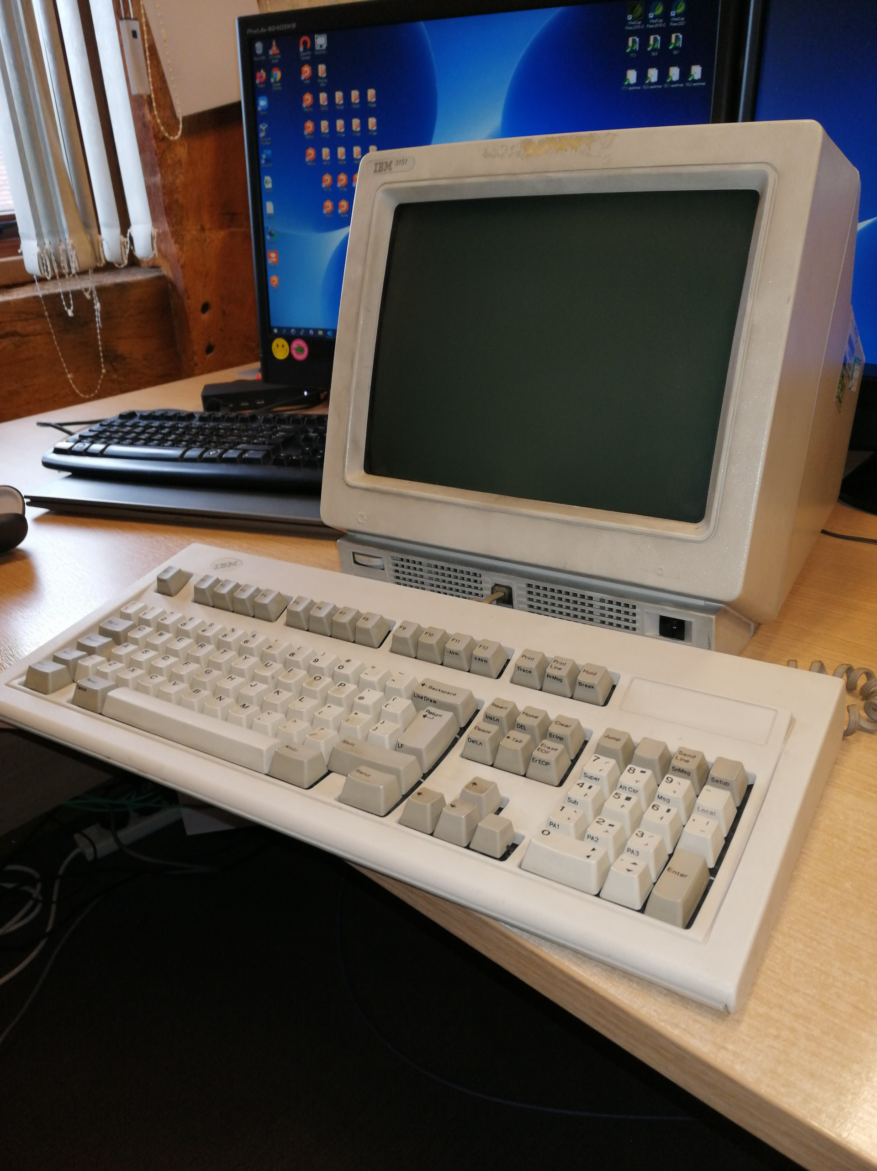
IBM 3151 ASCII terminal

Slide 26
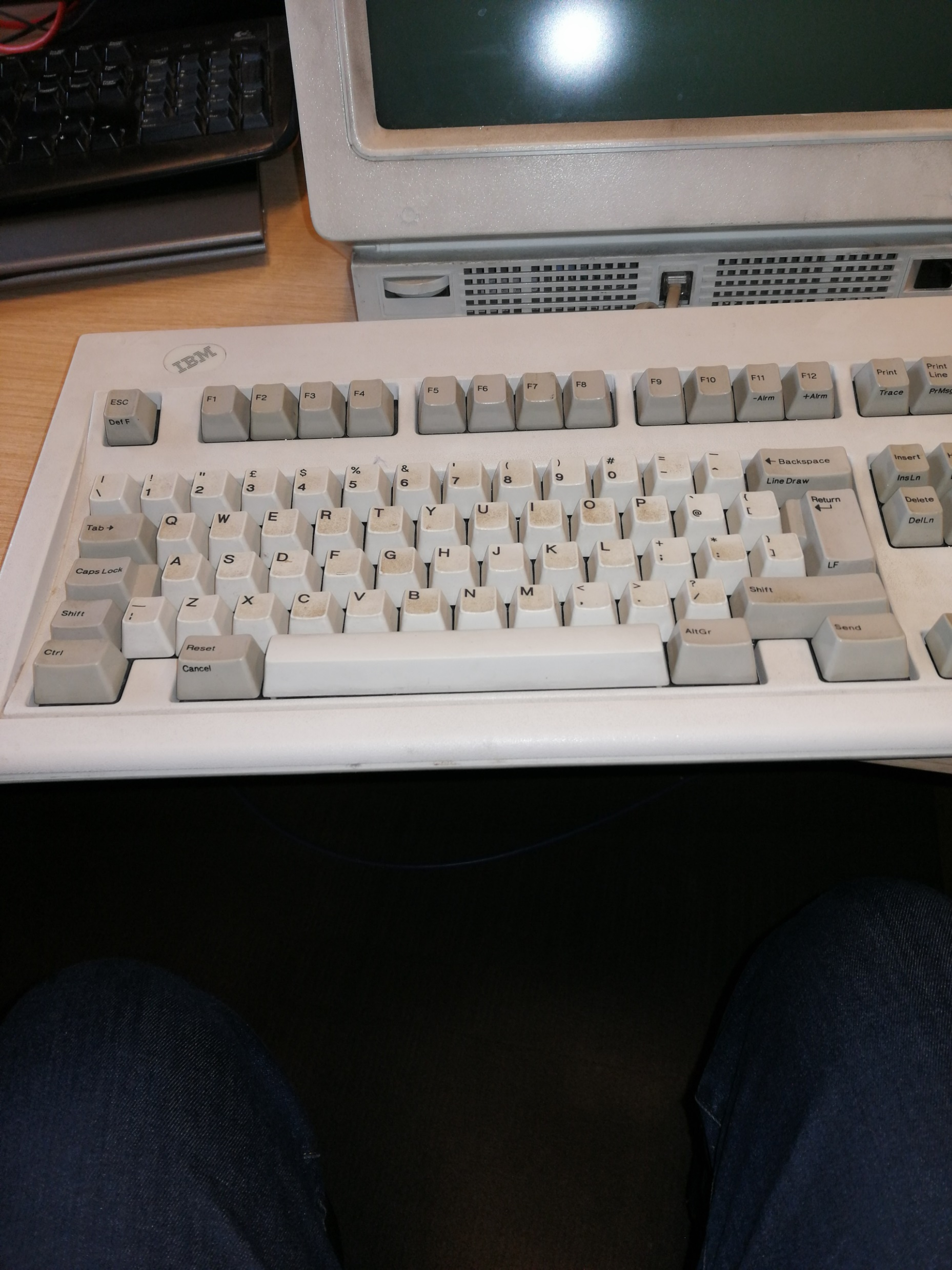
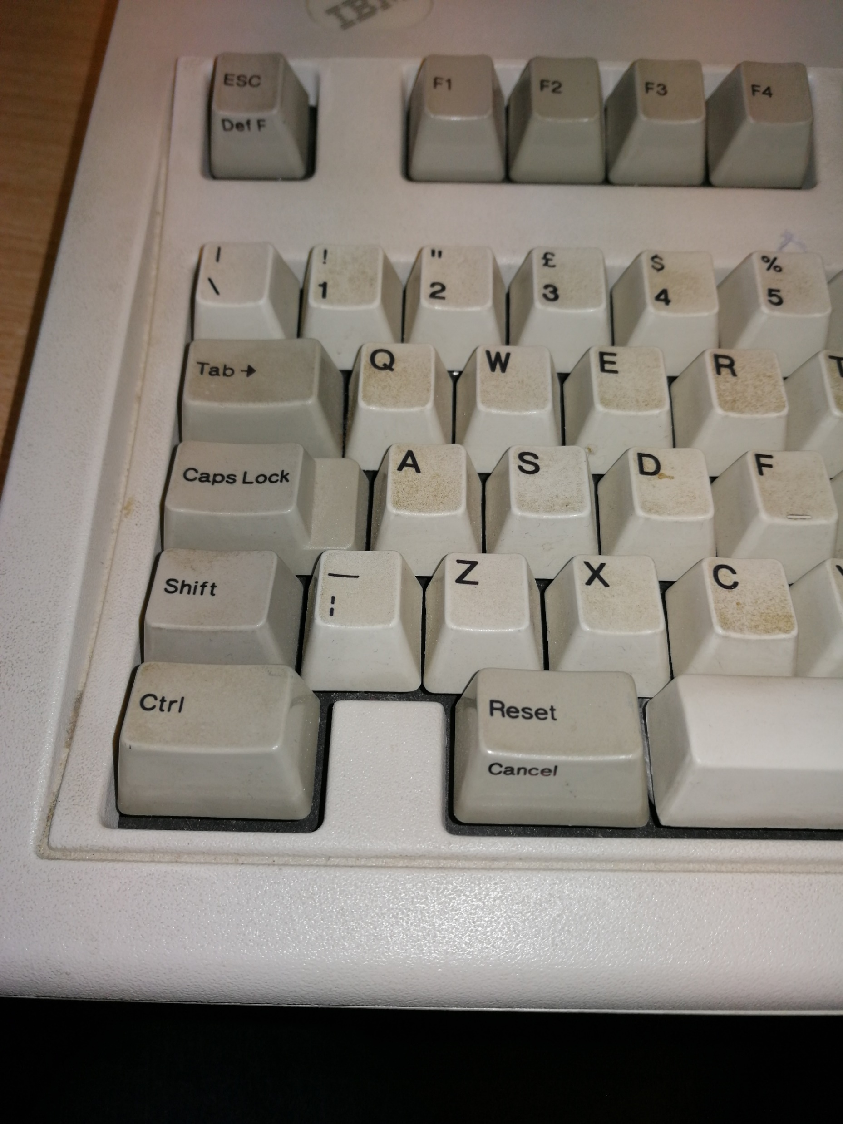

Slide 27
Terminal Emulator
Windows
PuTTY
Needs IME and APL-385 font
KEA Attachmate
Customer configured keyboard
Linux
Xterm and other terminal windows
Generally Unicode

Slide 28
Classic issues
Can't use ⊆ ⌸ ⌺ ⍠ ⍤ ⍥ ⍸
No slots free in ⎕av (nor some fonts)
Write cover functions/operators and use them
Many classic workspaces still use the underscored alphabet
Problems rendering them in terminal emulators
Lack of keystrokes available
May not paste well between APL and other applications

Slide 29
Default keyboard layouts
Classic / Windows
Various different layouts over the years, last updated with 12.1
Unicode / Windows
Uses IME
Unicode/Linux terminal emulators
Supplied with recent Linux distributions
Classic / PuTTY
Uses the Unicode layout & IME
Classic/KEA
Ctrl-o Ctrl-n, underscored alphabet

Slide 30
Keyboard commands
Listed in UNIX User Guide, Appendix A
http://help.dyalog.com/17.1/#UNIX_IUG/Appendix%20A%20Table%20of%20keycodes-te.htm
Classic: use ⎕KL to see what the keystroke is
Need to know the 2 character command mnemonic
Can have multiple keystrokes for one command
Will be in 18.2 for Unicode

Slide 31
Configuration parameters (Dyalog env vars)
Are environment variables or command line parameters
On UNIX MUST be in uppercase
From 17.1 can appear in config files in $HOME/.dyalog
MAXWS=1G mapl # Start APL with a 1G workspace
APLK=kea_apl mapl # Set my input translate table to kea_apl

Slide 32
APLK/APLKEYS, APLT/APLTRANS
Classic only
APLK/APLKEYS
Defines what keystroke is used to enter each character
Defines what keystroke is used to enter each keyboard command
APLT/APLTRANS
Defines what the interpreter must send to generate each character
Defines how to generate colours
APLKEYS/APLTRANS are similar to PATH: a list of directories to look in
APLK/APLK0, APLT/APLT1/APLT2 is the name of the file to use
Generally is the same as the value of $TERM

Slide 33
Useful URLs
help.dyalog.com/17.1 and docs.dyalog.com/17.1
UNIX-specific documentation
www.dyalog.com/user-meetings/index.htm
Uncle Andy's Fireside chats (and The Doctor is in)
www.ibm.com/docs/en/aix/7.2?topic=commands
On most UNIX boxes,
command -?
command –h
man command

