Slide 1
APL and Microsoft Excel
Richard Park

Slide 2
APL is great, why this?

Slide 3
APL is great, why this?
Microsoft Excel still commonly used
Data entry
Processing
Graphics
… + much more

Slide 4
So why APL again?

Slide 5
So why APL again?
Great for data processing
Especially arrays (duh!)
Spreadsheets are arrays

Slide 6
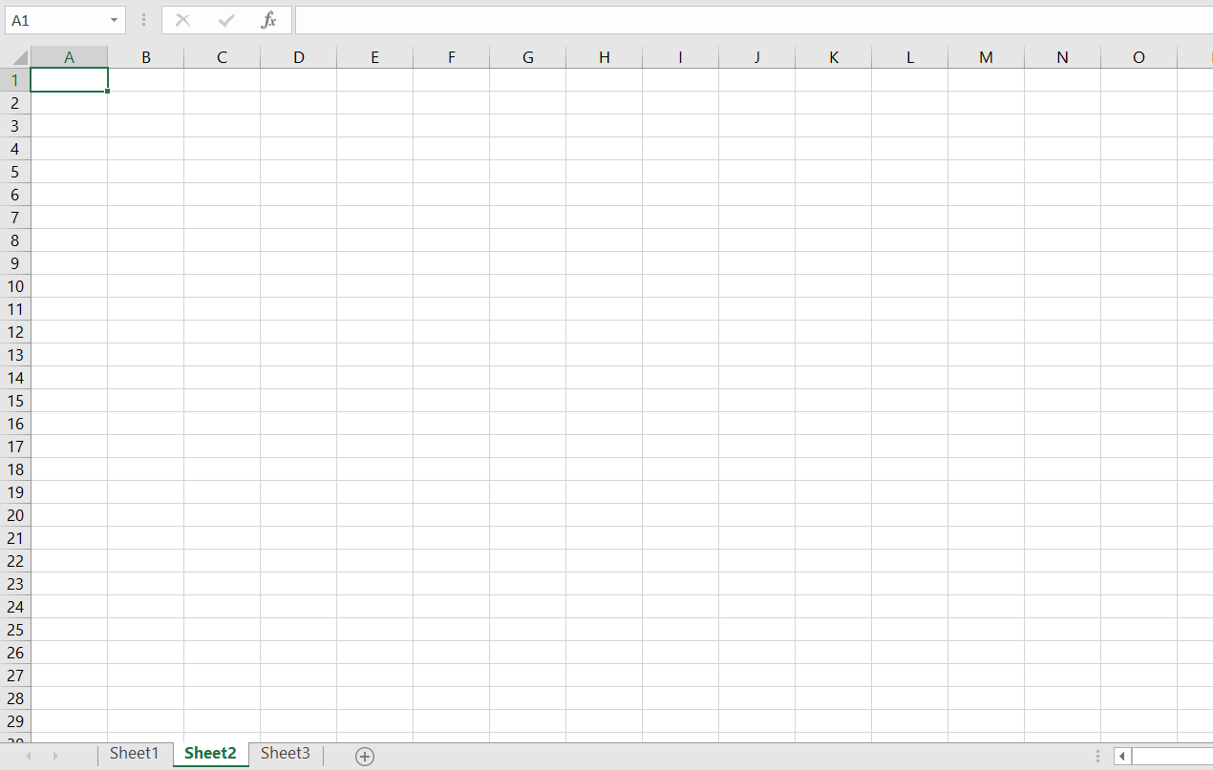
So why APL again?
Great for data processing
Especially arrays (duh!)
Spreadsheets are arrays

Slide 7
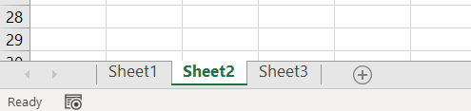
So why APL again?
Great for data processing
Especially arrays (duh!)
Spreadsheets are arrays

Slide 8
Modes of Operation
Using Microsoft Excel Files (.xls .xlsx)
Read Excel Files with Dyalog
Write Excel Files with Dyalog
Dyalog & Excel inter-processing
Dyalog as Client
Dyalog as Server

Slide 9
Using Microsoft Excel Files
Acquiring data from
The internet
Databases
Files
Computations
Etc…

Slide 10
Using Microsoft Excel Files
Acquiring data from
Microsoft Excel!

Slide 11
Using Microsoft Excel Files
Acquiring data from
Microsoft Excel!
https://github.com/the-carlisle-group/XL2APL

Slide 12
Excel Objects
COM: Component Object Model
Collection of workbooks: object
Workbook: object
Sheet: object
Range: object

Slide 13
Excel Objects
COM: Component Object Model
OLE: Object Linking and Embedding

Slide 14
Modes of Operation
Dyalog as Client
Control Microsoft Excel from inside the Dyalog session

Slide 15
Modes of Operation
Dyalog as Server
Write functions and macros as in APL!

Slide 16
Carlisle group: APL2XL
XL2APL
https://github.com/rikedyp/[APL2XL , XL2APL]

Slide 17
Documentation & Tutorials

Slide 18
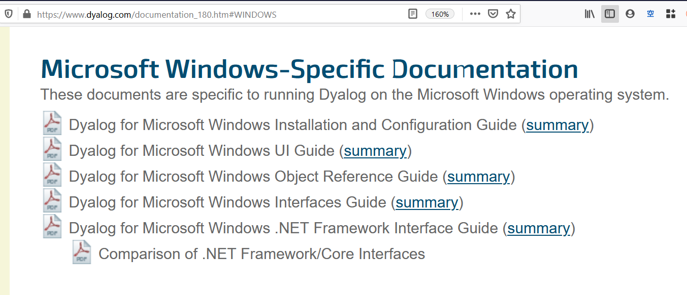
Documentation & Tutorials

Slide 19
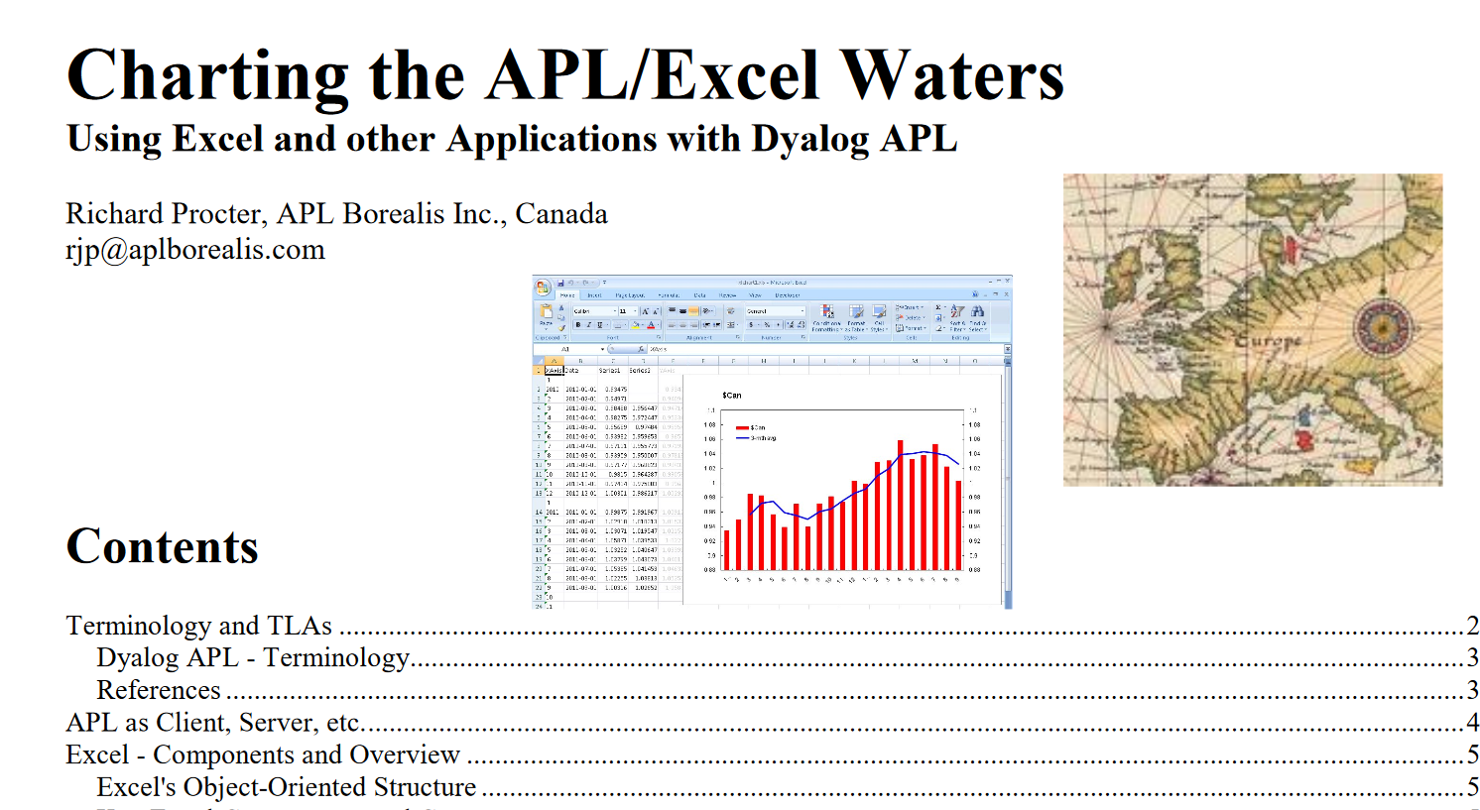
Documentation & Tutorials

Slide 20
Upcoming webinars
4 June 2020
BAA webinar: Paul Grosvenor (BAA Chairman) hosts
the British APL Association AGM (15:00 UTC)
11 June 2020
Dyalog webinar: Adám presents
Language Features of Dyalog version 18.0 in Depth (part 2) (15:00 UTC)

