Slide 1
MERIDIAN
SECURITY CASE STUDY
E01 — E43
Evidence-backed implementation
Linux Server Hardening, Monitoring, Auditing, Detection & Recovery
SSH • UFW • Fail2ban • Suricata auditd • Postfix • Cron • Backup
43 evidence captures
Professional review deck
MERIDIAN SECURITY CASE STUDY
01

Slide 2
EXECUTIVE SUMMARY
Case Study Overview
A concise review of the implemented controls and their evidence trail.
HARDEN
MONITOR
AUDIT
SSH service, key-based authentication, root/password restrictions
Authentication, firewall, Fail2ban and IDS visibility
auditd rules, file changes, SSH configuration and account events
ALERT
OPERATE
RECOVER
Postfix-based notifications tied to security detections
Cron, time synchronization and log rotation
Backup creation, verification, restore and scheduled validation
MERIDIAN SECURITY CASE STUDY
02

Slide 3
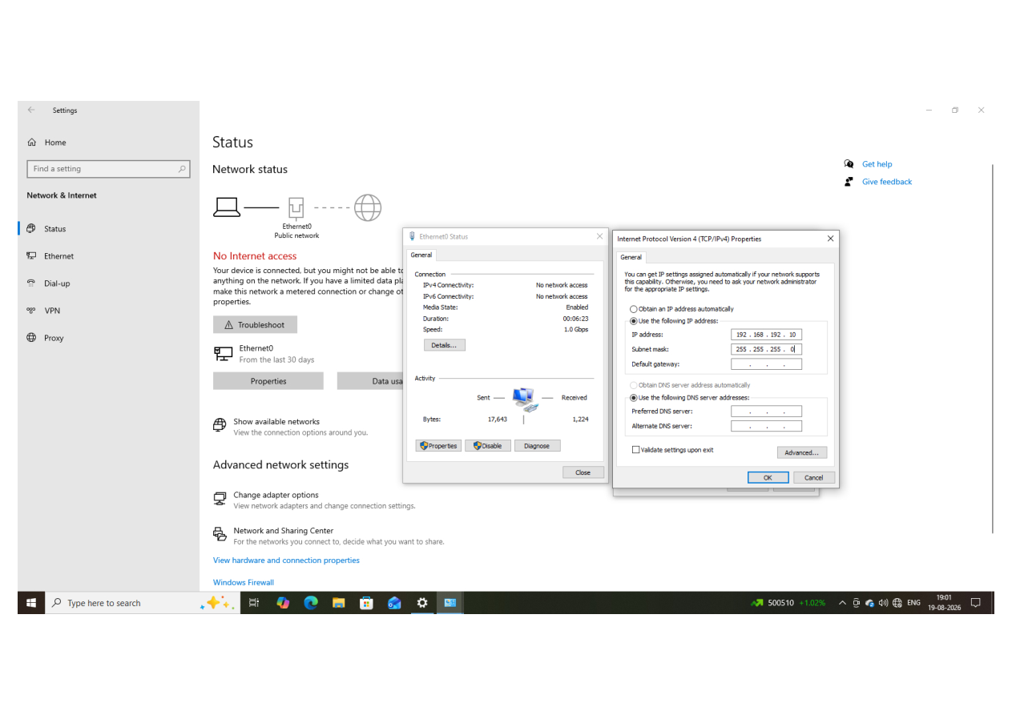
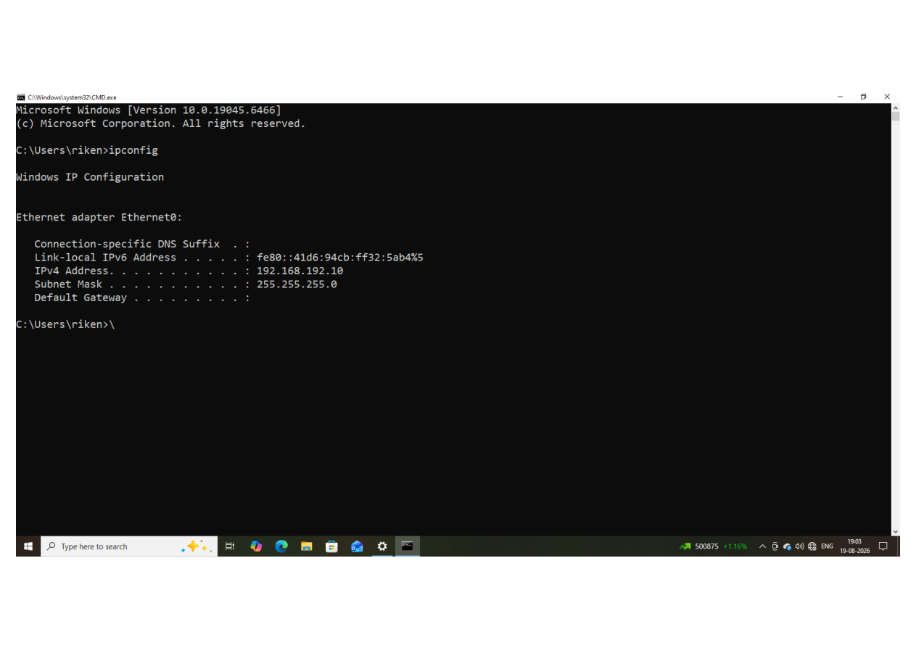
01
Network & SSH Trust Path
Two evidence captures — full screenshots preserved without cropping.
E01
Windows static IP configuration
E02
Windows IP configuration verification
Evidence screenshot
Evidence screenshot
MERIDIAN SECURITY CASE STUDY
04

Slide 4
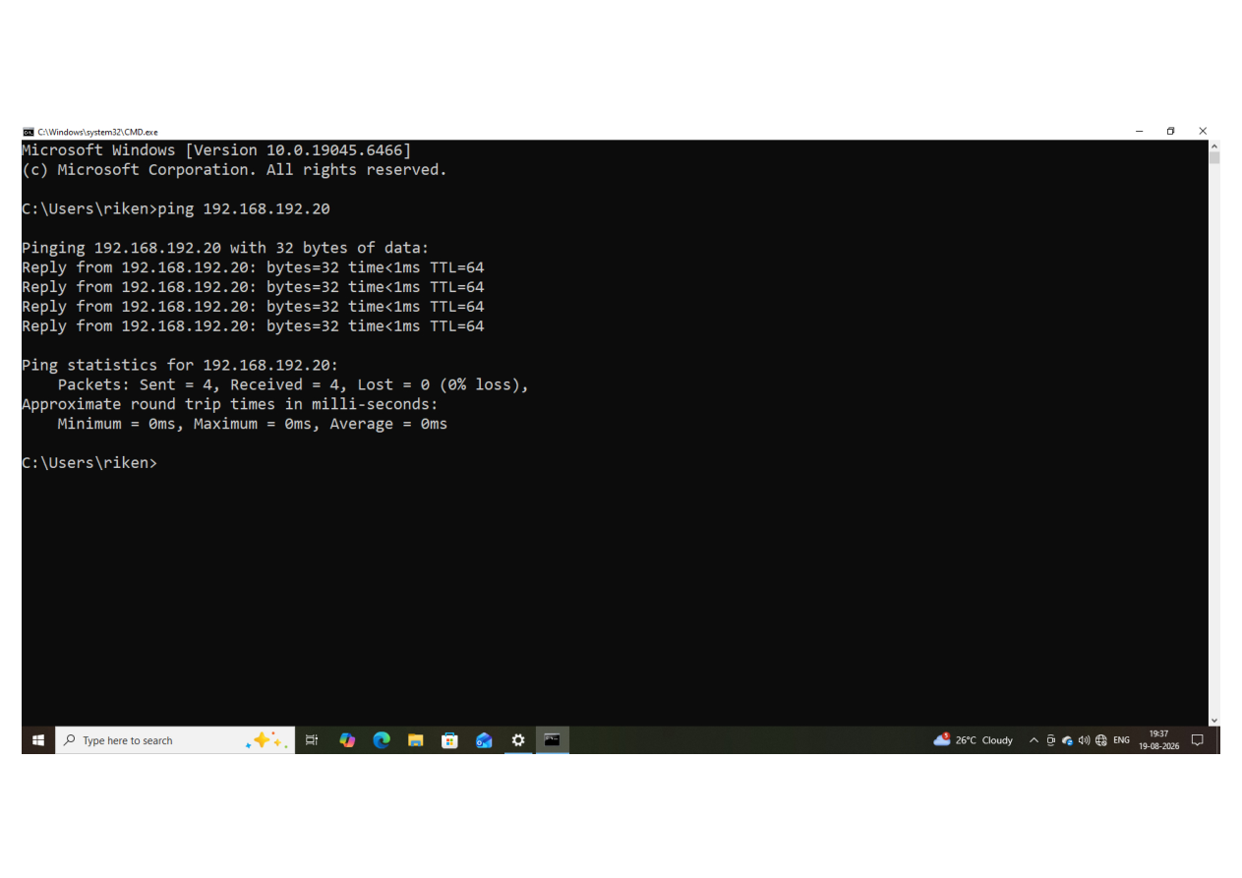
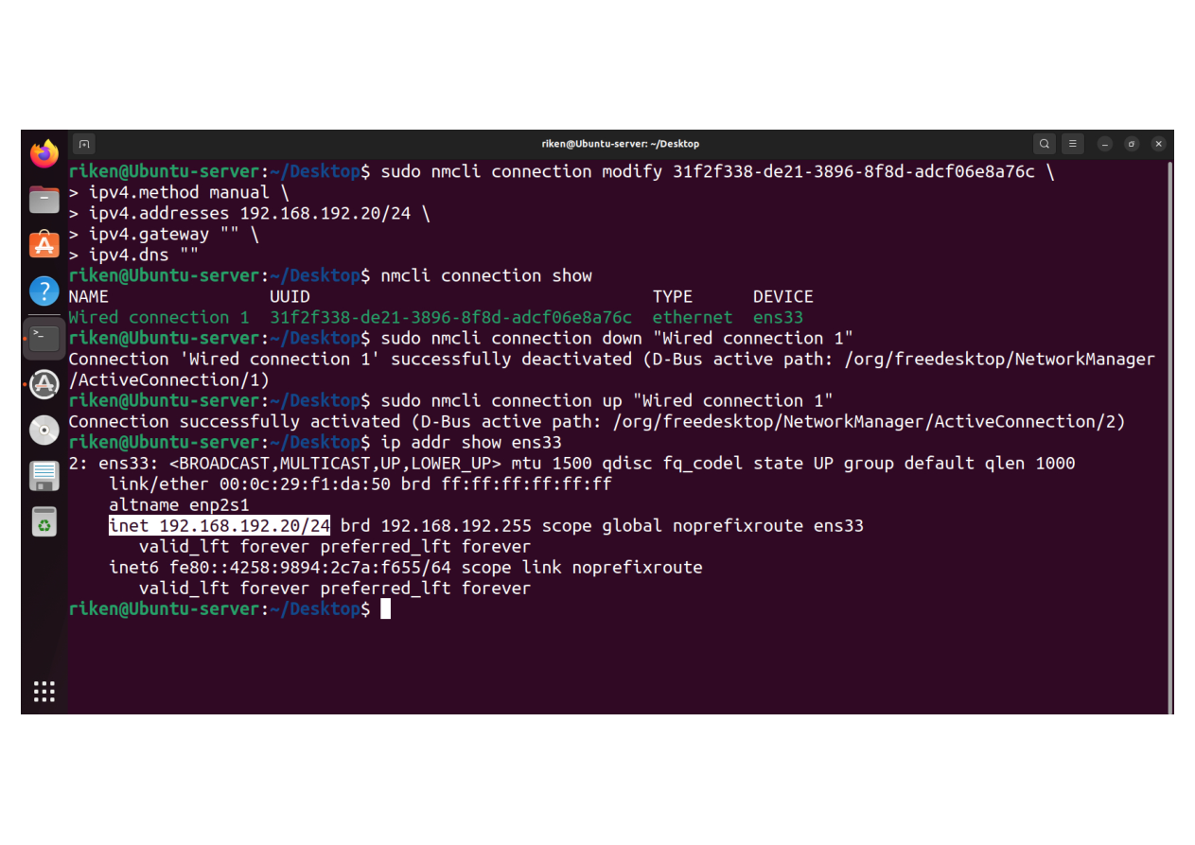
01
Network & SSH Trust Path
Two evidence captures — full screenshots preserved without cropping.
E03
Initial Linux network / baseline connectivity
E04
Ubuntu static IP verification
Evidence screenshot
Evidence screenshot
MERIDIAN SECURITY CASE STUDY
05

Slide 5
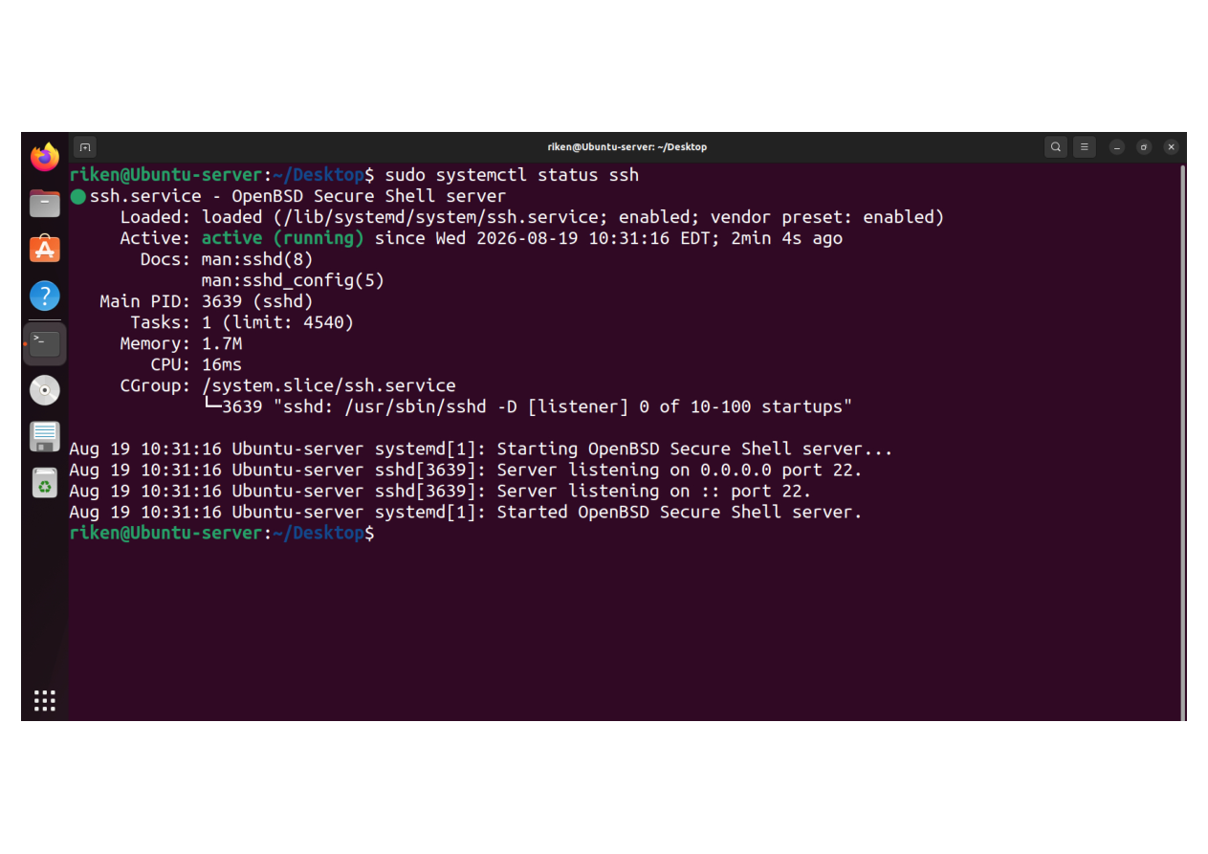
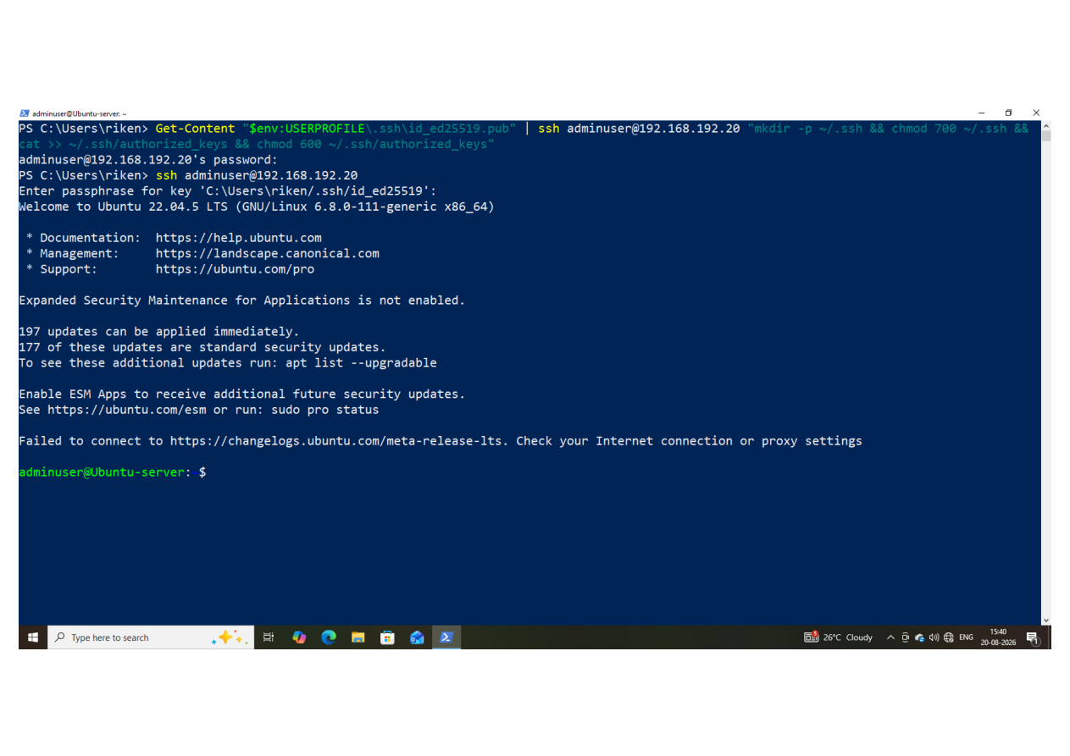
02
SSH Service & Authentication
Two evidence captures — full screenshots preserved without cropping.
E05
SSH service active before hardening
E06
SSH key-based authentication / network verification
Evidence screenshot
Evidence screenshot
MERIDIAN SECURITY CASE STUDY
06

Slide 6
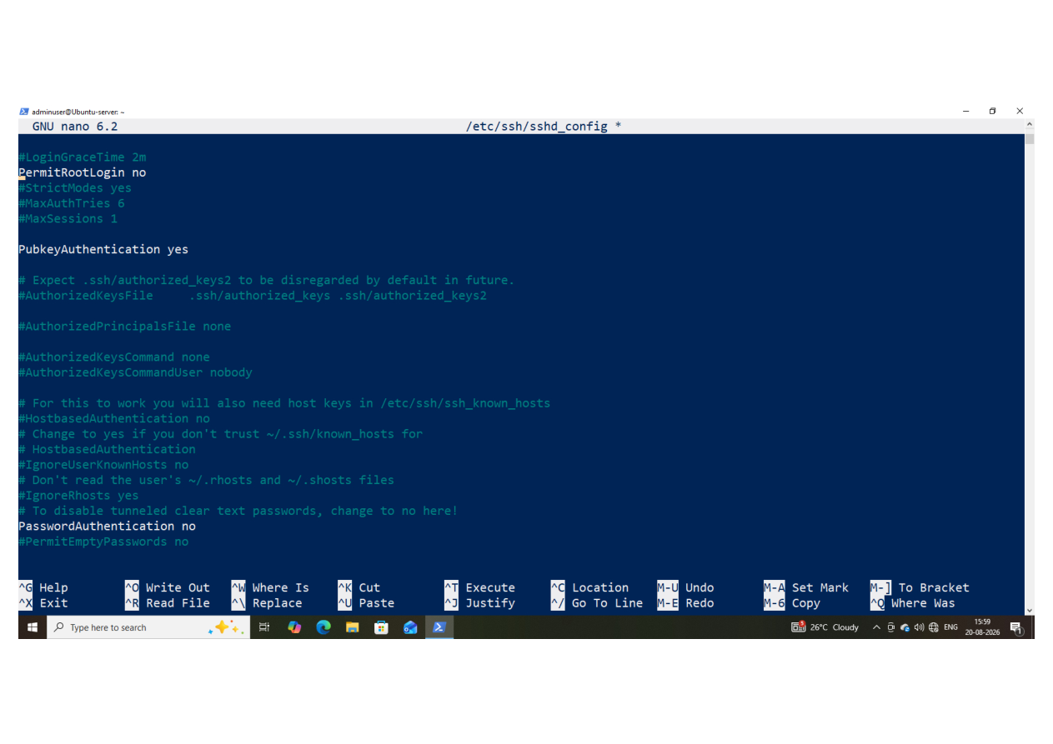
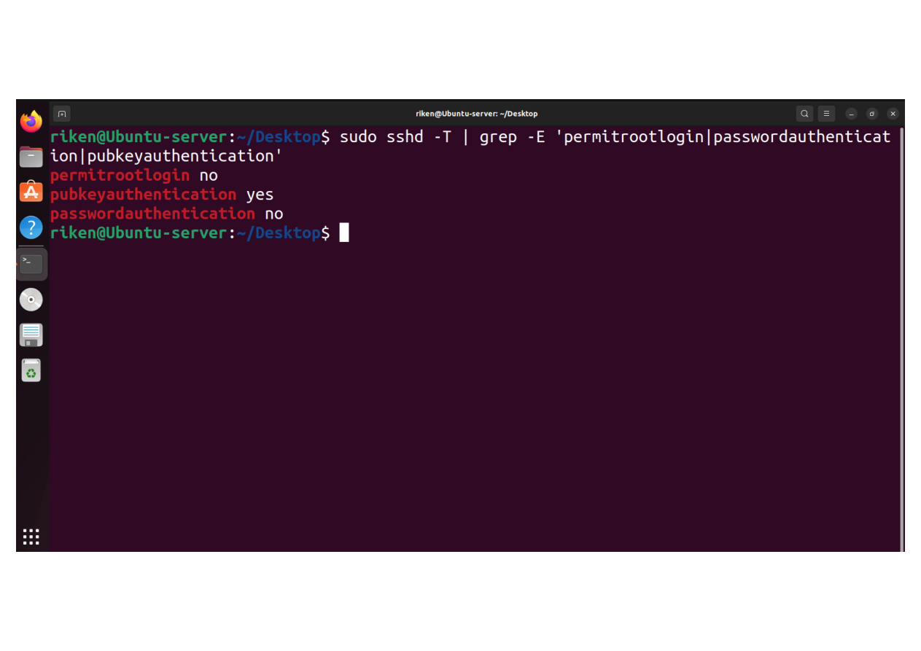
02
SSH Service & Authentication
Two evidence captures — full screenshots preserved without cropping.
E07
SSH hardening configuration
E08
SSH hardening configuration validation
Evidence screenshot
Evidence screenshot
MERIDIAN SECURITY CASE STUDY
07

Slide 7
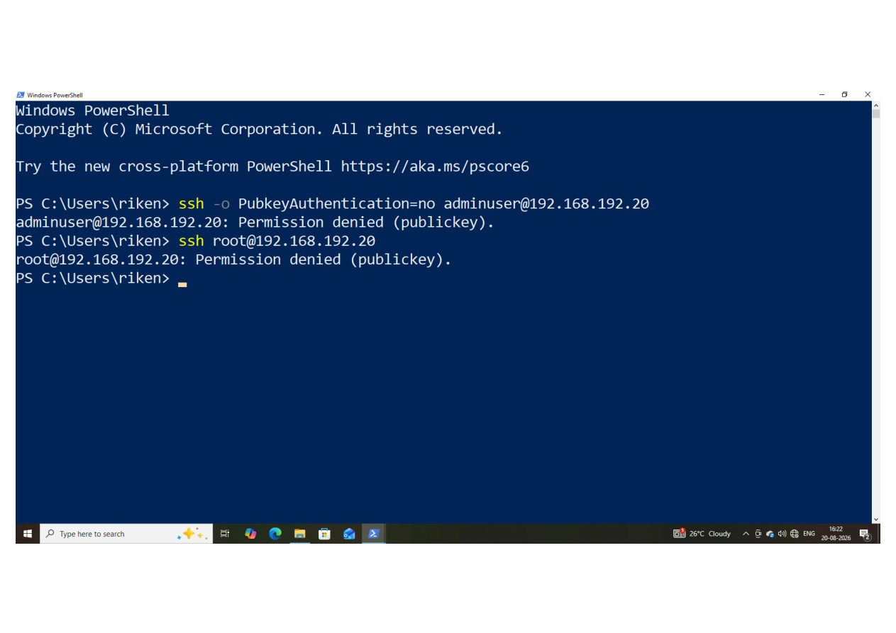
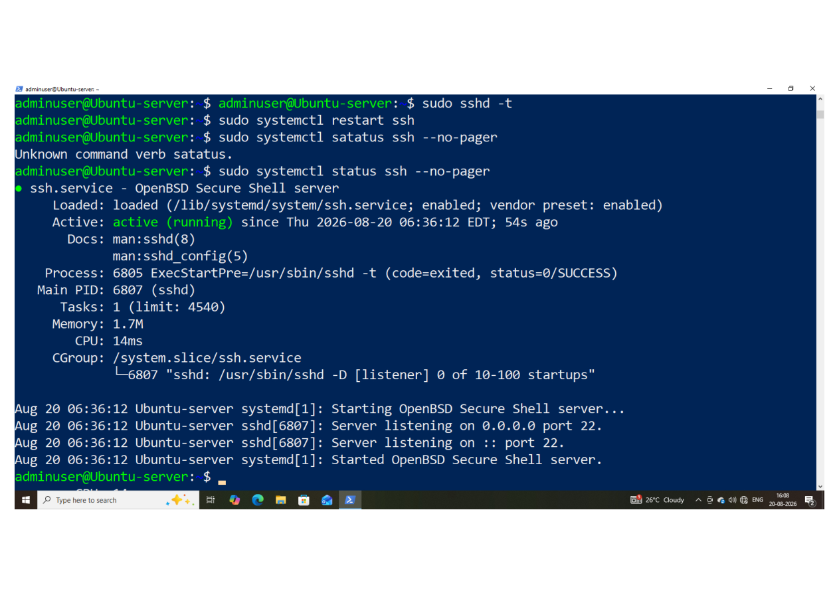
03
SSH Hardening & Access Control
Two evidence captures — full screenshots preserved without cropping.
E09
SSH password and root access blocked
E10
SSH service active after hardening
Evidence screenshot
Evidence screenshot
MERIDIAN SECURITY CASE STUDY
08

Slide 8
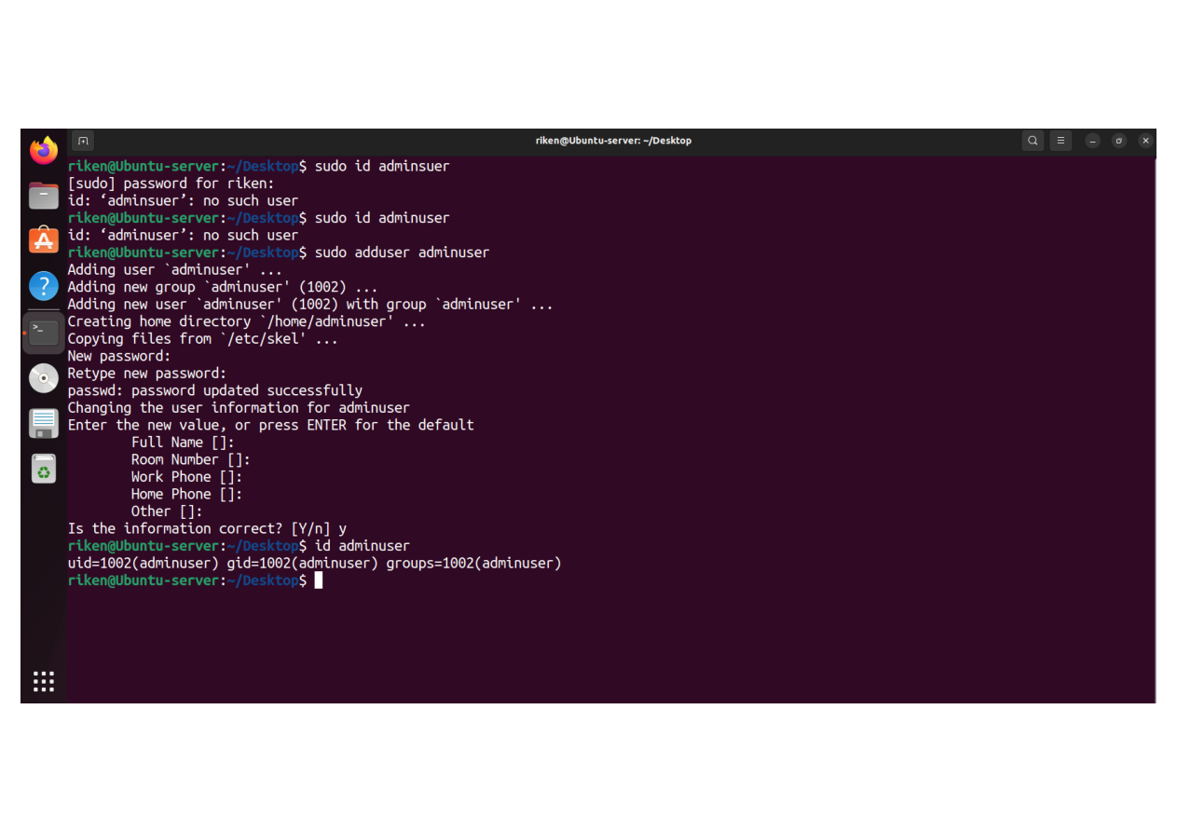
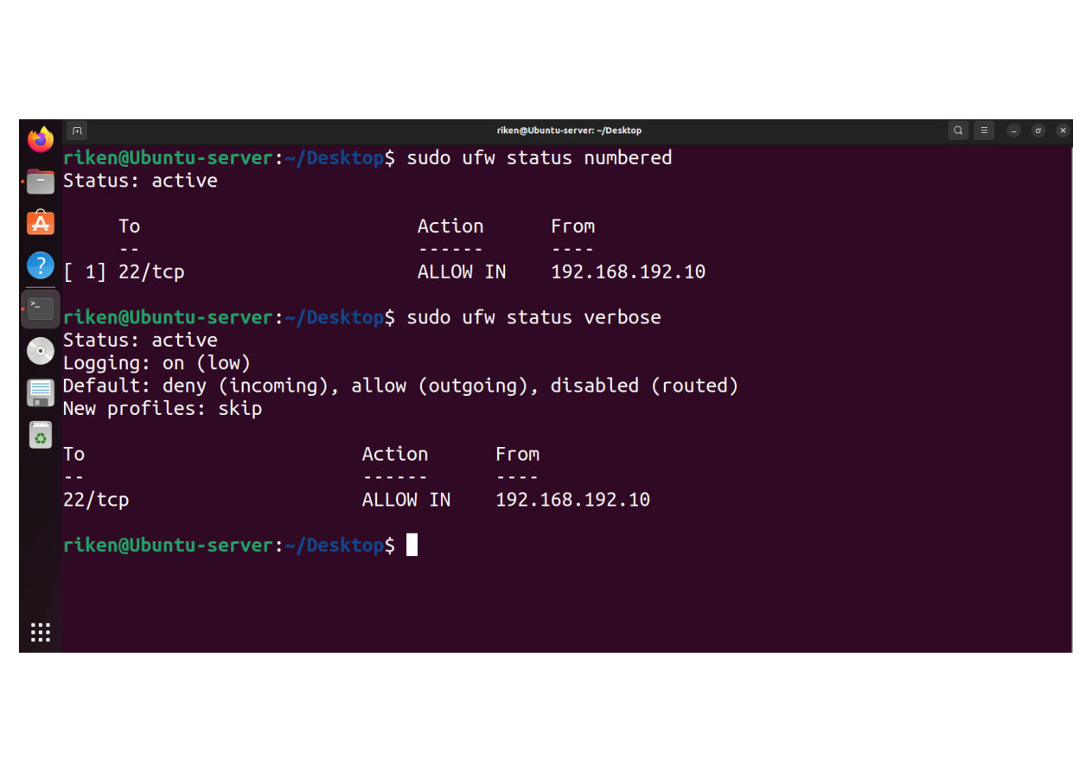
03
SSH Hardening & Access Control
Two evidence captures — full screenshots preserved without cropping.
E11
Admin user creation and verification
E12
UFW firewall active and SSH restricted
Evidence screenshot
Evidence screenshot
MERIDIAN SECURITY CASE STUDY
09

Slide 9
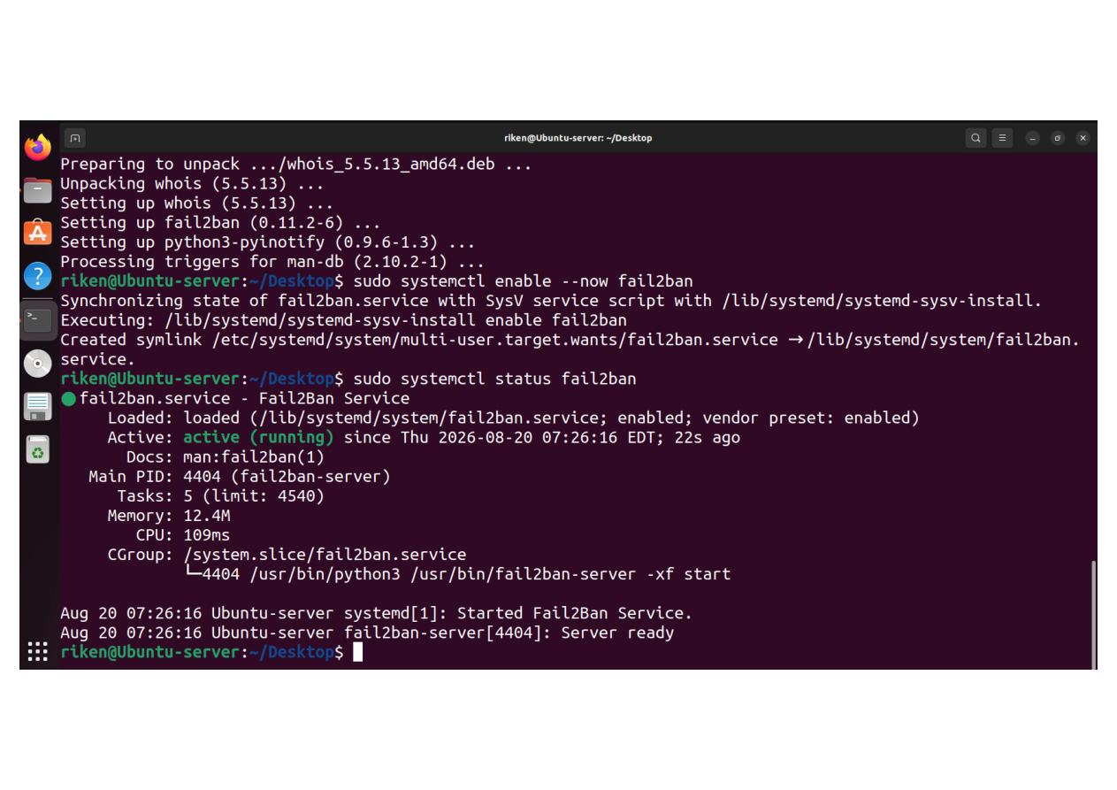
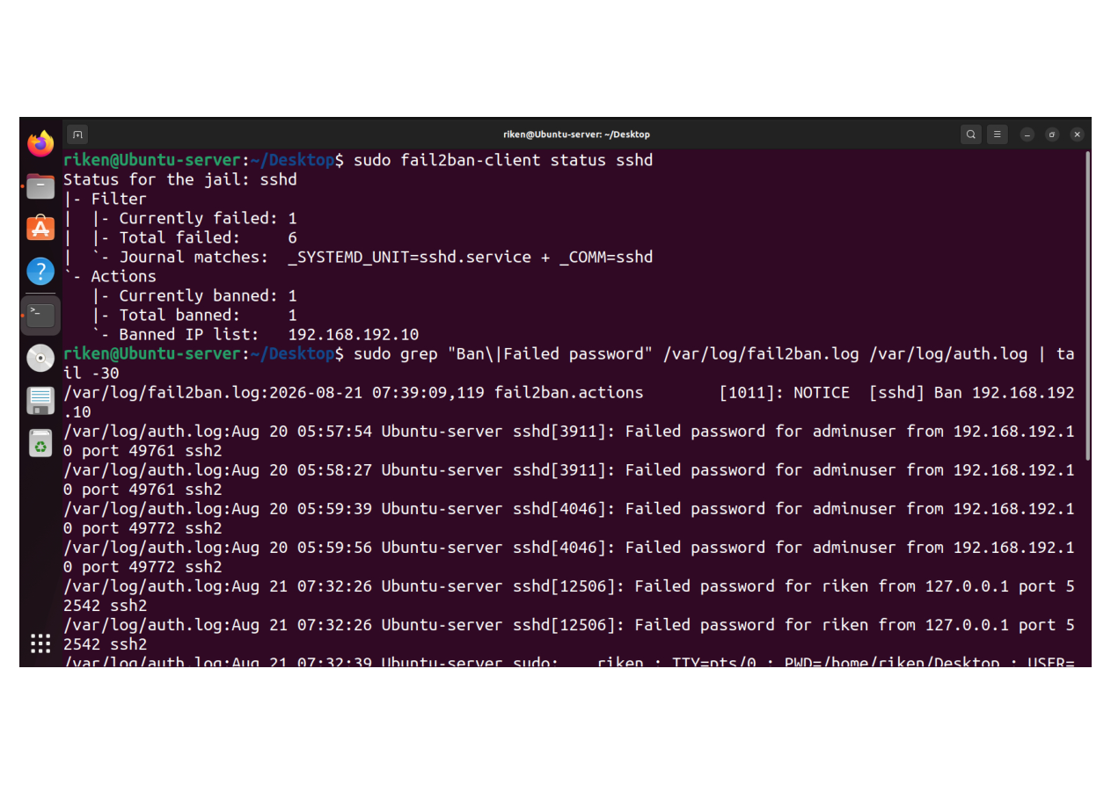
04
Intrusion Prevention & Network Defense
Two evidence captures — full screenshots preserved without cropping.
E13
Fail2ban active
E14
Fail2ban SSH brute-force IP ban
Evidence screenshot
Evidence screenshot
MERIDIAN SECURITY CASE STUDY
10

Slide 10
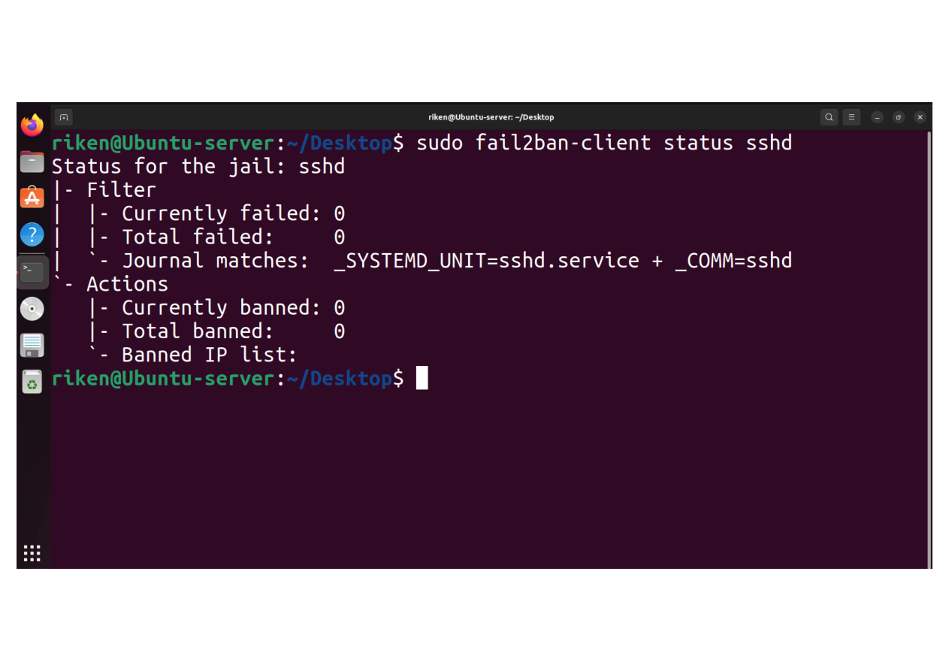
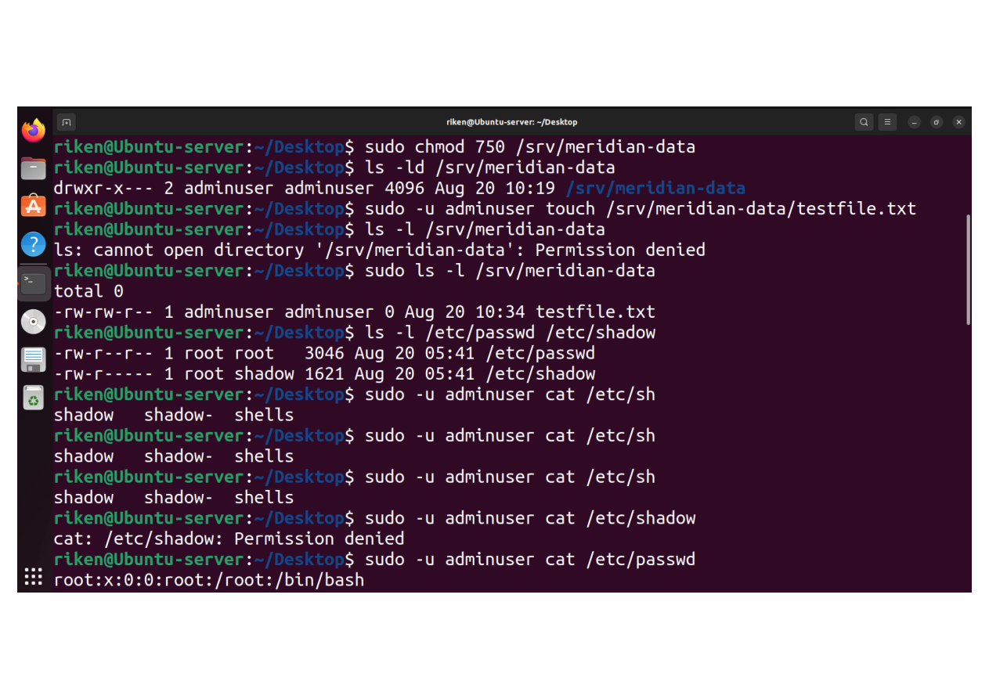
04
Intrusion Prevention & Network Defense
Two evidence captures — full screenshots preserved without cropping.
E15
Fail2ban SSHD jail status
E16
Meridian data directory permissions and access control
Evidence screenshot
Evidence screenshot
MERIDIAN SECURITY CASE STUDY
11

Slide 11
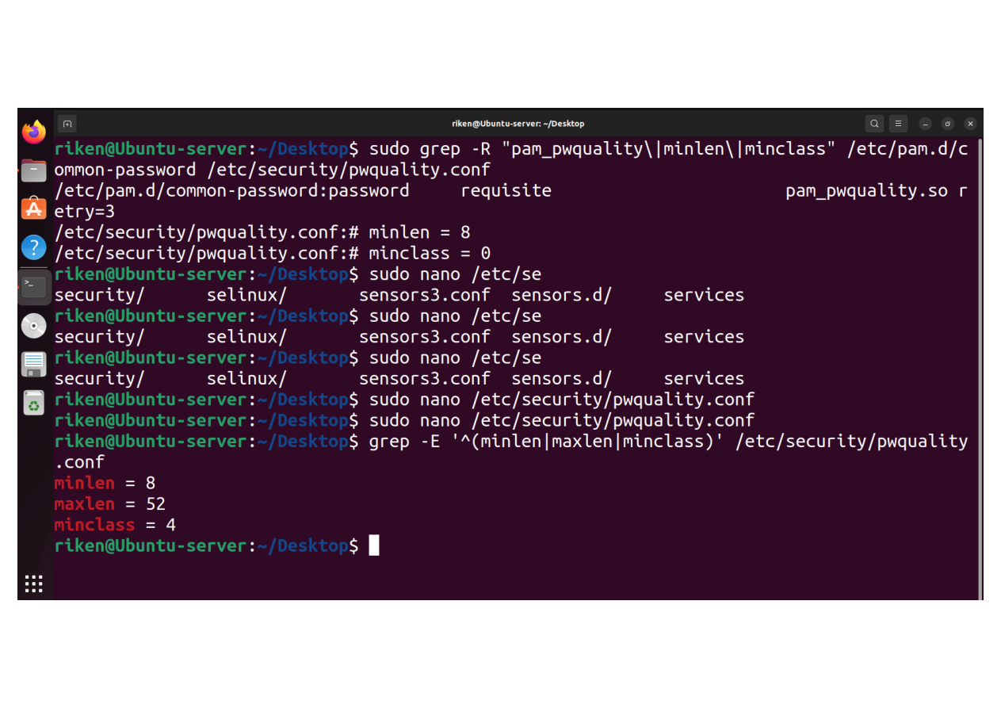
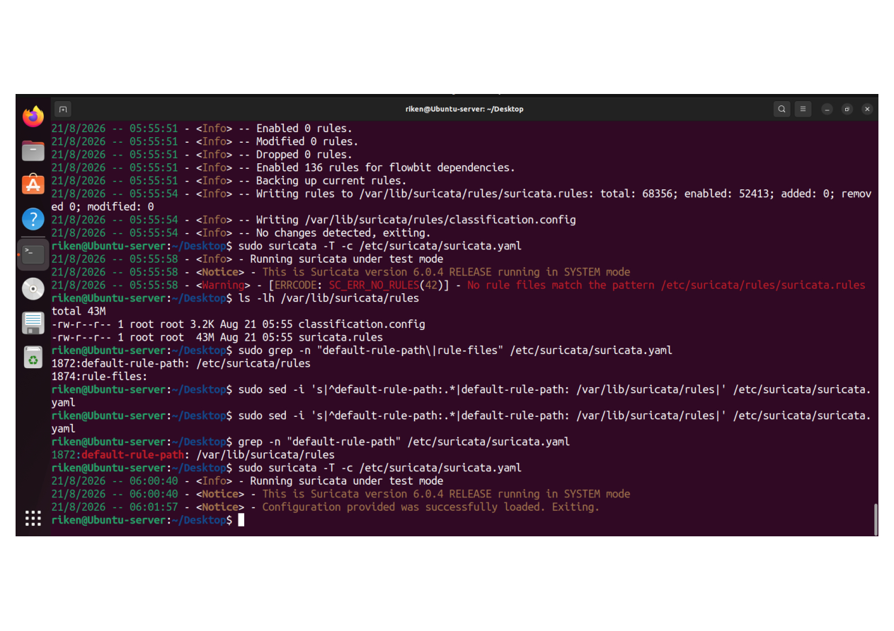
05
Authentication & Policy Controls
Two evidence captures — full screenshots preserved without cropping.
E17
Password policy configuration
E18
Suricata configuration test success
Evidence screenshot
Evidence screenshot
MERIDIAN SECURITY CASE STUDY
12

Slide 12
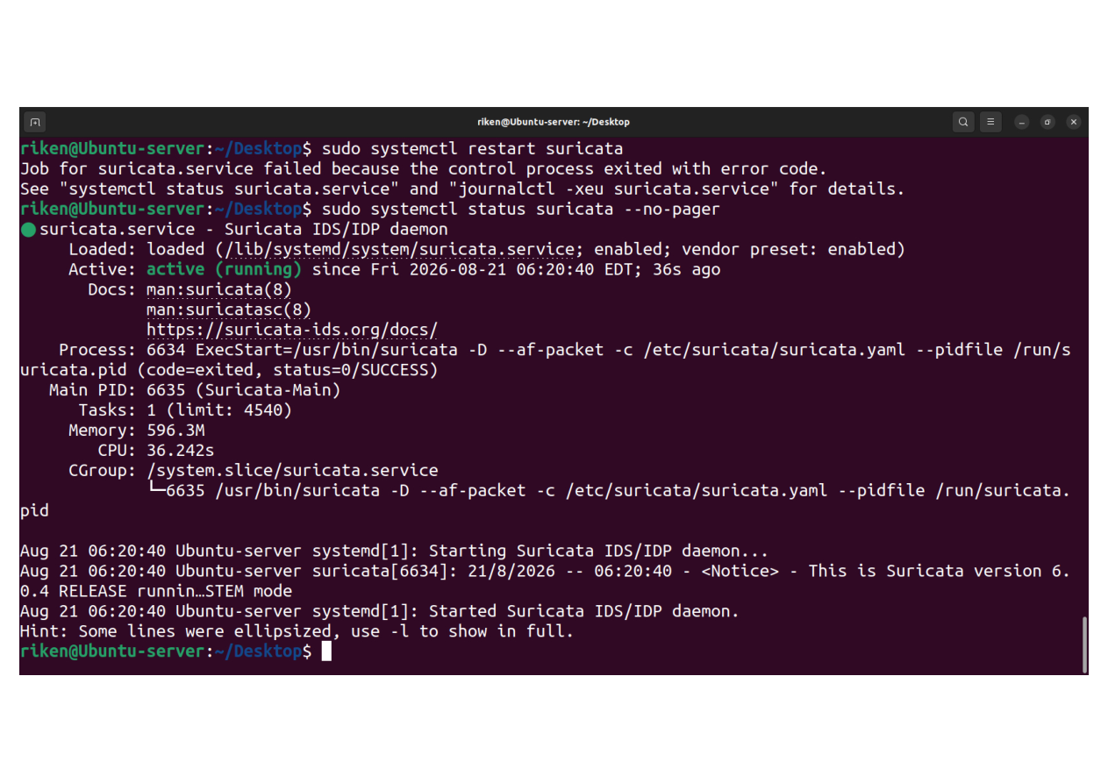
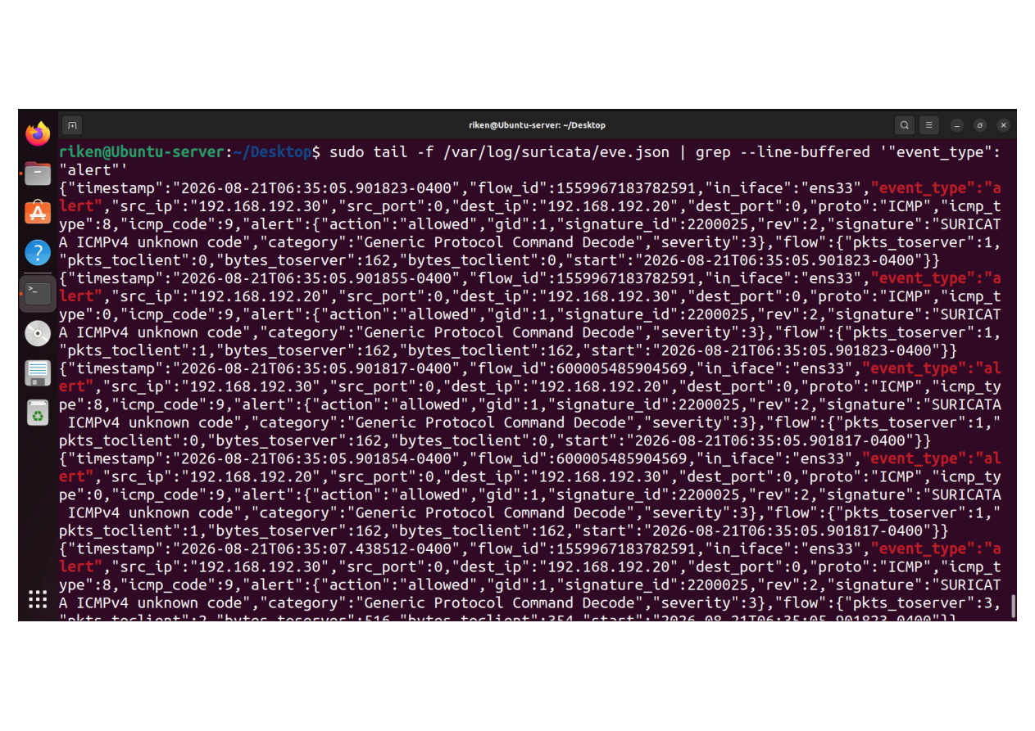
05
Authentication & Policy Controls
Two evidence captures — full screenshots preserved without cropping.
E19
Suricata IDS service active
E20
Suricata IDS alert detection
Evidence screenshot
Evidence screenshot
MERIDIAN SECURITY CASE STUDY
13

Slide 13
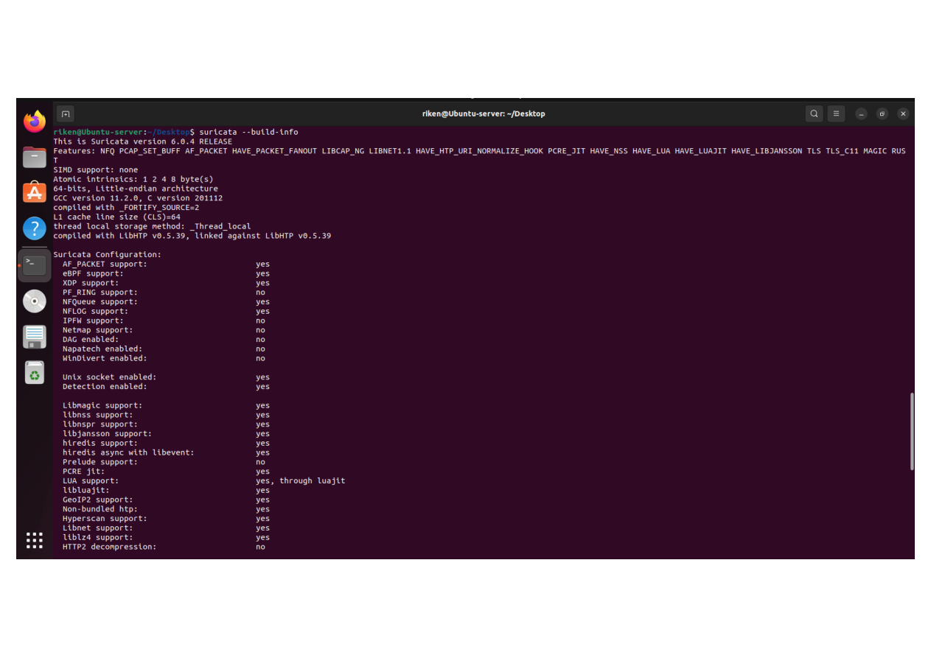
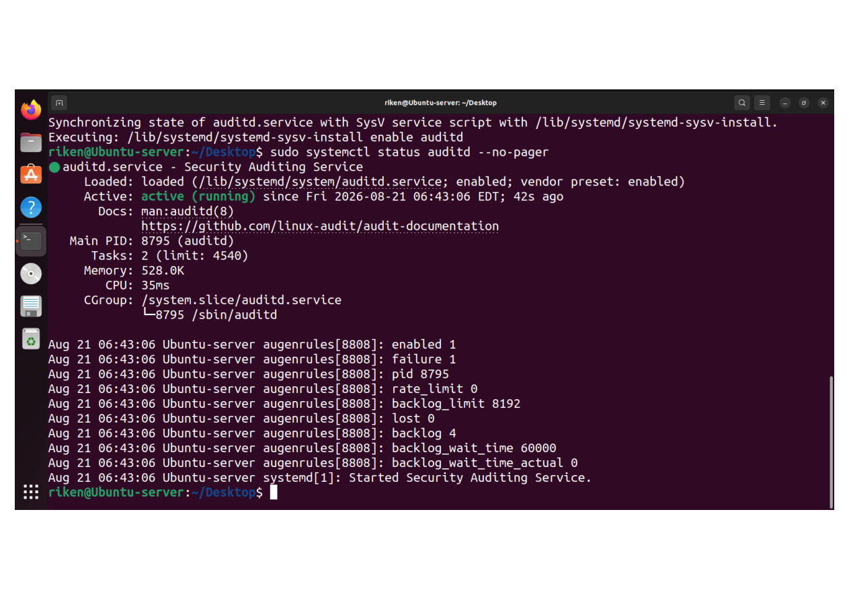
06
IDS / Security Event Detection
Two evidence captures — full screenshots preserved without cropping.
E21
Suricata installation verification
E22
Auditd service active / protected data context
Evidence screenshot
Evidence screenshot
MERIDIAN SECURITY CASE STUDY
14

Slide 14
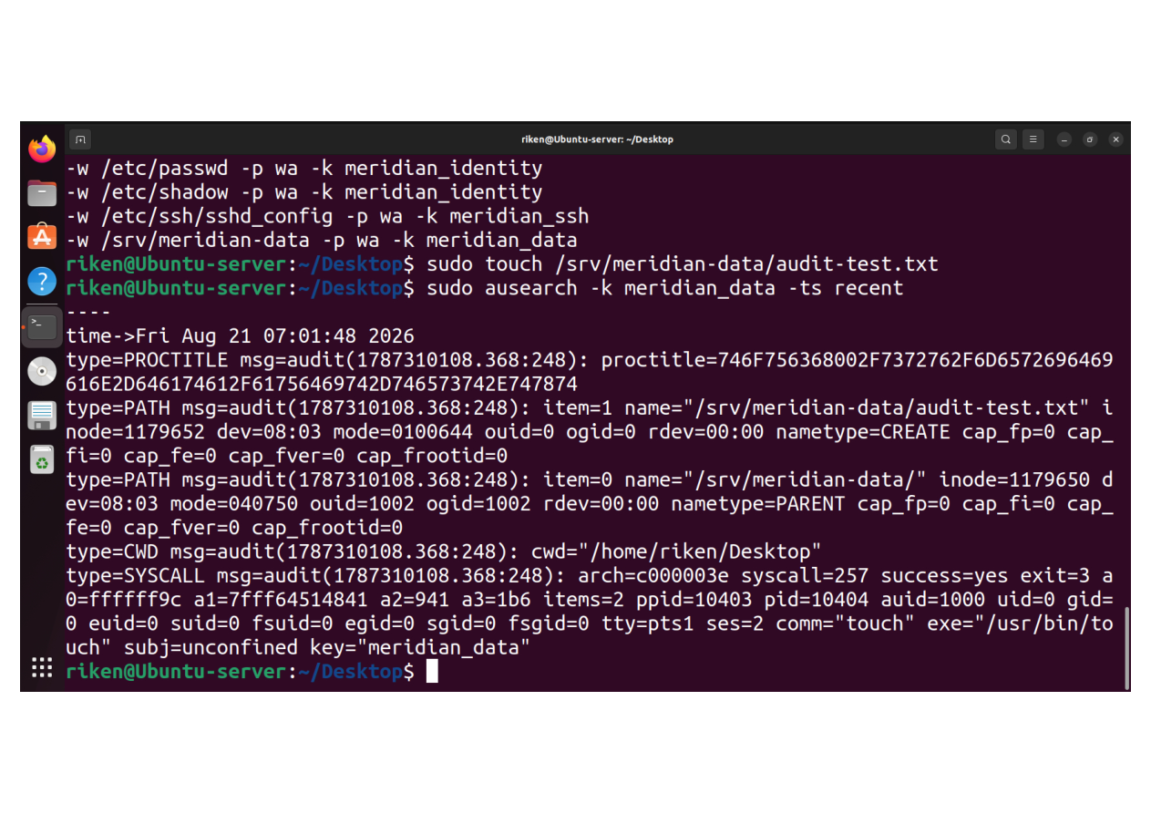
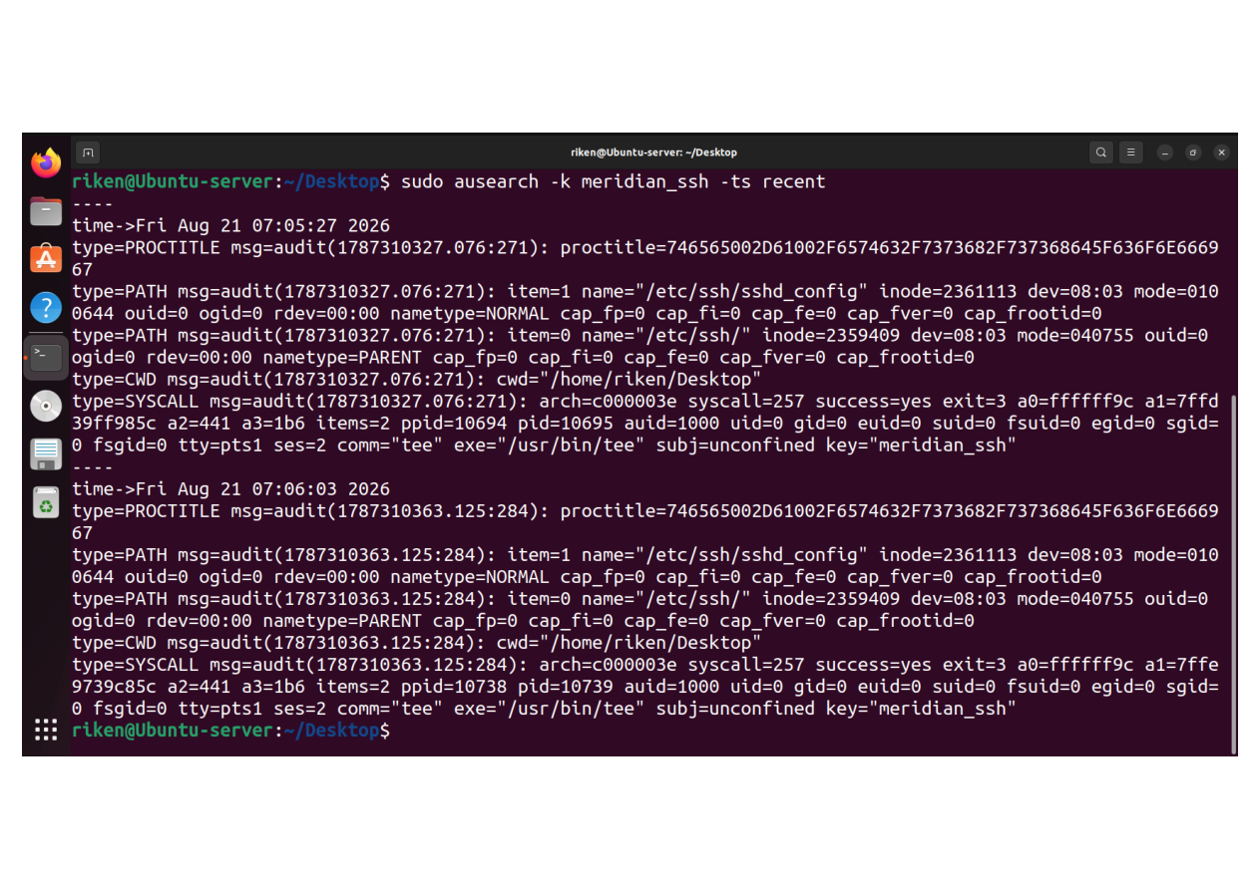
06
IDS / Security Event Detection
Two evidence captures — full screenshots preserved without cropping.
E23
Auditd file-change detection
E24
Auditd SSH configuration monitoring
Evidence screenshot
Evidence screenshot
MERIDIAN SECURITY CASE STUDY
15

Slide 15
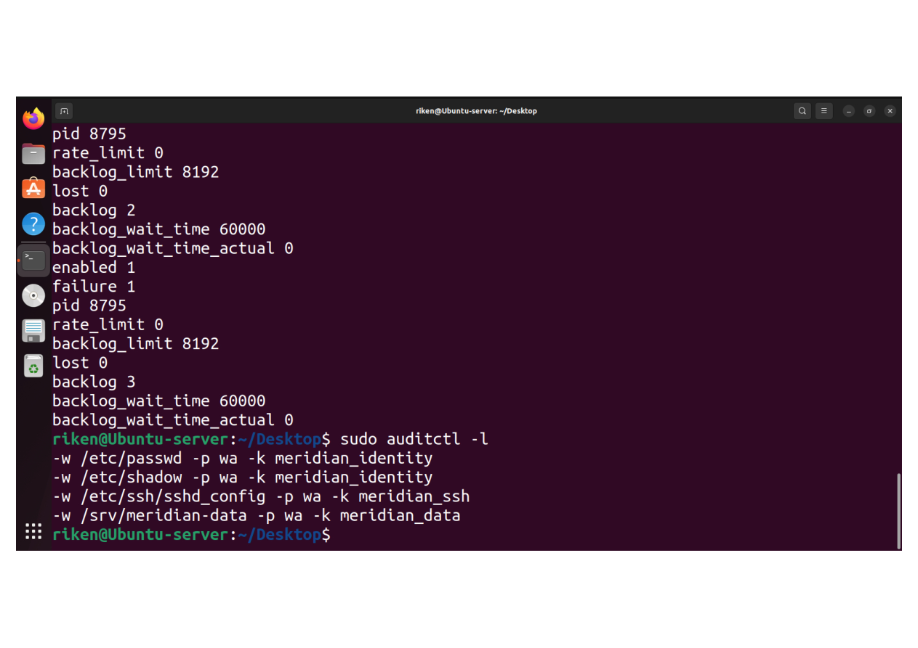
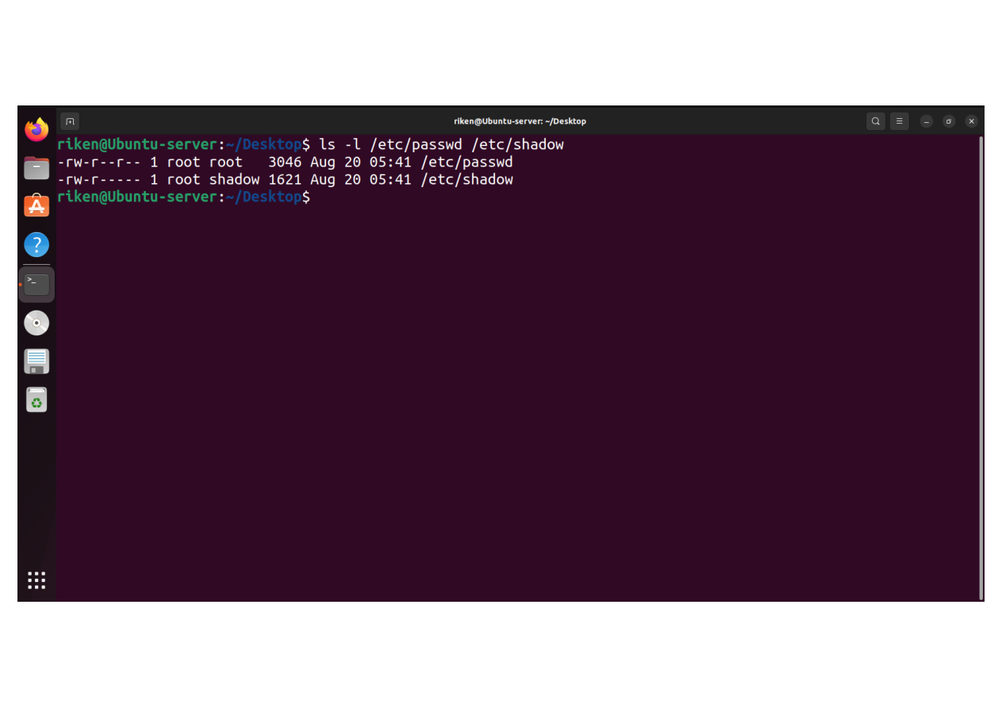
07
Auditd Rules & File Monitoring
Two evidence captures — full screenshots preserved without cropping.
E25
Meridian auditd security rules
E26
Password file permissions verification
Evidence screenshot
Evidence screenshot
MERIDIAN SECURITY CASE STUDY
16

Slide 16
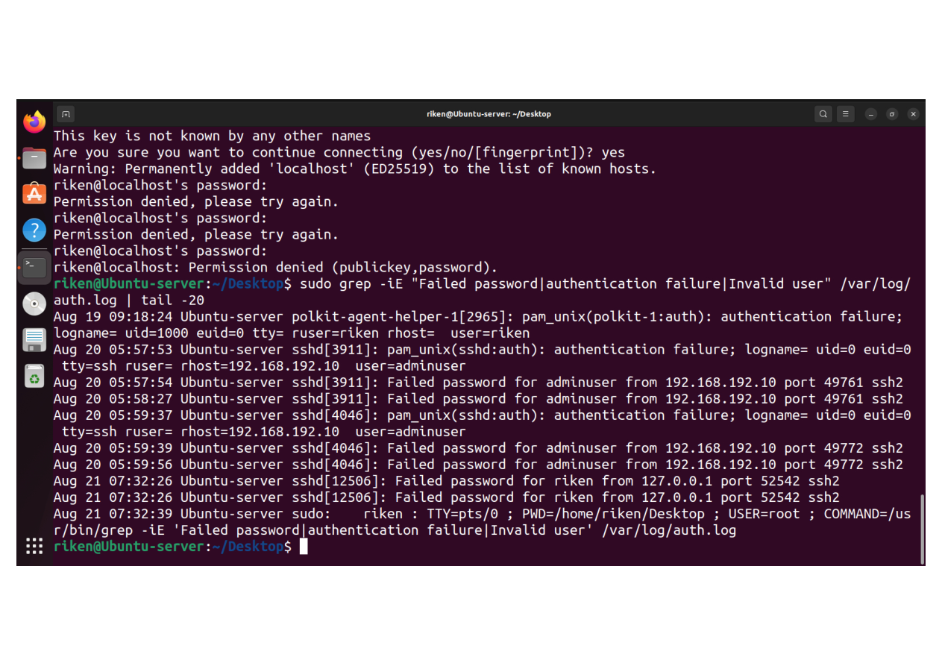
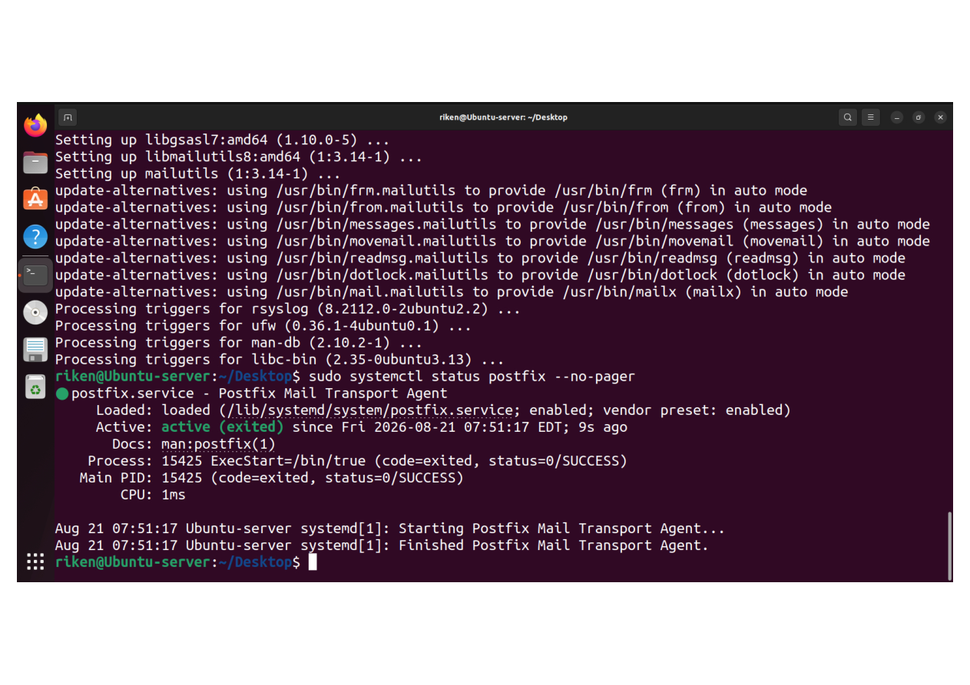
07
Auditd Rules & File Monitoring
Two evidence captures — full screenshots preserved without cropping.
E27
Repeated SSH failed authentication
E28
Postfix email alerting service active
Evidence screenshot
Evidence screenshot
MERIDIAN SECURITY CASE STUDY
17

Slide 17
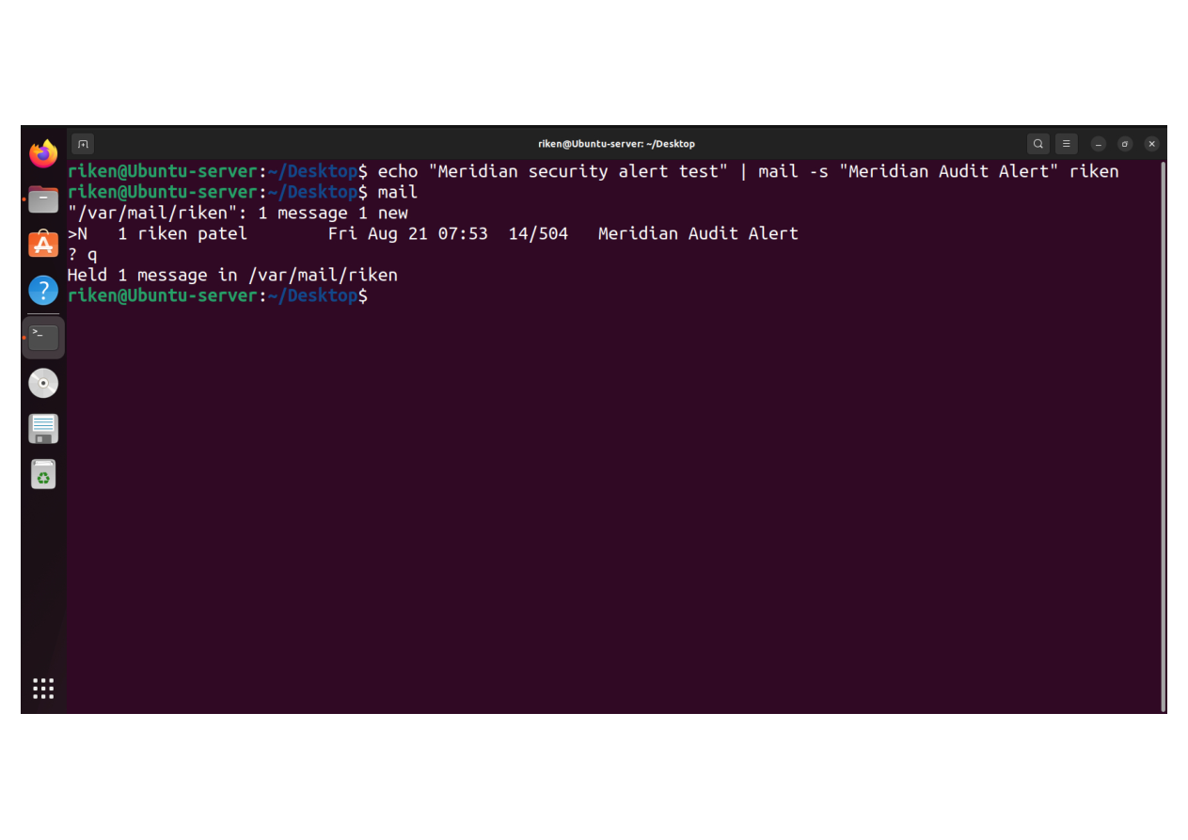
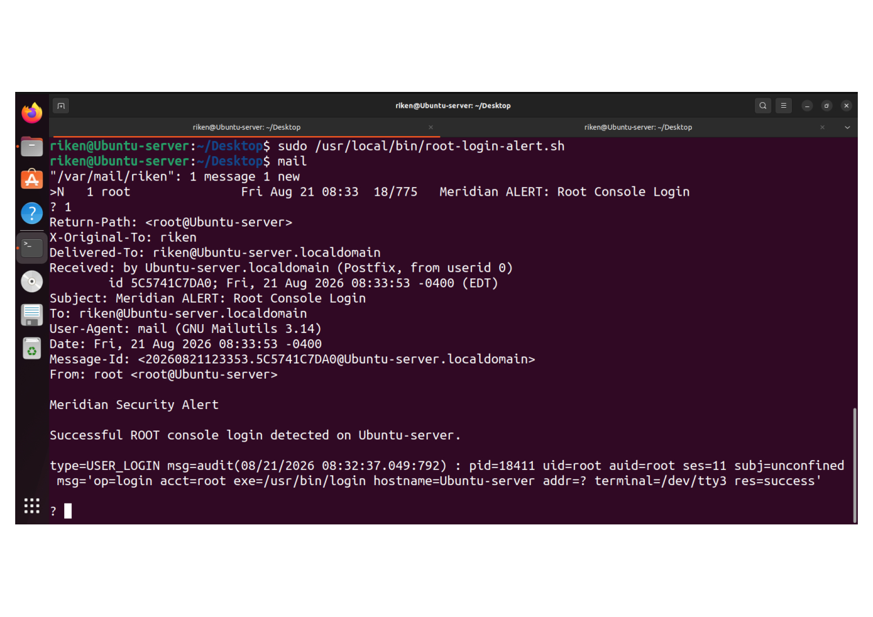
08
Alerting & Email Pipeline
Two evidence captures — full screenshots preserved without cropping.
E29
Postfix local mail delivery
E30
Root console login automatic alert
Evidence screenshot
Evidence screenshot
MERIDIAN SECURITY CASE STUDY
18

Slide 18
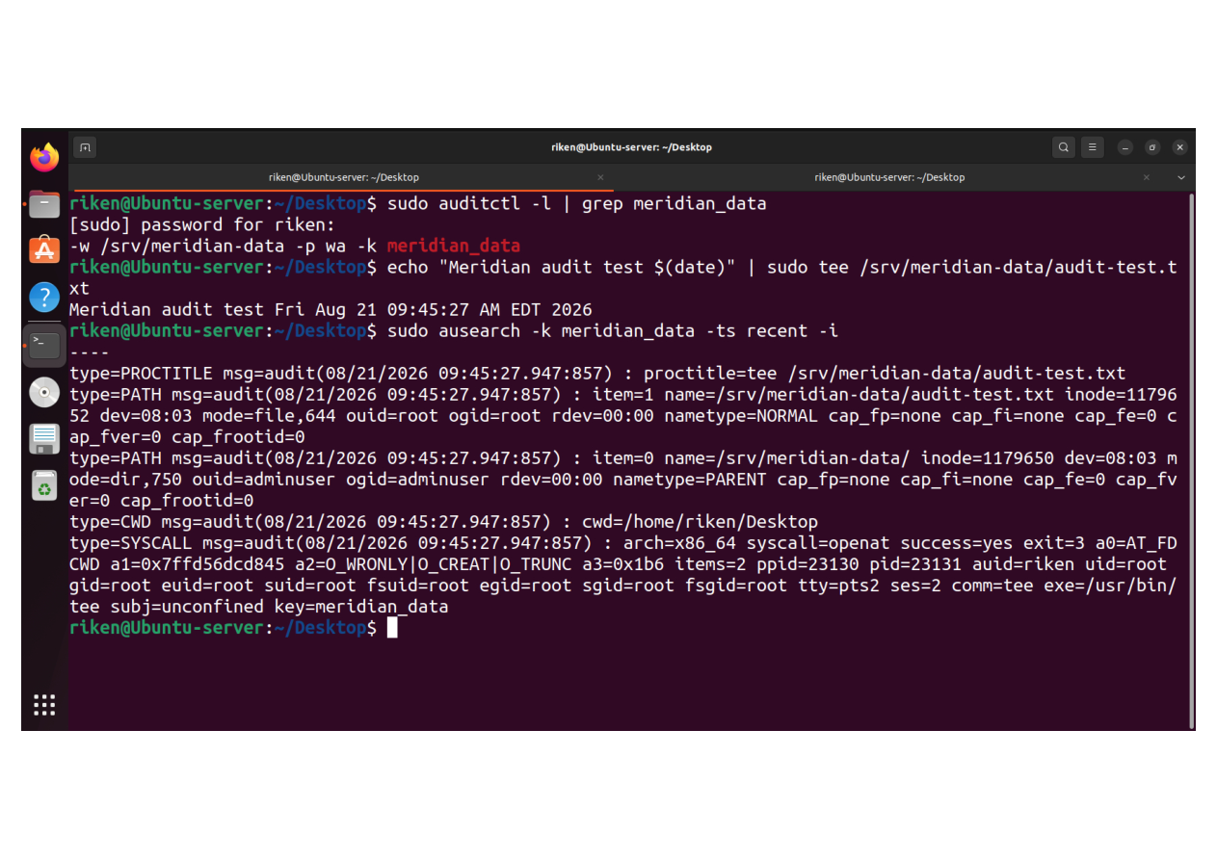
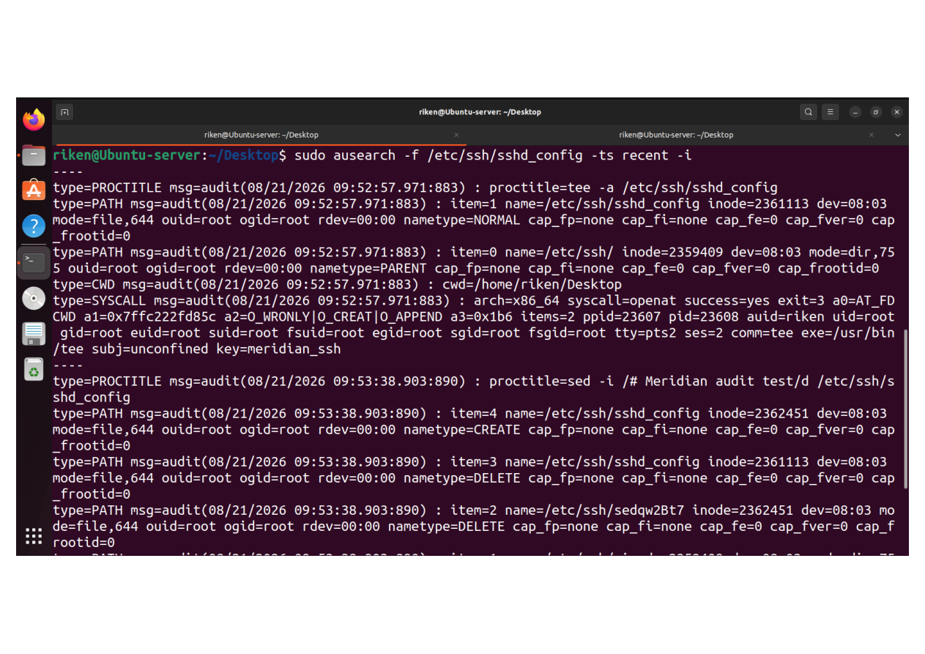
08
Alerting & Email Pipeline
Two evidence captures — full screenshots preserved without cropping.
E31
Sensitive data directory monitoring
E32
SSH configuration monitoring
Evidence screenshot
Evidence screenshot
MERIDIAN SECURITY CASE STUDY
19

Slide 19
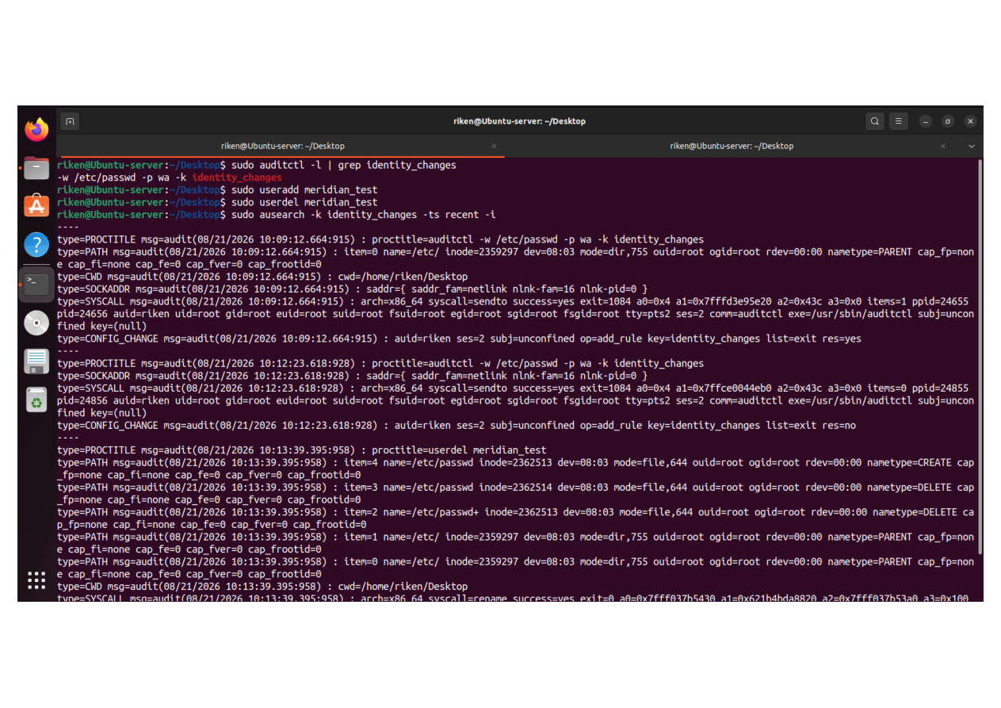
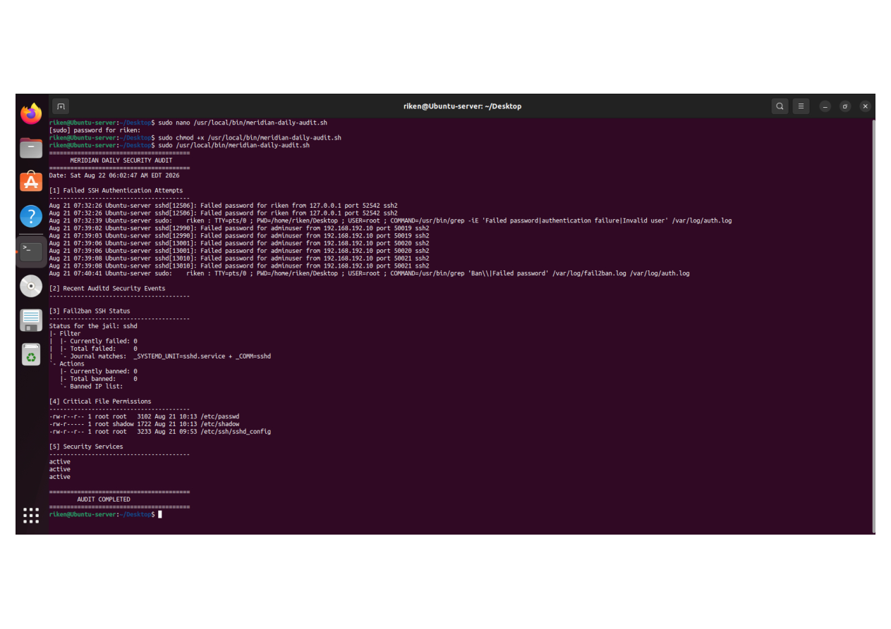
09
Investigation Use Cases
Two evidence captures — full screenshots preserved without cropping.
E33
Identity and account changes detection
E34
Meridian daily security audit script
Evidence screenshot
Evidence screenshot
MERIDIAN SECURITY CASE STUDY
20

Slide 20
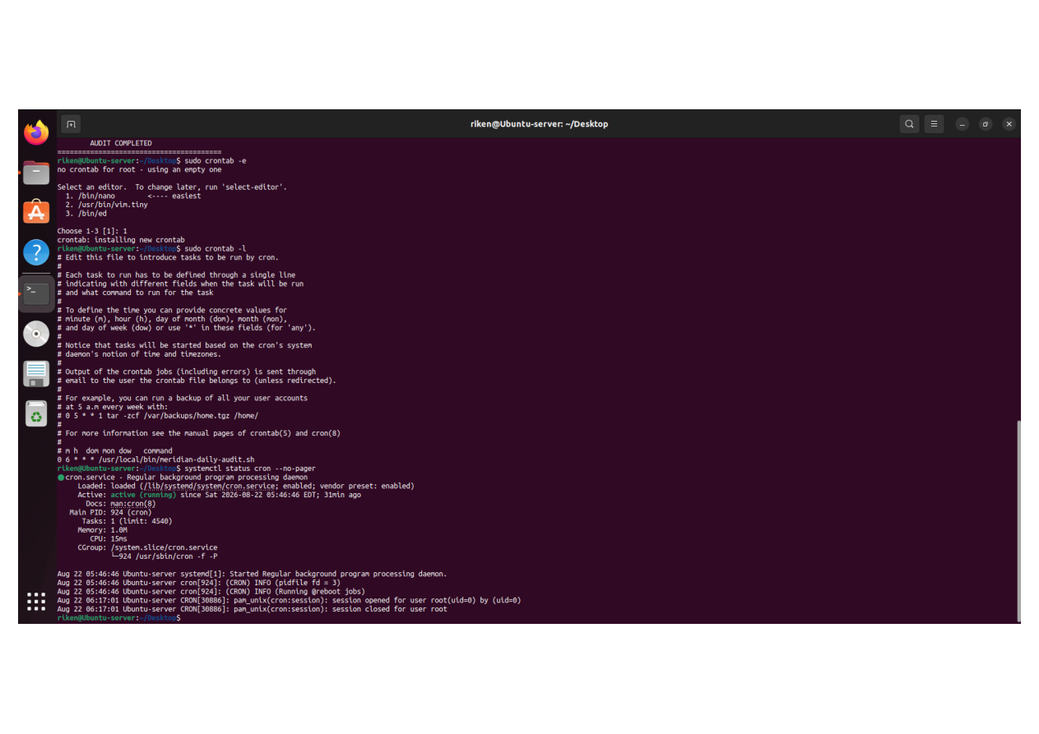
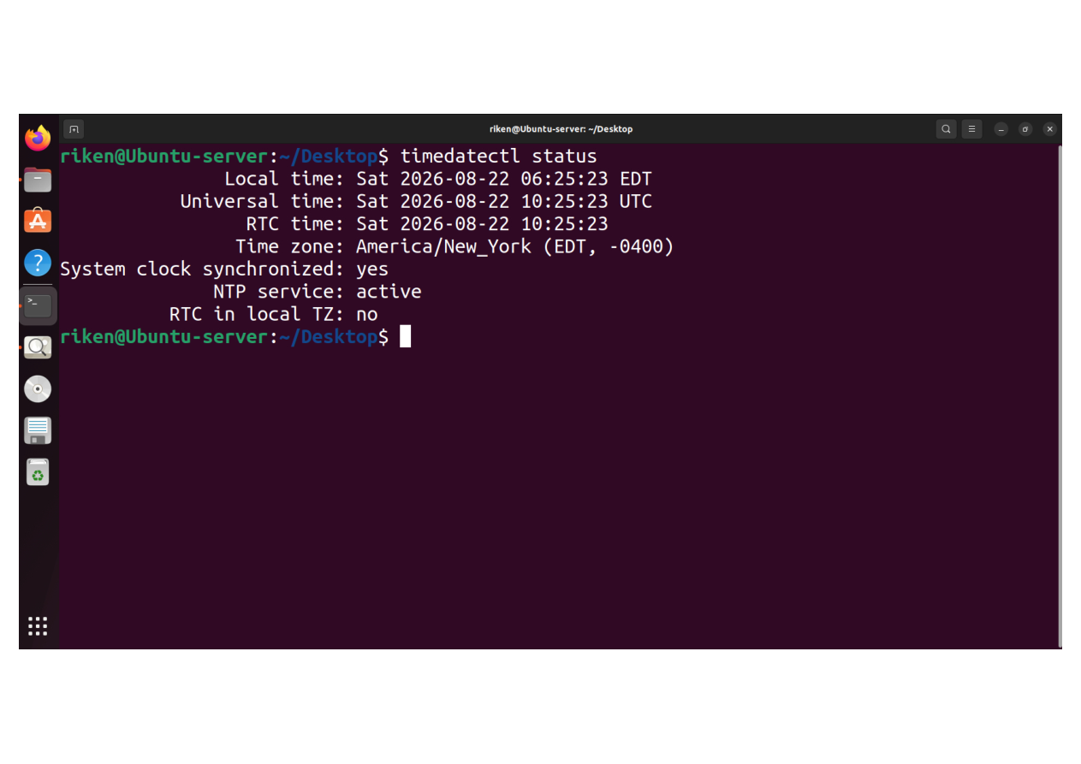
09
Investigation Use Cases
Two evidence captures — full screenshots preserved without cropping.
E35
Cron job / daily audit log configured
E36
Time synchronization status
Evidence screenshot
Evidence screenshot
MERIDIAN SECURITY CASE STUDY
21

Slide 21
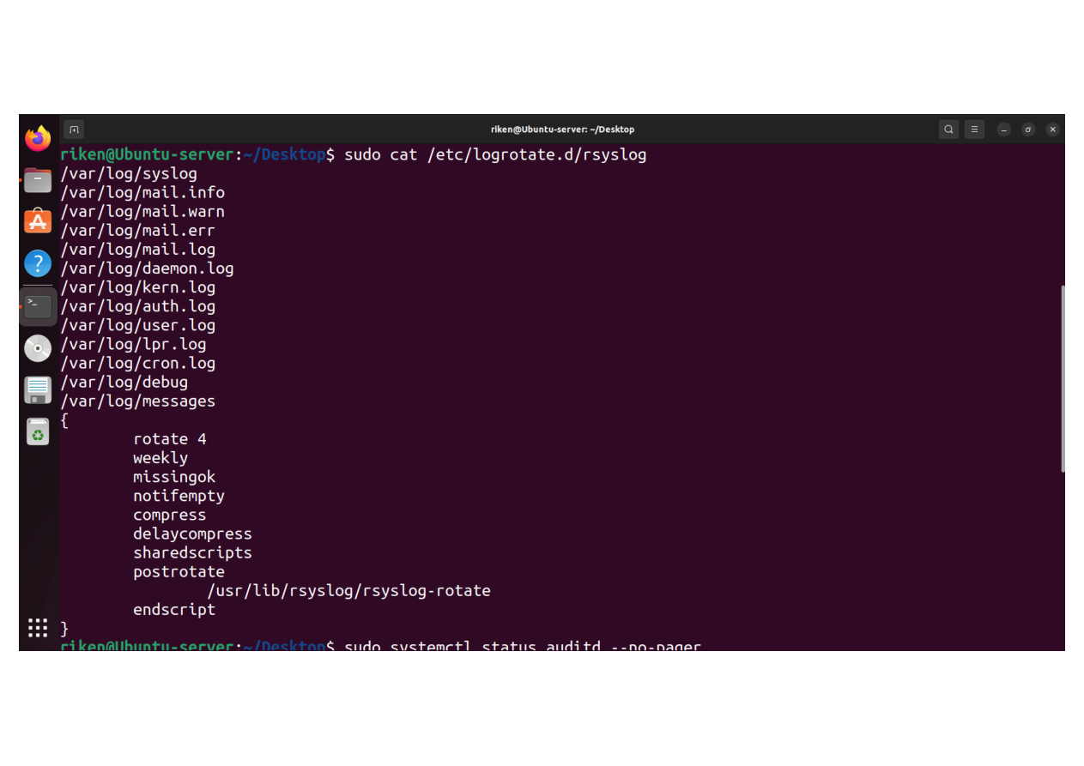
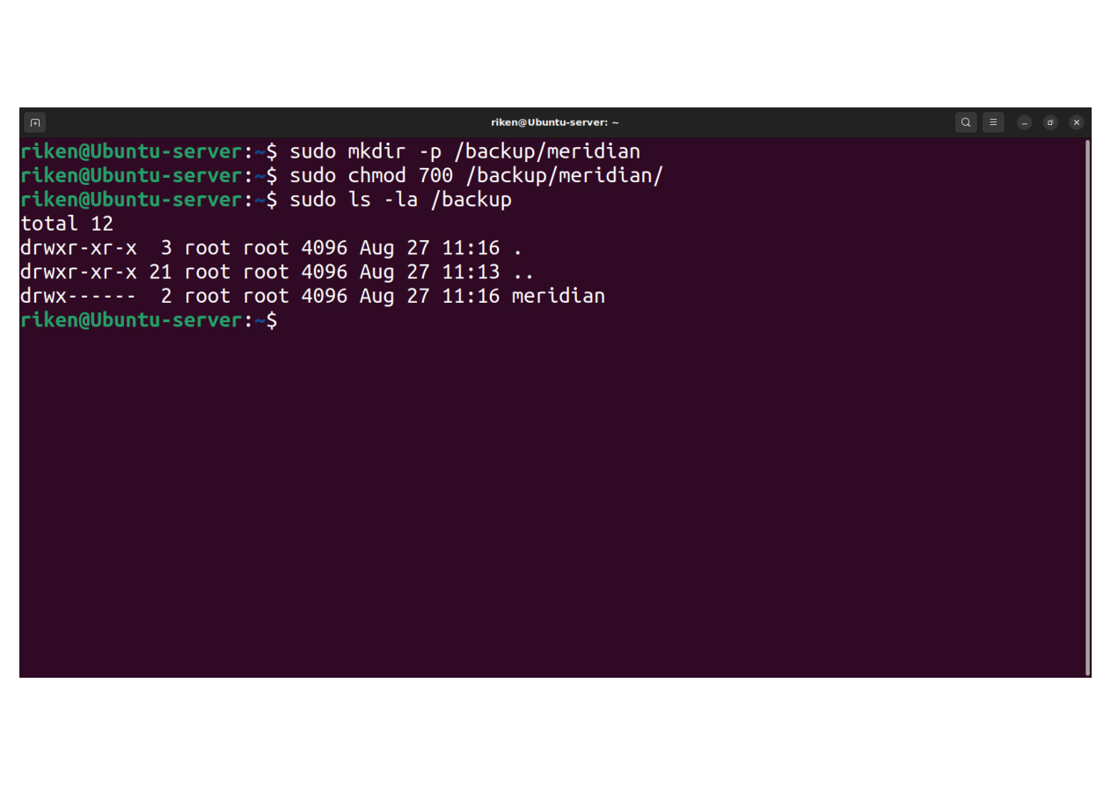
10
Operations: Time & Log Hygiene
Two evidence captures — full screenshots preserved without cropping.
E37
Log rotation security logs
E38
Backup directory created
Evidence screenshot
Evidence screenshot
MERIDIAN SECURITY CASE STUDY
22

Slide 22
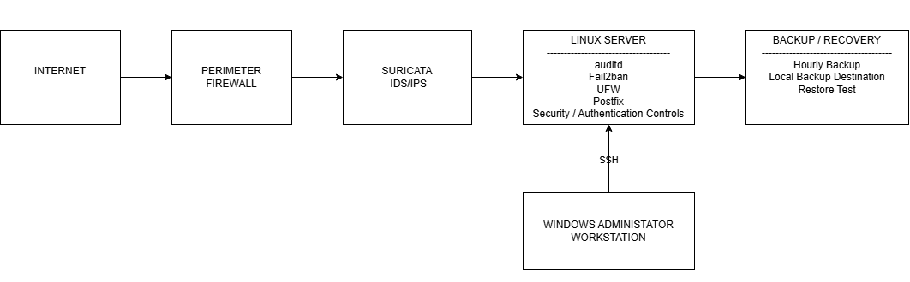
ARCHITECTURE
Layered Security Architecture
Network flow, host controls, administrative access and recovery controls.
Security Control Justifications
• Perimeter Firewall: Blocks unauthorized external traffic before it enters the internal network.
• Suricata IDS/IPS: Inspects network traffic to detect suspicious patterns and intrusion attempts.
• Linux Server: Applies host-level security using UFW, Fail2ban, authentication and logging controls.
• Windows Administrator Workstation: Provides authorized administrative access through SSH.
• Backup / Recovery: Supports data recovery and business continuity after system failure or attack.
Every control is tied to evidence captures E01–E43.
MERIDIAN SECURITY CASE STUDY
03

Slide 23
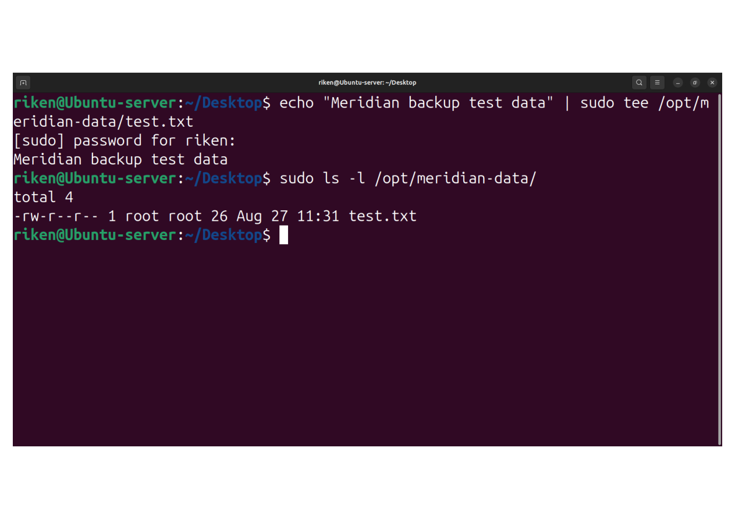
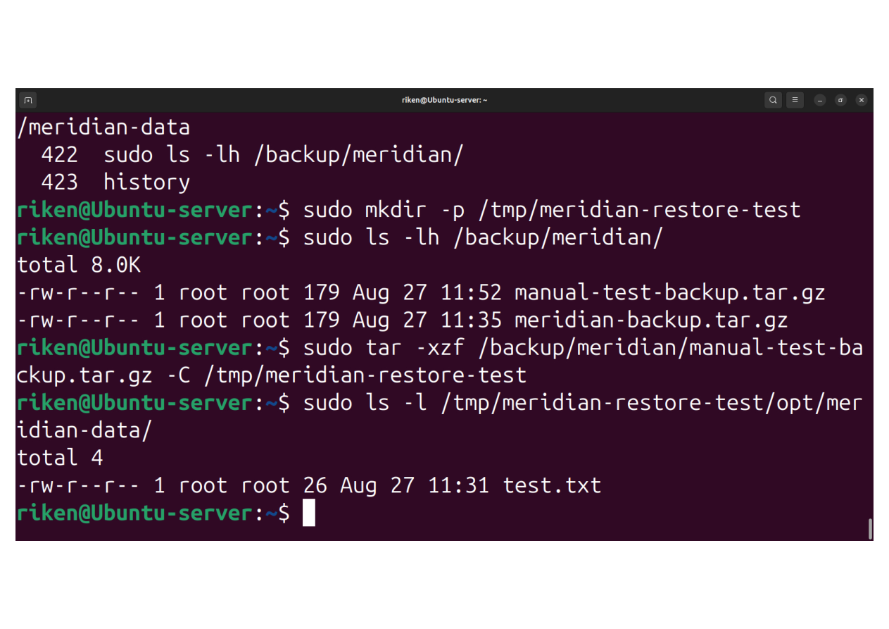
10
Operations: Time & Log Hygiene
Two evidence captures — full screenshots preserved without cropping.
E39
Backup test data
E40
Backup restore verification
Evidence screenshot
Evidence screenshot
MERIDIAN SECURITY CASE STUDY
23

Slide 24
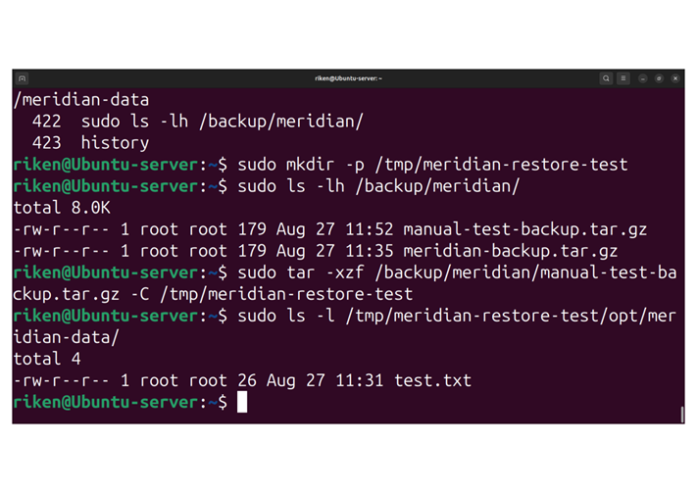

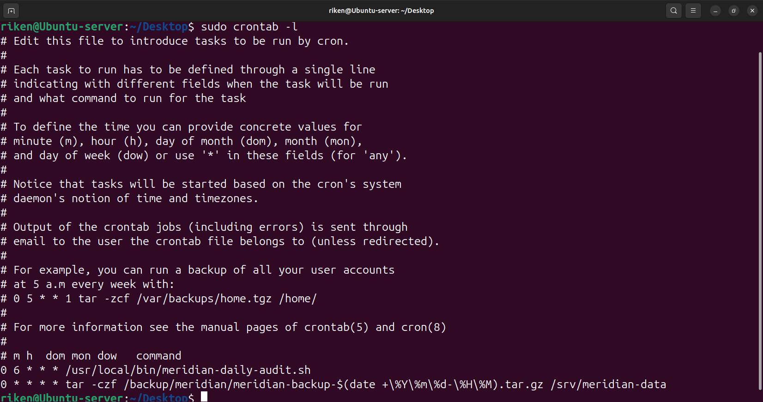
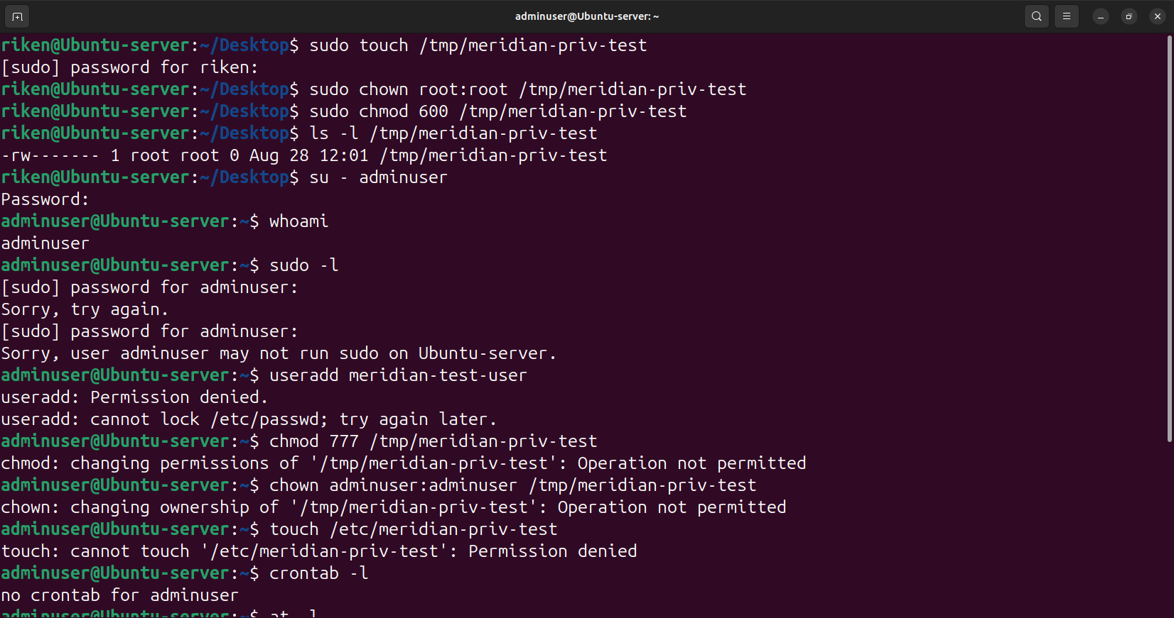
11
Backup & Recovery
Two evidence captures — full screenshots preserved without cropping.
E41
Backup hourly cron verification
E42
Backup / integrity verification
Evidence screenshot
Evidence screenshot
MERIDIAN SECURITY CASE STUDY
24

Slide 25
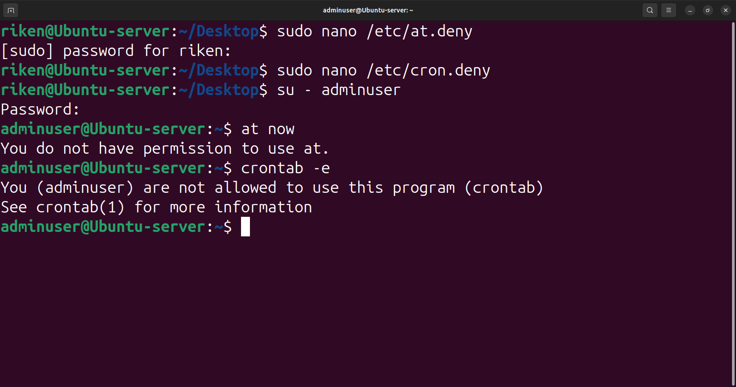

12 • FINAL VALIDATION
validates least-privilege restrictions on scheduled task access.
E43
E43
Adminuser at / crontab access denied
VALIDATION
• at access denied for adminuser
• crontab access denied for adminuser
• Least-privilege restriction validated
• Evidence captured
STATUS ✓ VALIDATED
MERIDIAN SECURITY CASE STUDY
25

Slide 26
RESULTS
Security Outcomes
The implementation addresses the case-study objectives with evidence-backed controls.
Attack surface
SSH access hardened; root/password access restricted.
Visibility
Authentication, IDS and audit events are captured for investigation.
Action
Fail2ban and alerting provide response-oriented controls.
Resilience
Backup creation, verification and restore evidence support recovery.
Operations
Time synchronization, log rotation and scheduled jobs improve hygiene.
MERIDIAN SECURITY CASE STUDY
26

Slide 27
VALIDATION
Final Validation Matrix
Evidence coverage across the major control families.
SSH Security
E01–E10
✓ Validated
Firewall / Network
E12
✓ Validated
Intrusion Prevention / IDS
E13–E21
✓ Validated
Auditd / Auditing
E22–E27
✓ Validated
Alerting / Investigation
E28–E34
✓ Validated
Operations / Recovery
E35–E43
✓ Validated
MERIDIAN SECURITY CASE STUDY
27

Slide 28
MERIDIAN
SECURITY FOUNDATION
Hardened • Monitored • Audited • Recoverable
Evidence scope
E01–E43 complete
The final deck keeps two evidence screenshots per slide, preserves the full screenshots, and avoids image cropping.
Q&A
MERIDIAN SECURITY CASE STUDY
28

