Slide 1
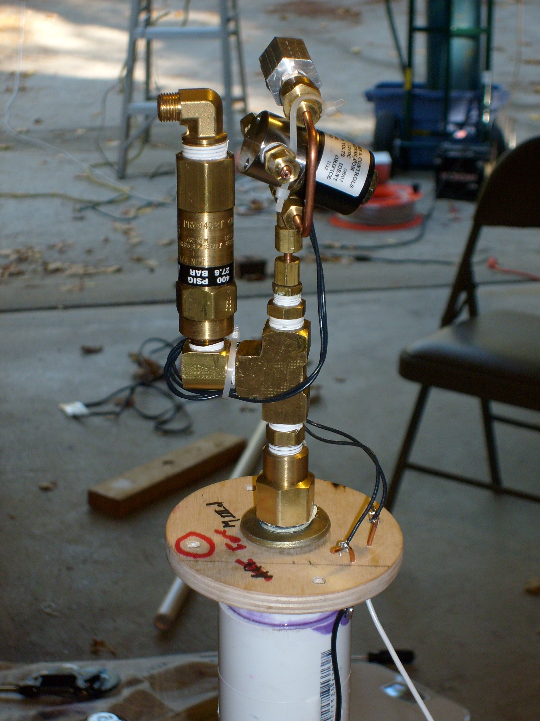
⅛” NPT
check-valve
Quick-disconnect
fill fitting
Solenoid dump valve
⅛” NPT compression fitting, drilled to allow ⅛” copper dip tube to pass through
400 PSI pressure relief valve
Dip tube, extends to bottom of flight tank
Various fittings

