Slide 1
Machine Learning
(25SC2107E)
E-Commerce Customer Churn Prediction
Team Members:
Sameer Reddy: 2520030276
S.Rikhil: 2520030480
Under the Esteemed Guidance of
Ms. Rani Medidha
CSE department

Slide 2
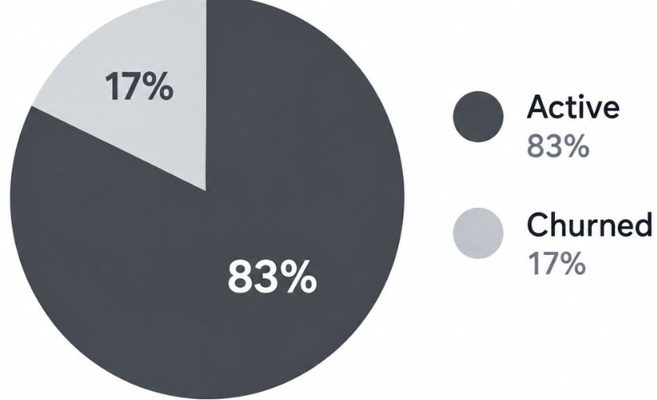
Problem Definition
What problem?
Predicting online shoppers at risk of abandoning the platform before they stop buying.
Why important?
Acquiring a new customer costs 5x more than retaining an existing one, and a 5% boost in retention can lift profits by up to 95%.
Who will use it?
Marketing & Retention Teams to run targeted promotions, discounts, and proactive customer support.
Expected output?
A Churn Risk Score (0–100%) and a binary label (Churn / Retained) for every active customer.
Source:- E-Commerce Customer Churn Dataset on Kaggle

Slide 3

Dataset Collection
Dataset Source:
Kaggle → E-Commerce Customer Churn Analysis and Prediction (by Ankit Verma).
Dimensions:
5,630 rows (customers) and 20 columns (features).
Target Variable:
Churn → Binary (0 = Retained, 1 = Churned).
Key Feature Categories:
  Demographics: CityTier, Gender, MaritalStatus.
  Account Details: Tenure, PreferredLoginDevice, WarehouseToHome.
  Behaviour & Usage: OrderCount, DaySinceLastOrder, CashbackAmount.
  Customer Service: Complain (0 or 1), SatisfactionScore (1 to 5).

Slide 4
Data Understanding
Dataset Scale: 5,630 rows, 20 columns (19 features + 1 target), and 0 duplicates.
Data Types: 14 numerical (e.g., Tenure, CashbackAmount, DaySinceLastOrder) and 6 categorical (e.g., Gender, MaritalStatus, PreferredPaymentMode).
Missing Values: Found across 7 numerical columns, but all are under 6% (e.g., DaySinceLastOrder at 5.5%, Tenure at 4.7%) → suitable for median imputation.
Key Finding: Churned users leave early (median tenure of 1–2 months vs. 9+ months for active users) and file 2x more complaints.
Metric | Value
Total Records | 5,630
Duplicates | 0
Features / Target | 19 / 1 (Churn)
Missing Values | 7 columns (<6% each)
Class Split | 83% Active / 17% Churned

Slide 5
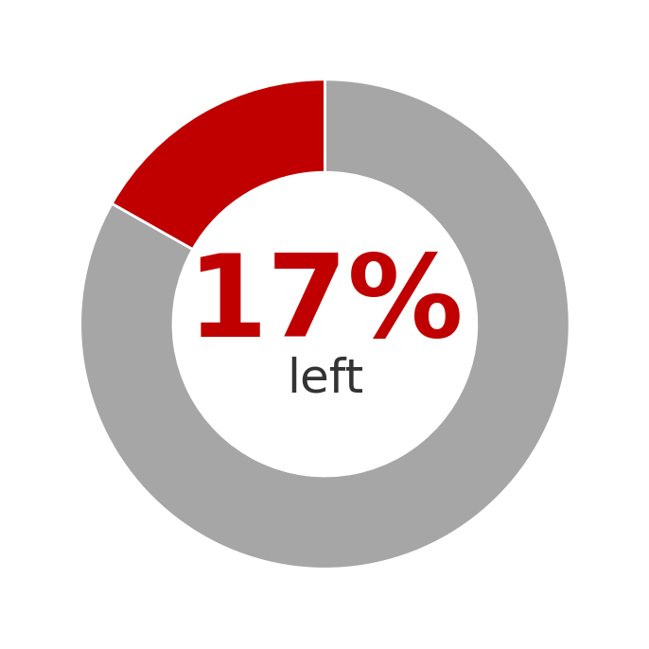
Data at a Glance
5,630
customers in the dataset
1 in 6
customers stopped buying (churned)
Very few
missing values (under 6%)
of customers left the platform

Slide 6
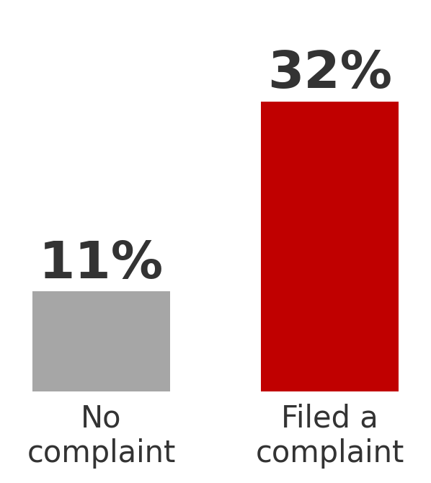
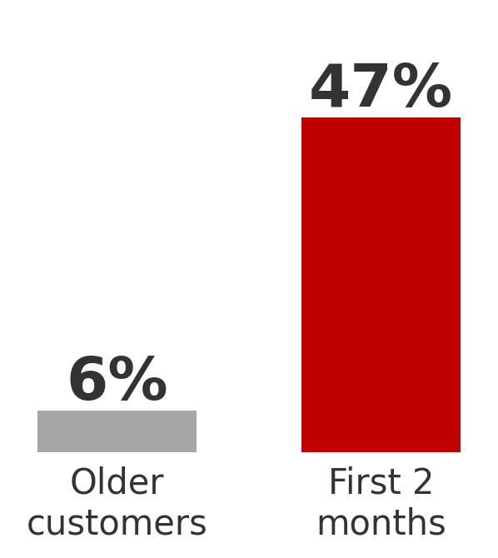
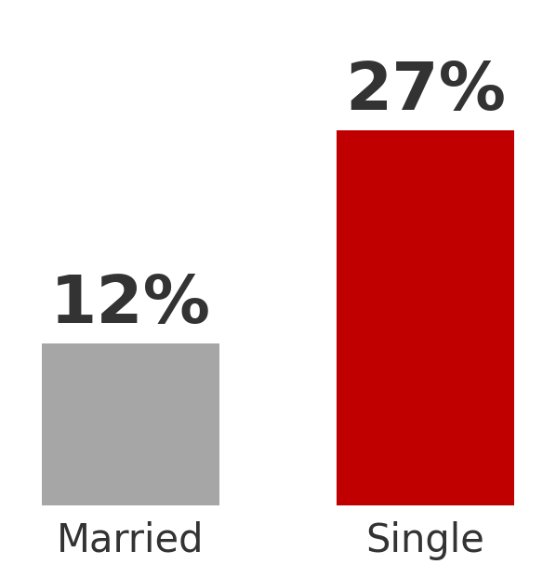
Who Leaves the Most?
Complaints
New customers
Marital status
Customers who complain are 3x more likely to leave
Nearly half leave in their first 2 months
Single customers leave more than married ones
In short: new and unhappy customers are the ones most likely to leave.

Slide 7
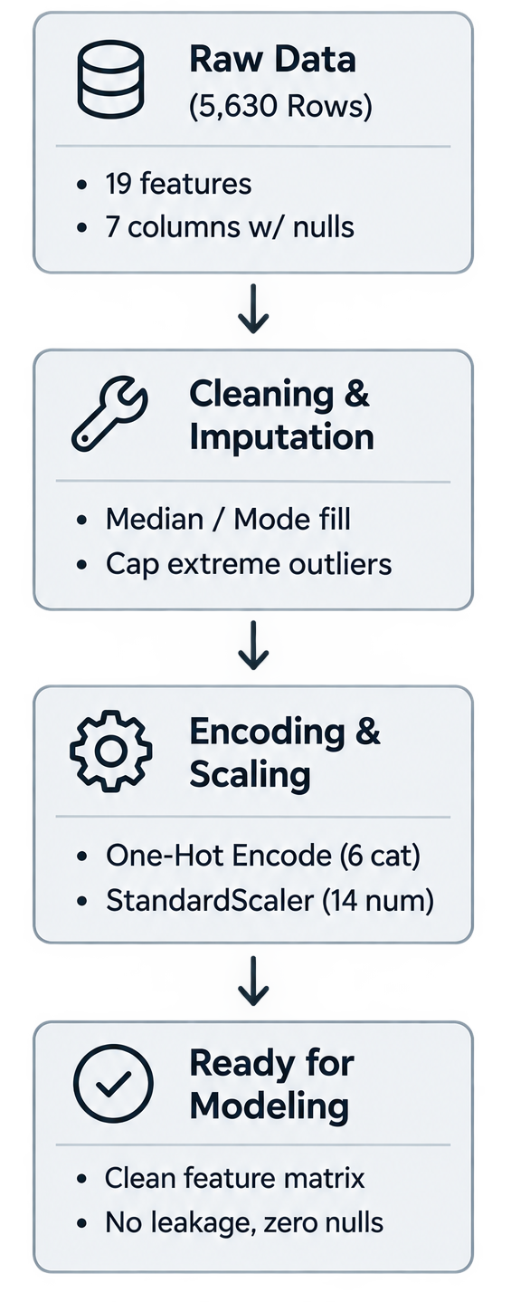
Data Preprocessing
Missing Values: Filled blank spaces using middle values (median) so the AI doesn't get confused.
Duplicates & Typos: Removed duplicate rows and fixed spelling mistakes (for example, merged "Phone" and "Mobile Phone").
Extreme Numbers (Outliers): Fixed weird, crazy numbers (like a delivery distance of 120 km) by capping them at normal limits.
Text to Numbers (Encoding): Computers only understand numbers, so words like "Male", "Female", "Single", and "Married" were changed into 0s and 1s.

Slide 8
Feature Selection / Feature Engineering
Features Removed (Dropped):
CustomerID: Unique identifier with zero predictive value (causes data leakage/overfitting).
New Features Created (Feature Engineering):
OrderPerDay = OrderCount / (DaySinceLastOrder + 1): Measures current purchasing velocity.
ComplainPerTenure = Complain / (Tenure + 1): Measures dissatisfaction intensity relative to customer lifespan.
IsNewCustomer = (Tenure <= 2): Binary flag targeting the highest-risk churn period identified during EDA.
Features Selected & Retained (Input Predictors):
Behavioral: Tenure, DaySinceLastOrder, OrderCount, CashbackAmount, OrderAmountHikeFromlastYear.
Customer Service: Complain, SatisfactionScore.
Demographics & Account: WarehouseToHome, MaritalStatus, PreferredPaymentMode, CityTier.

Slide 9
Train-Test Split
Dataset Partition | Proportion | Record Count | Class Distribution (Retained / Churned) | Purpose
Training Set (X_train, y_train) | 80% | 4,504 | 3,745 (83.1%) / 759 (16.9%) | Fit model parameters and feature weights
Testing Set (X_test, y_test) | 20% | 1,126 | 937 (83.2%) / 189 (16.8%) | Unseen validation for final performance

Slide 10
Model Evaluation
Accuracy is not enough: 83% customers stay, so a model can get 83% accuracy by predicting “Stay” for everyone — but it finds 0 churners.
Main Focus: We focused on Recall & F1 to catch more customers who may leave.
Best Model: XGBoost → 84% Recall and 0.93 ROC-AUC.
Model | Accuracy | Caught Churners (Recall) | Overall Score (F1) | Result
Logistic Regression | 78% | 76% | 0.54 | Baseline
Random Forest | 91% | 68% | 0.73 | Good
XGBoost | 94% | 84% | 0.79 | Winner (Best Model)
Recall = How many of the actual churners did our model successfully catch?
ROC-AUC = How well the model separates “Churn” customers from “Stay” customers.

Slide 11
Conclusion
In this project, we built a machine learning system to predict which e-commerce customers are likely to leave the platform. Using a dataset of over 5,600 shoppers, our best model, XGBoost, successfully caught 84% of churned customers before they left. We discovered that brand-new customers in their first two months and those who filed complaints are at the highest risk of leaving. By deploying this model into a simple web app, marketing teams can now spot unhappy shoppers early and offer them quick discounts or extra support, saving the business money that would otherwise be spent trying to win back lost customers.

Slide 12
Thank you

