Slide 1

Welcome to Coursera with Coursea Subtitle Re-sizer
The Most popular amazing video to help your career
The Great Extension to help your easy understanding

Slide 2
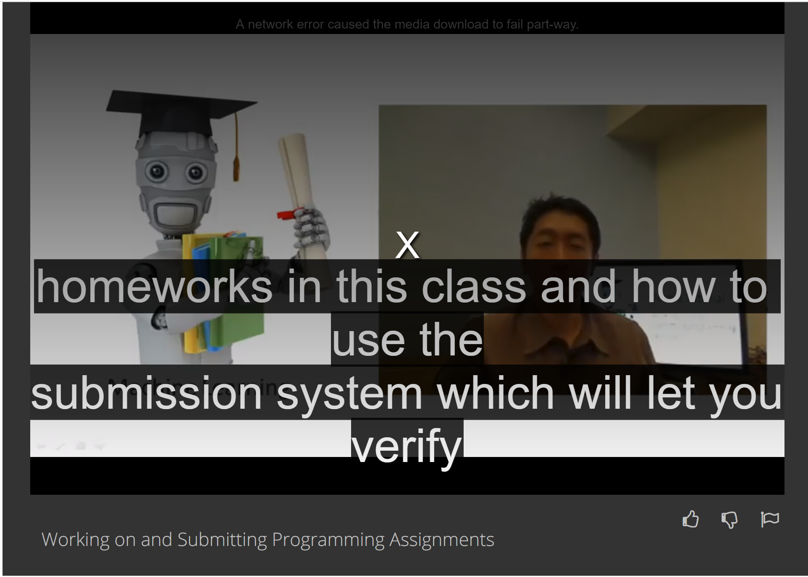
The Subtitle size cannot be controlled
Coursera have a lot of videos and material, However when we are watching video, the subtitle size is too big / too short by browser default settings.
Alternatively, we can use developer tool in the browser to modify it, but for normal user, they could not able to do that.

Slide 3
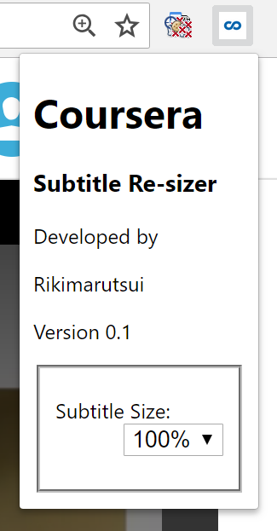
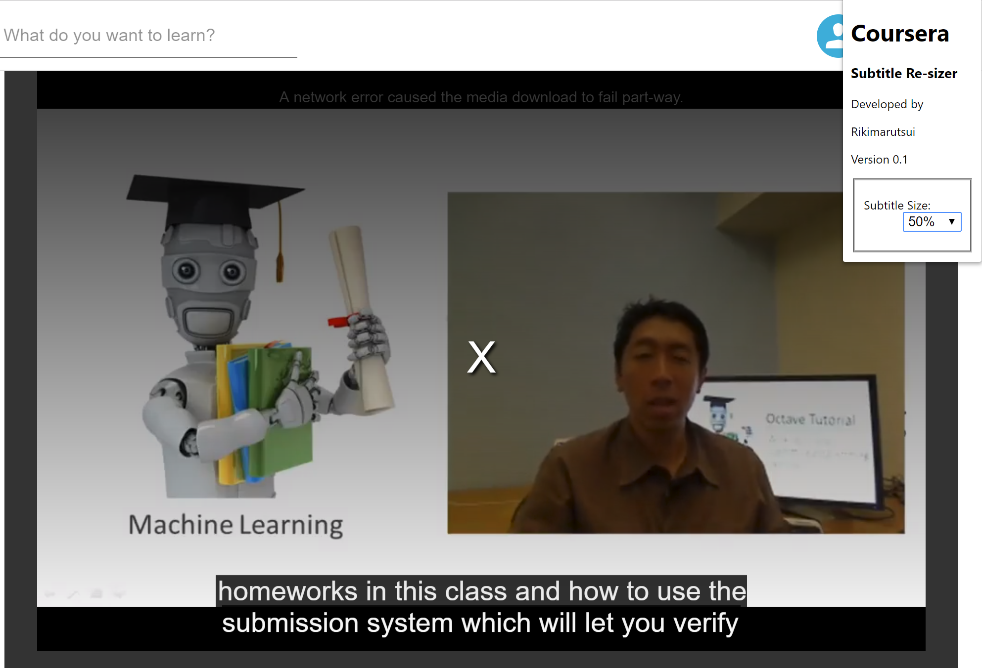
Now using Coursera Subtitle Re-sizer
How it works:
1
Expand the Coursera Subtitle Re-sizer menu
2
Select what size you to change
3
There you are!

