Slide 1
Parallelizing Sorting Algorithms
Kevin Alfonso
Gabriella On-Cuen
Faiz Ahmed
Raciel Antela Pardo
Isaac Munshi
Notes:
Everyone (Introduce ourselves in order of names on slide)

Slide 2
Introduction
Parallelized common sorting algorithms
Multi-threaded vs. linear versions
Focused on six sorting algorithms
Goal: explore differences in run-time and efficiency
Notes:
Faiz
Live script Our objective was to compare the run-time and efficiency of multi-threaded and linear sorting algorithms.
We focused on six common algorithms, bubble sort, merge sort, radix sort, insertion sort, selection sort, and quick sort, and expected parallelized versions to be faster for large arrays and have higher CPU usage due to increased resource demands.
Script:
Our goal was to explore the differences in run-time and efficiency between multi-threaded and linear versions of these sorting algorithms.
For this experiment, we focused on six widely-used sorting algorithms: bubble sort, merge sort, radix sort, insertion sort, selection sort, and quick sort.
Our initial expectation was that the parallelized versions of each sorting algorithm would take less time, particularly for large arrays, compared to their linear counterparts.
Additionally, we hypothesized that CPU usage would increase for the multi-threaded sorting algorithms in comparison to the linear versions, as they would require more resources to execute in parallel.
Old: We parallelized common sorting algorithms to explore the differences in run-time and efficiency between the multi-threaded and linear versions
In this experiment, we tested bubble sort, merge sort, radix sort, insertion sort, selection sort, and quick sort
At the beginning of our experiment, we expected for each sort to take less time, at least when it comes to large arrays
We also expected for the CPU usage to increase for the multithreaded sorting algorithms in comparison to the normal linear sorting algorithms

Slide 3
Motivation
Parallelized algorithms faster for large arrays
Increased CPU usage for multi-threaded versions
Compare performance and resource utilization
Investigate trade-offs between linear and parallelized algorithms
Notes:
Faiz
Live:
Our project addresses the widespread use of sorting in computer science, where handling large data can be time-consuming.
We aimed to rewrite sorting algorithms using multithreading, reducing sorting time and leveraging modern computing power.
We find the trade-off of increased power for faster sorting worthwhile due to advancements in computer hardware.
Script:
The motivation behind our project stems from the ubiquity of sorting in computer science, ranging from student projects to enterprise-level software. As we often deal with large amounts of data, sorting can be time-consuming, negatively impacting the overall efficiency of a system.
Our aim was to rewrite popular sorting algorithms to take advantage of multithreading, enabling us to reduce the time it takes to sort large datasets while leveraging the increased computing power of modern computers.
We believe that the trade-off of increased computing power for faster sorting times is worthwhile, as computers have come a long way since the original sorting algorithms were written and implemented, offering us the opportunity to optimize these algorithms for today's hardware.
Old:
Sorting is used everywhere in computer science, from student projects to enterprise-level software. Oftentimes, this deals with large amounts of data which leads to the sorting taking longer. By rewriting popular sorting algorithms to take advantage of parallelism and multithreading in a clever way, we can reduce the time it takes to sort large amounts of data at the cost of increased computing power, which is a worthwhile trade due to computers getting more powerful since the days the original sorting algorithms were written and implemented.

Slide 4
Technique
Utilized std::thread for parallelism
Lock-free data structures & atomic operations
Vectors of threads for safety & performance
Implemented & parallelized normal sorting algorithms
Merged individual thread results
Tested with 1, 2, 4, and 8 threads
Validity check: ensure arrays correctly sorted
Notes:
Faiz
Live:
We implemented parallelism in sorting algorithms using the std::thread library, lock-free data structures, and atomic operations.
We adopted vectors of threads for safety and performance, and parallelized by splitting the array into chunks, running the normal algorithms, and merging the results.
We tested each algorithm with 1, 2, 4, and 8 threads, comparing run-times and validating the sorted arrays.
script :
To implement parallelism in our sorting algorithms, we used the std::thread library to create parallel threads that could work on different parts of the data simultaneously.
We utilized lock-free data structures and atomic operations to prevent race conditions and ensure data integrity.
To improve concurrent thread safety and performance, we opted for vectors of threads instead of arrays.
Our approach involved implementing the normal sorting algorithms first, then parallelizing them by allowing each thread to complete its own sorting work using the normal algorithms. Once the individual threads were finished, we merged their results together.
We conducted tests for each sorting algorithm with 1, 2, 4, and 8 threads to compare run-times and understand the impact of varying the number of threads.
To ensure the validity of our results, we gave each sort a copy of the array and checked if it was correctly sorted after the process was completed.
Old: Used std::thread to create parallel threads that work on different parts of the data simultaneously
Used lock-free data structures and atomic operations to avoid race conditions
Used vectors of threads instead of arrays to improve concurrent thread safety and performance
Implemented normal sorting algorithms then parallelized them
Allowed each thread to complete its own sorting work with the normal sorting algorithms, then merged them together at the end
Tested each sorting algorithm with 1, 2, 4, and 8 threads to compare run-times
Sort was given copy of array, checked if it was sorted afterwards to ensure validity

Slide 5
Evaluation
Time Taken(µs): std::chrono's high-resolution clock
CPU Usage(%): Linux's rusage library
Data format: CSV
Data analysis: Python Jupyter notebook, Pandas, Matplotlib, Seaborn
Graphs: Time Taken vs. Array Size, CPU Usage vs. Array Size
Notes:
Raciel
Time Taken(µs) measured with std::chrono’s high resolution clock
CPU Usage(%) measured with Linux’s rusage library
Data outputted to CSV file
Analyzed with Pandas, Matplotlib, and Seaborn to create graphs

Slide 6
Parallel Sorting Code
void concurrent____Sort(int arr[], int n, int numThreads) {
vector<thread> threads;
int chunkSize = (int)floor(n / numThreads);
for (int i = 0; i < numThreads - 1; i++) {
int start = i * chunkSize;
int end = start + chunkSize;
threads.emplace_back(____Sort, ref(arr), start, end); // could be end - 1
}
threads.emplace_back(____Sort, ref(arr), (numThreads - 1) * chunkSize, n);
for (auto &thread: threads) {
thread.join();
}
// Similar to merging in merge sort, but we merge chunks of size chunk_size
// Doubles the size of the chunks each iteration
for (int size = chunkSize; size < n; size *= 2) {
for (int i = 0; i < n - size; i += 2 * size) {
int left = i;
int mid = i + size - 1;
int right = min(i + 2 * size - 1, n - 1);
merge(arr, left, mid, right);
}
}
}
Notes:
Raciel
This is the core algorithm we use for most of our concurrent sort implementations.
We first figure out how big each chunk of the array should be based on the array size and number of threads.
If the array size is evenly divisible by the number of threads, then the threads handle the same size chunk.
Otherwise, the last chunk handles the smaller remainder of data.
Afterwards, we assign each thread its respective chunk and make it sort.
We join the threads to ensure they are all finished sorting, and then proceed to the final merge step to join together all the chunks of data.
This merge is similar to the merge step in merge sort, in that it merges adjacent chunks together, doubling in size every iteration. This is faster than just calling merge on the entire array.

Slide 7
Bubble, Insertion, & Selection Sort
Average Runtime: Θ(n^2)
Notes:
Gabriella

Slide 8
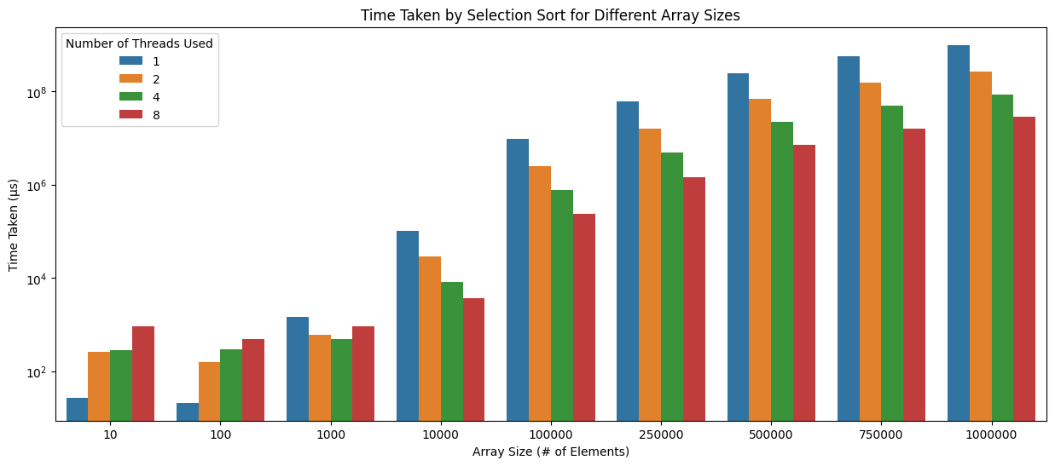
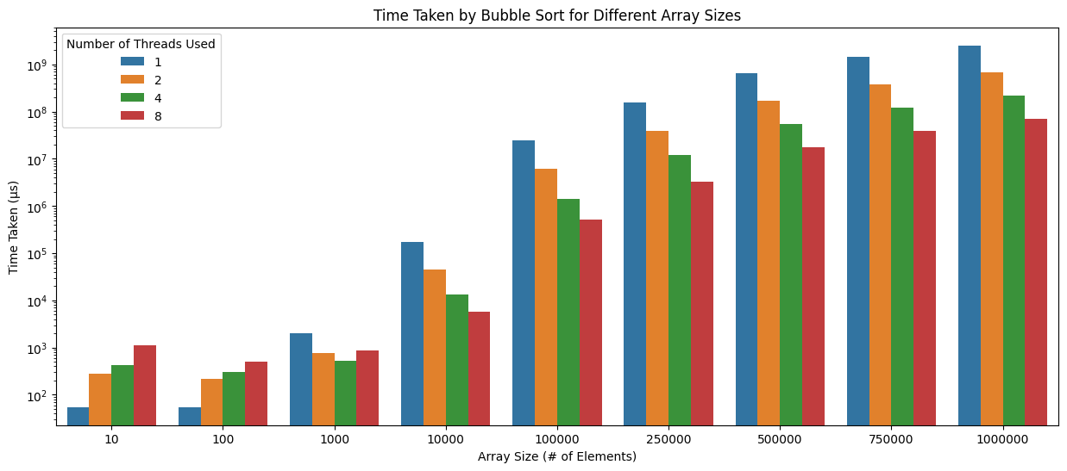
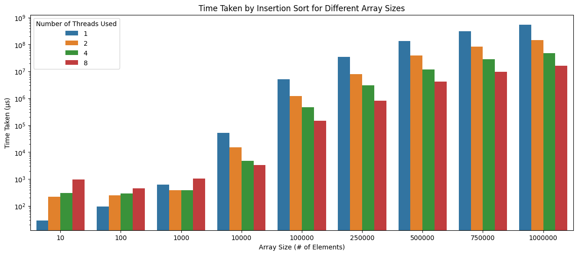
Evaluation - Time Taken
Selection Sort
Bubble Sort
Insertion Sort
Notes:
Gabriella
Now let’s evaluate the time taken for our concurrent implementations of selection sort, bubble sort, and insertion sort
All 3 sorts show noticeable benefits when multi-threading, likely because their runtime is on the slower side O(n²)
Starts to become worth to multithread between 100 and 1000 elements, likely at the higher end of this range
This is because at these array sizes, it’s able to save more time through multithreading than it wastes from thread creation and management overhead
The decrease in runtime per thread seems to take a linear pattern starting at around 10,000 elements

Slide 9
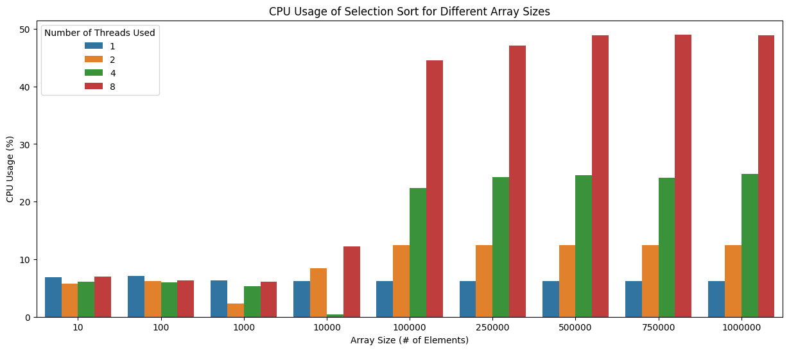
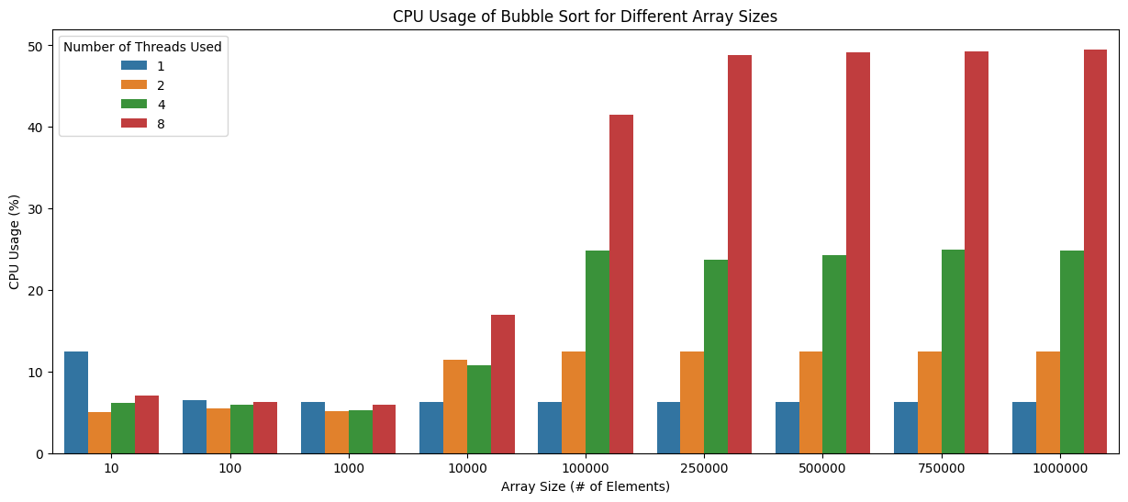
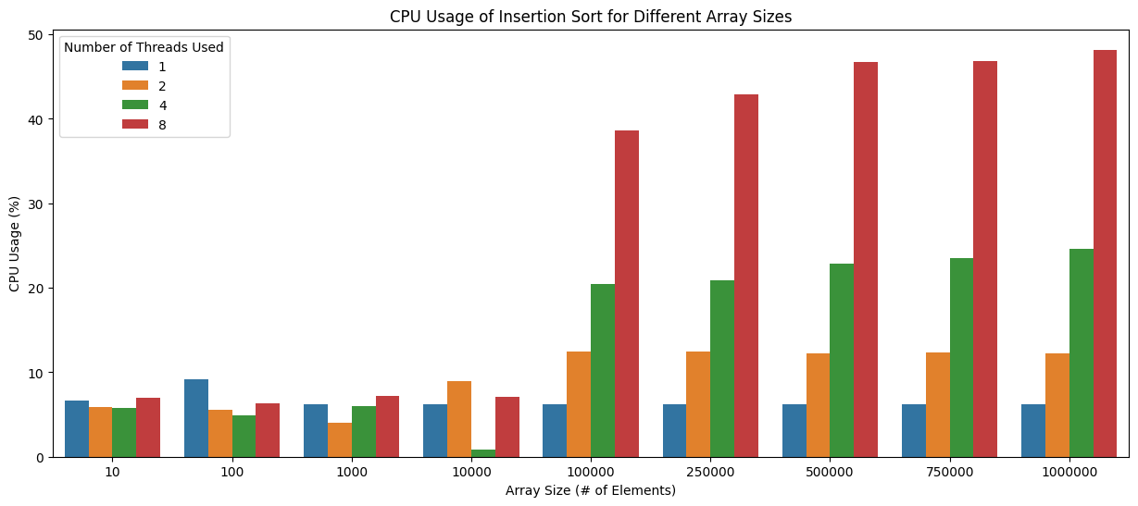
Evaluation - CPU Usage
Selection Sort
Bubble Sort
Insertion Sort
Notes:
Gabriella
Starting somewhere between 10,000 and 100,000 elements, there begins a linear relationship between the increase in number of threads and increase in CPU usage
Generally, above the threshold of 10,000 elements, if you double the number of threads, then the CPU usage about doubles as well

Slide 10
Radix Sort
Average Runtime: Θ(nk)
Notes:
Gabriella

Slide 11
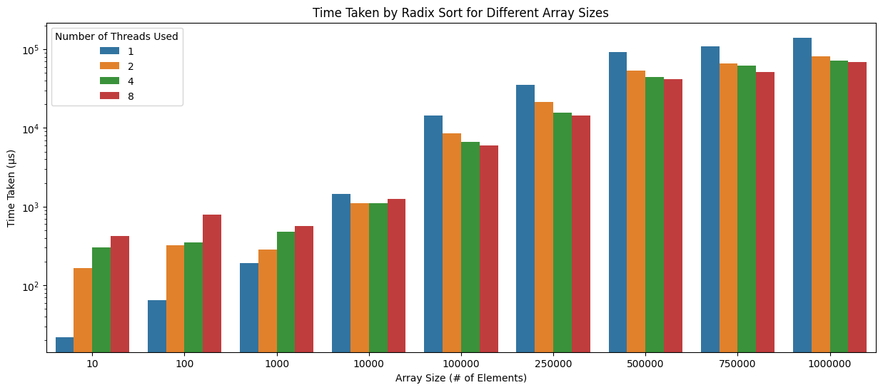
Evaluation - Time Taken
Notes:
Faiz Live:
In our concurrent radix sort evaluation, multi-threading benefited larger arrays but less significantly than other algorithms due to its fast runtime.
It became worthwhile for 1,000 to 10,000 elements, where time saved outweighed thread overhead. We observed a linear decrease in runtime per thread from 10,000 elements.
Now let's discuss the evaluation of our concurrent radix sort implementation.
Our results showed that radix sort did benefit from multi-threading, particularly at larger array sizes. However, the improvement in performance was somewhat less significant compared to other sorting algorithms, owing to radix sort's already fast average runtime.
We observed that it started to become worthwhile to use multi-threading for radix sort when dealing with arrays containing between 1,000 and 10,000 elements, with the benefits increasing towards the higher end of this range.
The reason for this is that at these array sizes, the time saved through multi-threading outweighs the overhead associated with thread creation and management.
Additionally, we noticed that the decrease in runtime per thread appeared to follow a linear pattern, starting at around 10,000 elements.
Radix sort shows some benefits when multi-threading, especially at higher array sizes, although less than some of the other sorts, due to its already fast average runtime O(d( n + k ))
Starts to become worth to multithread between 1,000 and 10,000 elements, likely on the higher end of this range
This is because at these array sizes, it’s able to save more time through multithreading than it wastes from thread creation and management overhead
The decrease in runtime per thread seems to take a linear pattern starting at around 10,000 elements

Slide 12
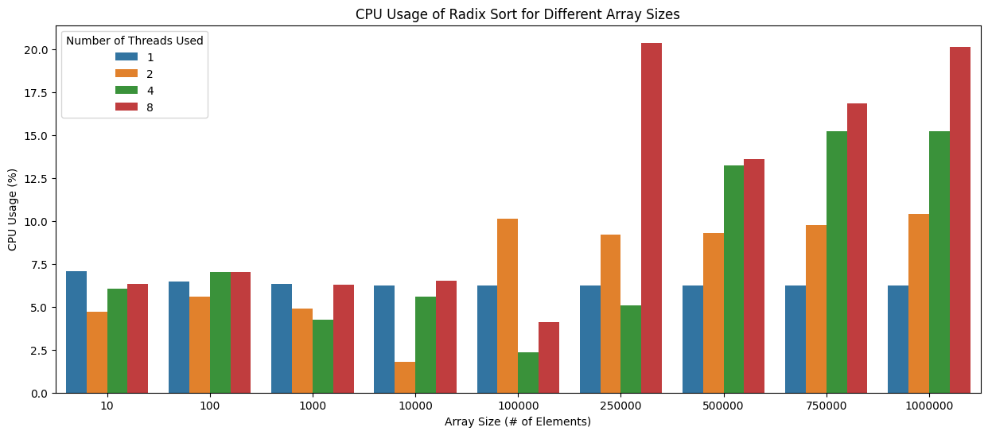
Evaluation - CPU Usage
Notes:
Faiz
Live: For our concurrent radix sort, we observed a linear relationship between increased thread count and CPU usage, starting between 250,000 and 500,000 elements, highlighting the trade-off between performance improvement and resource utilization.
When examining the CPU usage of our concurrent radix sort implementation, we found an interesting pattern.
Starting somewhere between 250,000 and 500,000 elements, a linear relationship emerged between the increase in the number of threads and the increase in CPU usage.
This relationship indicates that as we increase the number of threads, the CPU usage grows proportionally, illustrating the trade-off between improved performance and higher resource utilization.
Starting somewhere between 250,000 and 500,000 elements, radix sort starts to develop a linear relationship between increase in thread number and increase in CPU usage

Slide 13
Quick Sort and Merge Sort
Average Runtime: Θ(nlog(n))
Notes:
Gabriella

Slide 14
Merge Sort Code
template <class T>
void concurrentMergeSort(T arr[], int start, int end, int numThreads) {
if (start < end) {
int mid = (start + end) / 2;
if (numThreads > 1) {
vector<thread> threads(2);
int numThreadsLeft = numThreads / 2;
int numThreadsRight = numThreads - numThreadsLeft;
threads[0] = thread(concurrentMergeSort<T>, arr, start, mid, numThreadsLeft);
threads[1] = thread(concurrentMergeSort<T>, arr, mid + 1, end, numThreadsRight);
for (auto& thread : threads) {
thread.join();
}
} else {
concurrentMergeSort(arr, start, mid, 1);
concurrentMergeSort(arr, mid + 1, end, 1);
}
merge(arr, start, mid, end);
}
}
Notes:
Kevin
This merge sort is the only one done differently for parallelizing compared to the other implementations.
It assumes that the number of threads is a power of 2, then continually divides the array into two parts, calling the thread constructor on each part.
Afterwards, when 1 thread is reached as the base case, it calls itself recursively on each part.
When its done, the array is merged together.

Slide 15
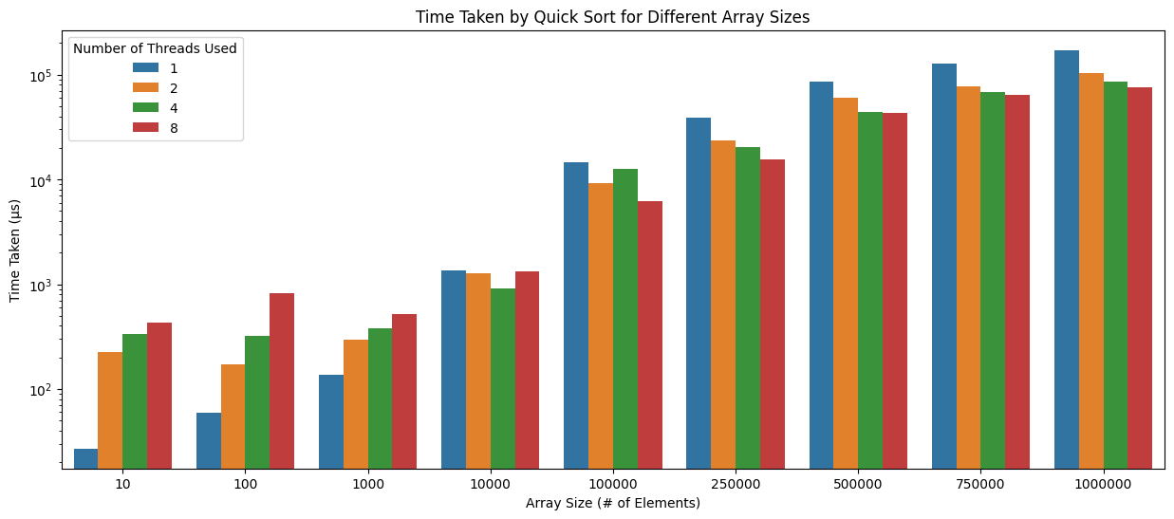
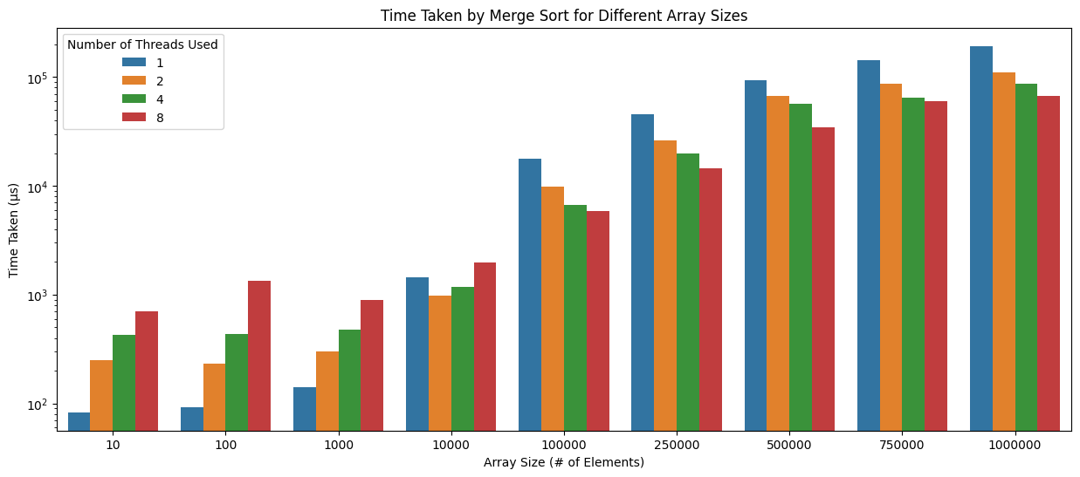
Evaluation - Time Taken
Quick Sort
Merge Sort
Notes:
Isaac
Here is the graph for the runtime of merge sorting. Unfortunately, it only slightly benefits from parallelization, just doing a little bit better than radix sort. This might be due to it’s fast runtime.
Comparing it to merge sort, we see that the The runtime patterns are very similar to merge sort but unfortunately it benefits slightly less than merge.
Compared to merge sort, it also needs a larger dataset for it to be worth using multithreading, somewhere between 100,000 elements and 250,000 depending on the threads used
(this is significantly higher than most of the other sorts)
The decrease in runtime per thread seems to take almost a logarithmic shape starting at around 250,000 elements.
This shows that quick sort does not benefit greatly from using more than 2 threads.
This is something to greatly consider as using more threads heavily increases the CPU usage as we can see in the next slide, and here we see that the runtime does not increase despite the large amount of resources used..

Slide 16
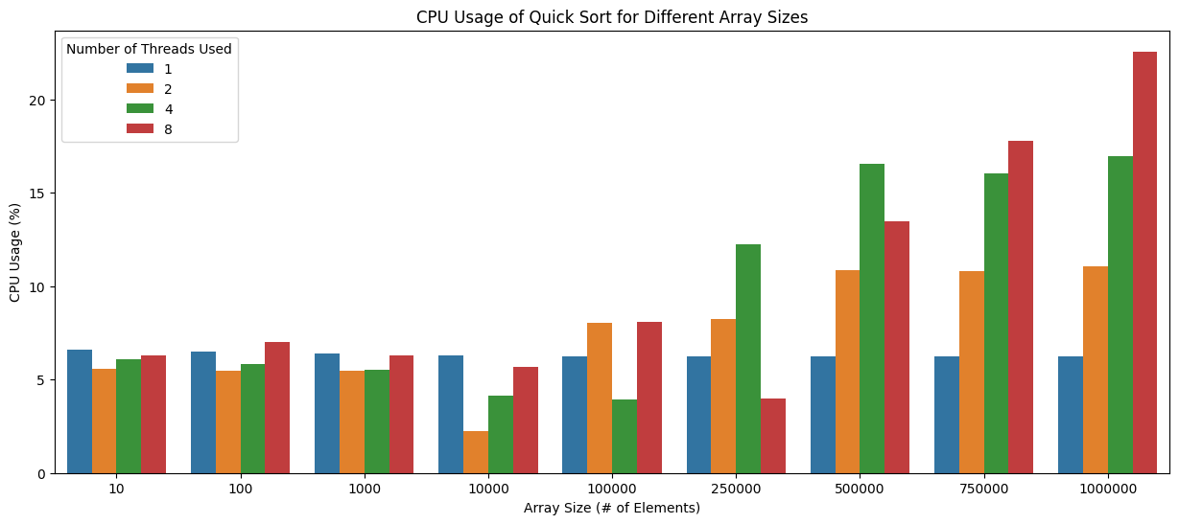
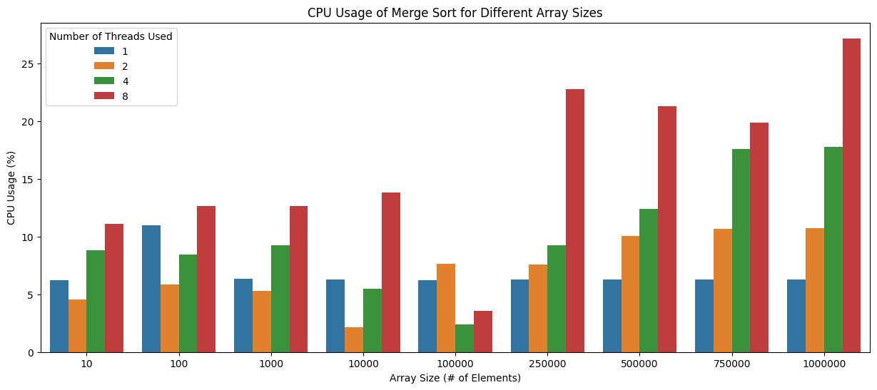
Evaluation - CPU Usage
Quick Sort
Merge Sort
Notes:
Isaac
Here is the graph for the runtime of merge sorting. Unfortunately, it only slightly benefits from parallelization, just doing a little bit better than radix sort. This might be due to it’s fast runtime.
Comparing it to merge sort, we see that the The runtime patterns are very similar to merge sort but unfortunately it benefits slightly less than merge.
Compared to merge sort, it also needs a larger dataset for it to be worth using multithreading, somewhere between 100,000 elements and 250,000 depending on the threads used
(this is significantly higher than most of the other sorts)
The decrease in runtime per thread seems to take almost a logarithmic shape starting at around 250,000 elements.
This shows that quick sort does not benefit greatly from using more than 2 threads.
This is something to greatly consider as using more threads heavily increases the CPU usage as we can see in the next slide, and here we see that the runtime does not increase despite the large amount of resources used..

Slide 17
Overall…
Notes:
Kevin

Slide 18
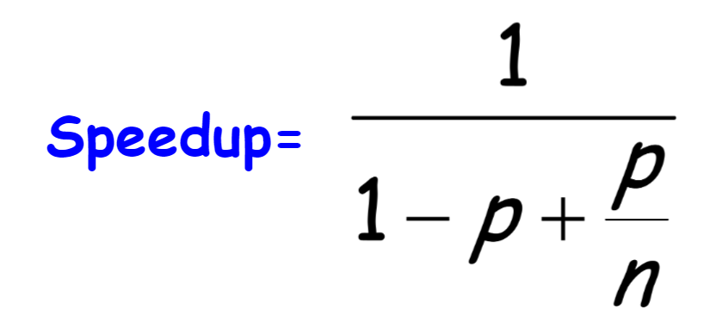
Discussion
The faster sorts require a larger array for multithreading to become worth it
CPU Usage has a more linear relationship as array size increases
For further exploration, researchers could try implementing concurrency in sorting algorithms by having the merge be done “along the way” as the sort is being completed, instead of having a merge step to merge the pieces of the array at the end. Can also implement merge concurrently.
Amdahl’s Law:
Notes:
Kevin
The faster sorts require a larger array for multithreading to become worth it
CPU Usage has a more linear relationship as array size increases
Can implement merge step concurrently
Due to Amdahl’s Law, it can be seen that the efficiency of our system did not have a linear increase when increasing the number of threads. The speedup of the concurrent sorting algorithms will initially increase, but will eventually level off due to the limitations imposed by the serial fraction (Amdahl's law formula). This means that adding more threads beyond a certain point will not result in significant improvements in performance.
Amdahl’s Law can be expressed in mathematically as follows −
SpeedupMAX = 1/((1-p)+(p/s))
SpeedupMAX = maximum performance gain
s = performance gain factor of p after implement the enhancements.
p = the part which performance needs to be improved.

Slide 19
Key Issues and Challenges
Original bubble sort implementation was faulty
Merging of arrays produced arrays not sorted at chunk bounds
Some parallel sorts did not work when array size was not evenly divisible by the number of chunks
Notes:
Kevin
Original bubble sort implementation was faulty
Fixed with loop bounds change
Merging of arrays produced arrays not sorted at chunk bounds
Changed from linear merging to merge-sort like merging
Some parallel sorts did not work when array size was not evenly divisible by the number of chunks
Fixed by making last thread handle remainder of data

Slide 20
Conclusion
Our data appears to confirm our original hypothesis
Multithreading can speed up sorting, but the point where it becomes beneficial depends on array size, sorting algorithm, and system specifications.
Notes:
Isaac
Overall, our findings supports our hypothesis:
Multithreading can speed up sorting algorithms, but the extra work to set-up and to clean-up the work done by the threads is very noticeable in smaller array sizes.
The benefits of multi-threading are specific to each sorting algorithm and should be carefully selected based on the application such as the resources available and the size of the dataset.
Overall, we were satisfied with our results and how we were able to show a visual representation of the advantages and drawbacks of the different sorting algorithms and approaches.
We hope our research aids in the research of multithreading in sorting applications and we hope that others can learn from our work and build off of it.
Thank you!
Our data appears to confirm our original hypothesis that implementing common sorting algorithms with multi-threading improves the run-time for that sort to complete at the cost of increased CPU usage of the system
the run-time benefits of multithreading are typically only worth it for larger array sizes, and that the threshold where these benefits become worth it differ for each specific sort and the specifications of the system doing the sorting

