Slide 1
Parallelizing Sorting Algorithms
Kevin Alfonso
Gabriella On-Cuen
Faiz Ahmed
Raciel Antela Pardo
Isaac Munshi
Notes:
Everyone (Introduce ourselves in order of names on slide)

Slide 2
Introduction
Parallelized common sorting algorithms
Multi-threaded vs. linear versions
Focused on six sorting algorithms
Goal: explore differences in run-time and efficiency
Notes:
Faiz
Script:
Our goal was to explore the differences in run-time and efficiency between multi-threaded and linear versions of these sorting algorithms.
For this experiment, we focused on six widely-used sorting algorithms: bubble sort, merge sort, radix sort, insertion sort, selection sort, and quick sort.
Our initial expectation was that the parallelized versions of each sorting algorithm would take less time, particularly for large arrays, compared to their linear counterparts.
Additionally, we hypothesized that CPU usage would increase for the multi-threaded sorting algorithms in comparison to the linear versions, as they would require more resources to execute in parallel.
Old: We parallelized common sorting algorithms to explore the differences in run-time and efficiency between the multi-threaded and linear versions
In this experiment, we tested bubble sort, merge sort, radix sort, insertion sort, selection sort, and quick sort
At the beginning of our experiment, we expected for each sort to take less time, at least when it comes to large arrays
We also expected for the CPU usage to increase for the multithreaded sorting algorithms in comparison to the normal linear sorting algorithms

Slide 3
Motivation
Parallelized algorithms faster for large arrays
Increased CPU usage for multi-threaded versions
Compare performance and resource utilization
Investigate trade-offs between linear and parallelized algorithms
Notes:
faiz
Script:
The motivation behind our project stems from the ubiquity of sorting in computer science, ranging from student projects to enterprise-level software. As we often deal with large amounts of data, sorting can be time-consuming, negatively impacting the overall efficiency of a system.
Our aim was to rewrite popular sorting algorithms to take advantage of multithreading, enabling us to reduce the time it takes to sort large datasets while leveraging the increased computing power of modern computers.
We believe that the trade-off of increased computing power for faster sorting times is worthwhile, as computers have come a long way since the original sorting algorithms were written and implemented, offering us the opportunity to optimize these algorithms for today's hardware.
Old:
Sorting is used everywhere in computer science, from student projects to enterprise-level software. Oftentimes, this deals with large amounts of data which leads to the sorting taking longer. By rewriting popular sorting algorithms to take advantage of parallelism and multithreading in a clever way, we can reduce the time it takes to sort large amounts of data at the cost of increased computing power, which is a worthwhile trade due to computers getting more powerful since the days the original sorting algorithms were written and implemented.

Slide 4
Technique
Utilized std::thread for parallelism
Lock-free data structures & atomic operations
Vectors of threads for safety & performance
Implemented & parallelized normal sorting algorithms
Merged individual thread results
Tested with 1, 2, 4, and 8 threads
Validity check: ensure arrays correctly sorted
Notes:
Faiz
script :
To implement parallelism in our sorting algorithms, we used the std::thread library to create parallel threads that could work on different parts of the data simultaneously.
We utilized lock-free data structures and atomic operations to prevent race conditions and ensure data integrity.
To improve concurrent thread safety and performance, we opted for vectors of threads instead of arrays.
Our approach involved implementing the normal sorting algorithms first, then parallelizing them by allowing each thread to complete its own sorting work using the normal algorithms. Once the individual threads were finished, we merged their results together.
We conducted tests for each sorting algorithm with 1, 2, 4, and 8 threads to compare run-times and understand the impact of varying the number of threads.
To ensure the validity of our results, we gave each sort a copy of the array and checked if it was correctly sorted after the process was completed.
Old: Used std::thread to create parallel threads that work on different parts of the data simultaneously
Used lock-free data structures and atomic operations to avoid race conditions
Used vectors of threads instead of arrays to improve concurrent thread safety and performance
Implemented normal sorting algorithms then parallelized them
Allowed each thread to complete its own sorting work with the normal sorting algorithms, then merged them together at the end
Tested each sorting algorithm with 1, 2, 4, and 8 threads to compare run-times
Sort was given copy of array, checked if it was sorted afterwards to ensure validity

Slide 5
Algorithm to Merge Pieces of Array
while (left <= mid) {
temp[tempIndex] = arr[left];
left++;
tempIndex++;
}
while (right <= end) {
temp[tempIndex] = arr[right];
right++;
tempIndex++;
}
for (int i = start; i <= end; i++) {
arr[i] = temp[i - start];
}
}
template <class T>
void merge(T arr[], int start, int mid, int end) {
int left = start;
int right = mid + 1;
int temp[end - start + 1];
int tempIndex = 0;
while (left <= mid && right <= end) {
if (arr[left] < arr[right]) {
temp[tempIndex] = arr[left];
left++;
} else {
temp[tempIndex] = arr[right];
right++;
}
tempIndex++;
}
Notes:
Raciel
We implemented each concurrent sorting algorithm by splitting the array into multiple smaller subsections and performing a regular sort on each of these subsections before merging them together at the end.
To do so we have implemented the merge() function, which we use to merge the smaller sections back together into a full sized array. We call this merge function in each of our concurrent sort functions

Slide 6
Evaluation
Time Taken(µs): std::chrono's high-resolution clock
CPU Usage(%): Linux's rusage library
CPU Usage calculation formula
Data format: CSV
Data analysis: Python Jupyter notebook, Pandas, Matplotlib, Seaborn
Graphs: Time Taken vs. Array Size, CPU Usage vs. Array Size
Number of threads represented by color
Notes:
Raciel
Time Taken(µs) measured with std::chrono’s high resolution clock
CPU Usage(%) measured with Linux’s rusage library
Calculated as (busy time) / (elapsed time) / (number of cores) * 100
Data outputted to CSV file in format of “Sort Name,Array Size,Time Taken,CPU Usage,Number of Threads Used”
Read by Python Jupyter notebook
Analyzed with Pandas, Matplotlib, and Seaborn to create graphs

Slide 7
Bubble Sort
Notes:
Raciel

Slide 8
Code
template<class T>
void concurrentBubbleSort(T arr[], int n, int numThreads) {
vector<thread> threads;
int chunkSize = (int)floor(n / numThreads);
for (int i = 0; i < numThreads - 1; i++) {
int start = i * chunkSize;
int end = start + chunkSize;
threads.emplace_back(bubbleSort<T>, ref(arr), start, end);
}
threads.emplace_back(bubbleSort<T>, ref(arr), (numThreads - 1) * chunkSize, n);
for (auto &thread: threads) {
thread.join();
}
// Similar to merging in merge sort, but we merge chunks of size chunk_size
// Doubles the size of the chunks each iteration
for (int size = chunkSize; size < n; size *= 2) {
for (int i = 0; i < n - size; i += 2 * size) {
int left = i;
int mid = i + size - 1;
int right = min(i + 2 * size - 1, n - 1);
merge(arr, left, mid, right);
}
}
}
Notes:
Raciel
For our concurrent bubble sort, we first figure out how big each chunk of the array should be based on the array size and number of threads. If the array size is evenly divisible by the number of threads, then the threads handle the same size chunk. Otherwise, the last chunk handles the smaller remainder of data and likely finishes faster. Afterwards, we assign each thread its respective chunk and make it bubble sort it. We join the threads to ensure they are all finished sorting, and then proceed to the final merge step to join together all the chunks of data. This merge is similar to the merge step in merge sort, in that it merges adjacent chunks together, doubling in size every iteration.

Slide 9
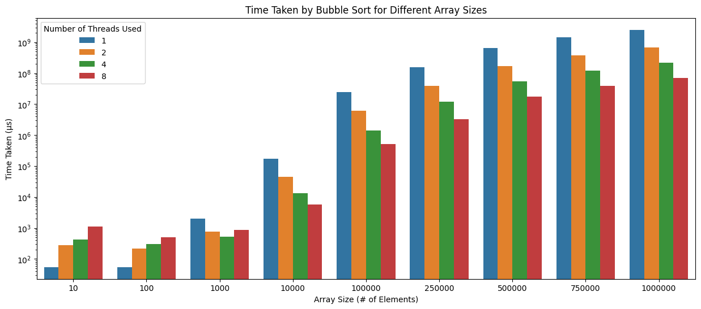
Evaluation - Time Taken
Notes:
Raciel
Bubble sort shows noticeable benefits when multi-threading, likely because its runtime is on the slower side O(n²)
Starts to become worth to multithread between 100 and 1000 elements
This is because at these array sizes, it’s able to save more time through multithreading than it wastes from thread creation and management overhead
The decrease in runtime per thread seems to take a linear pattern starting at more than 10,000 elements
Bubble sort clearly shows that at some point between 100 and 1000 for the array size, bubble sort benefits more from multi-threading through time saving than it wastes time from the thread creation and management overhead.

Slide 10
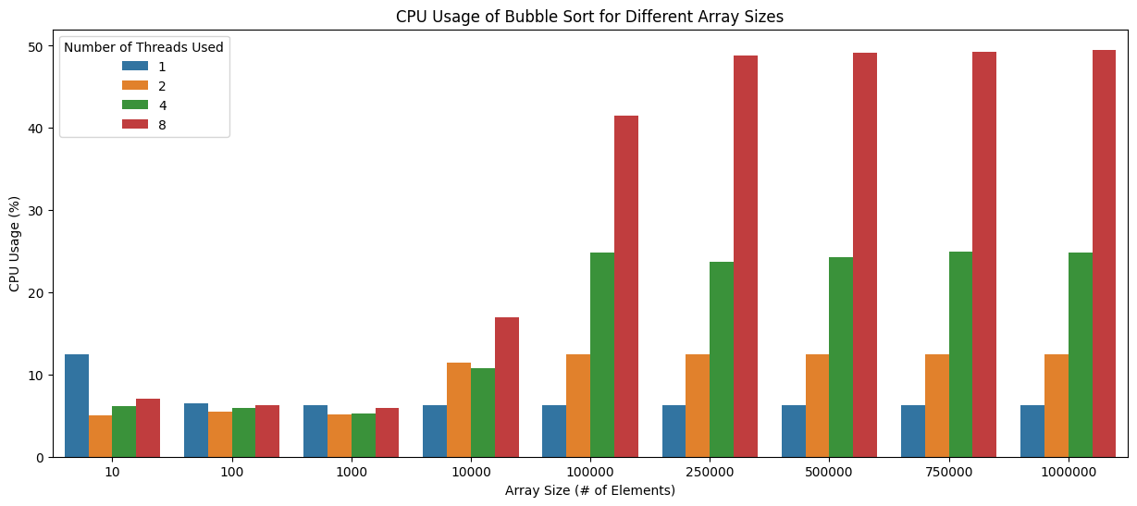
Evaluation - CPU Usage
Notes:
Raciel
Starting somewhere between 10,000 and 100,000 elements, there begins a linear relationship between the increase in number of threads and increase in CPU usage
Generally, if you double the number of threads, then the CPU usage about doubles as well
Regarding the CPU usage, starting somewhere between 10,000 and 100,000 elements, there begins a linear relationship between the increase in number of threads and increase in CPU usage.
It shows in an almost exact perfect relationship that multithreading puts more strain on the CPU compared to sequential programming (doubling threads means doubling CPU usage percent).
However, as mentioned in the introduction, this is often worth it due to constantly improving computing power mixed with a need for quickly sorted data.

Slide 11
Merge Sort
Notes:
Kevin

Slide 12
Code
template <class T>
void concurrentMergeSort(T arr[], int start, int end, int numThreads) {
if (start < end) {
int mid = (start + end) / 2;
if (numThreads > 1) {
vector<thread> threads(2);
int numThreadsLeft = numThreads / 2;
int numThreadsRight = numThreads - numThreadsLeft;
threads[0] = thread(concurrentMergeSort<T>, arr, start, mid, numThreadsLeft);
threads[1] = thread(concurrentMergeSort<T>, arr, mid + 1, end, numThreadsRight);
for (auto& thread : threads) {
thread.join();
}
} else {
concurrentMergeSort(arr, start, mid, 1);
concurrentMergeSort(arr, mid + 1, end, 1);
}
merge(arr, start, mid, end);
}
}
Notes:
Kevin
This merge sort is the only one done differently for parallelizing compared to the other implementations.
It assumes that the number of threads is a power of 2, then continually divides the array into two parts, calling the thread constructor on each part.
Afterwards, when 1 thread is reached as the base case, it calls itself recursively on each part.
When its done, the array is merged together.

Slide 13
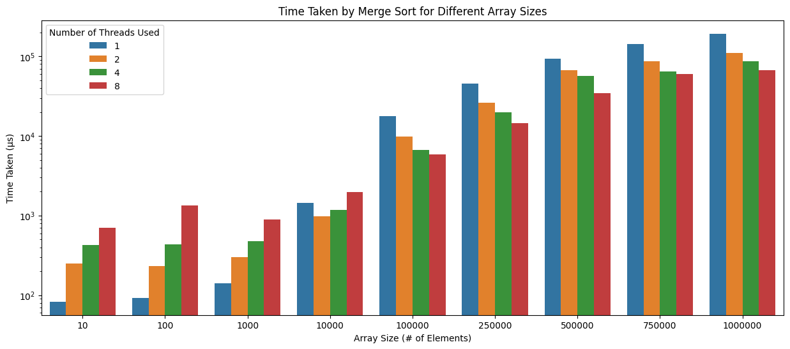
Evaluation - Time Taken
Notes:
Kevin
Merge sort shows some benefits when multi-threading, especially at higher array sizes, although less than some of the other sorts, due to its already fast average runtime O(n*log(n))
Starts to become worth to multithread between 1000 and 10000 elements, this is because at these array sizes, it’s able to save more time through multithreading than it wastes from thread creation and management overhead
The decrease in runtime per thread seems to take a linear pattern starting at around 100,000 elements

Slide 14
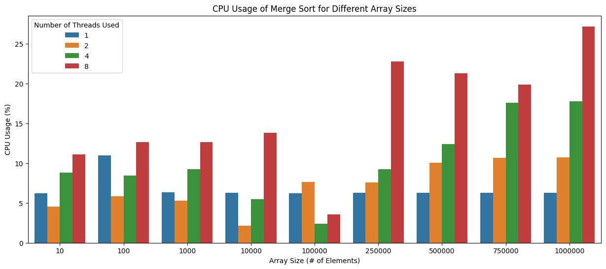
Evaluation - CPU Usage
Notes:
Kevin
At first, the CPU usage spikes for 1 thread, then starts increasing linearly for 2, 4, and 8 threads
Starting somewhere between 100,000 and 250,000 elements, there begins a linear relationship between the increase in number of threads and increase in CPU usage

Slide 15
Radix Sort
Notes:
faiz

Slide 16
Code
void concurrentRadixSort(int arr[], int n, int numThreads) {
vector<thread> threads;
int chunkSize = (int)floor(n / numThreads);
for (int i = 0; i < numThreads - 1; i++) {
int start = i * chunkSize;
int end = min(start + chunkSize, n);
threads.emplace_back(radixSort, ref(arr), start, end);
}
threads.emplace_back(radixSort, ref(arr), (numThreads - 1) * chunkSize, n);
for (auto &thread: threads) {
thread.join();
}
// Similar to merging in merge sort, but we merge chunks of size chunkSize
// Doubles the size of the chunks each iteration
for (int size = chunkSize; size < n; size *= 2) {
for (int i = 0; i < n - size; i += 2 * size) {
int left = i;
int mid = i + size - 1;
int right = min(i + 2 * size - 1, n - 1);
merge(arr, left, mid, right);
}
}
}
Notes:
faiz
Script:
Let's take a look at how we implemented the concurrent radix sort algorithm in our project.
Similar to our concurrent bubble sort implementation, we first split the input array into smaller chunks based on the array size and the number of threads being used.
We then assigned each thread to perform radix sort on its respective chunk of the array.
Once all threads completed their sorting tasks, we joined the threads to ensure all of them had finished before proceeding.
Finally, we merged all the sorted chunks together, similar to how merging is done in merge sort. This was accomplished by doubling the size of the chunks in each iteration and merging them accordingly.
This approach allowed us to parallelize the radix sort algorithm effectively. report :
Our concurrent radix sort is implemented extremely similarly to the concurrent bubble sort. We split the array into chunks based on the array size and number of threads, assign each thread to radix sort its respective chunk, join the threads, then merge all the chunks together.

Slide 17
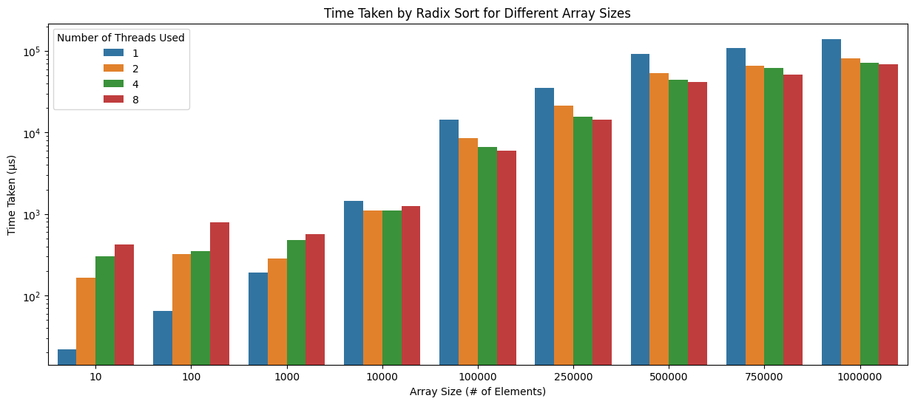
Evaluation - Time Taken
Notes:
Faiz
Now let's discuss the evaluation of our concurrent radix sort implementation.
Our results showed that radix sort did benefit from multi-threading, particularly at larger array sizes. However, the improvement in performance was somewhat less significant compared to other sorting algorithms, owing to radix sort's already fast average runtime.
We observed that it started to become worthwhile to use multi-threading for radix sort when dealing with arrays containing between 1,000 and 10,000 elements, with the benefits increasing towards the higher end of this range.
The reason for this is that at these array sizes, the time saved through multi-threading outweighs the overhead associated with thread creation and management.
Additionally, we noticed that the decrease in runtime per thread appeared to follow a linear pattern, starting at around 10,000 elements.
Radix sort shows some benefits when multi-threading, especially at higher array sizes, although less than some of the other sorts, due to its already fast average runtime O(d( n + k ))
Starts to become worth to multithread between 1,000 and 10,000 elements, likely on the higher end of this range
This is because at these array sizes, it’s able to save more time through multithreading than it wastes from thread creation and management overhead
The decrease in runtime per thread seems to take a linear pattern starting at around 10,000 elements

Slide 18
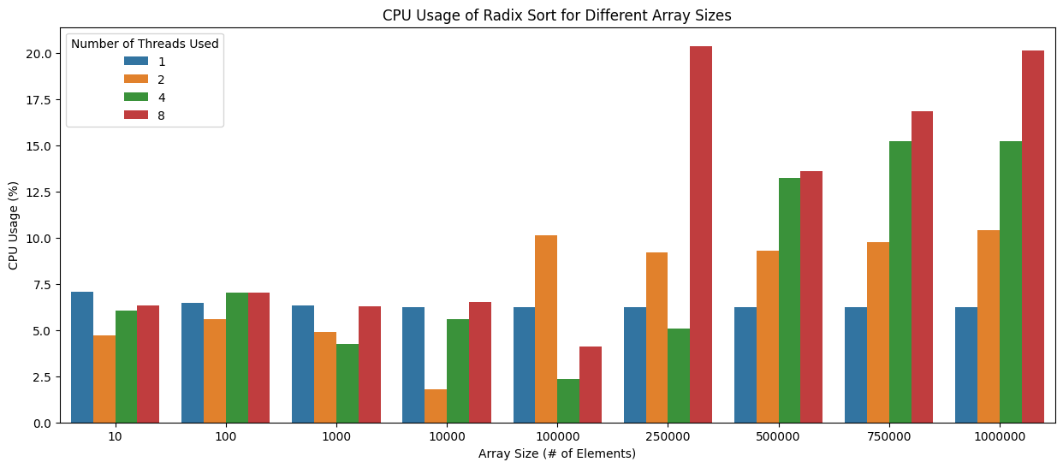
Evaluation - CPU Usage
Notes:
Faiz
When examining the CPU usage of our concurrent radix sort implementation, we found an interesting pattern.
Starting somewhere between 250,000 and 500,000 elements, a linear relationship emerged between the increase in the number of threads and the increase in CPU usage.
This relationship indicates that as we increase the number of threads, the CPU usage grows proportionally, illustrating the trade-off between improved performance and higher resource utilization.
Starting somewhere between 250,000 and 500,000 elements, radix sort starts to develop a linear relationship between increase in thread number and increase in CPU usage

Slide 19
Insertion Sort
Notes:
Gabriella

Slide 20
Code
void concurrentInsertionSort(int arr[], int n, int num_threads) {
vector<thread> threads;
int chunkSize = (int)floor(n / num_threads);
for (int i = 0; i < num_threads - 1; i++) {
int start = i * chunkSize;
int end = min(start + chunkSize, n);
threads.emplace_back(insertionSort, ref(arr), start, end - 1);
}
threads.emplace_back(insertionSort, ref(arr), (num_threads - 1) * chunkSize, n - 1);
for (auto &thread : threads) {
thread.join();
}
// Similar to merging in merge sort, but we merge chunks of size chunkSize
// Doubles the size of the chunks each iteration
for (int size = chunkSize; size < n; size *= 2) {
for (int i = 0; i < n - size; i += 2 * size) {
int left = i;
int mid = i + size - 1;
int right = min(i + 2 * size - 1, n - 1);
merge(arr, left, mid, right);
}
}
}
Notes:
Gabriella
The concurrentInsertion sort works similarly to the concurrent bubble sort. It splits the array into various different subsections depending on the array size and the number of threads for this execution, and then performs a regular insertion sort on each of the subsections. At the end, it calls the merge() function to merge the subsections back together into one final, sorted array.

Slide 21
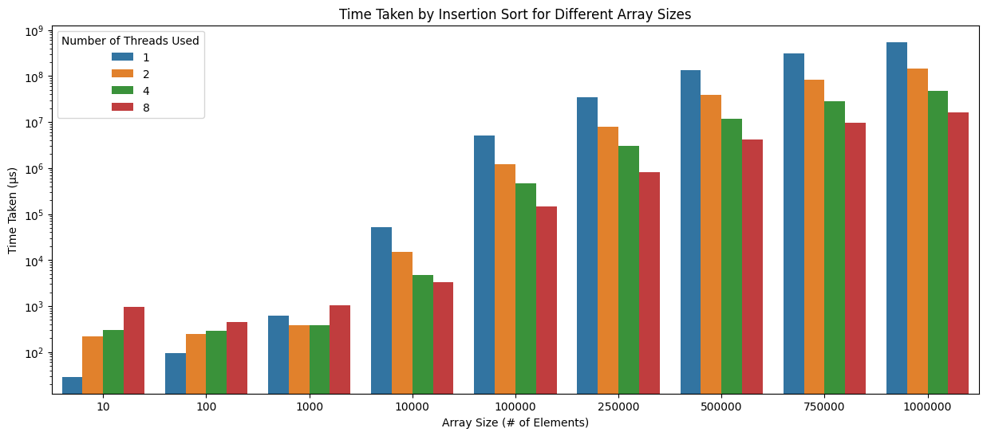
Evaluation - Time Taken
Notes:
Gabriella
Insertion sort shows noticeable benefits when multi-threading, likely because its runtime is on the slower side O(n²)
Starts to become worth to multithread between 100 and 1000 elements, likely at the higher end of this range
This is because at these array sizes, it’s able to save more time through multithreading than it wastes from thread creation and management overhead
The decrease in runtime per thread seems to take a linear pattern starting at around 10,000 elements
Above a threshold of around 10,000 elements, there is an almost perfect inverse relationship between the number of threads and the execution time

Slide 22
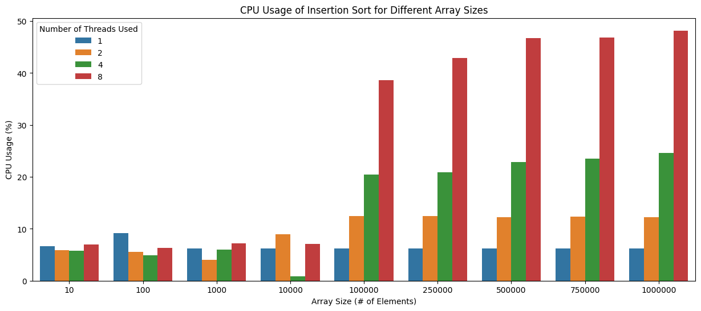
Evaluation - CPU Usage
Notes:
Gabriella
Starting somewhere between 10,000 and 100,000 elements, insertion sort starts to develop a linear relationship between increase in thread number and increase in CPU usage
Once we reach 100,000 elements and higher, there is an almost perfect correlation between thread count and CPU usage
If you double the number of threads, then the CPU usage doubles as well

Slide 23
Selection Sort
Notes:
Gabriella

Slide 24
Code
void concurrentSelectionSort(int arr[], int n, int numThreads) {
vector<thread> threads;
int chunkSize = (int)floor(n / numThreads);
for (int i = 0; i < numThreads - 1; i++) {
int start = i * chunkSize;
int end = min(start + chunkSize, n);
threads.emplace_back(selectionSort, ref(arr), start, end - 1);
}
threads.emplace_back(selectionSort, ref(arr), (numThreads - 1) * chunkSize, n - 1);
for (auto &thread : threads) {
thread.join();
}
// Similar to merging in merge sort, but we merge chunks of size chunkSize
// Doubles the size of the chunks each iteration
for (int size = chunkSize; size < n; size *= 2) {
for (int i = 0; i < n - size; i += 2 * size) {
int left = i;
int mid = i + size - 1;
int right = min(i + 2 * size - 1, n - 1);
merge(arr, left, mid, right);
}
}
}
Notes:
Gabriella
The concurent selection sort works like the concurrent bubble and insertion sorts. It splits the full array into smaller sections, whose sizes are determined by the number of threads and array size, calls selection sort on each section, and finally merges them back together.

Slide 25
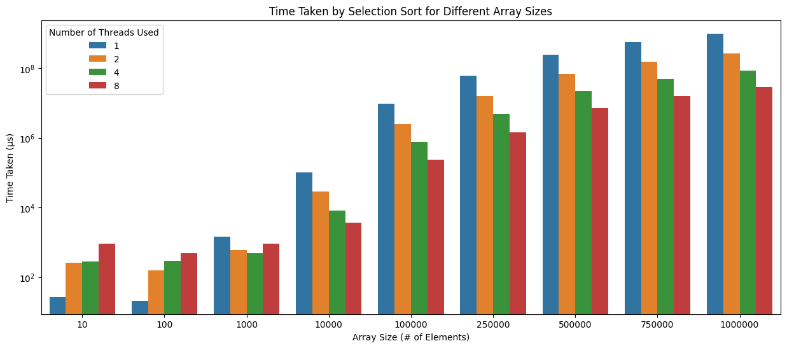
Evaluation - Time Taken
Notes:
Gabriella
Selection sort shows noticeable benefits when multi-threading, likely because its runtime is on the slower side O(n²)
Starts to become worth to multithread between 100 and 1000 elements, likely at the higher end of this range
This is because at these array sizes, it’s able to save more time through multithreading than it wastes from thread creation and management overhead
The decrease in runtime per thread seems to take a linear pattern starting at around 10,000 elements
Bubble sort shows noticeable benefits when multi-threading, likely because its runtime is on the slower side O(n²)
Starts to become worth to multithread between 100 and 1000 elements
This is because at these array sizes, it’s able to save more time through multithreading than it wastes from thread creation and management overhead
The decrease in runtime per thread seems to take a linear pattern starting at more than 10,000 elements

Slide 26
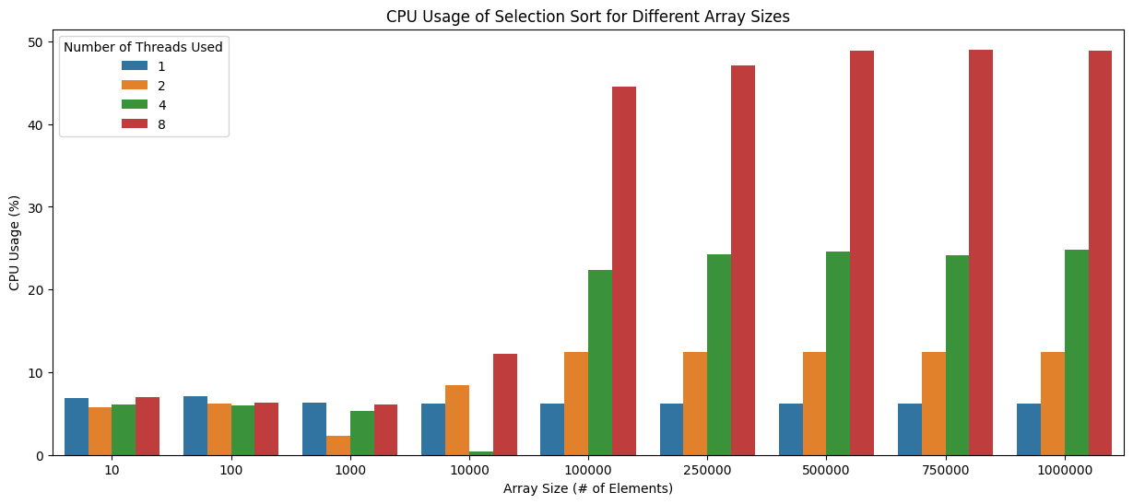
Evaluation - CPU Usage
Notes:
Gabriella
Starting somewhere between 10,000 and 100,000 elements, there begins a linear relationship between the increase in number of threads and increase in CPU usage
Generally, above the threshold of 10,000 elements, if you double the number of threads, then the CPU usage about doubles as well

Slide 27
Quick Sort
Notes:
Isaac

Slide 28
Code
void concurrentQuickSort(int arr[], int n, int numThreads) {
vector<thread> threads;
int chunkSize = (int)floor(n / numThreads);
for (int i = 0; i < numThreads - 1; i++) {
int start = i * chunkSize;
int end = min(start + chunkSize, n);
threads.emplace_back(quickSort, ref(arr), start, end - 1);
}
threads.emplace_back(quickSort, ref(arr), (numThreads - 1) * chunkSize, n - 1);
for (auto &thread : threads) {
thread.join();
}
// Similar to merging in merge sort, but we merge chunks of size chunkSize
// Doubles the size of the chunks each iteration
for (int size = chunkSize; size < n; size *= 2) {
for (int i = 0; i < n - size; i += 2 * size) {
int left = i;
int mid = i + size - 1;
int right = min(i + 2 * size - 1, n - 1);
merge(arr, left, mid, right);
}
}
}
Notes:
Isaac -
Describe the code
Quick sort has a best-case-scenario runtime of O(n*log(n)) and a worst-case runtime of O(n^2), so we expect to show similar growth to merge sort.

Slide 29
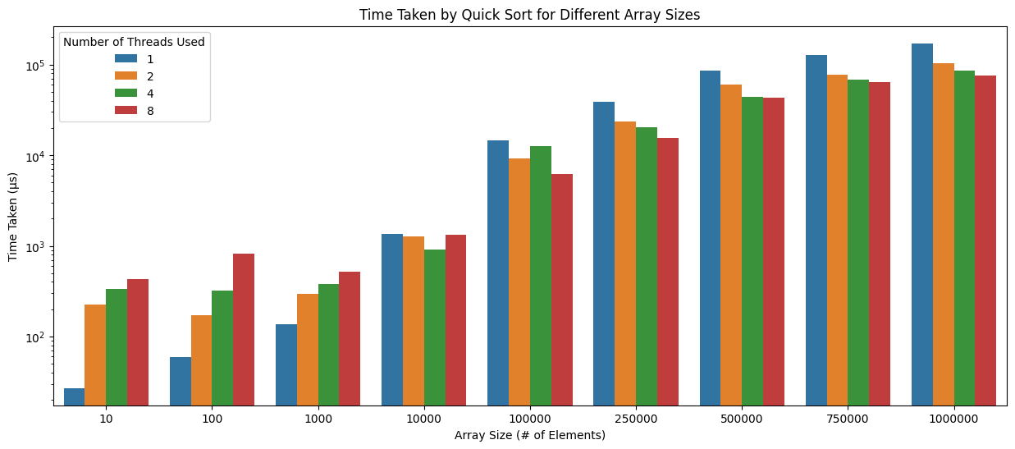
Evaluation - Time Taken
Notes:
Isaac
Here is the graph for the runtime of merge sorting. Unfortunately, it only slightly benefits from parallelization, just doing a little bit better than radix sort. This might be due to it’s fast runtime.
Comparing it to merge sort, we see that the The runtime patterns are very similar to merge sort but unfortunately it benefits slightly less than merge.
Compared to merge sort, it also needs a larger dataset for it to be worth using multithreading, somewhere between 100,000 elements and 250,000 depending on the threads used
(this is significantly higher than most of the other sorts)
The decrease in runtime per thread seems to take almost a logarithmic shape starting at around 250,000 elements.
This shows that quick sort does not benefit greatly from using more than 2 threads.
This is something to greatly consider as using more threads heavily increases the CPU usage as we can see in the next slide, and here we see that the runtime does not increase despite the large amount of resources used..

Slide 30
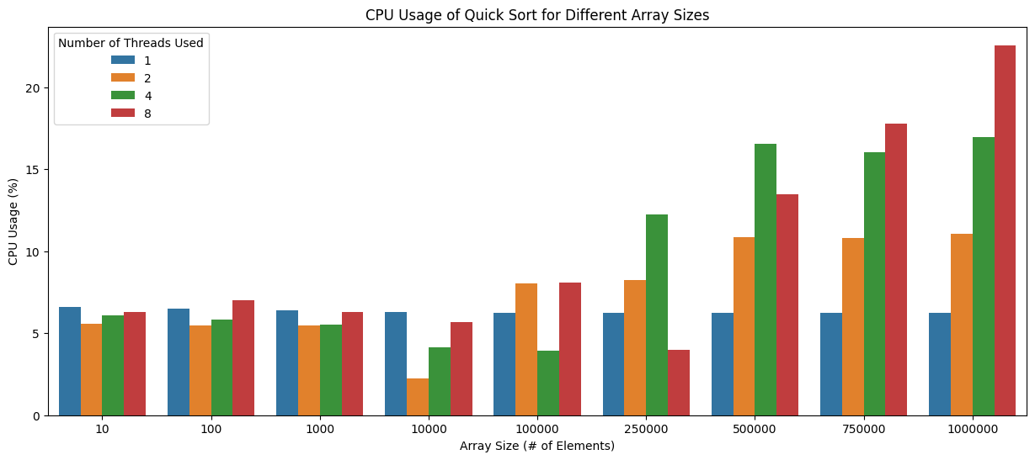
Evaluation - CPU Usage
Notes:
Isaac
Here is the graph of CPU usage
There is no meaningful Relationship until we handle arrays of sizes greater than 250,000
there begins a linear relationship between the increase in number of threads and increase in CPU usage
Compared to Merge Sort, The CPU usage in smaller datasets is a lot better, but as we look at 250,000 and beyond, it looks the same as merge sort.
In last slide we saw that 2 threads helps the runtime, but anything more doesn’t really help, but it greatly increases the resource usage
This is important and an interesting point, maybe an interesting research point for further studies to see exactly

Slide 31
Overall…
Notes:
Kevin

Slide 32
Discussion
The faster sorts require a larger array for multithreading to become worth it
CPU Usage has a more linear relationship as array size increases
For further exploration, researchers could try implementing concurrency in sorting algorithms by having the merge be done “along the way” as the sort is being completed, instead of having a merge step to merge the pieces of the array at the end
Notes:
Kevin
Due to Amdahl’s Law, it can be seen that the efficiency of our system did not have a linear increase when increasing the number of threads. The speedup of the concurrent sorting algorithms will initially increase, but will eventually level off due to the limitations imposed by the serial fraction (Amdahl's law formula). This means that adding more threads beyond a certain point will not result in significant improvements in performance.

Slide 33
Key Issues and Challenges
Original bubble sort implementation was faulty
Merging of arrays produced arrays not sorted at chunk bounds
Some parallel sorts did not work when array size was not evenly divisible by the number of chunks
Notes:
Kevin
Fixed with loop bounds change
Changed from linear merging to merge-sort like merging
Fixed by making last thread handle remainder of data

Slide 34
Critical Enabling Technology
C++
Std::thread
Python
Matplotlib, Pandas, Seaborn
Notes:
Isaac
For this project, we utilized the Thread capability that is a part of the standard library in C++. The thread class had everything we needed for our concurrent code.
We used python as our data visualization tool to develop the graphs. and we used Pandas to handle the arrays and MatplotLib and Seaborn to create and display the graphs for the different array sizes and the different number of threads.
We implemented our parallelized sorting algorithms in C++ using the various tools and libraries provided by the language
We used the C++ thread class provided by the standard library, which allows for multiple operations to be executed concurrently
We used Python to create graphs representing the time taken by each sorting algorithm, for different array sizes, at 1, 2, 4, and 8 threads
We also used Python to create graphs representing the CPU usage of each sorting algorithm, for different array sizes, at 1, 2, 4, and 8 threads

Slide 35
Conclusion
Our data appears to confirm our original hypothesis
Multithreading can speed up sorting, but the point where it becomes beneficial depends on array size, sorting algorithm, and system specifications.
Notes:
Isaac
Overall, our findings supports our hypothesis:
Multithreading can speed up sorting algorithms, but the extra work to set-up and to clean-up the work done by the threads is very noticeable in smaller array sizes.
The benefits of multi-threading are specific to each sorting algorithm and should be carefully selected based on the application such as the resources available and the size of the dataset.
Overall, we were satisfied with our results and how we were able to show a visual representation of the advantages and drawbacks of the different sorting algorithms and approaches.
We hope our research aids in the research of multithreading in sorting applications and we hope that others can learn from our work and build off of it.
Thank you!
Our data appears to confirm our original hypothesis that implementing common sorting algorithms with multi-threading improves the run-time for that sort to complete at the cost of increased CPU usage of the system
the run-time benefits of multithreading are typically only worth it for larger array sizes, and that the threshold where these benefits become worth it differ for each specific sort and the specifications of the system doing the sorting

