Slide 1
Dictionaries and Tolerant Retrieval
Lecture 3
Based on Introduction to Information Retrieval
Manning, Raghavan & Schütze — Cambridge University Press

Slide 2
Recap of the Previous Lecture
The type/token distinction
Terms are normalized types put in the dictionary
Tokenization problems
Hyphens, apostrophes, compounds, CJK text
Term equivalence classing
Numbers, case folding, stemming, lemmatization
Skip pointers
Encoding a tree-like structure in a postings list
Introduction to Information Retrieval — Lecture 3: Dictionaries and Tolerant Retrieval
2

Slide 3
This Lecture
Four building blocks of tolerant, error-forgiving retrieval
01
02
Dictionary Data Structures
Wild-card Queries
How to store and search the term vocabulary efficiently
Answering mon*, *mon and co*tion style queries
03
04
Spelling Correction
Soundex
Edit distance, n-gram overlap, and context-sensitive fixes
A classic heuristic for phonetic (sound-alike) matching
Introduction to Information Retrieval — Lecture 3: Dictionaries and Tolerant Retrieval
3

Slide 4
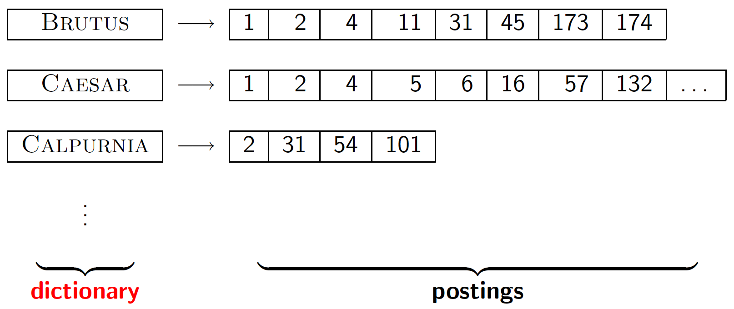
Dictionary Data Structures for Inverted Indexes
The dictionary stores the term vocabulary, document frequency, and a pointer to each postings list
A naïve dictionary: an array of struct
char[20]
int
Postings *
20 bytes
4/8 bytes
4/8 bytes
Two key questions:
• How do we store a dictionary in memory efficiently?
• How do we quickly look up elements at query time?
These questions are answered differently depending on the data structure chosen for the dictionary — hashtables or trees.
Introduction to Information Retrieval — Lecture 3: Dictionaries and Tolerant Retrieval
4

Slide 5
Two Main Choices
Some IR systems use hashtables, some use trees — the right choice depends on the workload
Hashtables or Trees
1
How many keys are we likely to have?
2
Is the number likely to remain static, or change a lot — and if it changes, are keys only inserted, or also deleted?
3
What are the relative frequencies with which various keys will be accessed?
The choice of solution (hashing vs. search trees) is governed by these questions about the vocabulary's size and dynamics.
Introduction to Information Retrieval — Lecture 3: Dictionaries and Tolerant Retrieval
5

Slide 6
Hashtables vs. Trees
Each vocabulary term is hashed to an integer, or placed by a standard character ordering
Hashtables
Trees (Binary Tree, B-Tree)
✓ Lookup faster than a tree: O(1)
✓ Solves the prefix problem (e.g., terms starting with “hyp”)
✗ No easy way to find minor variants (judgment / judgement)
✗ Slower: O(log M) — and this requires a balanced tree
✗ No prefix search — a problem for tolerant retrieval
✗ Rebalancing binary trees is expensive — B-trees mitigate this problem
✗ A growing vocabulary occasionally forces an expensive full rehash
Trees require a standard ordering of characters (and hence strings) — but we typically have one.
(We assume you've seen hashtables before)
Introduction to Information Retrieval — Lecture 3: Dictionaries and Tolerant Retrieval
6

Slide 7
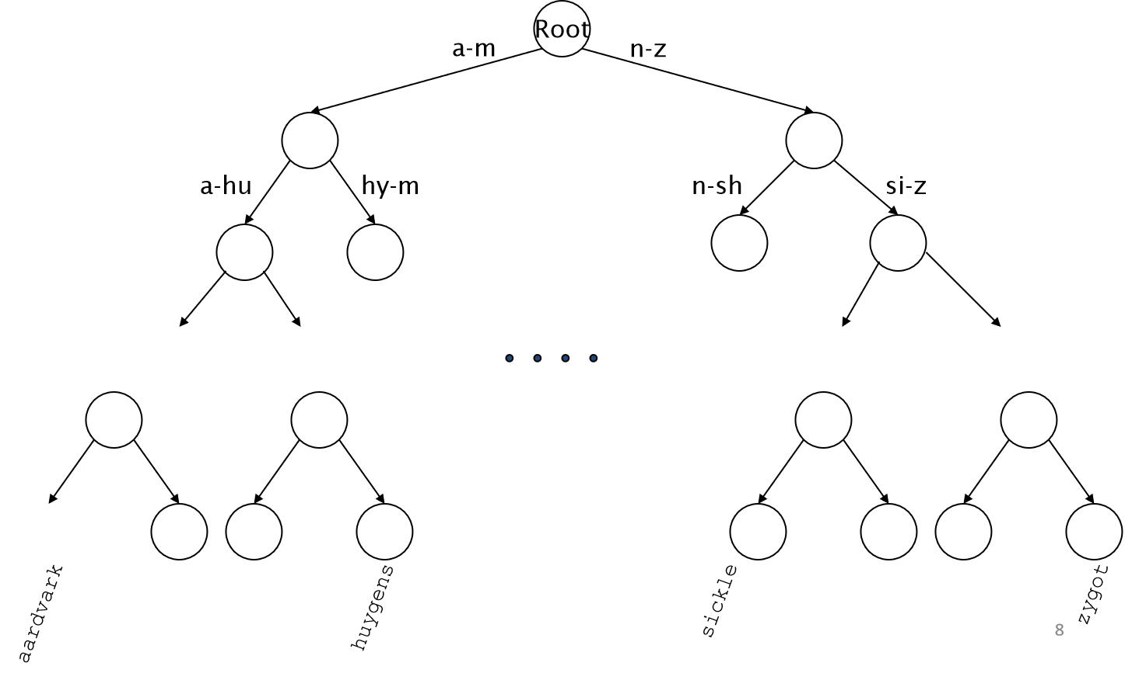
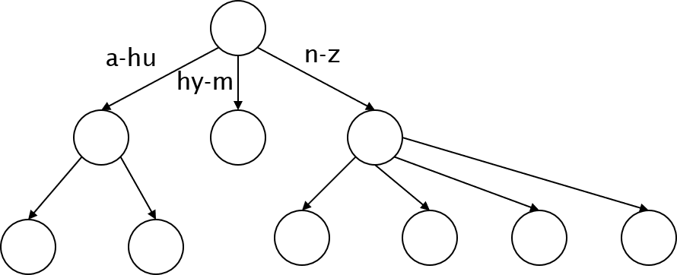
Trees in Practice: Binary Tree & B-Tree
Simplest: binary tree. More usual in practice: B-trees
Binary Tree
B-Tree
Definition: every internal node has a number of children in the interval [a,b], e.g., [2,4].
A variable branching factor lets B-trees stay shallow and balanced with far less rebalancing overhead than a plain binary tree.
Introduction to Information Retrieval — Lecture 3: Dictionaries and Tolerant Retrieval
7

Slide 8
INTRODUCTION TO INFORMATION RETRIEVAL
Wild-card Queries
Answering queries when the user isn't sure of the exact spelling

Slide 9
Why Do We Need Wild-cards?
Four situations where users reach for a wild-card query
Uncertain spelling
Known spelling variants
Sydney vs. Sidney → S*dney
color vs. colour
Unsure if stemming applies
Foreign word / phrase rendition
judicial vs. judiciary → judicia*
Universit* Stuttgart
Introduction to Information Retrieval — Lecture 3: Dictionaries and Tolerant Retrieval
9

Slide 10
Trailing & Leading Wild-cards
Easy with a binary tree (or B-tree) lexicon: just retrieve a range
mon* — Trailing Wild-card
*mon — Leading Wild-card (harder)
Find all docs containing any word beginning with “mon”.
Find words ending in “mon”. Maintain an additional B-tree for terms spelled backwards.
mon ≤ w < moo
nom ≤ w < non
Exercise: how can we enumerate all terms meeting the wild-card query pro*cent ?
Answer: intersect the results of pro* and *cent
Introduction to Information Retrieval — Lecture 3: Dictionaries and Tolerant Retrieval
10

Slide 11
Query Processing After Enumeration
Finding matching terms is only half the job
1
We now have an enumeration of all terms in the dictionary that match the wild-card query.
2
We still have to look up the postings for each enumerated term.
3
This may result in the execution of many Boolean AND queries.
Example query:
se*ate AND fil*er
Each wild-card term may enumerate several matches, so this single query can expand into many AND combinations.
Introduction to Information Retrieval — Lecture 3: Dictionaries and Tolerant Retrieval
11

Slide 12
Middle Wild-cards: The Permuterm Index
co*tion needs a different trick — B-trees only handle *'s at the end
The transform: co*tion → tion$co*
Rewrite the wild-card query so the * always occurs at the end — this gives rise to the Permuterm Index.
For term hello, index under every rotation ($ marks the word boundary):
hello$
ello$h
llo$he
lo$hel
o$hell
$hello
Query | Lookup | Query | Lookup
X | lookup on X$ | *X* | lookup on X*
X* | lookup on $X* | X*Y | lookup on Y$X*
*X | lookup on X$* | X*Y*Z | ??? (exercise)
Introduction to Information Retrieval — Lecture 3: Dictionaries and Tolerant Retrieval
12

Slide 13
Permuterm Query Processing
Rotate the wild-card to the right, then use a B-tree lookup as before
The Permuterm Problem
Query = hel*o
Storing every rotation of every term roughly
X = hel, Y = o
QUADRUPLES
Lookup o$hel*
the size of the lexicon.
The pattern X*Y rotates to Y$X* — a simple trailing wild-card lookup on the permuterm B-tree.
This trade-off motivates the k-gram index, covered next.
Introduction to Information Retrieval — Lecture 3: Dictionaries and Tolerant Retrieval
13

Slide 14
Bigram (k-gram) Indexes
A space-efficient alternative to the permuterm index
Enumerate all k-grams (sequences of k characters) occurring in any term
Maintain a second inverted index mapping each k-gram to the dictionary terms that contain it
e.g., from the text “April is the cruelest month” we get these 2-grams (bigrams) — $ is a special word-boundary symbol:
$a
ap
pr
ri
il
l$
$i
is
s$
$t
th
he
e$
Second inverted index: bigram → matching dictionary terms
mo → among, mortal, mortgage, moth … on → along, among, once, only …
Introduction to Information Retrieval — Lecture 3: Dictionaries and Tolerant Retrieval
14

Slide 15
Processing Wild-cards with k-grams
Query mon* can now be run as a Boolean AND of bigrams
$m AND mo AND on
1
Gets all terms matching the AND version of the wild-card query.
2
But we'd also enumerate false positives — e.g., moon matches all three bigrams but doesn't match mon*.
3
Post-filter the surviving enumerated terms against the actual wild-card pattern.
4
Look up the survivors in the term–document inverted index.
✓ Fast and space-efficient — a big improvement over the permuterm index's ~4x storage blow-up.
Introduction to Information Retrieval — Lecture 3: Dictionaries and Tolerant Retrieval
15

Slide 16
INTRODUCTION TO INFORMATION RETRIEVAL
Spelling Correction
Two flavors of the problem, and three families of techniques

Slide 17
Spelling Correction: Two Principal Uses
The correction task differs sharply depending on where misspellings arise
1. Correcting Documents
2. Correcting Queries
Especially for OCR'd or scanned text — misrecognized characters produce spelling errors.
The most common case, particularly on the web.
Also arises from other recognition problems, e.g. handwriting recognition or speech transcription.
Especially important in interactive systems — users expect instant feedback.
The correction target is the document text itself, before it ever enters the index.
“Did you mean … ?” — even when we don't automatically correct the query, we often want to suggest an alternative.
Introduction to Information Retrieval — Lecture 3: Dictionaries and Tolerant Retrieval
17

Slide 18
Correcting Documents
OCR text is the classic case — errors are systematic, not random
Best technique depends on the source of the error
For scanning errors, the confusion of a “c” and a “t” is likely, but not the confusion of a “c” and a “q”. Character-shape similarity drives the error model.
Manual Approach
Automatic Approach
For heavily used documents, hand-correct errors using standard string-edit techniques.
For deeply scanned collections (e.g., historical or foreign-language material), manual correction is infeasible.
This can also be feasible for the frequently accessed portions of the collection.
Use statistical language models to detect and correct likely OCR errors automatically.
Introduction to Information Retrieval — Lecture 3: Dictionaries and Tolerant Retrieval
18

Slide 19
Correcting Queries
Two contexts in which we correct queries — with a key distinction between them
Isolated-term correction
Context-sensitive correction
Correct each query term on its own, without considering the other terms in the query.
Look at the neighboring words when correcting — a term may be correctly spelled but wrong in this context.
Example: flew form Heathrow
Every term is correctly spelled in isolation — “form” is a real word — but the intended query is almost certainly flew from Heathrow.
For English, spelling correction can be done at ~99% correct word accuracy using statistical language models built from a large corpus of correctly-spelled text.
Introduction to Information Retrieval — Lecture 3: Dictionaries and Tolerant Retrieval
19

Slide 20
Isolated-Term Correction
Basic idea: find the lexicon term closest to a misspelled term
“Closest” can be defined in several ways. We'll consider three:
1 Edit distance
2 Weighted edit distance
3 n-gram overlap
Levenshtein distance — count the minimum number of insertions, deletions, substitutions needed.
Edit distance where the weight of an operation depends on the character(s) involved, using a confusion matrix.
Measure the overlap between the character k-grams of the query term and lexicon term (Jaccard coefficient).
Where does the lexicon come from?
A standard dictionary (e.g., Webster's), or better, an “industry-specific” dictionary hand-built for the domain — or the dictionary of terms actually occurring in the collection being indexed.
Introduction to Information Retrieval — Lecture 3: Dictionaries and Tolerant Retrieval
20

Slide 21
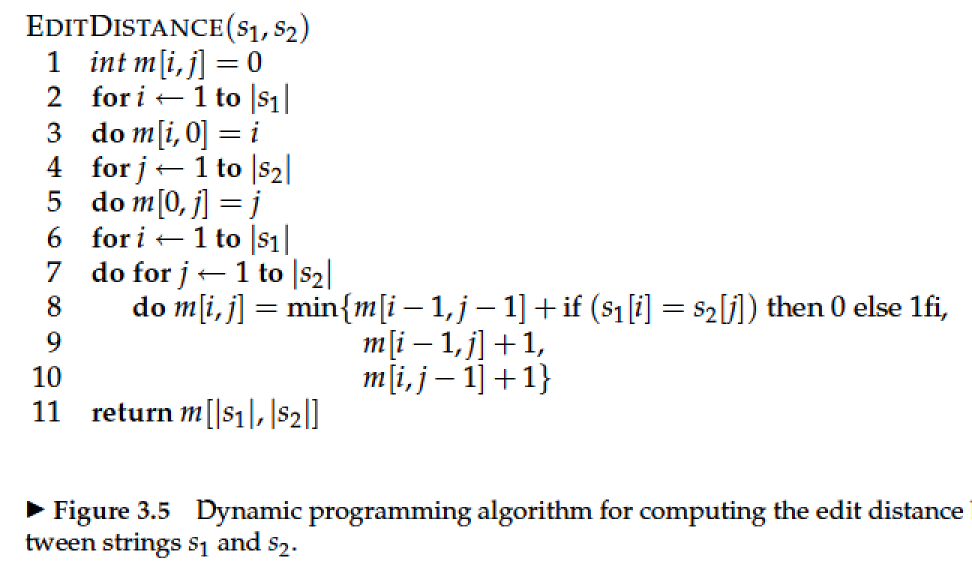
Edit Distance
The number of character edits needed to transform one string into another
Levenshtein Distance
How It's Computed
The minimum number of insertions, deletions, or substitutions needed to transform s₁ into s₂.
Dynamic programming — same idea as computing sequence alignments in bioinformatics.
d(cat, cot) = 1
Build a table of edit distances between all prefixes of s₁ and all prefixes of s₂.
Figure 3.5 — Dynamic-programming algorithm for computing the edit distance between strings s₁ and s₂.
Time complexity O(|s₁| × |s₂|) — quadratic in the string lengths, but each cell only needs its three neighbors.
Introduction to Information Retrieval — Lecture 3: Dictionaries and Tolerant Retrieval
21

Slide 22
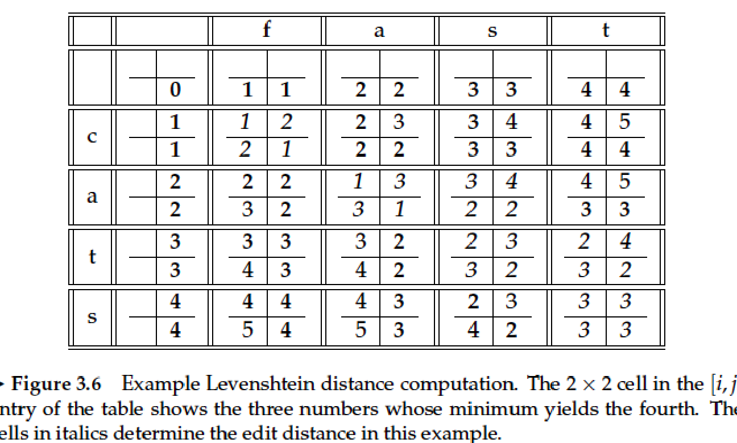
Edit Distance: Computing CATS → FAST
Figure 3.6 — the DP table filled in bottom-up
Reading the Table
Each cell [i,j] holds the edit distance between the first i letters of cats and the first j letters of fast.
The bottom-right cell gives the full edit distance between the two complete strings.
Result
d(cats, fast) = 3
Three edits (a mix of substitutions/insertions along the optimal alignment path) turn cats into fast.
For spelling correction, we scan the lexicon for terms with the smallest edit distance to the query term.
Introduction to Information Retrieval — Lecture 3: Dictionaries and Tolerant Retrieval
22

Slide 23
Weighted Edit Distance
Not all character substitutions are equally likely
The Idea
Two Sources of Weights
The weight of an operation depends on the character(s) involved.
Typing errors: adjacent keys on QWERTY (e.g. “e” ↔ “r”) more likely to be confused
Weights are typically based on the keyboard layout (for typing errors) or letter shape / phonetics (for OCR errors).
OCR errors: visually similar shapes (e.g. “rn” ↔ “m”, “c” ↔ “t”) more likely to be confused
Learned from a confusion matrix built from corpora of actual errors.
Same computation, different weights
The algorithm for computing weighted edit distance is essentially the same as for standard edit distance.
But the weight applied to each substitution / insertion / deletion in the DP recurrence is looked up from the confusion matrix instead of being fixed at 1.
Introduction to Information Retrieval — Lecture 3: Dictionaries and Tolerant Retrieval
23

Slide 24
Using Edit Distances for Correction
How the raw distance number becomes a ranked list of corrections
1
Given query term t, compute its edit distance to every term in the lexicon.
2
Keep only the lexicon terms with the smallest edit distance to t.
3
Show these terms to the user as spelling suggestions, or auto-correct if only one survives.
The Scaling Problem
Computing edit distance to every term in the lexicon for every query term is far too slow for interactive spelling correction over a large collection — we need to shortlist candidates first.
→ This motivates n-gram overlap as a fast pre-filter (next slides).
Introduction to Information Retrieval — Lecture 3: Dictionaries and Tolerant Retrieval
24

Slide 25
Shortlisting Candidates: n-gram Overlap
Use the bigram index (built for wild-card queries) to speed up spelling correction too
Enumerate all the n-grams in the query term.
Use the n-gram index (built earlier for wild-card queries) to retrieve lexicon terms that match a sufficient number of these n-grams.
Threshold using the Jaccard coefficient — measuring set overlap between the query term's n-grams and each candidate term's n-grams.
Jaccard Coefficient
A measure of the overlap of two sets X and Y, computed as the size of their intersection divided by the size of their union. Always between 0 and 1.
J(X, Y) = |X ∩ Y| / |X ∪ Y|
J is 1 when X = Y and 0 when X and Y share no members; J only requires that we deal with a set of small integers (n-gram overlap counts) which is fast to compute.
Introduction to Information Retrieval — Lecture 3: Dictionaries and Tolerant Retrieval
25

Slide 26
Matching Bigrams — Worked Example
How close is the misspelling “bord” to the lexicon term “border”?
Query term: bord
Lexicon term: border
bo
or
rd
bo
or
rd
de
er
Set overlap
X = {bo, or, rd} Y = {bo, or, rd, de, er}
X ∩ Y = {bo, or, rd} → 3 bigrams X ∪ Y = {bo, or, rd, de, er} → 5 bigrams
J(bord, border) = 3/5 = 0.6
A high Jaccard score makes border a strong correction candidate for bord.
Introduction to Information Retrieval — Lecture 3: Dictionaries and Tolerant Retrieval
26

Slide 27
Context-Sensitive Spelling Correction
Isolated-term methods can't catch every error — some errors need the sentence
flew form Heathrow
Neither “flew” nor “form” is misspelled in isolation — the error is only visible from the surrounding words.
One Approach
Exercise
Try all possible resolutions of each spelling error in a phrase — retrieve documents matching each combination.
Given a phrase with two possibly-misspelled terms, how many combinations of resolutions are there in total?
Retain those with the most hits — this exploits the corpus itself as a language model.
(1 + c₁)(1 + c₂) combinations
where cᵢ = number of alternative corrections found for term i. Each term independently keeps its original spelling or swaps to one of its cᵢ candidates, so the counts multiply across terms.
Introduction to Information Retrieval — Lecture 3: Dictionaries and Tolerant Retrieval
27

Slide 28
General Issues in Spelling Correction
Putting the pieces together into a single probabilistic framework
What We Need to Combine
The Noisy Channel Model
How likely is this word confusion? — informed by edit distance and confusion-matrix weights.
Treat the misspelling as the correct word passed through a noisy channel that introduces errors.
argmax P(w) · P(t | w)
How common is the correction term in the language / corpus? — some corrections are intrinsically more likely.
P(w) — prior probability of the correction w occurring (language model).
For query correction, is the correction consistent with the rest of the query?
P(t | w) — probability of typing/observing t given the writer meant w (error/channel model).
Introduction to Information Retrieval — Lecture 3: Dictionaries and Tolerant Retrieval
28

Slide 29
INTRODUCTION TO INFORMATION RETRIEVAL
Soundex
A phonetic matching algorithm — finding words that sound alike, however spelled

Slide 30
Phonetic Correction: Soundex
A class of heuristics for matching names by how they sound, not how they're spelled
The Problem
Classic Example
Soundex is used primarily to correct phonetic misspellings, most often of proper nouns — the same name may legitimately be spelled several different ways.
Chebyshev ↔ Tchebycheff
Two transliterations of the same Russian mathematician's name — very different edit distance, but nearly identical pronunciation.
The Basic Idea
Soundex is a class of heuristics that converts a name (or word) into a code, such that names with similar sounds map to the same code.
Every term is mapped to a 4-character code, based on its pronunciation — then matching is done on the codes, not the raw spelling.
Introduction to Information Retrieval — Lecture 3: Dictionaries and Tolerant Retrieval
30

Slide 31
The Soundex Algorithm
Every term is reduced to a letter followed by three digits
1
Turn every term to be indexed into a 4-character reduced form.
2
Do the same for query terms.
3
Build an index by the reduced forms (as if they were regular index terms).
4
Map query terms to their reduced forms and search on this.
Building the Reduced Form
Retain the first letter of the term.
Change all occurrences of a, e, i, o, u, y, h, w to “0” (zero).
Change letters to digits based on a fixed letter-to-digit mapping (see next slide).
Remove consecutive duplicate digits, then remove all zeros; pad or truncate to three digits after the initial letter.
Introduction to Information Retrieval — Lecture 3: Dictionaries and Tolerant Retrieval
31

Slide 32
Soundex: The Letter-to-Digit Mapping
Letters that sound alike are grouped and mapped to the same digit
Digit | Letters
1 | b, f, p, v
2 | c, g, j, k, q, s, x, z
3 | d, t
4 | l
5 | m, n
6 | r
Why Group These Letters?
Each group contains consonants that are acoustically similar or easily confused in speech / transliteration — e.g., b, f, p, v are all made with the lips.
Vowels (a, e, i, o, u), and also y, h, w, carry little distinguishing consonant sound — so they're dropped (mapped to 0) rather than assigned a digit.
Note
Two adjacent letters with the same code digit are combined into a single digit — this prevents double letters (or near-double sounds) from inflating the code.
Introduction to Information Retrieval — Lecture 3: Dictionaries and Tolerant Retrieval
32

Slide 33
Soundex — Worked Examples
Herman, Hermann, and Barman all reduce to related — or identical — codes
Name | Step-by-step reduction | Soundex Code
Herman | H-e(0)-r(6)-m(5)-a(0)-n(5) → drop 0s, merge dup 5s → H, 6, 5 | H650
Hermann | H-e(0)-r(6)-m(5)-a(0)-n(5)-n(5) → drop 0s, merge dup 5s → H, 6, 5 | H650
Barman | B-a(0)-r(6)-m(5)-a(0)-n(5) → drop 0s, merge dup 5s → B, 6, 5 | B650
Herman and Hermann share the identical code H650 — Soundex correctly treats them as phonetic matches, even though they differ in spelling (edit distance 1).
Barman gets a different first letter (B vs. H), so despite sharing the “650” suffix, it is not conflated with Herman/Hermann.
Introduction to Information Retrieval — Lecture 3: Dictionaries and Tolerant Retrieval
33

Slide 34
How Useful Is Soundex?
A cheap, fast heuristic — but a blunt instrument compared to edit-distance methods
Strengths
Limitations
Extremely fast — reduces matching to exact lookup on a 4-character code.
Soundex is a poor algorithm for general spelling correction — it is too coarse a grouping of consonants.
Works well for the specific case it targets: phonetic variation in proper nouns (esp. surnames).
It was developed for (and is best suited to) English surnames — it doesn't generalize well cross-lingually.
Simple, deterministic, and easy to implement.
It's just one of a family of phonetic matching algorithms; more refined variants exist for other languages / domains.
Introduction to Information Retrieval — Lecture 3: Dictionaries and Tolerant Retrieval
34

Slide 35
INTRODUCTION TO INFORMATION RETRIEVAL
Putting It All Together
How dictionaries, wildcards, and correction combine in a single query pipeline

Slide 36
Bringing It All Together
A single complex query can exercise every technique from this lecture
Query: Sydne* NEAR mother's, day
Sydne*
mother's
day
Wild-card query
Tokenization & normalization
Possible misspelling
Resolved via B-tree range lookup or a k-gram / permuterm index.
Decide how to treat the apostrophe — term equivalence classes from Lecture 2.
If not found, run isolated-term correction using edit distance or n-gram overlap.
Introduction to Information Retrieval — Lecture 3: Dictionaries and Tolerant Retrieval
36

Slide 37
Key Takeaways
The four pillars of tolerant retrieval covered in this lecture
Dictionary Structures
Wild-card Queries
Hashtables give O(1) exact lookup; trees (binary or B-trees) support range queries, prefix search, and wild-cards at the cost of O(log M) lookup.
Trailing/leading wild-cards use B-tree ranges; middle wild-cards need the permuterm index or the far more space-efficient k-gram index.
Spelling Correction
Soundex
Edit distance, weighted edit distance, and n-gram (Jaccard) overlap each define “closest” lexicon term differently — combine with a language-model prior for best results.
A fast phonetic heuristic for proper-noun matching — cheap, but too coarse to replace edit-distance methods for general spelling correction.
Introduction to Information Retrieval — Lecture 3: Dictionaries and Tolerant Retrieval
37

Slide 38
Questions?
Introduction to Information Retrieval — Lecture 3: Dictionaries and Tolerant Retrieval
Based on Manning, Raghavan & Schütze — Cambridge University Press

