Slide 1

CHEM 13 ACTIVITY 3: NAME IT, DRAW IT
LAGUILLES,
Rikki Kirsten M.
BSChE-2A

Slide 2
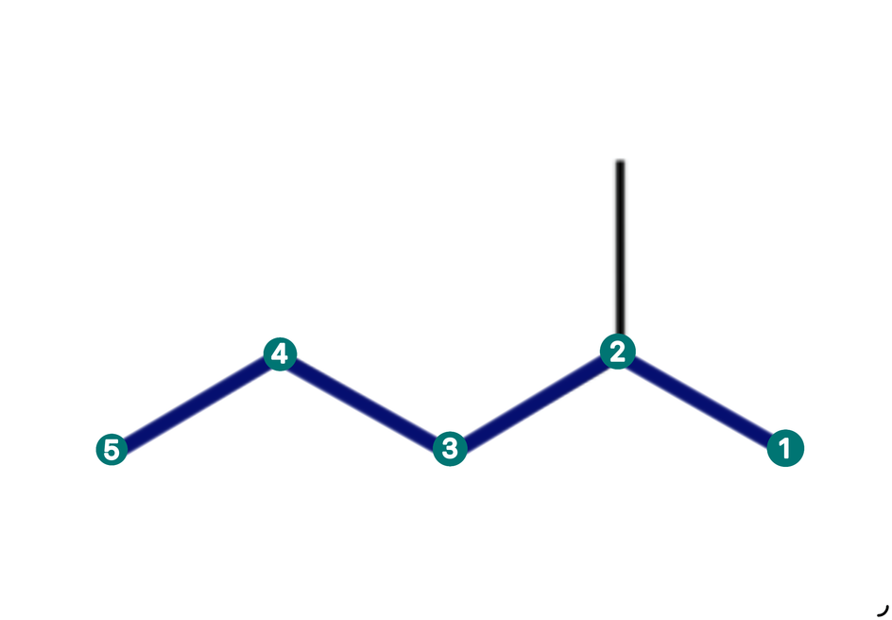
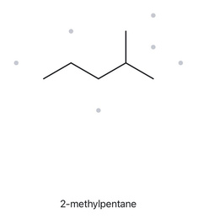

CARD A01
2-METHYLPENTANE
LEVEL: FOUNDATION
MOLECULAR FORMULA: C6H14
  NUMBERED PARENT
  NAMING TAIL
Parent: Pentane (5 C)
Numbering: Right to left; methyl gets 2
Substituents: Methyl at C2
  MY NAME
  THE ALKANE CHECK
Returned name:
2-methylpentane
2-METHYLPENTANE
Match
✓ longest chain confirmed ✓ lowest locants ✓ alphabetical order ✓ punctuation ✓ formula counted

Slide 3
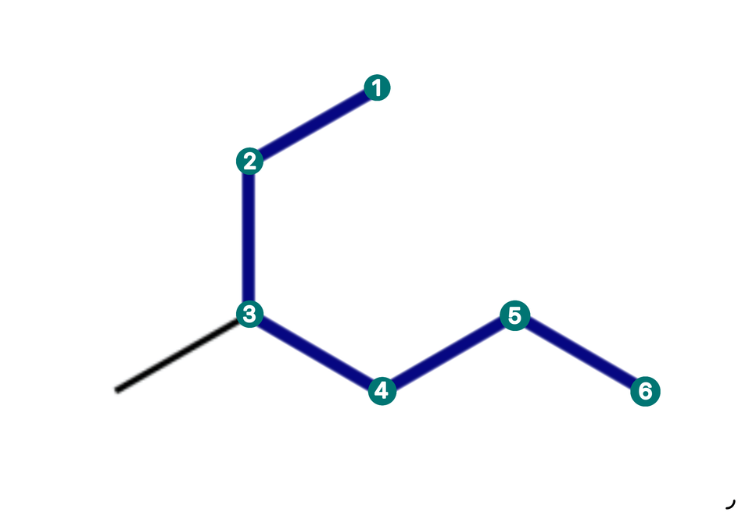
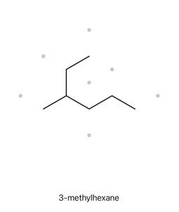
CARD A02
3-METHYLHEXANE
LEVEL: FOUNDATION
MOLECULAR FORMULA: C7H16
  NUMBERED PARENT
  NAMING TAIL
Parent: Hexane (6 C), through upper endpoint, junction, and lower zigzag to right endpoint
Numbering: Upper endpoint to right endpoint; methyl 3 gets 3 (reverse gives 4)
Substituent: Methyl at C3
  MY NAME
  THE ALKANE CHECK
Returned name:
3-methylhexane
3-METHYLHEXANE
Match
✓ longest chain confirmed ✓ lowest locants ✓ alphabetical order ✓ punctuation ✓ formula counted

Slide 4
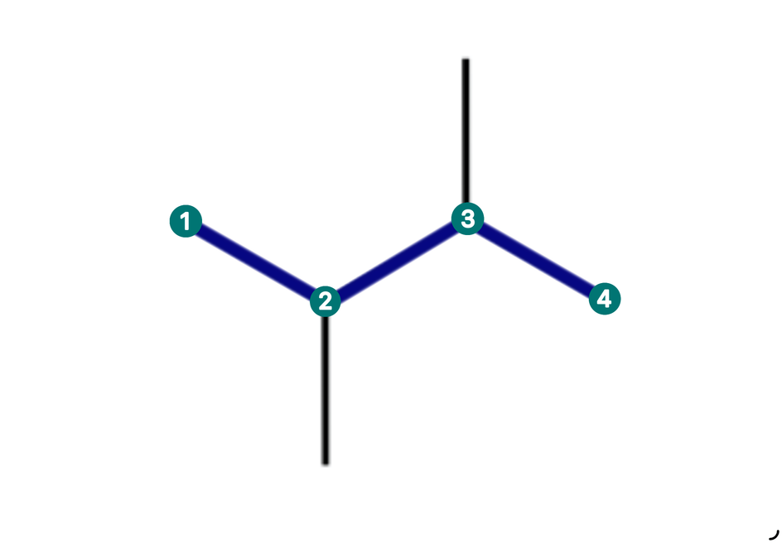
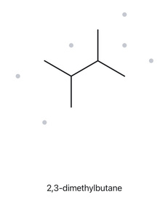
CARD A03
2,3-DIMETHYLBUTANE
LEVEL: FOUNDATION
MOLECULAR FORMULA: C6H14
  NUMBERED PARENT
  NAMING TAIL
Parent: Butane (4 C), through both central junctions
Numbering: Either directions gives 2,3
Substituent: Methyl at C2 and C3; use di-
  MY NAME
  THE ALKANE CHECK
Returned name:
2,3-dimethylbutane
2,3-DIMETHYLBUTANE
Match
✓ longest chain confirmed ✓ lowest locants ✓ alphabetical order ✓ punctuation ✓ formula counted

Slide 5
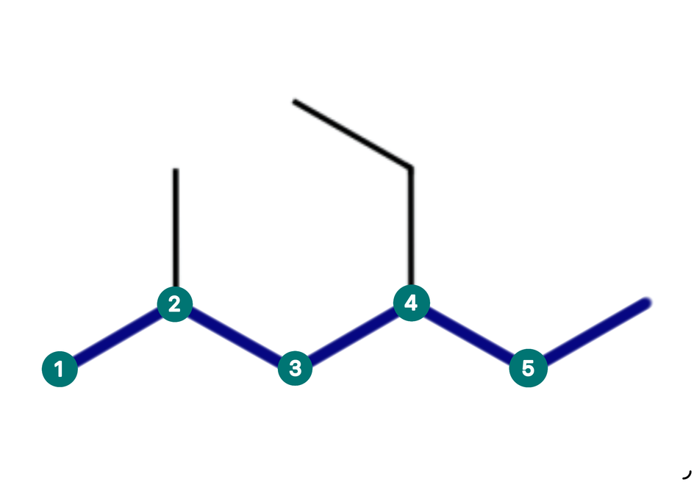
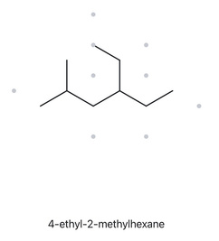
CARD A04
4-EHTYL-2-METHYLHEXANE
LEVEL: DEVELOPING
MOLECULAR FORMULA: C9H20
  NUMBERED PARENT
  NAMING TAIL
Parent: Hexane (6 C), from left terminal through lower zigzag to upper terminal
Numbering: Chosen direction gives 2,4; revenge gives 3,5
Substituent: Methyl at C2; ethyl at C4
  MY NAME
  THE ALKANE CHECK
4-EHTYL-2-METHYL
HEXANE
Returned name:
4-ethyl-2-methylhexane.
Match
✓ longest chain confirmed ✓ lowest locants ✓ alphabetical order ✓ punctuation ✓ formula counted

Slide 6
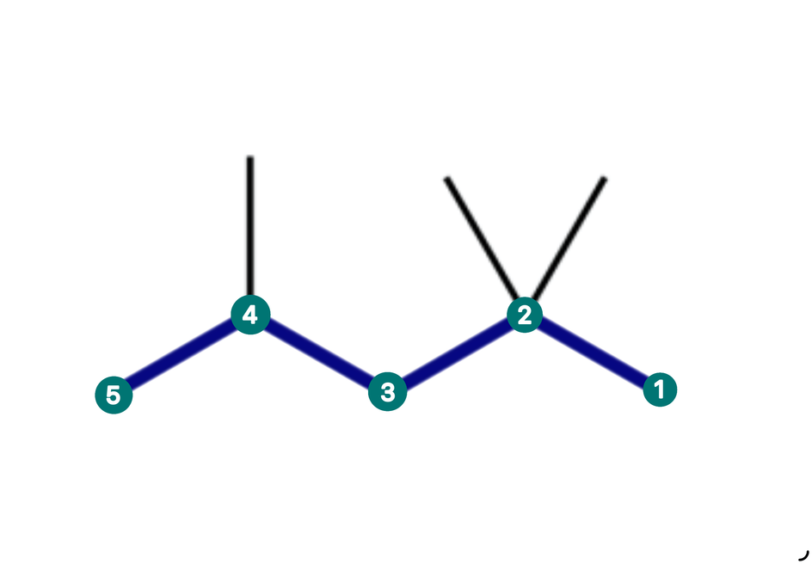
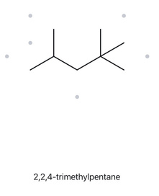
CARD A05
2,2,4-TRIMETHYLPENTANE
LEVEL: DEVELOPING
MOLECULAR FORMULA: C8H18
  NUMBERED PARENT
  NAMING TAIL
Parent: Pentane (5 C), through the highly branched carbon
Numbering: Gives 2,2,4; reverse gives 2,4,4
Substituent: Methyl x2 at C2 and methyl x1 at C4; use tri-
  MY NAME
  THE ALKANE CHECK
2,2,4-TRIMETHYL
PENTANE
Returned name:
2,2,4-trimethylpentane
Match
✓ longest chain confirmed ✓ lowest locants ✓ alphabetical order ✓ punctuation ✓ formula counted

Slide 7
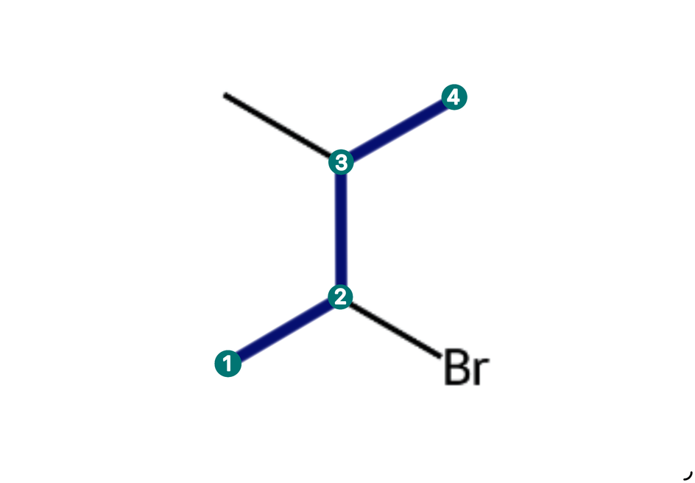
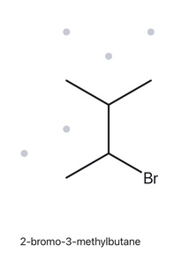
CARD A06
2-BROMO-3-METHYLBUTANE
LEVEL: DEVELOPING
MOLECULAR FORMULA: C5H11Br
  NUMBERED PARENT
  NAMING TAIL
Parent: Butane (4 C)
Numbering: Both direction gives 2,3; alphabetical tie-brake gives bromo the lower locant
Substituent: Bromo at C2; methyl at C3
  MY NAME
  THE ALKANE CHECK
2-BROMO-3-METHYL BUTANE
Returned name:
2-bromo-3methylbutane
Match
✓ longest chain confirmed ✓ lowest locants ✓ alphabetical order ✓ punctuation ✓ formula counted

Slide 8
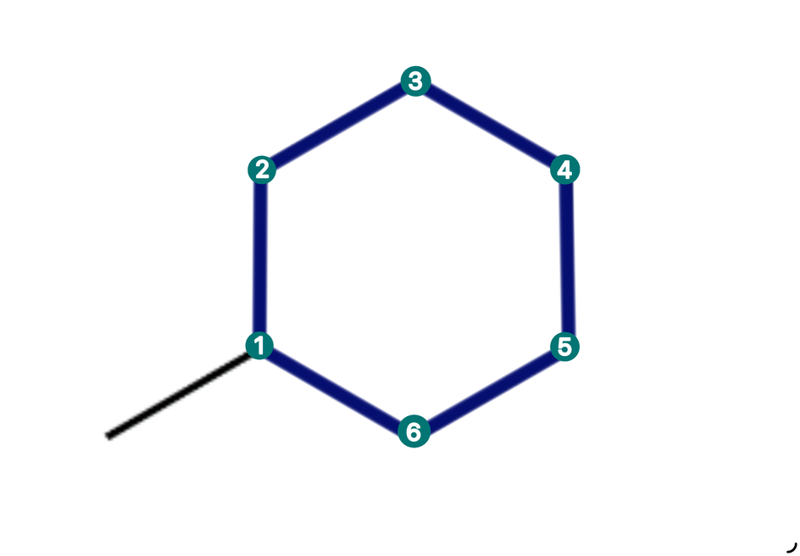
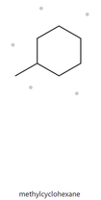
CARD A07
METHYLCYCLOHEXANE
LEVEL: DEVELOPING
MOLECULAR FORMULA: C7H14
  NUMBERED PARENT
  NAMING TAIL
Parent: Cyclohexane ring (6 C)
Numbering: Substituted ring carbon is C1; locant is 1 omitted for a single substituent
Substituent: Methyl at C1
  MY NAME
  THE ALKANE CHECK
Returned name:
Methylcyclohexane
METHYL
CYCLOHEXANE
Match
✓ longest chain confirmed ✓ lowest locants ✓ alphabetical order ✓ punctuation ✓ formula counted

Slide 9
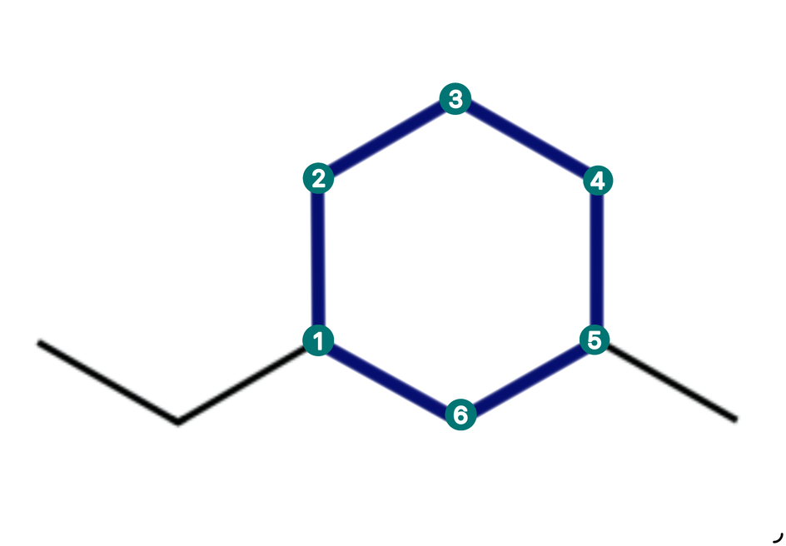
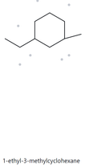
CARD A08
1-ETHYL-3-METHYLCYCLOHEXANE
LEVEL: CHALLENGE
MOLECULAR FORMULA: C9H18
  NUMBERED PARENT
  NAMING TAIL
Parent: Cyclohexane ring (6 C)
Numbering: Either direction gives 1,3; tie-brake assigns C1 to ethyl
Substituent: Ethyl at C1; methyl at C3
  MY NAME
  THE ALKANE CHECK
1-ETHYL-3-METHYL
CYCLOHEXANE
Returned name:
1-ethyl-3-methylcyclohexane
Match
✓ longest chain confirmed ✓ lowest locants ✓ alphabetical order ✓ punctuation ✓ formula counted

Slide 10
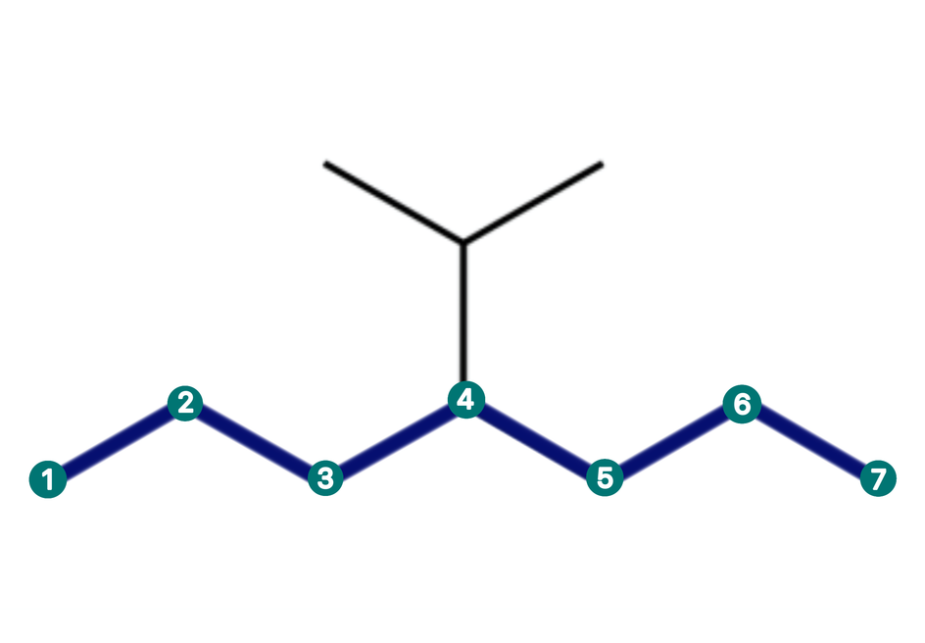
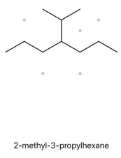

CARD A09
2-(PROPAN-2-YL)HEPTANE
LEVEL: CHALLENGE
MOLECULAR FORMULA: C10H22
  NUMBERED PARENT
  NAMING TAIL
Parent: Heptane (7 C), the lower zigzag
Numbering: Either direction places the branch at C4
Substituent: Propan-2-yl at C4
  MY NAME
  THE ALKANE CHECK
Returned name:
2-methyl-3-propylhexane
2-(PROPAN-2-YL)
HEPTANE
Not the same as the given
name
The site selected 6 carbon parent chain, but IUPAC requires choosing thelongest continuous chain, which has 7 carbons.
✓ longest chain confirmed ✓ lowest locants ✓ alphabetical order ✓ punctuation ✓ formula counted

Slide 11
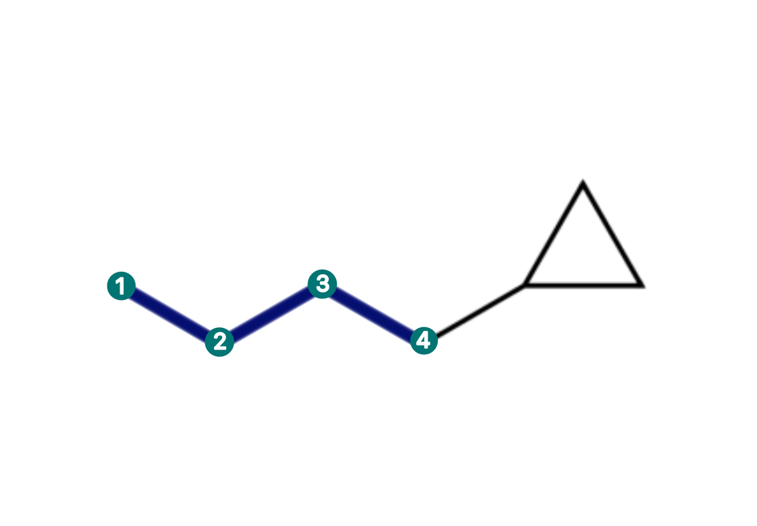
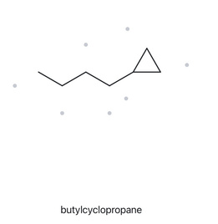
CARD A10
1-CYCLOPROPLYBUTANE
LEVEL: CHALLENGE
MOLECULAR FORMULA: C7H14
  NUMBERED PARENT
  NAMING TAIL
Parent: Butane (4 C); the attached ring has 3 C, so the chain is parent
Numbering: Start at the chain end attached to cyclopropyl; locant 1
Substituent: Cyclopropyl at C1
  MY NAME
  THE ALKANE CHECK
Returned name:
butylcyclopropane
1-CYCLOPROPLY
BUTANE
Not the same as the given
name
The site selected 3-carbon ring as the parent, but the attached open chain has 4 carbons. The longer chain takes priority
✓ longest chain confirmed ✓ lowest locants ✓ alphabetical order ✓ punctuation ✓ formula counted

Slide 12
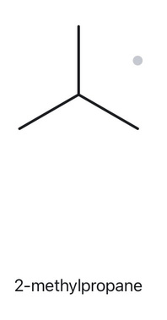
CARD B01
2-METHYLPROPANE
LEVEL: FOUNDATION
  NAME DECODED
  BOND-LINE STRUCTURE (THE ALKANE)
Parent: Propane; a 3-carbon chain
Substituents: Methyl on C2
Expected formula: 3 + 1 = 4 C; open chain to C4H10
  FORMULA CHECK
  BACK-CHECK
Counted from the drawing: C4H10
Returned by The Alkane: 2-methylpropane
Open chain: CnH2n+2 = C4H10
Same as the given name
✓ parent length matches ✓ substituent positions match ✓ formula agrees ✓ back-check recorded
.

Slide 13
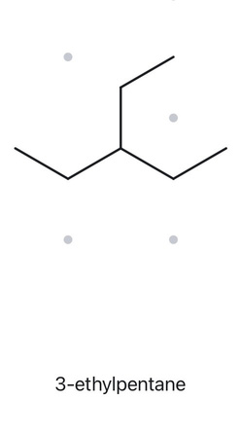
CARD B02
3-ETHYLPENTANE
LEVEL: FOUNDATION
  NAME DECODED
  BOND-LINE STRUCTURE (THE ALKANE)
Parent: Pentane; 5-carbon chain
Substituents: Ethyl on C3
Expected formula: 5+2=7 C; open chain to C7H16
  FORMULA CHECK
  BACK-CHECK
Counted from the drawing: C7H16
Returned by The Alkane: 3-ethylpentane
Open chain: CnH2n+2 = C7H16
Same as the given name
✓ parent length matches ✓ substituent positions match ✓ formula agrees ✓ back-check recorded
.

Slide 14
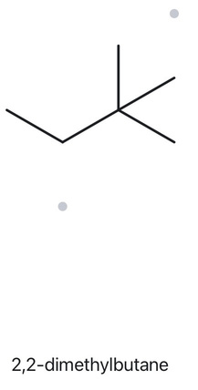
CARD B03
2,2-DIMETHYLBUTANE
LEVEL: FOUNDATION
  NAME DECODED
  BOND-LINE STRUCTURE (THE ALKANE)
Parent chain: Butane; 4-Carbon chain
Substituent: Two methyl, both on C2
Expected formula: 4+2=6 C; open chain to C6H14
  FORMULA CHECK
  BACK-CHECK
Counted from the drawing: C6H14
Returned by The Alkane:
2,2-dimethylbutane
Open chain: CnH2n+2 = C6H14
Same as the given name
✓ parent length matches ✓ substituent positions match ✓ formula agrees ✓ back-check recorded
.

Slide 15
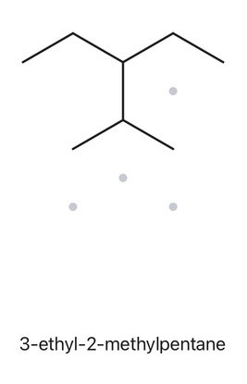
CARD B04
3-ETHYL-2-METHYLPENTANE
LEVEL: DEVELOPING
  NAME DECODED
  BOND-LINE STRUCTURE (THE ALKANE)
Parent chain: Pentane; 5-Carbon chain
Substituents: Methyl on C2; ethyl on C3
Expected formula: 5+1+2=8 C; open chain to C8H18
  FORMULA CHECK
  BACK-CHECK
Counted from the drawing: C8H18
Returned by The Alkane:
3-ethyl-2-methylpentane
Open chain: CnH2n+2 = C8H18
Same as the given name
✓ parent length matches ✓ substituent positions match ✓ formula agrees ✓ back-check recorded
.

Slide 16
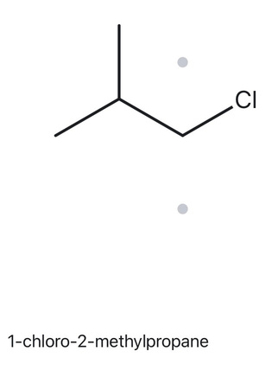
CARD B05
1-CHLORO-2-METHYL. PROPANE
LEVEL: DEVELOPING
  NAME DECODED
  BOND-LINE STRUCTURE (THE ALKANE)
Parent: propane → a 3-carbon chain.
Substituents: chloro on C1; methyl on C3
Expected formula: 3 + 1 = 4 C; open chain →
C4H10; Cl replaces one H → C4H9Cl
  FORMULA CHECK
  BACK-CHECK
Counted from the drawing: C4H9Cl
Open chain: C4H10; minus one H for Cl =
C4H9Cl
Returned by The Alkane:
1-chloro-2-methylpropane
Same as the given name
✓ parent length matches ✓ substituent positions match ✓ formula agrees ✓ back-check recorded
.

Slide 17
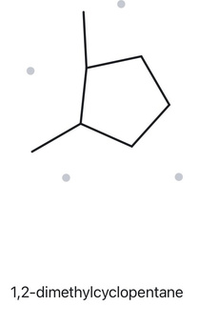
CARD B06
1,2-DIMETHYLCYCLOPENTANE
LEVEL: DEVELOPING
  NAME DECODED
  BOND-LINE STRUCTURE (THE ALKANE)
Parent: cyclopentane → a 5-carbon ring.
Substituents: methyl on C1; methyl on C2.
Expected formula: 5 + 2 = 7 C; one ring →
C7H14
  FORMULA CHECK
  BACK-CHECK
Returned by The Alkane:
1,2-dimethylcyclopentane
Counted from the drawing: C7H14
One ring: CnH2n = C7H14
Same as the given name
✓ parent length matches ✓ substituent positions match ✓ formula agrees ✓ back-check recorded
.

Slide 18
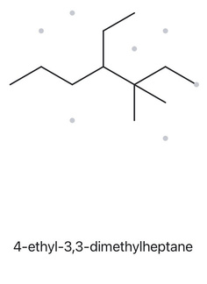
CARD B07
4-ETHYL-3,3-DIMETYLHEPTANE
LEVEL: DEVELOPING
  NAME DECODED
  BOND-LINE STRUCTURE (THE ALKANE)
Parent: heptane → a 7-carbon chain.
Substituents: two methyls on C3; ethyl on C4.
Expected formula: 7 + 2 + 2 = 11 C; open
chain → C11H24
  FORMULA CHECK
  BACK-CHECK
Counted from the drawing: C11H24
Open chain: CnH2n+2 = C11H24
Returned by The Alkane:
4-ethyl-3,3-dimethylheptane
Same as the given name
✓ parent length matches ✓ substituent positions match ✓ formula agrees ✓ back-check recorded
.

Slide 19
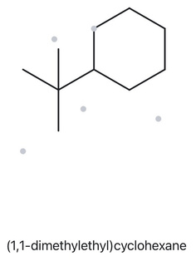
CARD B08
TERT-BUTYLCYCLEHEXANE
LEVEL: CHALLENGE
  NAME DECODED
  BOND-LINE STRUCTURE (THE ALKANE)
Parent: cyclohexane → a 6-carbon ring.
Substituents: tert-butyl on C1 (a carbon
bearing three methyls, 4 C in total).
Expected formula: 6 + 4 = 10 C; one ring →
C10H20
  FORMULA CHECK
  BACK-CHECK
Counted from the drawing: C10H20
One ring: CnH2n = C10H20
Returned by The Alkane:
(1,1-dimethylethyl)cyclohexane
Same compound, different accepted
substituent name. “tert-butyl” is the common name; “1,1-dimethylethyl” is its systematic name (an ethyl with two methyls on its C1).
✓ parent length matches ✓ substituent positions match ✓ formula agrees ✓ back-check recorded
.

Slide 20
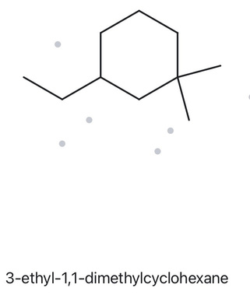
CARD B09
3-ETHYL-1,1-DIMETHYLCYCLOHEXANE
LEVEL: CHALLENGE
  NAME DECODED
  BOND-LINE STRUCTURE (THE ALKANE)
Parent: cyclohexane → a 6-carbon ring.
Substituents: two methyls on C1; ethyl on C3.
Expected formula: 6 + 2 + 2 = 10 C; one ring
→ C10H20
  FORMULA CHECK
  BACK-CHECK
Counted from the drawing: C10H20
One ring: CnH2n = C10H20
Returned by The Alkane:
3-ethyl-1,1-dimethylcyclohexane
Same as the given name
✓ parent length matches ✓ substituent positions match ✓ formula agrees ✓ back-check recorded
.

Slide 21
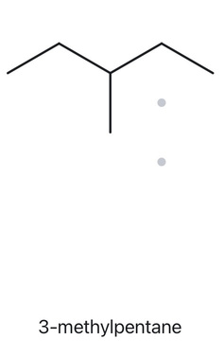
CARD B10
2-ETHYLBUTANE
LEVEL: CHALLENGE
  NAME DECODED
  BOND-LINE STRUCTURE (THE ALKANE)
Parent: Pentane chain → a 5-carbon chain (as given).
Substituents: methyl on C3.
Expected formula: 4 + 2 = 6 C; open chain → C6H14
  FORMULA CHECK
  BACK-CHECK
Counted from the drawing: C6H14
Open chain: CnH2n+2 = C6H14
Returned by The Alkane:
3-methylpentane
IUPAC nomenclature requires selecting the longest continuous carbon chain as the parent. The structure has a five-carbon chain, not four, leaving a methyl substituent at C3. Therefore, the correct name is 3-methylpentane.
✓ parent length matches ✓ substituent positions match ✓ formula agrees ✓ back-check recorded
.

