Slide 1
Investigating techniques to improve the performance of genetic algorithms used to train neural networks
Cameron Soulsby
Honours Dissertation Proposal

Slide 2
Introduction
Imagine we want to program a robot to dispose of mines from a mine field, using information on the position of the closest mine to navigate.
We could write code to direct the robot toward the nearest mine.
What happens if we want to change the behaviour of the robot, say to avoid certain types of mine?
Notes:
If we want to change the behaviour, we would need to re-program the robot. If the problem becomes more complex, this task may become difficult.

Slide 3
We want a system which will allow the robot to make decisions based on inputs, and to learn new behaviours.
A neural network can be used as the robot’s ‘brain’. This can allow a complex non-linear mapping of inputs to outputs, and the neural network can be trained to provide different behaviour.

Slide 4
Neural Networks
Neural networks are an optimization and learning technique inspired by research into the nature of the brain.
Feedforward neural networks are a common and simple form of neural network, used in a wide range of applications.

Slide 5
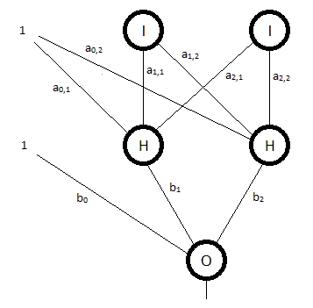
Diagram of a simple feedforward neural network
Notes:
This is just one example of a feedforward neural network. The number of layers and neurons will vary.
Describe operation of the neural network:
We have and input layer, a hidden layer, and an output layer.
We have two inputs, and also a bias, which helps to account for variation not attributed to inputs.
Each connection has a weight associated with it.
The hidden neurons take the weighted sum of inputs, processed by a transfer function (commonly sigmoid function, such as logistic).
This creates and output from each hidden node.
The output nodes also take the weighted sum of their inputs, and process the result with a transfer function (linear or non-linear).
This provides a mapping of inputs to outputs, with the non-linear transfer function of the hidden nodes allowing highly non-linear mapping.
In our tank example, we may have two input nodes, which give the relative position of the nearest mine to the robot.
We would have two output nodes in this case, which determined the speed of each of the tracks, controlling the direction and speed of movement.

Slide 6
Learning
The weights of the neural network are usually initialised randomly. At this point, it is unlikely that the network will perform as desired.
Training neural networks involves adjustment of the connection weights.
Commonly, supervised learning methods are used.
This requires that target outputs are known.
Notes:
Describe supervised learning methods:
Input data is presented to the network, along with the target output.
The actual output of the network is compared with the target output
The error in the output of each output node is used to adjust the weights.
Each weight is adjusted in a direction which will help to reduce the output errors (Won’t go in to detail of how).

Slide 7
Training the robot
In the example described, the specific target outputs are not known, so supervised learning techniques are not suitable.
In this type of situation, a genetic algorithm can be used to train the neural network.
Notes:
Outputs not known because we can only know how well the robot performs after simulation.

Slide 8
Genetic Algorithms
Genetic algorithms are another form of optimization algorithm, also based on a biological process.
They mimic the process of natural evolution, using techniques such as:
Inheritance
Mutation
Selection
Crossover
Notes:
Describe basic idea – we have generations, and new candidate solutions are created from the fittest individuals in a previous generation.
Describe what each technique is briefly.

Slide 9
Elements of a genetic algorithm
Encoding to get representation of solution
Initialisation of population
Fitness evaluation
Recombination/mutation operators
Parameter settings
How can this be applied to our example?
Notes:
Describe the five components as they relate to the tank example.

Slide 10
Genetic algorithm diagram
I am working on this diagram now,
Will show two networks, with their encoded genome. The genomes will then be crossed and mutated, to get a new genome, and the will be decoded to new network…

Slide 11
Example

Slide 12
Problems which arise
Traditional crossover methods may be inefficient
Representation method
Functional units broken by standard crossover
Permutation problem
Local maxima may lead to sub-optimal solutions
Large computation requirements
Notes:
Describe how representation is important – will affect which genetic material is shared using standard crossover techniques.
Explain how ‘function units’ can be broken. Flick back to last slide to show how a neurons inputs weights are split.

Slide 13
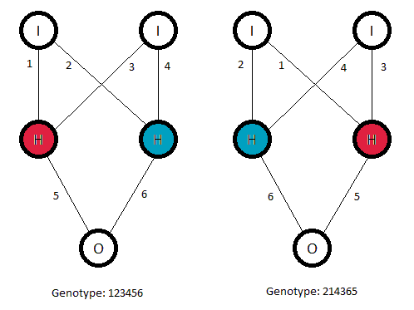
The ‘permutation problem’

Slide 14
Objective
Investigate techniques to improve the performance of genetic algorithms in training neural networks.
The following areas will be investigated:
Crossover/mutation methods
Parallel genetic algorithms
Distributed computing
Notes:
Explain parallel genetic algorithms, how they may help reduce problems with local minima/maxima. Add diversity through speciation.

Slide 15
Previous work
Genetic algorithms are commonly used with neural networks, both to train weights and to evolve network topology.
Several crossover methods have been developed to attempt to reduce problem described above. David Montana (1989) tested a range of different crossover and mutation techniques in a genetic algorithm for training a neural network.
Parallel genetic algorithms have been shown to reduce problems caused by local maxima.
Distributed computing has been used in training neural network with supervised learning methods, providing significant speed-ups.
Notes:
I will not be considering network topology evolution.
Montana’s work may be useful, and may be extended with more processing power available.

Slide 16
Implementation and testing
Develop test problem and measure initial performance.
Implement new recombination/mutation methods and compare performance
Node-level crossover
Mutation within nodes
Rearrangement of node order to overcome permutation problem
Notes:
Describe requirements of test problem:
- Must require simulation to evaluate fitness.
Must be complex enough to require significant computation time.
New methods – these are just a few that may be trialled.

Slide 17
Implementation and testing
Test different types of parallel genetic algorithms and compare performance.
Number of populations
Population size
Migration rates
Investigate gains from distributed computing
Using condor to harness power of computers in labs on campus.

Slide 18
Evaluation
Evaluate the performance gains achieved from implementing different techniques.
Possible measures may include:
Quality of final solutions
Number of generations to reach a desired fitness
Clock time taken to reach a desired fitness
Notes:
‘Final’ may mean after the population has not improved for a certain amount of time.
Number of generations will show improvements in genetic algorithm, clock time will show gains from distributed computing.

Slide 19
Thank you for your time
Questions?

