Slide 1

Investigating interactive visualization in a cloud computing environment.
Johari Abdullah
Supervisors:
Stuart Charters
Walt Abell
12 August 2010

Slide 2

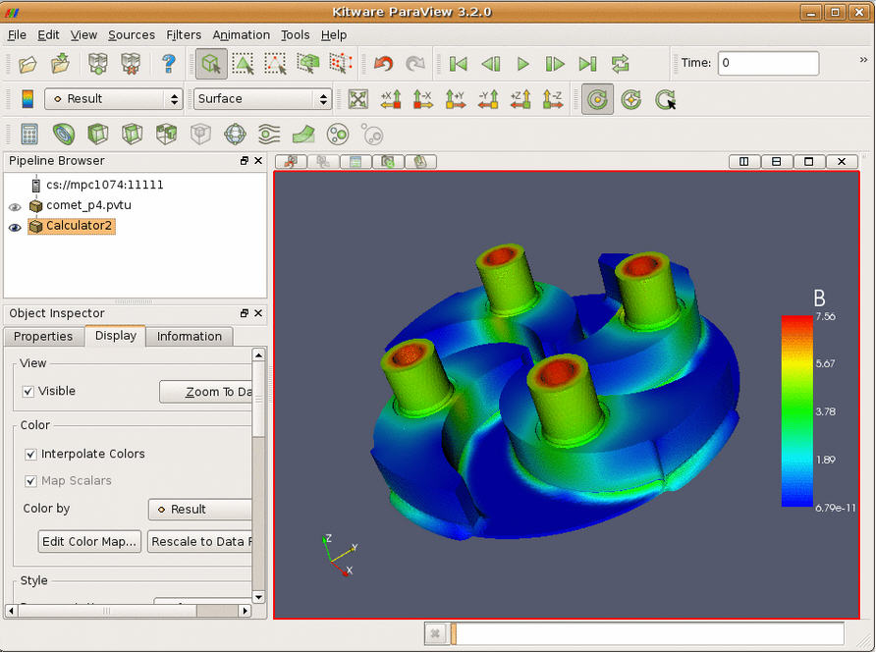

The Problem
Visualization – as dataset size increases, there can be delays in getting the results unless users upgrade their processor or memory.
Notes:
Tell a story. Scientist doing viz on their desktop. Now the data is very big. They couldn’t visualize using their desktop anymore.

Slide 3
Objective
The objective of this study is to investigate if interactive visualization is possible in a cloud computing environment.
“Cloud”

Slide 4
Background
Visualization can be process & memory intensive, therefore better hardware are needed to process large dataset.
Cloud Computing can offer more powerful processing than available on desktops.
Virtualization technologies (VMWare, Sun VirtualBox, KVM).
Auckland BeSTGRID – Cloud Computing on a Grid Infrastructure.
Notes:
Cloud Computing is based on virtualization technologies. Example, VMWare, Sun VirtualBox.
Talk about Virtual Machines.
Grid – introduce Auckland. Cloud on Grid infra.

Slide 5
User requirements
Users need to do interactive visualization.
Dataset often requires more CPU/memory than they have locally.
Users want to do visualization at their desktop.
Users want to do visualization whenever they are ready (“on-demand”).
Notes:
This is a summary of the story I told ealier.

Slide 6

How Cloud Computing can solve our problem?
Upgrade hardware – not enough
Local viz clusters – too expensive
Remote HPC/Grid – not interactive
Cloud Computing:-
  Efficient: remote visualization
  Scalability: CPU/memory/storage
  Cost: pay as you go
  Interactive
Notes:
Options for the users. Never enough processing power to upgrade hardware.

Slide 7








What is Cloud Computing
SAAS
PAAS
IAAS
Amazon EC2
Notes:
Compare & relate each stage:-
Software as a Service – on-demand access to any application.
Platform as a Service – platform for building and delivering web applications (on the server)
Infrastructure as a Service – delivery of a raw computer infrastructure (provide the server)
Amazon EC2 (Elastic Compute Cloud) – Cluster Compute instances for HPC applications only available recently, 13 July 2010 (http://aws.amazon.com/).
Amazon EC2 server in USA, while Auckland BestGrid in NZ (also supported by KAREN high speed network).
BeSTGRID – Broadband enabled Science and Technology GRID
We would use Auckland BestGrid infra – offer Paraview as PAAS.

Slide 8
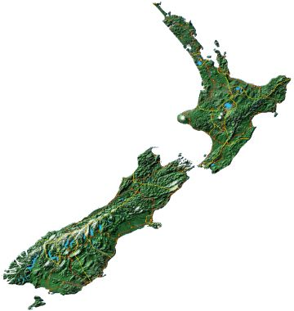
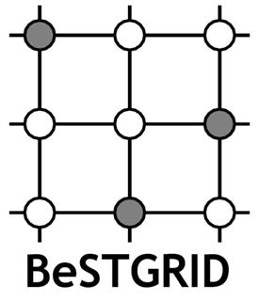


Notes:
BeSTGRID – Broadband enabled Science and Technology GRID
KAREN – Kiwi Advanced Research & Education Network
KAREN high speed network, 10GB/s: from desktop to LU switch (100MB/s), from LU to KAREN (1GB/s).

Slide 9
Proposed Approach
Use Cloud Computing environment provided by University of Auckland.
Use ParaView visualization software to test interactive visualization.
Deploy ParaView in the Cloud and access from the standard desktop in Lincoln University.

Slide 10


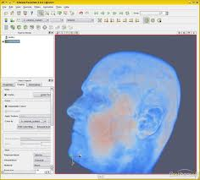
What we want
(1) Load data
VM – ParaView Server
(2) Render data
(4) Display result
(3) Get result
ParaView Client
Notes:
Explain what ParaView is….

Slide 11
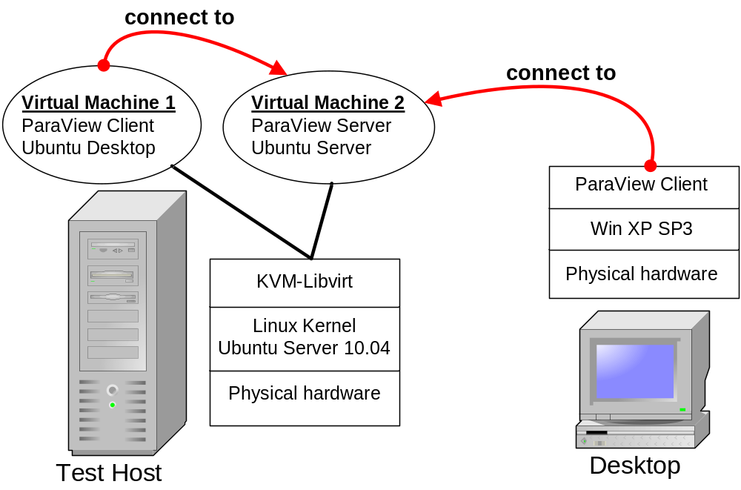
Initial Test Setup
Notes:
Running a version of Linux similar to Auckland.
Test if we can link them (internal network).
Test firewall and networking.

Slide 12
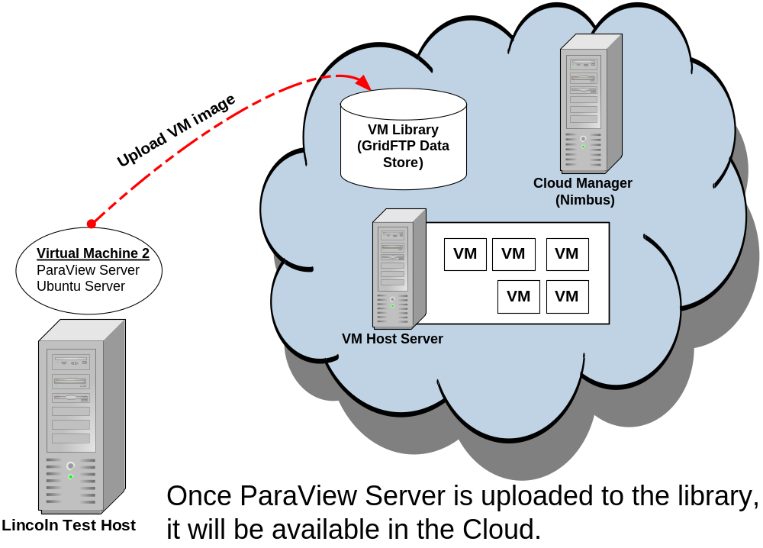
Deploying ParaView to the Cloud

Slide 13
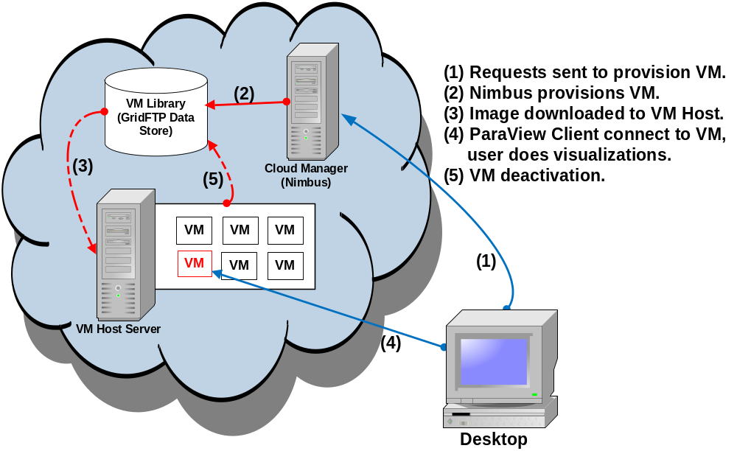
Visualization in the Cloud
Notes:
Provisioning means assigning appropriate hardware (CPU/memory) to the VM, then choosing the Image.
Every user will get a fresh copy of the Image.

Slide 14
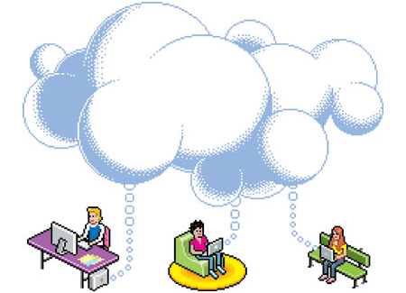
Evaluation
Does remote visualization in the Cloud work? If not, what are the problems?
Any delays in “on-demand” provisioning?
Is the process user-friendly?
Notes:
Network - can connect to the Cloud? Performance - test with a dataset that couldn’t be visualize on the desktop.
Test on how “on-demand” it is.
Self evaluation. Is it easy for the user who knows ParaView to use Cloud?

Slide 15
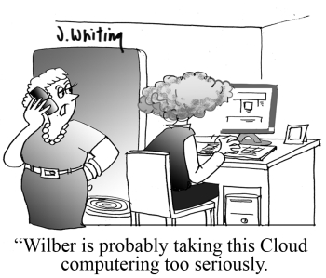
Thank you

