Slide 1

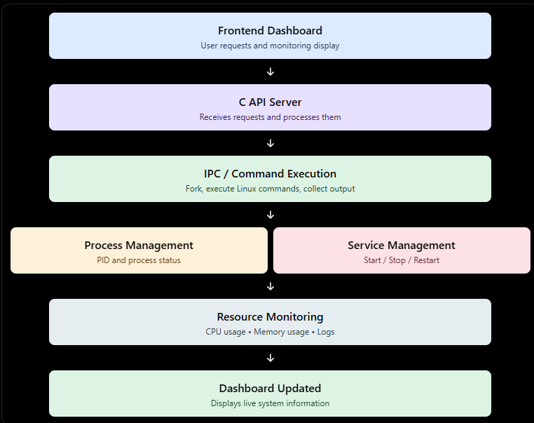
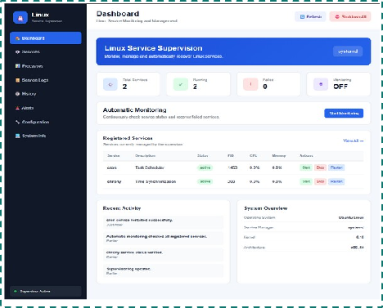
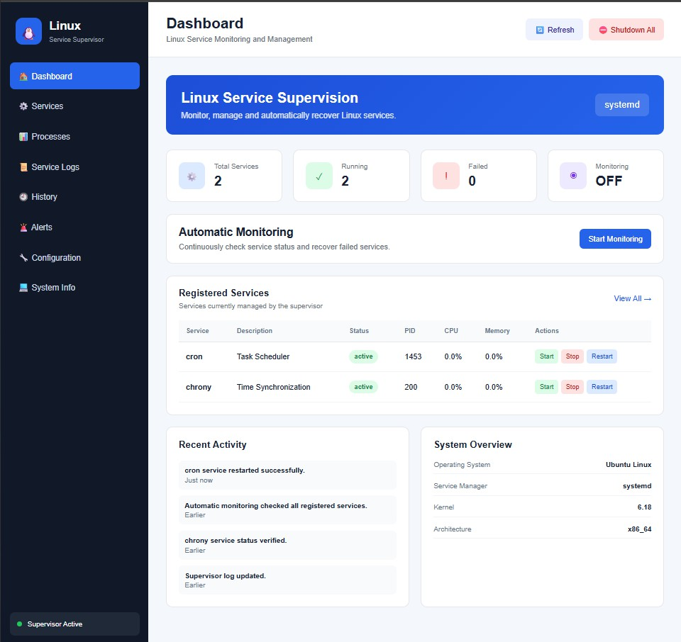
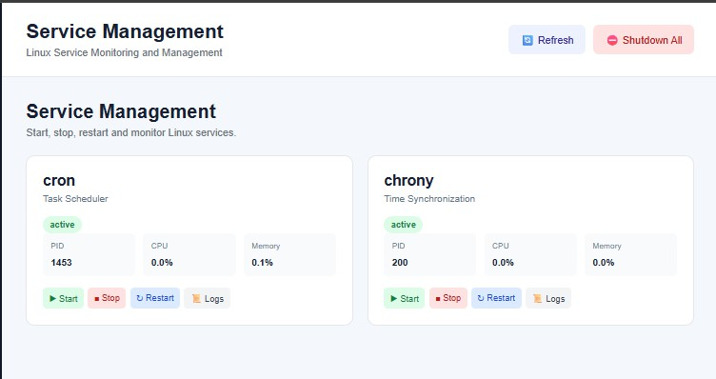

KLH BACHUPALLY
LINUX SERVICE SUPERVISOR
Team ID: 19 | Section: 9
Members: GS. Hasini – 2500030238 | R. Pravalika – 2520030402 | K. Rishitha – 2520030202 Guide: Harika
Operating Systems and Systems Programming (OSSP) | KLH Bachupally Campus, CSE | PBL 2026–27
Abstract
Tools & Technologies
•
Linux services often need continuous monitoring and quick recovery when they stop. This project provides a browser-based interface to view and manage registered services, inspect processes and read service logs using a C HTTP backend and Linux commands.
•
Programming: C, HTML, CSS and JavaScript.
Platform: Ubuntu Linux running in WSL.
Outcome: a single dashboard for service status, service actions, process details and alerts.
OS concepts: Processes, process creation, command execution, waiting, service management and resource monitoring.
System interfaces: socket(), bind(), listen(), accept(), recv(), send(), fork(), exec(), waitpid(), popen().
Tools: GCC, VS Code, Chrome and Linux system utilities.
Problem Statement & Objectives
•
Problem: Managing Linux services through separate terminal commands makes monitoring less convenient.
System Workflow / Architecture
Objective 1: Display live status, PID, CPU and memory details for registered services.
Objective 2: Start, stop and restart services through a web interface.
USER INTERFACE • Browser
Dashboard | Service Management | Process Monitor | Logs | Alerts
BACKEND • C HTTP API Server (127.0.0.1:8080)
GET /api/services • POST /api/service • GET /api/processes • GET /api/logs
LINUX OPERATING SYSTEM
systemctl → cron / chrony | ps → running processes
journalctl → service logs | tail → supervisor.log
CONFIGURATION & LOG FILES
services.conf • logs/supervisor.log
Objective 3: View process information and service logs; show alerts for inactive/failed services.
Scope: Ubuntu/WSL, registered services cron and chrony, process listing and log viewing.
Existing vs Proposed System
Aspect | Basic / Existing | Proposed Project
Service handling | Run commands manually | Web controls call systemctl
Monitoring | Check status separately | Dashboard reads service status
Process view | Use ps in terminal | Process table in browser
Logs | Run journalctl manually | Filter cron / chrony / supervisor logs
Failure visibility | Notice manually | Inactive/failed status creates alert
Process, IPC & Resource Design
Browser action
↓ HTTP request
C server accepts client socket
↓
Validate service / action
↓
Run Linux command or service action
↓
Collect command output / exit status
↓ HTTP response
Update dashboard, process table, logs or alerts
No shared-memory or custom pipe/FIFO module is claimed.
Feasibility Study
•
Technical: C, GCC, Ubuntu/WSL, sockets, fork(), exec(), waitpid(), popen(), systemctl, ps and journalctl.
Implementation Screenshots
Economic: Uses open-source software and existing computer hardware; no paid hosting required for local demo.
Operational: Browser interface simplifies common service tasks; service actions require configured sudo permissions.
Schedule: Design → backend API → frontend integration → logs/alerts → final testing.
API / TEST EVIDENCE
GET /api/services → HTTP 200 cron: active
chrony: active
Process list retrieved using ps.
Logs filtered by cron, chrony and supervisor.
Results & Testing
Conclusion
Future Scope
Add periodic background monitoring and recovery with safer policy controls.
Add authentication, role-based access, more registered services, exportable reports and improved alert history.
•
Observed: cron and chrony reported active; dashboard showed PID/CPU/memory fields. Process API returned Linux process entries. Log API returned service-specific journal entries.
•
Implemented a web-based Linux service supervisor with a C backend and browser frontend. It connects service management, process monitoring and log viewing in one interface, demonstrating Linux process and system-programming interfaces.
Tests: service status retrieval, process retrieval, cron/chrony log filtering, supervisor log-file reading and service restart.
https://github.com/rikkipravalika07-dot/KLH-CSE-2026-19-LinuxServiceProcessSupervisor/tree/main
DEMO URL

