Slide 1
COMP6005 IES
Game Project
Rikki Prince
Emma Lee-Choon

Slide 2
Project Brief
3-D platform maze game
Player is a ball that rolls on the platforms
Goal is to get to the exit point of the maze
Strategy
Feedback

Slide 3
Plans for Our Game
Collision detection
3D models of the ball and obstacles
Create levels of increasing difficulty, using size of platform/length of level, varying obstacles, strategy to get around maze to the goal.

Slide 4
Technical Challenge
Control using Nintendo Wii controllers
Tilt Wiimote to control direction of the ball
Connects to PC using Bluetooth
Implements HID interface
Using a library from http://www.wiili.org/index.php/Wiimote

Slide 5
Decisions to be made
Sensitivity of controls
Speed of ball
Level of difficulty
Obstacles to put in
Collectibles?

Slide 6
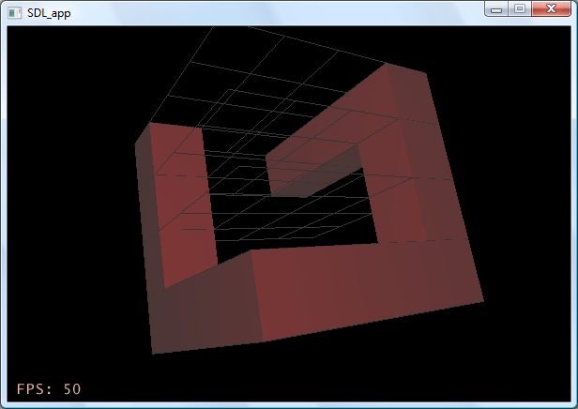
What we’ve done so far…
Extended the GridFrame structure to make a 3D block based world.

