Slide 1
Functional Data Analysis Regression
Li sun
11/30/2015

Slide 2
Index
Background
Functional data representation
Smoothing
Description of smoothing functions
Functional Linear Models for Scalar Responses
Linear Models for Functional Responses
Reference

Slide 3
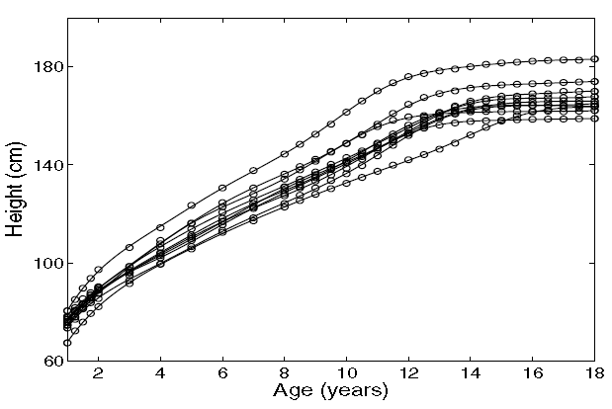
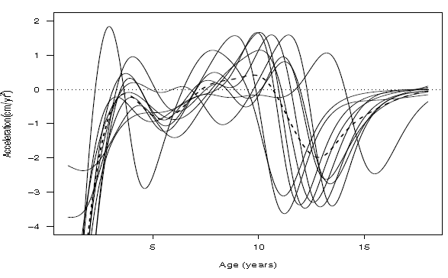
Background
What is functional data analysis?
Collection of techniques to model data from dynamic systems
Multivariate data with infinite and ordered features

Slide 4
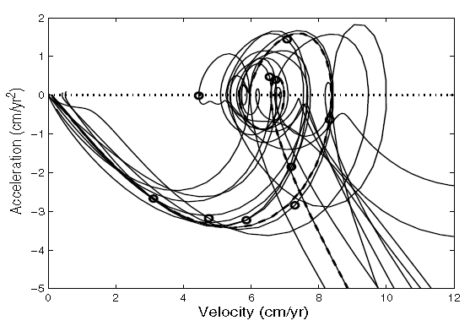
Why fda?
Reflect nature of some data types
Study of derivatives
Handling observations with different length
Phase plane plots
D¹ vs D²
Help understanding cyclic nature

Slide 5
Assumptions
Underlying functions is continuous and smooth(Ds exist)
y(j) and y(j+1) are linked to some extent. Or treat data as multivariate

Slide 6
ANATOMY OF A FUNCTION
Feature
levels, crossing, peaks/valleys
Data Resolution (n) and Functional dimensionality
Total amount of information required to define it as demanded
Size (N)

Slide 7
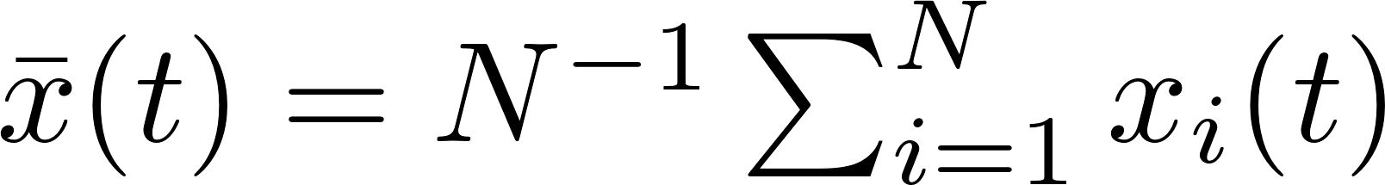
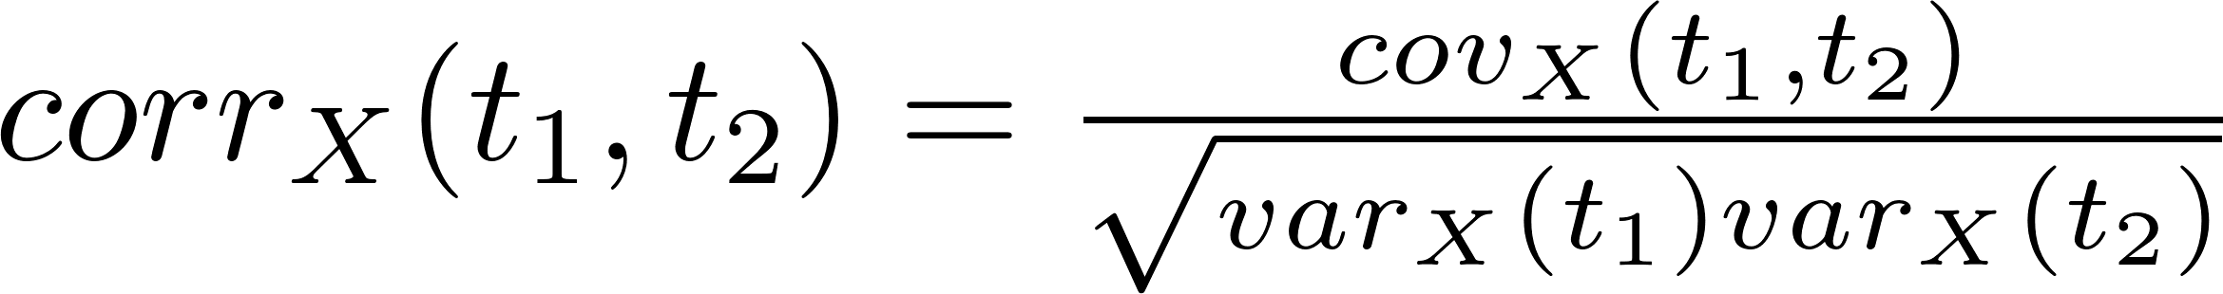
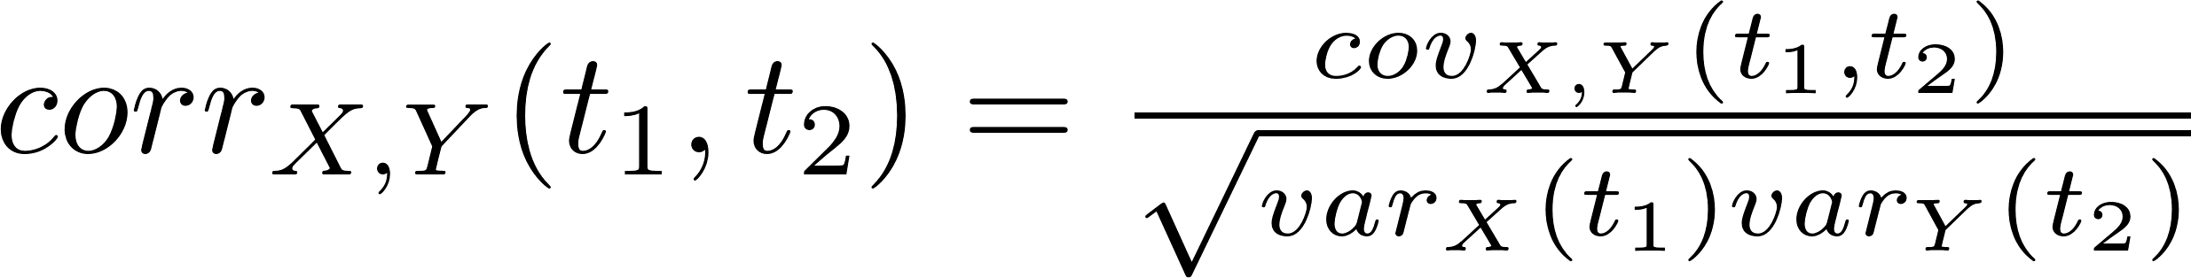
FD Representation
Mean
Variance
Covariance
Correlation
Cross-covariance
Cross-correlation

Slide 8
From Data to Function (Smoothing)
Basis functions combination
Powers (Polynomials)
Fourier (More suitable for periodic data)
B-spline
wavelet

Slide 9

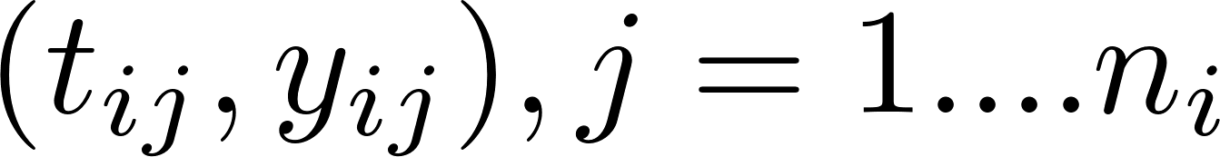
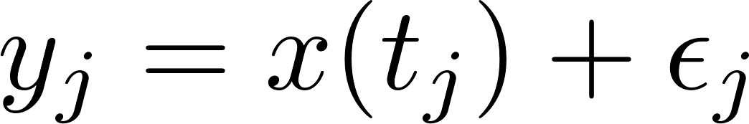
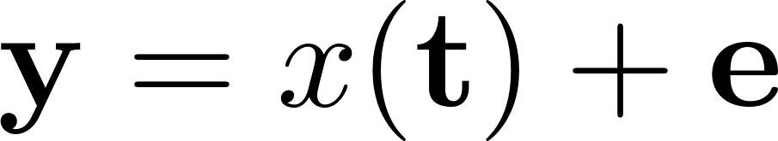

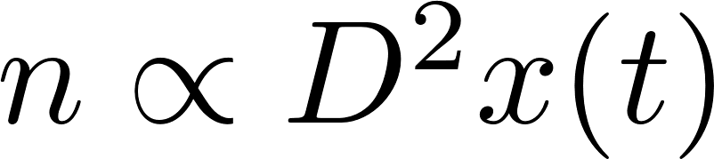
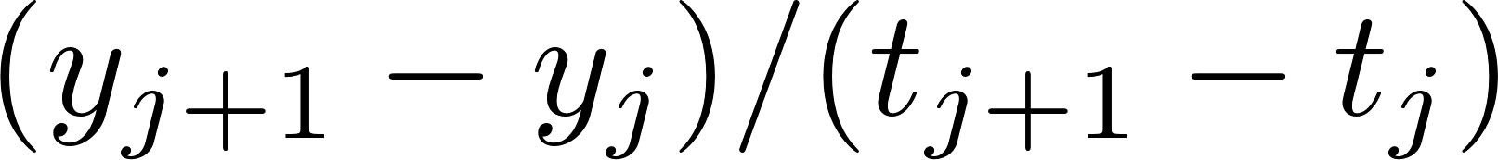
Smoothing
We normally have pairs of
Normally we smooth each record separately
About sample rate/resolution of data
Derivative est.
First forward difference
Central difference
Second central difference estimate

Slide 10
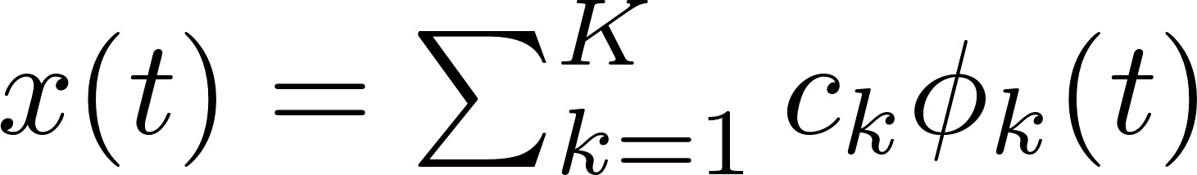


Representing functions by basis functions
Weighted sum of basis functions
Choosing basis
Small k (restrict df)
Derivative behave reasonably
When we have N observations, we need to fit N curves.
C is N by K matrix
create.constant.basis()
create.fourier.basis()
create.bspline.basis()
……

Slide 11
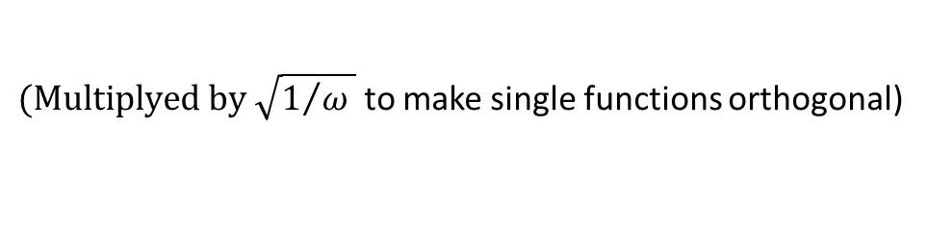

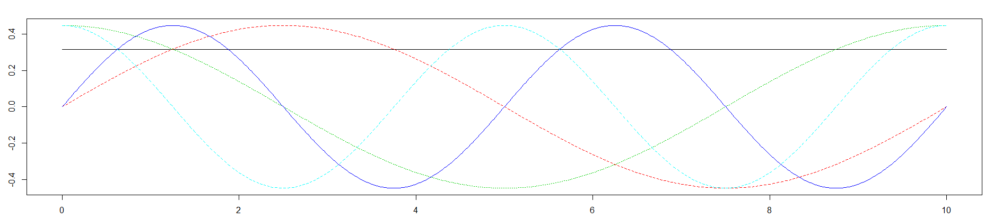
Fourier Basis System
Mainly used by periodic data
Does not have end fitting problems
Define k and omega
K needs to be odd
Basis needs to be orthogonal
T could be default to range(t)
to make single functions orthogonal)

Slide 12
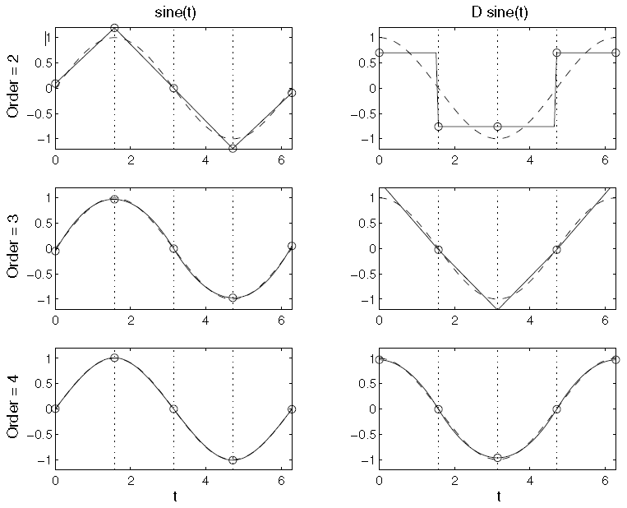
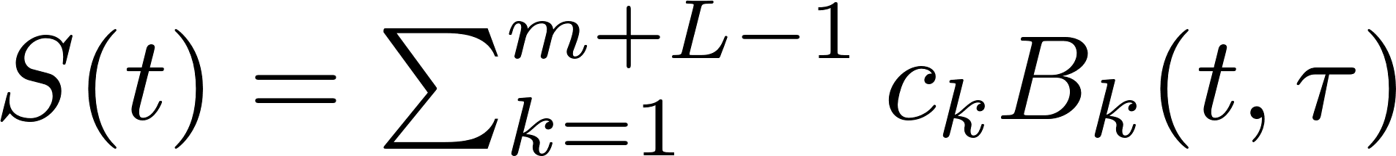
Spline basis
Divide interval into L subintervals
Df of fit=order(m) + L-1=number of basis
Higher order brings better fit, normally order of 4 and 5 works for most functions
The more breakpoints bring higher flexibility
B-Splines
m: order
L: subintervals
Notes:
Order m = highest degree of polynomial + 1
<number>

Slide 13
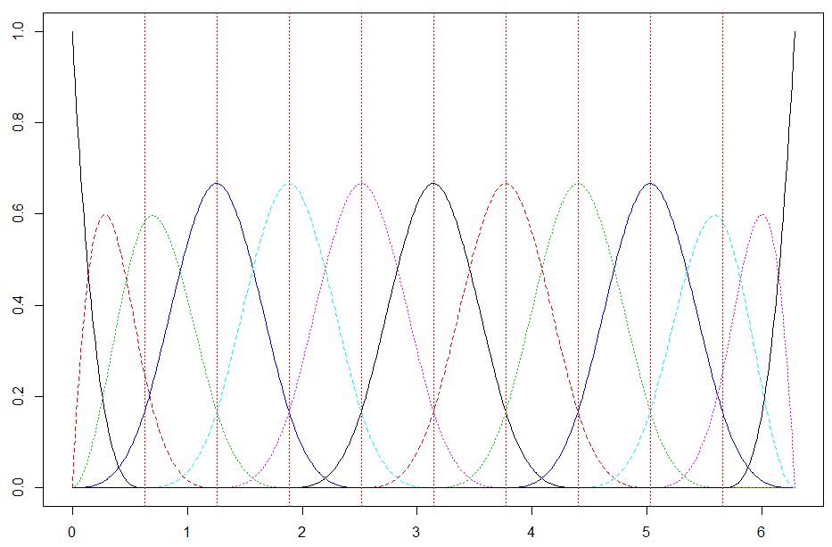

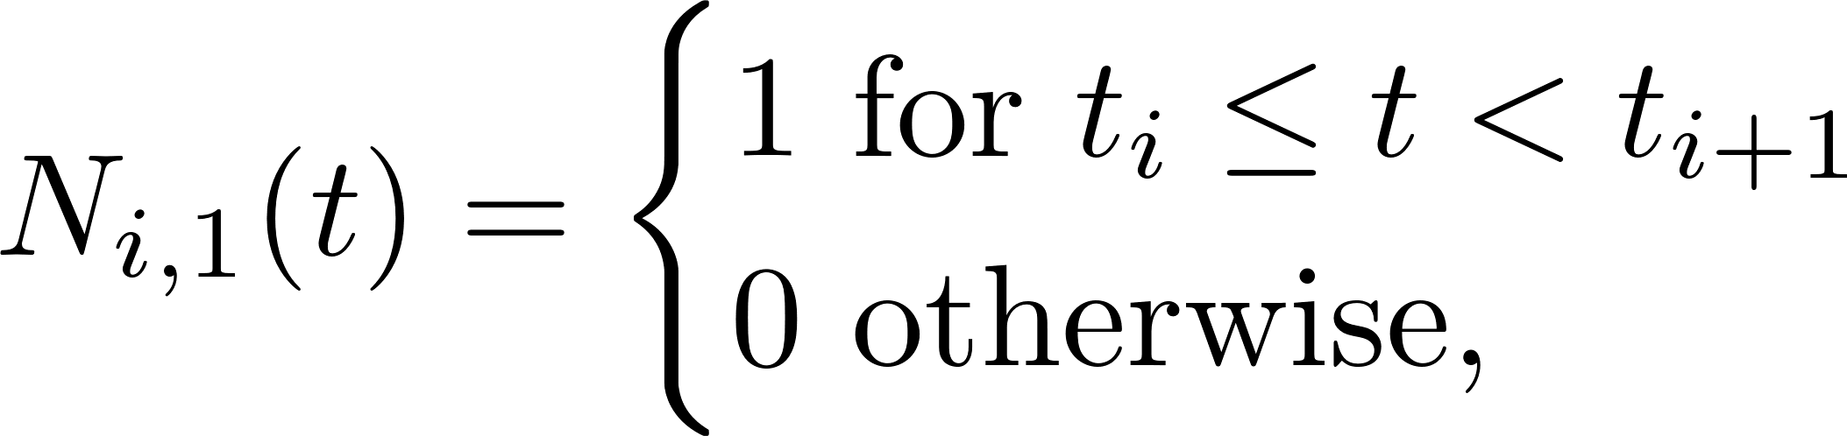
B-Spline
Order k B-spline: joining several pieces of polynomials of degree k-1 with at most D(k-2) continuity.
Define:
Knots:
B-spline basis function:
Then:
We will define function degree: m (quadratic,3. Cubic, 4. …)
We will define how many intervals (L) and where the knots are
Then we need to add m-1 knots to each boundary, and any number of knots in the middle. The number of intervals in L, knots(if all distinct in interval) is L-1.
Now we need m+L-1 basis functions. And we define the spline function as
So the problem left to modeler is
Where to put interior breakpoints
Equal spaced
At quantile of sampling points (or At sampling point, called ‘smoothing splines’)
There are some algorithms can help
Increase m will fit better but increase L might not (trade off between bias and var)

Slide 14
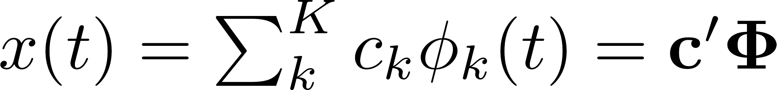
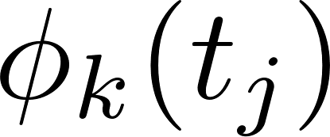
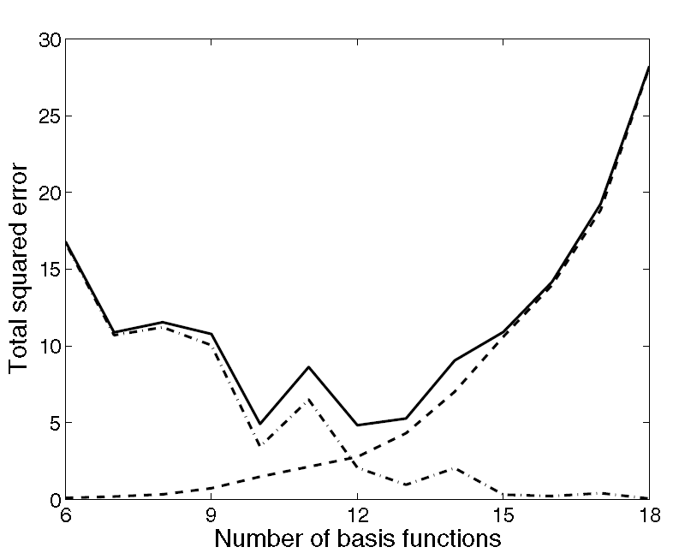
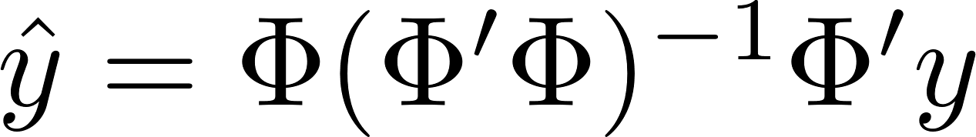
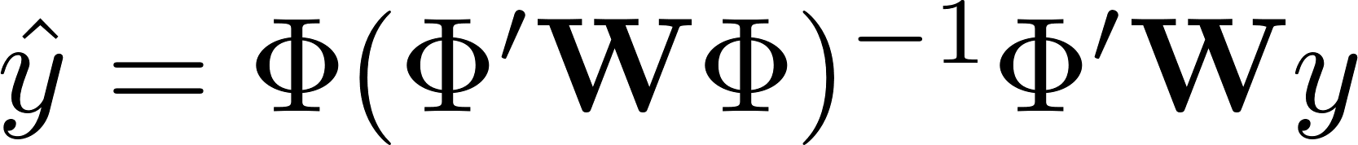
Smoothing functional data by least square
Fit
Choose K: number of basis equations
MSE=Bias²+Var
Forward/backward selection
Notes:
The boundary estimate pools much less information than do interior
estimates, and is especially sensitive to the boundary observations
It is the same as regression we will mention later when our response is scaler.
Phi is matrix of values from each basis function evaluated at measure points
<number>

Slide 15
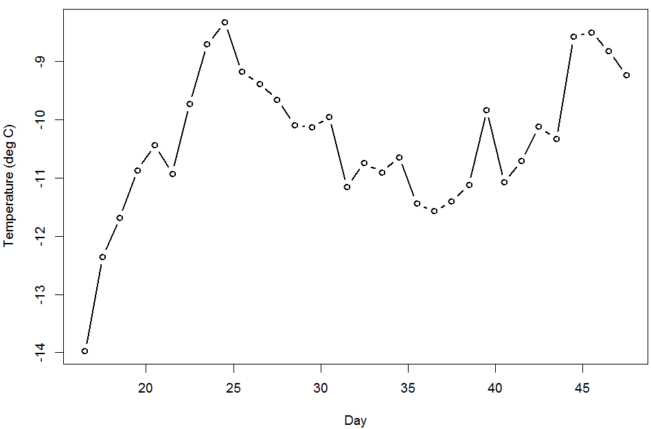
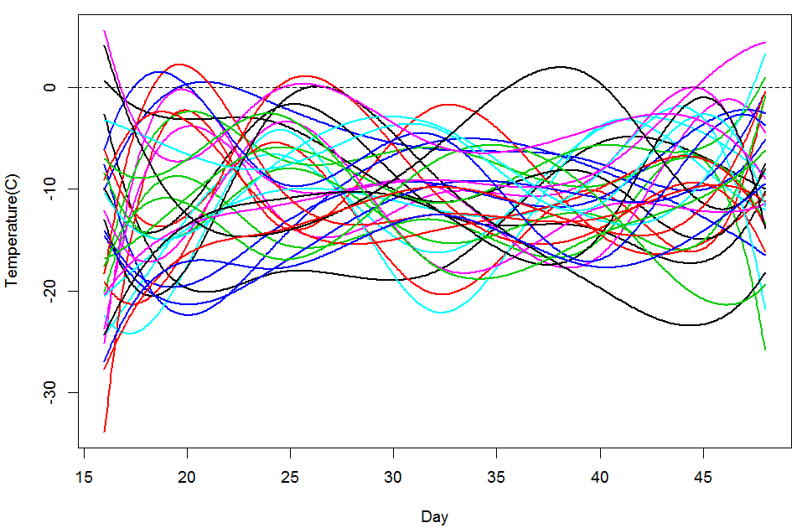
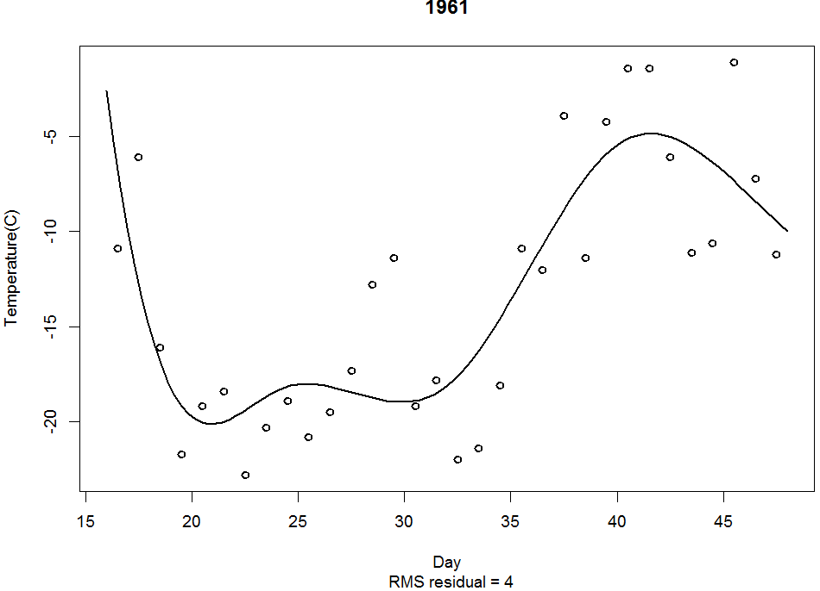
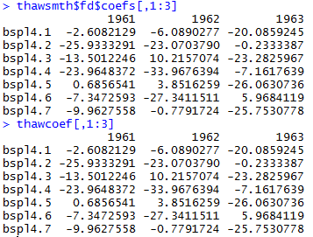
Mean temp of Jan 15th to Feb 15th across 34 years
Temp curves of Jan 15th to Feb 15th of 34 years
Temp of Jan 15th to Feb 15th of 1961 and fitted curve
Notes:
Smooth.basis function in R used LS method to smooth curves if no Lfd specified.
<number>

Slide 16
thawdata = t(MontrealTemp[, 16:47])
daytime = ((16:47)+0.5)
par(cex=1.2)
plot(daytime, apply(thawdata,1,mean), "b", lwd=2,
xlab="Day", ylab="Temperature (deg C)")
thawbasis=create.bspline.basis(c(16,48), nbasis = 7, norder=4)
thawbasismat=eval.basis(daytime,thawbasis)
thawcoef=solve(crossprod(thawbasismat),crossprod(thawbasismat,thawdata))
thawfd=fd(thawcoef,thawbasis,list('Day','Year','Temperature(C)'))
plot(thawfd,lty=1,lwd=2,col=1)#fig4.4
plotfit.fd(thawdata[,1],daytime,thawfd[1], lty=1,lwd=2)#4.5
thawsmth=smooth.basis(daytime, thawdata, thawbasis)

Slide 17
Lfd objects (Linear differential equations)
Generally
Harmonic accelerator operator

Slide 18
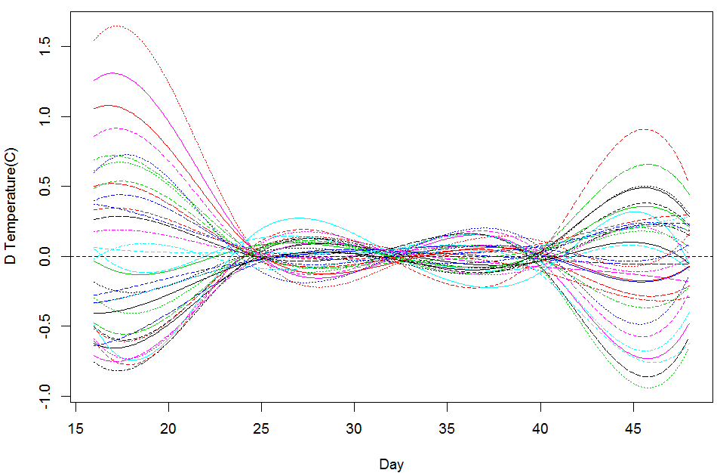
betalist = vector("list", 3)
betalist[[1]] = fd(0, thawconst.basis)
betalist[[2]] = fd(omegaˆ2, thawconst.basis)
betalist[[3]] = fd(0, thawconst.basis)
harmaccelLfd = Lfd(3, betalist)
accelLfd = int2Lfd(2)
harmaccelLfd = vec2Lfd(c(0,omegaˆ2,0), c(0, 365))
Ltempmat = eval.fd(daytime, tempfd, harmaccelLfd)
Ltempfd = deriv.fd(tempfd, harmaccelLfd)

Slide 19
How to fit a smoothing?
Regression smoothing or LS smoothing
Smoothing using roughness penalties
Large number of basis functions
Imposing smoothness by penalizing roughness

Slide 20
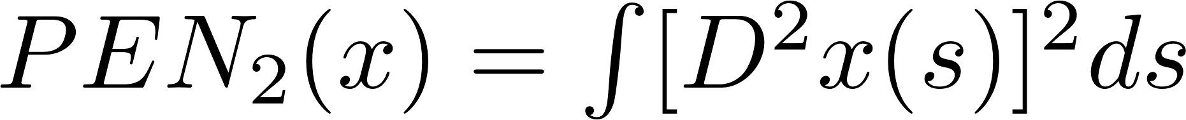
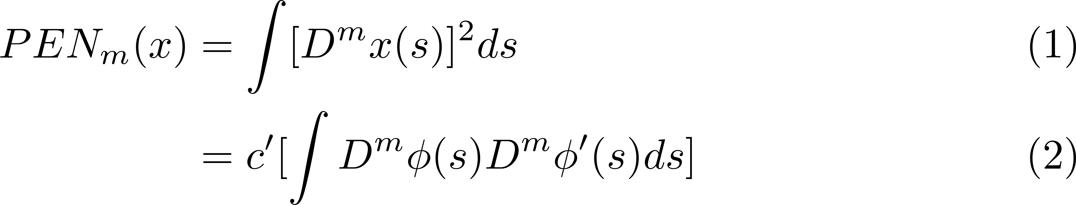

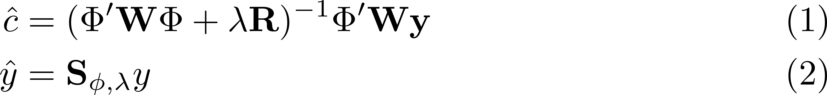
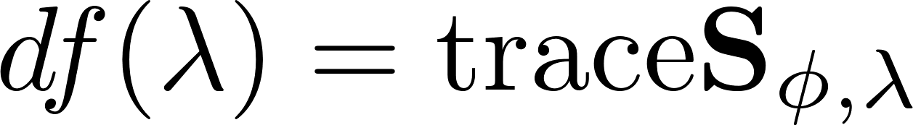
Smoothing with roughness penalty
Measure of roughness
Fitting criterion
Thm: the curve x that minimizes PENSSE is a cubic spline with knots at the data points t_{j}.
Strategy (most common): Order 4 B-spline basis function expansion with knots on sampling points, minimizing above criterion
c
Notes:
<number>

Slide 21
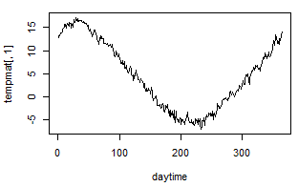
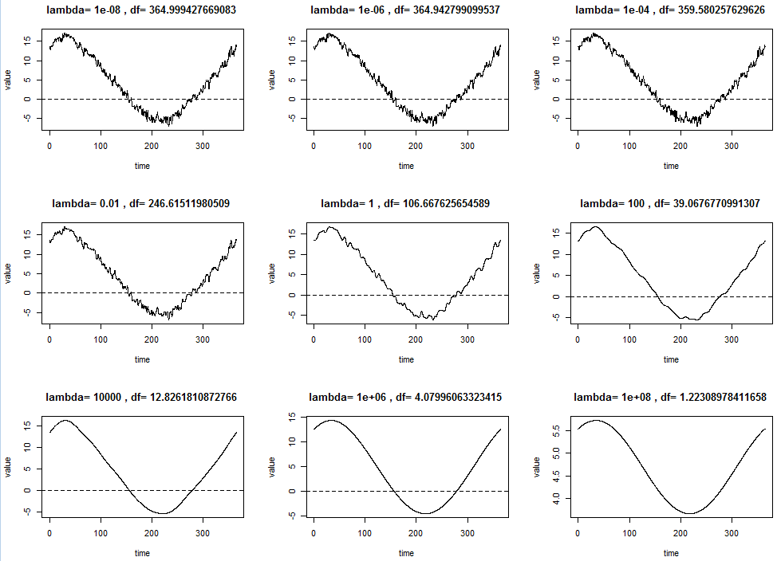
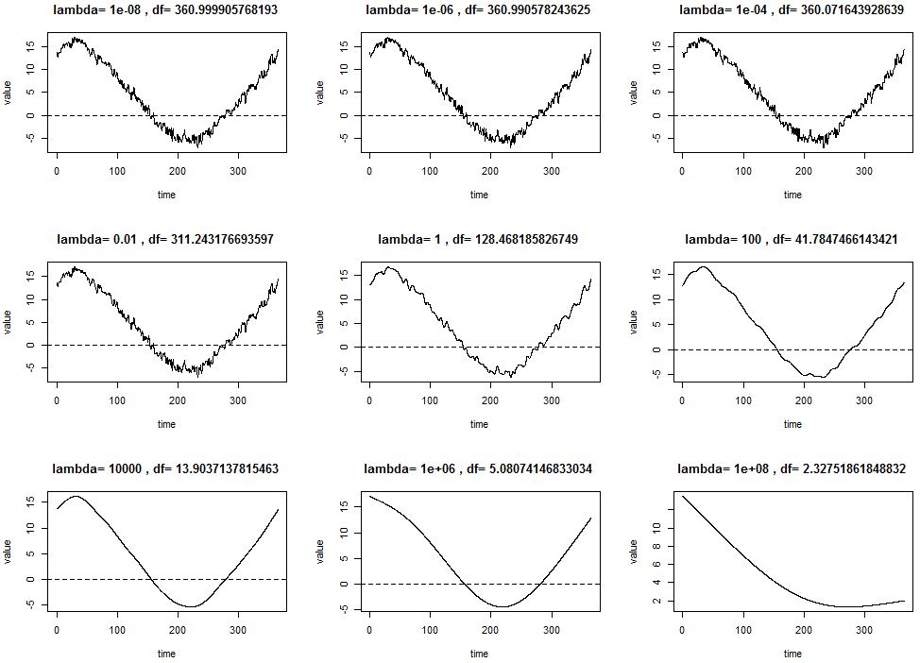
More on roughness penalty…
Generally, measure of roughness could be any Linear differential operator on target functions.
E.g. for a function suppose to have periodic nature by , we should penalize basic curvature but extra roughness.
Thus we use Harmonic accelerator operator

Slide 22



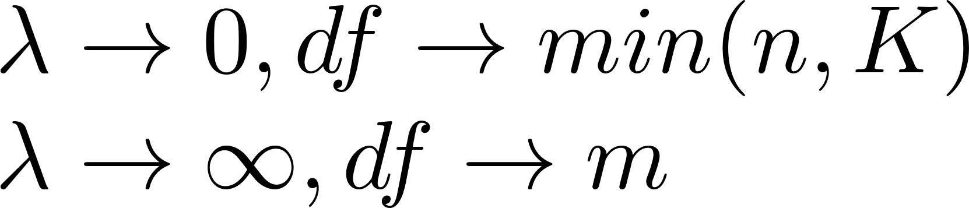
Important matrices
y2cMap=
roughness penalty matrices
Hat/smoothing matrix:
Smooth df:
Error df:
k by k symmetric
Notes:
Phi: n by k
R: k by k
phi: k col vector of functions
m: m is the order of the highest derivative used to define the roughness penalty
<number>

Slide 23
Choosing smoothing parameter
Norm of R is increasing along the order and number of basis functions
Upper limit: A rough rule of thumb is that the size of λR should not be more than 10^10 times the size of ΦWΦ. Or inverse will be bad if possible.
Lower limit: Choose λ at least large enough to ensure that the size of λR is at least with ten orders of magnitude of the size of ΦWΦ.

Slide 24
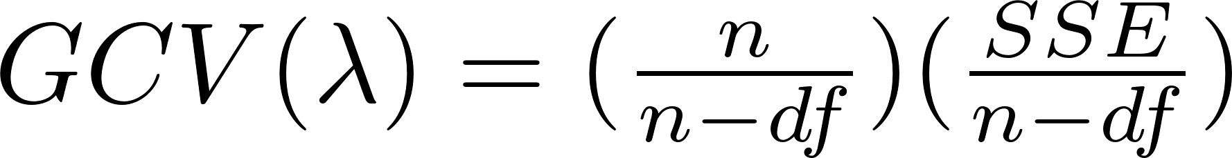
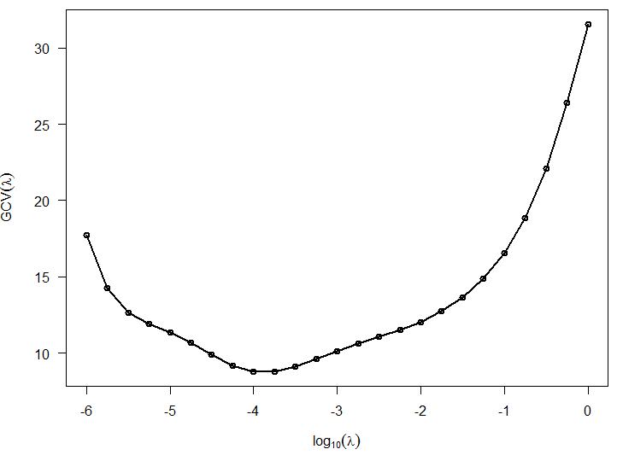
Choosing lambda by GCV
ageRng = c(1,18)
age = growth$age
heightmat = growth$hgtf
norder = 6
nbasis = length(age) + norder - 2
heightbasis = create.bspline.basis(ageRng, nbasis, norder, age)
loglam = seq(-6, 0, 0.25)
Gcvsave = rep(NA, length(loglam))
names(Gcvsave) = loglam
Dfsave = Gcvsave
for(i in 1:length(loglam)){
hgtfdPari = fdPar(heightbasis, Lfdobj=4, 10^loglam[i])
hgtSm.i = smooth.basis(age, heightmat, hgtfdPari)
Gcvsave[i] = sum(hgtSm.i$gcv)
Dfsave[i] = hgtSm.i$df
}
plot(loglam, Gcvsave, 'o', las=1, xlab=expression(log[10](lambda)),
ylab=expression(GCV(lambda)), lwd=2 )

Slide 25
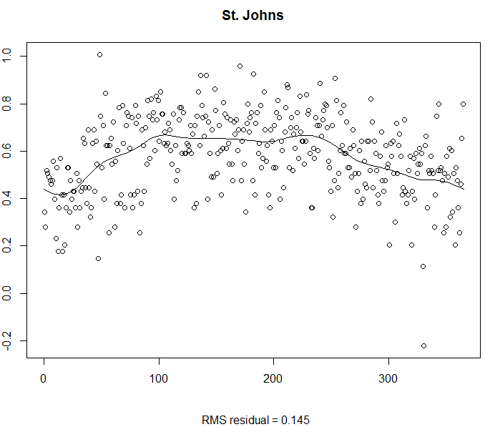
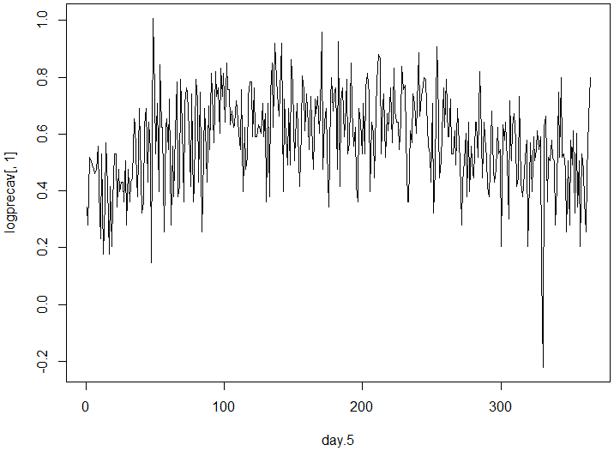
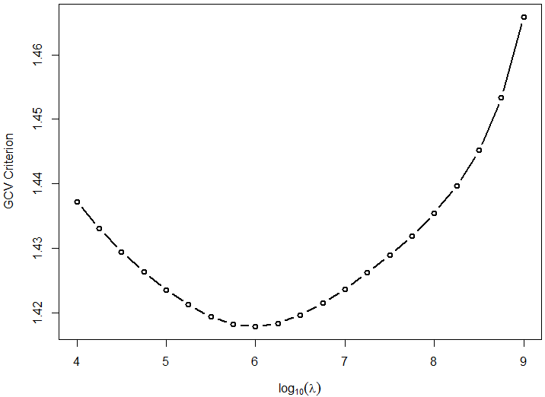
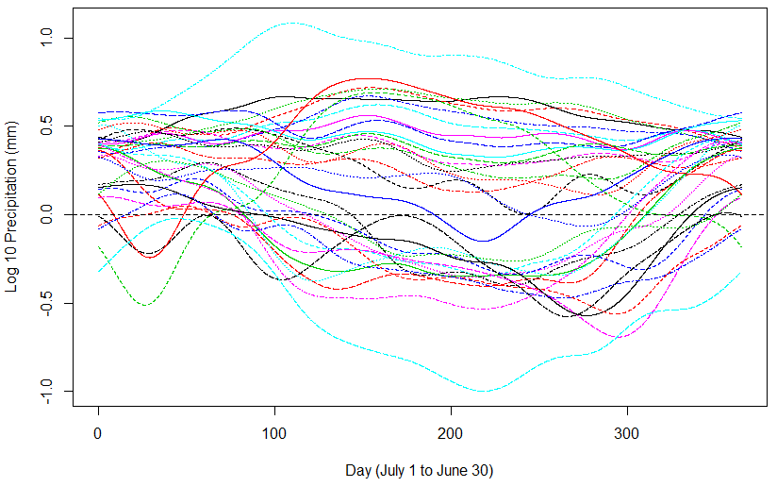
Smooth Canadian annual precipitation data

Slide 26
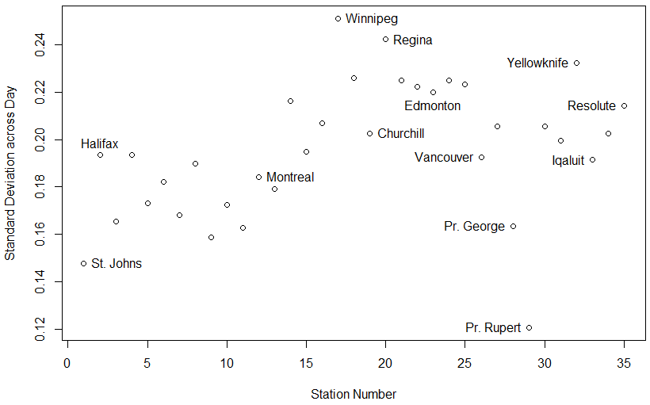
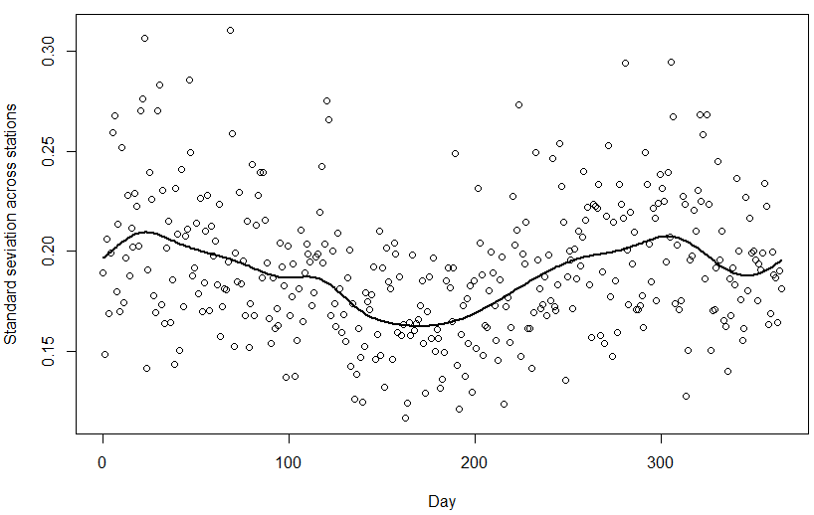
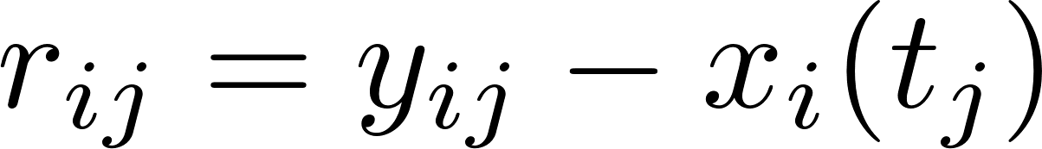
Assessing smoothing
Analyzing the residuals
GCV works for all curves at once, FPCA
Do residuals conform to assumptions (unweighted)?
Residual at all time points are normally distributed
Variance of residuals are constant across both years and stations
logprecmat=eval.fd(day.5, logprec.fd)
logprecres=logprecav-logprecmat
logprecvar1 = apply(logprecres^2, 1, sum)/35
logprecvar2=apply(logprecres^2,2,sum)/(365-12)
logstddev.fd = smooth.basis(day.5,log(logprecvar1)/2, fdParobj)$fd
logprecvar1fit = exp(eval.fd(day.5, logstddev.fd))

Slide 27
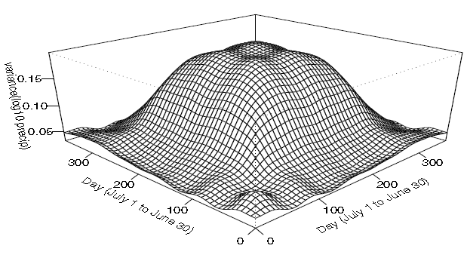
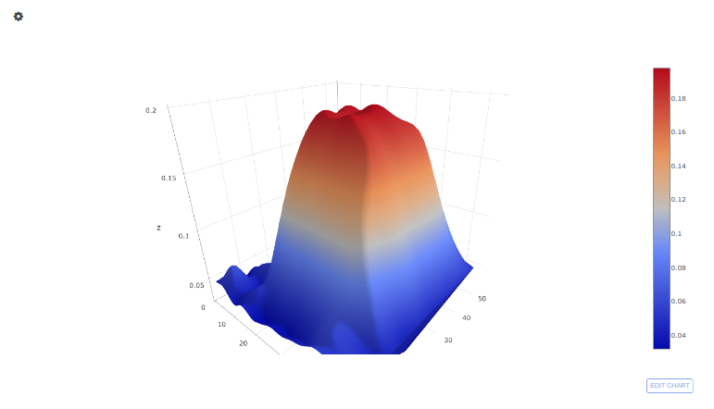
Description: Bivariate Covariance Function v(s, t)

Slide 28

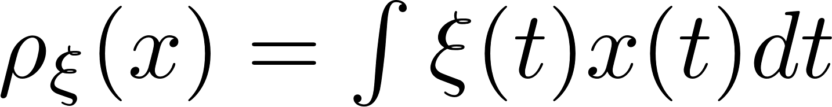
Functional probes
This is used to ‘zoom in’ on certain feature of curves
It is analogous to contrast in linear model but not sum to zero
PCA will produce a probe highlight large variation

Slide 29
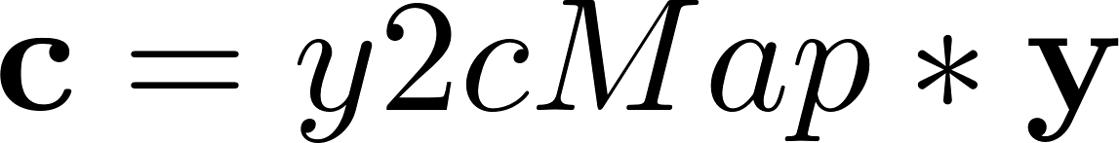
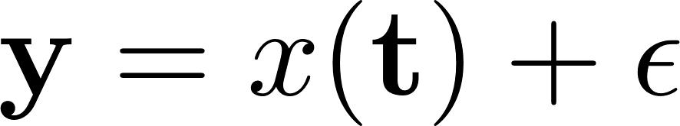


Confidence limits
Two linear mapping
y2cMap (k by n)
c2rMap (1 by k)
y2rMap (1 by n)
inprod function in R
variance-covariance matrix
So
Calculate
Assume independence

Slide 30

E.g. of calculating CL (pointwise) of hat(y)
logprecmat = eval.fd(day.5, logprec.fd)
logprecres = logprecav - logprecmat
logprecvar = apply(logprecresˆ2, 1, sum)/(35-1)
lambda = 1e8
resfdParobj = fdPar(daybasis, harmaccelLfd, lambda)
logvar.fit = smooth.basis(day.5, log(logprecvar),resfdParobj)
logvar.fd = logvar.fit$fd
varvec = exp(eval.fd(daytime, logvar.fd))
SigmaE = diag(as.vector(varvec))
y2cMap = logprecList$y2cMap
c2rMap = eval.basis(day.5, daybasis)
Sigmayhat = c2rMap %*% y2cMap %*% SigmaE %*%t(y2cMap) %*% t(c2rMap)
logprec.stderr = sqrt(diag(Sigmayhat))
logprec29 = eval.fd(day.5, logprec.fd[29])
plot(logprec.fd[29], lwd=2, ylim=c(0.2, 1.3))
lines(day.5, logprec29 + 2*logprec.stderr,lty=2, lwd=2)
lines(day.5, logprec29 - 2*logprec.stderr,lty=2, lwd=2)
points(day.5, logprecav[,29]))

Slide 31



Confidence limit
Variances:
Estimating
When standard model for error is accepted
This is better than MLE
Generalized cross-validation
Assume autoregressive (AR) structure when N is small
When N is large, we have residual matrix E, but normally not possible
CL
Promblems
We assume K fixed
Pointwise CL itself is biased
Notes:
N is replications
<number>

Slide 32


Localized least square
h: bandwidth parameter
Pro:
easy to understand
Excellent computational characteristics
H is well-explained
Cons:
Instable boundary performance

Slide 33
Localized basis smoother
Adapts well to unequally spaced arguments

Slide 34

We want to control curvature of the highest order of derivative we are interested (choose m). If we are interested in acceleration, we control D4
Comparing to LS estimates

Slide 35
Extension of Spline smooth
Avoiding putting knot on each sampling point when too many (hand-writing)
Use likelihood instead residual sum of squares
Different PEN

Slide 36
Cross-validation
cross-validated error sum of squares (LOO)
Too intensive to compute
Tend to fit noise

Slide 37



Generalized cross-validation

Slide 38

Confidence limits
y2cMap
c2rMap
y2rMap

Slide 39
Functional Linear Models for Scalar Responses
Our example: predict logarithm of annual precipitation for 35 Canadian weather stations from their temperature profiles.
Stations | Response | Covariate
St. Johns | 3.170496 | -3.6, -3.1, -3.4, -4.4……
Halifax | 3.162863 | -4.4, -4.2, -5.3, -5.4……
Sydney | 3.168615 | -3.8, -3.5, -4.6, -5.0……
Yarmouth | 3.101231 | -1.4, -1.6, -2.5, -2.3……
…… | …… | ……

Slide 40
Convert covariates to functions
tempbasis =create.fourier.basis(c(0,365),65)
tempSmooth=smooth.basis(day.5,daily$tempav,tempbasis)
tempfd =tempSmooth$fd
Stations | Response | Covariate
St. Johns | 3.170496 | Temperature function x₁(t) for St. Johns
Halifax | 3.162863 | Temperature function x₂(t) for Halifax
Sydney | 3.168615 | Temperature function x₃(t) for Sydney
Yarmouth | 3.101231 | Temperature function x₄(t) for Yarmouth
…… | …… | ……

Slide 41


Modeling
Impossible problem? To deal with underdetermination issue
Low dimension of basis expansion of
Replaces by a low dimensional approximation using PCA

Slide 42
Fit the model
We use fRegress in R to fit a model it needs
yfdPar: response object, either function of scalars of length N
annualprec = log10(apply(daily$precav,2,sum))
Xfdlist: covariates of length m (list in R), elements could be scalar or functional vectors
templist = vector("list",2)
templist[[1]] = rep(1,35)
templist[[2]] = tempfd65
Betalist: coeficients list of length m (list in R), elements should be functional parameter objects
conbasis = create.constant.basis(c(0,365))
betabasis = create.fourier.basis(c(0,365),5)
betalist = vector("list",2)
betalist[[1]] = conbasis
betalist[[2]] = betabasis
Model fit
fRegressList = fRegress(annualprec, templist, betalist)

Slide 43


Result
Intercept: 0.0095
Df=6
Dfe=35-6=29
fRegressList = fRegress(annualprec, templist, betalist)
betaestlist = fRegressList$betaestlist
tempbetafd = betaestlist[[2]]$fd
plot(tempbetafd, xlab="Day",ylab="Beta for temperature")
yhat=fRegressList$yhatfdobj
plot(1:35,annualprec,'l',col='black', lwd=2,ylab='Annual precipitation', xlab='Stations')
lines(1:35, yhat, lwd=2,col='red')
legend(2,2.4, c('Real', 'fitted'),lty=c(1,1), lwd=c(2.5,2.5),col=c('black','red'))

Slide 44
Assess fit
SSE: 0.5609261 (df=29)
SST: 2.744239 (df=34)
SSR: 2.183312 (df=5)
R²: 0.7956
F: 22.576
P value: 3.434412e-09 *
annualprechat1 = fRegressList$yhatfdobj
annualprecres1 = annualprec - annualprechat1
SSE1.1 = sum(annualprecres1^2)
SSE0 = sum((annualprec - mean(annualprec))^2
SSR=sum((annualprechat1-mean(annualprec))^2)
RSQ1 = (SSE0-SSE1.1)/SSE0
Fratio1 = ((SSE0-SSE1.1)/5)/(SSE1.1/29))

Slide 45
Estimating beta using roughness penalty
Everything is the same except the way we define betalist
conbasis = create.constant.basis(c(0,365))
betabasis = create.fourier.basis(c(0,365),5)
betalist = vector("list",2)
betalist[[1]] = conbasis
betalist[[2]] = betabasis
betabasis35 = create.fourier.basis(c(0, 365), 35)
lambda = 10^12.5
betafdPar. = fdPar(betabasis35, harmaccelLfd, lambda)
betalist2 = betalist1
betalist2[[2]] = betafdPar.

Slide 46


Result
Intercept: 0.008
Df: 4.655
Dfe: 35-4.655=30.345
annPrecTemp = fRegress(annualprec, templist, betalist2)
betaestlist2 = annPrecTemp$betaestlist
plot(betaestlist2[[2]]$fd, xlab='Day', ylab='Beta for temperature')
betaestlist2[[1]]$fd
annPrecTemp$df
yhat2=annPrecTemp$yhatfdobj
plot(1:35,annualprec,'l',col='black', lwd=2,ylab='Annual precipitation', xlab='Stations')
lines(1:35, yhat2, lwd=2,col='red')
legend(2,2.4, c('Real', 'fitted'),lty=c(1,1), lwd=c(2.5,2.5),col=c('black','red'))

Slide 47
Assess and compare
Model 1 Model2
SSE: 0.5609 (df=29) 0.6757 (df=30.3)
SST: 2.7442 (df=34) 2.7442 (df=34)
SSR: 2.1833 (df=5) 2.0685 (df=3.7)
R²: 0.7956 0.7538
F: 22.576 25.069
P value: 3.434412e-09 * 5.388813e-09* (approx.)

Slide 48

Comparing 2 models…

Slide 49





Picking lambda

Slide 50




More covariates

Slide 51



resid = annualprec - annualprechat2
SigmaE. = sum(resid^2)/(35-annPrecTemp$df)
SigmaE = SigmaE.*diag(rep(1,35))
#y2cMap = tempSmooth65$y2cMap
stderrList = fRegress.stderr(annPrecTemp, diag(rep(1,35)), SigmaE)
betafdPar = betaestlist2[[2]]
betafd = betafdPar$fd
betastderrList = stderrList$betastderrlist
betastderrfd = betastderrList[[2]]
plot(betafd, xlab="Day", ylab="Temperature Reg. Coeff.",
ylim=c(-6e-4,1.2e-03), lwd=2)
lines(betafd+2*betastderrfd, lty=2, lwd=1)
lines(betafd-2*betastderrfd, lty=2, lwd=1)
Confidence intervals
Notes:
roughness
penalty approach is to be preferred over the fixed low-dimension strategy; now
we see that only the autumn months really matter in defining the relationship, and
that the substantial oscillations over other parts of the year in Figure 9.1 are actually
extraneous.
<number>

Slide 52

Statistical test
Non-parametric permutation test
Calculate some test statistics many times when the response is permuted randomly
F stat: 3.033
95% quantile: 0.281
F.res = Fperm.fd(annualprec, templist, betalist2)
F.res$Fobs
F.res$qval

Slide 53

Linear Models for Functional Responses
FANOVA
Responses are functional
All covariates are scalars
Y : n functional vector containing n functions with parameter t
e: n residual functions with parameter t
Beta: b parameter functions, b=1 + # of treatment groups
Z: design matrix same as ANOVA

Slide 54

E.g. Climate Region Effects on Temperature
Data
Stations | Region | Response (Daily temp)
St. Johns | Atlantic | -3.6, -3.1, -3.4, -4.4……
Halifax | Atlantic | -4.4, -4.2, -5.3, -5.4……
Sydney | Atlantic | -3.8, -3.5, -4.6, -5.0……
Yarmouth | Atlantic | -1.4, -1.6, -2.5, -2.3……
…… | …… | ……

Slide 55


Prepare for modeling
Build design matrix
1 | 1 | 0 | 0 | 0
1 | 1 | 0 | 0 | 0
1 | 1 | 0 | 0 | 0
1 | 0 | 1 | 0 | 0
1 | 0 | 1 | 0 | 0
1 | 0 | 0 | 1 | 0
1 | 0 | 0 | 0 | 1
1 | 0 | 0 | 0 | 1
0 | 1 | 1 | 1 | 1
regions. = unique(CanadianWeather$region)
p = length(regions.) + 1
regionList = vector("list", p)
names(regionList) = c('Canada', regions.)
regionList[[1]] = c(rep(1,35),0)
for (j in 2:p) {
xj = (CanadianWeather$region == regions.[j-1])
regionList[[j]]= c(xj,1)
}
To constrain

Slide 56
Prepare for modeling
Build response component
Based on ‘tempfd’ we built in last example with 65 Fourier basis functions, using roughness penalty method, lambda=10⁶ , and harmonic acceleration operator as penalty target
Create functional parameter component
Number of basis here has nothing to with the degree of freedom, but if you use more basis than data points in y, you should use a roughness penalty. And they could be different.
coef = tempfd$coef
coef36 = cbind(coef,matrix(0,65,1))
temp36fd = fd(coef36,tempbasis,tempfd$fdnames)
betabasis = create.fourier.basis(c(0, 365), 11)
betafdPar = fdPar(betabasis)
betaList = vector("list",p)
names(betaList) = regions.
for (j in 1:p) betaList[[j]] = betafdPar

Slide 57


Model fit

Slide 58





yhatfdobj2=fRegressList$yhatfdobj$fd
yhatmat = eval.fd(day.5, yhatfdobj2)[,1:35]
ymat = tempShifted
rmatb = ymat - yhatmat
SigmaEb = var(t(rmatb))
y2cMap = tempSmooth65$y2cMap
stderrList = fRegress.stderr(fRegressList, y2cMap,SigmaEb)
str(stderrList)
betalist3=stderrList$betastderrlist
class(betalist3[[1]])
plotbeta(betaestList,betalist3)

Slide 59
Thank you!! Any questions?

