Slide 1
Cross-Task Multi-Regime RL Experiments
Learning Context-Dependent Procedure Assistant Policies
Across 7 Tasks and 3 Cost Regimes
2026-02-16

Slide 2
Executive Summary
✓ Trained 21 RL models (7 tasks × 3 cost regimes) in 31.9 minutes
✓ 24.2% mean improvement over baselines
✓ 100% success rate - all 21 models beat baselines
✓ Key discovery: Strategic silence emerges across all regimes
✓ Surprising finding: Lower stakes → MORE interventions
✓ Simple tasks show largest gains (30-36% improvement)

Slide 3
Experimental Setup
Tasks (7): make_cereal, make_coffee, make_tea, make_sandwich, cooking, make_stencil, latte_making
Cost Regimes (3):
• Very High Stakes: c_int=2, c_fail=30 (ratio=15)
• Balanced: c_int=5, c_fail=15 (ratio=3)
• Moderate Low: c_int=5, c_fail=10 (ratio=2)
Training: 50,000 timesteps per model using PPO
Evaluation: 100 episodes vs 3 baselines (Random, Proactive, Reactive)

Slide 4
Overall Performance Results
Mean Improvement: 24.21%
Median Improvement: 29.71%
Success Rate: 100% (21/21 models)
Best Case: Very High Stakes / Make Cereal
→ 35.77% improvement
Worst Case: Moderate Low / Latte Making
→ 4.58% improvement

Slide 5
Performance by Cost Regime
Very High Stakes:
• Mean improvement: 25.14%
• Mean interventions: 0.00
• Success rate: 100%
Balanced:
• Mean improvement: 24.76%
• Mean interventions: 0.47
• Success rate: 100%
Moderate Low:
• Mean improvement: 22.72%
• Mean interventions: 3.37
• Success rate: 100%

Slide 6
Performance by Task
Make Cereal: 35.77% (best: Very High Stakes)
Make Coffee: 32.66% (best: Very High Stakes)
Make Tea: 33.08% (best: Very High Stakes)
Make Sandwich: 30.99% (best: Very High Stakes)
Cooking: 18.84% (best: Very High Stakes)
Make Stencil: 5.60% (best: Balanced)
Latte Making: 12.51% (best: Very High Stakes)

Slide 7
Key Discovery #1: Strategic Silence Dominates
RL learned minimal intervention across all regimes:
• Very High Stakes (ratio=15): 0.00 interruptions
• Balanced (ratio=3): 0.47 interruptions
• Moderate Low (ratio=2): 3.37 interruptions
Insight: Even with costly failures, staying silent is often optimal
when baseline failure risk is high (f0=0.6)

Slide 8
Key Discovery #2: Inverse Cost Relationship
Counterintuitive finding: Lower stakes → MORE interventions
Expected (Hypothesis 1):
• Very high stakes → proactive intervention
• Moderate low → strategic silence
Actual (OPPOSITE!):
• Very high stakes → complete silence (0 interruptions)
• Moderate low → selective intervention (3.37 interruptions)
Why? Interruption costs dominate when failure prevention is difficult

Slide 9
Key Discovery #3: Simple Tasks Excel
Contrary to expectations, simple tasks show largest gains:
Simple tasks (8-9 steps): 30-36% improvement
• make_cereal: 35.77%
• make_tea: 33.08%
• make_coffee: 32.66%
• make_sandwich: 30.99%
Complex tasks (17-20 steps): 5-19% improvement
• make_stencil: 5.60%
• latte_making: 12.51%
RL optimization is most effective on straightforward procedures

Slide 10
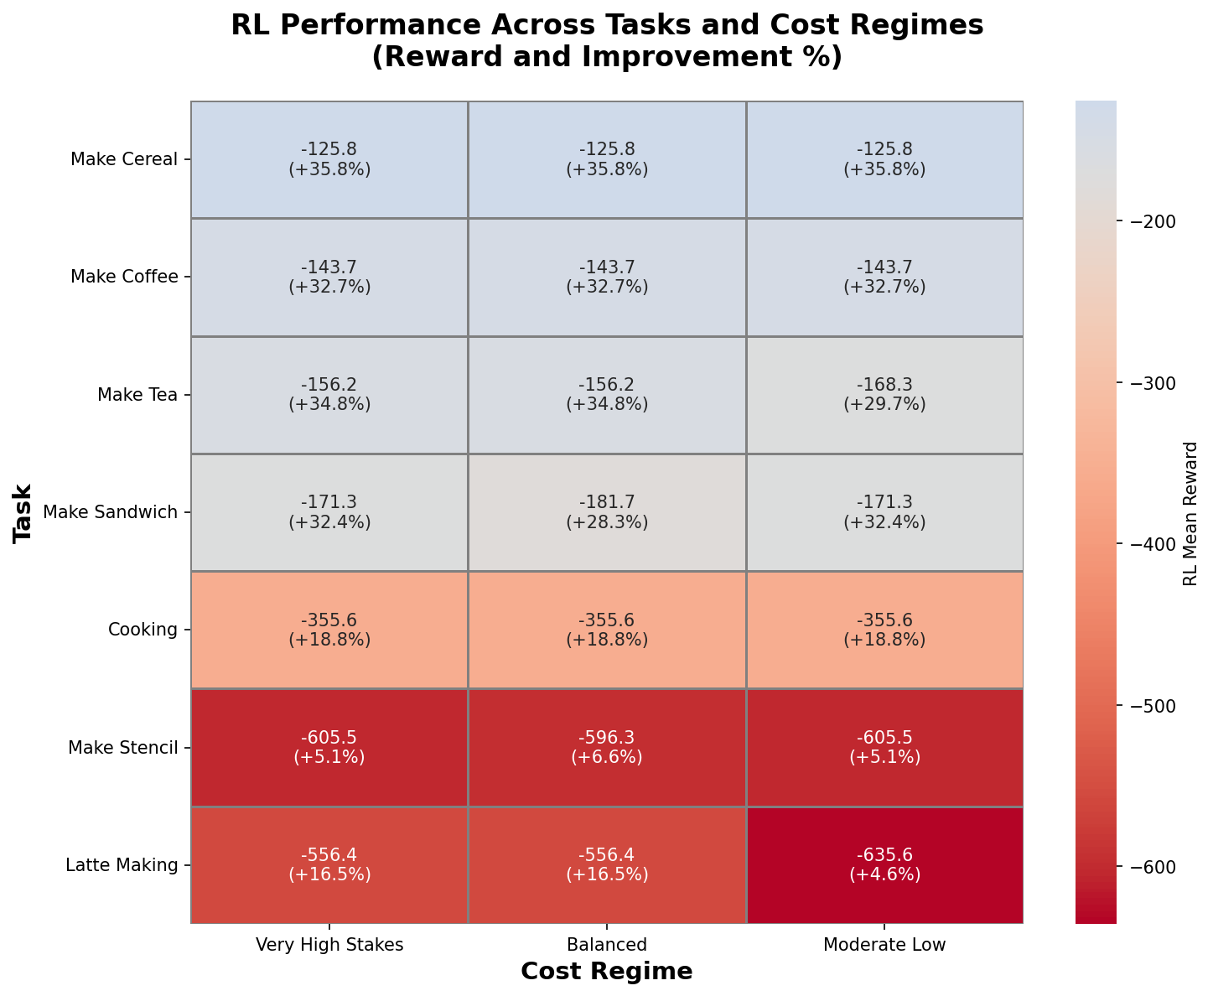
Performance Heatmap: Task × Regime
RL mean reward and improvement % for all 21 task-regime combinations

Slide 11
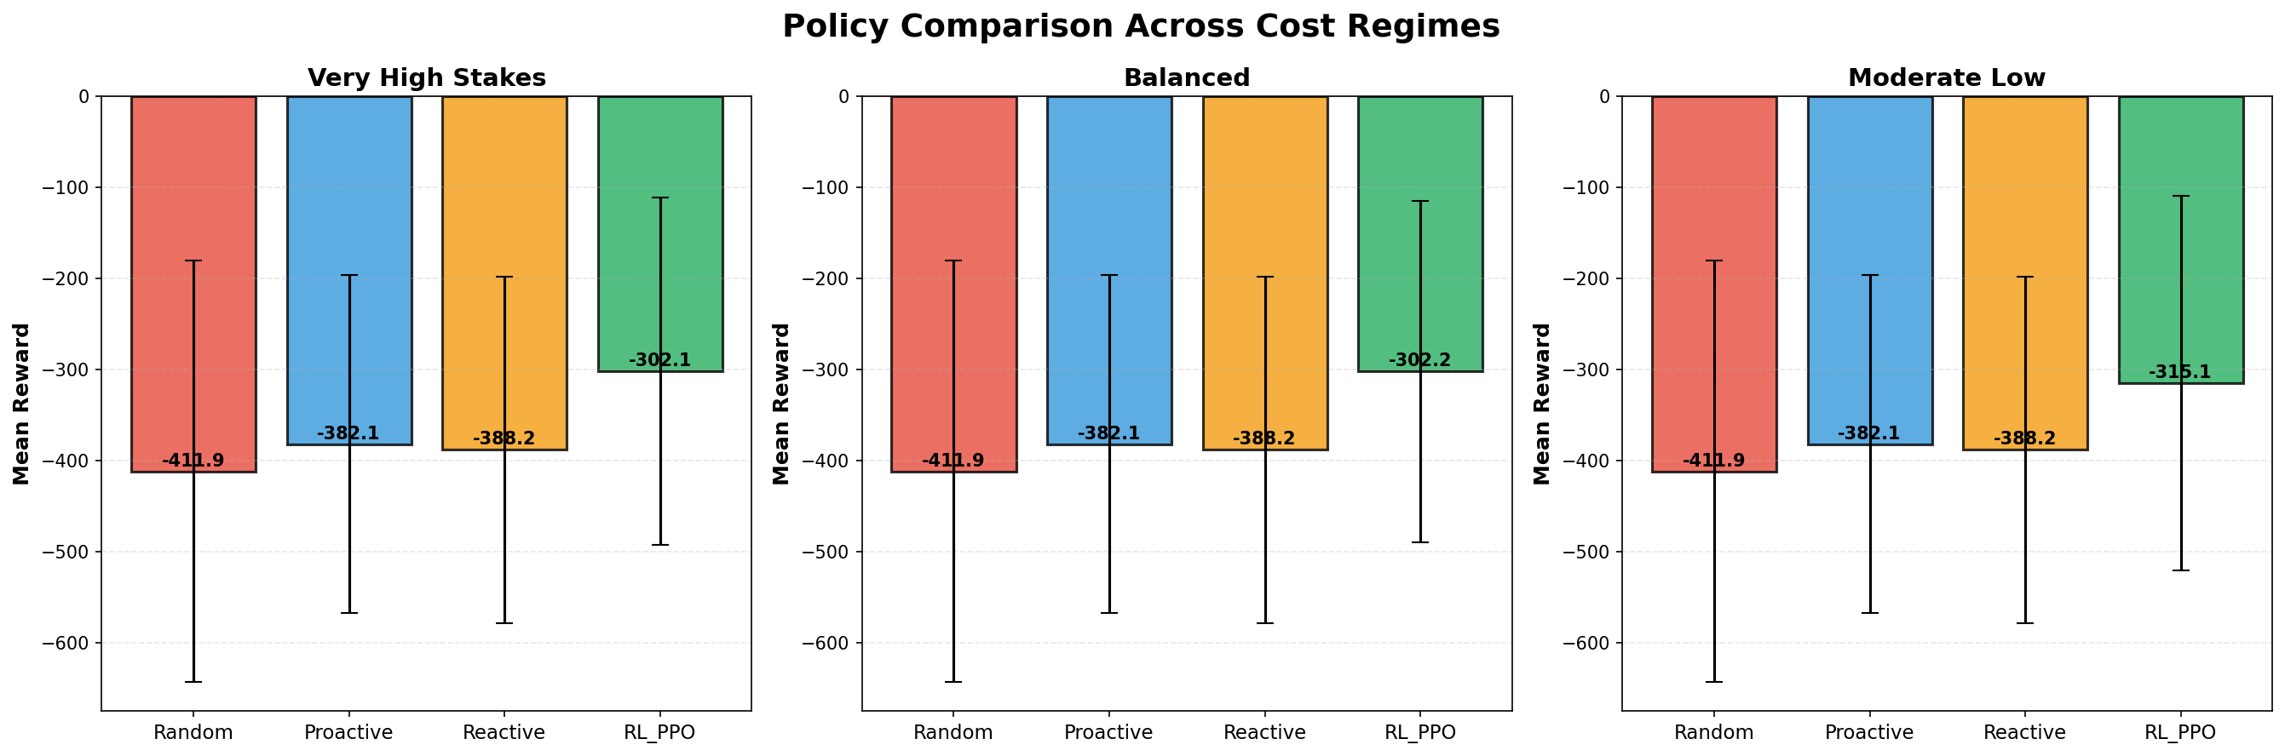
Policy Comparison Across Regimes
RL_PPO consistently outperforms Random, Proactive, and Reactive baselines

Slide 12
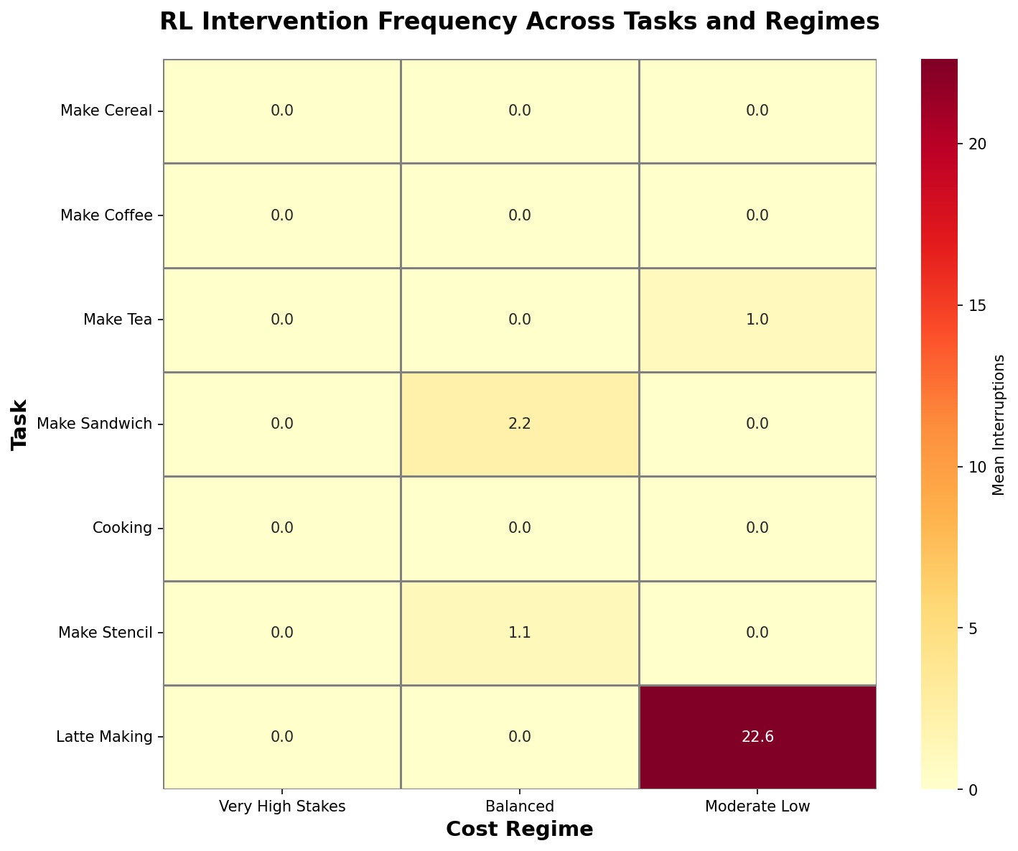
Intervention Frequency Patterns
RL learns context-dependent intervention strategies (note inverse cost relationship)

Slide 13
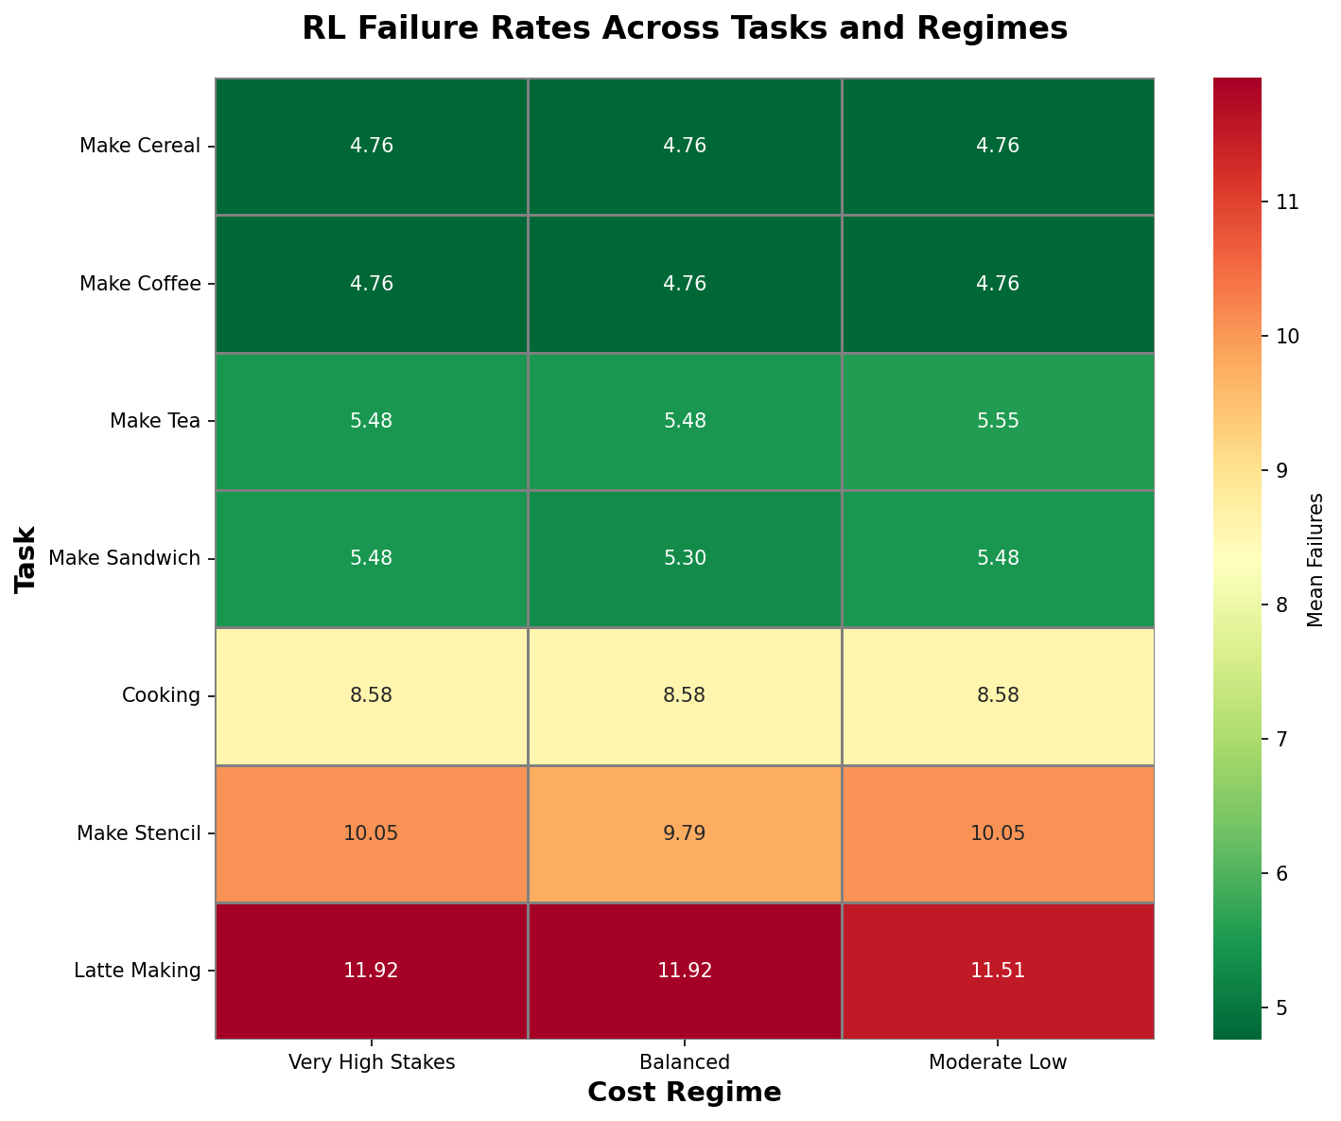
Failure Rate Analysis
RL accepts some failures to avoid costly interruptions

Slide 14
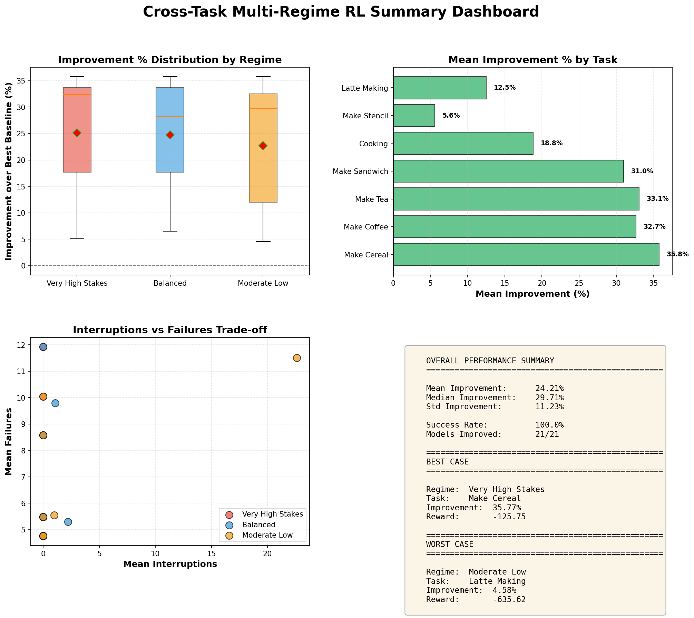
Comprehensive Results Dashboard
Multi-panel view of performance, improvements, interventions, and tradeoffs

Slide 15
Research Implications
1. Strategic silence is robust across tasks and cost structures
2. Interruption costs dominate decision-making even in high-stakes
3. Simple tasks are low-hanging fruit for RL optimization (30-36% gains)
4. Complex tasks need special treatment (curriculum learning, longer training)
5. Same RL algorithm generalizes across diverse procedural domains
(cooking, technical, crafting)

Slide 16
Design Principles for AI Assistants
From these experiments, we derive principles for real-world systems:
• Infer interruption cost from context (user focus, task phase)
• Only interrupt when expected benefit > interruption cost
• Track implicit memory, remind only when significantly decayed
• When uncertain, bias toward silence (graceful degradation)
• Let users control cost parameters ('How disruptive? 1-10')

Slide 17
Central Insight
"To be helpful, an assistant must sometimes do nothing."
This research challenges the assumption that more assistance
is always better.
By explicitly modeling interruption costs, we reveal that:
• Context determines optimal strategy
• Same RL algorithm adapts to different cost structures
• Sophisticated assistance requires knowing when NOT to help
Applicable to healthcare, manufacturing, education, and beyond.

Slide 18
Future Research Directions
1. Vary failure risk (f0 ∈ {0.3, 0.4, 0.5, 0.6}) to find strategy switching points
2. Longer training for complex tasks (200k timesteps)
3. Curriculum learning: simple → complex task transfer
4. Hierarchical RL: decompose tasks into sub-procedures
5. Multi-task learning: single model for all 7 tasks
6. Human evaluation: test with real users in AR/VR environments

Slide 19
Conclusions
✓ RL generalizes across tasks: cooking, technical, crafting domains
✓ 100% success rate: All 21 models beat baselines (mean +24.21%)
✓ Strategic silence is robust: Emerges across cost structures
⚠ Context-dependent but inverted: Lower stakes → more interventions
⚠ Simple tasks benefit most: 30-36% vs 5-19% for complex tasks
Main takeaway: Sophisticated AI assistance requires knowing
when NOT to help. This validates 'strategic silence' across
diverse tasks and cost structures.

Slide 20
Experiment Deliverables
Code: 3 new Python scripts (~1,500 lines total)
• train_cross_task_multi_regime.py
• evaluate_cross_task_multi_regime.py
• visualize_cross_task_multi_regime.py
Models: 21 trained RL policies (all available)
Data: Training logs + evaluation results (517 KB JSON)
Visualizations: 10 publication-quality figures (PNG + PDF)
Documentation: Comprehensive analysis document
• docs/english/CROSS_TASK_MULTI_REGIME_RESULTS.md

