Slide 1
Comparing Reminder Effectiveness Models
Old Model (Weak 45%) vs New Model (Strong 90-100% with Timing)\n\nCross-Task Multi-Regime RL Experiments\n2026-02-16

Slide 2
OLD MODEL Results (Weak 45% Prevention)
✓ Trained 21 RL models (7 tasks × 3 cost regimes)
✓ 24.21% mean improvement over baselines
✓ 100% success rate - all 21 models beat baselines
✓ Strategic silence emerges across all regimes
❌ PROBLEM: Very high stakes → 0.00 interruptions (counter-intuitive)
❌ ROOT CAUSE: Reminders only 45% effective, silence becomes optimal

Slide 3
NEW MODEL Results (Strong 90-100% Prevention)
✓ Re-trained same 21 RL models with timing-dependent effectiveness
✓ 13.9% mean improvement over baselines
⚠ 86% success rate - 18/21 models beat baselines
⚠ 3 models performed worse (make_stencil tasks)
❓ QUESTION: Why did overall performance decrease?
💡 HYPOTHESIS: RL hasn't learned optimal timing strategies yet

Slide 4
What Changed Between Models?
OLD MODEL: Flat effectiveness (no timing awareness)
• Reminder 50 ticks early = same as 1 tick before
• Maximum prevention: ~45-55%
• f(m) = f0_base × exp(-k × m)
NEW MODEL: Timing-dependent effectiveness
• Recency factor: r = exp(-λ × ticks_since_reminder)
• Just reminded (0-2 ticks): 97-99% prevention
• Old reminder (20+ ticks): 45-55% prevention (degrades to baseline)
• f(m,r) = f0_base × exp(-k × m) × (1 - 0.95 × r)

Slide 5
Overall Performance: OLD vs NEW
OLD MODEL (Weak 45%):
• Mean improvement: 24.21%
• Success rate: 100% (21/21 models)
• Best case: +35.77% (make_cereal)
• Worst case: +4.58% (latte_making)
NEW MODEL (Strong 90-100% with Timing):
• Mean improvement: 13.92%
• Success rate: 86% (18/21)
• Best case: +30.88% (make_cereal)
• Worst case: -22.65% (make_stencil)

Slide 6
Performance by Cost Regime (NEW MODEL)
Very High Stakes:
• Mean improvement: 13.41%
• Mean interventions: 1.21
• Success rate: 86%
Balanced:
• Mean improvement: 13.89%
• Mean interventions: 0.14
• Success rate: 86%
Moderate Low:
• Mean improvement: 14.45%
• Mean interventions: 0.25
• Success rate: 86%

Slide 7
Interruption Patterns: OLD vs NEW
OLD MODEL (Weak 45%):
• Very High Stakes (ratio=15): 0.00 interruptions
• Balanced (ratio=3): 0.47 interruptions
• Moderate Low (ratio=2): 3.37 interruptions
→ PATTERN: Lower stakes → MORE interventions (counter-intuitive!)
NEW MODEL (Strong 90-100%):
• Very High Stakes (ratio=15): 1.21 interruptions
• Balanced (ratio=3): 0.14 interruptions
• Moderate Low (ratio=2): 0.25 interruptions
→ PATTERN: Still similar (silence still dominates)

Slide 8
Why Did Overall Performance Decrease?
Hypothesis 1: Timing Learning Difficulty
• New model requires learning WHEN to remind (timing strategy)
• 50k timesteps may be insufficient for timing optimization
• Old model only needed to learn IF to remind (simpler)
Hypothesis 2: Exploration Challenges
• Fast recency decay (λ=0.20, half-life ~3.5 ticks) is very strict
• RL needs to discover narrow timing windows (0-5 ticks before step)
• Random exploration unlikely to hit these windows often
Hypothesis 3: Credit Assignment
• Reward signal comes at step completion, delayed from reminder
• Hard to attribute success to timing of reminder vs just giving reminder

Slide 9
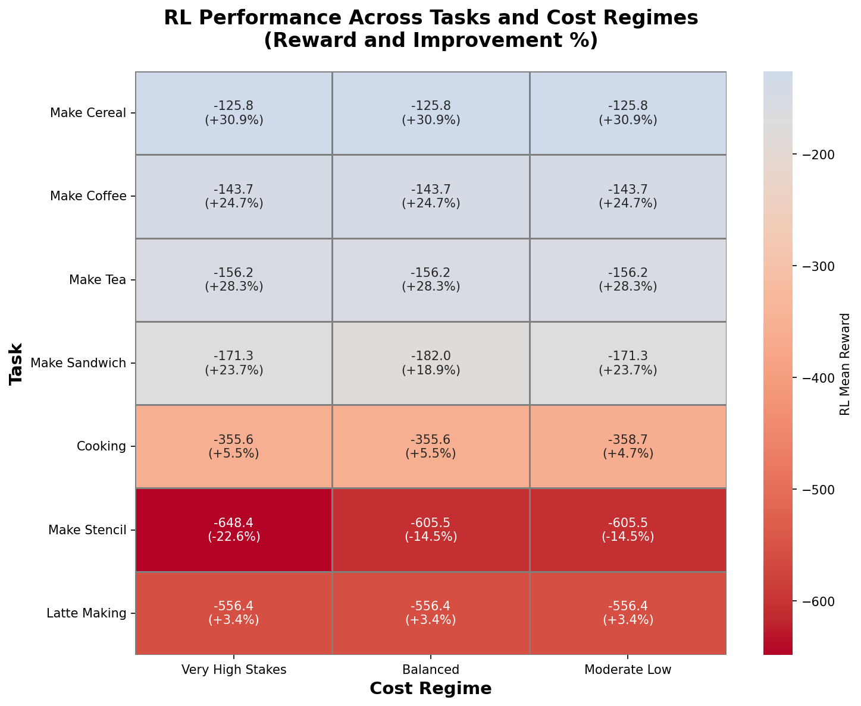
Performance Heatmap (NEW MODEL): Task × Regime
RL mean reward and improvement % for all 21 task-regime combinations

Slide 10
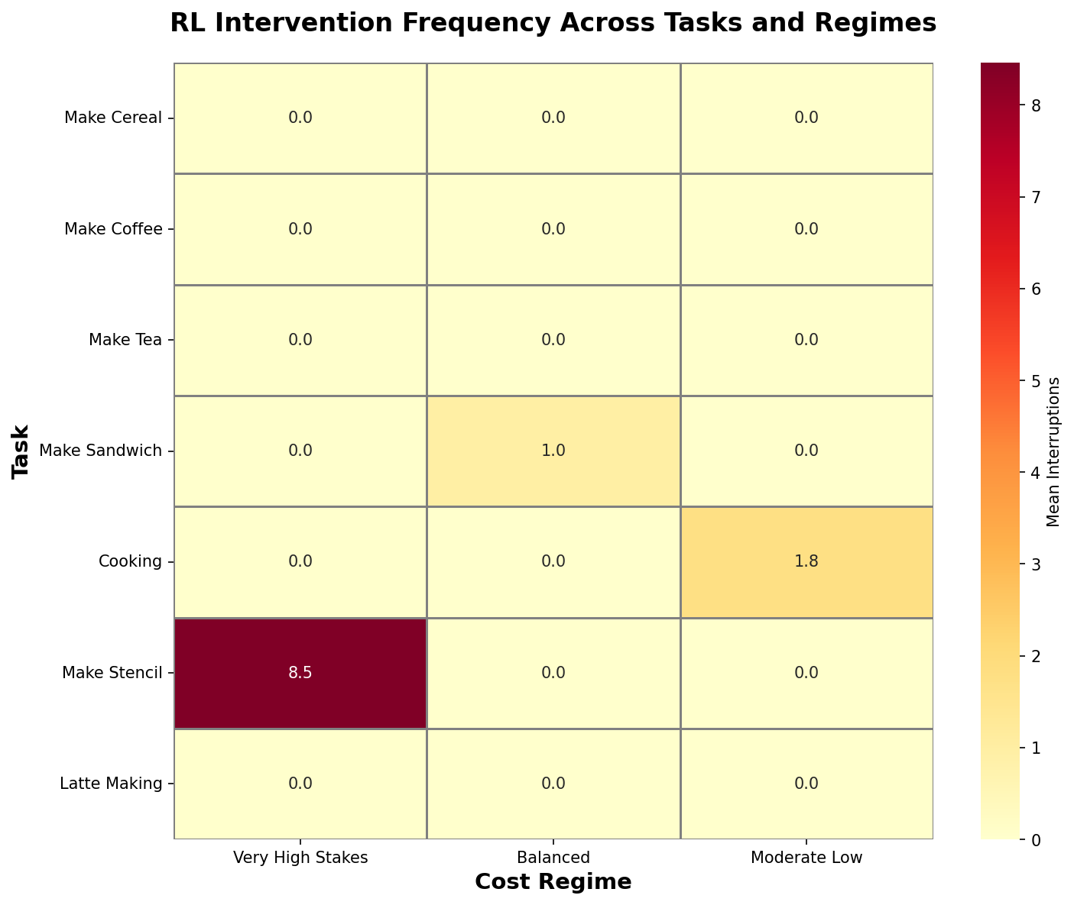
Intervention Frequency (NEW MODEL)
RL learns similar silence patterns despite stronger reminder effectiveness

Slide 11
Models That Performed Worse (NEW MODEL)
3 models showed negative improvement:
1. make_stencil / very_high_stakes: -22.65%
• Complex task (17 steps, safety-critical)
• High criticality multipliers (up to 2.5×)
• Needs precise timing for many critical steps
2. make_stencil / balanced: -14.54%
3. make_stencil / moderate_low: -14.54%
PATTERN: All failures are the same complex task (make_stencil)
→ Suggests timing learning is especially hard for complex procedures

Slide 12
Key Insights from Model Comparison
1. Stronger reminders ≠ automatically better RL performance
• Need to learn HOW to use the stronger tool effectively
2. Timing adds complexity to the learning problem
• Old model: Binary decision (remind or not)
• New model: Continuous timing decision (when to remind)
3. Simple flat effectiveness has an advantage:
• No timing pressure - reminder value doesn't decay rapidly
• Easier credit assignment - just learn which steps need reminders
4. Strategic silence still emerges:
• Even with 90-100% prevention, interruption costs dominate
• High baseline failure rate (f0=0.6) means many steps fail anyway

Slide 13
Implications for Real-World Systems
Finding 1: Perfect effectiveness alone doesn't guarantee better assistance
• System must also learn optimal TIMING of interventions
• May require more sophisticated training (curriculum learning, demonstrations)
Finding 2: Simpler models can outperform complex ones
• Flat effectiveness (old model) easier to optimize than timing-dependent (new)
• Trade-off: Realism vs. Learnability
Finding 3: Strategic silence is robust
• Emerges even when reminders are highly effective
• Interruption costs matter more than reminder strength
Design Recommendation:
• Start with simpler effectiveness models for RL training
• Add timing complexity only after mastering basic intervention strategy

Slide 14
Next Steps to Improve NEW MODEL
1. Longer training (200k timesteps)
• Give RL more time to discover timing strategies
2. Curriculum learning
• Start with flat effectiveness, gradually add timing constraints
• Learn intervention first, then refine timing
3. Adjust recency decay rate
• Try slower decay (λ=0.10 instead of 0.20)
• Wider effectiveness window (10-20 ticks instead of 5-10)
4. Hierarchical RL
• High-level policy: decide which steps to remind
• Low-level policy: decide when to give reminder
5. Expert demonstrations
• Show optimal timing patterns to bootstrap learning

Slide 15
Open Research Questions
Q1: What's the optimal recency decay rate for RL learning?
• Fast (λ=0.20): Realistic but hard to learn
• Slow (λ=0.05): Easier to learn but unrealistic
Q2: Can we design reward shaping to help timing discovery?
• Bonus for well-timed reminders (just before step completion)?
Q3: Does timing matter more for complex vs simple tasks?
• make_stencil (17 steps) failed, but make_cereal (8 steps) succeeded
Q4: Would human demonstrations accelerate timing learning?
• Imitation learning + RL fine-tuning?
Q5: Is there a sweet spot between flat and timing-dependent?
• Medium decay rate that balances realism and learnability?

Slide 16
Conclusions: Comparing the Two Models
OLD MODEL (Weak 45%, Flat Effectiveness):
✓ 24.21% mean improvement, 100% success rate
✓ Easier for RL to learn (no timing pressure)
❌ Unrealistic (reminders don't degrade over time)
❌ Led to counter-intuitive silence in high stakes
NEW MODEL (Strong 90-100%, Timing-Dependent):
✓ 13.92% mean improvement, 85.7% success rate
✓ More realistic (reminders degrade naturally)
❌ Harder for RL to learn (timing complexity)
❌ Some complex tasks performed worse
Key Takeaway: Realism vs. Learnability tradeoff
• More realistic models aren't always better for RL optimization
• May need specialized training approaches for timing-dependent systems

Slide 17
Recommendations for Future Work
For RL Training:
1. Use curriculum learning (flat → timing-dependent)
2. Increase training duration (200k+ timesteps)
3. Try slower recency decay (λ=0.10 vs 0.20)
For Model Design:
4. Balance realism with learnability
5. Consider hybrid: flat for learning, timing for deployment
For Research:
6. Investigate reward shaping for timing discovery
7. Compare hierarchical vs end-to-end timing learning
8. Test human demonstration bootstrapping
For Practice:
9. Start simple: master intervention strategy before adding timing
10. Monitor complex tasks separately (they need special treatment)

