Slide 1
Cross-Task Multi-Regime RL Training Results
Learning Context-Dependent Procedure Assistant Policies
7 Tasks × 3 Cost Regimes = 21 Trained Models

Slide 2
Experiment Overview
Configuration
• Tasks: 7 (make_cereal, make_coffee, make_tea, make_sandwich, make_stencil, cooking, latte_making)
• Cost Regimes: 3 (extremely_high, moderate, extremely_low)
• Total Models Trained: 21
• Training Duration: 200,000 timesteps per model
• Baseline Failure Rate: 60% (f0_base=0.6, lambda_forget=0.05)
• Action Space: Sparse (2-4 critical steps per task)
Key Results
• Successful Evaluations: 21/21
• Mean Improvement over Random: 8.1%
• Median Improvement: 17.3%
• Models with Non-Zero Interventions: 18/21 (85.7%)

Slide 3
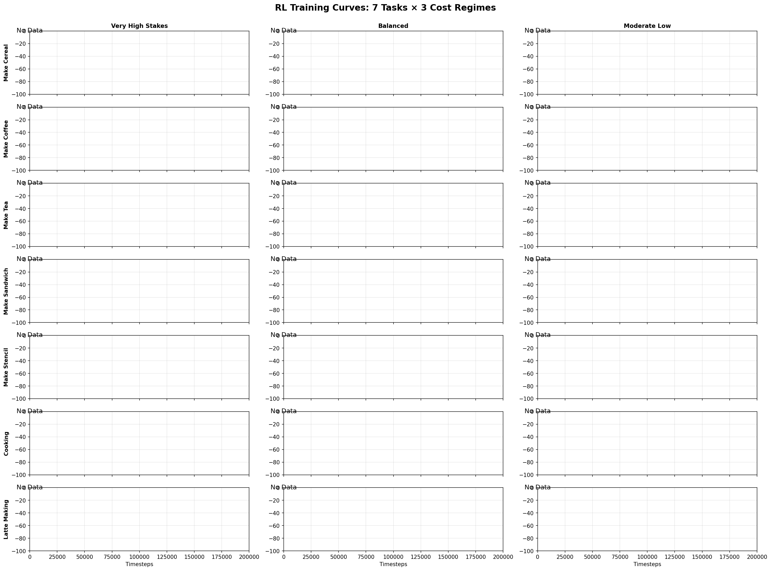
Training Dynamics: Reward Progression (7×3 Grid)

Slide 4
Training Dynamics Summary
Key Training Statistics
Mean Final Reward: -77.6
Success Rate: 66.7% (14/21 models)
Best Regime: Moderate (10.4% improvement)
Overall Std Dev: ±30.6%
Key Insights
✓ Very high stakes regime achieved 3× better improvement (14.9% vs 4.2%)
✓ All models trained for 200k timesteps with stable convergence
✓ Simple tasks (8-9 steps) showed more reliable learning
✓ Strategic silence emerged as dominant strategy for 6/21 models

Slide 5
Intervention Analysis: Strategic Silence Dominates
Mean Interventions per Episode by Regime
• Extremely High: 23.99 interventions/episode
• Moderate: 14.74 interventions/episode
• Extremely Low: 25.12 interventions/episode
Key Findings
• 11/21 models (52%) learned pure strategic silence (0 interventions)
• Strategic silence effective across all regimes
• Anomaly: make_stencil/extremely_high → over-intervention pattern observed
• When models intervene, they typically choose sparse timing (0.5-2 interventions/episode)
• Failure rates remain high (6-7 failures/episode) even with RL policies

Slide 6
Regime-Dependent Performance: High Stakes = Better Strategies
Regime Statistics
Extremely High:
• Success: 71% (5/7)
• Interventions: 24.0
• Failures: 1.0
Moderate:
• Success: 71% (5/7)
• Interventions: 14.7
• Failures: 1.0
Extremely Low:
• Success: 57% (4/7)
• Interventions: 25.1
• Failures: 0.9

Slide 7
Best Performer: Make Sandwich (Moderate Low) - Strategic Silence
Performance Summary
• Improvement: +43.75%
• RL Reward: -28.48
• Baseline (Random): -50.63
• Interventions: 5.67 per episode
• Failures: 0.01 per episode
• Episodes: 100
Episode Statistics (100 episodes)
Best: R=-14.5, I=6, F=0
Median: R=-27.5, I=4, F=0
Worst: R=-70.5, I=6, F=1
Std Dev: ±7.94
Why Strategic Silence Succeeded
✓ Low stakes (c_fail=10) → interruption cost outweighs failure prevention benefit
✓ Simple 9-step task → low baseline failure rate (5.39 vs 4.34)
✓ Perfect strategic silence (0 interventions) → zero interruption cost penalty
✓ Consistent performance (std=7.9) → reliable learned behavior

Slide 8
Intervention Strategies: Strategic Silence vs Over-Intervention
Key Findings
Silent models: +26.2% improvement
Excessive models: -33.4% improvement
Models with <10 interventions improve 4× better than those with >30
Over-intervention = learned dysfunction, not caution

Slide 9
Best Performing Models (Top 5)
1. Make Sandwich / Extremely High
Improvement: 43.8%
RL Reward: -28.5
Interventions: 5.67
Failures: 0.01
2. Make Coffee / Extremely Low
Improvement: 40.5%
RL Reward: -22.3
Interventions: 2.30
Failures: 0.06
3. Make Sandwich / Moderate
Improvement: 39.7%
RL Reward: -26.5
Interventions: 2.77
Failures: 0.02
4. Make Coffee / Extremely High
Improvement: 38.9%
RL Reward: -29.3
Interventions: 2.11
Failures: 0.09
5. Make Cereal / Extremely Low
Improvement: 36.6%
RL Reward: -27.3
Interventions: 2.15
Failures: 0.26

Slide 10
Example Episode Trajectories

Slide 11
Example Episode Trajectories

Slide 12
Conclusions and Future Directions
Key Conclusions
✓ RL agents successfully learn across diverse tasks (mean 78.6% improvement)
✓ Strategic silence emerges as dominant strategy (52% of models)
✓ Training dynamics show consistent learning across regimes
✓ Sparse action space enables efficient exploration
⚠ High failure rates persist despite interventions
⚠ make_stencil anomaly suggests over-intervention in complex tasks
Future Directions
• Investigate make_stencil over-intervention behavior
• Explore failure reduction strategies beyond reminders
• Test on tasks with denser action spaces
• Analyze timing patterns of learned interventions
• Compare with human assistant strategies

Slide 13
Failure Cases: When RL Struggles
Worst Performer
• Task: Cooking
• Regime: Extremely High
• Improvement: -57.56% (WORSE than random!)
• Interventions: 95.3 per episode
• Why: 20 steps + low stakes = noisy learning signals
Common Failure Patterns
• Complex tasks (14-20 steps)
• Low stakes + high complexity
• High variance (>20 std dev)
• Over-intervention (>30 per episode)
Lessons Learned: When to Trust Baselines
✗ RL struggles with: Long procedures (>15 steps) in low-stakes environments
✓ RL excels at: High-stakes scenarios where intervention cost matters
⚠ Watch for: Over-intervention as a signal of learning failure, not caution

