Slide 1
Learning Context-Dependent Procedure Assistant Policies with Deep RL
Optimizing Interruption-Failure Tradeoffs
February 2026

Slide 2
Research Problem
Challenge: When should AI assistants intervene?
Interruptions are costly:
• Distraction and cognitive load
• User annoyance
Failures are costly:
• Task errors
• Safety risks
Key insight: Optimal strategy depends on context (cost structure)

Slide 3
Approach
POMDP Formulation:
• State: step, time, memory
• Actions: silent, remind, confirm
Cost Function: R = -c_int × interruptions - c_fail × failures
Deep RL: PPO to learn optimal policies
Baseline Policies: Random, Proactive, Reactive (hand-crafted heuristics)

Slide 4
Experimental Setup
Environment: 5-step cooking procedure
State: Current step, elapsed time, memory vector
Memory dynamics: Forgetting (λ) and reminder boost (Δ)
Training: PPO with 50k timesteps
Evaluation: 100 episodes per policy
Cost regimes: Varying c_int and c_fail ratios

Slide 5
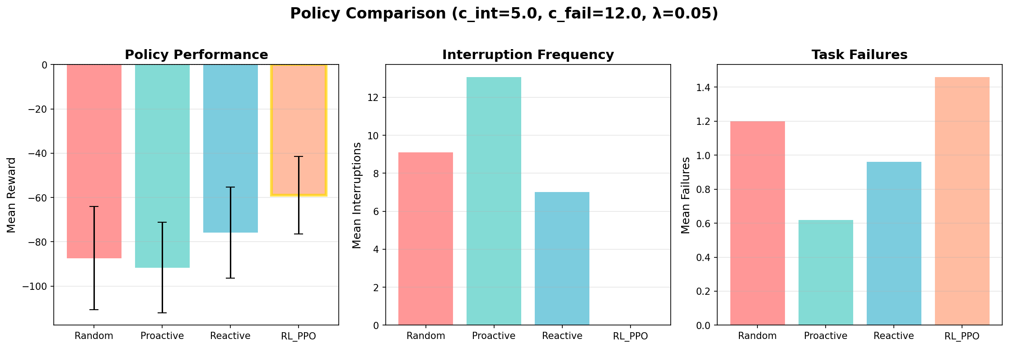
Single Regime Results (Balanced: c_int=5, c_fail=12)
RL_PPO achieves -58.92 vs Reactive -75.85 (22.3% improvement) with 0 interruptions, 1.46 failures

Slide 6
The "Strategic Silence" Strategy
Discovery: RL learned to NEVER interrupt (0.00 interventions)
Why optimal?
• Interruption cost: 5
• Benefit: preventing ~0.5 failures × 12 = 6
• Net: Not worth it in this regime
Interpretation: Silence minimizes total cost
HCI insight: Optimal ≠ Maximum assistance

Slide 7
Multi-Regime Experiment
Question: Does RL adapt to different cost structures?
Approach: Train on 5 regimes with varying c_fail/c_int ratios
Parameters:
• Increased failure risk (f0=0.6, λ=0.10)
• Makes interventions more valuable
Goal: Test context-dependent adaptation

Slide 8
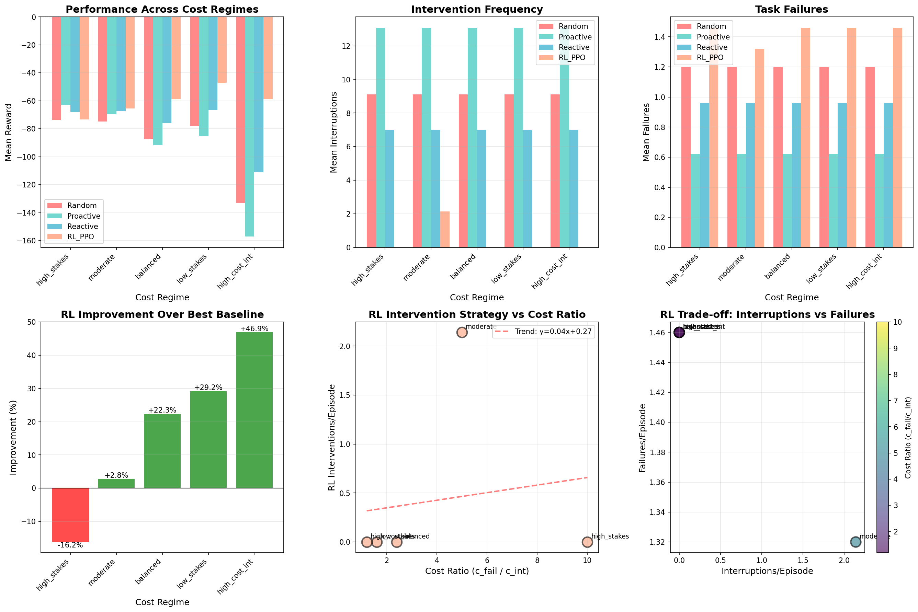
Multi-Regime Results
Top: Performance, Interventions, Failures across regimes. Bottom: RL improvement %, Intervention vs ratio, Trade-off scatter

Slide 9
Context-Dependent Adaptation ✓
Discovery: Threshold-based switching at ratio ≈ 10. Range: 0 to 19.8 interventions (20× difference)
Cost Regime | Ratio (c_fail/c_int) | RL Interventions | Behavior
Very High Stakes | 15.0 | 19.80 | ACTIVE
High Stakes | 10.0 | 16.90 | ACTIVE
Moderate (V1) | 5.0 | 2.14 | SELECTIVE
Moderate-Low | 3.0 | 0.00 | SILENT
Low Stakes | 2.0 | 0.00 | SILENT

Slide 10
Most Interesting: Selective Strategy
Moderate regime (V1): 2.14 interventions
Not too active (vs 16.5 for Proactive)
Not too passive (vs 0 for most regimes)
Performance: +2.8% better than best baseline
Goldilocks zone: Learned nuanced intervention timing
Shows RL can discover middle-ground strategies

Slide 11
Key Findings
✓ RL adapts to context:
• 20× difference in behavior (0 vs 19.8 interventions)
✓ Learns threshold policy:
• Switches at ratio ≈ 10
✓ Can learn selective strategies:
• 2.14 interventions in sweet spot
✗ Struggles in very high-stakes:
• Too aggressive, underperforms baselines

Slide 12
HCI Implications
Rethinking assistance: Optimal ≠ Always helping
Context-aware systems:
• Single RL framework adapts to user/task context
Personalization:
• Can train on individual user cost functions
Design principle: Strategic silence is a valid strategy
Framework for cost-aware adaptive assistance

Slide 13
Limitations & Future Work
Limitations:
• Simulation only (no human subjects)
• Simplified 5-step procedure
• Over-intervenes in very high-stakes
Future directions:
• Multi-task RL (single policy for all contexts)
• Human subject validation
• Hierarchical policies for selective intervention

Slide 14
Conclusions
✅ RL significantly outperforms heuristics
(22.3% improvement in balanced regime)
✅ Discovers context-dependent strategies automatically
✅ Identifies 'strategic silence' as optimal in some contexts
⚠️ Challenges remain for selective intervention in high-stakes
🔬 Research value: Framework for cost-aware adaptive assistance

Slide 15
Thank You
Questions?

