Slide 1
Learning Context-Dependent Procedure Assistant Policies
Dec-POMDP + IPPO — Multi-Agent RL for Cooperative Assistance
7 tasks × 3 failure-cost regimes × 15 training rounds comm=cheap_narrate | decay=step_transition | obs=durable

Slide 2
Problem Setting
When should an AI assistant speak up — and when stay silent?
• Human performs sequential procedural tasks (cooking, crafting, …)
– N steps, each with a specific order; some steps are safety-critical
– Execution order varies across rollouts (partial flexibility)
• Human has memory that degrades between steps
– Memory determines failure probability f(m) = f₀ · exp(−k · m)
– Without support: f₀ = 60% failure at zero memory
• AI assistant observes (partially) and must decide each tick:
– Remind a critical step? Confirm what the human is doing? Stay silent?
• Core tension:
– Interrupting too much → interruption cost, slows human
– Interrupting too little → steps fail, high failure cost
• Research question: Can RL learn context-dependent policies that adapt to cost structure?

Slide 3
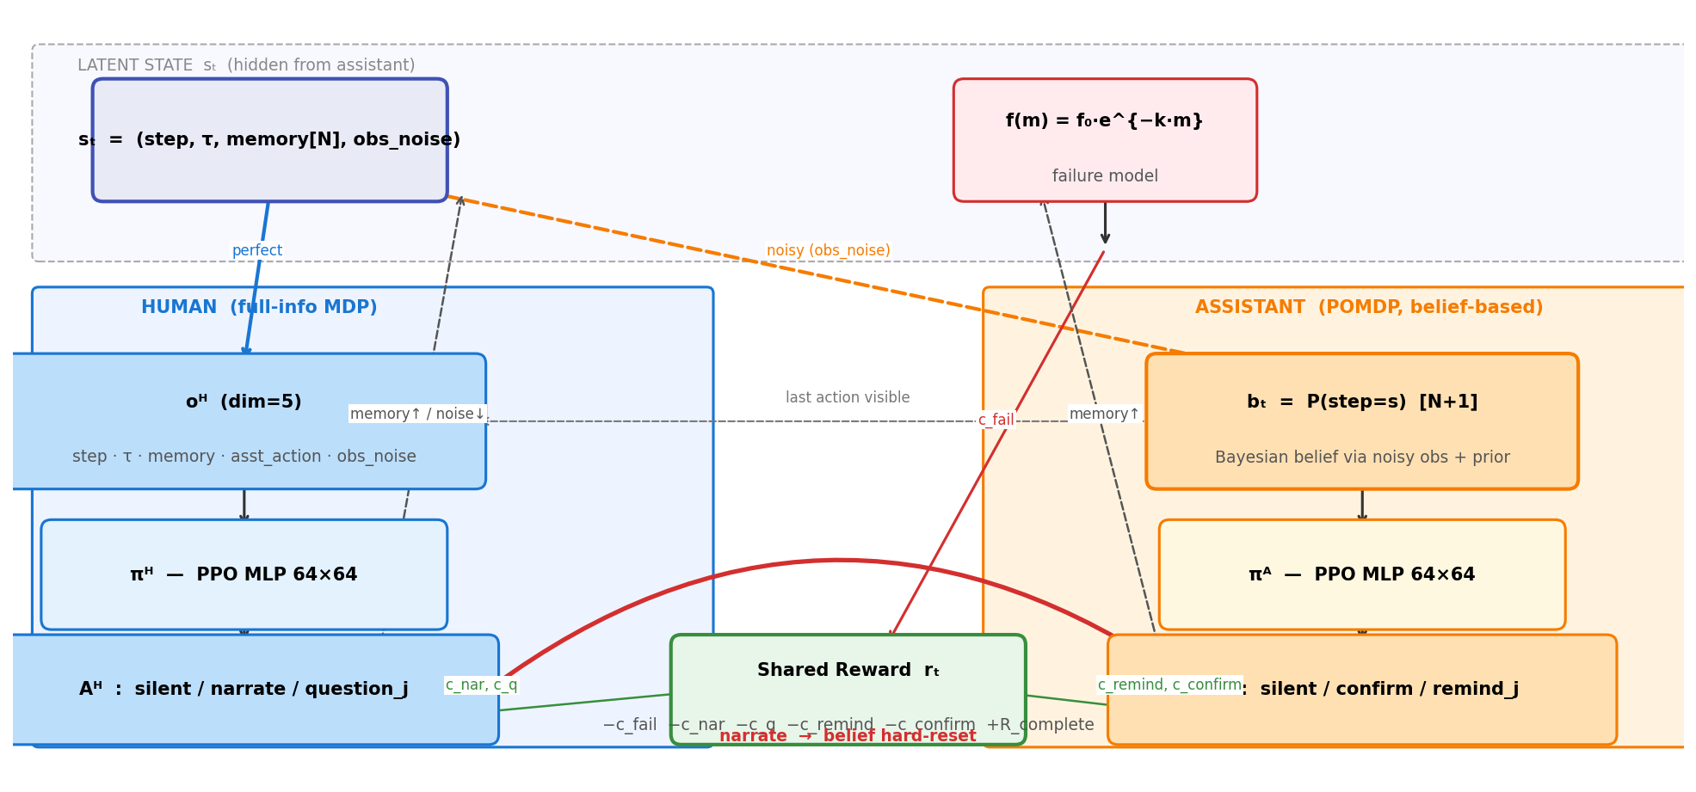
Dec-POMDP System Overview
Human: full-info MDP | Assistant: POMDP with Bayesian belief | Shared cooperative reward

Slide 4
Agent Observation & Action Spaces
Key asymmetry: Human has perfect state info; Assistant infers via Bayesian belief
HUMAN AGENT (MDP)
ASSISTANT AGENT (POMDP)
• Observation oᴴ (dim = 5)
– current_step — exact (perfect channel)
– τ — elapsed ticks (exact)
– memory[current_step] (own memory, exact)
– assistant_last_action
– obs_noise_state
• Actions Aᴴ (size = 2 + Nc)
– silent
– narrate → belief hard-reset + obs_noise ↓
– question_j → memory[crit_j] += 0.4
• Observation oᴬ (dim = N+1 + Nc + 1)
– step_belief[N+1] — Bayesian posterior P(step=s)
– memory_estimate_critical[Nc] (inferred, never ground truth)
– human_last_action
• Actions Aᴬ (size = 2 + Nc)
– silent
– confirm → costs c_confirm
– remind_j → memory[crit_j] += 0.8
· + c_off_timing penalty if wrong step
↔ last action visible ↔

Slide 5
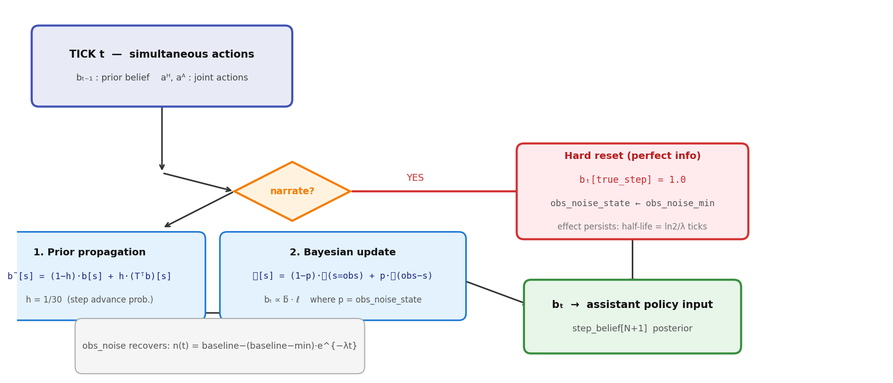
Belief Update Mechanism (per tick)
Prior propagation + Bayesian update each tick | Narration bypasses with hard reset

Slide 6
Simulation Parameters — 4 Orthogonal Axes
Each experiment = one combination of (fail_regime, comm_regime, decay_regime, obs_regime)
1. Failure Cost
2. Comm Cost
3. Memory Decay
4. Obs Noise
extremely_low: scale = 2.0 balanced: scale = 15.0 extremely_high: scale = 50.0 c_fail_per_step = scale × criticality
default: c_nar=0.5 c_remind=1.0 c_q=0.5 c_confirm=1.0 cheap_narrate: c_nar=0.1 c_remind=1.0 c_q=0.5 c_confirm=0.5 c_off_timing = 3.0 (both)
default: λ_forget = 0.03 memory_init = 0.0 step_transition: λ_forget = 0.10 memory_init = 0.3 Decay at step transition: m *= (1−λ)^elapsed
default: λ_recover = 0.10 half-life ≈ 7 ticks (< 1 step avg.) durable: λ_recover = 0.02 half-life ≈ 35 ticks (≈ 1 step avg.) obs_noise_min = 0.05
Fixed: f₀=0.6 k=3.0 δ_remind=0.8 δ_q=0.4 R_complete=10.0 β=1.0 step_dur=30±10 tick | PPO: lr=3e-4 n_steps=2048 batch=64 epochs=10 γ=0.99

Slide 7
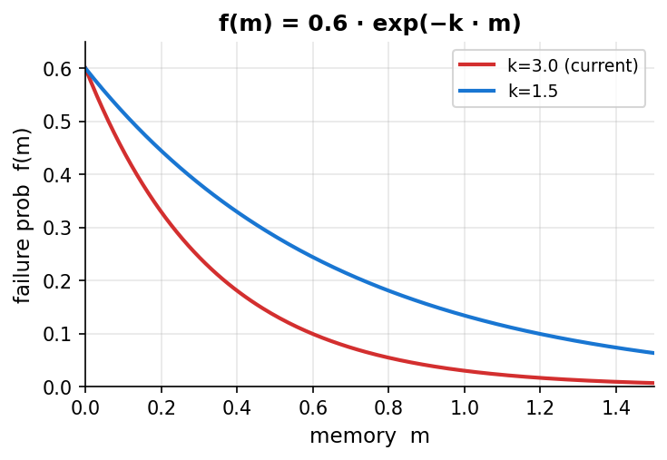
Failure Model & Task Overview
Discrete hazard model with memory-dependent failure probability
7 Tasks
Task
N
Nc
c_fail base
Domain
make_coffee
8
1
12.0
cooking
make_cereal
8
2
10.0
cooking
make_tea
9
2
12.0
cooking
make_sandwich
9
1
15.0
cooking
cooking
14
4
20.0
cooking
make_stencil
17
4
30.0
crafting
latte_making
20
2
25.0
technical

Slide 8
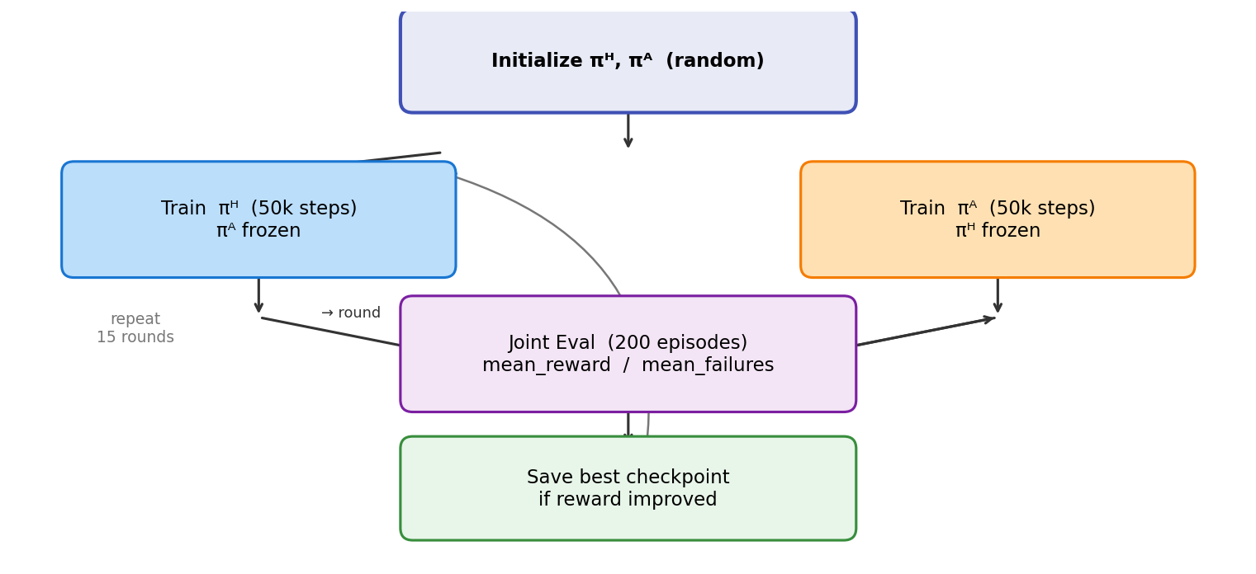
IPPO Training Procedure
Alternating best-response: fix one agent, train the other; repeat for 15 rounds
• Independent PPO (IPPO)
– Each agent has its own policy network
– No shared parameters between agents
• Alternating best-response training
– Odd round: fix πᴬ, train πᴴ for 50k steps
– Even round: fix πᴴ, train πᴬ for 50k steps
• Checkpoint saving
– Save if joint eval reward improves
– Final eval uses best checkpoint
• Total compute per task × regime
– 15 rounds × 2 × 50k = 1.5M env steps
– 3 regimes = 4.5M steps per task

Slide 9
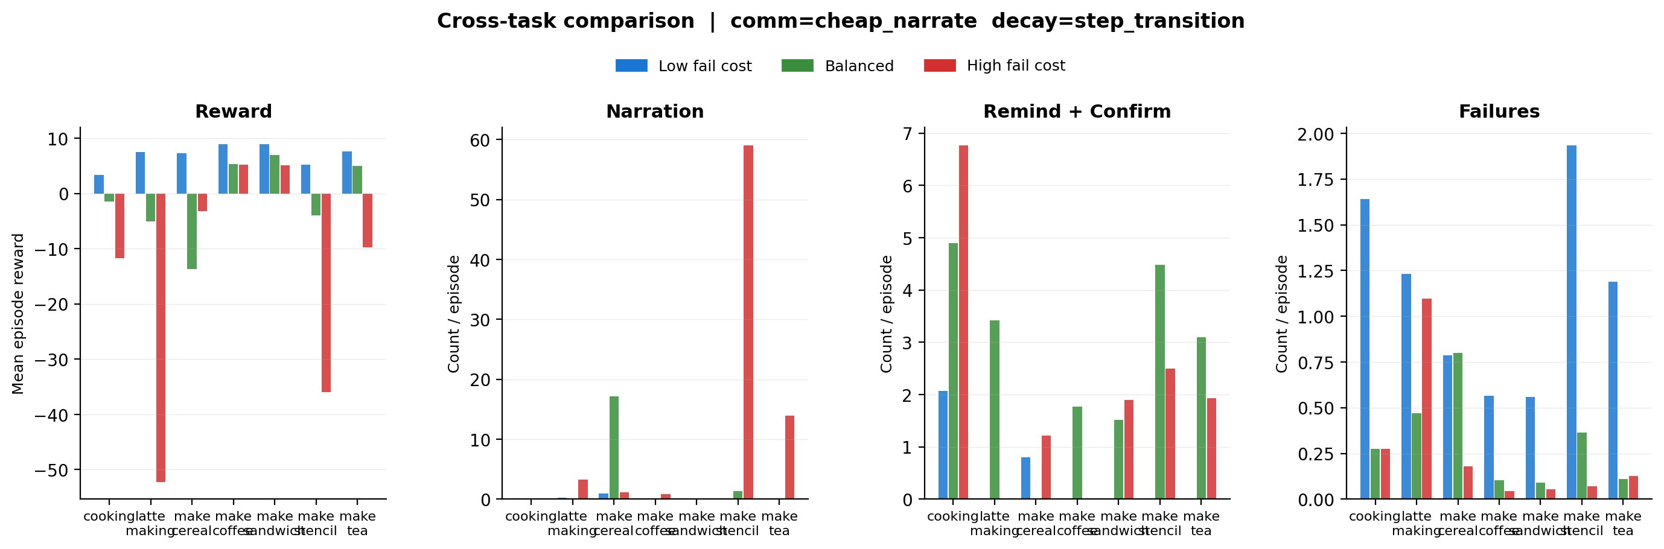
Results: Cross-Task Summary
Final eval across 7 tasks × 3 failure-cost regimes | comm=cheap_narrate decay=step_transition obs=durable

Slide 10
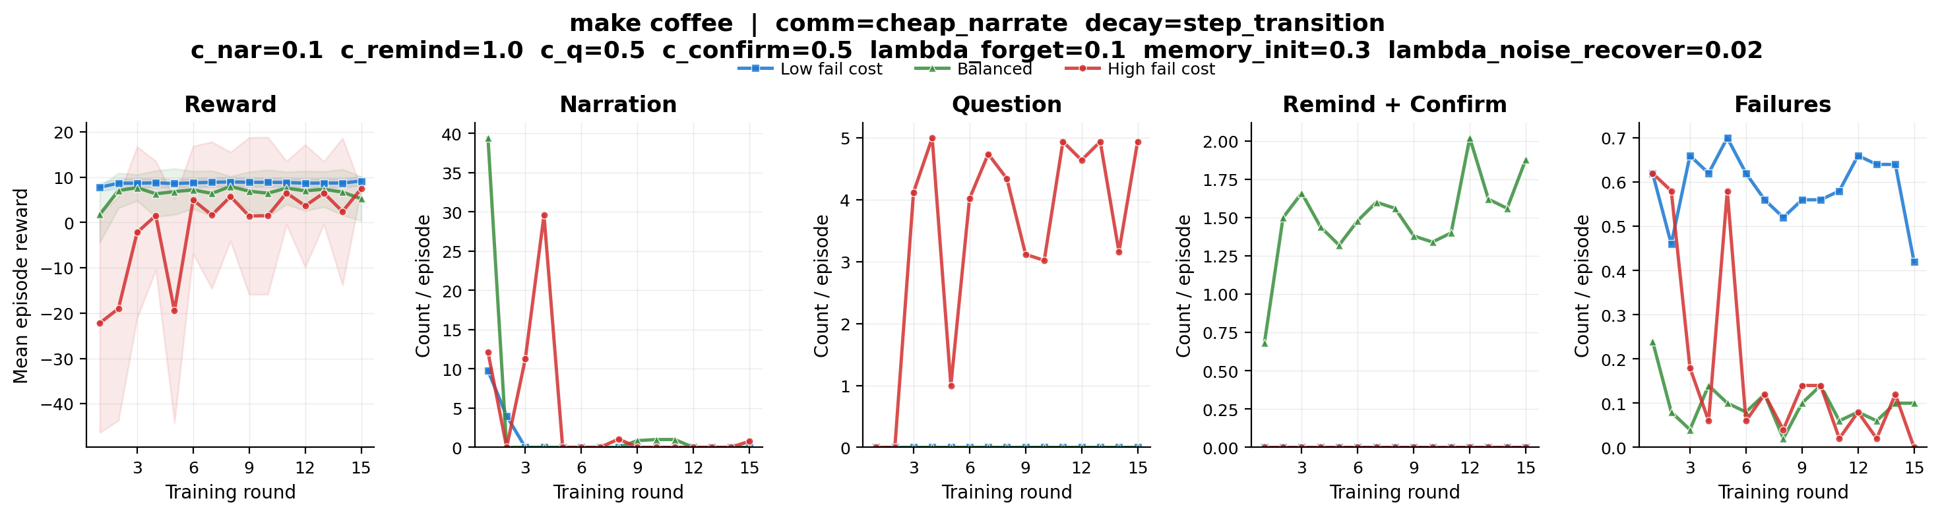
Learning Curves: Make Coffee
Reward, Narration, Questions, Remind+Confirm, Failures vs training round
extremely_low reward=+8.87 fail=0.56 narr=0.00 balanced reward=+5.34 fail=0.10 narr=0.00 extremely_high reward=+5.18 fail=0.04 narr=0.82

Slide 11
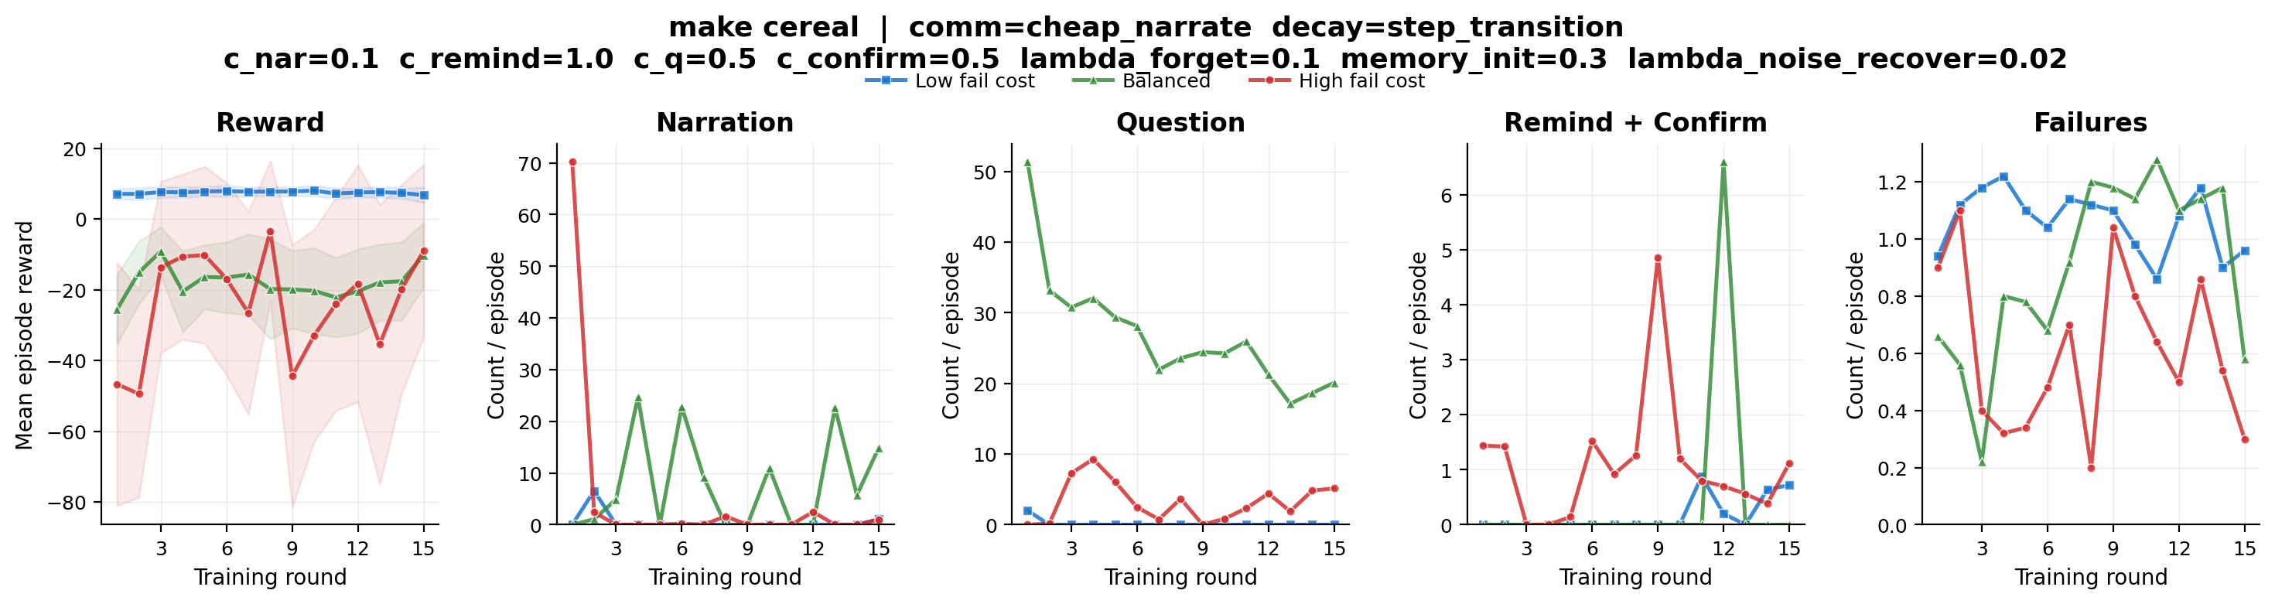
Learning Curves: Make Cereal
Reward, Narration, Questions, Remind+Confirm, Failures vs training round
extremely_low reward=+7.31 fail=0.79 narr=0.96 balanced reward=-13.74 fail=0.80 narr=17.13 extremely_high reward=-3.20 fail=0.18 narr=1.16

Slide 12
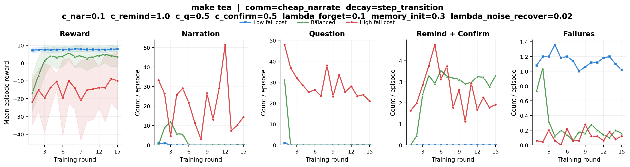
Learning Curves: Make Tea
Reward, Narration, Questions, Remind+Confirm, Failures vs training round
extremely_low reward=+7.62 fail=1.19 narr=0.00 balanced reward=+4.97 fail=0.11 narr=0.00 extremely_high reward=-9.77 fail=0.12 narr=13.95

Slide 13
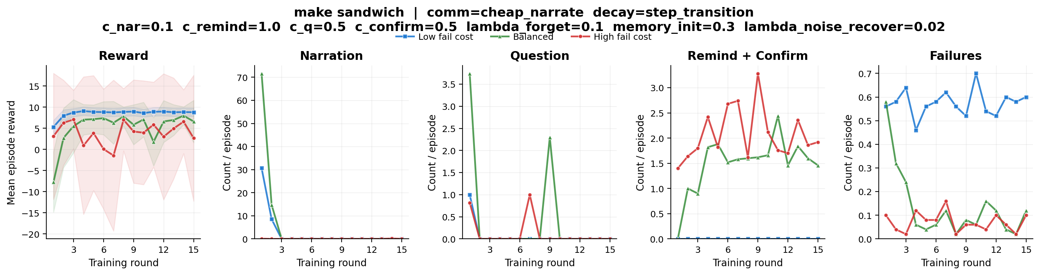
Learning Curves: Make Sandwich
Reward, Narration, Questions, Remind+Confirm, Failures vs training round
extremely_low reward=+8.88 fail=0.56 narr=0.00 balanced reward=+6.93 fail=0.09 narr=0.00 extremely_high reward=+5.07 fail=0.06 narr=0.00

Slide 14
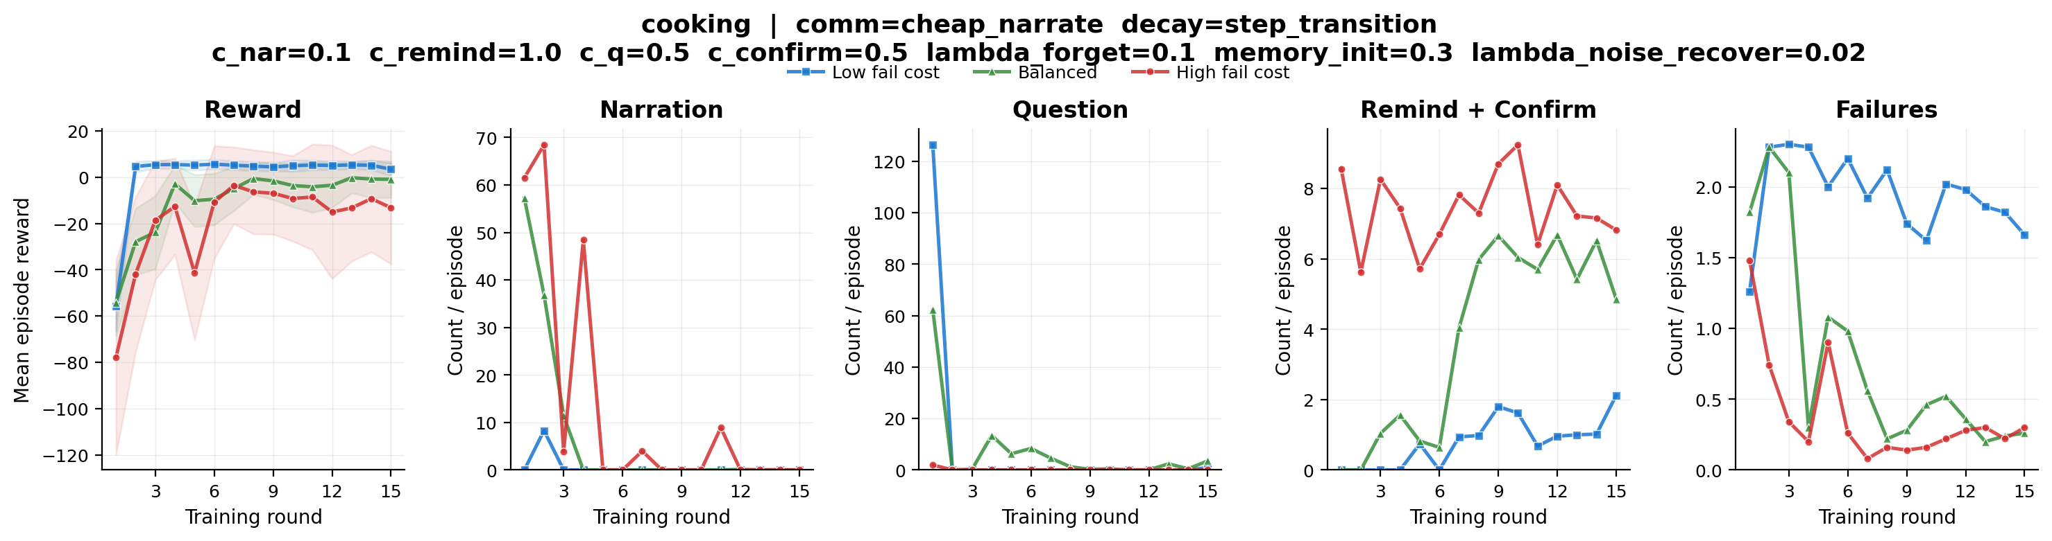
Learning Curves: Cooking
Reward, Narration, Questions, Remind+Confirm, Failures vs training round
extremely_low reward=+3.39 fail=1.64 narr=0.04 balanced reward=-1.49 fail=0.28 narr=0.00 extremely_high reward=-11.71 fail=0.28 narr=0.00

Slide 15
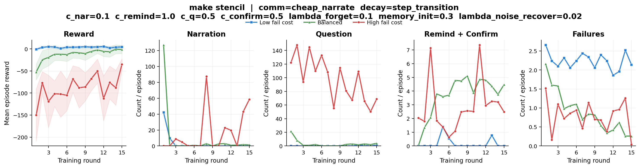
Learning Curves: Make Stencil
Reward, Narration, Questions, Remind+Confirm, Failures vs training round
extremely_low reward=+5.18 fail=1.94 narr=0.00 balanced reward=-3.95 fail=0.36 narr=1.35 extremely_high reward=-36.00 fail=0.07 narr=59.05

Slide 16
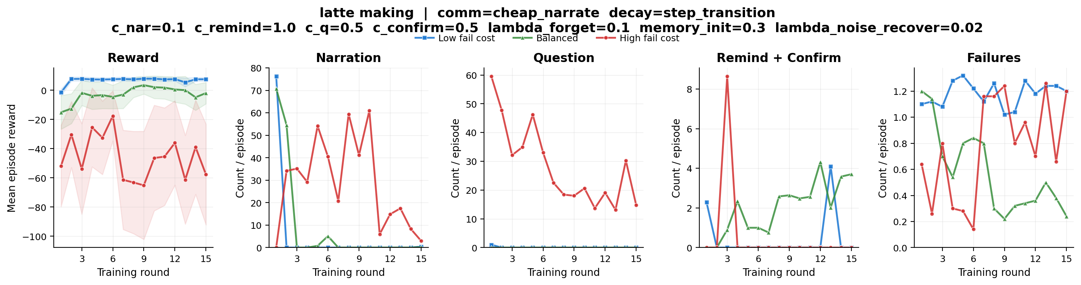
Learning Curves: Latte Making
Reward, Narration, Questions, Remind+Confirm, Failures vs training round
extremely_low reward=+7.51 fail=1.23 narr=0.28 balanced reward=-5.04 fail=0.47 narr=0.17 extremely_high reward=-52.29 fail=1.09 narr=3.29

Slide 17
Key Findings
What the agents learned across 7 tasks × 3 failure-cost regimes
• Strategic silence is the dominant strategy at low failure cost
– Agents learn to trust human and stay silent → minimal interruption cost
• Narration is rarely learned (obs=durable reduces spurious narration loops)
– Most narration appears only in high-cost regimes with complex tasks
– make_stencil (17 steps) still shows narr≈59 at extremely_high
• Question-asking is the primary cooperation signal at medium/high cost
– make_cereal balanced: narr=17 — cereal has 2 critical steps, questioning pays off
• Remind-based strategy emerges for assistant when failure cost is high
– cooking extremely_high: interact=6.77/ep, failures reduced to 0.28
• Task complexity drives strategy divergence
– Simple tasks (make_coffee, make_sandwich): reward stays positive even at high cost
– Complex tasks (latte_making 20 steps): harder convergence, reward −52 at high cost
• Durable obs regime (half-life 35 ticks) successfully eliminates narration=100 loops
– make_stencil: was narr=101 with default obs → now narr=59 (1 narrate/critical step)

Slide 18
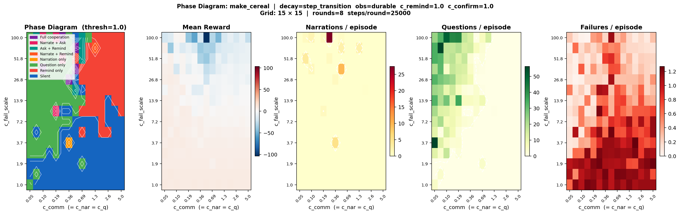
Phase Diagram: Emergent Communication Regimes
15×15 grid search | c_comm (=c_nar=c_q) × c_fail_scale | c_remind=1.0 fixed | make_cereal
• Clear phase transitions emerge along two axes:
– Low c_fail (< 5): Silent — interruption cost dominates, agents learn to stay quiet
– High c_fail + low c_comm: Question-dominated — cheap info-seeking to prevent costly failures
– High c_fail + high c_comm: Remind-only — assistant uses minimal targeted interventions
• Boundary at c_fail ≈ 5–15 marks the transition from silence to active cooperation
• Narration is rarely used — question is strictly preferred when c_q = c_nar

Slide 19
Discussion
Interpretation, limitations, and open questions
• Why does IPPO converge to strategic silence in low-cost regimes?
– Interruption costs outweigh expected failure cost savings → optimal to stay quiet
– Both agents independently learn this equilibrium without communication
• Narration vs. questioning: different information channels
– Narration: hard-resets assistant belief, but costs c_nar each time
– Question: boosts human memory directly, cheaper with cheap_narrate regime
• The durable obs regime changes narration economics
– Longer-lasting effect per narration → fewer narrations needed
– Agents find narration more 'efficient' when each narration persists longer
• Limitations
– IPPO may not converge to true Nash equilibrium — only local best responses
– 15 rounds may not be sufficient for complex tasks (latte_making)
– Simulation assumes discrete ticks; real tasks are continuous
– Human policy is also learned — may not reflect real human behavior
• The 4-axis regime structure enables systematic ablation
– Each axis can be varied independently to isolate effects

Slide 20
Next Steps
Future work directions
• Extend phase diagram analysis
– Run grid search on complex tasks (cooking, make_stencil, latte_making)
– Add asymmetric cost axis: vary c_nar independently from c_q
– Higher resolution at phase boundaries for sharper transitions
• Ablation studies across all 4 regime axes
– Compare durable vs default obs regime across all tasks
– Isolate memory decay effect: default vs step_transition
• More training rounds for complex tasks
– latte_making extremely_high shows −52 reward — needs more rounds or larger network
– Try 30 rounds or adaptive stopping based on convergence
• Richer agent architectures
– Replace MLP with LSTM to handle temporal dependencies within a step
– Attention over belief state for assistant
• Real human evaluation
– Replace learned human policy with human subjects in a user study
– Measure whether learned assistant policy transfers to real humans
• Additional task domains
– Medical procedures, lab protocols, manufacturing checklists
– Tasks with irreversible failures (higher stakes than c_fail=50)

