Slide 1
A buried requirement becomes a missed deliverable
BriefProof
Deliver what the brief actually asks for
Project scopes get read once.
Delivery decisions need their evidence every day.
BriefProof
01
Notes:
Problem: requirements are scattered across rubrics and client briefs. This is a product hypothesis based on the target workflow, not measured survey data. Introduce BriefProof and its capstone context.

Slide 2
Teams with a brief and a deadline
Student capstone teams
Turn assignment rubrics into a reviewed delivery checklist.
Small agencies and independent builders
Keep client scope commitments beside their original evidence.
BriefProof
02
Notes:
Initial audience: student capstone teams, independent project builders and small agencies. First pilot proposed with a few student teams. No customer acquisition figures are claimed.

Slide 3
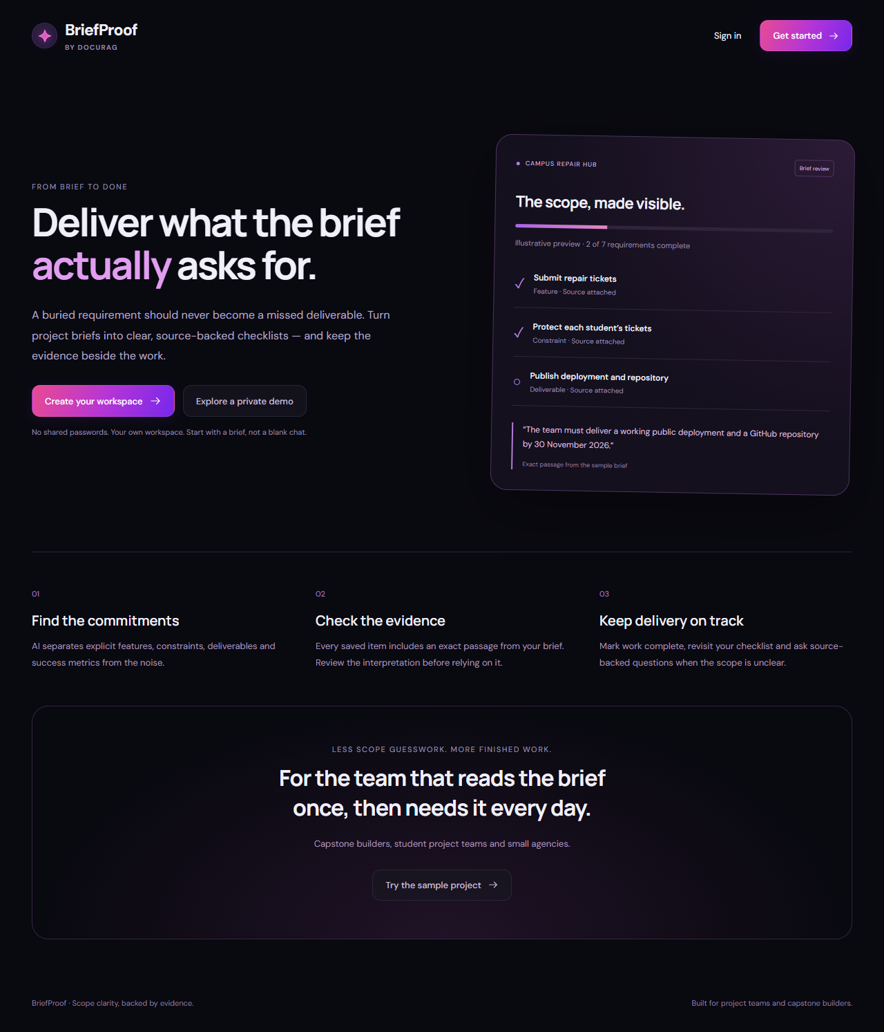
BriefProof: the scope, made visible
Save a brief.
Review the commitments.
Keep the source.
Track completion and export a checklist your team can use.
BriefProof
03
Notes:
Product screenshot: public production homepage captured during implementation. The homepage preview is explicitly illustrative. Checklist extraction is a live model call only when requested in a saved brief.

Slide 4
A three-minute product workflow
01 Enter a private workspace
02 Save a brief and generate the checklist
03 Compare a requirement with its exact source
04 Save progress, refresh and verify a detail
05 Export the delivery checklist
BriefProof
04
Notes:
Demo: enter private sample workspace, save a new text brief, generate live AI requirements, inspect the quote, mark completion and refresh, then ask the pilot budget question. The sample checklist is preloaded and must not be described as fresh inference. Export the checklist.

Slide 5
AI and technical architecture
Next.js + React
Authenticated APIs → Prisma → PostgreSQL + pgvector
Groq extraction → exact quote validation → saved checklist
MiniLM retrieval + reranking → Groq evidence verification
AI labels need review. Original sources stay visible.
BriefProof
05
Notes:
Implementation source: repository README, lib/requirements.js, lib/rag.js, lib/auth.js and Prisma schema. Exact quote matching checks presence, not completeness or every interpretation. Source answers use the existing evidence support check and original passages. User ownership is checked on each request.

Slide 6
Value and a business hypothesis
Less manual scope transcription
Evidence when a requirement is disputed
Progress that outlasts a chat response
Pilot: time to a reviewed checklist, missed requirements and repeat use.
Future hypothesis: free individual use and paid team workspaces.
BriefProof
06
Notes:
Value propositions and business model are hypotheses. Billing is not implemented. Pilot should measure time to first reviewed checklist, requirements missed according to human reviewers and repeat progress updates. No unsupported revenue, user or accuracy statistics.

Slide 7
Roadmap and pilot invitation
Now
Private briefs, evidence, progress and export
Next
Account recovery, scope revisions and reviewer edits
Pilot ask
Try BriefProof with a real project brief.
Tell us what the checklist missed.
BriefProof
07
Notes:
Now: private signup, checklists, PDFs, persistent completion, source questions and export. Next: email verification/recovery, brief revisions and reviewer editing. Later: team workspaces, integrations and validated billing. Recruit a few student teams and collect feedback on completeness.

