Slide 1
Emotion Recognition From Text
Presented By:
Rishit Kumar Ojha
Anshuman Agarwal
Adit Jain
Aman Gehlout
Ujjwal Sharma

Slide 2
Introduction
Emotion detection in text data involves identifying the emotions expressed in textual data. This can be a challenging task since emotions are often expressed in complex and subtle ways. Natural language processing (NLP) techniques can be used to analyse text data and identify the emotions expressed in it.
The aim of this project is to develop a model that uses NLP techniques to accurately detect emotions in text data. The model can be used for sentiment analysis, customer feedback analysis, and social media monitoring. The model is trained on a dataset of text data that has been labelled with the corresponding emotions expressed in it.

Slide 3
Motivation
In today’s digital age, a large portion of communication happens through text — emails, chats, and social media.
Understanding the emotional tone behind this text is crucial for applications in customer service, mental health, marketing, and more.
However, machines often lack the ability to accurately interpret human emotions from text.
Our system aims to address this gap by using NLP to recognize and classify emotions in textual data, enabling more emotionally aware and responsive AI solutions.

Slide 4
Problem Significance
With the rise of digital communication, people increasingly express their thoughts and emotions through text on platforms like social media, emails, and chat applications.
However, most systems still lack the ability to interpret the emotional tone behind this text, limiting their effectiveness in understanding user intent and response.
This gap is especially critical in areas such as customer support, mental health monitoring, and sentiment-driven marketing.
In this project, we use Natural Language Processing (NLP) techniques to detect and classify emotions from text, enabling machines to understand human emotions more effectively and respond appropriately.

Slide 5
Related Works 📃
Several systems have been developed to recognize emotions from text using various machine learning and deep learning approaches.
Two comparable works include: “Deep Learning for Emotion Recognition in Text” and “Emotion Detection from Text using NLP Techniques”.
These existing systems primarily focus on emotion detection using either classical ML or neural networks, often limited to small emotion sets.
In contrast, our system leverages Natural Language Processing techniques with a focus on multi-label emotion classification using the GoEmotions dataset — a human-annotated dataset by Google containing 58 fine-grained emotion labels.

Slide 6
Dataset Details
For this project, we use the GoEmotions dataset, a comprehensive emotion dataset derived from Reddit comments. It consists of:
Total Data Samples: 58,000+ text instances
Emotion Categories: 27 distinct emotions including joy, sadness, anger, fear, surprise, etc.
Data Splits:
Training Set: 80% of the total dataset
Test Set: 20% for final model evaluation
Each instance in the dataset consists of a short text and its corresponding emotion label(s). The dataset is pre-processed to remove noisy labels and duplicate entries.

Slide 7
Text Preprocessing
To enhance the quality of input data, the following normalization techniques are applied:
Stemming: Reduces words to their root form (e.g., "running" → "run").
Lemmatization: Converts words to their base dictionary form (e.g., "better" → "good").
Lowercasing: Converts all text to lowercase for uniformity.
Stopword Removal: Eliminates common words like "the," "is," and "and" that do not contribute to emotion classification.
Punctuation and Special Character Removal: Cleans text by removing unnecessary symbols.

Slide 8

Logistic Regression
This project employs Logistic Regression as the primary classification model. Logistic Regression is a statistical model that predicts the probability of a categorical outcome based on input features. In text classification, it is commonly used to determine the likelihood of a given text belonging to an emotion category.
Understanding Logistic Regression:
Logistic Regression is a linear model used for binary and multiclass classification problems. It applies the logistic (sigmoid) function to map predicted values to probabilities between 0 and 1. The equation for Logistic Regression is given by:

Slide 9
Model Architecture
The proposed model consists of the following steps:
Text Preprocessing: Tokenization, stopword removal, and stemming.
Feature Extraction: Applying TF-IDF (Term Frequency-Inverse Document Frequency) to convert text into numerical vectors.
Classification Model: Logistic Regression is trained on labelled data to predict emotions.
Prediction Output: The model generates probability scores for each emotion category and assigns the most probable emotion to a given text.

Slide 10
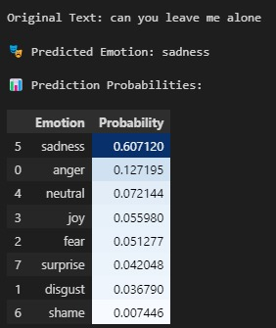
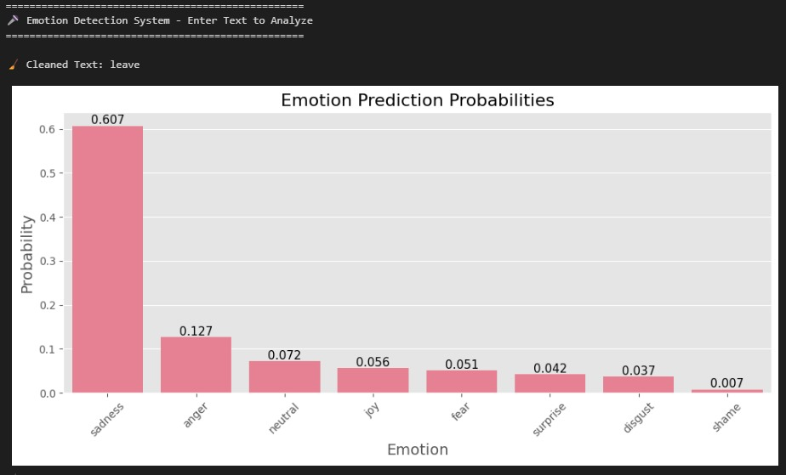
Emotion Recognition From Text

Slide 11
Emotion Recognition From Text
Emotion Recognition from Text is a rapidly growing area in NLP focused on identifying and classifying emotions expressed in written language. It aims to bridge the gap between human expression and machine understanding by analyzing the emotional undertone behind words. This technique can be applied in domains like customer support, mental health analysis, social media monitoring, and personalized content delivery.
In this project, we use NLP-based techniques to detect emotions such as joy, anger, sadness, and more from user-generated text. By employing a fine-grained labeled dataset like GoEmotions, we train models to recognize multiple emotions simultaneously. Emotion recognition helps systems respond more empathetically and enables deeper analysis of user intent, sentiment, and behavior.

Slide 12
Future Work
Expand Emotion Categories : Incorporate more nuanced or compound emotions beyond the GoEmotions dataset for richer emotional understanding.
Real-Time Emotion Detection : Develop a system capable of detecting emotions from live chat or social media streams for real-time insights.
Multilingual Emotion Recognition : Extend the system to support multiple languages using translation models or multilingual embeddings.
Model Optimization : Experiment with advanced models like BERT, RoBERTa, or LSTM-based architectures to improve accuracy.
Context-Aware Analysis : Incorporate contextual emotion tracking across multiple sentences or conversations for better emotional continuity.
User Interface Development : Build a simple web or desktop app to make the tool more accessible and user-friendly for non-technical users.

Slide 13
“Language is the road map of a culture. NLP is the GPS.”

Slide 14
Thank You

