Slide 1

Efficient Image Classification using LSNet Variants
Vinay Kumar Kushwaha — EE25M314
Bhoumik Chandra Bagh — EE25M305
MLSI Mini Project

Slide 2
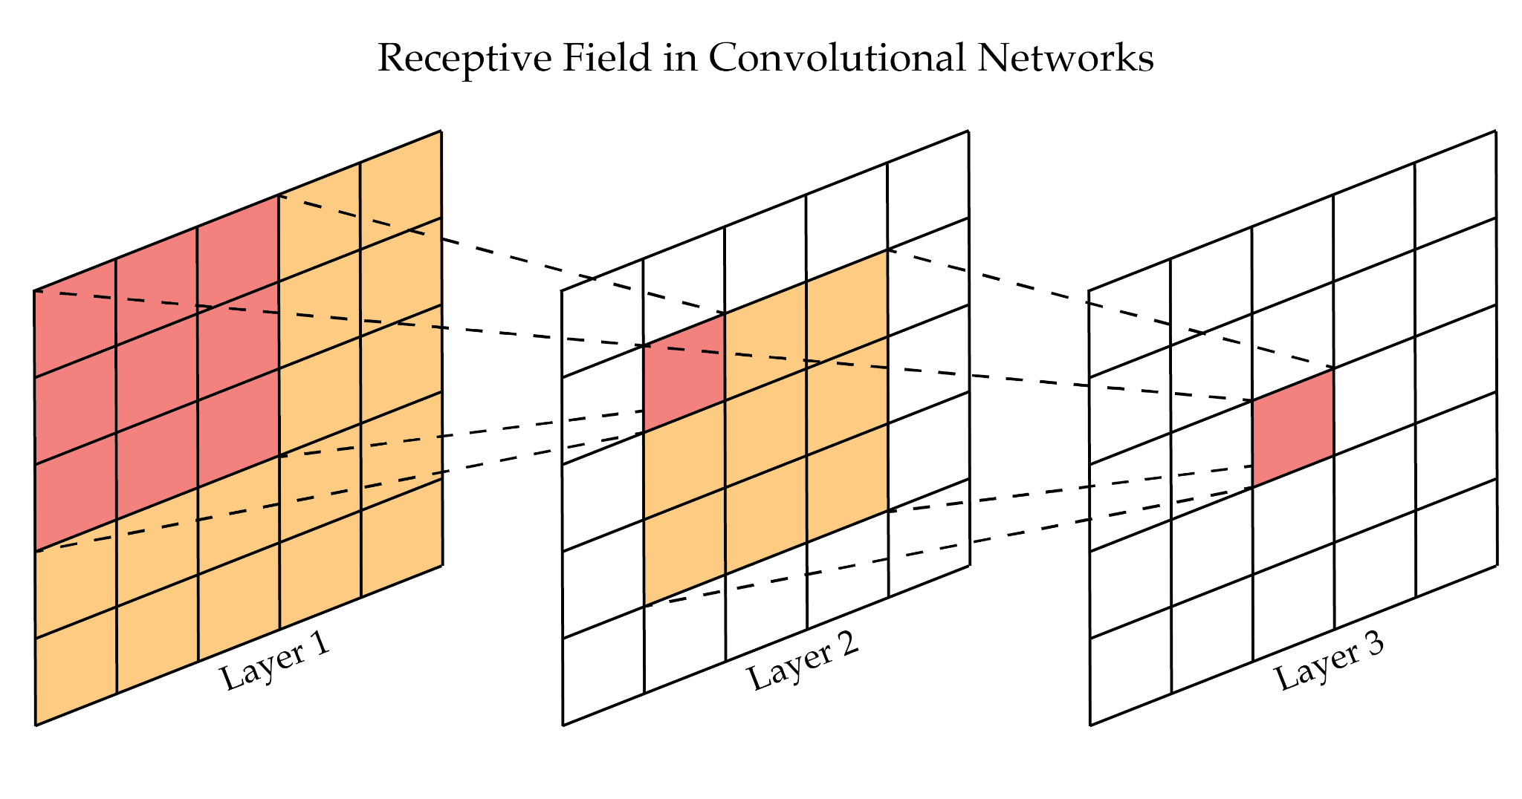
Problem Statement
Lightweight CNN models are efficient but suffer from limited receptive fields, preventing them from capturing global contextual information.
Therefore, we can use LSNet (Large-Small Network), which follows the “See Large, Focus Small”. It can capture both global contextual information and local features while maintaining computational efficiency. Feature representation and classification performance can be improved.

Slide 3
Project Objective
Establish a baseline using ResNet for image classification.
Implement LSNet variants (Tiny, Small, Base) using the “See Large, Focus Small” strategy.
Train and evaluate models on CIFAR-10 under consistent settings.
Compare performance using accuracy, parameters, FLOPs, and inference time.
Analyze feature representation improvements using visualization techniques.

Slide 4
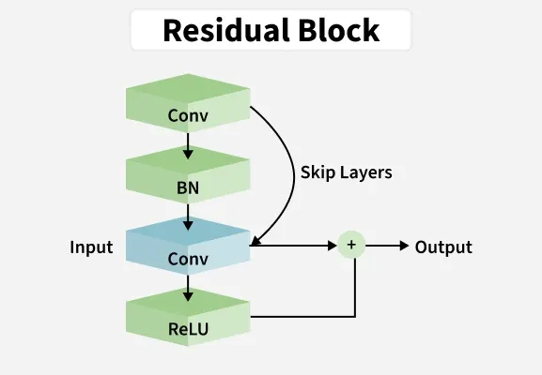
Baseline Architecture: ResNet
ResNet uses residual (skip) connections to enable stable training of deep networks.
Learns residual mappings, improving gradient flow and convergence.
Key Components:
Convolutional layers for feature extraction
Batch Normalization for faster convergence
ReLU activation for non-linearity
Residual (skip) blocks for efficient gradient flow

Slide 5
Drawbacks of Conventional CNNs
Small kernel sizes lead to a limited receptive field and restricted context understanding.
Struggle to capture long-range spatial dependencies effectively.
Use fixed convolution filters, lacking adaptability to varying input features.
Increasing depth to improve performance results in higher computational cost.

Slide 6
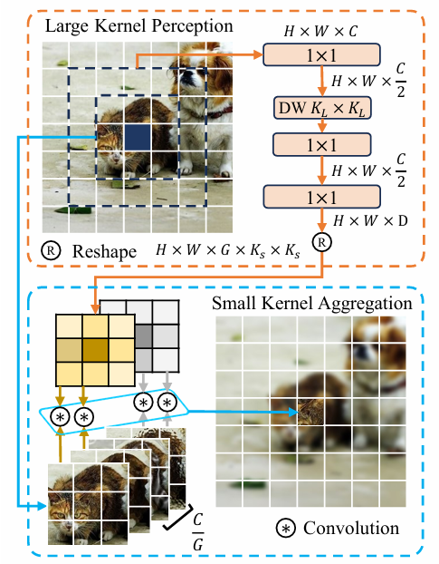
LS Convolution
Consists of two stages: Large-Kernel Perception (LKP): captures wide contextual information Small-Kernel Aggregation (SKA): refines local fine-grained features
Effectively combines global perception with precise local feature extraction.

Slide 7
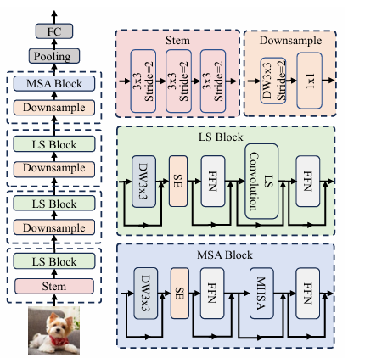
LSNet Architecture & It’s Varients
LSNet-T (Tiny): ~0.3 GFLOPs → lightweight and fastest, suitable for real-time applications
LSNet-S (Small): ~0.5 GFLOPs → balanced trade-off between accuracy and efficiency
LSNet-B (Base): ~1.3 GFLOPs → higher representational capacity and best accuracy

Slide 8
Datasets
Name : | CIFAR-10 | E-MNIST
No. of classes : | 10 | 47 (Balanced)
Image size : | 32 X 32 | 28 X 28
Training samples : | 50,000 | 112,800
Testing samples : | 10,000 | 18,800

Slide 9
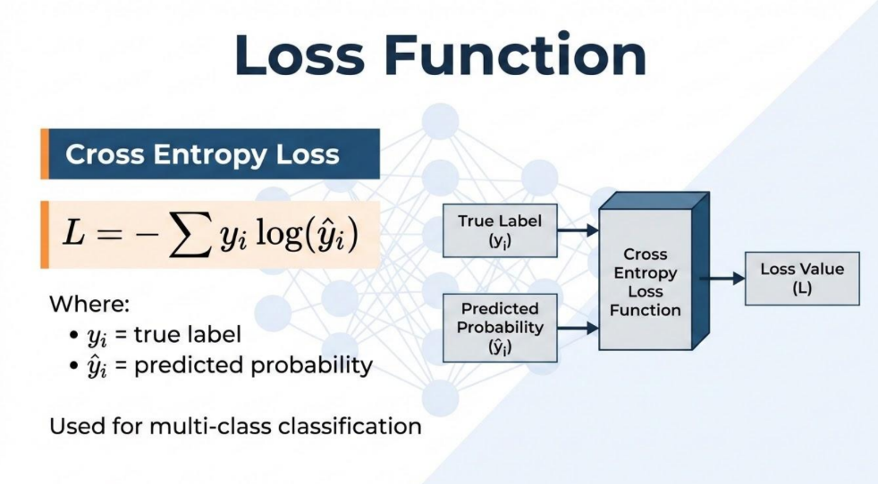

Slide 10
Evaluation Metrics
Classification Accuracy : measures the model’s prediction performance.
Params : Represents the total number of learnable parameters in the model.
FLOPs : reflects computational complexity and efficiency.
Inference Time: evaluates real-time performance.
Throughput : Indicates the number of images processed per second during inference.
Total Inference TIme : Measures the complete time required to process the entire test dataset.
Avg Time/Image : Represents the average inference time taken for a single image prediction.

Slide 11
TRAINING AND TESTING ON CIFAR-10 DATASET WITH RESNET-18 ARCHITECTURE

Slide 12
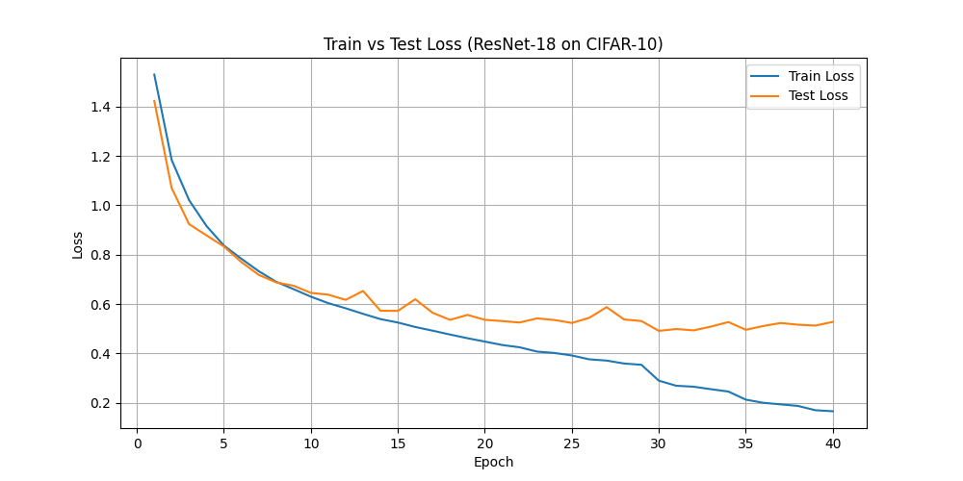
Top-1 Accuracy | 84.4300 %
Params | 11181642.0
FLOPs | 37220352.0
Throughput | 20501.89 images/sec
Total Inference Time | 0.4878 sec
Avg Time/Image | 0.00004878 sec

Slide 13
TRAINING AND TESTING ON CIFAR-10 DATASET WITH LSNET ARCHITECTURE

Slide 14
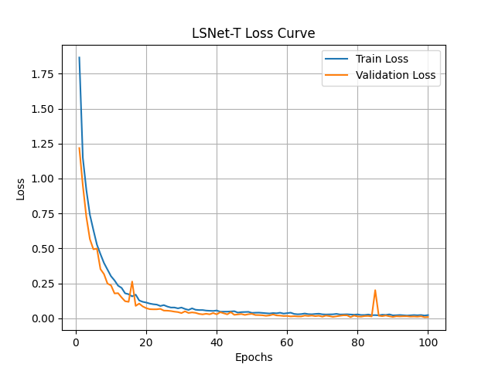
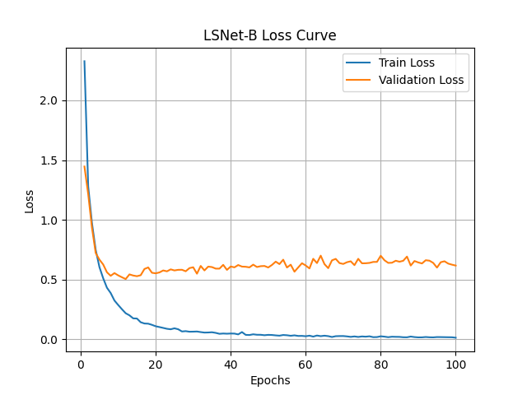
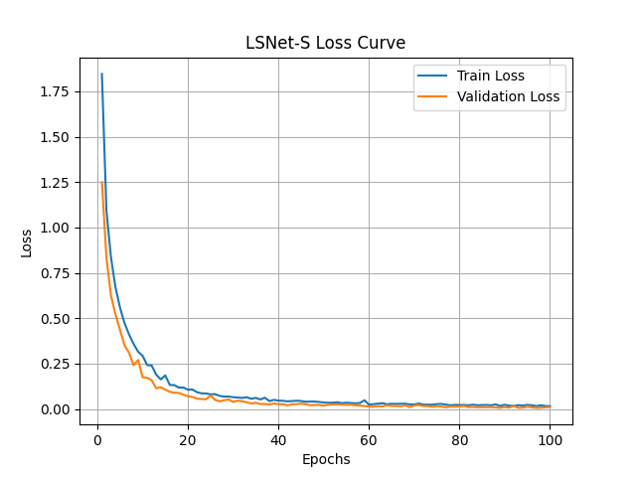

Slide 15
WITH PRE-TRAINED WEIGHTS OF IMAGE-NET DATASET : -
WITH TRAINED WEIGHTS OF CIFAR-10 DATASET : -
Model/ Matrix | Top-1 Accuracy | Params | FLOPs | Throughput | Total Inference Time | Avg Time/Image
LSNET-T | 0.2600 % | 11,406,920.0 | 320,698,496.0 | 1644.84 images/sec | 6.0796 sec | 0.00060796 sec
LSNET-S | 0.8400 % | 16,142,672.0 | 546,113,856.0 | 1248.22 images/sec | 8.0114 sec | 0.00080114 sec
LSNET-B | 0.1400 % | 23,307,528.0 | 1,263,077,888.0 | 687.70 images/sec | 14.5412 sec | 0.00145412 sec
Model/ Matrix | Top-1 Accuracy | Params | FLOPs | Throughput | Total Inference Time | Avg Time/Image
LSNET-T | 84.98 % | 11,406,920.0 | 320,698,496.0 | 1527.71 images/sec | 6.5457 sec | 0.00065457 sec
LSNET-S | 85.92 % | 16,142,672.0 | 546,113,856.0 | 1107.80 images/sec | 9.0268 sec | 0.00090268 sec
LSNET-B | 87.82 % | 23,307,528.0 | 1,263,077,888.0 | 637.36 images/sec | 15.6896 sec | 0.001568963 sec

Slide 16
TRAINING AND TESTING ON E-MNIST DATASET WITH LSNET ARCHITECTURE

Slide 17
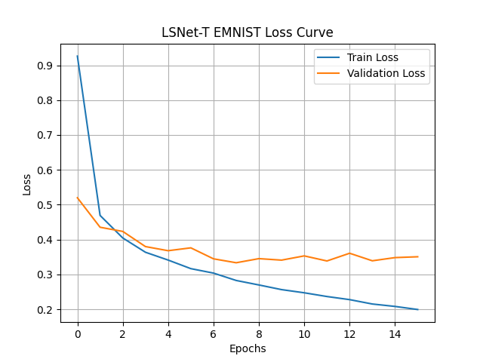
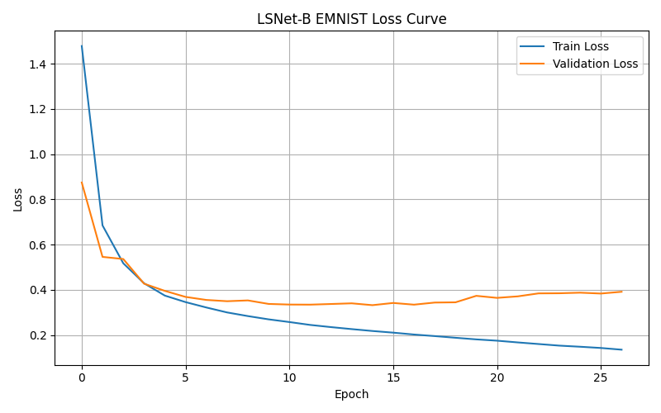
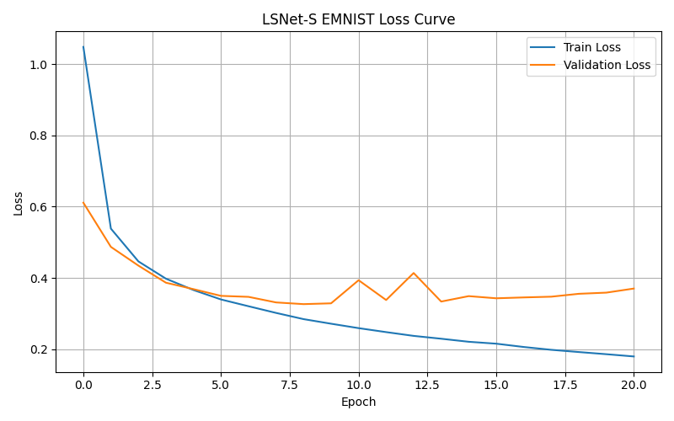

Slide 18
WITH TRAINED WEIGHTS OF E-MNIST DATASET : -
Model/ Matrix | Top-1 Accuracy | Params | FLOPs | Throughput | Total Inference Time | Avg Time/Image
LSNET-T | 87.3245 % | 15,748,827.0 | 35,185,472.0 | 4650.65 images/sec | 4.0424 sec | 0.00021502 sec
LSNET-S | 87.7500 % | 32,864,151.0 | 58,640,832.0 | 4294.61 images/sec | 4.3776 sec | 0.00023285 sec
LSNET-B | 88.4415 % | 96,590,591.0 | 157,471,812.0 | 3142.76 images/sec | 5.9820 sec | 0.00031819 sec

Slide 19
CONCLUSION
LSNet effectively combines global context perception and local feature aggregation for efficient image classification.
LSNet-B achieved the highest classification accuracy on both CIFAR-10 and E-MNIST datasets.
Pretrained ImageNet weights significantly improved LSNet performance on CIFAR-10.
LSNet-T provided lightweight architecture with faster inference suitable for real-time applications.

Slide 20
REFERENCES
https://openaccess.thecvf.com/content/CVPR2025/papers/Wang_LSNet_See_Large_Focus_Small_CVPR_2025_paper.pdf
https://github.com/jameslahm/lsnet

Slide 21
THANK YOU

