Slide 1
Blockly Tic-Tac-Toe
Getting started with Blockly's API

Slide 2
A Guided Tour
This workshop will connect Blockly with a Tic-Tac-Toe game so that users can program a computer opponent. In the process we will explore the major aspects of Blockly's API.
Estimated time: 1 hour

Slide 3
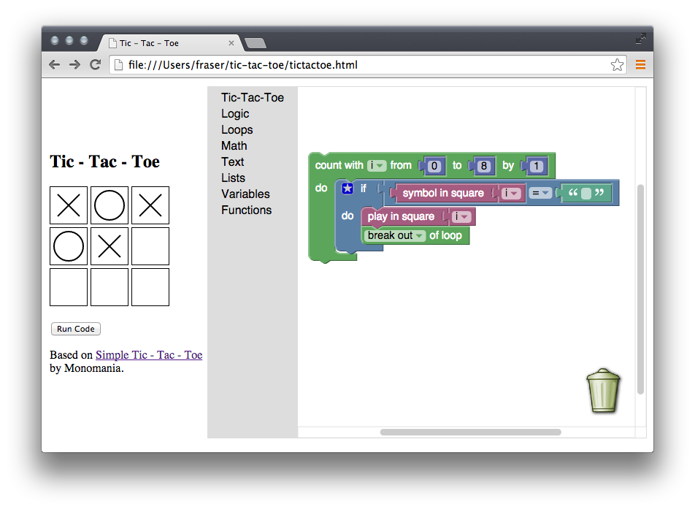
The Goal

Slide 4
Download Tic-Tac-Toe
First, download the Tic-Tac-Toe game:
drive.google.com/file/d/0B_5TNOBUDB1yMm14WkY2WXNDTUE/view
Test it in a browser: tictactoe.html
It is not an example of great code, you can improve it later if you like.

Slide 5
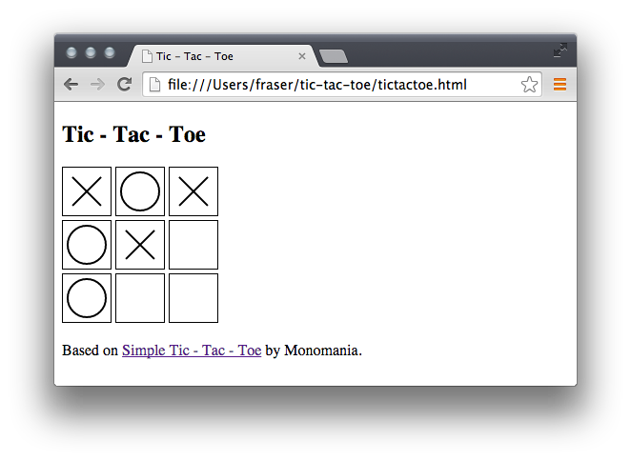
Tic-Tac-Toe

Slide 6
Download Blockly
Second, download Blockly:
https://github.com/google/blockly
Blockly can be downloaded with Git, Subversion, or as a zip file.
Test it in a browser: demos/fixed/index.html

Slide 7
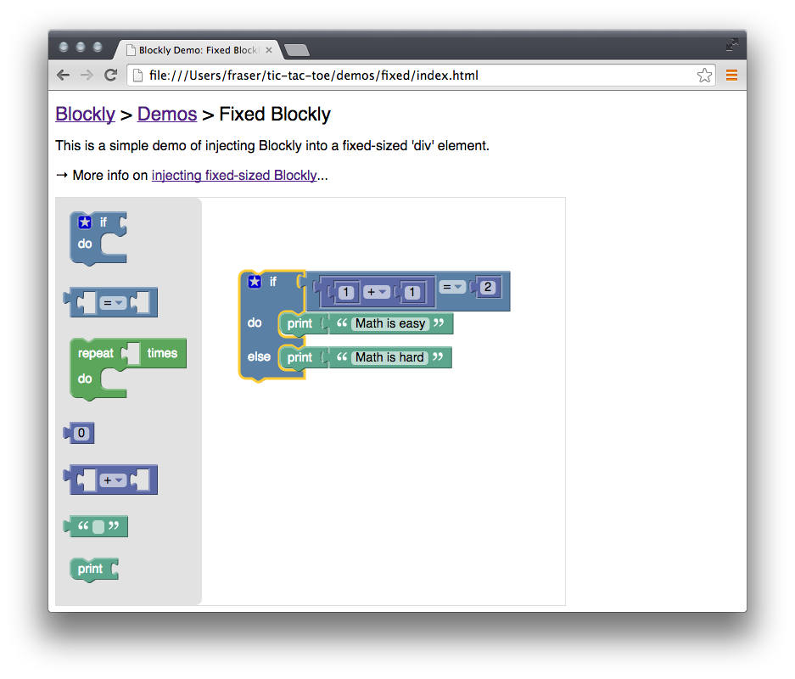
Blockly

Slide 8
Inject Blockly into tictactoe.html
Modify tictactoe.html to add Blockly:
developers.google.com/blockly/guides/configure/web/fixed-size
Optional: Place the Tic-Tac-Toe game and Blockly in a one-row, two-column table so that they are next to each other:
Tic
Tac
Toe
Blockly

Slide 9
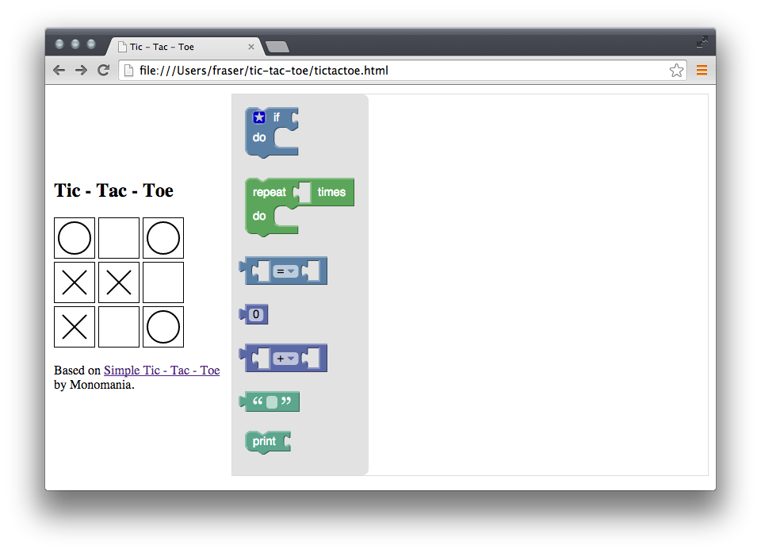
Tic-Tac-Toe + Blockly

Slide 10
Generate Code
Blockly is not a programming language. It is a visual editor that generates code. Generators have been written for JavaScript, Python, PHP, Lua, Dart and more.
Let's add a button that takes the user's blocks and generates JavaScript.

Slide 11
Generate JavaScript
Import this script file:
<script src="javascript_compressed.js"></script>
Add a button to the page with this onclick function:
<button onclick="runJS()">Run Code</button>
<script>
function runJS() {
Blockly.JavaScript.addReservedWords('code');
var code = Blockly.JavaScript.workspaceToCode();
alert(code);
try {
eval(code);
} catch (e) {
alert(e);
}
}
</script>

Slide 12

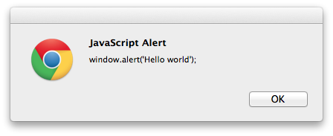
Running JavaScript

Slide 13
More Blocks
Every use of Blockly needs a different set of blocks.
Blockly comes with more than 50 sample blocks, but you will need to chose which (if any) are relevant.
You also need to create API blocks that are custom to your project.

Slide 14
Core Blocks
Replace the toolbox in tictactoe.html with this monster:
docs.google.com/file/d/0B_5TNOBUDB1yZWVpLWdyT3YzcUE/view
Reload tictactoe.html in a browser to see (nearly) every sample block that comes with Blockly.
Next, prune out those blocks that are irrelevant to Tic-Tac-Toe (such as colours and trigonometry).

Slide 15
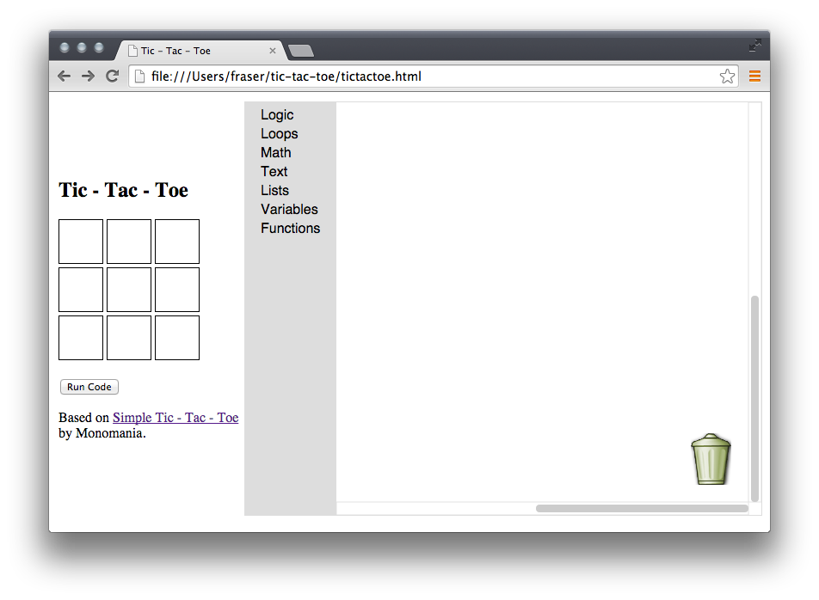
Category Toolbox

Slide 16


Create Custom Blocks
API blocks for your application need to be custom built. In the case of Tic Tac Toe we need a block to play in a square (0-8):
We also need a block to get the symbol ("X", "O", or "") in a square (0-8):
The easiest way to design custom blocks is to use the Block Factory:
blockly-demo.appspot.com/static/demos/blockfactory/index.html

Slide 17
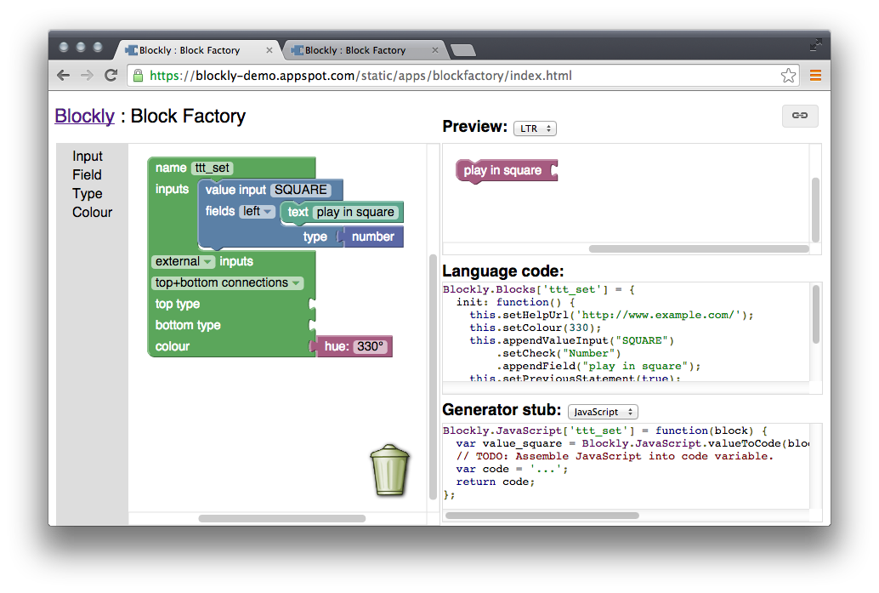
Block Factory (set)

Slide 18
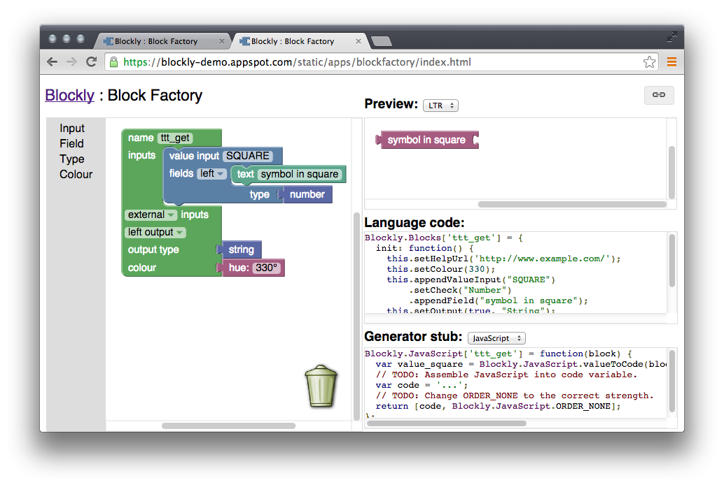
Block Factory (get)

Slide 19
Insert Custom Blocks
For each of the new blocks, copy the "Language code" and "Generator stub" from the Block Factory and paste it into a script your tictactoe.html
Then add a new category to the toolbar's XML:
<category name="Tic-Tac-Toe">
<block type="ttt_set"></block>
<block type="ttt_get"></block>
</category>

Slide 20
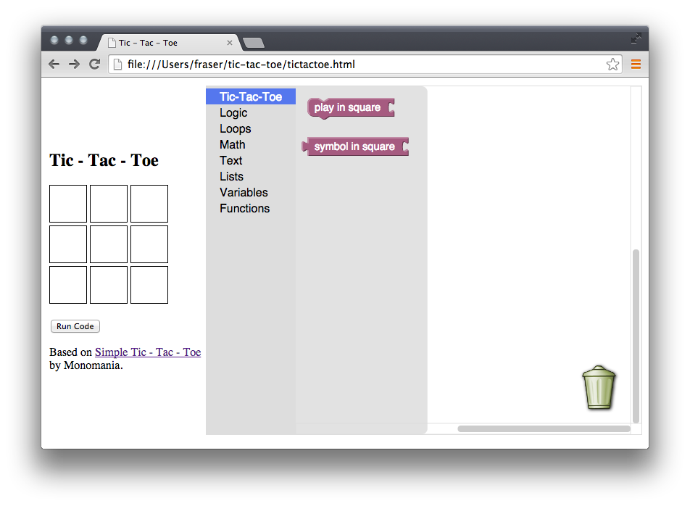
Custom Blocks

Slide 21
JavaScript for Set Block
The Block Factory can only write a stub for the JavaScript generators. You need to fill in the details. In the case of ttt_set, replace these lines:
// TODO: Assemble JavaScript into code variable.
var code = '...';
With this line:
var code = 'canvasClicked(' + value_square + ');\n';

Slide 22
JavaScript for Get Block
In the case of ttt_get, replace these lines:
// TODO: Assemble JavaScript into code variable.
var code = '...';
With this line:
var code = 'content[' + value_square + ']';

Slide 23
Minimally Playable

Slide 24
Further Steps
Change ttt_get's ORDER_NONE to the correct operator precedence (ORDER_MEMBER).
Add a block to get which symbol is currently being played.
Add an infinite loop check, or go professional and use the JS Interpreter.
Use cloud storage on App Engine to allow users to save programs.
For additional help, or just to show off what you've built, join the
Blockly newsgroup.
Blockly is free and open source. Go integrate Blockly into your projects as a friendly UI. It is also more than just for programming UIs (e.g. Blockly Puzzle).

