Slide 1
Engine of Fighting Game on JavaScript
Chris
160821

Slide 2
Description
W
Home
A
S
D
Del
End
Page Down
D
A
B
C

Slide 3

Challenges
To simulate 8-direction stick with 4 buttons
Catch special skills of the character
Effect determination
Real time gaming
Extendibility
Easily create new characters

Slide 4
Architecture (1/2)
Controller
Singleton obj
Monitor pressed key, trigger events to characters
Env
Environment settings, such as width, height of frame; gravity; delta time for screen frequency
Phy-obj
Object react with the environment
Linear move
Parabola move
Collision handler
Role
Common act like jump, rush, walk, crouch
Characters
Characters with unique skills

Slide 5
Architecture (2/2)
Characters
have a common parent – role
Each character just define their own skills
Phy-obj
env
$(‘<div>’)
+linearMove
+paraMove
+stopMove
-width
-height
-gravity
-delta
role
+stickEventLisenter
+buttonEventListener
controller
Adam
-listener_list []
+catchStickKeydown
+catchStickKeyup
+catchButton
Bob
+skillEventLisenter
Chris
+skillEventLisenter
+skillEventLisenter

Slide 6
Stick and button simulation (1/2)
Challenge: key comes linearly, meaning instead of , the we get the key as a combination of and
If consecutive keys indicate a pattern of key combination within the given interval, then we assert a combined key detected
Approach 1, setTimeout()
It’s suitable for combined button
Time line

Slide 7
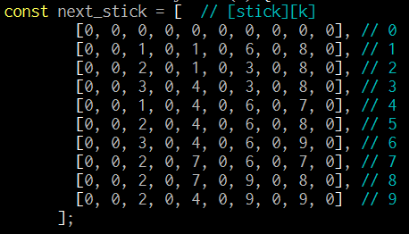
Stick and simulation (2/2)
Approach 2, track keydown with state machine ✓
More efficient
Easy to implement
W
S

Slide 8
Catch skill pattern (1/2)
Challenge: keys come linearly, how to effectively track the pressed keys of specific pattern?
Approach 1: setTimeout()
Approach 2: backtrack✓
Skill pattern tree
Efficiency
Easy to extend

Slide 9
Catch skill pattern (2/2)
Create a backtrack pattern tree
Eg.: pat_list [‘⇨A’, ‘⇨⇨A’, ‘⇦B’ , ‘⇨B’]
R
A
B
⇨
⇦
⇨
⇩
⇩
⇩
⇨
⇨A
⇦B
⇨B
⇨⇨A

Slide 10
Valid act (1/3)
There complicated rules of valid act
Eg.: ‘⇨A’ works only on the ground; buttons and stick are inactivated as skills going
2 state machines used to maintain current states
Status: still, crouch, jump, forward, backword
Act: idle, punch, kick, defense, skill

Slide 11
Valid act (2/3)
status
act
jump
skill
7,8 && act== idle
8,9 && act == idle
7,8,9 && act == idle
Skill done
26a && st == still or fwrd 24b && st == still or bwrd 626a && st == still or fwrd
bwrd
4
Still
6
fwrd
Kick
B,D
idle
A,C
punch
1,2,3 && act == idle
1,2 && act == idle
crouch
2,3 && act == idle
dfns
7
8
9
=

⇧

4
6

⇨
1
2
3

⇩


Slide 12
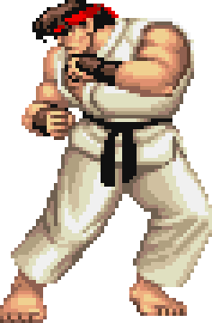
Object collision effect (planning)
Eg.: Ryu got hit by Hadoken
Detect overlap
Ryu.collision(Hadoken) ? Ryu.winAct() : Ryu.loseAct()
Hadoken.collision(Ryu) ? Hadoken.winAct() : Hadoken.loseAct()
Both they will have a consistent effect
Phy-obj
+linearMove
+paraMove
+stopMove +collision
+winAct
+loseAct

Slide 13
Real time gaming (planning) (1/2)
Node Socket.IO
Any control events would be collected by server, and broadcast to both players
Character objects act only with events from server
Server
Key, skill events
Key, skill events
Controll events
Player 1
Player 2

Slide 14
Real time gaming (2/2)
Challenges
Latency due to network delay
Might define application level timestamp

