Slide 1
Project 2
Riley Anderson

Slide 2
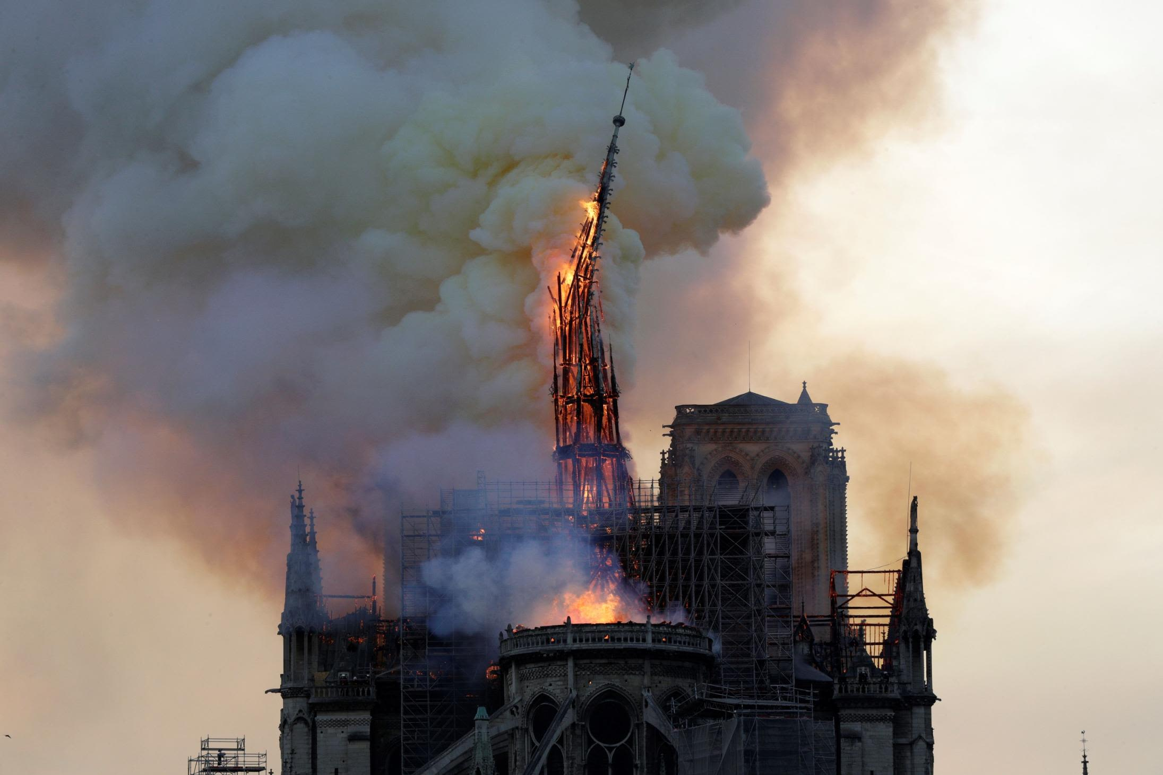
Introduction to FIREDAM
15 residential fires
Distance to nearest Fire Station miles
Damage done $
From MS
Notre Dame Fire

Slide 3
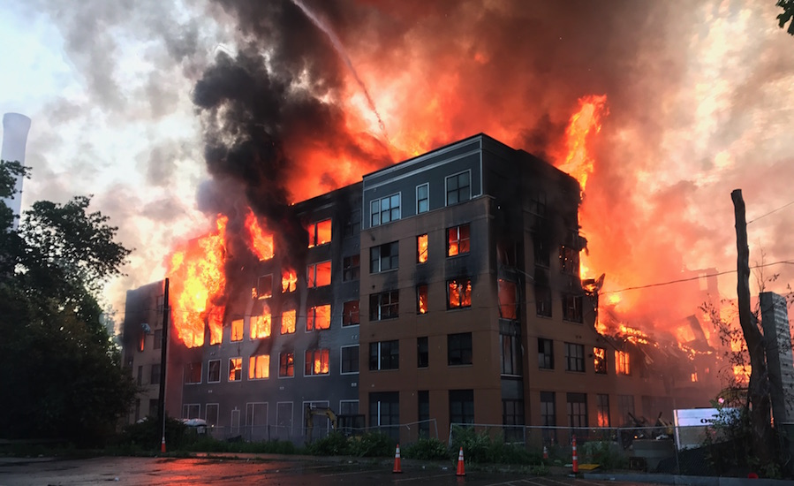
Question
Significant relationship Damage~Distance?
Continuous and quantitative
Applications to city planning
Residential Fire

Slide 4
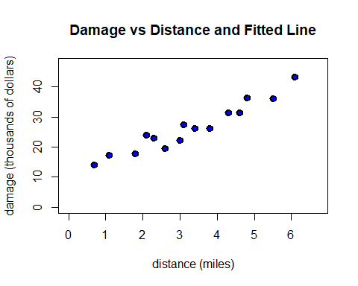
Theory - Straight-Line Hypothesis

Slide 5
Model and Assumptions
$$y=β_{0}+β_{1}x+ϵ$$
$$E\left(ϵ\right)=0\text{ ( the mean of the error is 0)}$$
$$V\left(ϵ\right)=σ^{2}\text{ (the variance of the error takes a constant value)}$$
$$ϵ∼N\text{ (the error is distributed normally)}$$
$$ϵ\text{ is independent}$$

Slide 6
SLR Model
$$\hat{y}=4.919x+10.278$$
-Interpretation:
Base of 10,278 dollars
Increase of 4,919 dollars per mile
Valid over $\left(0.7,6.1\right)$

Slide 7
Confidence Intervals of Parameter Estimates
## 95 % C.I.lower 95 % C.I.upper ## (Intercept) 7.20960 13.34625 ## x 4.07085 5.76781

Slide 8
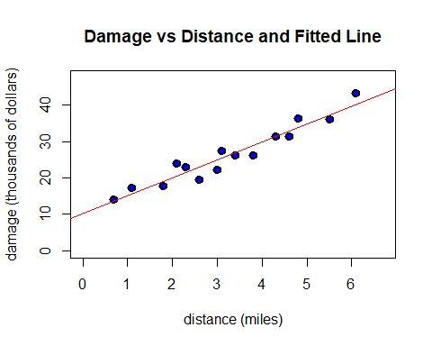
Plot of fitted line and points

Slide 9
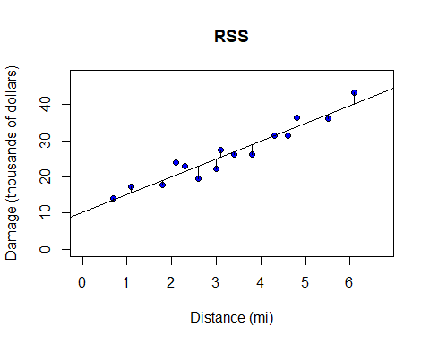
Veryifing Our Assumptions - RSS

Slide 10
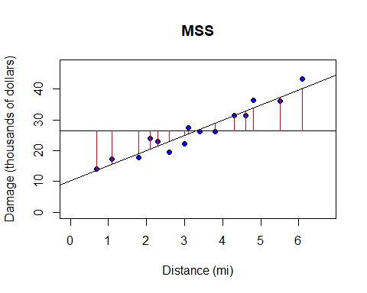
MSS

Slide 11
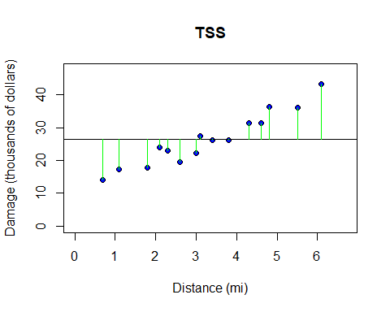
TSS

Slide 12
Analyzing RSS, MSS, and TSS
-From theory, $R^{2}=\frac{MSS}{TSS}$.
mrsq <- MSS / TSS mrsq
## [1] 0.9234782

Slide 13
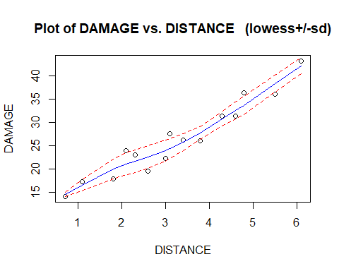
Checking assumptions about error

Slide 14
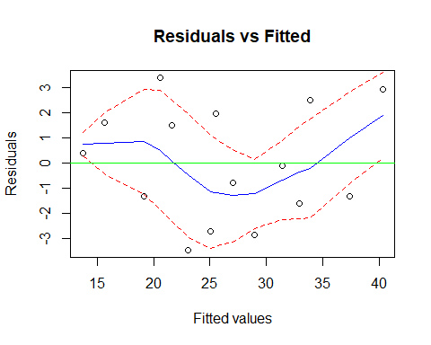
Checking for signal in our residuals vs fitted values

Slide 15
Checking normality
We check the null hypothesis
-
$$H_{0}: ϵ_{i}\overset{\text{iid}}{∼}N\left(0,σ^{2}\right)$$
-
$$H_{1}: ϵ_{i}≁N\left(0,σ^{2}\right)$$

Slide 16
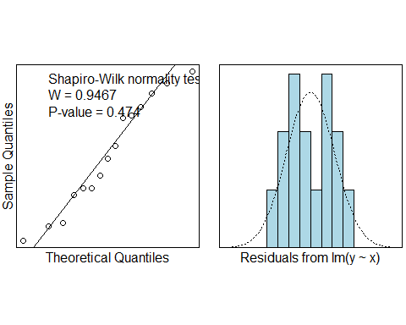
Checking normality cont.

Slide 17
Are errors independent?
Across length of time
Randomly chosen geographically and time
Could be fire-prone neighborhood bias
Not enough evidence to say otherwise

Slide 18
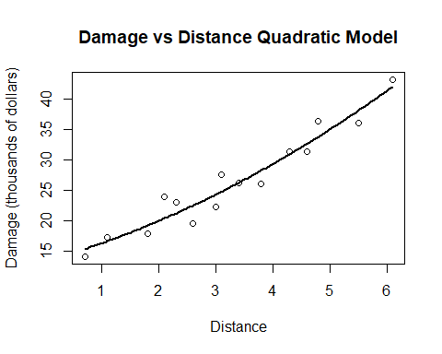
Quadratic model
## ## Call: ## lm(formula = y ~ x + I(x^2)) ## ## Residuals: ## Min 1Q Median 3Q Max ## -2.8856 -1.6915 -0.0179 1.5490 3.6278 ## ## Coefficients: ## Estimate Std. Error t value Pr(>|t|) ## (Intercept) 13.3395 2.5303 5.272 0.000197 *** ## x 2.6400 1.6302 1.619 0.131327 ## I(x^2) 0.3376 0.2349 1.437 0.176215 ## --- ## Signif. codes: 0 '***' 0.001 '**' 0.01 '*' 0.05 '.' 0.1 ' ' 1 ## ## Residual standard error: 2.227 on 12 degrees of freedom ## Multiple R-squared: 0.9347, Adjusted R-squared: 0.9238 ## F-statistic: 85.91 on 2 and 12 DF, p-value: 7.742e-08

Slide 19
Confidence Intervals for Quadratic
## 95 % C.I.lower 95 % C.I.upper ## (Intercept) 7.82657 18.85247 ## x -0.91199 6.19202 ## I(x^2) -0.17419 0.84933

Slide 20
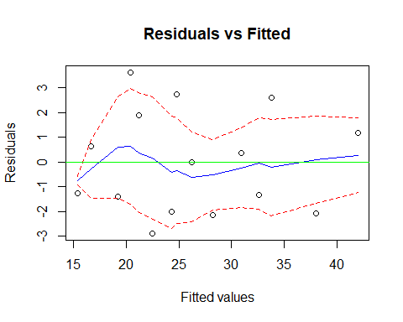
Checking for signal in residuals vs fitted values

Slide 21
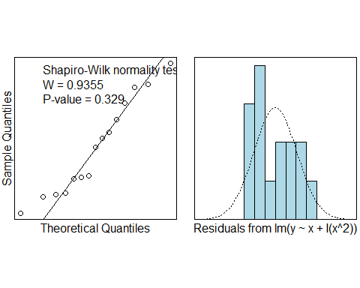
Checking normality

Slide 22
Comparison
summary(quad.lm)$r.squared
## [1] 0.9347158
summary(quad.lm)$adj.r.squared
## [1] 0.9238351
summary(fire.lm)$r.squared
## [1] 0.9234782
summary(fire.lm)$adj.r.squared
## [1] 0.9175919

Slide 23
Predicting damage based on our model
linear.model <- function(x) {b0hat + b1hat * x} linear.model(2)
## [1] 20.11659
linear.model(4)
## [1] 29.95525
linear.model(5.5)
## [1] 37.33425

Slide 24
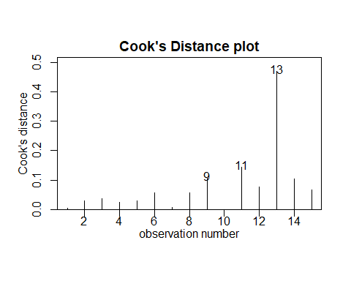
Cook’s Distance

Slide 25
Cook’s Distance cont.
fire2.lm <- lm(DAMAGE~DISTANCE, data=fire[-13,]) summary(fire2.lm)$r.squared
## [1] 0.905347

Slide 26
Conclusion - Is There a Relationship?
-
$$R^{2}=0.9235$$
-
$$\hat{y}=4.919x+10.278 ∀ x∈\left(0.7,6.1\right)$$
Improve with:
Sample size
Euclidean distance vs Roadside distance
Multiple cites and suburbs

