Slide 1
Welcome!

Slide 2
About Me!
About to graduate from the University of Queensland studying Computer Science (majoring in Machine Learning)
For a long time I didn’t know what I wanted to do!
Never coded during school!
My dream is to create a company, or multiple!

Slide 3

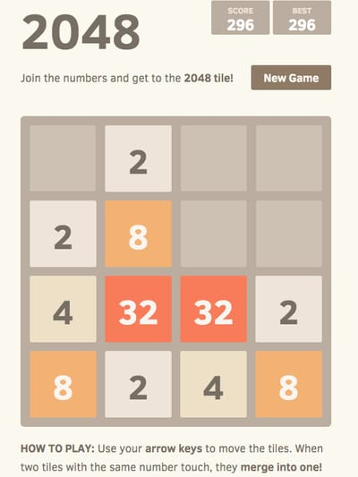
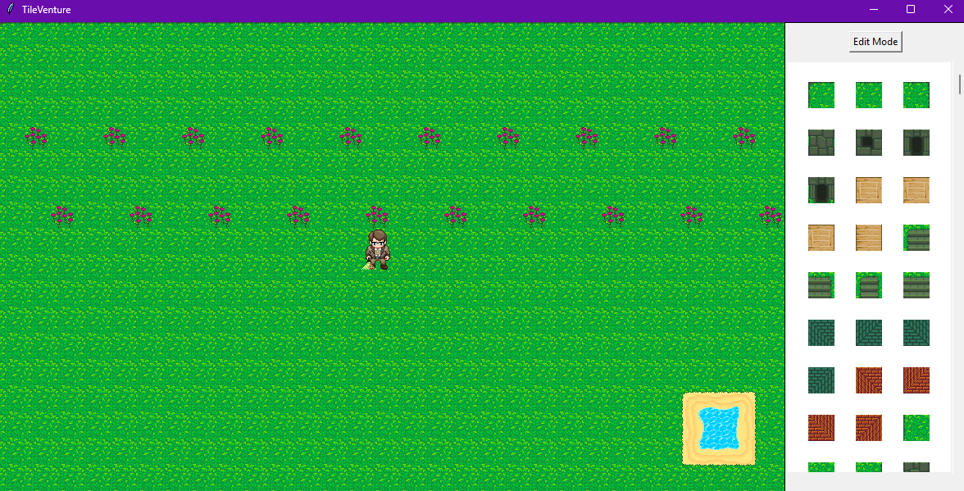

Slide 4
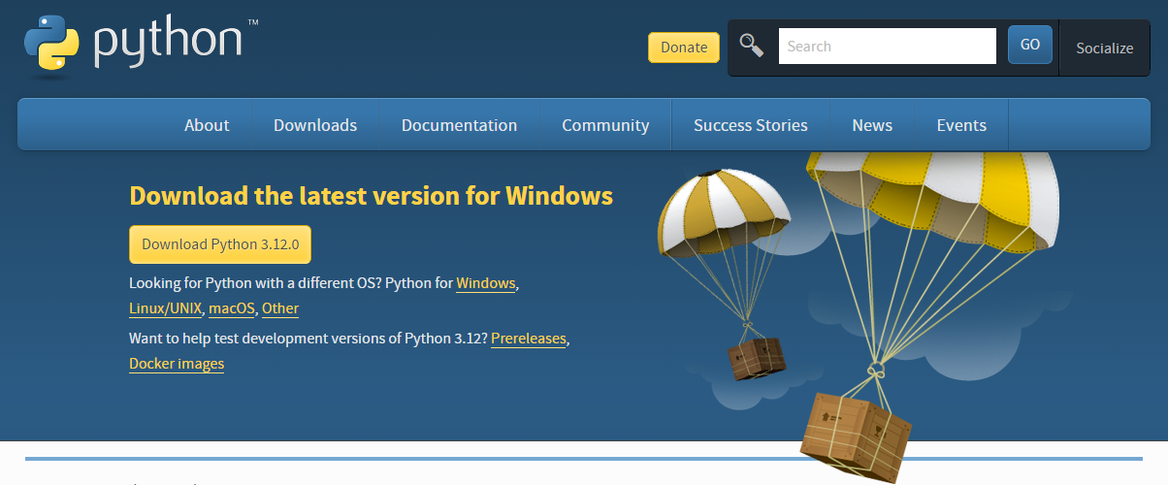
Installing Python
Step 1: Download Python Installer
Navigate to Python Downloads https://www.python.org/downloads/
Step 2: Run the Installer
Double-click the downloaded file.
Ensure “Add Python to PATH” is checked.
Click "Install Now".

Slide 5
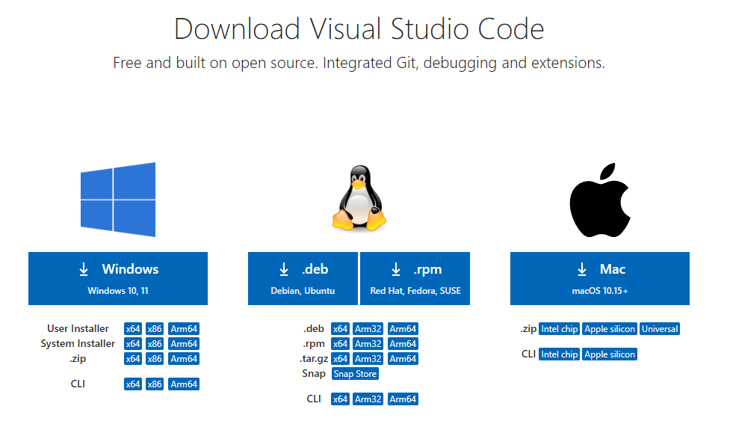
Installing VS Code
Step 1: Download VS Code Installer
Navigate to VS Code Downloads https://code.visualstudio.com/Download
Click the download button for your OS.
Step 2: Run the Installer
Follow the prompts in the setup wizard.
Step 3: Verify Installation
Open VS Code to ensure it installed correctly.

Slide 6
Let’s See If It Worked!
Up the top click File and then click Open Folder
Create a new folder called Playtech
Create a file in there called week1.py
Write: print("Hello World!") and then press ctrl + s to save
Up the top click Terminal and then click New Terminal
Now type python week1.py to run the code!

Slide 7
Exercises
https://www.hackinscience.org/exercises/

