Slide 1
The Security Engineer’s Guide to Infrastructure-As-Code!
Dakota Riley - Senior Security Engineer, Aquia Inc

Slide 2

Introduction
Dakota Riley
Senior Security Engineer @ Aquia Inc
NKU COI class of 2017
Notes:
My name is Dakota Riley
I am a Senior Security Engineer with Aquia
Super excited to speak here at the NKU Cyber Symposium, not only because I am passionate about Infrastructure-As-Code + Security, But also because I graduated from Northern Kentucky University College of Informatics in 2017, super cool to be virtually back in this capacity

Slide 3
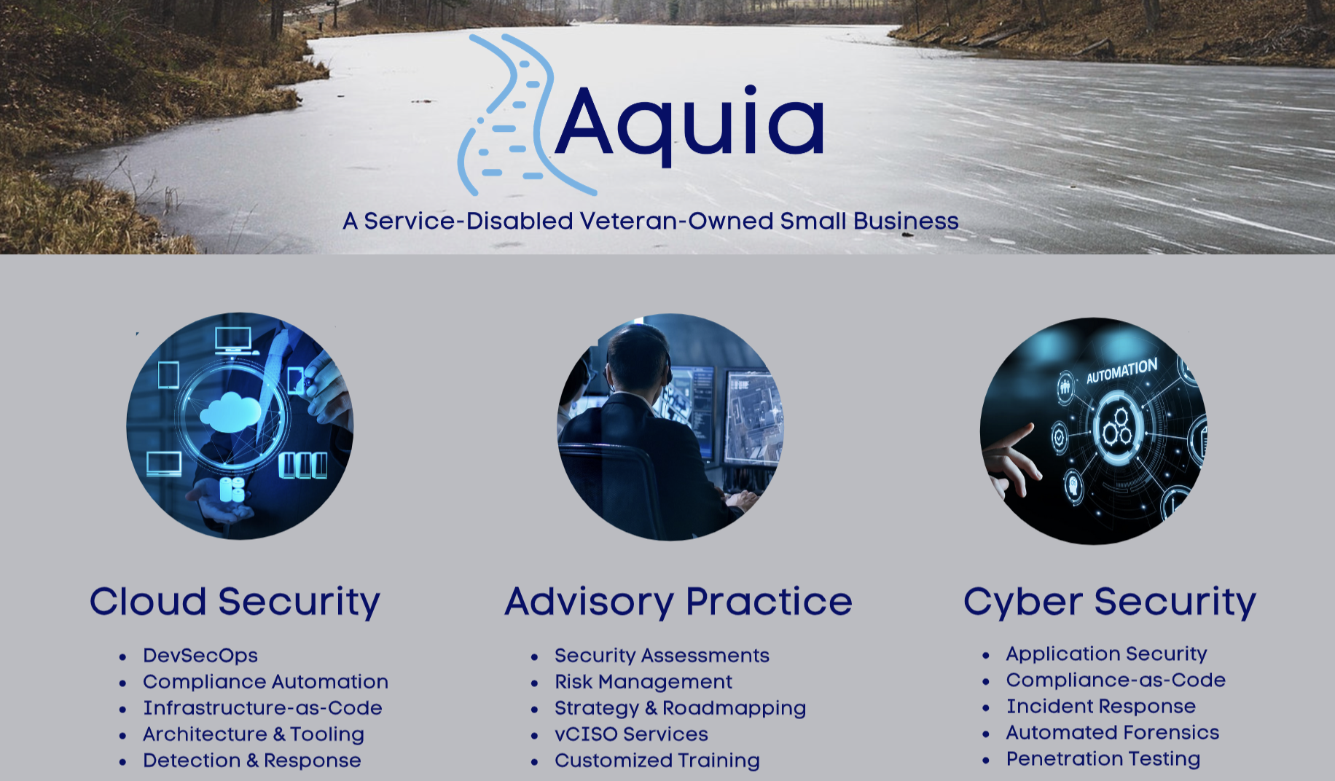
Notes:
So - before I get started, just wanted to briefly share a little bit about Aquia:
We are a Cyber Security service company, founded by military veterans, currently focused on working on supporting innovative technology initiatives in the Public Sector
Oh - and by the way, we are hiring :) (Mention a bit about open roles)

Slide 4
Security Engineering/Architectural Professional
Development teams are beginning to adopt Infrastructure-As-Code (IaC)
Tasked with securing the implementation and usage of IaC at the company
What is IaC?
What is needed from a Security Perspective?
Should we (Security) be using it?
Notes:
I wrote this talk from the perspective of a (READ SLIDE)
In this talk -
I will cover What Infrastructure-As-Code is,
what kinds of tooling/trends exist in the IaC landscape
Even take a look at a few code samples of common ones
Throughout the talk - I have a live implementation that I will occasionally jump over to throughout the presentation to actually demonstrate the
Concepts I am talking about during it, Hopefully the demo gods will be kind to me, and everything will just run smoothly
After that - we will discuss what needs to be handled from a security perspective, specifically surrounding the implementation, and then securing the “code” itself
With all that being said - this a technical/engineering level talk. I will do my best to provide agnostic advice and guidance, but we are going to dive into some details. Please don’t hesitate to ask questions, worst case scenario we can chat after the talk

Slide 5
What is IaC?
Tooling that allows you to express the configuration of systems, services or infrastructure via code/templates and apply them automatically
Notes:
So with that being said - what actually is Infrastructure-As-Code? So - Infrastructure-As-Code is pretty much any tool or service that allows you to express the configuration of systems, services, or infrastructure via code or templates, and apply them automatically to get your systems to a desired state

Slide 6
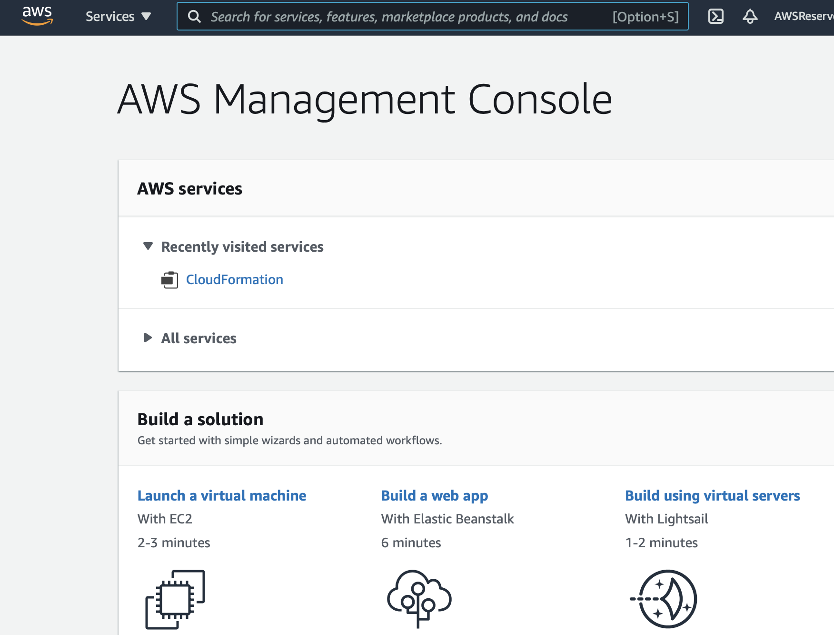
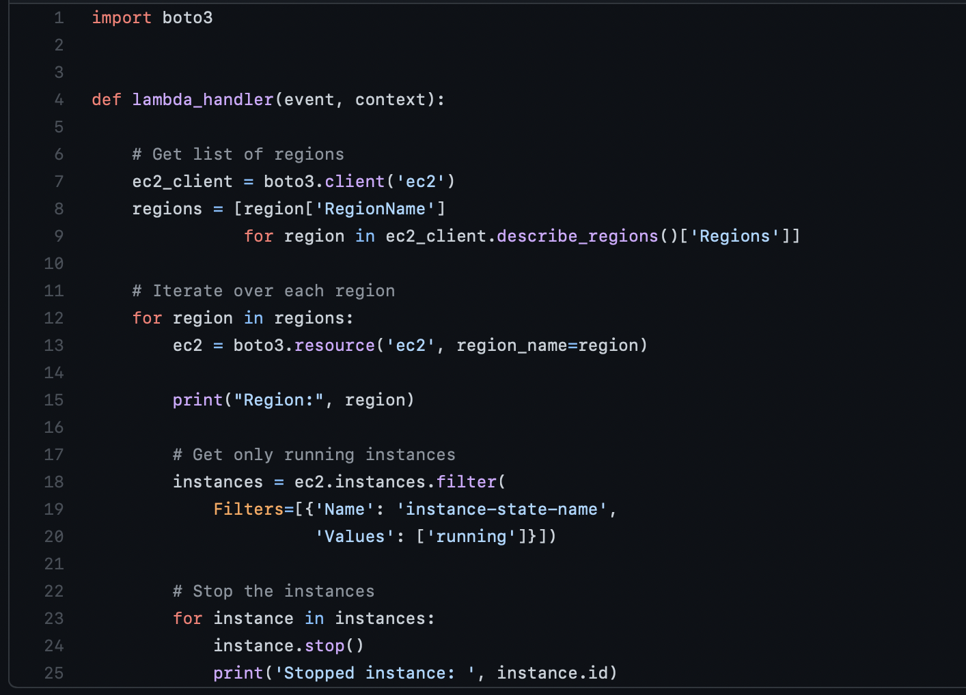
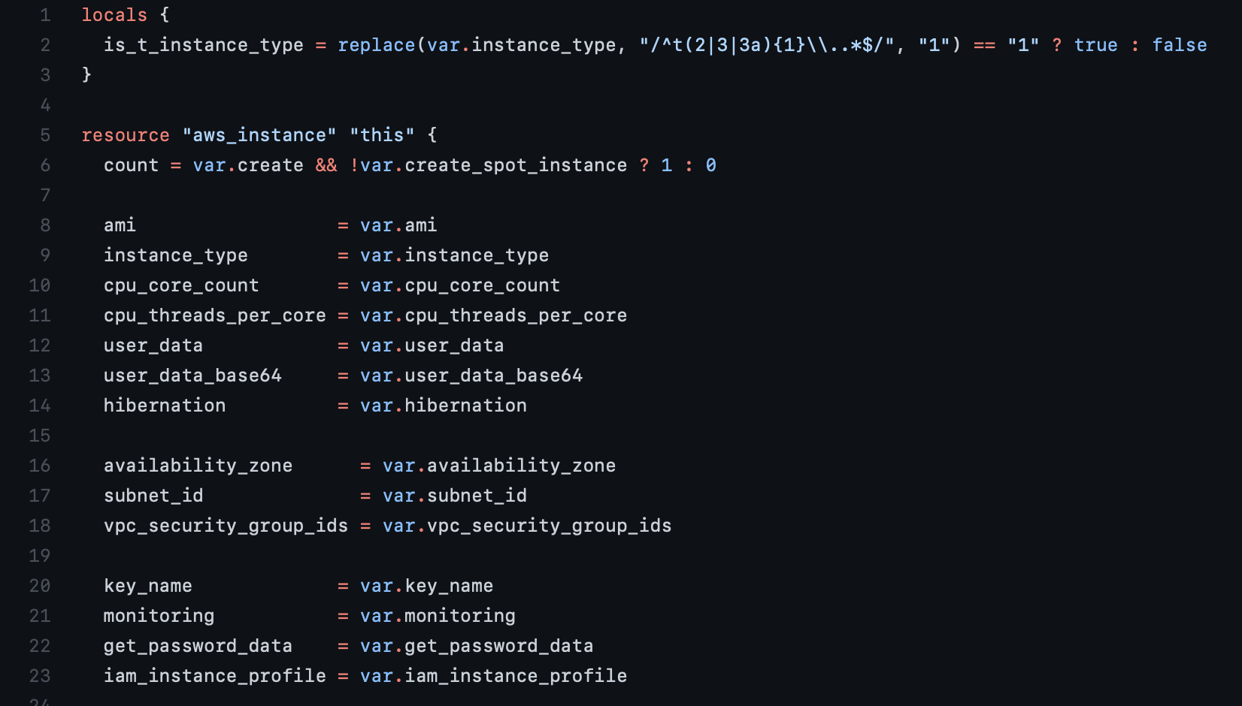
How We Configure Things
Manual Configuration
Great for learning
Break Glass Access
Effort/Time tradeoff
Scripting/SDKs/APIs
Better than Manual
Imperative
Edge cases
(Modern) Infrastructure-As-Code
Dependency-Aware
Declarative (in most cases)
All the benefits of code!
Notes:
So, to add a little more context to what “IaC” is, I like to explain the way things are often configured - it comes down to really 3 main ways:
Manual Configuration
Refers to a human manually accessing the console, cli, or UI of a service to directly make configuration changes
Obviously this is a presentation about an automation tool, and security of that automation tooling, but even in a scenario where IaC is fully embraced, there are still scenarios where this will be still relevant
Learning new services or systems, or interacting with IaC deployed systems in lower level environments
Breakglass access - eg for troubleshooting or return-to-service situations (in a perfect world, we use automation even for break-fix, but this doesn’t always pan out)
Scenarios where configuring something via IaC isnt supported out of the box, and the time to develop a resource provider isnt justifiable versus the amount of time it will save. A practical situation of this is organizational level AWS settings, for example delegated admin, and formerly AWS Organizational Cloudtrail werent supported by CloudFormation - meaning you either had to hack together custom automation to automate this, or….. just do it manually. For most customers, they only have one organization, and it takes 2 seconds enable these things once. As time goes on - this becomes less of an issue (and is already a rare occurrence) as the tooling advances.I love automation (and IaC of course), but technology dogma in any situation is never good.
Scripting - utilizing APIs or an SDK to configure a service
The “next” level of configuring something is using programmatic access by directly using the APIs or SDKs to configure a service
Obviously - this is better then directly manually configuring something, but it comes with its own drawbacks
Its on you to navigate the edgecases, dependencies and order of anything you create - this method is purely “Imperative” - meaning you care not only about the “What”, but also the “How” of things getting done
Finally - we have what we know as Modern Infrastructure-As-Code
The “Optimal” way of configuring things for most cases
“Modern” IaC is declarative, meaning you arent terribly concerned with the “How” are accomplished in most cases, more that you are focused on the “End State” of what you want to be deployed.
The tool/engine in most cases will navigate the dependencies between resources and edgecases of resources
In addition to what I have said you get all the benefits of your infrastructure configuration being code

Slide 7
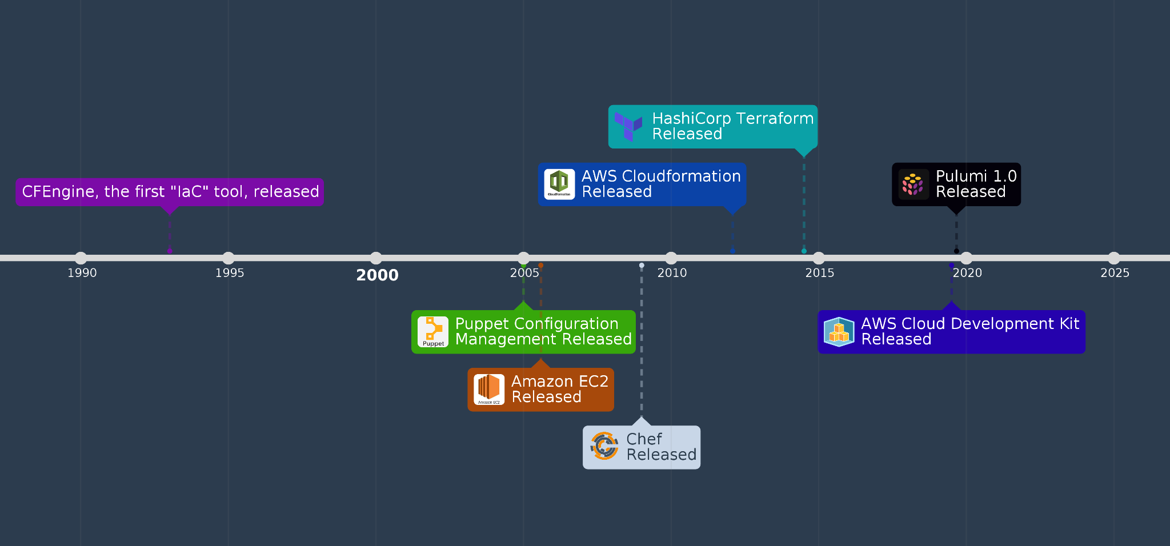
How we got here
Notes:
So - before we dive any further, lets talk about how we got where we are today, a little informal history of Infrastructure-As-Code tooling based on release dates.
As I was preparing for the presentation - I did some light research into how long IaC has been around, by taking a look at the release of major commercial products over a timeline.
You might be surprised to know that Infrastructure-As-Code in some form has actually been around since 1993 - a tool called CFEngine, a configuration management tool that provided a declarative DSL for managing large amounts of unix boxes of various distros.
Now, that being said - you might notice that rather large gap from 1993 to 2005. Alot of people attribute this to the fact that the driving need for IaC really just wasnt there yet, most businesses didnt have the scale of infrastructure, or were limited by other bottlenecks in their infrastructure procurement processes to the point that this level of automation just didn’t make sense.
So in 2006 - Amazon released their EC2 Service - which basically meant that anyone with a credit card could spin up hundreds of VMs with just a few clicks or API Calls - which meant that the aforementioned issues technically could be non-issues for any business. Commodity Computing made large scale pretty much accessible to anyone, which in turn, made Infrastructure-As-Code more relevant to the average business
There are obviously a few not pictured, (Ansible, Salt, Serverless Application Model, Serverless Framework, Cloud Provider Native Frameworks), I didn’t want to clutter the graph too much, but after that point - we see a sort of “explosion” of IaC tooling released - with AWS kicking off their own offering, followed by HashiCorp Terraform in 2014.
On the more recent side of things - there is interesting trend going on where we are seeing new tools move away from Templating Languages to defining Infrastructure in actual programming languages, but maintaining the “Declarative” feel of these things. I’ll dive into that more in a bit

Slide 8
Modern IaC Tooling
Self-Hosted vs SaaS/Managed
Configuration Languages
Data Serialization Languages/Domain Specific Languages
JSON
YAML
HCL
Turing Complete Languages
Python
TypeScript
Platform Specific vs Vendor Agnostic
Notes:
So with that in mind, lets talk about the “Traits” of modern Infrastructure as Code tooling.
Some tools come in a Open Source/Self Hosted nature, Some offer a Provider Managed/SaaS capability, which abstracts some level of management away from you, depending on the tool/offering itself
Something I am personally excited to talk about (And have some strong opinions on), The languages we are seeing able to be used to define IaC nowadays.
As I mentioned previously, a large majority of the existing tools utilize either a Data Serialization Language, such as JSON, YAML, or a or Domain Specific Language such as HashiCorp Configuration Language
Most of these languages add some programmability to these via references, macros, and basic flow control - because YAML and JSON arent actually programming languages, but they made sense for describing the “Desired State” of how something should actually be
However - a recent trend with tooling releases has been embracing defining Infrastructure with Turing complete programming languages, which allow you all the flexibility of these languages (flow control, modules, object oriented structures
Lastly - there are platform specific options and vendor agnostic options in the IaC tooling space

Slide 9
Modern IaC Tooling (Con’t)
Tool | Vendor | Language | Platform | Custom Resource Types?
AWS Cloudformation | AWS | JSON, YAML | AWS, Agnostic with the addition of Resource Providers | Yes
Terraform | HashiCorp | HCL, JSON | Agnostic | Yes
Pulumi | Pulumi | TypeScript, JS, Python, Go | Agnostic, Major CSPs | No
Cloud Development Kit | AWS | TypeScript, JS, Python, Go | AWS, Terraform, K8s | Yes
Notes:
This is obviously a non-exuastive list, but I wanted to explore what the current trends of the available tools are for Infrastructure-As-Code
Some of the things I looked at:
Who made the tool
What platforms can it be used to manage
What Language can you express your configurations in
And finally - does the platform expose Custom Resources, how far can you stretch it
Obviously im not going to list off every single one these, but just touch on a few of the interesting points (Slides are available online after)
Most of the major Cloud Providers have their own IAC Engines
AWS Cloudfomation being the oldest, and probably the most mature of the CSP offerings
On the platform-agnostic side, we have Terraform (which we will be using today in some of our small demos), and Pulumi
Orchestration Tooling like kubernetes

Slide 10
Modern IaC Tooling (Con’t)
Tool | Vendor | Language | Platform | Custom Resource Types?
Azure Resource Management | Microsoft | JSON | Azure | No
Google Cloud Deployment Manager | Google | Jinja Templates, Python | Google Cloud Platform | No
Kubernetes YAML | Cloud Native Computing Foundation | YAML | Kubernetes | Yes
Dockerfiles | Docker | Text, Bash | Agnostic | N/A

Slide 11
IaC Terminology
Template - File(s) containing the code/configuration
Engine - The Service that takes our templates and makes them reality!
State (State File) - “Lay of the Land” as known by our engine
Plan/Change Set/Diff - What will happen if we apply our Template?
Drift - A difference between the deployed templates and actual configuration

Slide 12
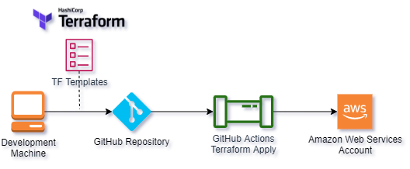
Live Implementation
Notes:
As I mentioned earlier - I will have a live implementation running alongside to actually demonstrate some of the concepts I talk about throughout the presentation.
Highlight each of the tools in use
We are using Terraform - Which is an Open Source IaC tool that can manage almost anything with an API due to the healthy community and extensibility via providers - to define our infrastructure. GitHub as both our Source Control System, and CICD via the GitHub actions capability, and we are deploying these things into AWS.
Throughout the presentation - I will mix in various scanners, services, settings, and break stuff based on what we are talking about at the time.
(WALK THROUGH THE LAYOUT OF THE DEMO) (CREATE SOME INITIAL INFRASTRUCTURE AND DEPLOY IT)
Show Terraform plan capability
Show Apply
Show Provisioned Infra In AWS

Slide 13
Security of The Implementation
Notes:
So

Slide 14
GitOps
An approach to working where Git is the Source Of Truth for all System Configurations
Pull Requests used to modify the state of a system - which is then automatically deployed via CI/CD
Vital to a secure usage of Infrastructure-As-Code
IaC
Repo
System

Slide 15
Credentials/Access
Pipeline Credentials are often privileged!
Deployment Credentials should be:
Provided in a secure manner - via a vault, secrets functionality, etc
Ephemeral/Rotated regularly
Automatically Redacted from Build Logs if exposed
Least Privileged - both by scope and action if possible!
Monitor the usage of those credentials
Abnormal Activity
Credential Theft

Slide 16
Credentials/Access (Con’t)
Common pattern is to only allow Write access to Prod via CI/CD
Ensures Git is ACTUALLY the source of truth for your Infrastructure
Lower environments
Break-Glass access is still needed!

Slide 17
State
Most IaC tools have a concept of “State” (Which may not be directly accessible to you in SaaS/Provider Hosted Offerings)
State is the “Lay of the Land” as your IaC tool understands it
Terraform utilizes a “State File” that is generated or updated whenever you apply changes
From a Security Perspective - the state file is:
At Best - A manifest of your entire environment
At Worst - Contains sensitive data/secrets

Slide 18
State (Con’t)
Specific to AWS and Terraform:
Utilize either 1) Remote State functionality, or 2) Terraform Cloud
If using Remote State Functionality via AWS S3:
Restrict bucket access via IAM and SCPs appropriately
Apply Bucket versioning
Apply Bucket Encryption!

Slide 19
Modules/Extensions Security
Highly dependent on Risk Posture/Threat Model for Org
Custom Resources, Providers, Modules are CODE!
Can be used as a vehicle for malicious code
Private Repositories exist - MAY make sense for your organization

Slide 20
Security Of The Code

Slide 21
Codifying Best Practices: Secure Modules
Most modern IaC tooling supports some form of Module capability
Pulumi & CDK - Language native (Python/NodeJs packages)
Terraform - Modules
Raw Cfn - Modules
Secure Architecture Patterns
Application Architecture patterns with common security challenges already solved
Democratizing Security System/Knowledge via providing modules
Network Firewalls, WAFs, Authentication
Bastion Hosts
Detections
Tooling

Slide 22
Change Control & Management
Both Git Diffs and Terraform Plan summaries make it easy to understand the WHAT of a change
Pull Request Body should describe the WHY
Enforcing Change Management in GitHub
Branch Protection for Main
Required Approvals for Merging Pull Requests
Required Checks
Proven strategy to meet compliance requirements (eg - SOC2)

Slide 23
Finding Misconfigurations Before Deployment
Static Code Analysis - Analyzing code without actually applying it or executing it
Tooling specifically exists for Infrastructure-As-Code SAST!
Complimentary with CSPM/Compliance Monitoring toolsets
Buy or Build - still need to tune rulesets!

Slide 24
Credentials In Code
Like Application Code - Hard-coded credentials still an issue in IaC
Best to set a “zero tolerance” regardless of ENV or credential type
Environment Variables
IaC Native Functions to Retrieve credentials from
Secrets Manager
SSM
Other External Vaults
Consider both CICD integration and central scanning

Slide 25
Conclusion
While primarily an Automation tool - IaC brings alot net wins for Security teams
Knowing IaC as a Security Pro helps to bridge the gap between App/Ops teams
Reviewing and Fixing issues
Being able to build our own things
It’s Fun!

Slide 26
Thank you!
Contact Information:
Email: dakota.riley@aquia.us
LinkedIn: https://www.linkedin.com/in/dakota-riley-b48401b7
GitHub: https://github.com/rileydakota
Presentation and Code for the Demo available here:
https://github.com/rileydakota/nku-cyber-2021-iac-security

