Slide 1
Nanoscale thermal transport
Lecture 3
Riley Hanus
http://rileyhanus.com/science.html

Slide 2
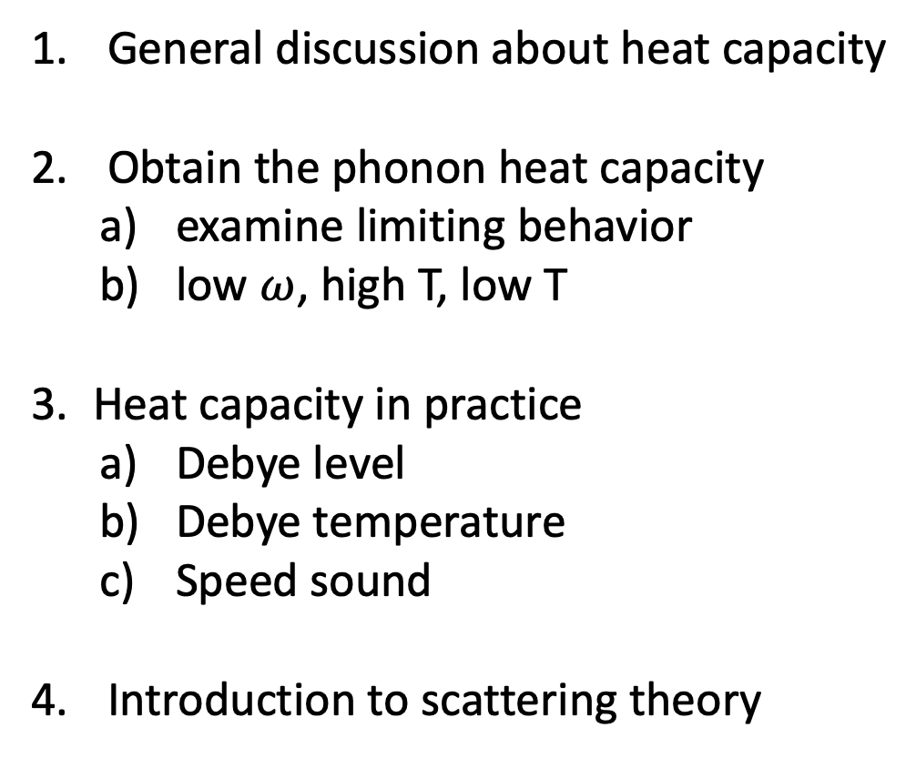
General discussion about heat capacity
Obtain the phonon heat capacity
examine limiting behavior
low $ω$, high T, low T
Heat capacity in practice
Debye level
Debye temperature
Speed sound
Introduction to scattering theory

Slide 3
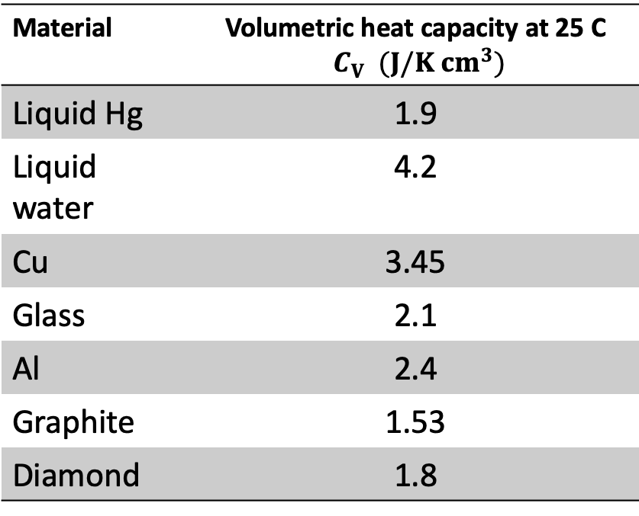
Heat capacity
Heat capacity is generally a very boring material property.
Material | Volumetric heat capacity at 25 C $C_{V} (J/K{ cm}^{3})$
Liquid Hg | 1.9
Liquid water | 4.2
Cu | 3.45
Glass | 2.1
Al | 2.4
Graphite | 1.53
Diamond | 1.8

Slide 4

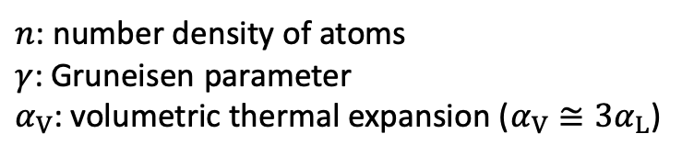
constant
$$T^{3}$$
$n$: number density of atoms
$γ$: Gruneisen parameter
$α_{V}$: volumetric thermal expansion ($α_{V}≅3α_{L}$)

Slide 5

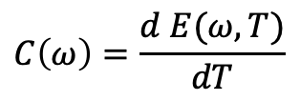
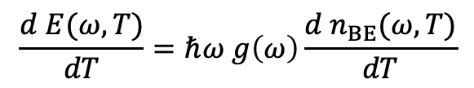
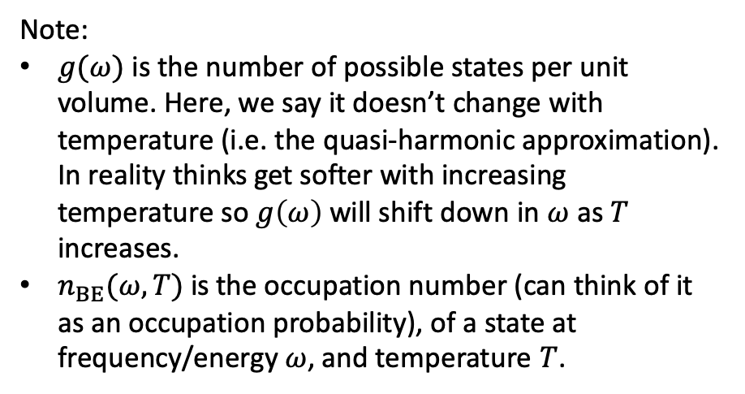
on board
Derivation set-up
$$C\left(ω\right)=\frac{d E(ω,T)}{dT}$$
Heat capacity is the change in energy with temperature
We will look for the spectral heat capacity per unit volume
Energy density: $E\left(ω,T\right)=ℏω n(ω,T)$
Number density of phonons: $n\left(ω,T\right)=g\left(ω\right) n_{BE}(ω,T)$
Note:
$g(ω)$ is the number of possible states per unit volume. Here, we say it doesn’t change with temperature (i.e. the quasi-harmonic approximation). In reality thinks get softer with increasing temperature so $g\left(ω\right)$ will shift down in $ω$ as $T$ increases.
$n_{BE}(ω,T)$ is the occupation number (can think of it as an occupation probability), of a state at frequency/energy $ω$, and temperature $T$.
$$\frac{d E(ω,T)}{dT}=ℏω g\left(ω\right)\frac{d n_{BE}(ω,T)}{dT}$$

Slide 6
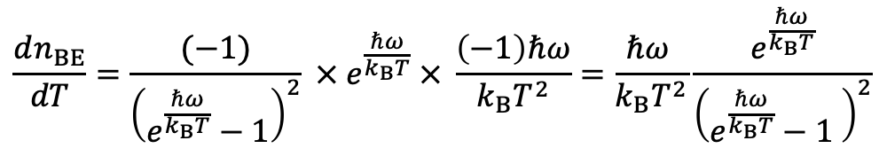
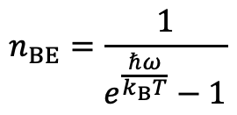
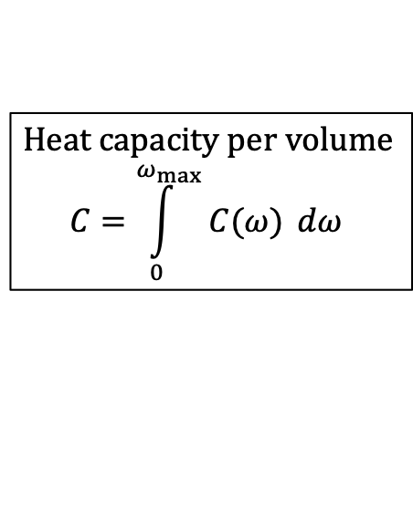
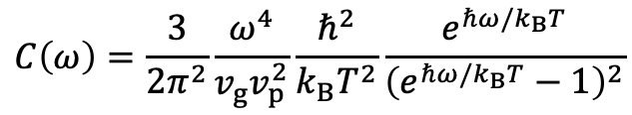
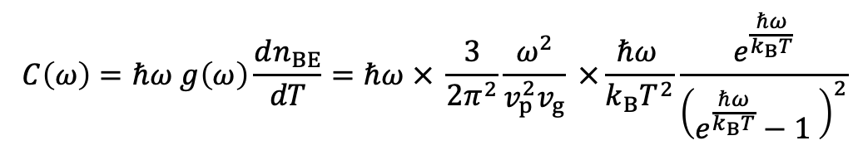
on board
Derivation
$$n_{BE}=\frac{1}{e^{\frac{ℏω}{k_{B}T}}−1}$$
Crazy triple chain rule
$$\frac{dn_{BE}}{dT}=\frac{(−1)}{{\left(e^{\frac{ℏω}{k_{B}T}}−1\right)}^{2}} ×{ e}^{\frac{ℏω}{k_{B}T}} × \frac{\left(−1\right)ℏω}{k_{B}T^{2}}=\frac{ℏω }{k_{B}T^{2}}\frac{e^{\frac{ℏω}{k_{B}T}}}{{\left(e^{\frac{ℏω}{k_{B}T}}−1 \right)}^{2}}$$
$$C\left(ω\right)=ℏω g\left(ω\right)\frac{dn_{BE}}{dT}=ℏω × \frac{3}{2π^{2}}\frac{ω^{2}}{v_{p}^{2}v_{g}} ×\frac{ℏω }{k_{B}T^{2}}\frac{e^{\frac{ℏω}{k_{B}T}}}{{\left(e^{\frac{ℏω}{k_{B}T}}−1 \right)}^{2}}$$
Heat capacity per volume
$$C=\int_{0}^{ω_{max}}{C(ω)} dω$$
$$C\left(ω\right)=\frac{3}{2π^{2}}\frac{ω^{4}}{v_{g}v_{p}^{2}}\frac{ℏ^{2}}{k_{B}T^{2}}\frac{e^{ℏω/k_{B}T}}{{\left(e^{ℏω/k_{B}T}−1\right)}^{2}}$$

Slide 7
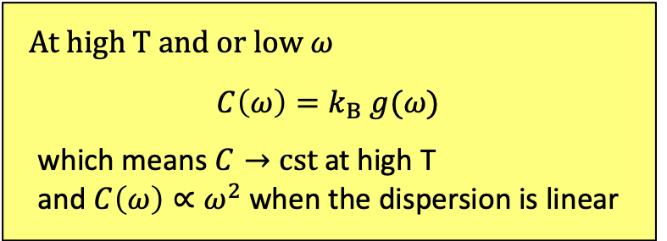

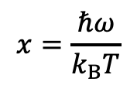


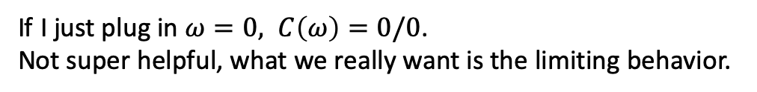
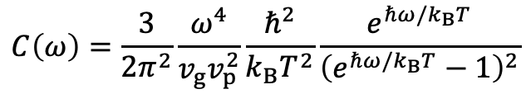
on board
Limiting behavior
Let’s look at the low $ω$ (and high T) behavior
$$C\left(ω\right)=\frac{3}{2π^{2}}\frac{ω^{4}}{v_{g}v_{p}^{2}}\frac{ℏ^{2}}{k_{B}T^{2}}\frac{e^{ℏω/k_{B}T}}{{\left(e^{ℏω/k_{B}T}−1\right)}^{2}}$$
If I just plug in $ω=0, C\left(ω\right)=0/0$.
Not super helpful, what we really want is the limiting behavior.
Define:
$$x=\frac{ℏω}{k_{B}T}$$
Taylor expand $e^{x}$ about $x=0$.
$$e^{x}≈1+x+…$$
$$C\left(ω\right)=\frac{3}{2π^{2}}\frac{ ω^{4}}{v_{p}^{2}v_{g}}\frac{ℏ^{2}}{k_{B}T^{2}} \frac{ (1)}{{\left(1+x−1\right)}^{2}}=\frac{3 }{2π^{2}}\frac{ω^{4}}{v_{p}^{2}v_{g}}\frac{ℏ^{2}}{k_{B}T^{2}}{\left(\frac{k_{B}T}{ℏω}\right)}^{2}=k_{B}\frac{3}{2π^{2}}\frac{ω^{2}}{v_{p}^{2}v_{g}}$$
At high T and or low $ω$
$$C\left(ω\right)=k_{B} g(ω)$$
which means $C→cst$ at high T
and $C\left(ω\right)∝ω^{2}$ when the dispersion is linear

Slide 8
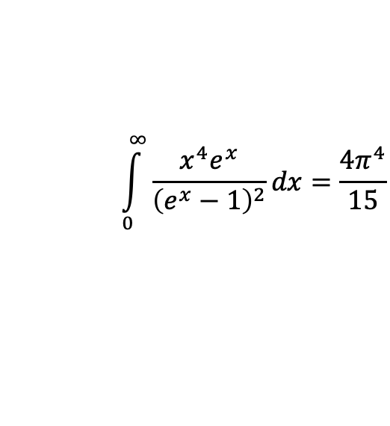

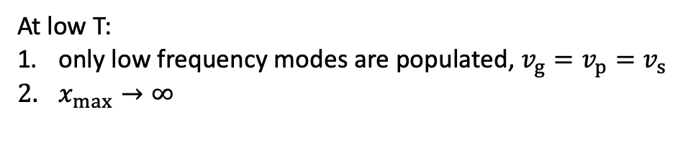
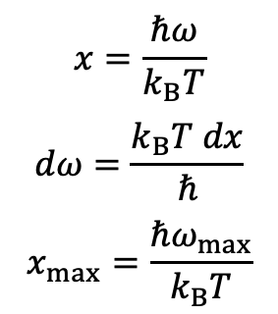
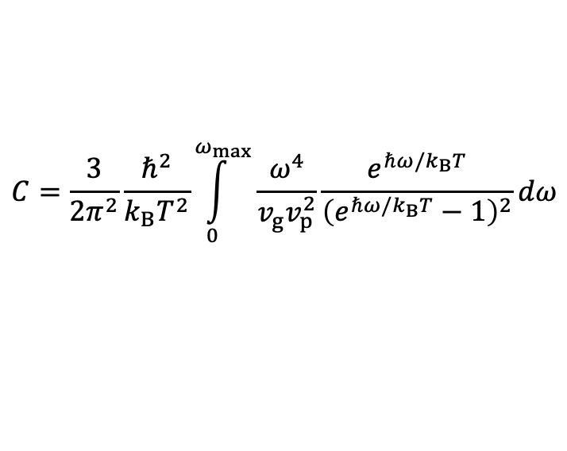
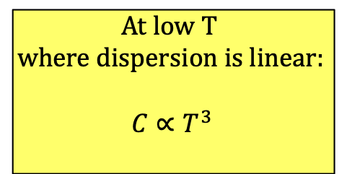
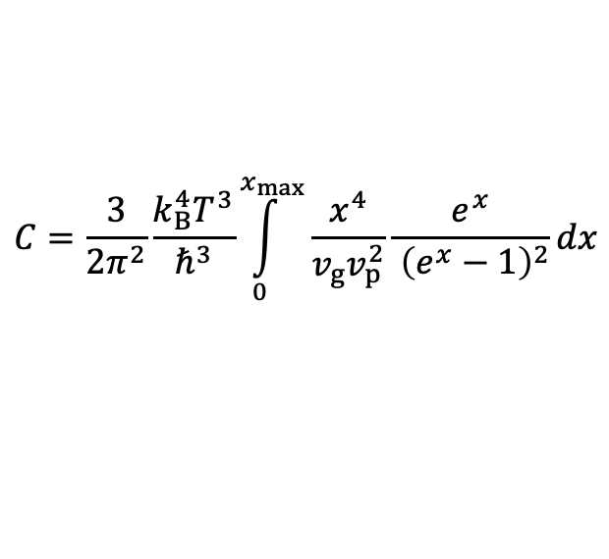
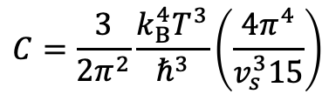
on board
Limiting behavior
Let’s look at low $T$ behavior
Convenient to convert the integral to be over the dimensionless parameter $x$.
$$x=\frac{ℏω}{k_{B}T}$$
$$dω=\frac{k_{B}T dx}{ℏ}$$
$$x_{max}=\frac{ℏω_{max}}{k_{B}T}$$
$$C=\frac{3}{2π^{2}}\frac{ℏ^{2}}{k_{B}T^{2}}\int_{0}^{ω_{max}}{\frac{ω^{4}}{v_{g}v_{p}^{2}}\frac{e^{ℏω/k_{B}T}}{{\left(e^{ℏω/k_{B}T}−1\right)}^{2}}}dω$$
$$C=\frac{3}{2π^{2}}\frac{k_{B}^{4}T^{3}}{ℏ^{3}}\int_{0}^{x_{max}}{\frac{x^{4}}{v_{g}v_{p}^{2}}\frac{e^{x}}{ {\left(e^{x}−1\right)}^{2}}dx}$$
At low T:
only low frequency modes are populated, $v_{g}=v_{p}=v_{s}$
$x_{max}→∞$
At low T
where dispersion is linear:
$$C∝T^{3}$$
$$\int_{0}^{∞}{\frac{x^{4}e^{x}}{{\left(e^{x}−1\right)}^{2}}dx=\frac{4π^{4}}{15}}$$
$$C=\frac{3}{2π^{2}}\frac{k_{B}^{4}T^{3}}{ℏ^{3}}\left(\frac{4π^{4}}{v_{s}^{3}15}\right)$$

Slide 9
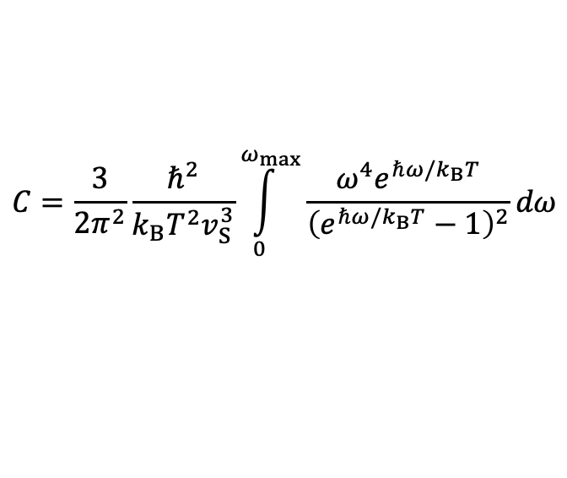

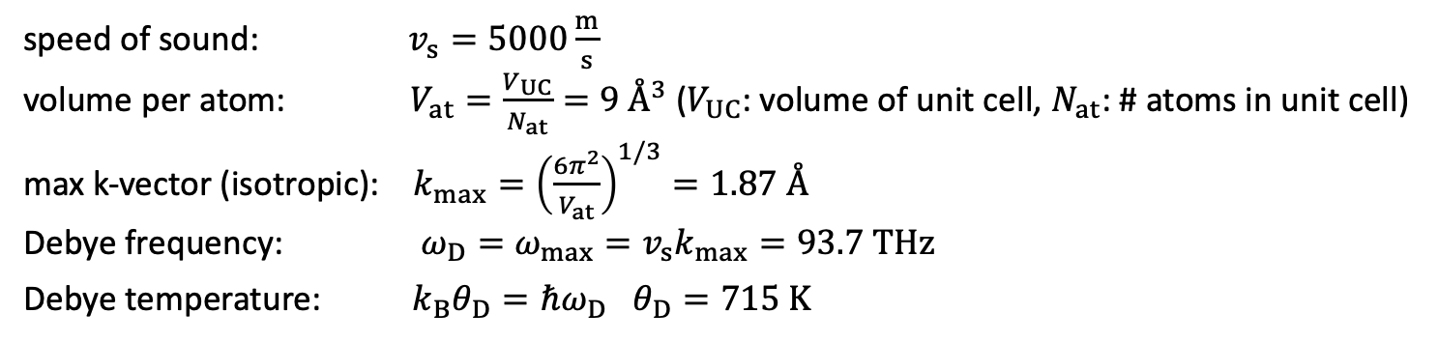

$$C=\frac{3}{2π^{2}}\frac{ℏ^{2}}{k_{B}T^{2}v_{S}^{3}}\int_{0}^{ω_{max}}{\frac{ω^{4}e^{ℏω/k_{B}T}}{{\left(e^{ℏω/k_{B}T}−1\right)}^{2}}}dω$$
on board
Example model
constant
$$T^{3}$$
$$θ_{D}$$
speed of sound: $v_{s}=5000\frac{m}{s}$
volume per atom: $V_{at}=\frac{V_{UC}}{N_{at}}=9 Å^{3}$ ($V_{UC}$: volume of unit cell, $N_{at}$: # atoms in unit cell)
max k-vector (isotropic): $k_{max}={\left(\frac{6π^{2}}{V_{at}}\right)}^{1/3}=1.87 Å$
Debye frequency: $ω_{D}=ω_{max}=v_{s}k_{max}=93.7 THz$
Debye temperature: ${k_{B}θ}_{D}=ℏω_{D}$ $θ_{D}=715 K$

Slide 10
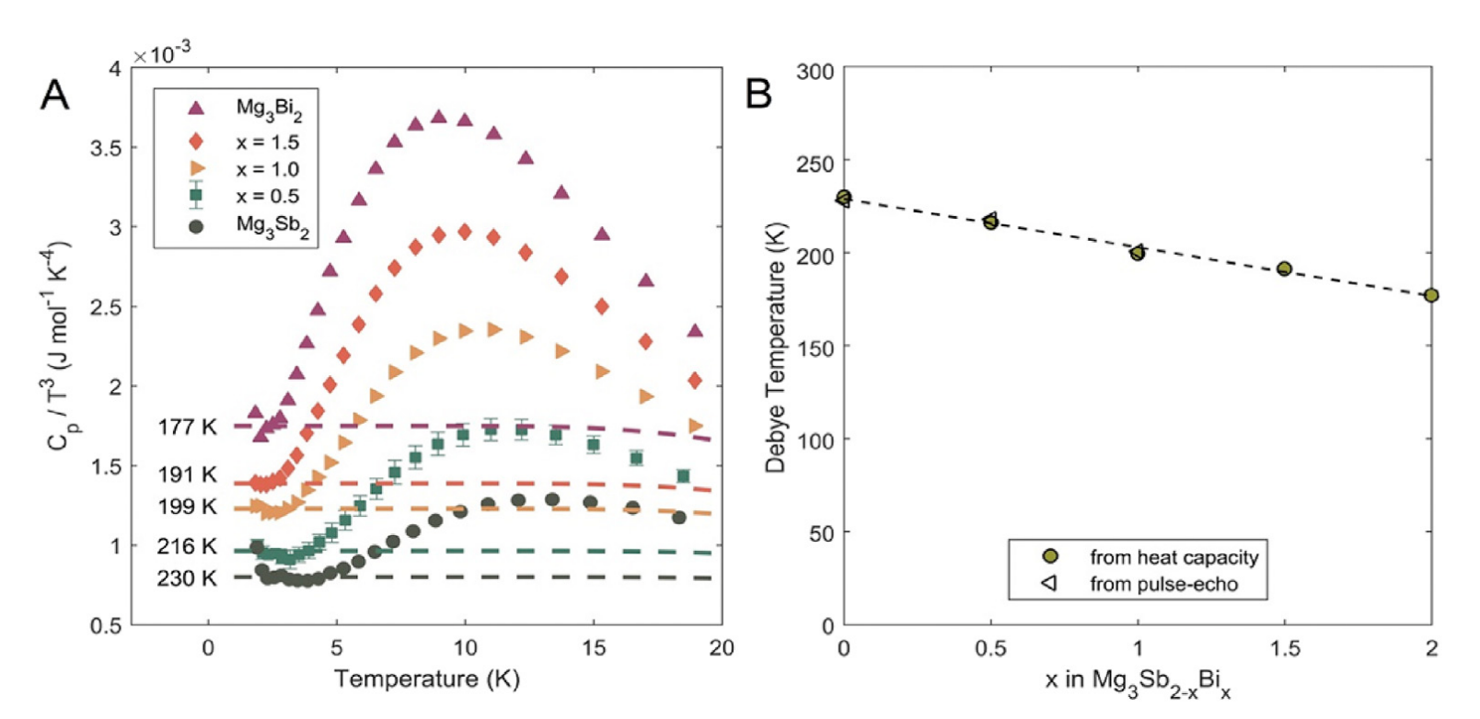

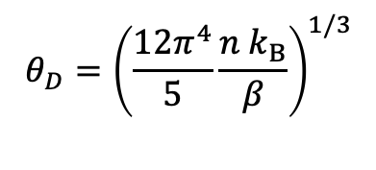
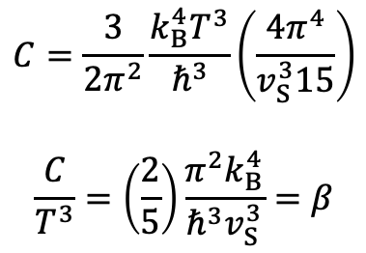
Analyzing low-T data
$$C=\frac{3}{2π^{2}}\frac{k_{B}^{4}T^{3}}{ℏ^{3}}\left(\frac{4π^{4}}{v_{S}^{3}15}\right)$$
$$\frac{C}{T^{3}}=\left(\frac{2}{5}\right)\frac{π^{2}k_{B}^{4}}{ℏ^{3}v_{S}^{3}}=β$$
good
exercise
$$θ_{D}={\left(\frac{12π^{4}}{5}\frac{n k_{B}}{β}\right)}^{1/3}$$
$n=\frac{1}{V_{at}}$: number density of atoms
Agne, M. T. et al. Heat capacity of Mg3Sb2, Mg3Bi2 and their alloys at high temperature. Mater. Today Phys. 6, DOI 10.1016/j.mtphys.2018.10.001 (2018).

Slide 11
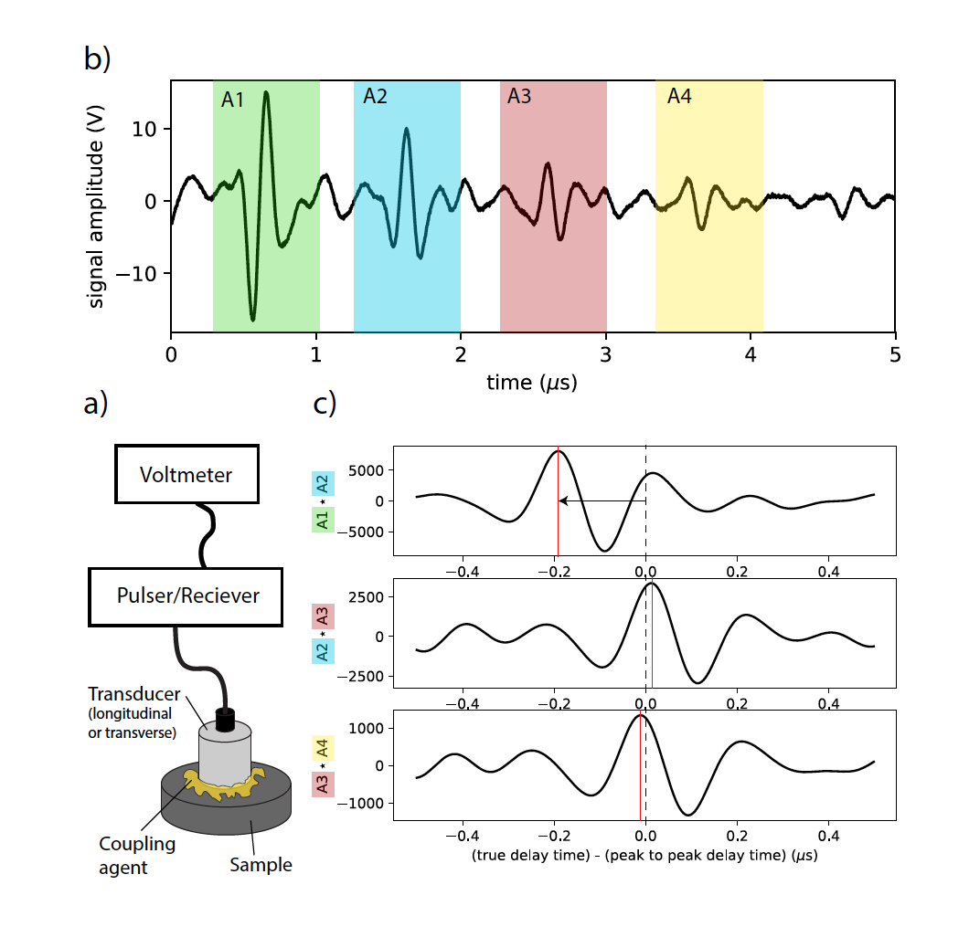
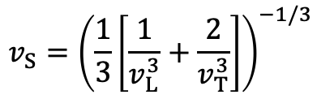
Speed of sound
When the cross-correlation is used to measure the time delay, the error is typically limit by the thickness variation of the sample. Can get better than 1% accuracy, if careful.
If sample is a randomly oriented polycrystalline, then you are measuring the isotropic average longitudinal and transverse speeds of sound.
Be mindful of preferred orientation of grains, especially for non-cubic materials.
Be mindful of sample density. Samples should be very dense, >98%.
The isotropic average speed of sound, used for thermal conductivity modeling, heat capacity modeling, Debye temperature.
$$v_{S}={\left(\frac{1}{3}\left[\frac{1}{v_{L}^{3}}+\frac{2}{v_{T}^{3}}\right]\right)}^{−1/3}$$
Anderson, O. L. A simplified method for calculating the Debye temperature from elastic constants. J. Phys. Chem. Solids 24, 909–917 (1963).

Slide 12
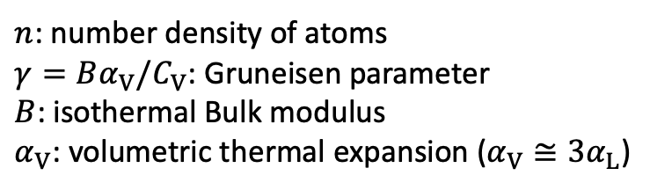

Thermal expansion contribution
$n$: number density of atoms
$γ=Bα_{V}/C_{V}$: Gruneisen parameter
$B$: isothermal Bulk modulus
$α_{V}$: volumetric thermal expansion ($α_{V}≅3α_{L}$)
$$C_{p}=C_{V}(1+γα_{V}T)$$

Slide 13
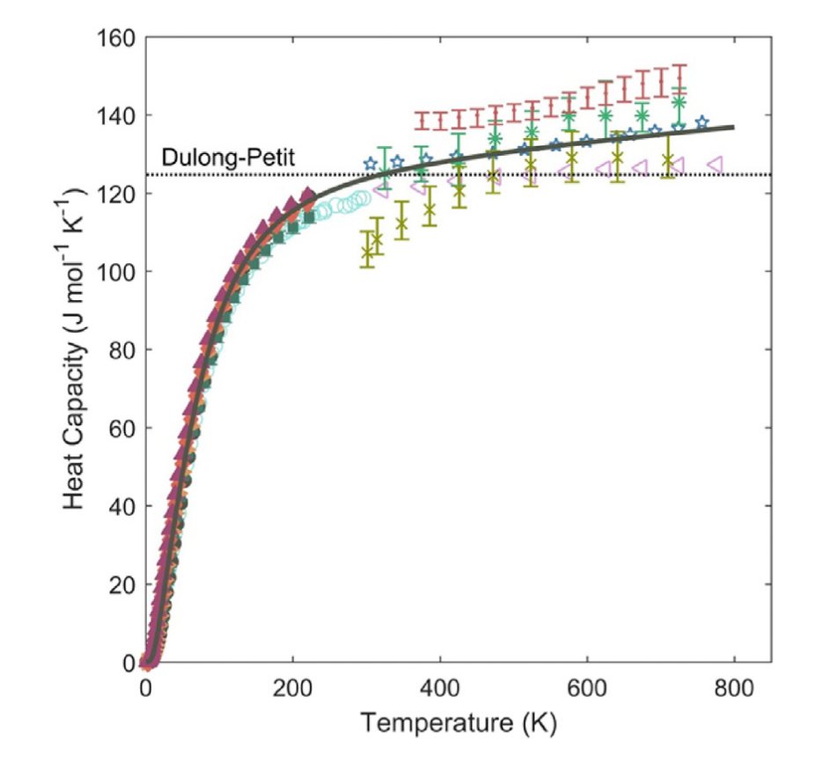
Analyzing high-T data
Absolute value of high temperature heat capacity is notoriously hard to measure.
In contrast low-temperature heat capacity can be very accurate (e.g. physical property measurement system PPMS in heat capacity mode).
Often times our models are better at predicting it then and one given measurement is.
The slope of Heat Capacity vs. T at high T can be reasonably accurate.
Agne, M. T. et al. Heat capacity of Mg3Sb2, Mg3Bi2 and their alloys at high temperature. Mater. Today Phys. 6, DOI 10.1016/j.mtphys.2018.10.001 (2018).

Slide 14
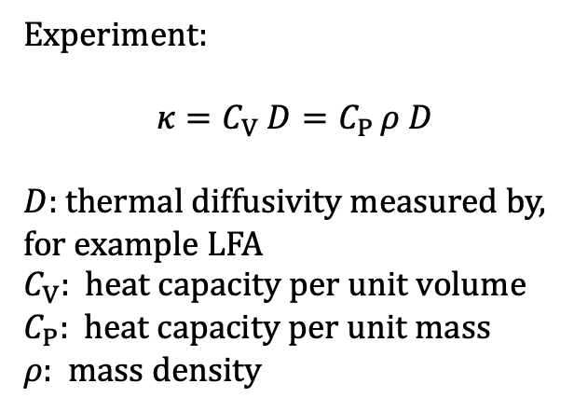
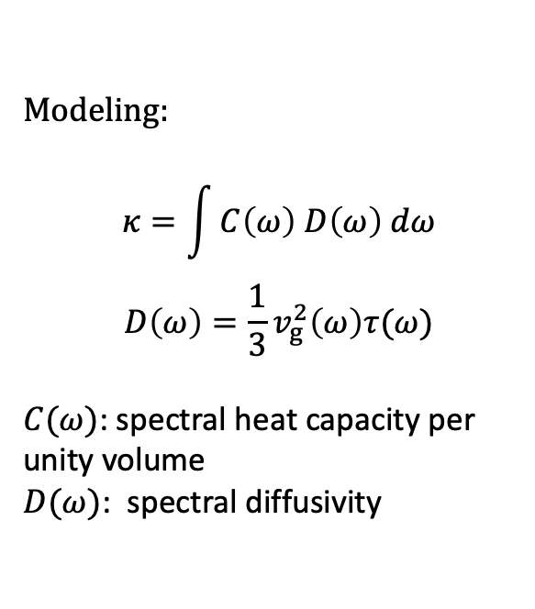
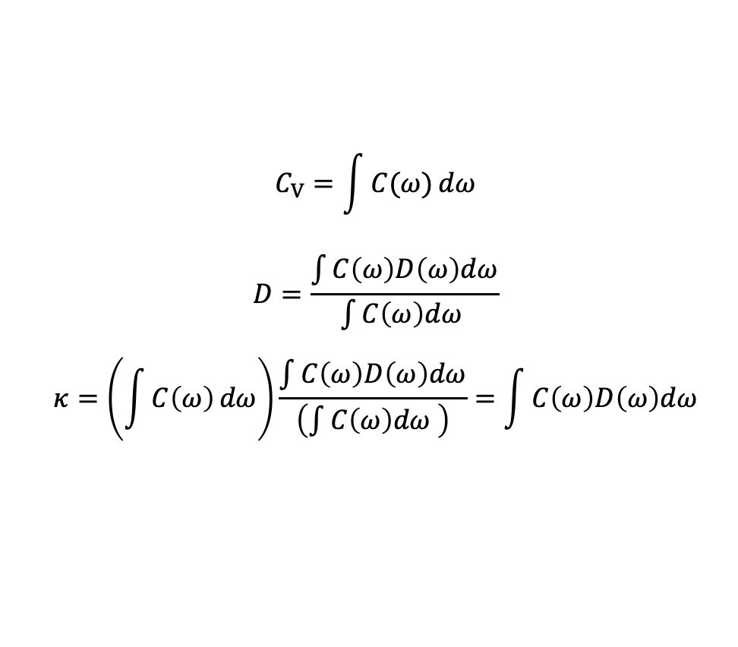
on board
Thermal conductivity considerations
Modeling:
$$κ=\int{C\left(ω\right) D\left(ω\right) dω}$$
$$D\left(ω\right)=\frac{1}{3}v_{g}^{2}\left(ω\right)τ(ω)$$
$C(ω)$: spectral heat capacity per unity volume
$D(ω)$: spectral diffusivity
Experiment:
$$κ=C_{V} D=C_{P }ρ D$$
$D$: thermal diffusivity measured by, for example LFA
$C_{V}$: heat capacity per unit volume
$C_{P}$: heat capacity per unit mass
$ρ$: mass density
$$C_{V}=\int{C(ω)}dω$$
$$D=\frac{\int{C\left(ω\right)D\left(ω\right)dω}}{\int{C\left(ω\right)dω }}$$
$$κ=\left(\int{C\left(ω\right)}dω\right)\frac{\int{C\left(ω\right)D\left(ω\right)dω}}{\left(\int{C\left(ω\right)dω }\right)}=\int{C\left(ω\right)D\left(ω\right)dω}$$
Heat capacity weighted average diffusivity

