Slide 1
Persistent Segment Trees
Riley Immel, Windsor antal, Brandon Yang

Slide 2
Overview
Today we will look at:
- A recap on Segment Trees
- Persistent Segment Trees Overview
- Time Complexities
- Applications
- Example problem walkthrough

Slide 3
Motivation: Segment Trees, but with history

Slide 4

Motivation
Goal: Given a list of integers $A=\{a_{1},a_{2},…,a_{n}\}$ and a function that operates on continuous ranges in A, called $f(l,r)$ where $l,r∈Z;l≤r$
Support the following operations:
1. Calculate (for any l,r) the value of $f\left(l,r\right)=f(a_{l},…,a_{r})$ in $O(\log{n)}$ time
2. Update the value of an element of A in $O(\log{n)}$ time.
3. Use no more than $O(n)$ memory (so no more than list A itself times a constant)
But what about Persistent Seg Trees?
Goals:
Be able to access any version of the tree and perform operations on it
Do so without copying the entire tree for each modification and without losing O(log n) for range queries
*Slide taken from “Trees-SegmentTrees” by Mark Floryan https://markfloryan.github.io/advAlgo/slides/Trees-SegmentTrees.pptx

Slide 5
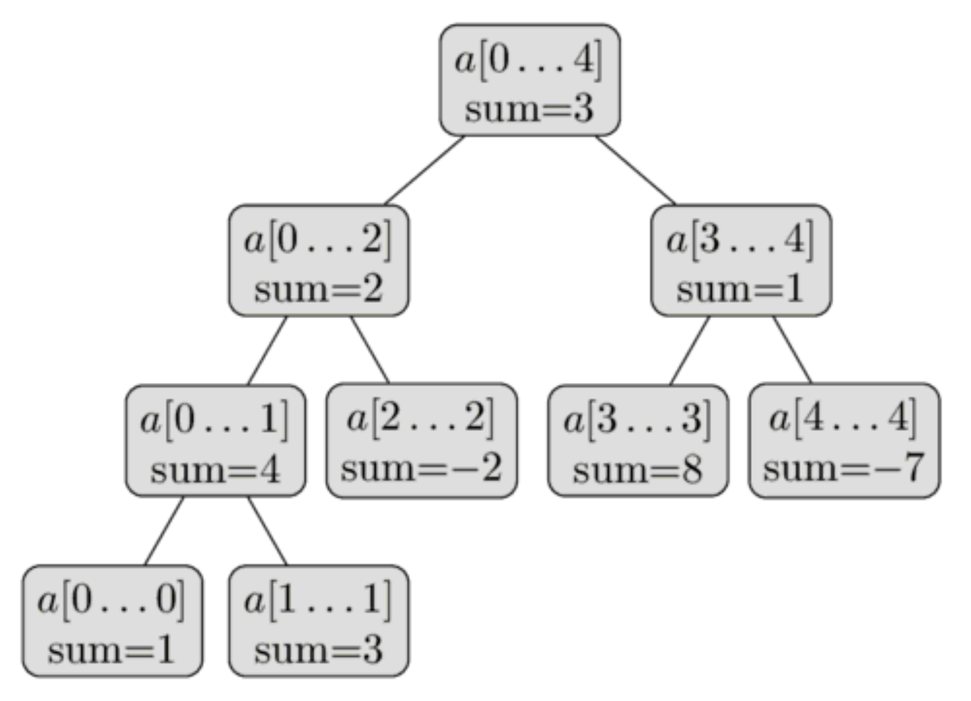
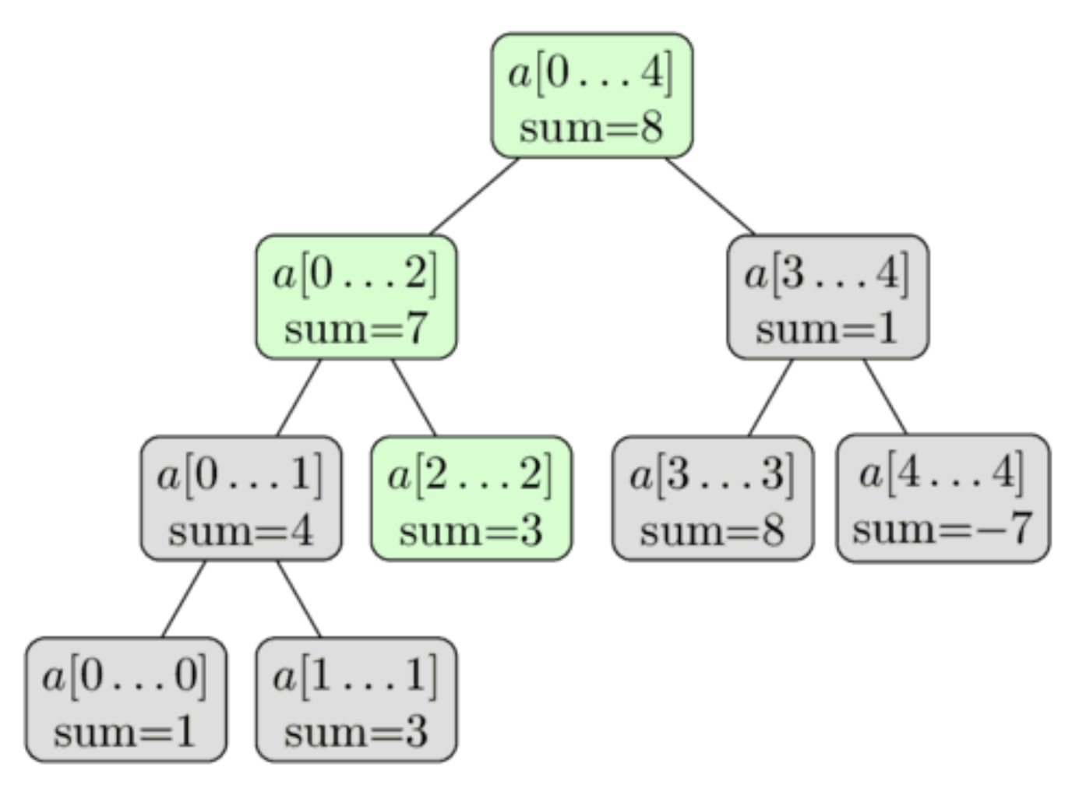
Recap on Segment tree updates
Original Segment Tree which stores:
New Tree storing:
A = {1, 3, -2, 8, -7}
update(2, 3)
A = {1, 3, 3, 8, -7}
Call update on index 2 with value 3
But now we’ve lost the fact that index 2 was once -2, how can we can fix this? With persistent seg trees; let’s see how they work

Slide 6
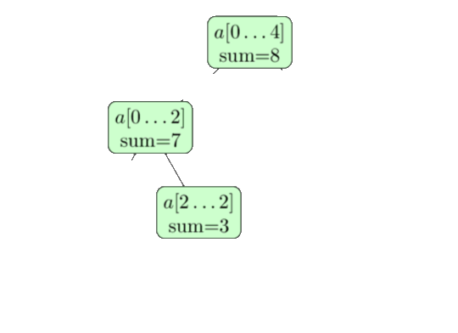
Persistent Segment tree updates
Original Segment Tree which stores:
update(2, 3)
A = {1, 3, -2, 8, -7}
Version 0
Version 1
New version means new root node, then make pointers either to previous versions node if that child is unaffected, or make a new node with the update, and make pointer to that

Slide 7






Persistent Segment tree updates
Version 3 Version 2
Version 1 Version 0
update(1,0)
update(3,10)
update(2,3)
Versions

Slide 8








Persistent Segment tree updates
Most Recent Version
Stores pointers to root nodes of each version
Versions Array:

Slide 9
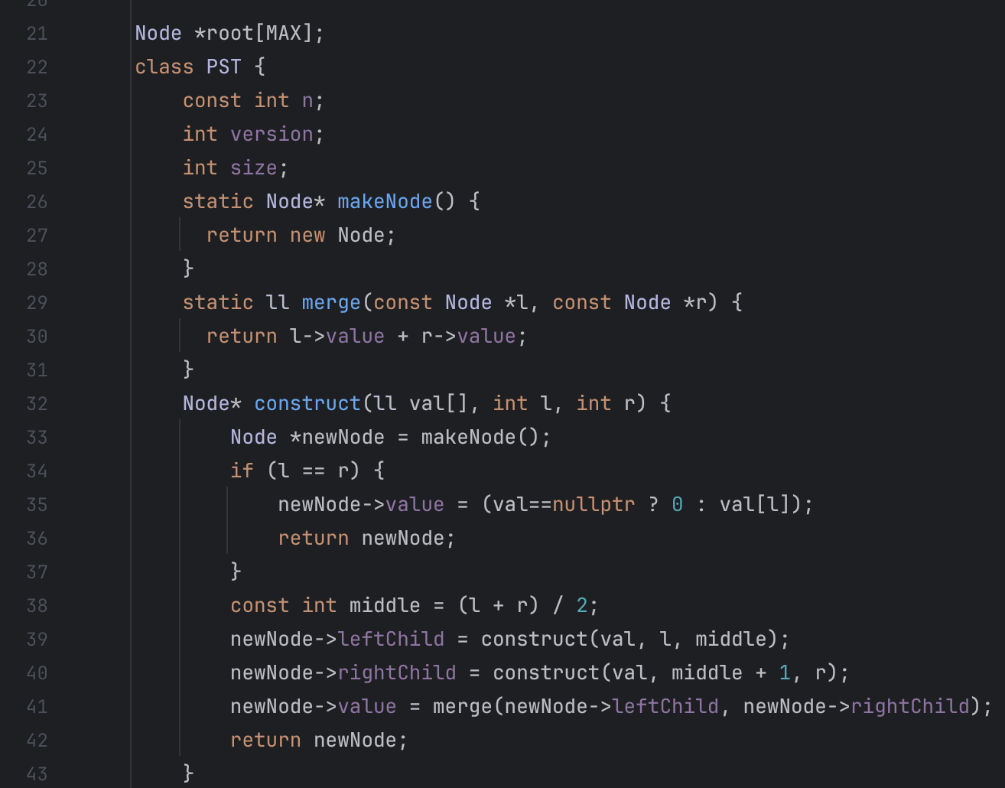
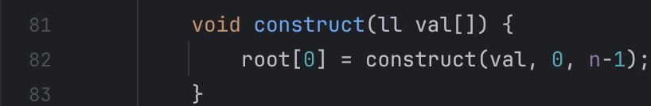
Versions array; MAX is var for # of versions allowed
Otherwise, the rest of the code is the same as regular seg tree
Public Construct method

Slide 10
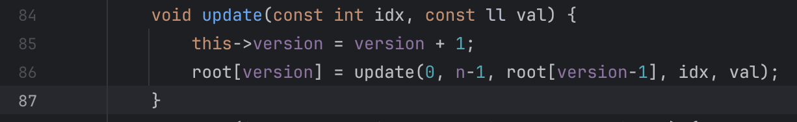
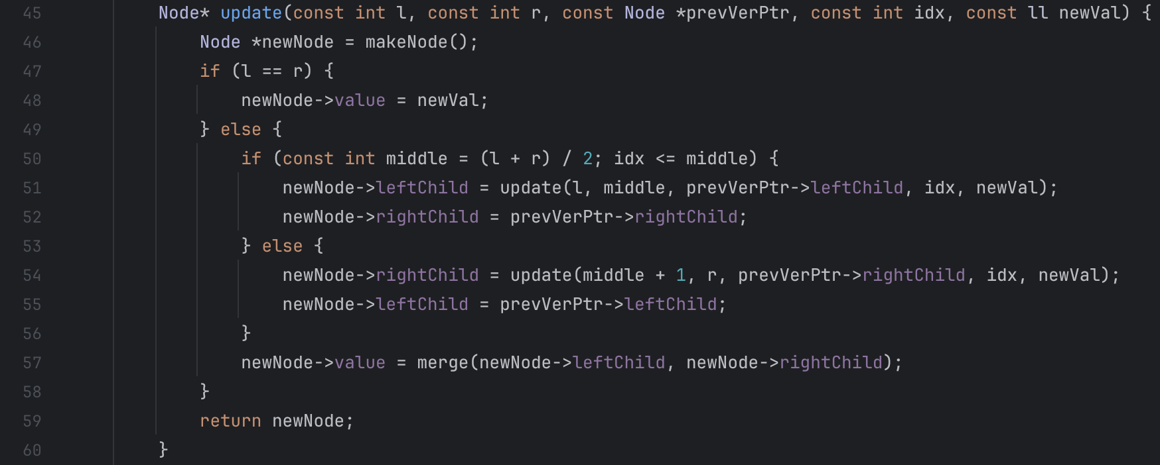
Public Update method
Update global var version then call private update method and store the return value (ptr to root) in the versions array
Private Update method- actually does the work
For the child that isn’t being updated, use the previous versions pointer, otherwise call update on the child

Slide 11
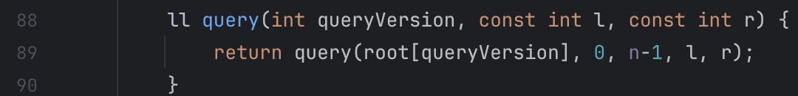
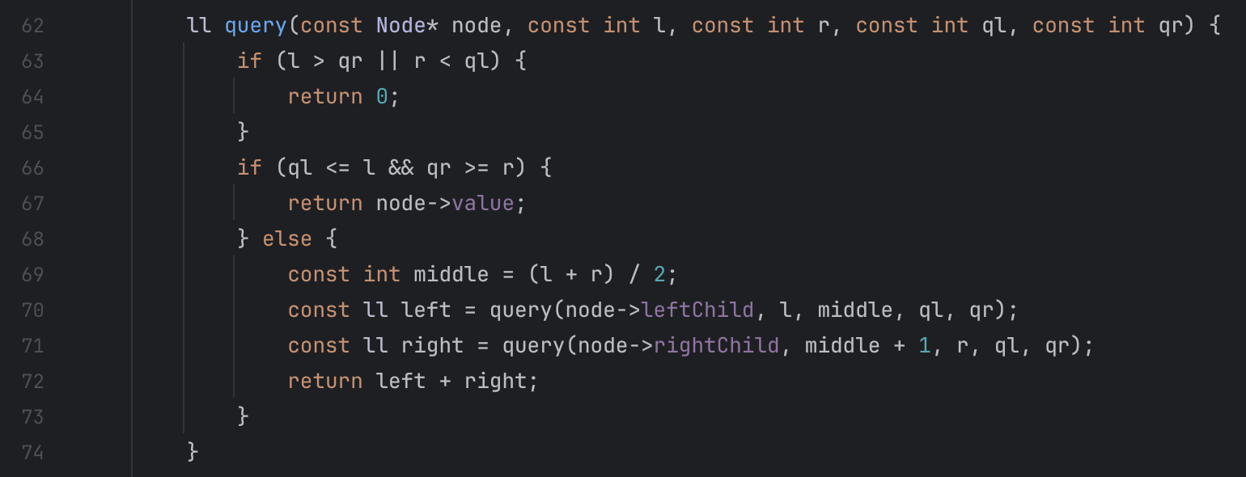
Public Query method
Takes version # as an arg., then calls private method passing the root node from versions array
Private Query method- actually does the work
Same as regular segment tree method

Slide 12
Recap Time Complexities
Recall that regular seg trees took:
O(n) to build
O(log n) for queries
O(log n) for updates
And had O(n) space complexity

Slide 13
PST Time Complexities
PSTs still have:
O(n) to build
O(log n) for queries
O(log n) for updates
However, their space complexity is more complicated

Slide 14
PST Space complexity
PSTs have a variable to control how many versions area allowed
Remember this array? It holds the root node for each version and has length MAX where MAX is total # of allowed versions
Each new version requires copying/creating O(log n) new nodes
So overall, the space complexity is O(n + MAX*log n) so the exact complexity depends on MAX

Slide 15
Applications
Version Control / Backups
Provide a structure that allows history to be preserved and revisited without massive duplication
Git(hub) is an example of this type of persistence– each commit is a new “version” but only affects the new changes; unchanged items aren’t duplicated
“Time-travel” or historical analysis
Can analyze previous versions / iterations and look at changes
Etc.

Slide 16

Example
A school district keeps track of enrollment numbers by geographic regions within their district; they keep records over the years and like to compare the changes over the years and look for trends.
Below are the enrollment numbers for the 2000-2001 school year (version 0).
- There are 7 geographic regions

Slide 17
Example cont.
It is now the 2001-2002 year and time to update the enrollment numbers; shockingly only 3 regions have different enrollment counts:
Region 1 now has 37 students
Region 4 now has 17 students
Region 5 now has 46 students
Update(1,37)
Update(4,17)
Update(5,46)

Slide 18
Example cont.
Even more shockingly, for the 2002-2003 school year, only region 7 changed to an enrollment of 29
Update(6,29)

Slide 19
Example cont.
The district now wants to compare enrollment info for region 7 over the 3 years they’ve tracked. Specifically, they want to know the ratio of region 7 to overall enrollment

Slide 20
Example cont.
For 2000-2001, we need to query version 0:
We simply grab region 7’s # and the overall and get: 20/203 = ~9.85%

Slide 21
Example cont.
For 2001-2002, we need to query version 1:
In code we would have to get a pointer to version 1’s root, then query for 7’s # and the overall sum and get: 20/199 = ~10.05%

Slide 22
Example cont.
For 2002-2003, we need to query version 2:
In code we would have to get a pointer to version 2’s root, then query for 7’s # and the overall sum and get: 29/208 = ~13.94%

Slide 23
Example cont.
Thus the district concludes that region 7 is steadily growing in ratio of overall enrollment:
2000-20001: ~9.85%
2001-2002: ~10.05%
2002-2003: ~13.94%

