Slide 1
Cheetah Sign
Iteration 3
Levi Shelley, Riley Jamison,
Tia Self

Slide 2
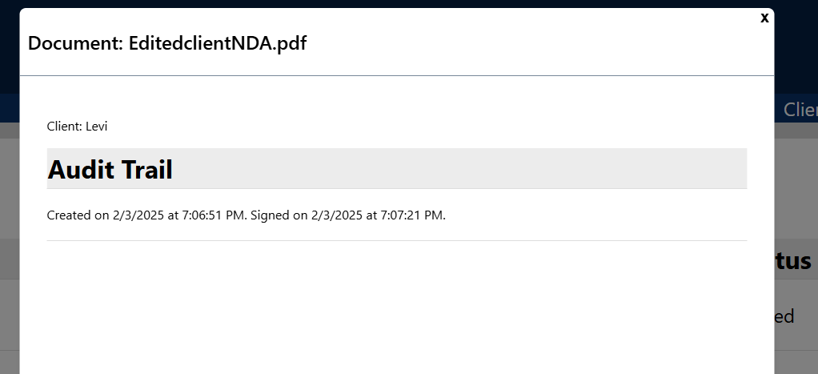
New Features: Audit Trail
Shows off the time that the job was created and signed
Can be accessed by clicking on the job name
This is the “tracking” portion of the business requirement, so admin users know where the job is currently held.

Slide 3
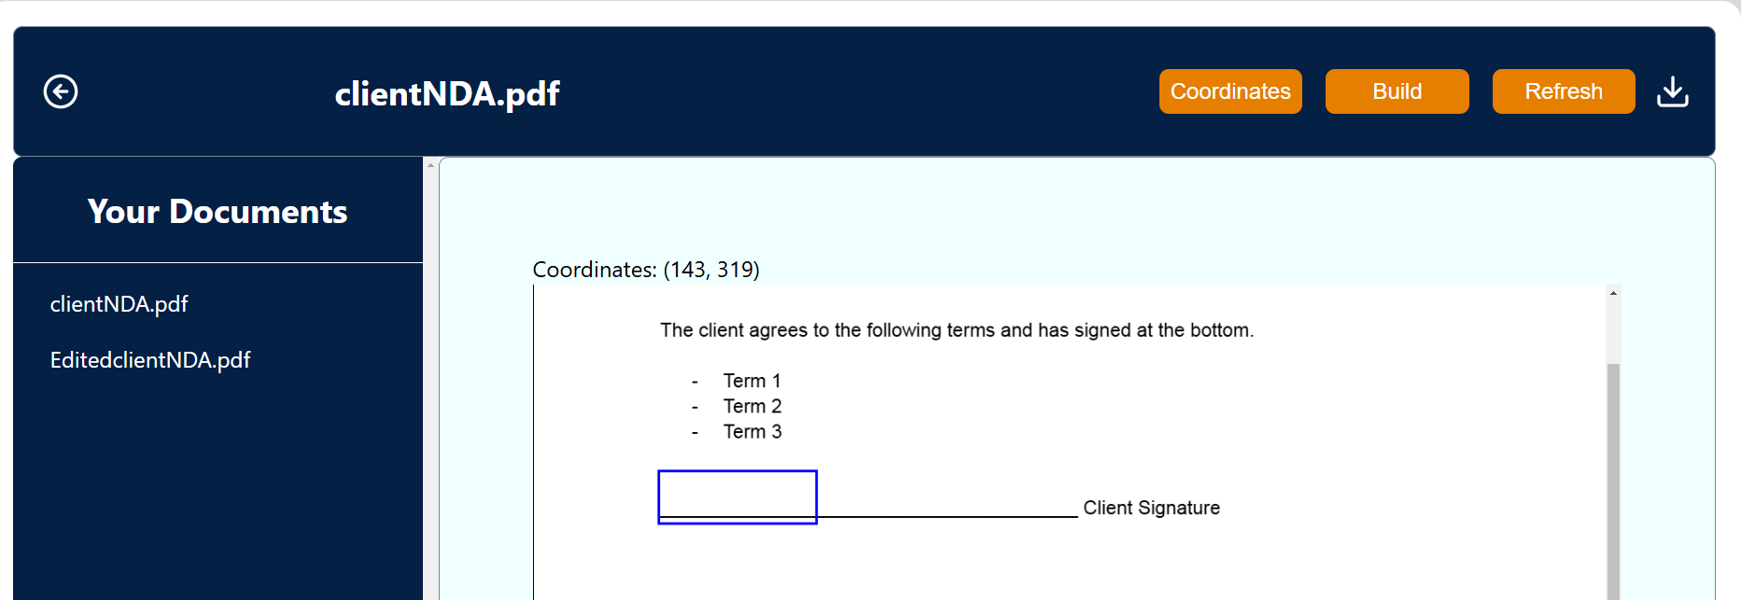
New Features: Document Builder
Able to click to create the text box!
Much easier to create edited documents without committing.
This improves the “sending” document process, making a more straightforward and intuitive experience.

Slide 4
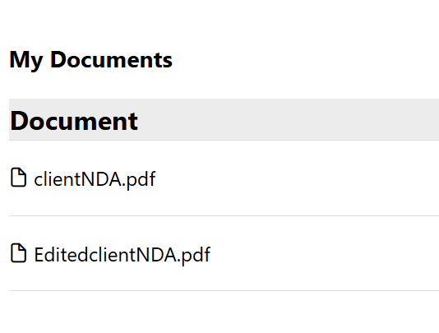
New Features: Dynamic Updates
Uploaded and deleted documents will move immediately
No refreshing required
This improves everything about handling documents, making it less confusing when “zombie” documents exist

Slide 5
Feedback

Slide 6
Mentor Feedback
Happy with how the group has come together to problem solve
Doing a good job at listening to client demands and making changes according to what was emphasized by the client

Slide 7
Client Feedback
Very happy with the document builder so far
Multiple signing fields is a critical feature they would like to see implemented
Implementing auto filled fields for client information was also emphasized
Happy with the smaller quality of life UI changes
Browser compatibility for Safari specifically is important as many of their clients use it
They would rather we prioritize refining the document builder and implementing multi fields over the browser compatibility

Slide 8
Teamwork
Levi
Implemented audit trail
Configured testing and pipelines
Riley
Reactive page rendering
Updated the UI of document builder
Refined signing and textbox placement on documents
Tia:
Updated styling to UI elements
Implemented alert messages for sending emails and uploading docs

Slide 9
Fourth Iteration Features
Clients Page
Multiple Signing Fields
01
02
Store commonly used information (ssn, address, name, etc.)
Pick from a list of clients instead of manually entering the fields to send documents
Allow for multiple textboxes to be placed in the document builder
Classify Text Fields
03
State what kind of information the text field should hold for the client

Slide 10

Random slide (optional)

