Slide 1
Innovation Adoption and Regulation Under Uncertainty: The Case of New Medical Procedures
Riley League
University of Illinois Urbana-Champaign

Slide 2
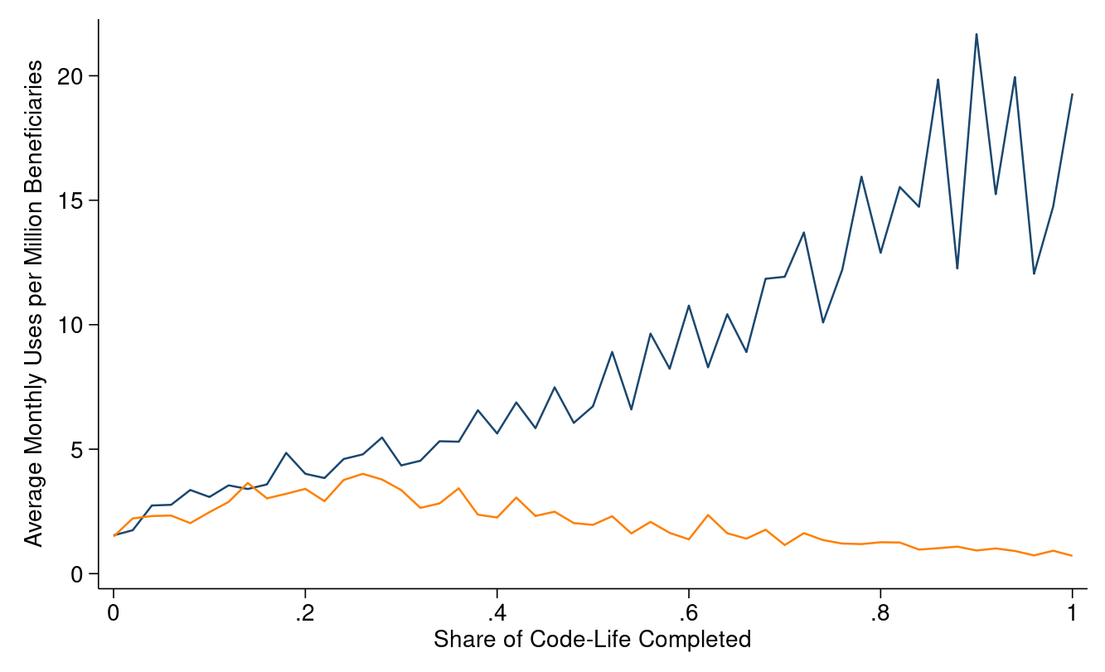
208 Codes Grow
135 Codes Fall

Slide 3
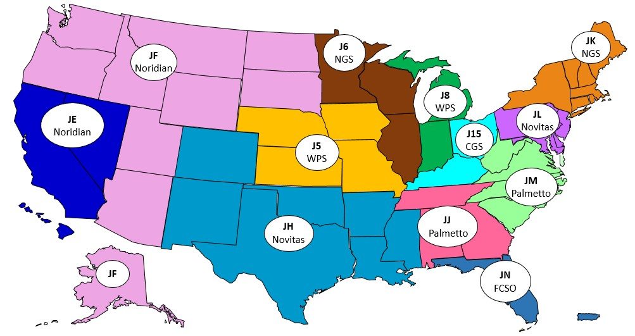

Slide 4
Research Questions
Does Medicare coverage affect the adoption of new procedures?
Yes, coverage increases utilization
Is social learning an important determinant of the diffusion of innovations in this context?
Yes, there are spillovers from idiosyncratic shocks to early use that depend on the ex-post value of the innovation
How could Medicare improve its coverage rules?
Universal coverage achieves 93% of gains of first best coverage rule

Slide 5
Social Learning
Updating of beliefs about the efficacy of an innovation through the receipt of public signals that are generated by the innovation’s use

Slide 6
Related Literature
Optimal Evidentiary Standard
Pharmaceuticals: Grabowski and Wang (2008), Olson (2008)
Medical devices: Budish, Roin, and Williams (2015), Stern (2017), Grennan and Town (2020)
Information Diffusion
Channels: Social networks (Allen et al., 2019; Bailey et al., 2019; Foster and Rosenzweig, 1995), geography (Agha and Molitor, 2018; Conley and Udry, 2010 ; Chandra and Staiger, 2007), professional connections (Stoyanov and Zubanov, 2012; Kellogg, 2011)
Little exogenous variation in global information: Moretti (2011), Gilchrist and Sands (2016)

Slide 7
Procedure Created
AMA Assigns Code
MACs Determine Coverage
AMA Reassigns Code

Slide 8
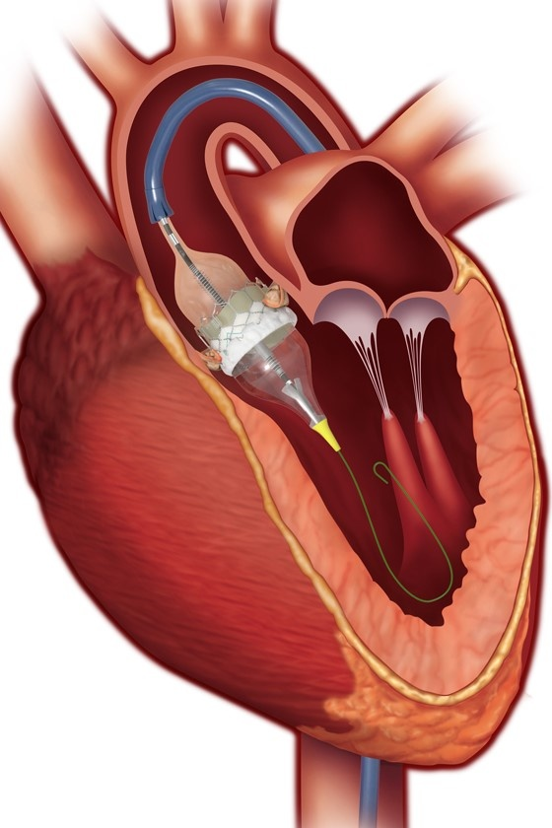
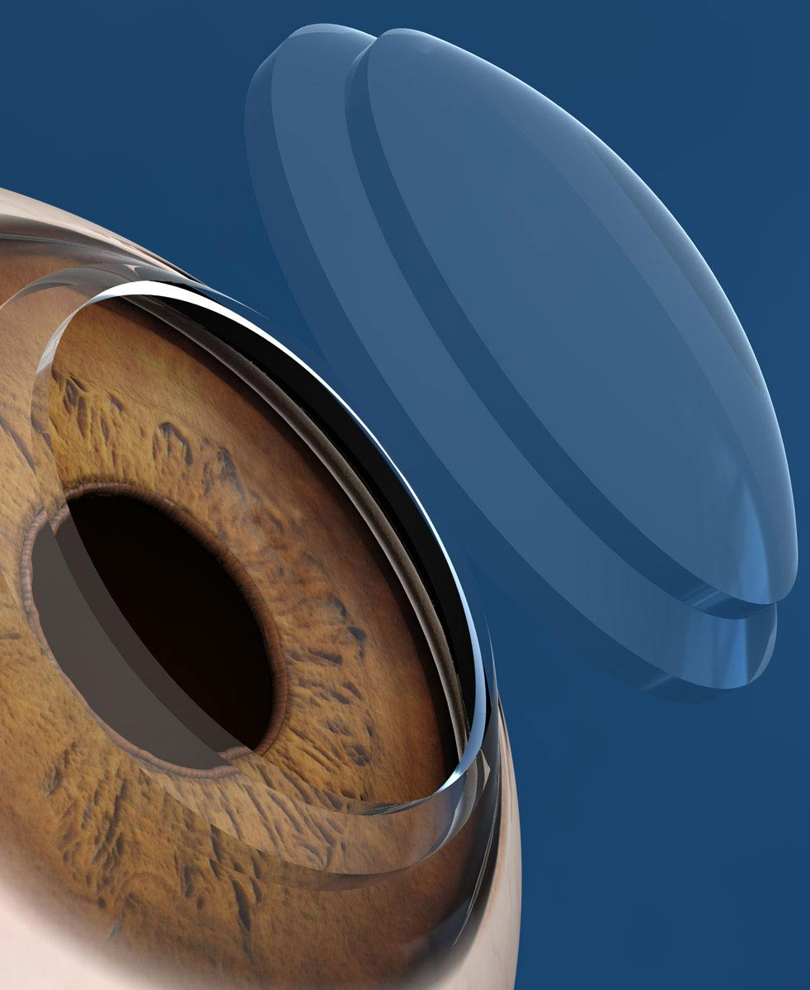

TAVR
Laser Corneal Transplant
Applied Behavior Analysis

Slide 9
208 Codes Grow
135 Codes Fall
AMA Decisions

Slide 10
Medicare Administrative Contractors (MACs)
MACs enroll providers, process claims, determine coverage rules
To be covered by Medicare “items and services will have to be safe and effective, not experimental or investigational, and appropriate for Medicare beneficiaries”

Slide 11
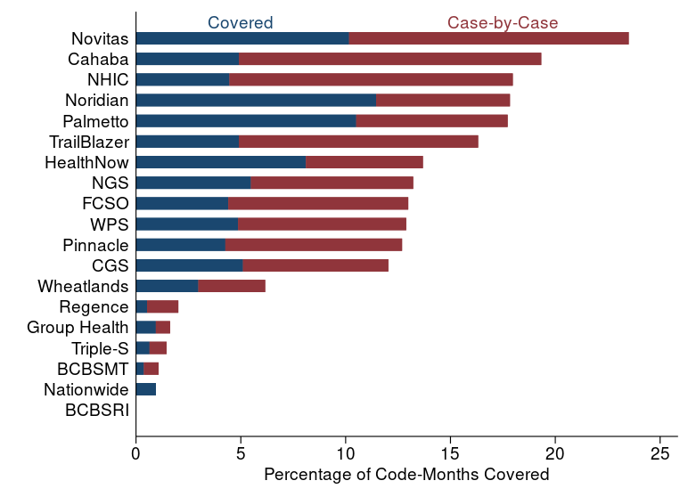
Medicare Administrative Contractors (MACs)
Conditional on being case-by-case or covered anywhere, it’s only covered everywhere 6.5% of the time
43.2% of code-months feature disagreement
Coverage Rules
Accuracy

Slide 12
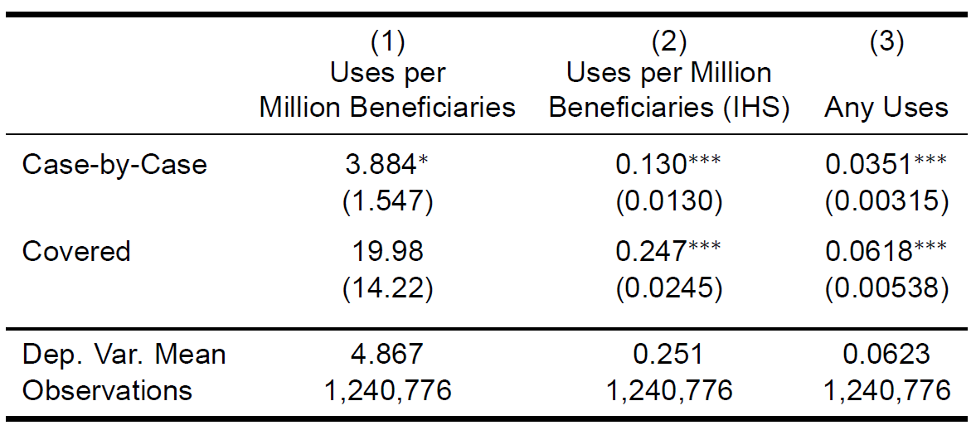
Dynamic

Slide 13
“In the ethical tradition expressed by Hippocrates and continuously affirmed thereafter, the role of the physician has been that of a healer who serves patients, a teacher who imparts knowledge of skills and techniques to colleagues, and a student who constantly seeks to keep abreast of new medical knowledge.” – AMA Code of Ethics

Slide 14
Evidence of Social Learning
Spillovers in utilization
Persistence in shocks to utilization conditional on ex-ante quality
Including when instrumenting utilization shocks with jurisdiction size
Effect of coverage differs by jurisdiction size
Spillovers
Persistence
IV
Jurisdiction Size
Other Explanations

Slide 15
Model Overview
Physicians make adoption decisions based on belief about value of technology and coverage status
Utilization generates noisy public signal of procedure quality
Physicians update beliefs by Bayes rule
Patient utility depends on true procedure value
Welfare-maximizing policy depends on true procedure values, responsiveness of physicians to policy, and spillover size

Slide 16

Adoption Decision
Physicians adopt new technology iff
$$U_{ipt}=E_{ipt}\left[δ_{p}^{∗}\right]−β_{p}Noncov_{ipt}−X_{ip}>0$$
$δ_{p}^{∗}$ - quality of new procedure
$X_{ip}$ - physician skill
Quality is unobserved by physician
Adoption decision is static

Slide 17

Quality Signals
Physicians have normally distributed prior beliefs about quality of new technology with mean $δ_{p}^{0}$ and variance $σ_{δp}^{2}$
Physicians produce a public signal of $δ_{p}^{∗}$ each time they treat a patient (with variance $σ_{ν}^{2}$)
Each provider receives an IID signal from each use

Slide 18

Belief Updating
Physicians update beliefs according to Bayes rule
Physician $i$’s beliefs are distributed $N(μ_{ipn},σ_{ipn})$
$σ_{ipn}=\frac{σ_{νp}σ_{δp}}{\sqrt{σ_{νp}^{2}+nσ_{δp}^{2}}}$ and $μ_{ipn}=σ_{ipn}^{2}\left(\frac{δ_{0ip}}{σ_{δp}^{2}}+\sum_{k=1}^{n}{\frac{ν_{ipk}}{σ_{νp}^{2}}}\right)$

Slide 19

Treatment Decision
Only $η_{p}$% of patients in consideration set are appropriate for treatment
Once adopted, physicians treated all patients for whom treatment is appropriate
Patient utility given by $V_{iptj}=η_{pj}(δ_{p}^{∗}−X_{ip})$

Slide 20

MAC Coverage Decisions
MAC $a$ has coverage standard $s_{ap}$ for procedure $p$:
$$s_{ap}=θ_{a}+μ_{p}+ε_{ap}$$
Cover iff evidence $e_{tp}>s_{ip}$

Slide 21

Estimation
Patients in consideration set are those with primary diagnosis of any patient ever treated with procedure
Can be estimated at coverage level-month-procedure level
Can be estimated by MLE
Assuming $ε_{ap}$ is T1EV, MAC FEs can be estimated using conditional logit with time-procedure fixed effects
Likelihood
Identification

Slide 22
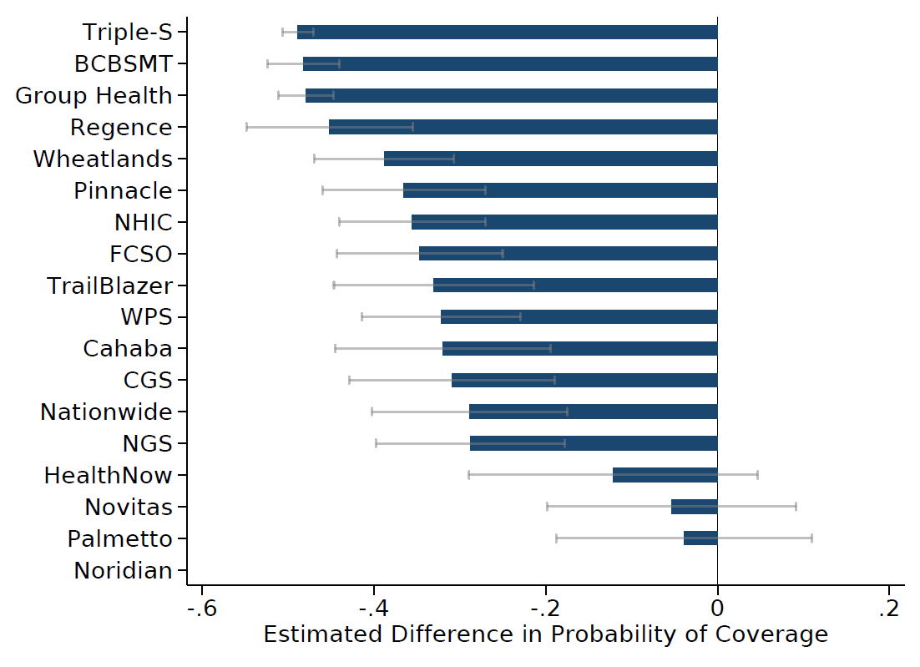
Estimated MAC Fixed Effects
Wide variation across contractors in coverage standards
Highlights range of plausible coverage standards

Slide 23
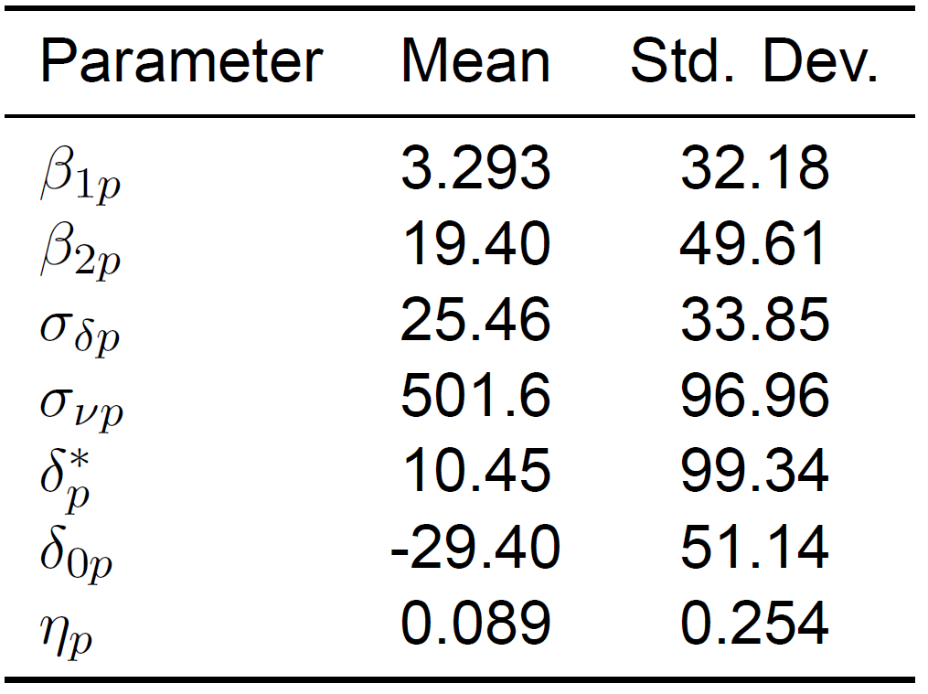
Parameter Estimates
Lots of initial uncertainty and subsequent signals are noisy
Initial beliefs are 25 times more disperse than physician ability
Median provider can correctly distinguish procedure’s value from incumbents at entry for 13% of procedures
Precision of median prior is equivalent to 1243 subsequent signals
On average, new procedures are better than incumbent procedures but providers initially believe they are worse
Model Fit

Slide 24
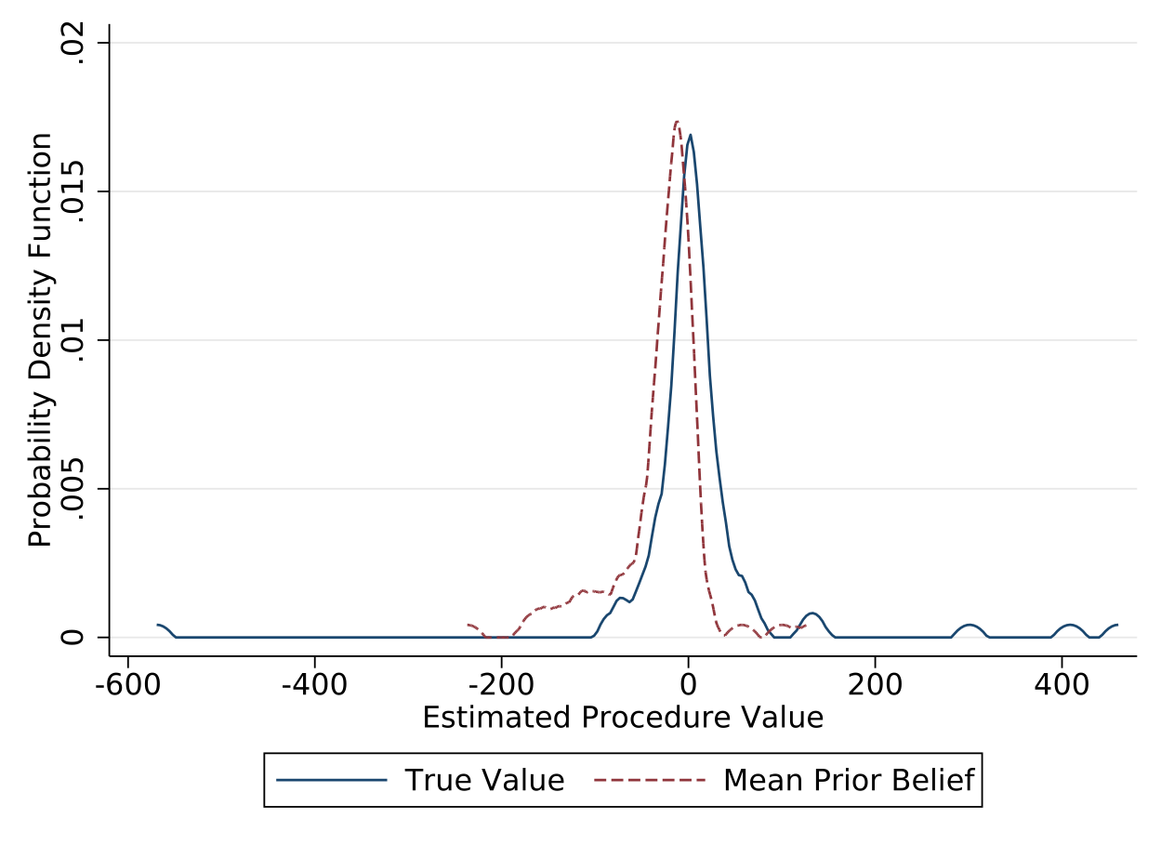
Perceived and True Procedure Values
True value is positive for 58.2% of procedures
Prior beliefs are similarly distributed, but modal prior is lower than modal true value
Correlation between true and perceived value: 0.05
Physicians are pessimistic about 76.9% of procedures, only significantly optimistic for 4.4%
Physicians are overconfident in priors:
59.3% of true values in 99% CI
51.6% of true values in 95% CI
39.6% of true values in 90% CI
Scatter

Slide 25
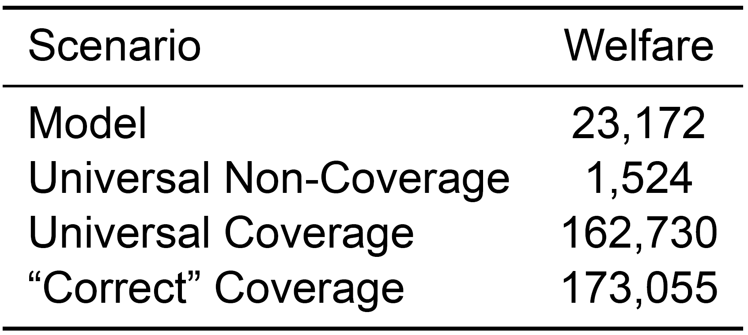
Welfare
Patient welfare is perceived inclusive value of procedure plus difference between true and perceived value for those that receive procedure
Universal coverage would achieve 93% of gains of correct coverage

Slide 26
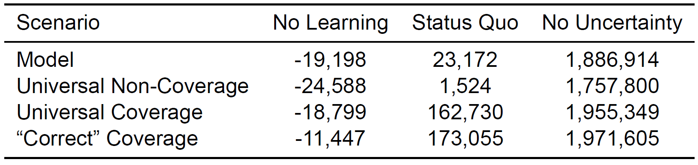
Value of Learning
Welfare cost of imperfect information dwarfs cost of imperfect coverage
We are much closer to no information than perfect information
Without learning, new procedures are (statically) a net welfare loss and coverage is less welfare-improving

Slide 27
Summary
Medicare coverage increases utilization of new medical procedures
Social learning contributes to diffusion patterns
More generous coverage rules could improve welfare

Slide 28
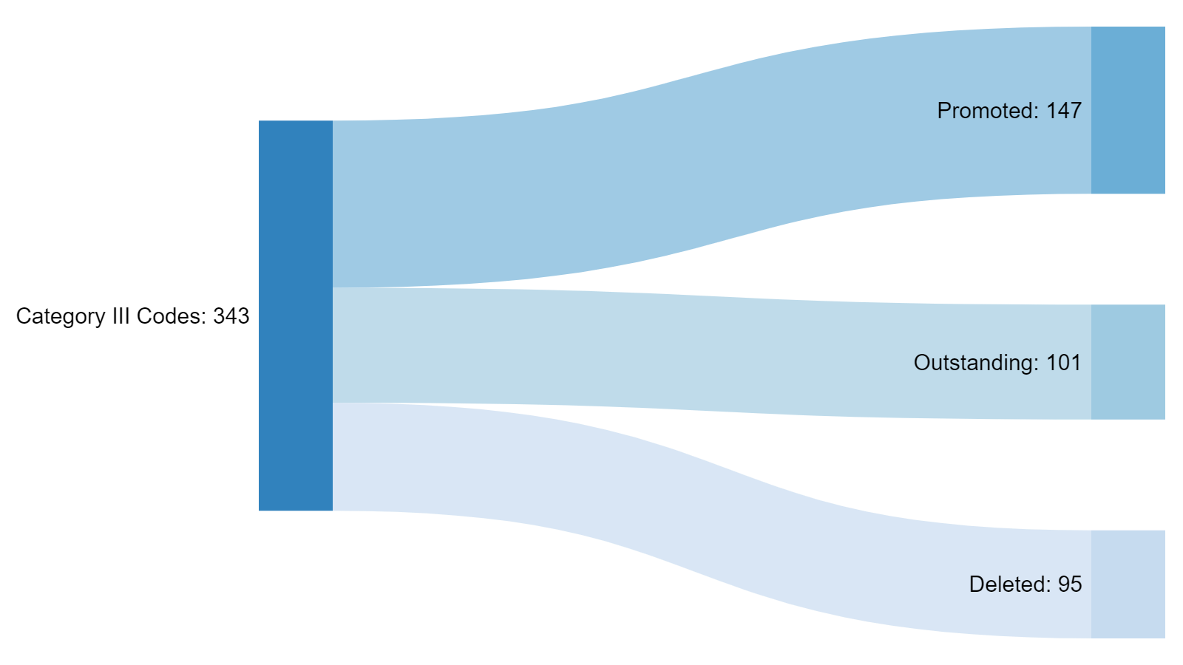
Concordance
Return

Slide 29
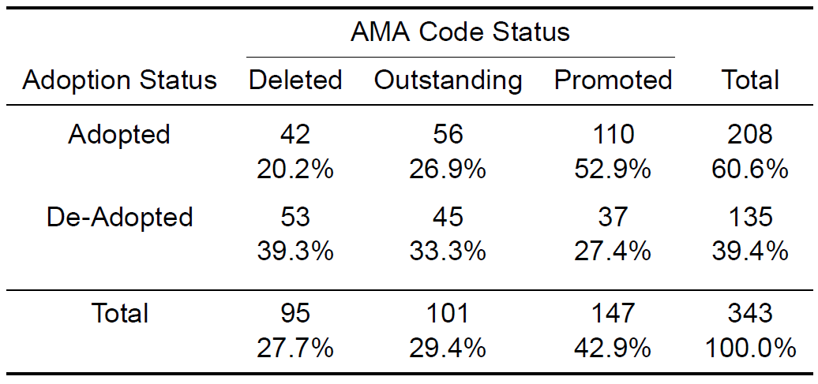
Return

Slide 30
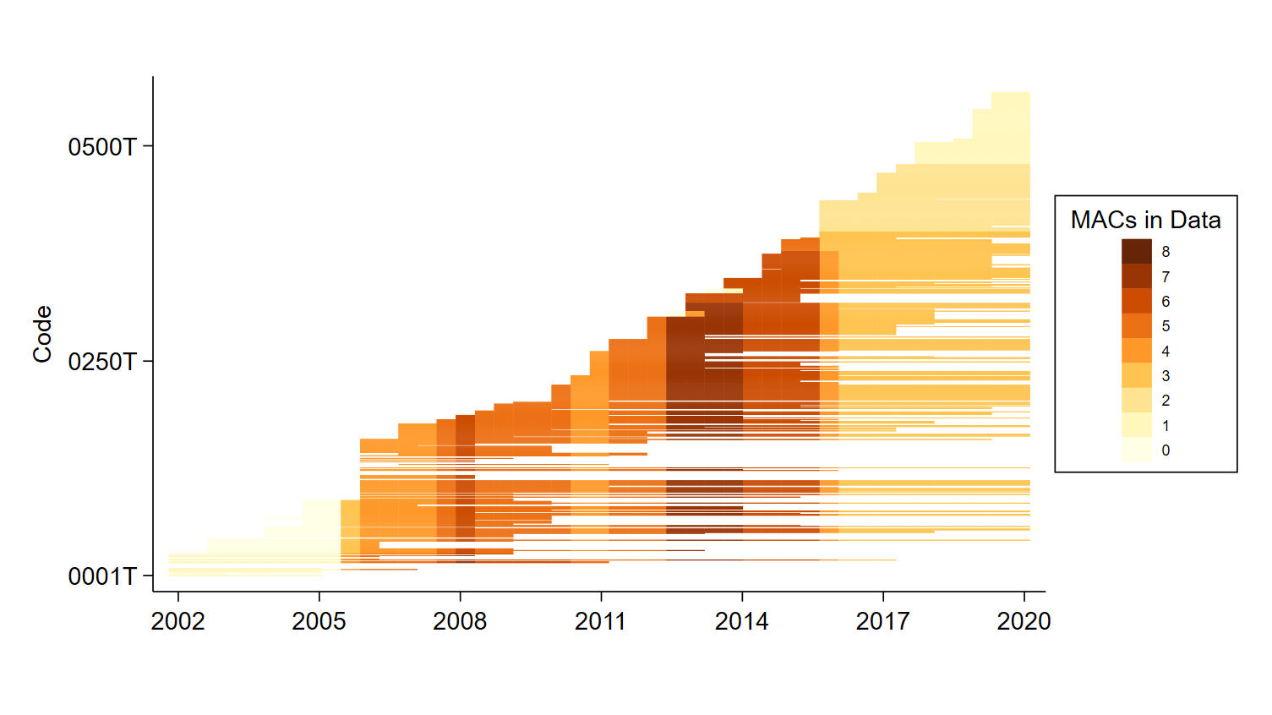
Return

Slide 31
Detect structural break in level and trend of denial rates by MAC for each procedure
Manually screen breaks to those that represent readily apparent coverage changes
Eliminate “breaks” of less than 15 percentage points
Use 20% cutoff for coverage, 80% cutoff for non-coverage
Move unclassified change to nearest bin
Codes without breaks defined as non-covered until first covered use
After first use, use 20% cutoff for coverage, 80% cutoff for non-coverage
Return

Slide 32
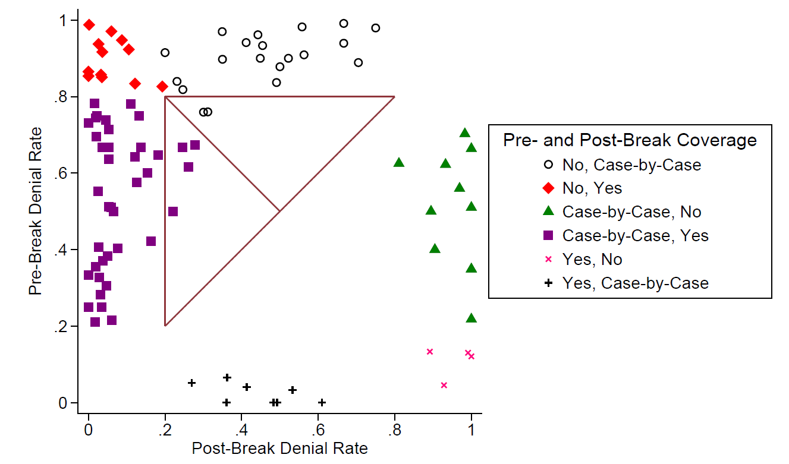
Return

Slide 33
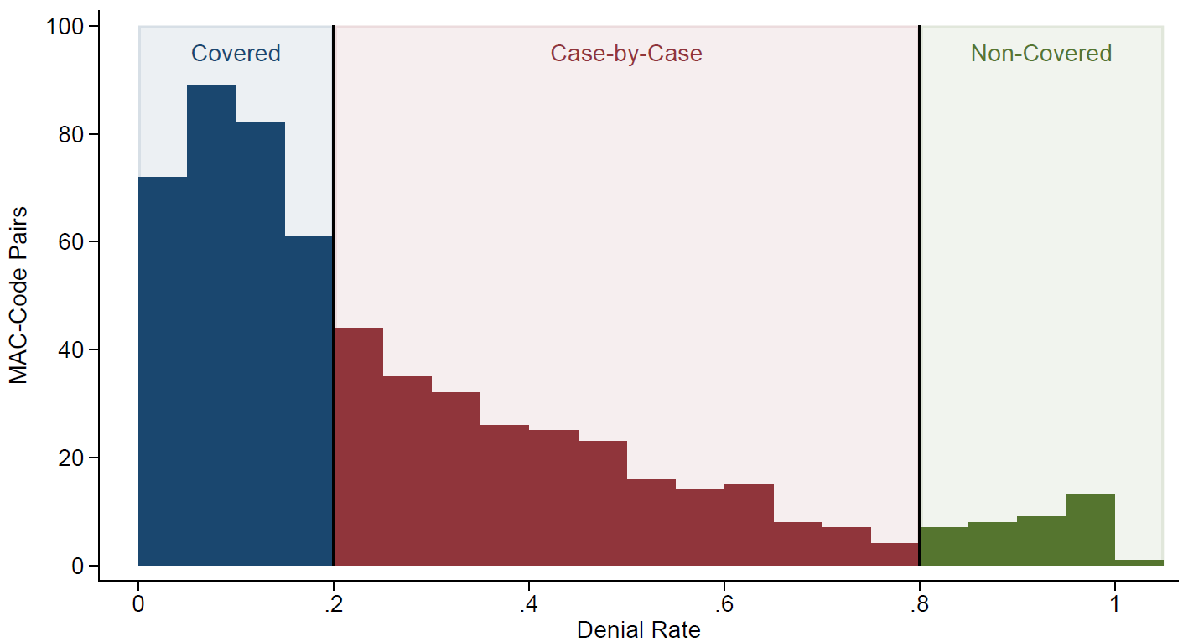
Return

Slide 34
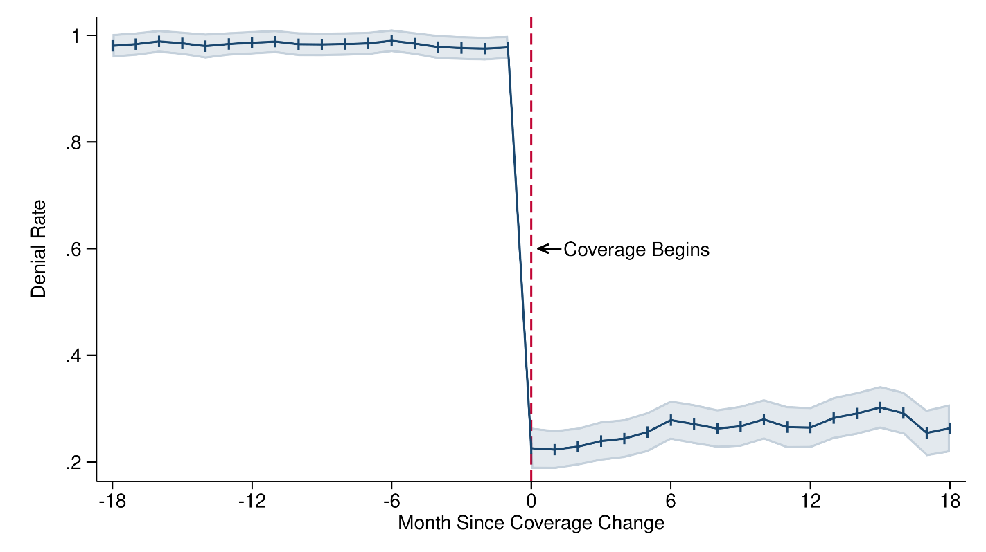
Return

Slide 35
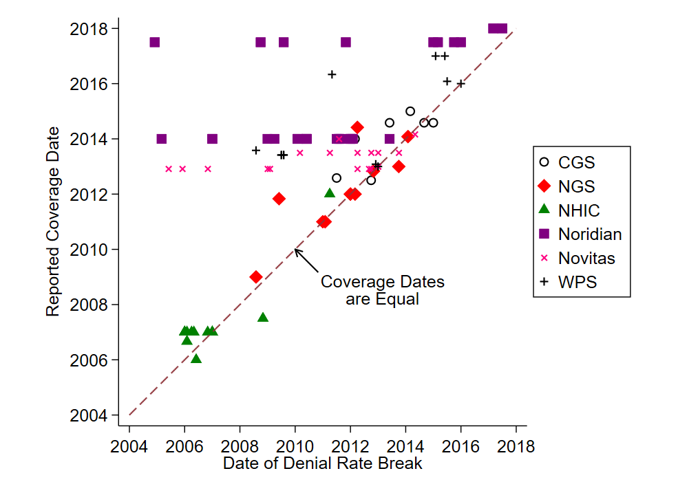
Return

Slide 36
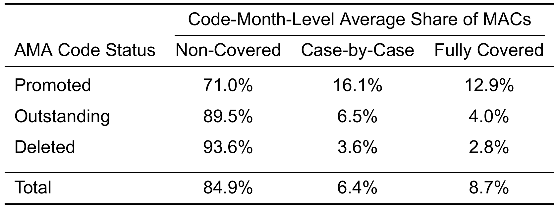
Return

Slide 37
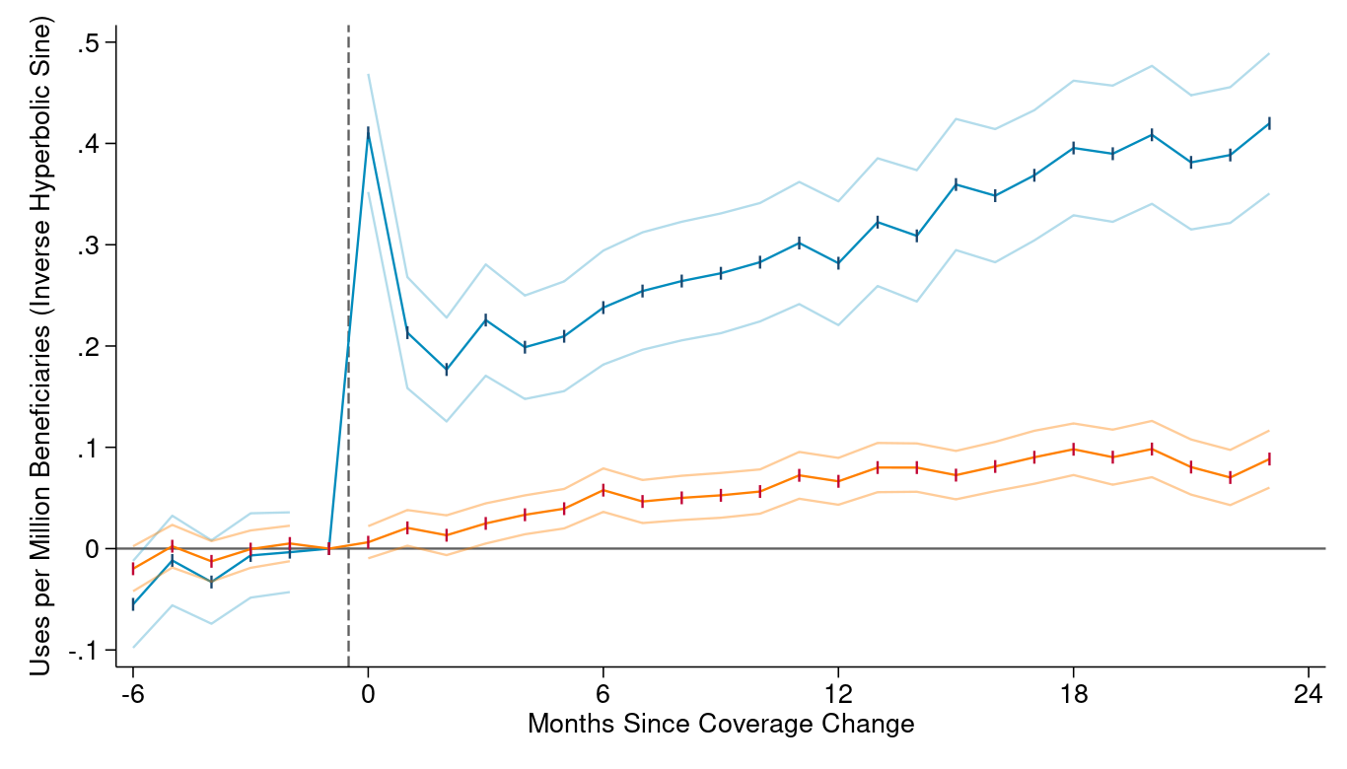
Return

Slide 38
Use Spikes then Grows Rapidly Upon Coverage
Use Grows Even In Other Jurisdictions

Slide 39
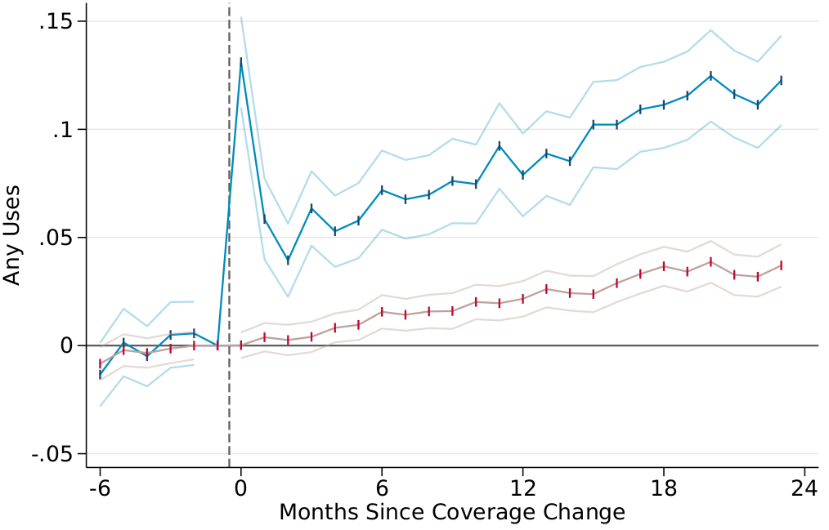
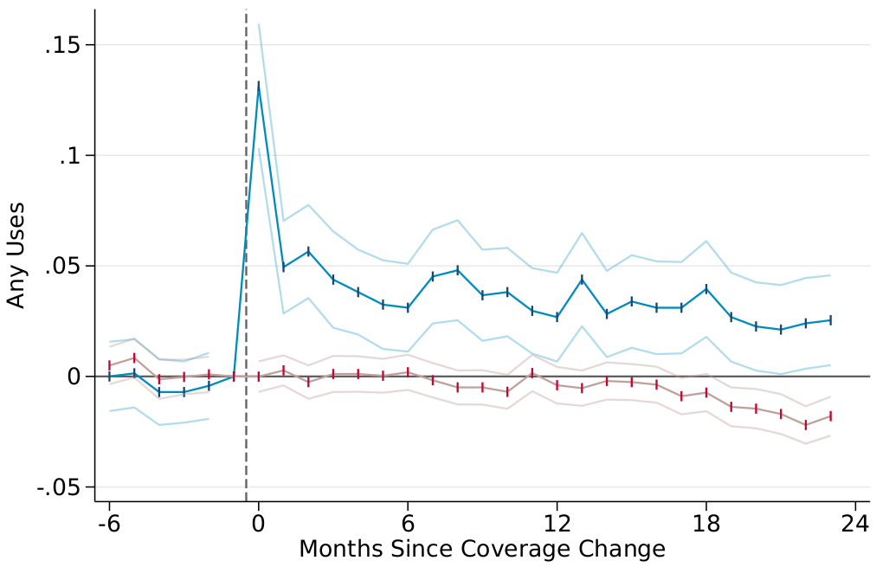
Adopted Procedures
De-Adopted Procedures
Return

Slide 40
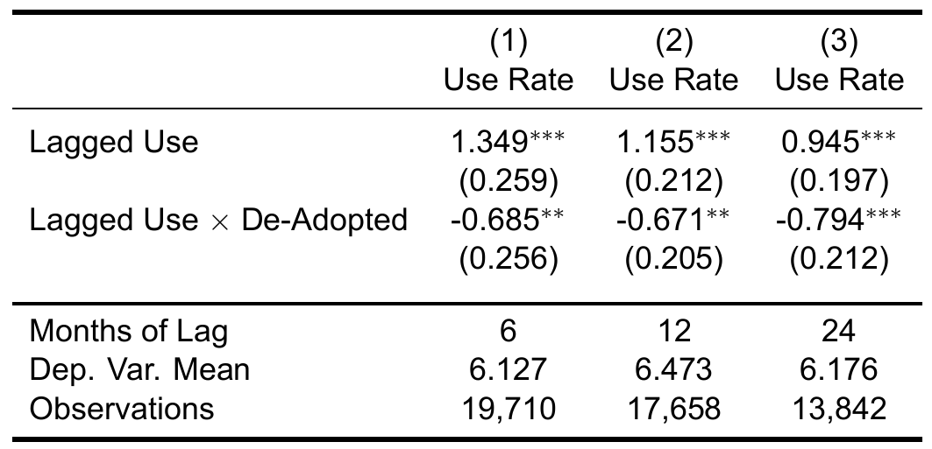
$$Y_{pt}=β_{1}Y_{pt}^{l}+β_{2}ShareCov_{pt}^{l}+γ_{t}+γ_{p}+ε_{pjt}$$
Ex-Ante Quality
Return

Slide 41
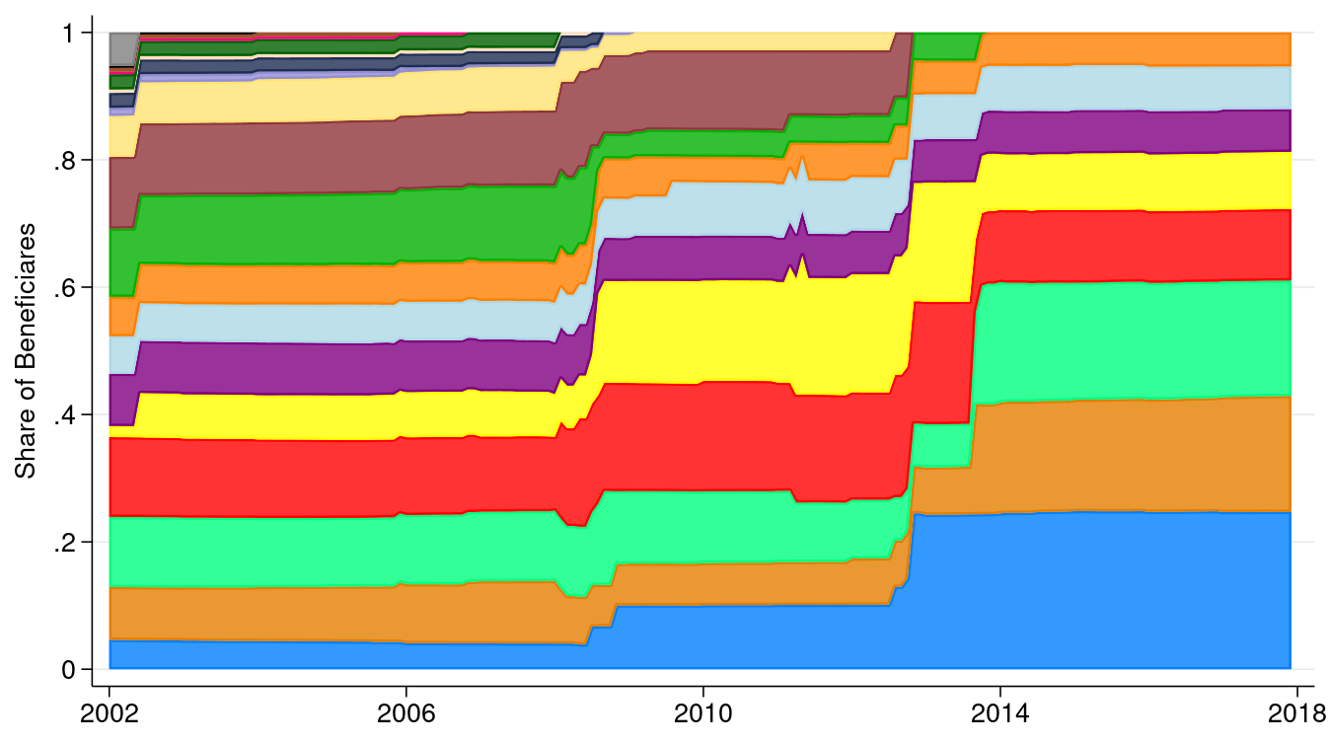

Slide 42
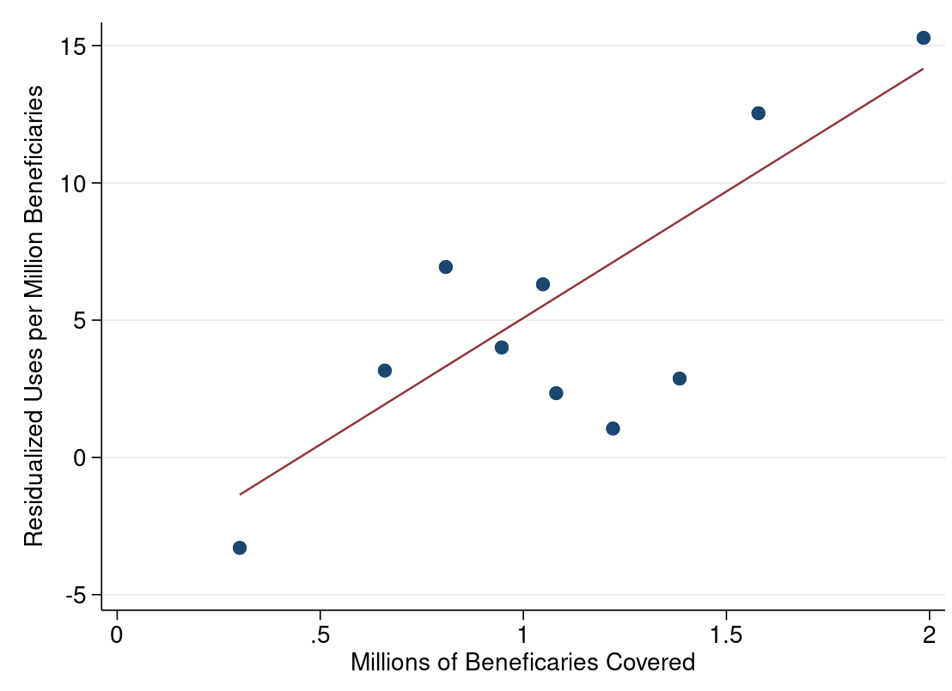

Slide 43
Return

Slide 44

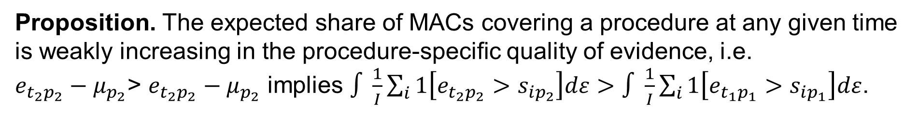
MACs can tell us beliefs
MAC $i$ has coverage standard $s_{ip}$ for procedure $p$:
$$s_{ip}=θ_{i}+μ_{p}+ε_{ip}$$
Cover iff evidence $e_{tp}>s_{ip}$
Proposition. The expected share of MACs covering a procedure at any given time is weakly increasing in the procedure-specific quality of evidence, i.e.
$e_{t_{2}p_{2}}−μ_{p_{2}}$> $e_{t_{2}p_{2}}−μ_{p_{2}}$ implies $∫\frac{1}{I}\sum_{i}{1\left[e_{t_{2}p_{2}}>s_{ip_{2}}\right]dε}>∫\frac{1}{I}\sum_{i}{1\left[e_{t_{1}p_{1}}>s_{ip_{1}}\right]dε}$.

Slide 45
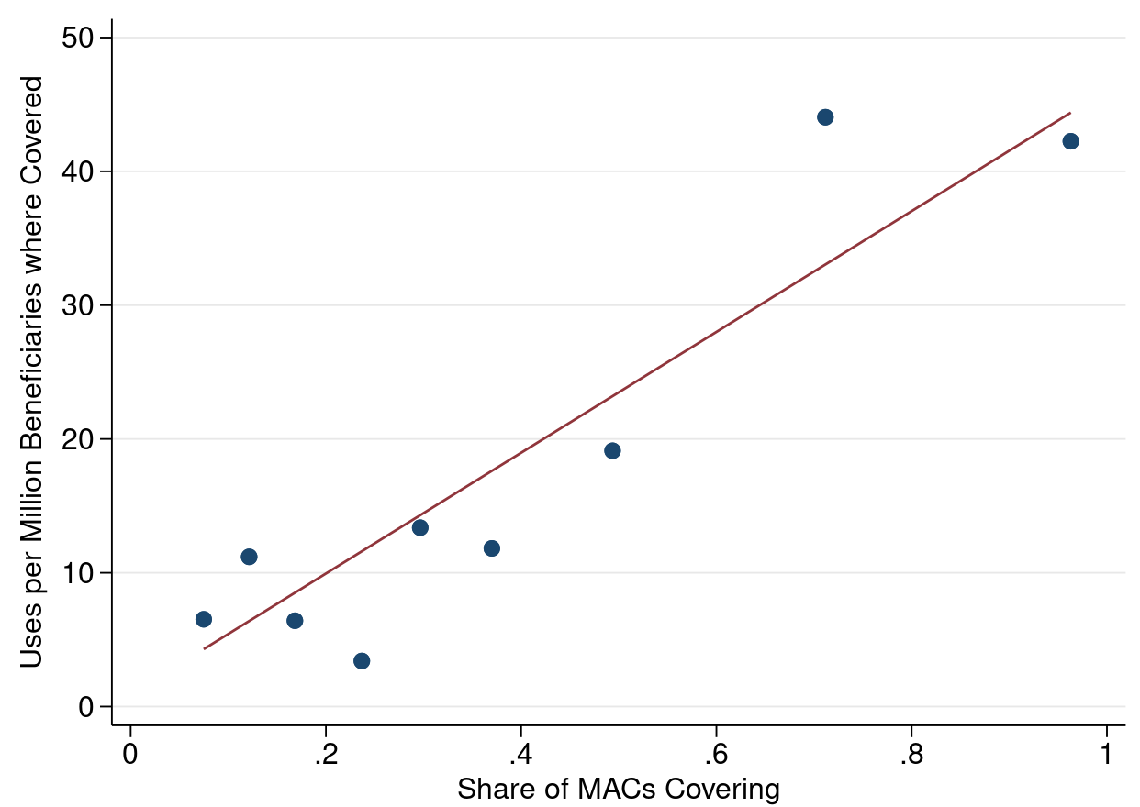
Return

Slide 46
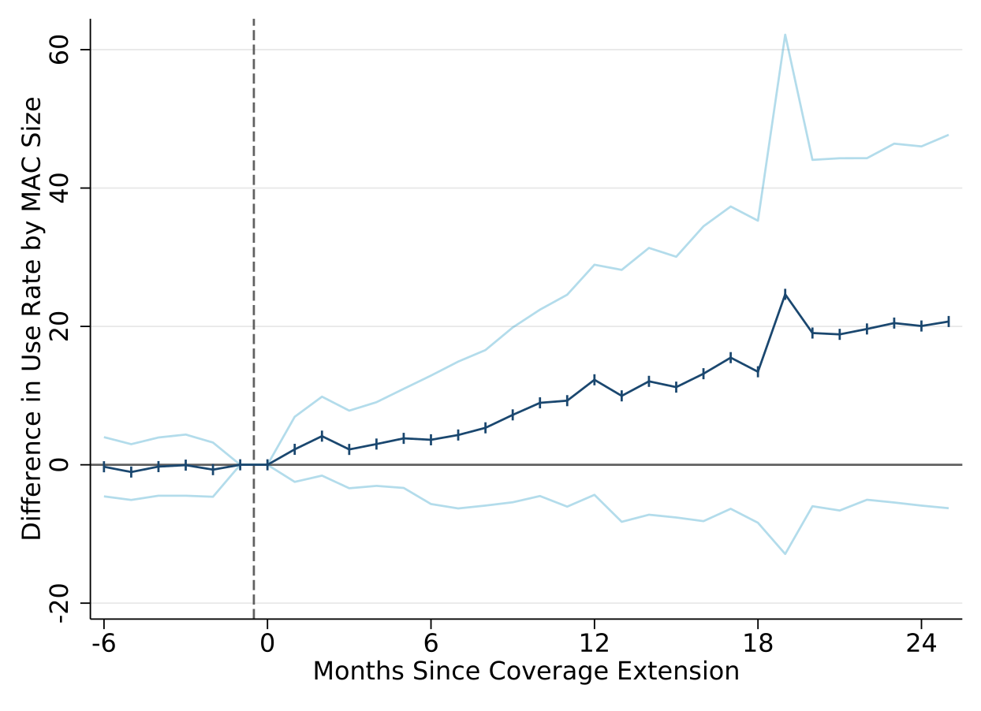
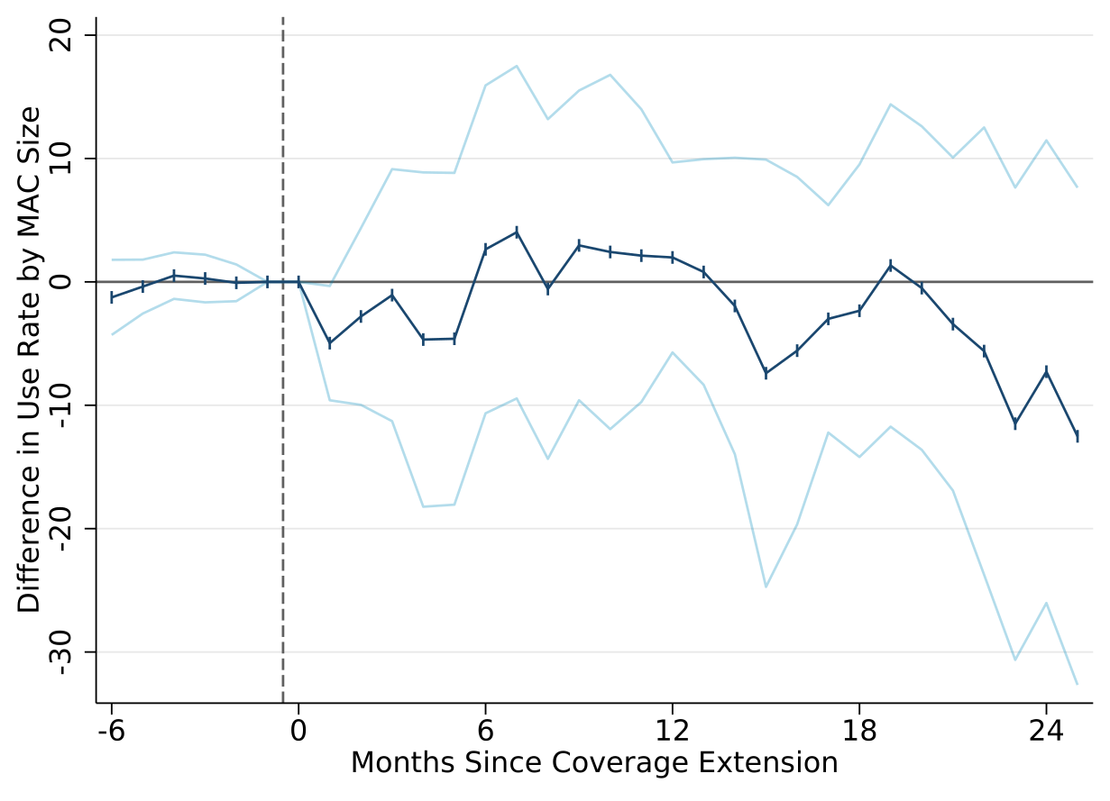
Adopted Procedures
De-Adopted Procedures
Return
Table

Slide 47
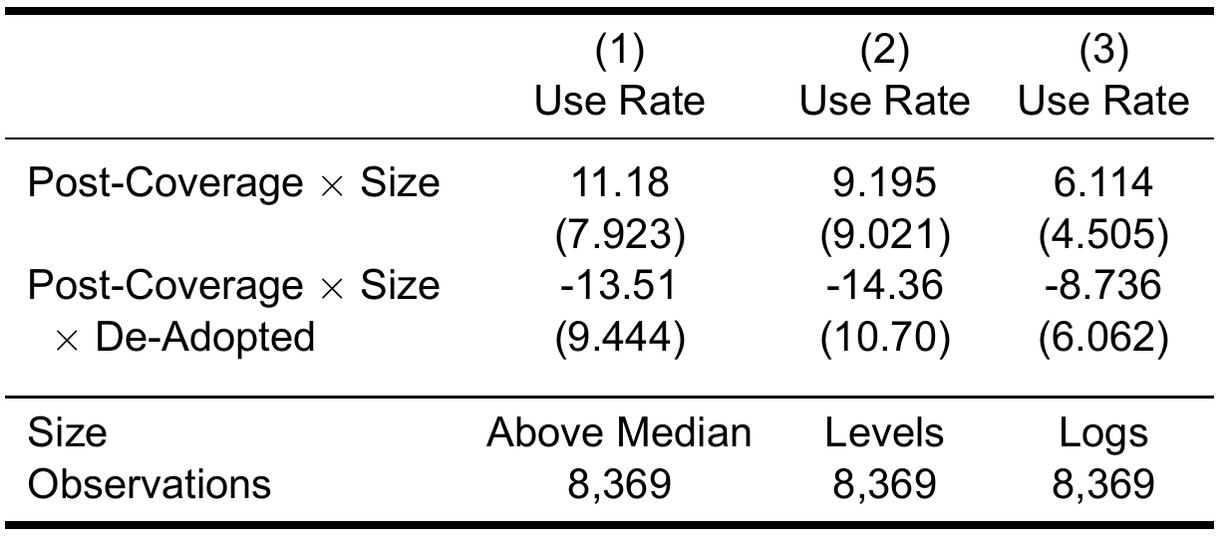
$$Y_{mpt}=β_{1}Cov_{mpt}+β_{2}Cov_{mpt}Adopt_{p}$$
$$+β_{3}Cov_{mpt}Size_{mp}+β_{4}Cov_{mpt}Size_{mp}Adopt_{p}+γ_{mp}+ε_{mpt}$$
Return

Slide 48
Other Possible Explanations
Technology improvement
Cannot explain de-adoption or heterogeneity
Device improvement is difficult
Non-device service improvement should be attributed to learning
Inertia
Learning by doing
Changing regulatory environment

Slide 49
Other Possible Explanations
Technology improvement
Inertia
Cannot generate convex adoption curves, which I observe
Learning by doing
Changing regulatory environment
Inertia

Slide 50
Other Possible Explanations
Technology improvement
Inertia
Learning by doing
There is no within-provider growth in use
Evidence of learning about match quality
Changing regulatory environment
LBD

Slide 51
Other Possible Explanations
Technology improvement
Inertia
Learning by doing
Changing regulatory environment
Patterns of gradual diffusion and de-adoption are present without changing coverage
Return

Slide 52
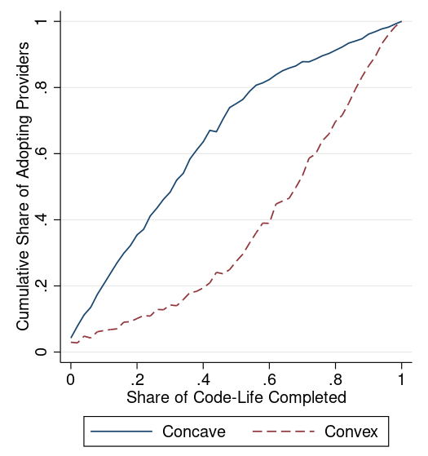
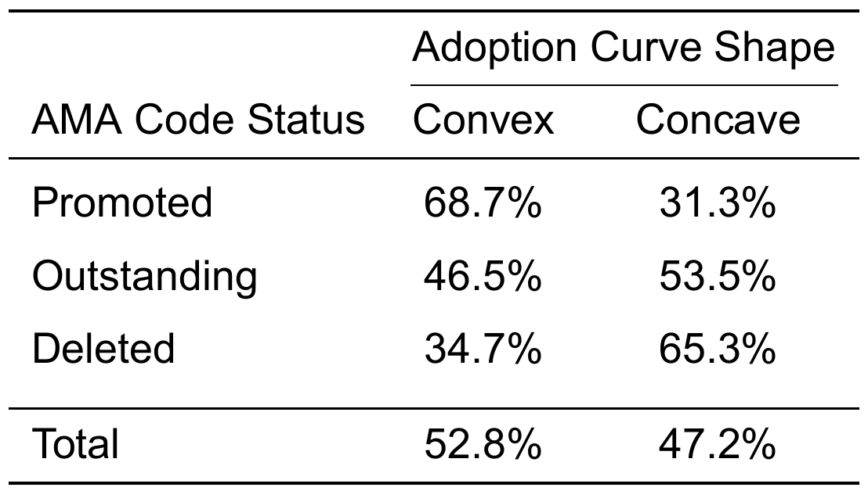
162 Concave
181 Convex
Return

Slide 53
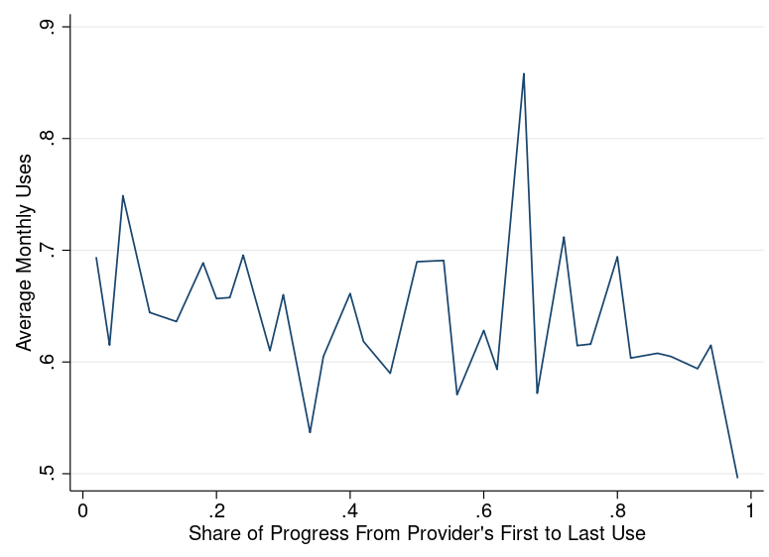
Return

Slide 54
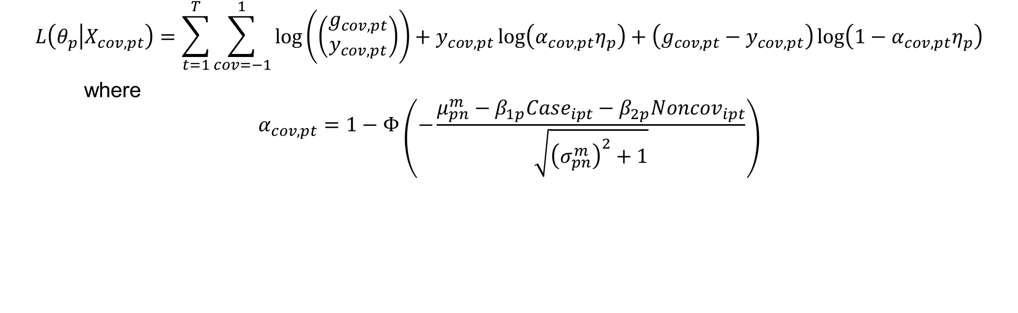
Likelihood Function
$$L\left(θ_{p} | X_{cov,pt}\right)=\sum_{t=1}^{T}{\sum_{cov=−1}^{1}{\log\left(\left(\begin{matrix}g_{cov,pt} \\ y_{cov,pt}\end{matrix}\right)\right)+y_{cov,pt}\log\left(α_{cov,pt}η_{p}\right)+\left(g_{cov,pt}−y_{cov,pt}\right)\log\left(1−α_{cov,pt}η_{p}\right)}}$$
where
$$α_{cov,pt}=1−Φ\left(−\frac{μ_{pn}^{m}−β_{1p}Case_{ipt}−β_{2p}Noncov_{ipt}}{\sqrt{{\left(σ_{pn}^{m}\right)}^{2}+1}}\right)$$
Return

Slide 55

Identification
$β_{1p}$, $β_{2p}$ are identified by within-time differences in utilization by coverage
$σ_{δp}$, $σ_{νp}$ are identified by the correlation of utilization convergence and utilization
$δ_{0p}$ ($δ_{p}^{∗}$) is identified by level of utilization at introduction (steady state)
$η_{p}$ is identified by the share treated by physicians that have adopted
Return

Slide 56
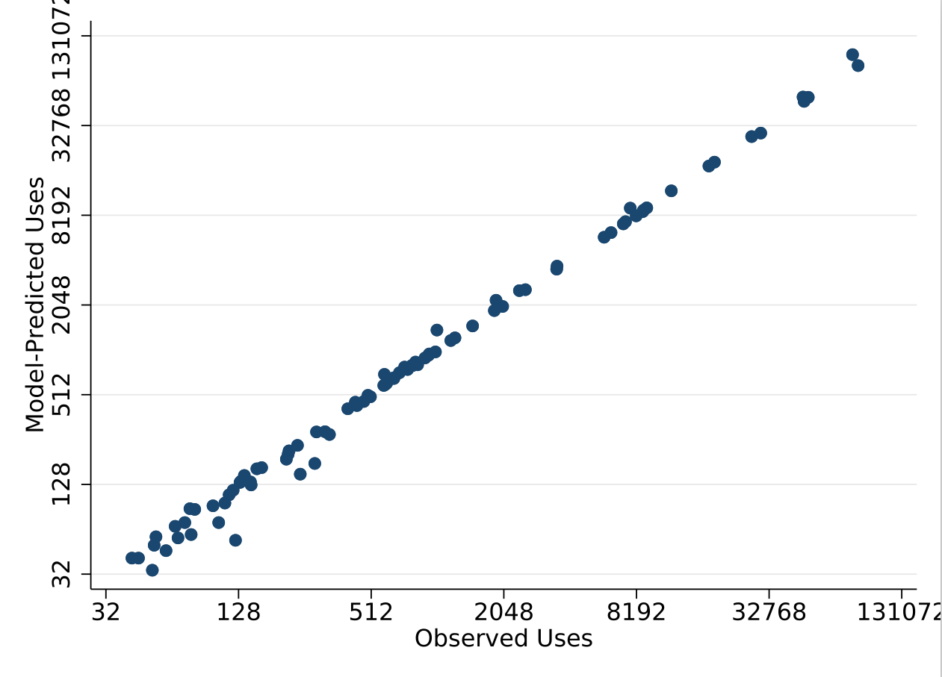

Model Fit
$β_{2p}$ is positive for 89% of procedures and never significantly negative
Appropriate share estimates are robust to separately estimating among only physicians that have already adopted the procedure
Return

Slide 57
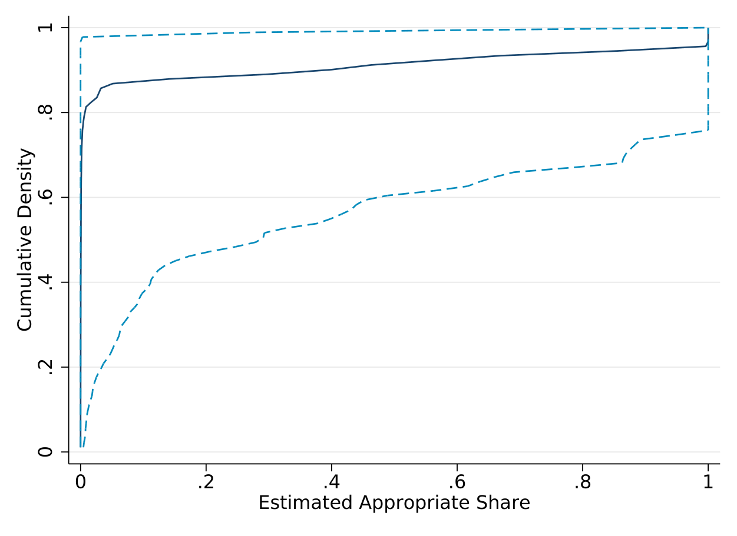
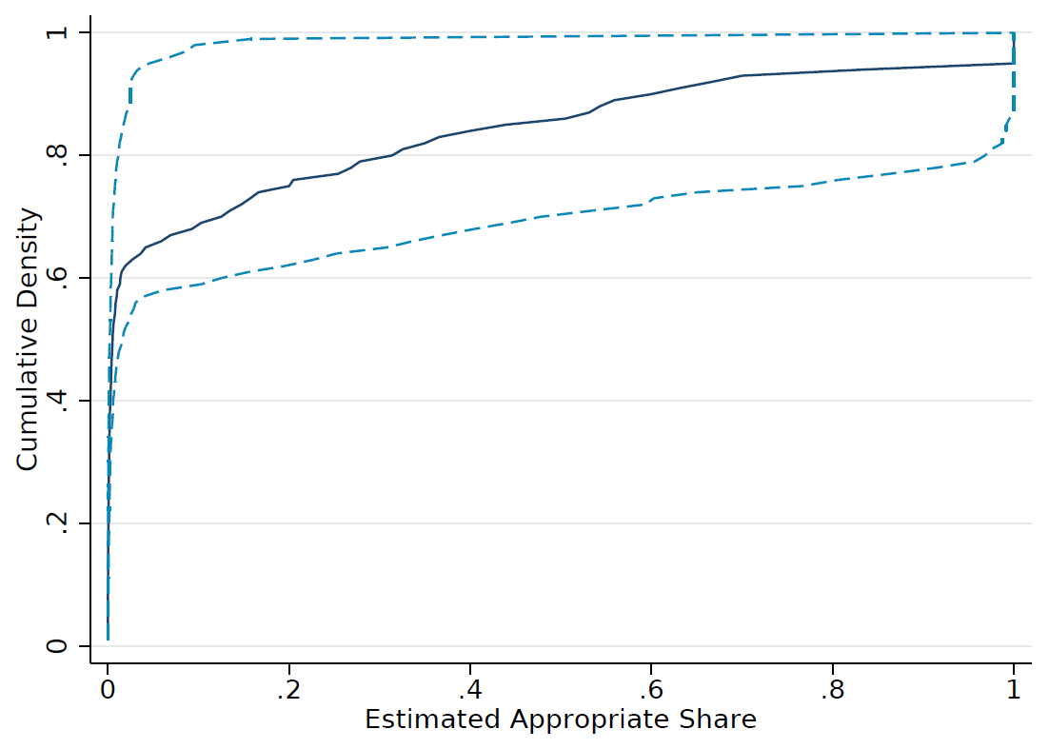
Estimates Similar if Separately Estimated
Estimated Jointly
Estimated Separately
Return

Slide 58
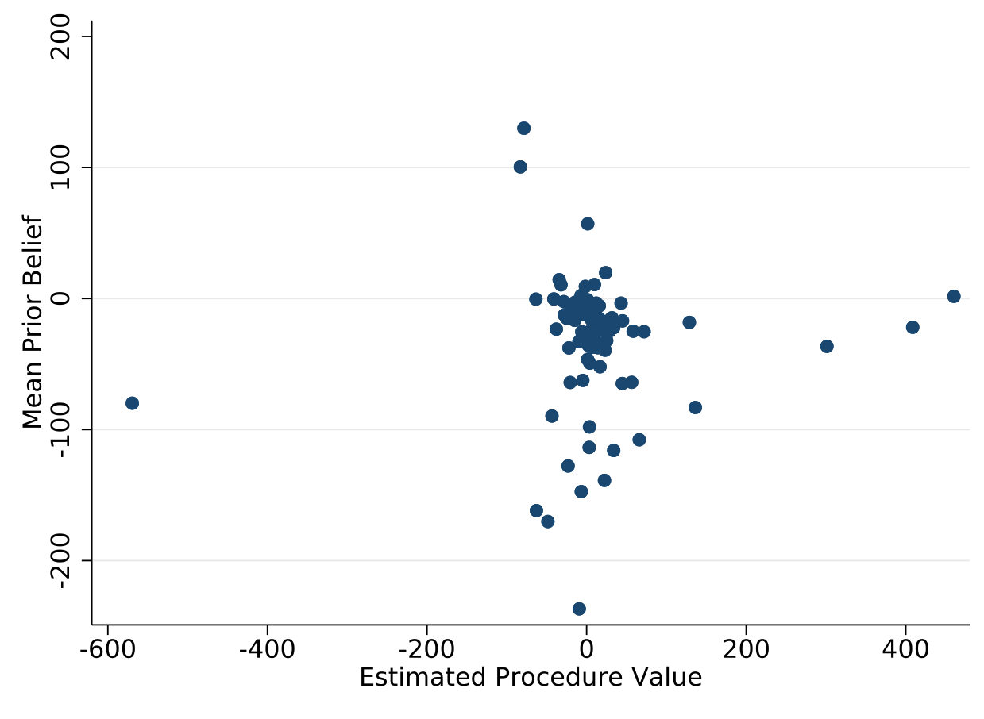
Return

