Slide 1

DAPC, EDM Artist, or Useful Data Analysis Tool?
INFO 523 – Summer 2024 Riley Mawson
Ben Morgan

Slide 2
Background Information

Slide 3
What is DAPC?
Discriminant Analysis of Principal Components (DAPC)
Multivariate method of classifying large datasets
Other multivariate methods of classification are too computer intensive (e.g. Bayesian clustering algorithms)
Focuses on describing clusters of genetically related individuals
Takes advantage of the benefits of:
Principal Component Analysis (PCA)
Discriminant Analysis (DA)

Slide 4
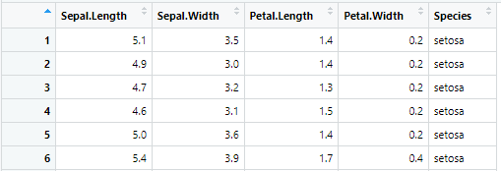
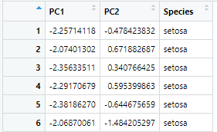
Principal Component Analysis (PCA)
Method to reduce dimensionality in datasets while maintaining variability
Does not consider different in class
Isolates uncorrelated features
Reducing feature size lowers computational intensity

Slide 5
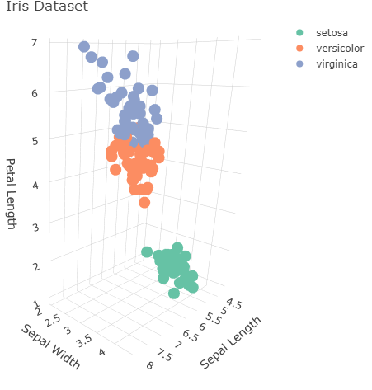
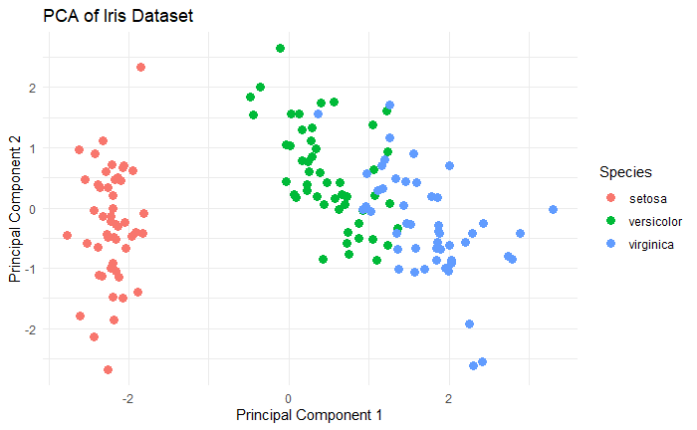
Principal Component Analysis (PCA)
Graphical representation of data 3D -> 2D

Slide 6
Discriminant Analysis (DA)
A method for classifying observations by finding linear combinations of features that best separate classes
Can also be used for dimensionality reduction
Types:
Linear Discriminant Analysis (LDA)
Quadratic Discriminant Analysis (QDA)

Slide 7
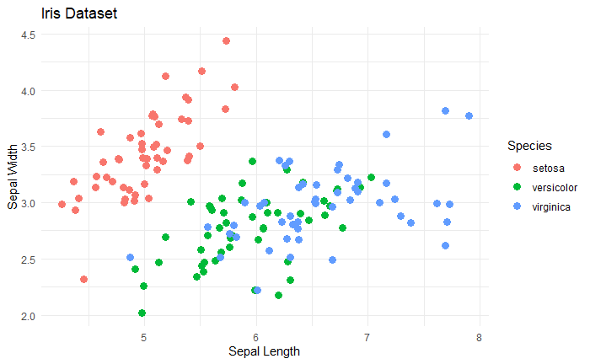
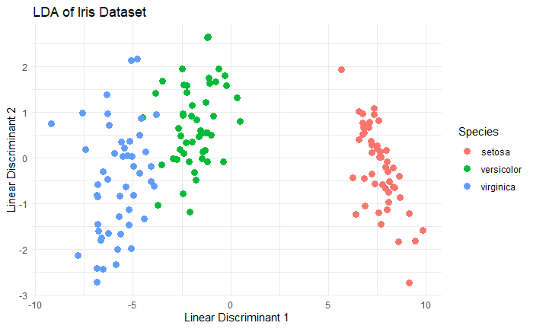
Discriminant Analysis (DA)
Graphical representation of data

Slide 8
Steps in DAPC
Apply PCA to the dataset
Reduce dimensionality of dataset
Select principal components for analysis
Apply DA to the reduced dataset for classification
Identify linear combinations in PCA components to separate groups
Interpret and validate results

Slide 9
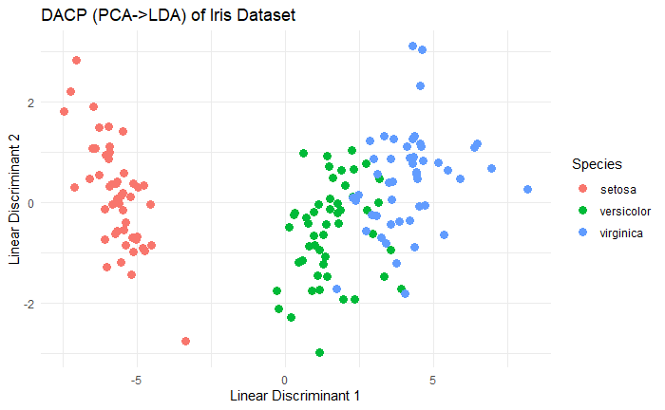
DAPC
Benefits
Current multivariate methods of classification are too computer intensive
Datasets growing at a faster rate than processing power
Can handle more features than samples
PCA step reduces feature size to be less than number of samples
Apply PCA then LDA

Slide 10
Relation to Course Materials

Slide 11
Clustering Methods
Builds on clustering methods studied in class
Uses K-means to establish ideal number of clusters prior to running DACP
Run successive K-means with increasing number of clusters to determine K.

Slide 12
Real-World
Applications

Slide 13
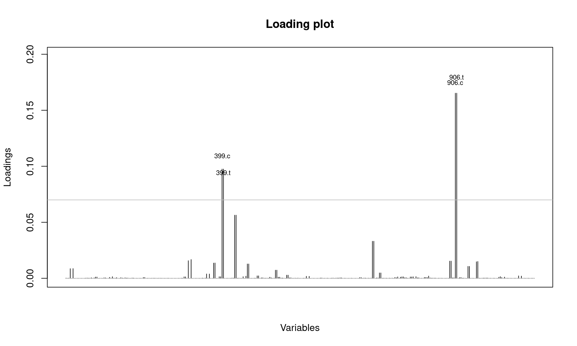
Detecting virus strains
In an analysis performed by Grünwald, Kamvar, and Everhart, they used the H3N2 dataset and DACP to study genetic variations in the virus. They found that from the years 2001-2005 the virus varied slightly but not to a significant degree. In 2006, however, the virus appeared to undergo a large mutation to the point where it became genetically distinct (see graph).
Using DACP they were able to isolate two new alleles that appeared in 2004 and 2005 that were the cause of the observed mutation.

Slide 14
Example

Slide 15
Case Study Example
Brief overview of a specific case study or dataset (e.g., wine or yeast dataset).
Summary of how DAPC was applied and the results.
Visual: Charts or graphs from the case study. Penguins?

Slide 16
Advantages of DAPC
Improved classification accuracy.
Effective handling of high-dimensional data.
Enhanced interpretability of results.
Visual: Bullet points or a table summarizing advantages.
Enhanced Classification Accuracy:
DAPC combines PCA and DA, often resulting in more accurate classification by leveraging reduced-dimensionality data that emphasizes key features.
Dimensionality Reduction:
PCA reduces the number of features, simplifying the data while retaining most of the variability, which helps in dealing with high-dimensional datasets.
Improved Computational Efficiency:
By reducing dimensionality before applying DA, DAPC reduces computational complexity and processing time, making it more efficient for large datasets.
Better Visualization:
PCA transforms data into a lower-dimensional space that can be visualized more easily, helping in understanding and interpreting complex data structures.
Noise Reduction:
PCA helps in filtering out noise and irrelevant features, leading to cleaner and more robust input for the discriminant analysis.
Handling Multicollinearity:
PCA addresses multicollinearity by transforming correlated features into uncorrelated principal components, improving the performance of the subsequent DA.
Flexibility in Classification:
DAPC can handle different types of discriminant analysis techniques (e.g., linear or quadratic) depending on the dataset and classification needs.
Scalability:
The method scales well with large datasets due to its combination of dimensionality reduction and classification, making it suitable for various domains.
Feature Extraction:
PCA identifies the most important features (principal components), which can be valuable for feature selection and understanding underlying data patterns.
Enhanced Interpretability:
By focusing on principal components, DAPC simplifies the data structure, making the results of the discriminant analysis easier to interpret and analyze.

Slide 17
Challenges and Considerations
Potential limitations: Choice of principal components, computational complexity.
Considerations for effective use: Data quality, parameter selection.
Visual: List of challenges with icons or illustrations.
Choice of Principal Components:
Determining the number of principal components to retain can be subjective and impacts the performance of the discriminant analysis.
Computational Complexity:
Although DAPC improves efficiency over raw data, the PCA step can still be computationally intensive for very large datasets.
Assumptions of Linearity:
DAPC assumes linear relationships among features, which may not always hold true, potentially affecting classification performance.
Interpretability of Principal Components:
Principal components are linear combinations of original features and can be challenging to interpret, especially in terms of their meaning and relevance.
Overfitting Risk:
With a high number of principal components, there is a risk of overfitting the discriminant model to the training data, which can affect generalizability.
Sensitivity to Data Scaling:
PCA is sensitive to the scale of features, requiring careful normalization or standardization of data before applying PCA.
Choice of Discriminant Analysis Method:
Selecting the appropriate discriminant analysis technique (e.g., Linear Discriminant Analysis vs. Quadratic Discriminant Analysis) can impact the effectiveness of the classification.
Dimensionality Reduction Loss:
Reducing dimensions through PCA may result in loss of some information, which can affect the accuracy of the classification if not managed properly.
Handling Non-Gaussian Data:
DAPC may not perform well with non-Gaussian data distributions, as traditional discriminant analysis techniques often assume normality.
Complexity in Implementation:
Implementing DAPC requires careful execution of PCA followed by discriminant analysis, which can be complex and requires a good understanding of both techniques.

Slide 18
Conclusion

Slide 19
Conclusion
DACP is built on running PCA followed by DA
Handles larger datasets while increasing performance
Excellent resource for studying genetic data

Slide 20

Thank you
Contact Information:
rileymawson@arizona.edu
benmorgan@arizona.edu

Slide 21
References
Jombart, T., Devillard, S. & Balloux, F. Discriminant analysis of principal components: a new method for the analysis of genetically structured populations. BMC Genet 11, 94 (2010). https://doi.org/10.1186/1471-2156-11-94
NJ Grünwald, ZN Kamvar, and SE Everhart, Discriminant analysis of principal components (DAPC), Available at: https://grunwaldlab.github.io/Population_Genetics_in_R/DAPC.html

Slide 22
What is DAPC?
Definition of DAPC: A method that integrates Principal Components Analysis (PCA) with Discriminant Analysis (DA) to improve classification.
Key components: Dimensionality Reduction and Classification.
Discriminant Analysis of Principal Components (DAPC) is a statistical technique that combines the strengths of Principal Components Analysis (PCA) and Discriminant Analysis (DA) to enhance classification performance, particularly in high-dimensional data settings. Here's a detailed description:
Overview
DAPC integrates two key methods:
Principal Components Analysis (PCA): A dimensionality reduction technique that transforms data into a new set of uncorrelated variables (principal components), capturing the maximum variance in the data.
Discriminant Analysis (DA): A classification method that finds linear combinations of features that best separate different classes.
The goal of DAPC is to improve classification accuracy by first reducing dimensionality with PCA and then applying DA on the reduced-dimensional data.
Steps in DAPC
Data Preparation
Objective: Clean and preprocess the data, handle missing values, and normalize or standardize features if necessary.
Principal Components Analysis (PCA)
Objective: Reduce dimensionality while retaining most of the variance in the dataset.
Process:
Standardize Data: Center and scale the data to ensure each feature contributes equally.
Compute Covariance Matrix: Calculate the covariance matrix of the standardized data to understand the relationships between features.
Eigen Decomposition: Perform eigenvalue decomposition on the covariance matrix to obtain eigenvalues and eigenvectors.
Select Principal Components: Choose the top principal components that capture the most variance (often based on a threshold or cumulative variance).
Discriminant Analysis (DA)
Objective: Classify the data into different categories based on the reduced set of principal components.
Process:
Apply DA: Use methods like Linear Discriminant Analysis (LDA) or Quadratic Discriminant Analysis (QDA) on the principal components to determine the decision boundaries for classification.
Train Model: Fit the discriminant model to the training data.
Classify Data: Use the trained model to predict class labels for new or unseen data.
Model Evaluation
Objective: Assess the performance of the classification model.
Process:
Cross-Validation: Use techniques like k-fold cross-validation to estimate the model’s performance on different subsets of the data.
Performance Metrics: Evaluate using metrics such as accuracy, precision, recall, F1-score, and confusion matrices.
Interpret Results
Objective: Analyze and interpret the results to make informed decisions or conclusions.
Process:
Examine Principal Components: Understand which components contribute most to the variance and their implications.
Analyze Classification Outcomes: Review how well the model performs and any potential improvements or insights.
Advantages
Improved Classification Accuracy: By reducing dimensionality and focusing on the most informative components, DAPC can lead to better classification results.
Dimensionality Reduction: PCA reduces the number of features, making the data more manageable and computationally efficient.
Noise Reduction: PCA filters out noise by focusing on the most significant components, improving the quality of the classification.
Better Visualization: Reducing dimensions to principal components can make it easier to visualize and understand complex datasets.
Challenges
Choice of Components: Determining how many principal components to retain can be challenging and impacts the performance of the DA.
Interpretability: Principal components are linear combinations of original features, which can be difficult to interpret.
Assumptions: Both PCA and DA make assumptions (e.g., linearity, normality) that may not always hold true in practice.
Applications
DAPC is widely used in various fields, including:
Genomics: Classifying genetic data to identify disease-related genes.
Ecology: Analyzing species distributions based on environmental variables.
Medical Diagnostics: Predicting disease outcomes based on patient data.
Marketing: Segmenting customers and analyzing market trends.
Finance: Assessing credit risk and detecting fraud.
Summary
DAPC is a powerful method for handling high-dimensional data by combining PCA for dimensionality reduction with DA for classification. It enhances classification accuracy, manages large datasets effectively, and provides valuable insights, although it requires careful consideration of component selection and interpretability.

Slide 23
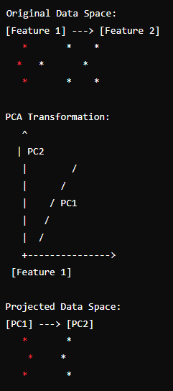
Principal Components Analysis (PCA)
Definition: A technique to reduce dimensionality by transforming features into a smaller set of uncorrelated components.
Purpose: To simplify data while retaining variance.
Visual: Diagram showing PCA transformation.
Detailed Description of Principal Components Analysis (PCA)
Principal Components Analysis (PCA) is a statistical technique used for dimensionality reduction while preserving as much variance in the dataset as possible. PCA transforms high-dimensional data into a lower-dimensional space, making it easier to visualize and analyze. It is widely used in various fields, including machine learning, data analysis, and pattern recognition.
1. Purpose of PCA
Dimensionality Reduction: PCA reduces the number of features in a dataset by transforming it into a new set of uncorrelated variables (principal components) that capture the maximum variance.
Data Visualization: By reducing dimensions, PCA helps in visualizing complex datasets in lower-dimensional spaces, typically 2D or 3D.
Feature Extraction: PCA identifies the most important features (principal components) that contribute most to the variance in the data, which can be useful for further analysis or modeling.
2. PCA Process
Standardize the Data
Objective: Ensure that each feature contributes equally to the analysis, especially if features are on different scales.
Process: Center the data by subtracting the mean of each feature from the data points, and scale the data by dividing by the standard deviation.
Formula:
Standardized X=X−Xˉσ\text{Standardized } X = \frac{X - \bar{X}}{\sigma}Standardized X=σX−Xˉ​Where Xˉ\bar{X}Xˉ is the mean and σ\sigmaσ is the standard deviation.
Compute the Covariance Matrix
Objective: Capture the relationships between features and understand how they vary together.
Process: Calculate the covariance matrix of the standardized data to assess how each pair of features covaries.
Formula:
Cov(X)=1n−1∑i=1n(xi−xˉ)(xi−xˉ)T\text{Cov}(X) = \frac{1}{n-1} \sum_{i=1}^n (x_i - \bar{x})(x_i - \bar{x})^TCov(X)=n−11​i=1∑n​(xi​−xˉ)(xi​−xˉ)TWhere nnn is the number of data points, xix_ixi​ is a data point, and xˉ\bar{x}xˉ is the mean vector.
Perform Eigen Decomposition
Objective: Find the directions (principal components) in which the data varies the most.
Process: Compute the eigenvalues and eigenvectors of the covariance matrix. Eigenvectors represent the directions of maximum variance, and eigenvalues indicate the magnitude of variance along those directions.
Eigen Decomposition:
Cov(X)=VΛVT\text{Cov}(X) = V \Lambda V^TCov(X)=VΛVTWhere VVV is the matrix of eigenvectors and Λ\LambdaΛ is the diagonal matrix of eigenvalues.
Select Principal Components
Objective: Reduce the dimensionality by selecting the top principal components that capture the most variance.
Process: Rank eigenvalues from largest to smallest and select the corresponding eigenvectors (principal components) that capture the most variance.
Variance Explained:
Explained Variance=EigenvalueSum of all Eigenvalues\text{Explained Variance} = \frac{\text{Eigenvalue}}{\text{Sum of all Eigenvalues}}Explained Variance=Sum of all EigenvaluesEigenvalue​
Project Data onto Principal Components
Objective: Transform the original data into the new lower-dimensional space defined by the principal components.
Process: Multiply the standardized data by the matrix of selected eigenvectors to get the reduced-dimensional representation.
Projection:
Z=X⋅VkZ = X \cdot V_kZ=X⋅Vk​Where VkV_kVk​ is the matrix of the top kkk eigenvectors.
3. Key Concepts in PCA
Principal Components: New variables created by PCA that are linear combinations of the original features. They are orthogonal and ordered by the amount of variance they capture.
Explained Variance: The amount of variance captured by each principal component. Helps in deciding how many components to retain.
Scree Plot: A plot of eigenvalues to visualize the amount of variance captured by each principal component and to determine the optimal number of components to retain.
4. Advantages of PCA
Reduces Complexity: Simplifies datasets by reducing the number of features while preserving essential patterns and structures.
Improves Visualization: Enables visualization of high-dimensional data in 2D or 3D, facilitating better understanding and analysis.
Removes Redundancy: Eliminates correlated features, reducing redundancy and multicollinearity in the dataset.
Enhances Performance: Improves the performance of machine learning algorithms by reducing the dimensionality of the input data.
5. Challenges and Limitations
Loss of Information: Some information may be lost when reducing dimensions, which can affect the accuracy of subsequent analyses or models.
Interpretability: Principal components are combinations of original features and may not always be easy to interpret in terms of the original variables.
Assumptions: PCA assumes linear relationships among features, which may not always be appropriate for non-linear data.
6. Applications of PCA
Data Preprocessing: Used as a preprocessing step in machine learning to reduce dimensionality and improve model performance.
Image Compression: Applied in image processing to compress images by reducing the number of pixels while retaining important features.
Exploratory Data Analysis: Helps in exploring and visualizing complex datasets to identify underlying patterns and relationships.
Noise Reduction: Used to filter out noise and enhance the quality of data by focusing on the most significant components.
PCA is a fundamental technique in data analysis and machine learning, providing valuable insights into the structure of data and enabling more efficient and interpretable analyses.

Slide 24
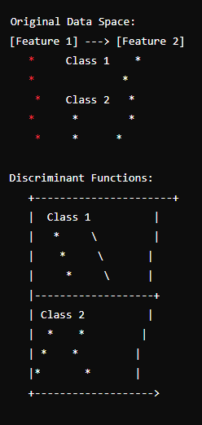
Discriminant Analysis (DA)
Definition: A method for classifying observations by finding linear combinations of features that best separate classes.
Types: Linear Discriminant Analysis (LDA) and Quadratic Discriminant Analysis (QDA).
Visual: Diagram showing DA classification.
Discriminant Analysis is a statistical technique used for classifying data into predefined categories based on the features or attributes of the data. It helps in identifying which variables discriminate between the categories and provides a model to predict the class of new observations. There are several types of Discriminant Analysis, including Linear Discriminant Analysis (LDA) and Quadratic Discriminant Analysis (QDA). Here is a detailed description:
1. Purpose of Discriminant Analysis
Classification: The primary goal is to classify data points into predefined categories or classes based on their attributes.
Feature Discrimination: Identify which features contribute most to the separation between classes.
Predictive Modeling: Develop models that can predict the class of new or unseen data based on the attributes.
2. Types of Discriminant Analysis
Linear Discriminant Analysis (LDA)
Objective: Find a linear combination of features that best separates two or more classes.
Assumptions:
Features are normally distributed within each class.
Classes have the same covariance matrix (homoscedasticity).
Process:
Compute Class Means: Calculate the mean of each feature for each class.
Compute Within-Class and Between-Class Scatter Matrices:
Within-Class Scatter Matrix: Measures the scatter (variance) of features within each class.
Between-Class Scatter Matrix: Measures the scatter (variance) between different class means.
Solve Generalized Eigenvalue Problem:
Solve for eigenvalues and eigenvectors to determine the linear discriminants.
Project Data: Project data onto the linear discriminants to maximize separation between classes.
Formula for Linear Discriminants:
y=WTXy = W^T Xy=WTXWhere WWW is the matrix of linear discriminants and XXX is the data matrix.
Quadratic Discriminant Analysis (QDA)
Objective: Extend LDA by allowing each class to have its own covariance matrix.
Assumptions:
Features are normally distributed within each class.
Classes have different covariance matrices (heteroscedasticity).
Process:
Compute Class Means: Calculate the mean of each feature for each class.
Compute Class Covariance Matrices: Calculate separate covariance matrices for each class.
Apply Bayes’ Theorem: Use Bayes' theorem to compute the posterior probability for each class and classify data based on the highest posterior probability.
Formula for Posterior Probability:
P(Ck∣X)=P(X∣Ck)P(Ck)P(X)P(C_k | X) = \frac{P(X | C_k) P(C_k)}{P(X)}P(Ck​∣X)=P(X)P(X∣Ck​)P(Ck​)​Where P(Ck∣X)P(C_k | X)P(Ck​∣X) is the posterior probability of class CkC_kCk​, P(X∣Ck)P(X | C_k)P(X∣Ck​) is the likelihood of XXX given class CkC_kCk​, and P(Ck)P(C_k)P(Ck​) is the prior probability of class CkC_kCk​.
3. Key Concepts in Discriminant Analysis
Class Separation: The ability of the discriminant function to separate different classes based on the features.
Prior Probabilities: The probability of each class before seeing the data, which can be used to weigh the importance of different classes in the model.
Decision Boundary: The boundary defined by the discriminant functions that separates different classes in the feature space.
Bayesian Approach: In QDA, the classification is based on Bayesian principles, estimating the probability of each class given the data.
4. Advantages of Discriminant Analysis
Effective Classification: Provides a robust method for classifying data into distinct categories.
Feature Importance: Helps identify and interpret the most important features that distinguish between classes.
Probabilistic Interpretation: In QDA, offers probabilistic classification, providing confidence levels for class predictions.
Dimensionality Reduction: LDA can be used as a preprocessing step to reduce dimensionality while preserving class separation.
5. Challenges and Limitations
Assumptions: Both LDA and QDA have assumptions (e.g., normality, equal or unequal covariance) that may not always hold in real-world data.
Outliers: Sensitive to outliers, which can affect the accuracy of the classification.
Computational Complexity: QDA can be computationally intensive with large datasets due to the estimation of covariance matrices for each class.
Interpretability: The results can sometimes be challenging to interpret, especially in high-dimensional spaces.
6. Applications of Discriminant Analysis
Medical Diagnosis: Classify patients based on diagnostic features to predict diseases or conditions.
Marketing: Segment customers into different groups based on purchasing behavior or demographic data.
Finance: Predict credit risk or detect fraudulent activities based on financial transactions.
Pattern Recognition: Used in image and speech recognition to classify patterns and objects.
Summary
Discriminant Analysis is a powerful statistical tool for classification and feature discrimination, offering both linear and quadratic methods to handle different types of data. It helps in building predictive models, understanding feature importance, and making informed decisions based on the class predictions. Despite its assumptions and potential challenges, it remains a valuable technique in data analysis and machine learning.

Slide 25
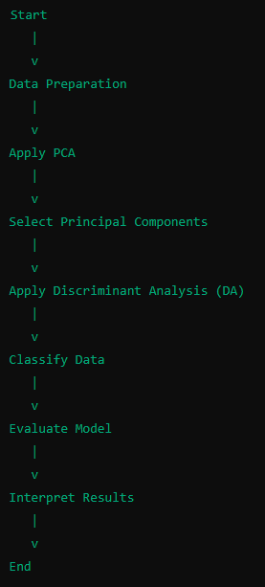
Combining PCA and DA
Process: PCA is applied first to reduce dimensionality, followed by DA for classification.
Benefits: Enhances classification performance, manages high-dimensional data.
Visual: Flowchart showing the DAPC process.

