Slide 1

DAPC, EDM Artist, or Useful Data Analysis Tool?
INFO 523 – Summer 2024 Riley Mawson
Ben Morgan

Slide 2
Background Information

Slide 3
What is DAPC?
Discriminant Analysis of Principal Components (DAPC)
Multivariate method of classifying large datasets
Other multivariate methods of classification are too computer intensive (e.g. Bayesian clustering algorithms)
Focuses on describing clusters of genetically related individuals
Takes advantage of the benefits of:
Principal Component Analysis (PCA)
Discriminant Analysis (DA)

Slide 4
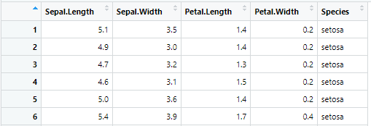
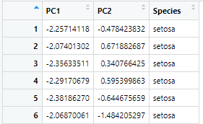
Principal Component Analysis (PCA)
Method to reduce dimensionality in datasets while maintaining variability
Does not consider different in class
Isolates uncorrelated features
Reducing feature size lowers computational intensity

Slide 5
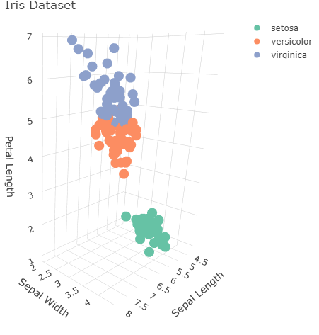
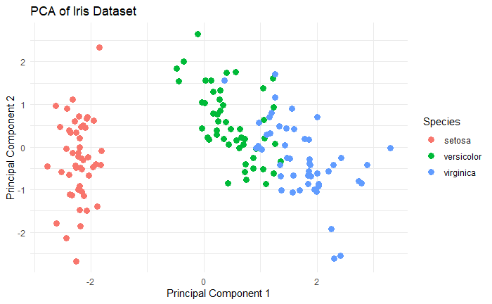
Principal Component Analysis (PCA)
Graphical representation of data 3D -> 2D

Slide 6
Discriminant Analysis (DA)
A method for classifying observations by finding linear combinations of features that best separate classes
Can also be used for dimensionality reduction
Types:
Linear Discriminant Analysis (LDA)
Quadratic Discriminant Analysis (QDA)

Slide 7
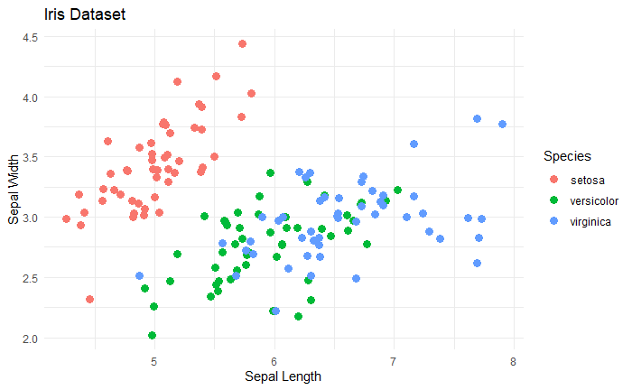
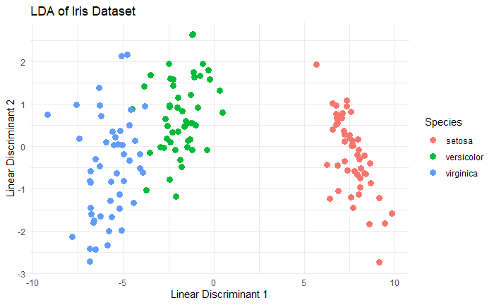
Discriminant Analysis (DA)
Graphical representation of data

Slide 8
Steps in DAPC
Apply PCA to the dataset
Reduce dimensionality of dataset
Select principal components for analysis
Apply DA to the reduced dataset for classification
Identify linear combinations in PCA components to separate groups
Interpret and validate results

Slide 9
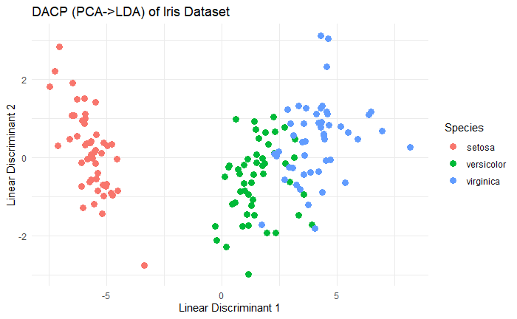
DAPC
Benefits
Current multivariate methods of classification are too computer intensive
Datasets growing at a faster rate than processing power
Can handle more features than samples
PCA step reduces feature size to be less than number of samples
Apply PCA then LDA

Slide 10
Relation to Course Materials

Slide 11
Clustering Methods
Builds on clustering methods studied in class
Uses K-means to establish ideal number of clusters prior to running DACP
Run successive K-means with increasing number of clusters to determine K.

Slide 12
Real-World
Applications

Slide 13
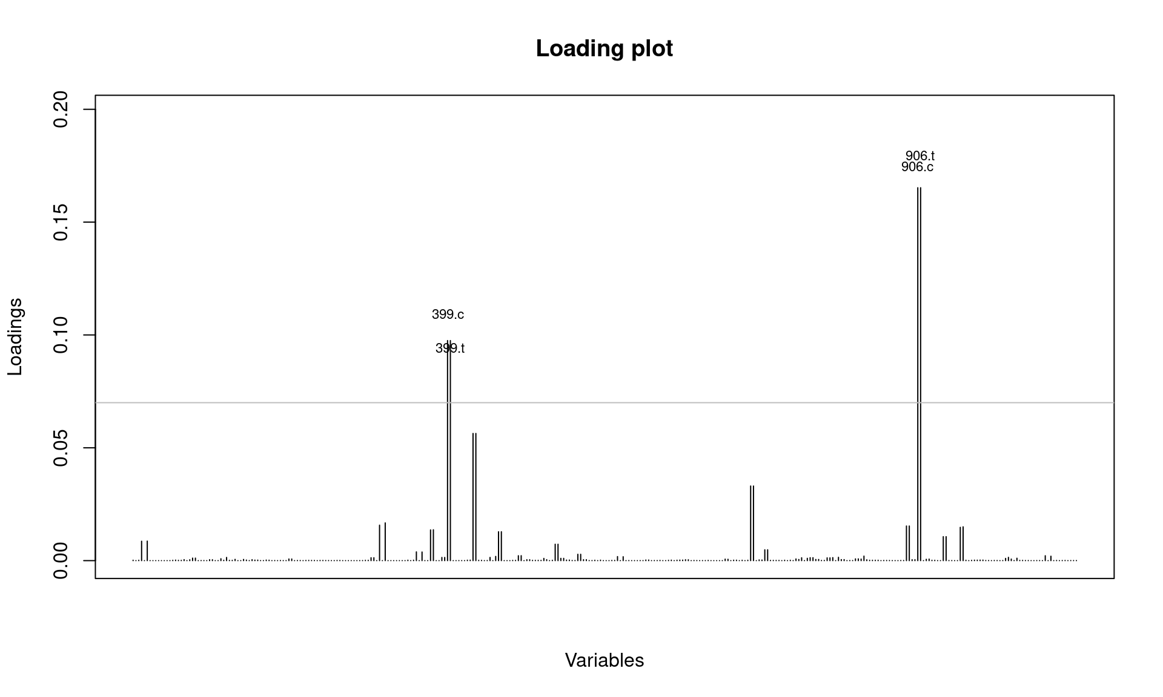
Detecting virus strains
In an analysis performed by Grünwald, Kamvar, and Everhart, they used the H3N2 dataset and DACP to study genetic variations in the virus. They found that from the years 2001-2005 the virus varied slightly but not to a significant degree. In 2006, however, the virus appeared to undergo a large mutation to the point where it became genetically distinct (see graph).
Using DACP they were able to isolate two new alleles that appeared in 2004 and 2005 that were the cause of the observed mutation.

Slide 14
Example

Slide 15
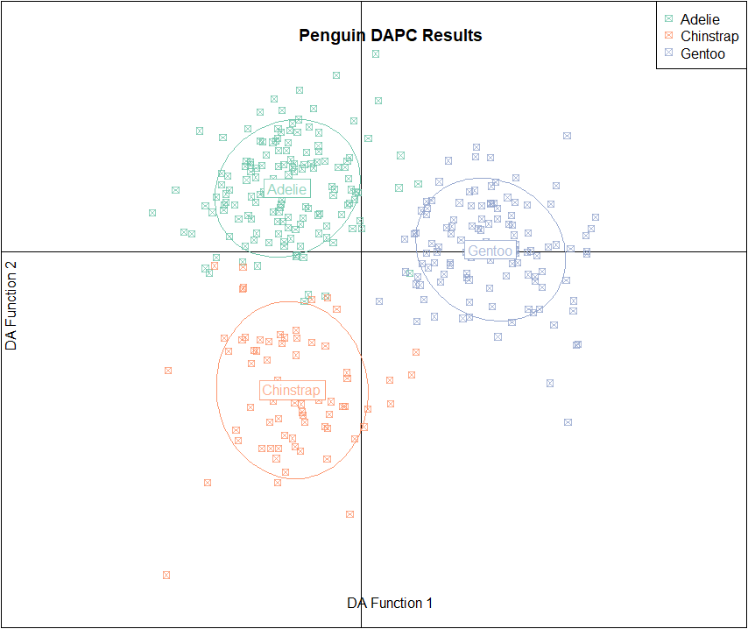
Case Study Example
Implemented DAPC on “Penguins” dataset from “palmerpenguins”
DA Function 1-axis is discriminant function with the largest variance, which means it is the most useful for categorizing the data
DA Function 2-axis is the second-most useful DA function for categorizing
When analyzing the results, it is desirable to see clusters distinctly separated from each other with little or no overlap. This demonstrates that the analysis is effective for categorizing the data.
In this case, it successfully groups the three penguin species with almost no overlap.

Slide 16
Conclusion

Slide 17
Conclusion
DACP is built on running PCA followed by DA
Handles larger datasets while increasing performance
Excellent resource for studying genetic data

Slide 18

Thank you
Contact Information:
rileymawson@arizona.edu
benmorgan@arizona.edu

Slide 19
References
Jombart, T., Devillard, S. & Balloux, F. Discriminant analysis of principal components: a new method for the analysis of genetically structured populations. BMC Genet 11, 94 (2010). https://doi.org/10.1186/1471-2156-11-94
NJ Grünwald, ZN Kamvar, and SE Everhart, Discriminant analysis of principal components (DAPC), Available at: https://grunwaldlab.github.io/Population_Genetics_in_R/DAPC.html

Slide 20
Advantages of DAPC
Improved classification accuracy.
Effective handling of high-dimensional data.
Enhanced interpretability of results.
Visual: Bullet points or a table summarizing advantages.
Enhanced Classification Accuracy:
DAPC combines PCA and DA, often resulting in more accurate classification by leveraging reduced-dimensionality data that emphasizes key features.
Dimensionality Reduction:
PCA reduces the number of features, simplifying the data while retaining most of the variability, which helps in dealing with high-dimensional datasets.
Improved Computational Efficiency:
By reducing dimensionality before applying DA, DAPC reduces computational complexity and processing time, making it more efficient for large datasets.
Better Visualization:
PCA transforms data into a lower-dimensional space that can be visualized more easily, helping in understanding and interpreting complex data structures.
Noise Reduction:
PCA helps in filtering out noise and irrelevant features, leading to cleaner and more robust input for the discriminant analysis.
Handling Multicollinearity:
PCA addresses multicollinearity by transforming correlated features into uncorrelated principal components, improving the performance of the subsequent DA.
Flexibility in Classification:
DAPC can handle different types of discriminant analysis techniques (e.g., linear or quadratic) depending on the dataset and classification needs.
Scalability:
The method scales well with large datasets due to its combination of dimensionality reduction and classification, making it suitable for various domains.
Feature Extraction:
PCA identifies the most important features (principal components), which can be valuable for feature selection and understanding underlying data patterns.
Enhanced Interpretability:
By focusing on principal components, DAPC simplifies the data structure, making the results of the discriminant analysis easier to interpret and analyze.

Slide 21
Challenges and Considerations
Potential limitations: Choice of principal components, computational complexity.
Considerations for effective use: Data quality, parameter selection.
Visual: List of challenges with icons or illustrations.
Choice of Principal Components:
Determining the number of principal components to retain can be subjective and impacts the performance of the discriminant analysis.
Computational Complexity:
Although DAPC improves efficiency over raw data, the PCA step can still be computationally intensive for very large datasets.
Assumptions of Linearity:
DAPC assumes linear relationships among features, which may not always hold true, potentially affecting classification performance.
Interpretability of Principal Components:
Principal components are linear combinations of original features and can be challenging to interpret, especially in terms of their meaning and relevance.
Overfitting Risk:
With a high number of principal components, there is a risk of overfitting the discriminant model to the training data, which can affect generalizability.
Sensitivity to Data Scaling:
PCA is sensitive to the scale of features, requiring careful normalization or standardization of data before applying PCA.
Choice of Discriminant Analysis Method:
Selecting the appropriate discriminant analysis technique (e.g., Linear Discriminant Analysis vs. Quadratic Discriminant Analysis) can impact the effectiveness of the classification.
Dimensionality Reduction Loss:
Reducing dimensions through PCA may result in loss of some information, which can affect the accuracy of the classification if not managed properly.
Handling Non-Gaussian Data:
DAPC may not perform well with non-Gaussian data distributions, as traditional discriminant analysis techniques often assume normality.
Complexity in Implementation:
Implementing DAPC requires careful execution of PCA followed by discriminant analysis, which can be complex and requires a good understanding of both techniques.

