Slide 1

Course – Web Programming
Course Instructor
Dr. Umadevi V
Department of CSE, BMSCE

Slide 2
Topic Covered in Todays Class
Unit 1:
Android: Open Platform for Mobile Development
Android SDK features
Open Handset Alliance (OHA)
Android Software Stack
Dalvik Virtual Machine
Android Application Architecture
Android Libraries
Android Development Tools

Slide 3
Question
What does .apk stand for
Android Application Kit
Android Package
Android Power Kit

Slide 4
Question
What does .apk stand for
Android Application Kit
Android Package
Android Power Kit

Slide 5
Question
Android applications are written in
Java and C++
Java
C++
Python

Slide 6
Question
Android applications are written in
Java and C++
Java
C++
Python

Slide 7
What is the Android Version Name released during the year 2017 ?
Kitkat
Nougat
Oreo
JellyBean

Slide 8
What is the Android Version Name released during the year 2017 ?
Kitkat
Nougat
Oreo
JellyBean

Slide 9
Check Android version on your Mobile Phone
On your mobile device goto
Settings -> MoreSettings
-> About Phone -> Version

Slide 10
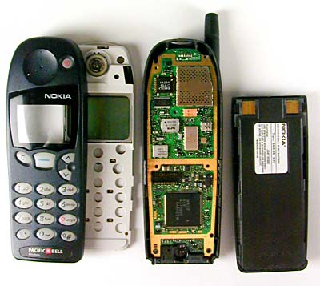
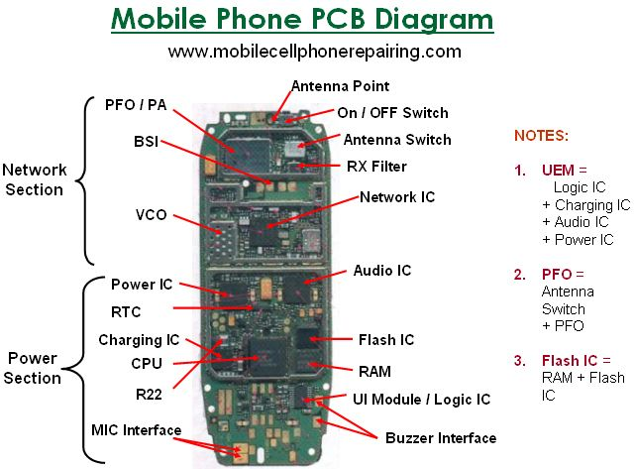
Mobile Phone Internals

Slide 11
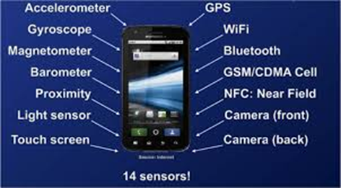
Smart Phone with Sensors

Slide 12

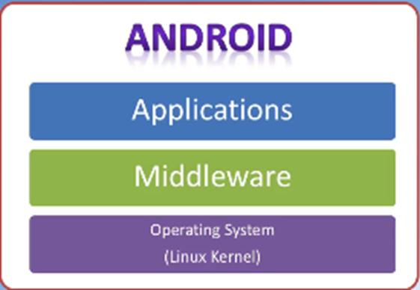

Role of Android
.apk files
User Developed
Applications such as
“Hello World App“ etc.
Software
Hardware

Slide 13
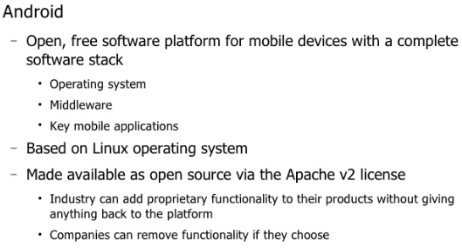
What is Android ?

Slide 14
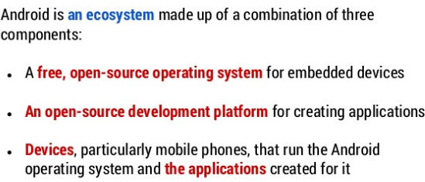
Android: Open Platform for Mobile Development

Slide 15
Android: Open Platform for Mobile Development (Contd…)
Android is made up of several necessary and dependent parts:
A Compatibility Definition Document (CDD) and Compatibility Test Suite (CTS) that describe the capabilities required for a device to support the software stack.
A Linux operating system kernel that provides a low-level interface with the hardware, memory management, and process control, all optimized for mobile and embedded devices.
Open-source libraries for application development, including SQLite, WebKit, OpenGL, and a media manager.
A run time used to execute and host Android applications, including the Dalvik Virtual Machine (VM) and the core libraries that provide Android-specific functionality. The run time is designed to be small and efficient for use on mobile devices.
An application framework that agnostically exposes system services to the application layer, including the window manager and location manager, databases, telephony, and sensors.
A user interface framework used to host and launch applications.
A set of core pre-installed applications.
A software development kit (SDK) used to create applications, including the related tools, plug-ins, and documentation

Slide 16
NATIVE ANDROID APPLICATIONS
An e-mail client
An SMS management application
A full PIM (personal information management) suite, including a calendar and contacts list
A WebKit-based web browser
A music player and picture gallery
A camera and video recording application
A calculator
A home screen
An alarm clock

Slide 17
What does Android SDK mean?
The Android SDK (Software Development Kit) is a set of development tools used to develop applications for Android platform.

Slide 18
Android SDK features
Access to Hardware, Including Camera, GPS, and Sensors
Data Transfers Using Wi-Fi, Bluetooth, and NFC
Maps, Geocoding, and Location-Based Services
Background Services
SQLite Database for Data Storage and Retrieval
Shared Data and Inter-Application Communication
Using Widgets and Live Wallpaper to Enhance the Home Screen
Extensive Media Support and 2D/3D Graphics
Cloud to Device Messaging
Optimized Memory and Process Management

Slide 19
Question
List out different SDK features supported by Android

Slide 20
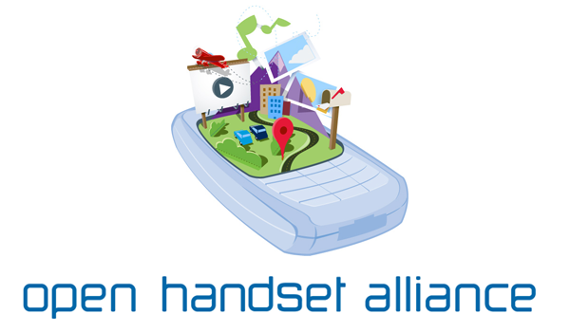
Unit 1: Open Handset Alliance (OHA)
What is OHA ? Why it was established ?

Slide 21
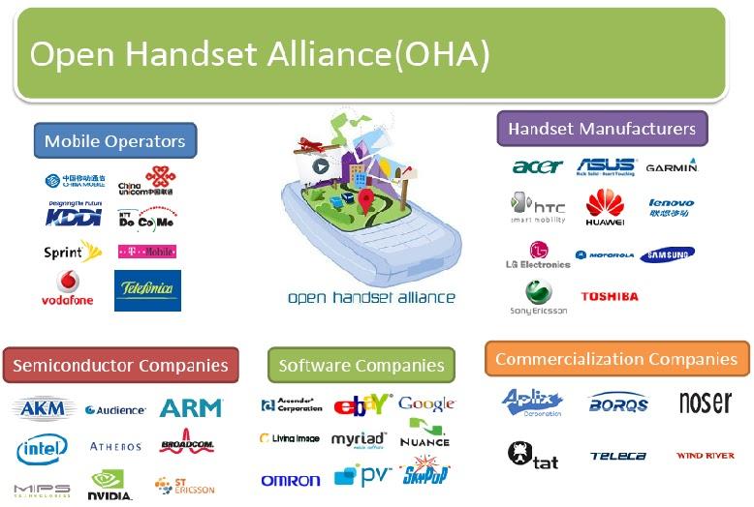
Open Handset Alliance (OHA)

Slide 22
Open Handset Alliance (OHA)

Slide 23
Open Handset Alliance (OHA)
The Open Handset Alliance (OHA) is a collection of more than 84 technology companies, including hardware manufacturers, mobile carriers, software developers, semiconductor companies, and commercialization companies. Of particular note are the prominent mobile technology companies, including Samsung, Motorola, HTC, T-Mobile, Vodafone, ARM, and Qualcomm.
The OHA hopes to deliver a better mobile software experience for consumers by providing the platform needed for innovative mobile development at a faster rate and with higher quality than existing platforms, without licensing fees for either software developers or handset manufacturers.

Slide 24

Question to Think Over
iOS is the iPhones mobile platform.
Why iPhone has not made iOS the open source ?
But Android is open source mobile platform.
Think over the MERITS and DEMERITS of iOS and Android.

Slide 25
Unit 1: Introducing Development Framework
Android Software Stack
Dalvik Virtual Machine
Android Application Architecture
Android Libraries
Android Development Tools

Slide 26
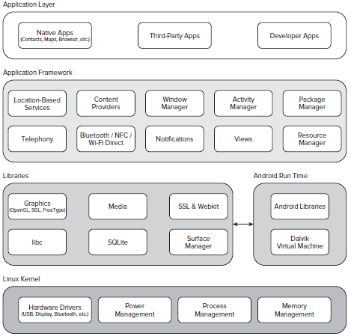
Android Software Stack or Android Architecture

Slide 27
Android Software Stack or Android Architecture
Android architecture or Android software stack is categorized into five parts:
Linux kernel
Native libraries (middleware)
Android Runtime
Application Framework
Applications

Slide 28
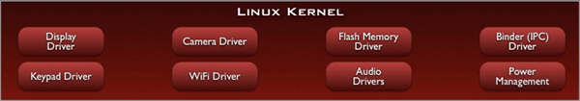
Android Software Stack or Android Architecture
Linux Kernel

Slide 29
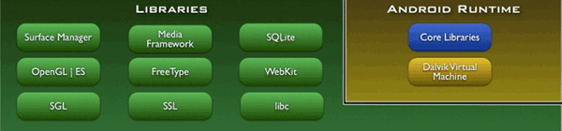
Android Software Stack or Android Architecture
Native Libraries Layer

Slide 30
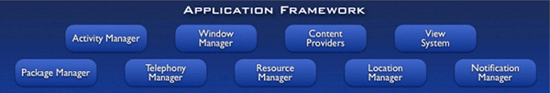
Android Software Stack or Android Architecture
Application Framework Layer

Slide 31

Android Software Stack or Android Architecture
Application Layer

Slide 32
Android Software Stack or Android Architecture
Linux kernel: It is the heart of android architecture that exists at the root of android architecture. Linux kernel is responsible for device drivers, power management, memory management, device management and resource access.
Native Libraries: On the top of linux kernel, their are Native libraries such as WebKit, OpenGL, FreeType, SQLite, Media, C runtime library (libc) etc. The WebKit library is responsible for browser support, SQLite is for database, FreeType for font support, Media for playing and recording audio and video formats.
Android Runtime: In android runtime, there are core libraries and DVM (Dalvik Virtual Machine) which is responsible to run android application. DVM is like JVM (Java Virtual Machine) but it is optimized for mobile devices. It consumes less memory and provides fast performance.
Android Framework: On the top of Native libraries and android runtime, there is android framework. Android framework includes Android API's such as UI (User Interface), telephony, resources, locations, Content Providers (data) and package managers. It provides a lot of classes and interfaces for android application development.
Applications: On the top of android framework, there are applications. All applications such as home, contact, settings, games, browsers are using android framework that uses android runtime and libraries. Android runtime and native libraries are using linux kernel.

Slide 33
Question
Describe with neat diagram Android Architecture or Android Software Stack

Slide 34
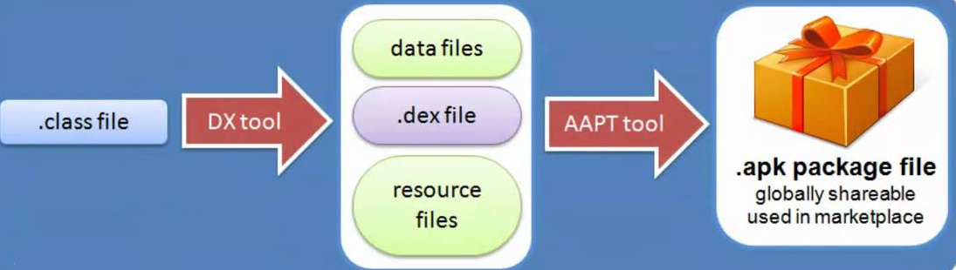
Unit 1: Dalvik Virtual Machine
DVM is written specifically for efficiently running programs on devices which have limited battery, limited memory and limited CPU
Android Runtime

Slide 35
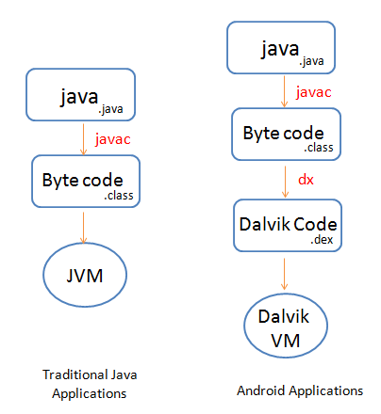
Difference between Java Virtual Machine (JVM) and Dalvik Virtual Machine (DVM)

Slide 36
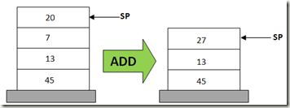
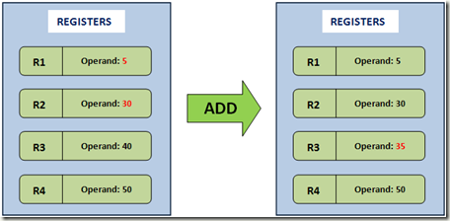
Difference between JVM and DVM
Java Virtual Machine (JVM) | Dalvik Virtual Machine (DVM)
JVM is Stack based which uses java byte code and runs .class file having JIT (Just In Time) . | DVM is Register based which is designed to run on low memory, uses its own byte code and runs .Dex file
Stack based VM | Registered based VM
POP 20 POP 7 ADD 20, 7, result PUSH result | ADD R1, R2, R3

Slide 37
Dalvik Virtual Machine (DVM)
As we know the modern JVM is high performance and provides excellent memory management. But it needs to be optimized for low-powered handheld devices as well.
The Dalvik Virtual Machine (DVM) is an android virtual machine optimized for mobile devices. It optimizes the virtual machine for memory, battery life and performance.
Dalvik is a name of a town in Iceland. The Dalvik VM was written by Dan Bornstein.
The Dex compiler converts the class files into the .dex file that run on the Dalvik VM. Multiple class files are converted into one dex file.

Slide 38
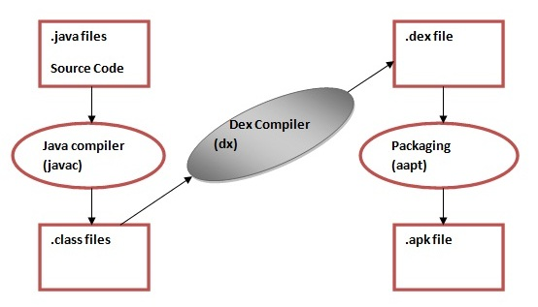
Dalvik Virtual Machine (Contd…)
The javac tool compiles the java source file into the class file.
The dx tool takes all the class files of your application and generates a single .dex file. It is a platform-specific tool.
The Android Assets Packaging Tool (aapt) handles the packaging process.
JVM (Java VM)

Slide 39
Android Libraries
Android offers a number of APIs for developing your applications.
http://developer.android.com/reference/packages.html,
which gives a complete list of packages included in the Android SDK.
Android is intended to target a wide range of mobile hardware.

Slide 40
Developing for Android
The Android design philosophy demands that applications be designed for:
Performance
Responsiveness
Freshness
Security
Seamlessness
Accessibility

Slide 41
Android Development Tool (ADT)
The Android SDK includes several tools and utilities to help you create, test, and debug your projects.
The Android Virtual Device and SDK Managers — Used to create and manage AVDs and to download SDK packages, respectively. The AVD hosts an Emulator running a particular build of Android, letting you specify the supported SDK version, screen resolution, amount of SD card storage available, and available hardware capabilities (such as touchscreens and GPS).
The Android Emulator — An implementation of the Android VM designed to run within an AVD on your development computer. Use the Emulator to test and debug your Android applications.
Dalvik Debug Monitoring Service (DDMS) — Use the DDMS to monitor and control the Emulators on which you’re debugging your applications.
Android Debug Bridge (ADB) — A client-server application that provides a link to virtual and physical devices. It lets you copy files, install compiled application packages (.apk), and run shell commands.
Logcat — A utility used to view and filter the output of the Android logging system.
Android Asset Packaging Tool (AAPT) — Constructs the distributable Android package fi les (.apk).

Slide 42
Thanks for Listening
TO DO
Installing Android Studio on your personal computers
Check whether you can upgrade your phone Android OS to current “Android version 8 Oreo” released during the year 2017
MERITS and DEMRITS of iOS and Android

Slide 43
Dalvik Virtual Machine
The Dalvik virtual machine is implemented by Google for the Android OS, and functions as the Interpreter for Java code running on Android devices.
It is a process virtual machine, whereby the the underlying Linux kernel of the Android OS spawns a new Dalvik VM instance for every process.
Each process in Android has its own Dalvik VM instance. This reduces the chances of multi-application failure if one Dalvik VM crashes.
Dalvik implements the register machine model, and unlike standard Java bytecode (which executes 8 bit stack instructions on the stack based JVM), uses a 16 bit instruction set.The registers are implemented in Dalvik as 4 bit fields.

Slide 44
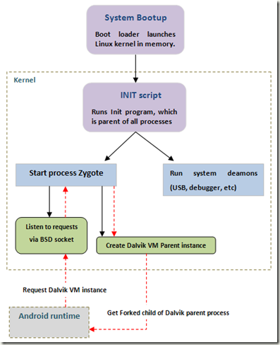
DVM
When the system boots up, the boot loader loads the kernel into memory and initializes system parameters. Soon after this,
The kernel runs the Init program, which is the parent process for all processes in the system.
The Init program starts system daemons and the very important ‘Zygote’ service.
The Zygote process creates a Dalvik instance which will be the parent Dalvik process for all Dalvik VM instances in the system.
The Zygote process also sets up a BSD read socket and listens for incoming requests.
When a new request for a Dalvik VM instance is received, the Zygote process forks the parent Dalvik VM process and sends the child process to the requesting application.
This is in essence, how the Dalvik virtual machine is created and used in the Android system.

Slide 45
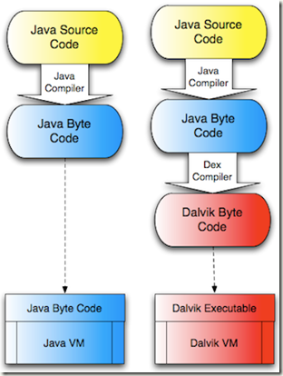
DVM (Contd…)
Dalvik differs from the Java virtual machine in that it executes Dalvik byte code, and not the traditional Java byte code. There is an intermediary step between the Java compiler and the Dalvik VM, that converts the Java byte code to Dalvik byte code, and this step is taken up by the DEX compiler. The difference between the JVM and Dalvik is depicted in the following diagram

