Slide 1
TEI export from the CDLI
Ralph Giles
Part of the 2019 Google Summer of Code

Slide 2
TEI export from the CDLI
Ralph Giles (student)
Willis Monroe (mentor)

Slide 3
Cuneiform Digital Library Initiative
Database of over 336000 inscribed objects
Over 123000 have transcriptions
Central resource for scholars

Slide 4
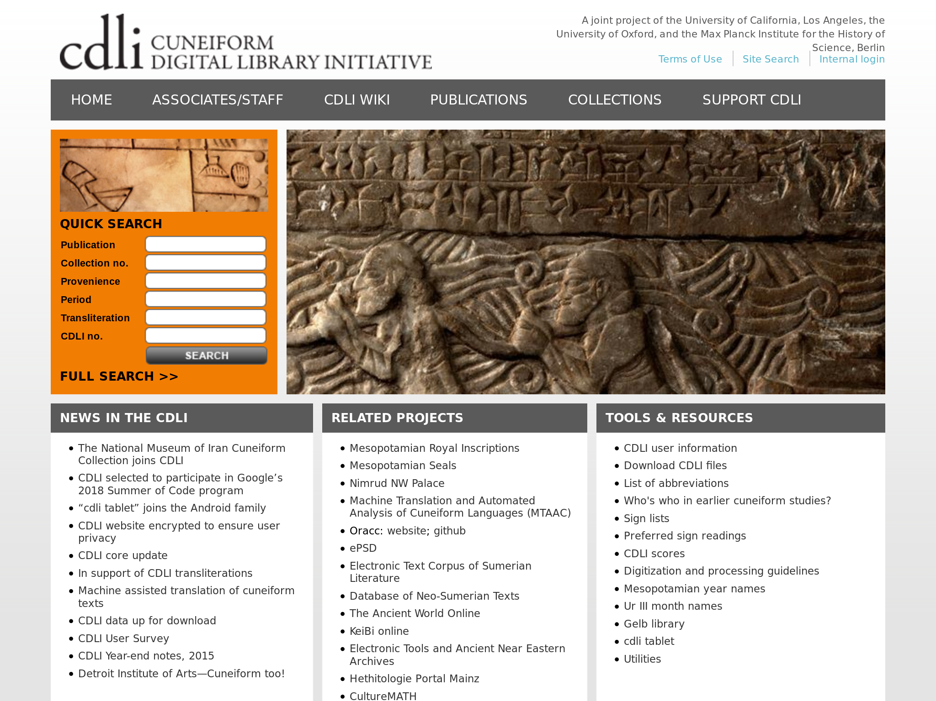

Slide 5
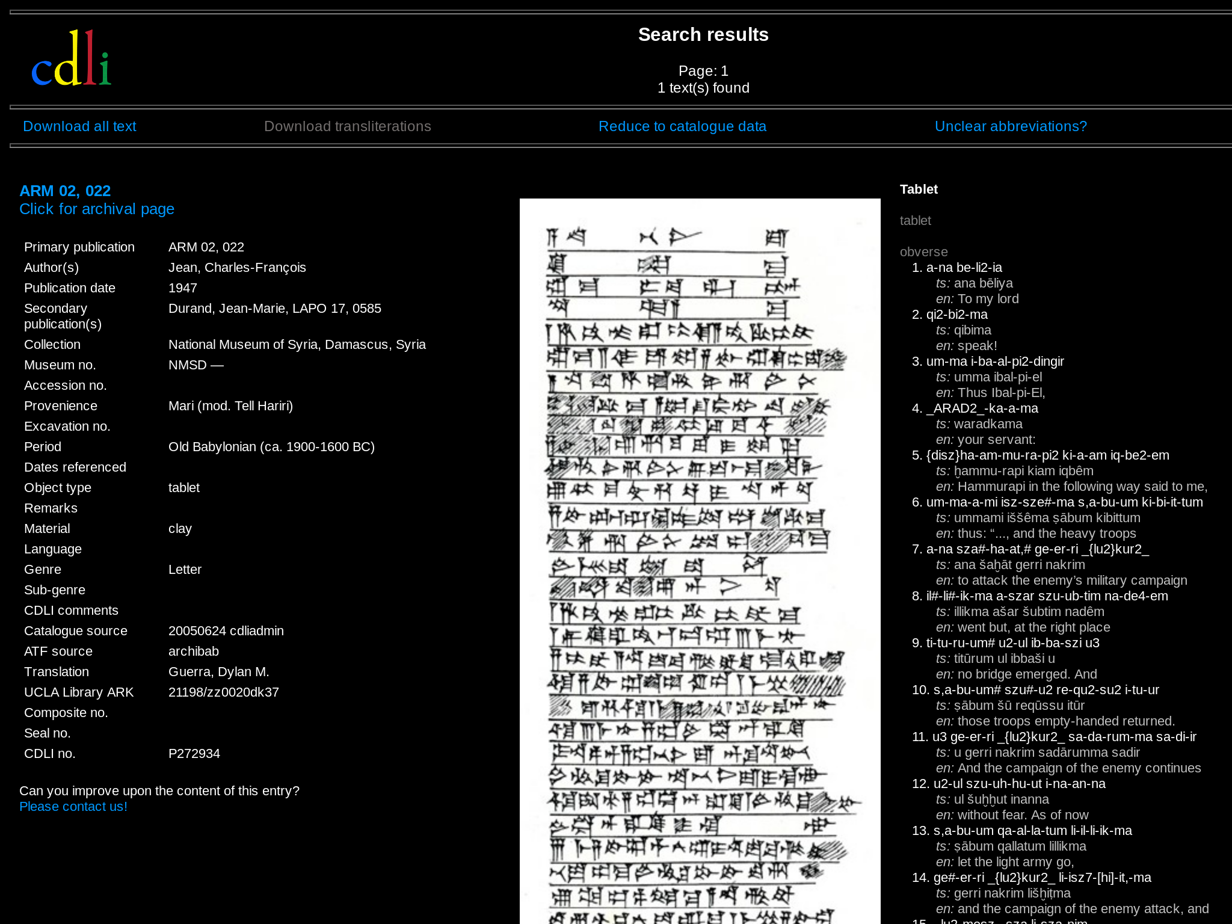

Slide 6
ATF format for transcriptions
Good for specialist input and exchange.
Requires specialist tools.
Transcriptions are in a custom, text-based format
&P272934 = ARM 02, 022
#atf: lang akk
@tablet
@obverse
1. a-na be-li2-ia
#tr.ts: ana bēliya
#tr.en: To my lord

Slide 7
Text Encoding Initiative (TEI) XML
Digital text format based on XML markup.
Widely used for annotation and distribution.
Used for many modern and ancient languages.
<text n="urn:cts:cdli:P272934" xml:lang="akk">
<body>
<div type="edition">
<div type="textpart" n="tablet">
<div type="textpart" n="obverse">
<l n="1"><w>a-na</w> <w>be-li2-ia</w></l>

Slide 8
atf2tei
Basic tool converts ATF record to TEI-XML
Written in Python
Uses pyoracc to parse ATF

Slide 9
Canonical Text Services
Standard file layout for TEI document libraries
Universal Resource Name citation scheme
CapiTainS project guidelines and tools

Slide 10
atf2cts
Convert a series of ATF records.
Loads atf2tei as a library.
Adds correct metadata.
Places files in the correct CTS hierarchy.

Slide 11
cdli2cts
Filter ATF records
  Specific CDLI id
  Catalogue metadata
Convert the whole database in about 30 minutes.

Slide 12




Text Conversion
Nightly export of ATF transcriptions to Github

Slide 13
Text Conversion
Fetch latest ATF from cdli/data repo.
Run cdli2cts to create TEI files.
Upload changes to cdli-cts repo.

Slide 14
cdli-cts-server
Repo wraps cdli-cts data repo
Serves TEI transcriptions through the CapiTainS Nautilus and Nemo packages.
Everything necessary to make the data accessible to reader software.

Slide 15
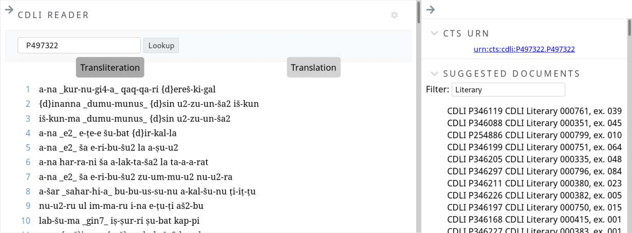
Available in Scaife Viewer

Slide 16
Thank you!

