Slide 1
ADO.NET

Slide 2
TOPICS TO BE DISCUSSED
Introduction​ to ado.net
Types of connection architecture
​Important classes of ado.net
How to build a database connection
​Summary​

Slide 3
introduction
ADO.NET provides a bridge between the front end controls and the back end database.
The ADO.NET objects encapsulate all the data access operations .
The controls interact with these objects to display data, thus hiding the details of movement of data.

Slide 4
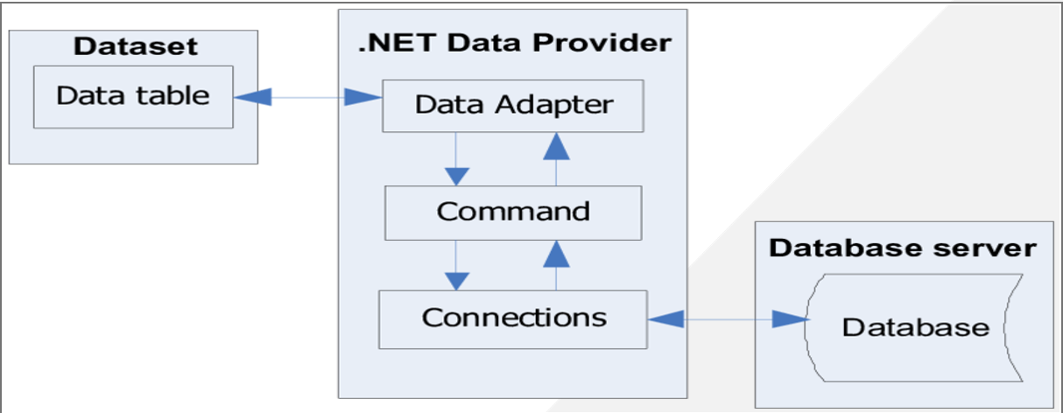
ADO.NET ARCHITECTURE

Slide 5
TYPES OF CONNECTION ARCHITECTURE
THERE ARE TWO TYPES OF ARCHITETCURE IN ADO.NET
CONNECTED ARCHITECTURE
DISCONNECTED ARCHITETCURE

Slide 6
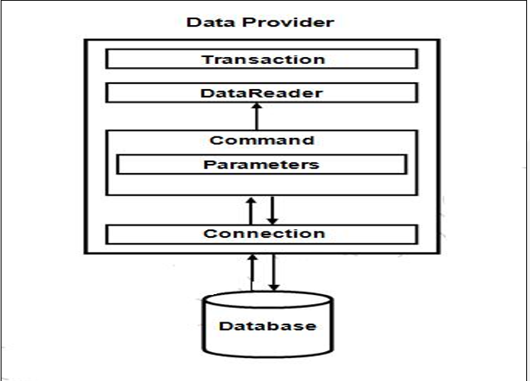
CONNECTED ARCHITECTURE
1.The architecture of ADO.net, in which connection must be opened to access the data retrieved from database is called as connected architecture.
2.Connected architecture was built on the classes connection, command, data reader and transaction.

Slide 7
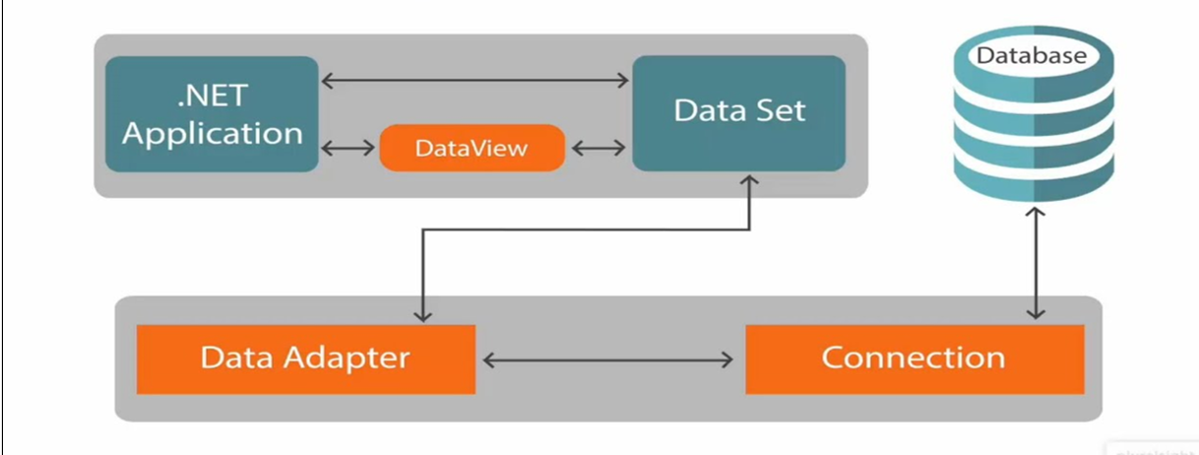
DISCONNECTED ARCHITECTURE
1.The architecture of ADO.net in which data retrieved from database can be accessed even when connection to database was closed is called as disconnected architecture.
2.Disconnected architecture of ADO.net was built on classes connection, data adapter, command builder and dataset and dataview.

Slide 8
CLASSES USED IN ADO.NET
CONNECTION CLASS
WE USE THIS CLASS TO CONNECT WITH DATABASE
COMMAND CLASS
TO STORING AND EXECUTING SQL STATEMENTS
DATA READER
USE TO RETRIEVE DATA
DATA ADAPTER
USED TO CONNECT DATASETS WITH DATABASE
DATA SET
IT IS HEART OF ADO.NET
IT MANAGES TARNSACTIONS BETWEEN APLLICATIONS AND DATABASE
EXECUTE READER
EXECUTE NON QUERY
EXECUTE SCALAR
EXECUTE XML RAEDER
IN DATA READER WE USE COMMAND CLASS OBJECT TO EXECUTE SQL STATEMENT TO RETRIVE DATA
COLLECTION OF DATA TABLES OBJECTS

Slide 9
CONNETCION CLASS
In ADO.NET ,WE use these connection classes to connect to database .These connection classes also manage transactions and connection

Slide 10
COMMAND CLASS
ExecuteReader: Returns data to the client as rows. This would typically be an SQL select statement or a Stored Procedure that contains one or more select statements. This method returns a DataReader object that can be used to fill a DataTable object or used directly for printing reports and so forth.
ExecuteNonQuery: Executes a command that changes the data in the database, such as an update, delete, or insert statement, or a Stored Procedure that contains one or more of these statements. This method returns an integer that is the number of rows affected by the query.
ExecuteScalar: This method only returns a single value. This kind of query returns a count of rows or a calculated value.
ExecuteXMLReader: (SqlClient classes only) Obtains data from an SQL Server 2000 database using an XML stream. Returns an XML Reader object.

Slide 11
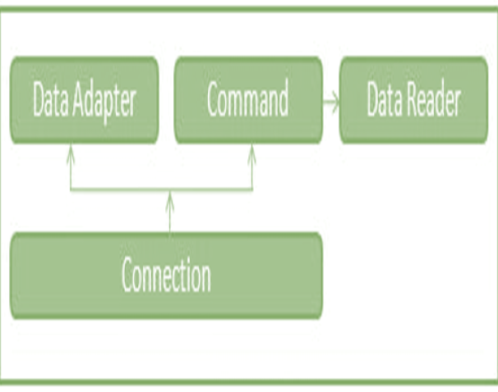
DATA READER
A data reader provides an easy way for the programmer to read data from a database as if it were coming from a stream. The DataReader is the solution for forward streaming data through ADO.NET.

Slide 12
DATA ADAPTER
The DataAdapter is used to connect DataSets to databases. The DataAdapter is most useful when using data-bound controls in Windows Forms, but it can also be used to provide an easy way to manage the connection between your application and the underlying database tables, views and Stored Procedures.

Slide 13
DATA SET
The ADO.NET DataSet contains DataTableCollection and their DataRelationCollection
It represents a collection of data retrieved from the Data Source.
The DataSet object offers a disconnected data source architecture.
It gives a better advantage over DataReader , because the DataReader is working only with the connection oriented Data Sources.

Slide 14
HOW TO CONNECT TO DATBASE
string connectionString = "Server=127.0.0.1;Port=3306;Database=sakila;Uid=root;Pwd=Ritu17@@;";
MySqlConnection con = new MySqlConnection(connectionString);
con.Open();
MySqlCommand cmd = new MySqlCommand("INSERT into myList values (@task)", con);
cmd.ExecuteNonQuery();

Slide 15
summary
We use ado.net to establish database connection with our application it provides number of classes and methods to easily implement the database connection.

Slide 16
Thank you

