Slide 1
Presented by : Sri Lutfiya Dwiyeni
MeetRecall AI
Improvement
Meeting Intelligence Platform
Transcription
RAG Chatbot
Topic Clustering
Sentiment Analysis

Slide 2
ABOUT ME
EDUCATION
Diponegoro University - Bachelor of Mathematics (2021 - 2025)
EXPERIENCE
Independent Study at Bangkit Academy 2024 (Sept 2024 - Jan 2025)
Independent Study at Startup Campus 2024 (Feb 2024 - Jun 2024)
OVERVIEW PROJECT
Clinical Research RAG Mini Chatbot:
SRI LUTFIYA DWIYENI
Mini chatbot RAG focused on Nightmare Disorder, IRT, and Major Depressive Episode.
MLOps Model Monitoring:
MLOps pipeline for house price prediction using MLflow, FastAPI, and Docker.
SmartSplit Bill Assistant:
AI tool to extract receipts and split bills automatically.
Intelligent Customer Assistant:
RAG-based assistant that answers customer queries accurately and contextually.

Slide 3
The Challenge
What professionals face every day with meeting recordings
Takes Too Much Time
Hard to Find Information
Writing down everything from a 1-hour meeting can take another 4 to 5 hours of manual work.
After a meeting, finding out what was said or who decided what requires replaying the entire recording.
No Clear Picture of Topics
Missing the Emotional Context
When a meeting covers many subjects, it is nearly impossible to separate and organize each theme manually.
Understanding how each participant felt during the discussion is invisible without the right tool.

Slide 4
How It Works
From raw recording to full meeting intelligence in a few clicks
1
1. Upload
2
2. AI Processing
3
3. Explore Insights
Upload any meeting recording from your computer.
Supports all common audio and video formats.
The system listens, identifies each speaker, and reads through the entire conversation automatically.
A set of AI tools is instantly available:
ask questions, discover topics, and see how each person spoke.
>
>
Built with industry-standard tools. Runs entirely on your own machine - your data never leaves your computer.
Web Interface
Processing Engine
Ready to Deploy
Clean, browser-based app.
No installation needed for the user.
Handles all requests between the
web app and the AI models.
One command to start the whole system.
Runs on any machine with Docker.

Slide 5
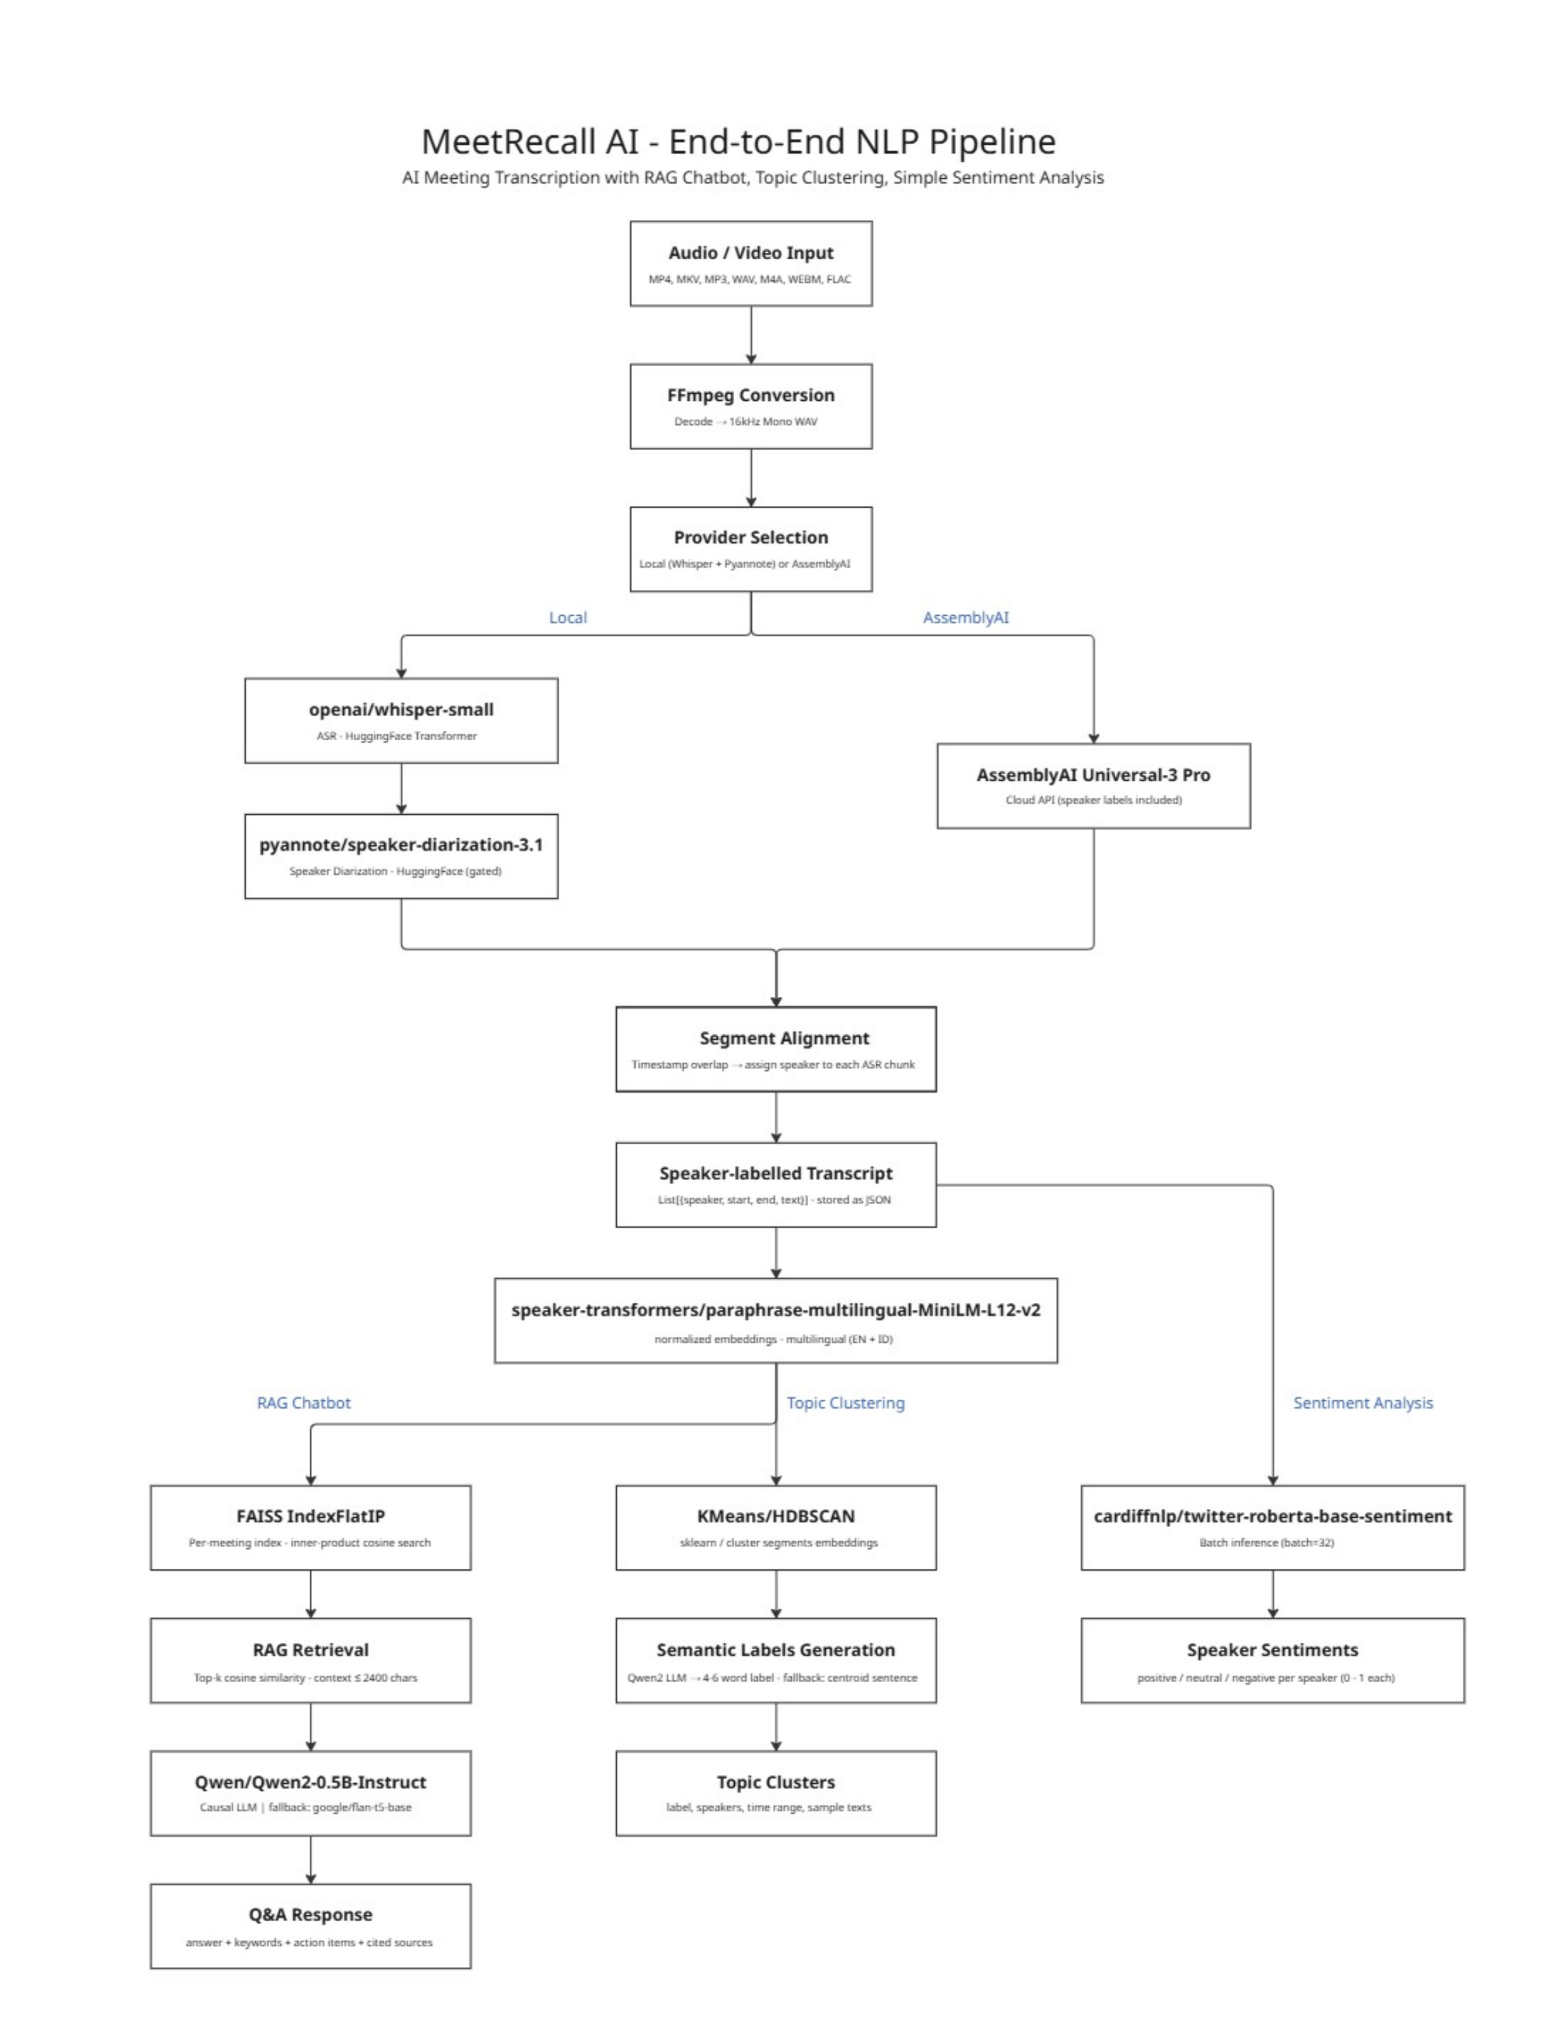
What the AI Does
A look at the intelligence inside the platform
When you upload a recording, the platform works in stages:
Listens to the recording
The AI converts speech to text and separates each person's voice automatically. No manual labelling needed.
Understands the content
The transcript is processed to understand meaning, not just words. It learns what was discussed, by whom, and in what context.
Surfaces three types of insight
You can ask questions about the meeting, see the main topics that were covered, and read how each participant came across emotionally.

Slide 6
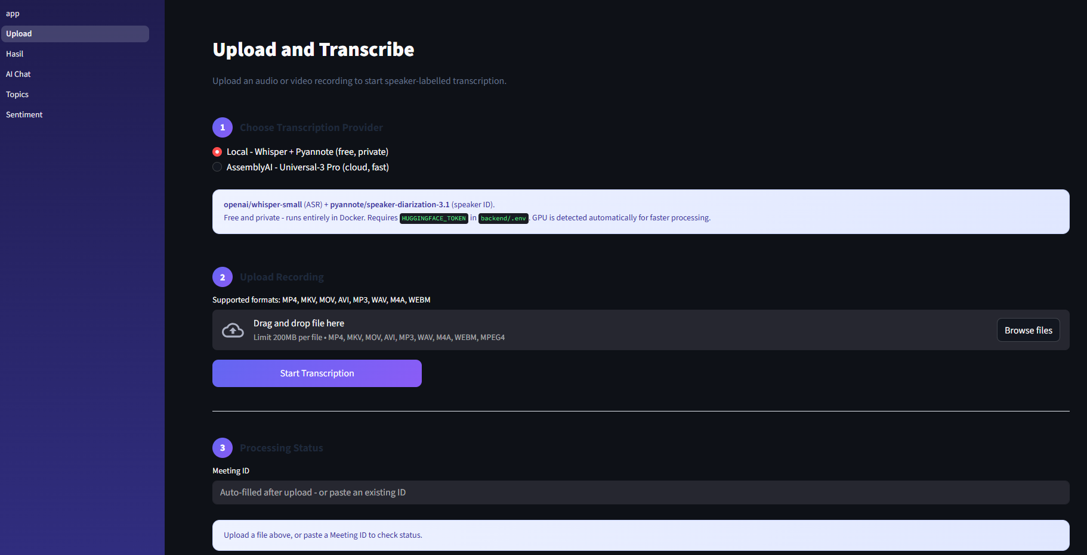
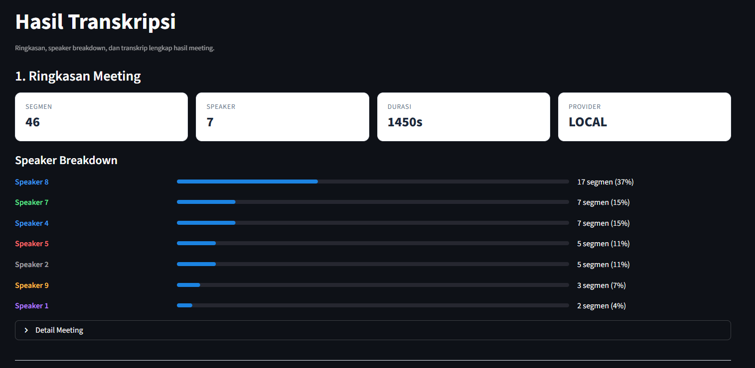
Demo - Upload and Transcription
Upload
Drag and drop any meeting file. The system accepts over 10 different audio and video formats.
Provider
Choose between a fully private local option or a fast cloud option, depending on your preference.
Result
A full transcript is produced with each speaker clearly identified and timestamped.
In this test
24-minute recording, 7 speakers, 46 segments detected automatically

Slide 7
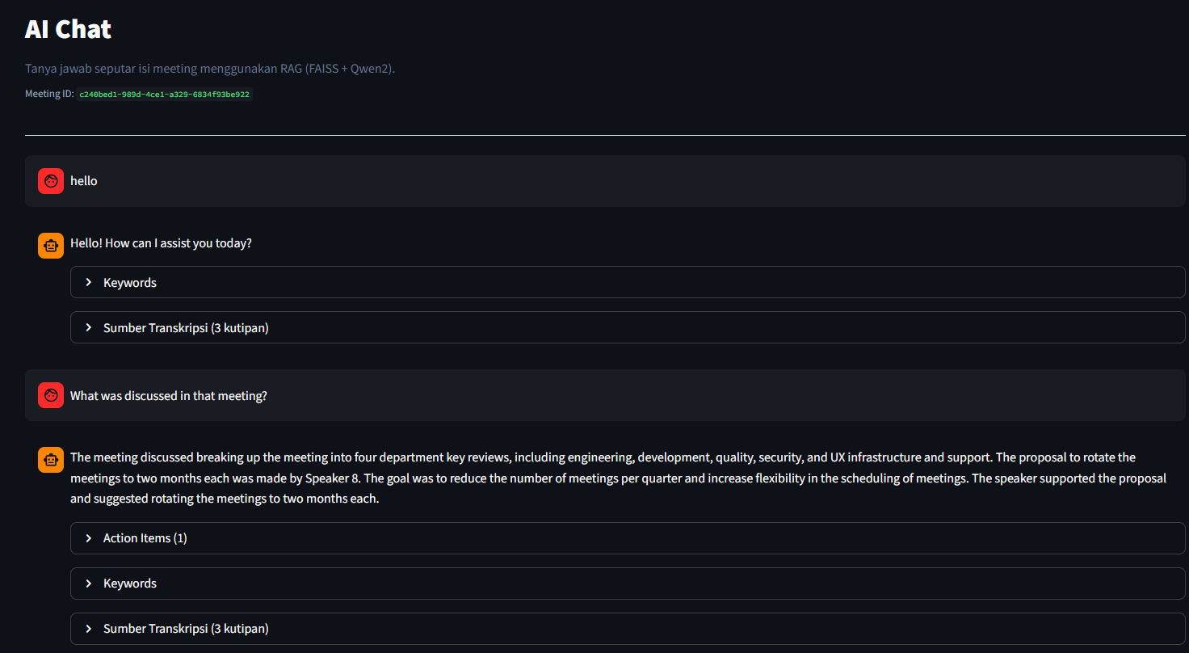
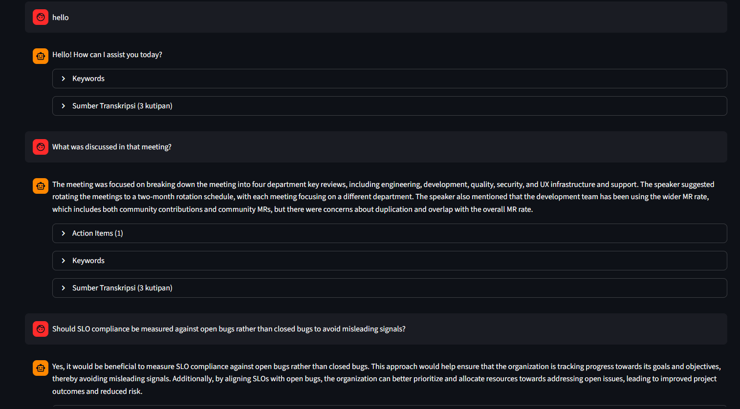
Demo - Ask Your Meeting
How it works
Type any question about the meeting and the AI finds the answer from the actual transcript.
Grounded answers
Every response points back to the exact part of the meeting it came from.
What you can ask
"What decisions were made?" "What did Speaker A say about budgets?" "Summarise the meeting."
Language
Works in English and Bahasa Indonesia

Slide 8
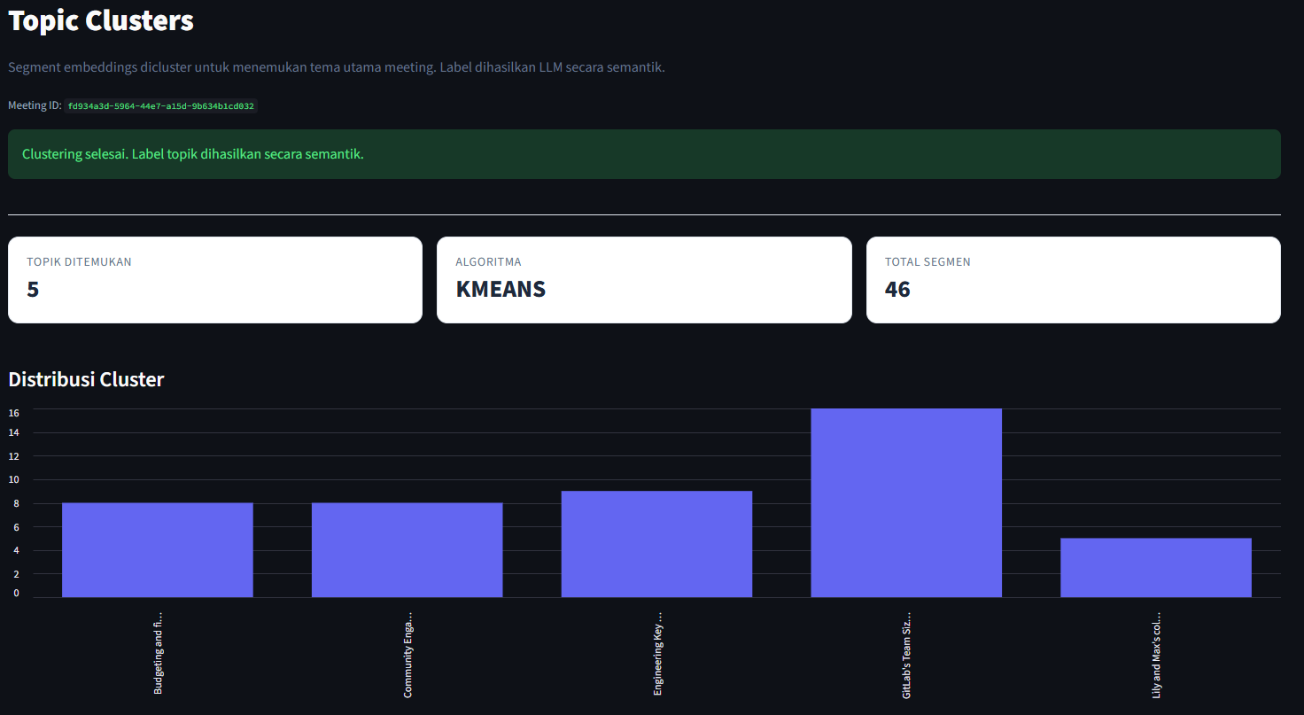
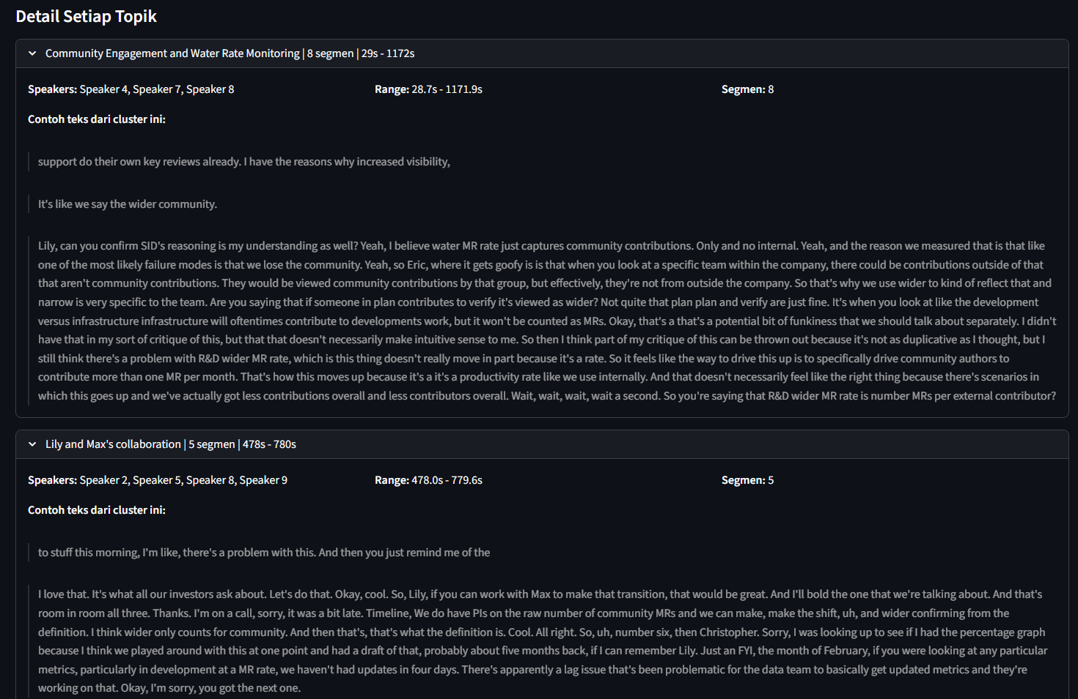
Demo - Topic Discovery
What it does
The AI reads through all discussion segments and automatically groups them into meaningful themes.
No manual work
Topics and their labels are generated by the AI. No human categorisation required.
In this test
5 distinct topics found across a 24-minute meeting with 46 discussion segments.
Use case
Quickly understand what a long meeting was really about without re-watching it.

Slide 9
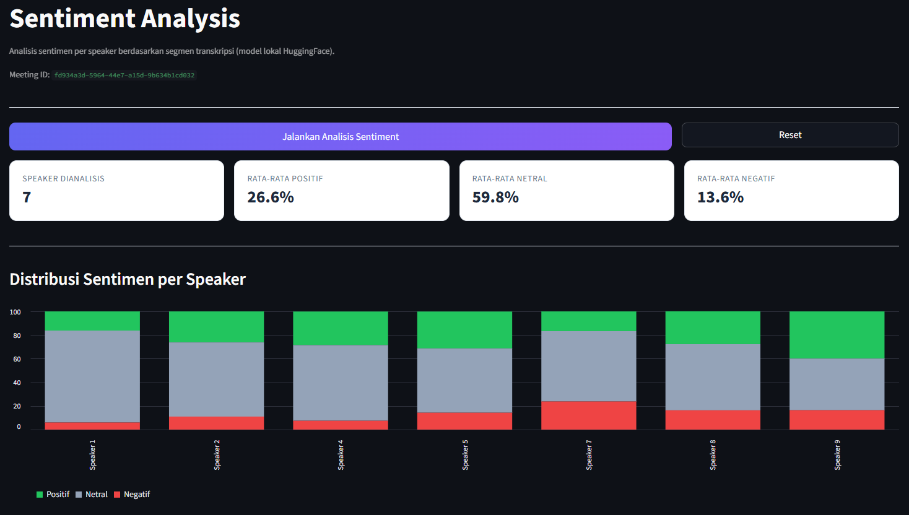
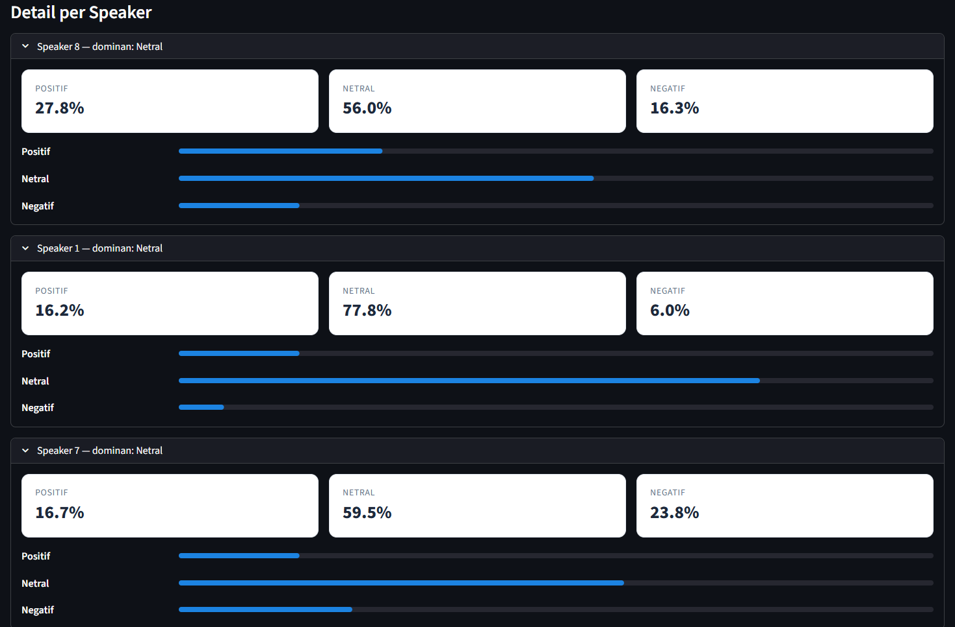
Demo - Read the Room
What it does
The AI analyses how each speaker came across throughout the meeting.
Per-person view
Each participant gets their own positive, neutral, and negative breakdown.
In this test
7 speakers analysed. Meeting tone was mostly neutral (59.8%), with 26.6% positive.
Use case
Useful for team health checks, client call reviews, or post-meeting reflection.

Slide 10
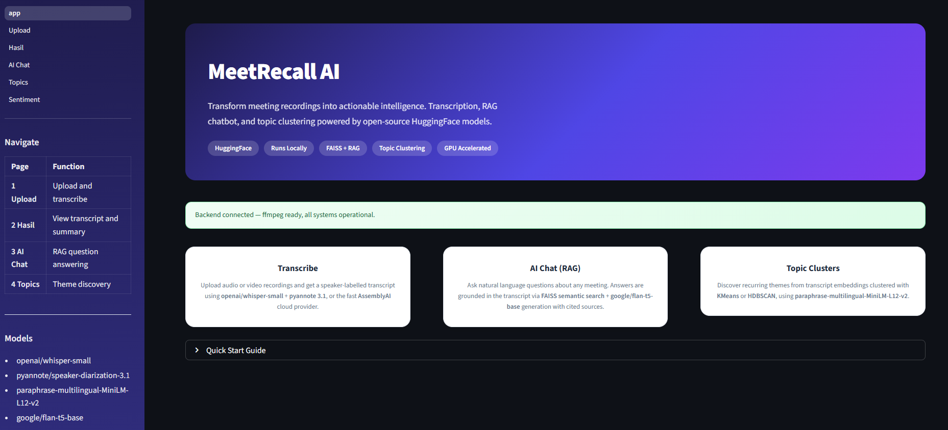
LET'S COLLABORATE!
Open to discussions, collaborations, and opportunities
in Artificial Intelligence and Machine Learning.
THANK YOU
Email
srilutfiyadwiy@gmail.com
MeetRecall AI Improvement
Meeting Intelligence Platform
LinkedIn
linkedin.com/in/sri-lutfiya-dwiyeni
GitHub
github.com/rilufiyy
Phone
+62 812-1457-7894

