Slide 1
Web designing
Free and open source software

Slide 2
WEBSITE APPLICATION
We have created a website for issuing admission for the student who are interested for applying in our institute.
We have displayed all the information about the website application.
The start page attracts the user with our web designing techniques.
Fine. Let’s Get Started with our website.

Slide 3
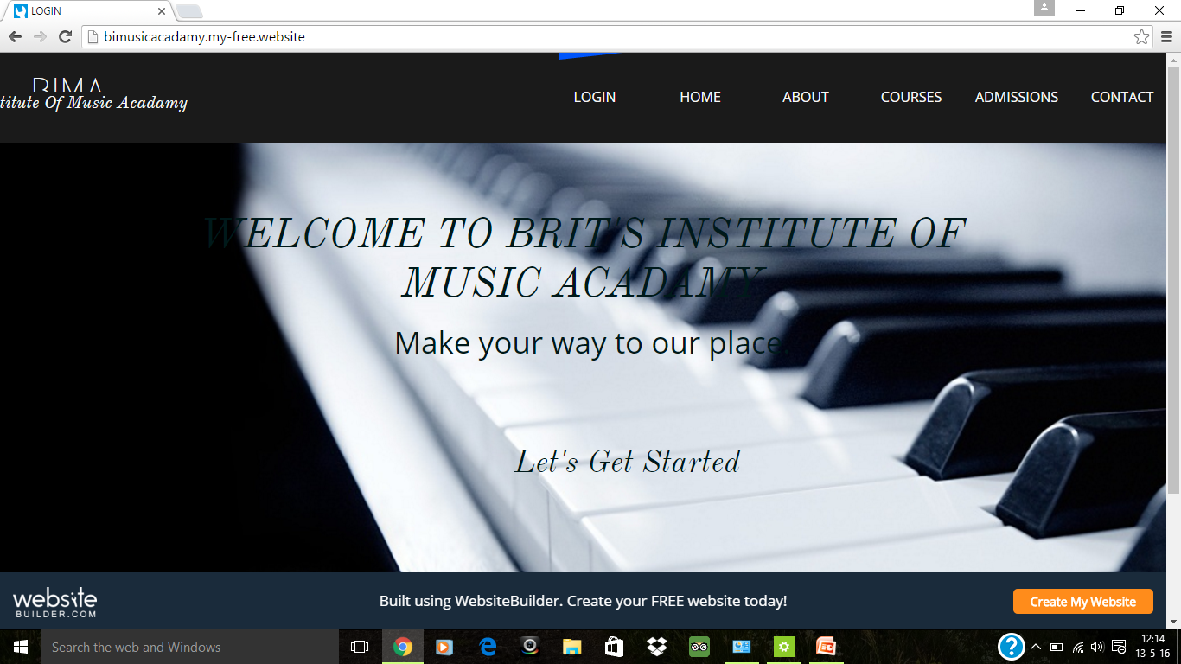

Slide 4
When the user click the “Let’s get started” link, it reaches the home page of the website.
We provide each and every information about the institution in the home page. This page gives a perfect information for the user who visits our site.

Slide 5
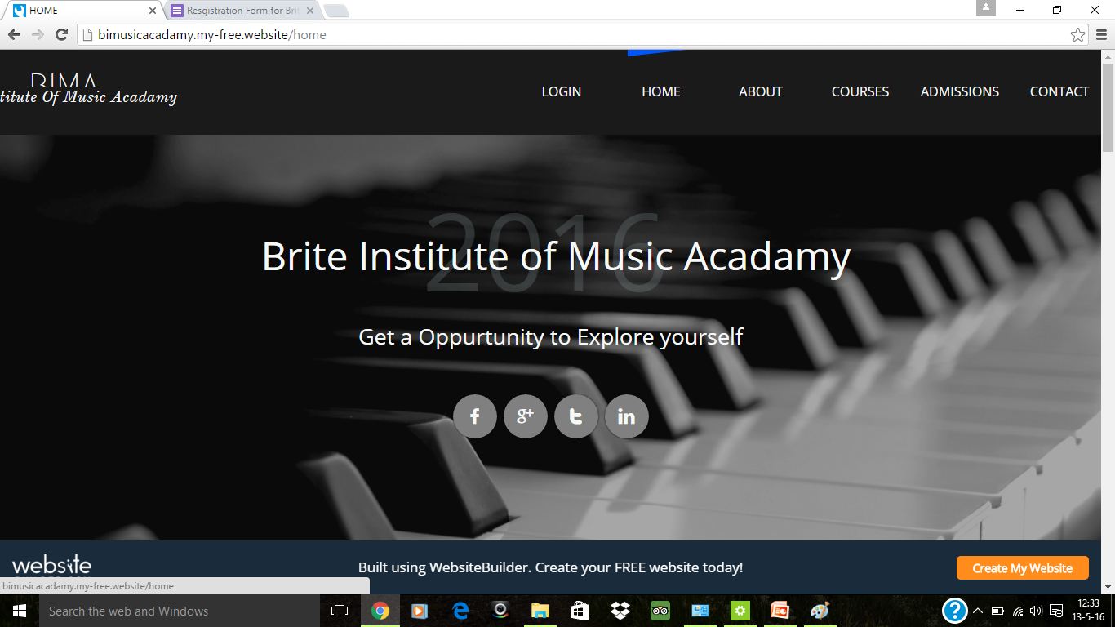

Slide 6
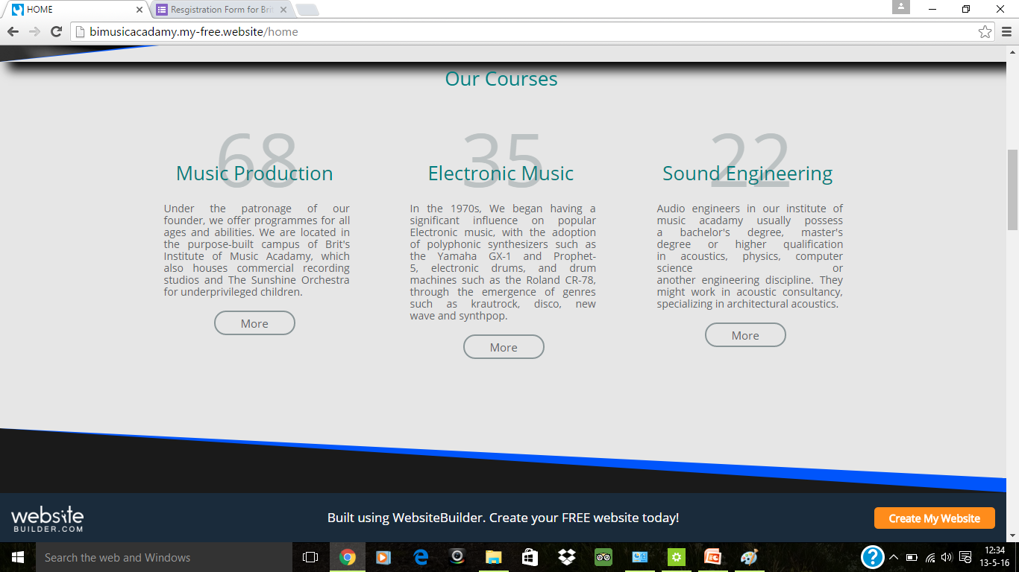

Slide 7
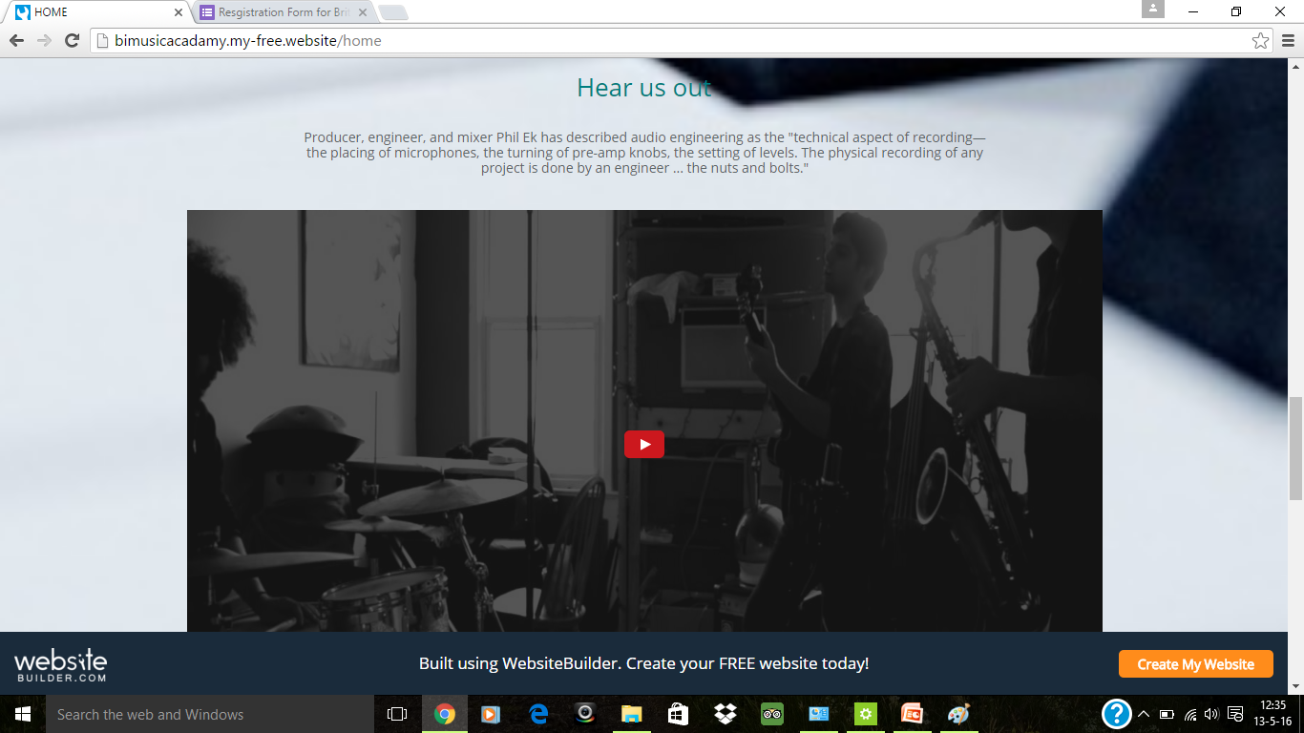

Slide 8
We issue many courses in our institution. Mainly now we provide admission for Audio Technology and Summer Programme.
And we provide the upcoming events that being conducted by the institute.

Slide 9
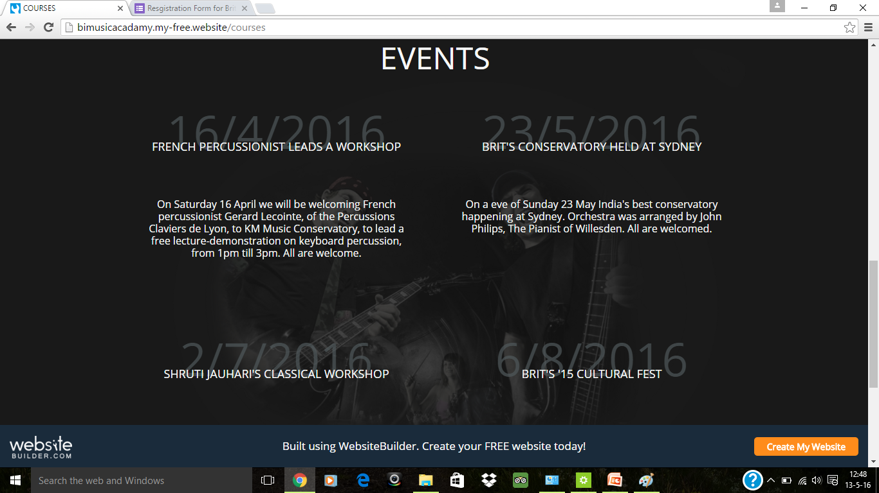

Slide 10
Admission is the webpage where the user can get information about the Audio Technology in UG and graduate.
The user can register his detail for the application and get the form for joining the institute.
The user can get the registration form by clicking the “Register for application” link

Slide 11
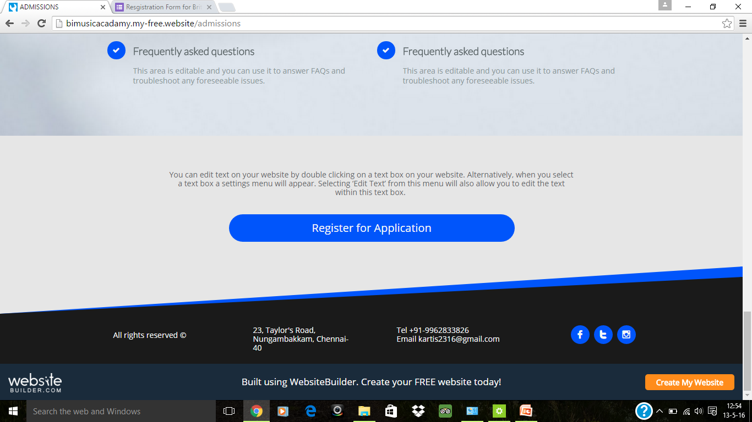

Slide 12
The registration form being displayed in this manner:

Slide 13
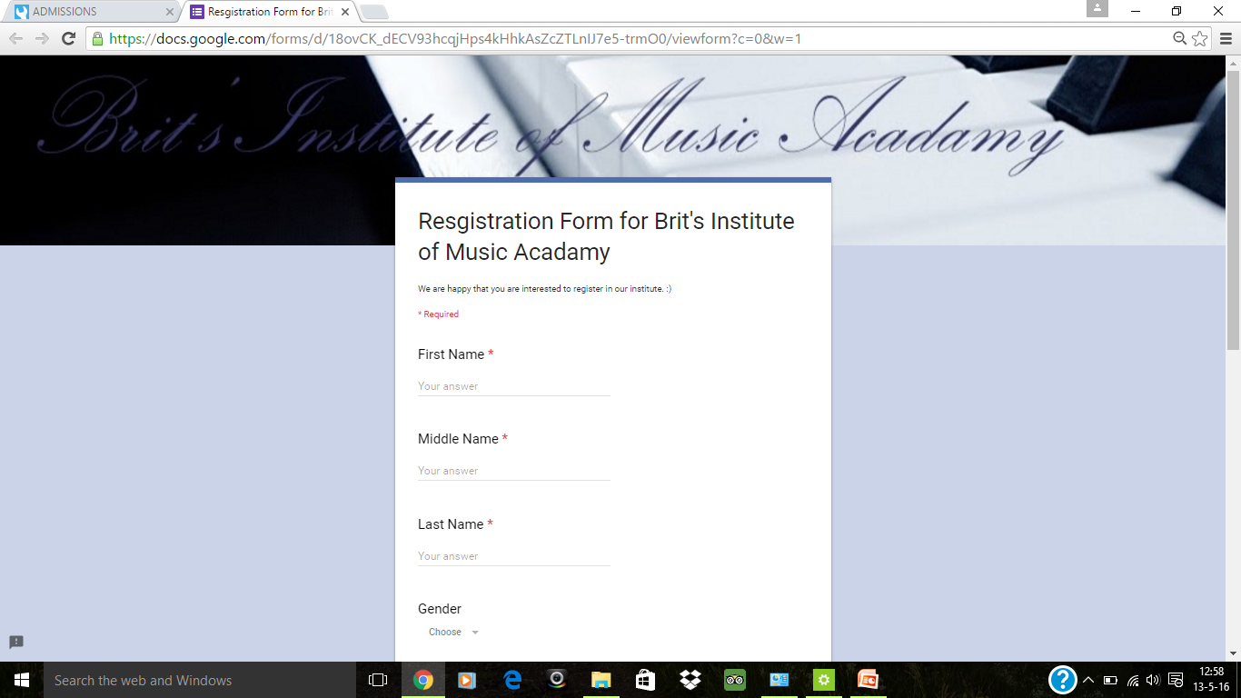
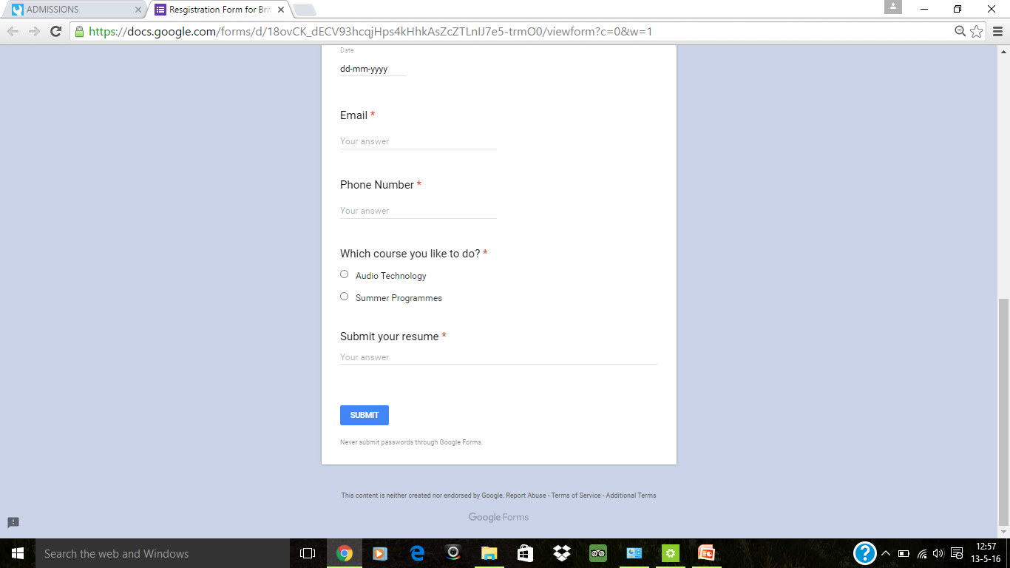

Slide 14
Back End
Back End is done by creating a database for the form which the user is giving the details.
The empty database is created for the entry of the user who register for the admission.

Slide 15
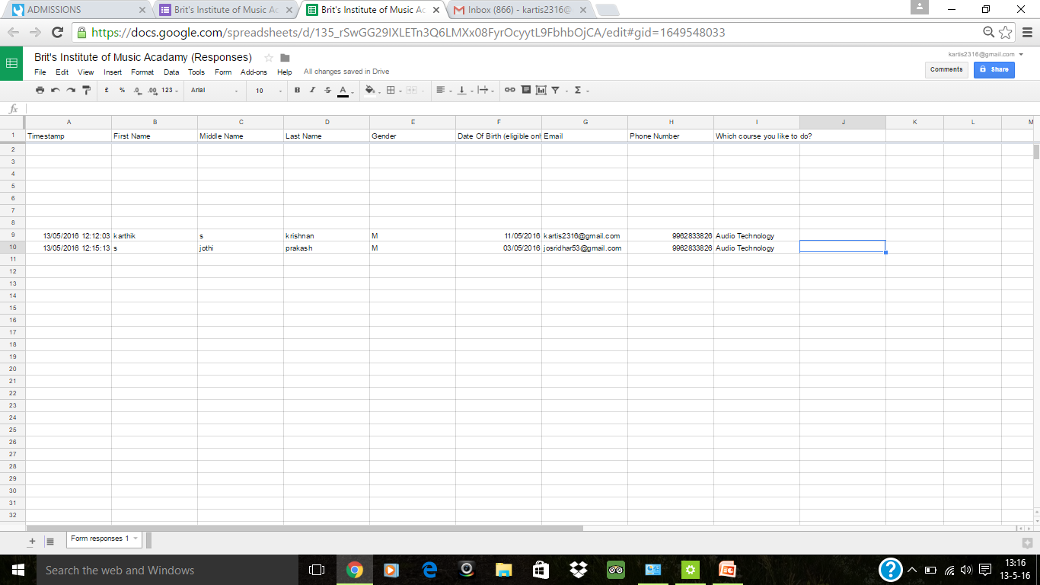

Slide 16
Thank You

