Slide 1
CMP 201: Computer Programming I

Slide 2
Programming Languages
C & C++ (an object-oriented language, based on C)
Java (We will use it in this course)
C# (a Java-like language developed by Microsoft)
JavaScript ( A Java-like scripting language for web development (Front & Back End (using Node.js))
Python (General purpose programming language use in data science, machine learning, web development, scripting, etc)
Visual Basic (Basic-like visual language developed by Microsoft)
Ruby (Ruby on Rails framework for web development)
PHP (General purpose scripting language for dynamic web development
Swift (General purpose programming language for iOS, iPadOS, macOS, tvOS, and watchOS
Kotlin (A cross-platform language for mobile, web, and desktop App

Slide 3
Why Java
The answer is that Java enables users to develop and deploy applications on the Internet for servers, desktop computers, and small hand-held devices. The future of computing is being profoundly influenced by the Internet, and Java promises to remain a big part of that future.
Java is Object Oriented Programming language
Java is the Internet programming language.
Java is a general purpose programming language.
Java is the Internet programming language.
Java can be used to develop Web applications.
Java Applets
Java Web Applications
Java can also be used to develop applications for hand-held devices such as Palm and cell phones

Slide 4
Java History
James Gosling and Sun Microsystems 1991
First called “Oak”
Renamed to “Java”, May 20, 1995, Sun World
HotJava
The first Java-enabled Web browser
Early History Website:
http://java.sun.com/features/1998/05/birthday.html

Slide 5
JDK Versions
JDK 1.02 (1996)
JDK 1.1 (1997)
JDK 1.2 (1998)
JDK 1.3 (2000)
JDK 1.4 (2002)
JDK 1.5 (2004) a. k. a. JDK 5 or Java 5
JDK 1.6 (2006) a. k. a. JDK 6 or Java 6
JDK 1.7 (possibly 2010) a. k. a. JDK 7 or Java 7
Check for the latest release: https://www.java.com/releases/matrix/

Slide 6
JDK Editions
Java Standard Edition (J2SE)
J2SE can be used to develop client-side standalone applications or applets.
Java Enterprise Edition (J2EE)
J2EE can be used to develop server-side applications such as Java servlets and Java ServerPages.
Java Micro Edition (J2ME).
J2ME can be used to develop applications for mobile devices such as cell phones.

Slide 7
Popular Java IDEs
NetBeans Open Source by Sun
Eclipse Open Source by IBM
IntelliJ IDEA Open Source by JetBrains
BlueJ Open Source by Michael Kolling and John Rosenberg
Jdeveloper Open Source by Oracle Corporation
JCreator by Xinox Software
Greenfoot by King’s College London for the purpose of education
JGrasp

Slide 8
Java Identifiers
To be able to refer to entities stored in computer memory, Java allows the programmer to attach names to portions of memory.
These names are called Identifiers
An identifier is a sequence of characters that consist of letters, digits, underscores (_), and dollar signs ($).
An identifier must start with a letter, an underscore (_), or a dollar sign ($). It cannot start with a digit.
An identifier cannot be a reserved word (“Java Keywords”).
Most significantly, identifiers are case sensitive. So, Sample is not same as sample.
There are also some other rules which are followed but are not compulsory:
All identifiers begin with a lowercase letter except it is the name of a class
For compound words, the first word begins with lower case while subsequent words begin with an upper-case letter e.g. classNumber, myProgram, areaOfTriangle

Slide 9
Variables and Constants
A variable is a placeholder for a value that can be updated as the program runs.
A variable in Java is most easily envisioned as a box capable of storing a value.
A variable whose value does not change during the course of a program is called a Constant.
Each variable has the following attributes:
A name, which enables you to differentiate one variable from another.
A type, which specifies what type of value the variable can contain.
A value, which represents the current contents of the variable.
The name and type of a variable are fixed. The value changes whenever you assign a new value to the variable.

Slide 10
Variable Declarations
In Java, you must declare a variable before you can use it. The declaration establishes the name and type of the variable and, in most cases, specifies the initial value as well.
The most common form of a variable declaration is
Datatype <variable name>;
where Datatype is the name of a Java primitive type or class, variable name is an identifier that indicates the name of the variable
A variable can be declared and initialize at the same time as follows:
Datatype <variable name> = value;
Where value is an expression specifying the initial value.
Most declarations appear as statements in the body of a method definition. Variables declared in this way are called local variables and are accessible only inside that method.
Variables may also be declared as part of a class. These are called instance variables

Slide 11
Expressions in Java
An expression in Java consists of terms joined together by operators
e.g. int total = n1 + n2;
The n1 + n2 that appears to the right of the equal sign is an example of an expression, which specifies the operations involved in the computation.
Each term must be one of the following:
A constant (such as 3.14159265 or "hello, world")
A variable name (such as n1, n2, or total)
A method calls that returns a values (such as readInt)
An expression enclosed in parentheses

Slide 12
Primitive Data Types
Although complex data values are represented using objects, Java defines a set of primitive types to represent simple data.
Of the eight primitive types available in Java, the programs in this course will use only the following four:
Int This type is used to represent integers, which are whole numbers such as 17 or –53.
Double This type is used to represent numbers that include a decimal fraction, such as 3.14159265.
Boolean This type represents a logical value (true or false).
Char This type represents a single character
String This type represents a sequence of characters

Slide 13
Operators and Operands
As in most languages, Java programs specify computation in the form of arithmetic expressions that closely resemble expressions in mathematics.
Operators in Java usually appear between two subexpressions, which are called its operands. Operators that take two operands are called binary operators.
The - operator can also appear as a unary operator, as in the expression -x, which denotes the negative of x.
The most common operators in Java are the ones that specify arithmetic computation:
+
Addition
*
Multiplication
–
Subtraction
/
Division
%
Remainder

Slide 14
Division and Type Casts
Whenever you apply a binary operator to numeric values in Java, the result will be of type int if both operands are of type int, but will be a double if either operand is a double.
This rule has important consequences in the case of division. For example, the expression
seems as if it should have the value 2.8, but because both operands are of type int, Java computes an integer result by throwing away the fractional part. The result is therefore 2.
If you want to obtain the mathematically correct result, you need to convert at least one operand to a double, as in
The conversion is accomplished by means of a type cast, which consists of a type name in parentheses.
14 / 5
(double)14 / 5

Slide 15
The Remainder Operator
The only arithmetic operator that has no direct mathematical counterpart is %, which applies only to integer operands and computes the remainder when the first divided by the second:
The result of the % operator make intuitive sense only if both operands are positive. The examples in the book do not depend on knowing how % works with negative numbers.
The remainder operator turns out to be useful in a surprising number of programming applications and is well worth a bit of study.
14 % 5
returns
4
14 % 7
returns
0
7 % 14
returns
7

Slide 16
Precedence
If an expression contains more than one operator, Java uses precedence rules to determine the order of evaluation. The arithmetic operators have the following relative precedence:
Thus, Java evaluates unary - operators and type casts first, then the operators *, /, and %, and then the operators + and -.
Precedence applies only when two operands compete for the same operator. If the operators are independent, Java evaluates expressions from left to right.
Parentheses may be used to change the order of operations.
unary - (type cast)
highest
* / %
+ -
lowest

Slide 17
Assignment Statements
You can change the value of a variable in your program by using an assignment statement, which has the general form:
The effect of an assignment statement is to compute the value of the expression on the right side of the equal sign and assign that value to the variable that appears on the left. Thus, the assignment statement
adds together the current values of the variables total and value and then stores that sum back in the variable total.
When you assign a new value to a variable, the old value of that variable is lost.
variable = expression;
total = total + value;

Slide 18
Shorthand Assignments
Statements such as
are so common that Java allows the following shorthand form:
The general form of a shorthand assignment is
where op is any of Java’s binary operators. The effect of this statement is the same as
For example, the following statement multiplies salary by 2.
total = total + value;
total += value;
variable op= expression;
variable = variable op (expression);
salary *= 2;

Slide 19
Increment and Decrement Operators
Another important shorthand form that appears frequently in Java programs is the increment operator, which is most commonly written immediately after a variable, like this:
The effect of this statement is to add one to the value of x, which means that this statement is equivalent to
or in an even longer form
The -- operator (which is called the decrement operator) is similar but subtracts one instead of adding one.
The ++ and -- operators are more complicated than shown here, but it makes sense to defer the details until in Repetition Statements.
x++;
x += 1;
x = x + 1;

Slide 20
The Math Class
Obviously, the arithmetic operators discussed above do not solve all possible mathematical problems. However, many mathematical functions are included in the Math class of the Java library, which is available for the programmers use. Some of the functions include:
Function Action
sqrt(X) Returns the square root of X
abs(X) Returns the absolute value of X
cos(X), sin(X), tan(X) Returns the trig values of an angle
exp(X) Returns the exponential number e to the power of X
log(X) Returns the natural logarithm of X
pow(X, Y) Returns X to the power of Y

Slide 21
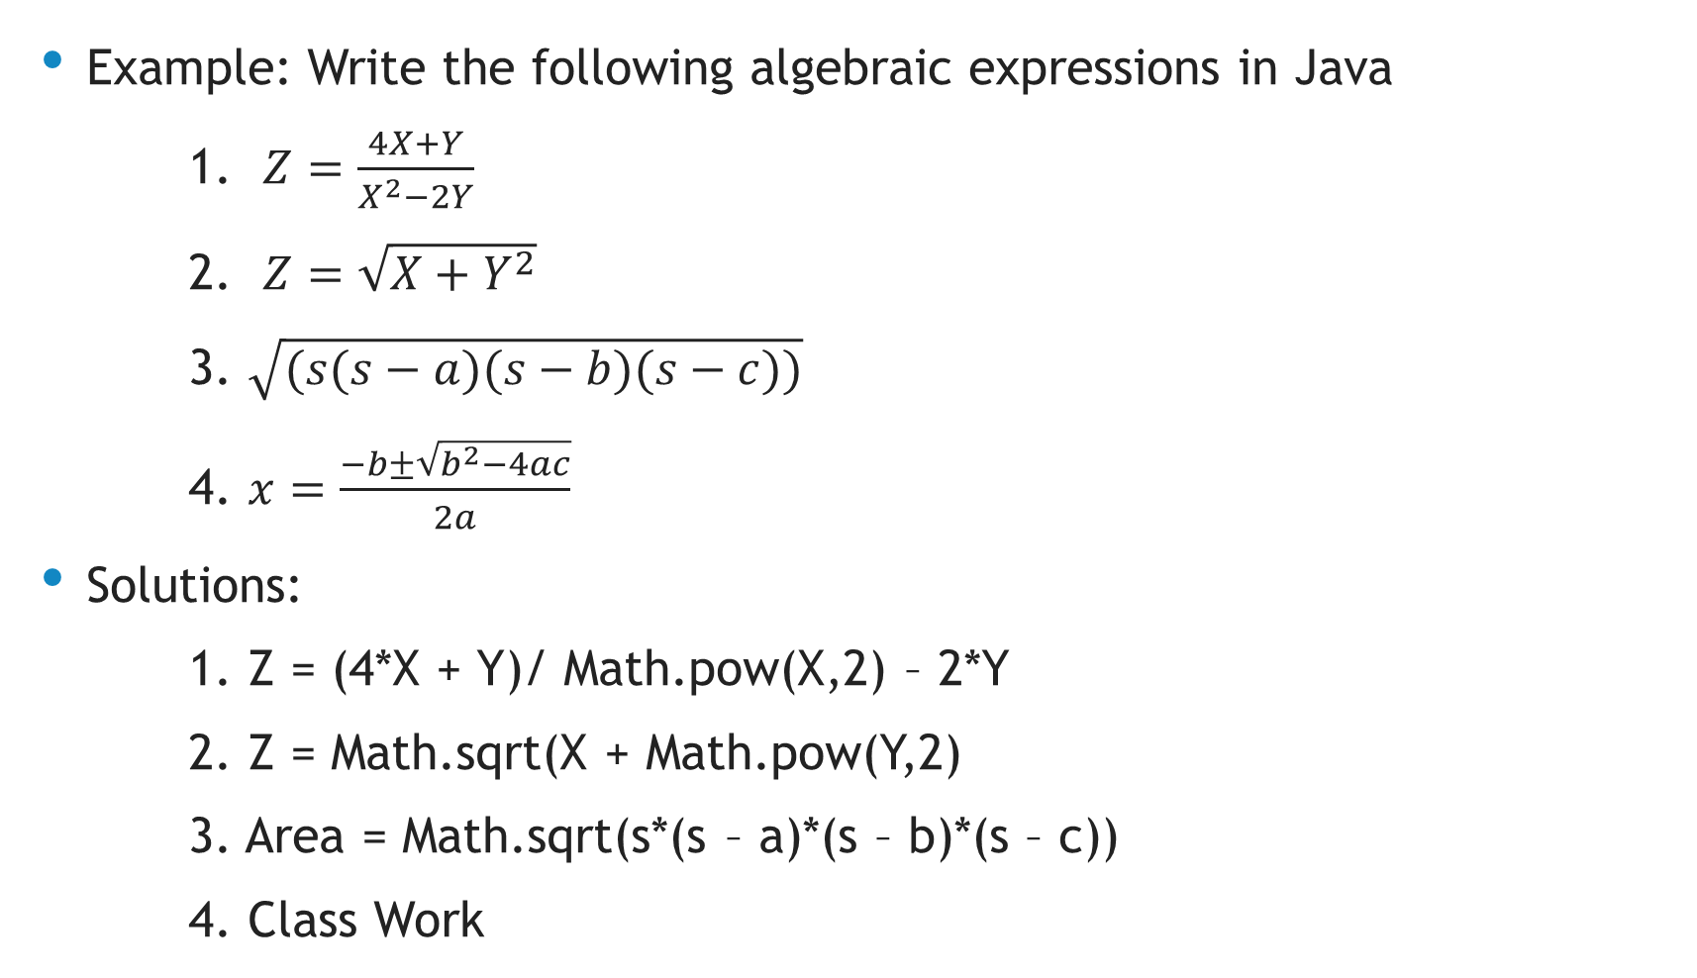
The Math Class
Example: Write the following algebraic expressions in Java
1. $Z=\frac{4X+Y}{X^{2}−2Y}$
2. $Z=\sqrt{X+Y^{2}}$
3. $\sqrt{(s(s−a)(s−b)(s−c))}$
4. $x=\frac{−b±\sqrt{b^{2}−4ac}}{2a}$
Solutions:
1. Z = (4*X + Y)/ Math.pow(X,2) – 2*Y
2. Z = Math.sqrt(X + Math.pow(Y,2)
3. Area = Math.sqrt(s*(s – a)*(s – b)*(s – c))
4. Class Work

