Slide 1
Evaluation of Point-Cloud Segmentation Approaches for Detecting Walkable Steps on Staircases in the Presence of Sensor Noise
Rimsha Nisar 1225800013
Master Program of Information and Computer Engineering
Electronic Engineering Polytechnic Institute of Surabaya (EEPIS)
Surabaya, Indonesia
Notes:
Frame this as a research study, not a class project: we benchmark four classical point-cloud segmentation methods for finding walkable stair treads, and we quantify how sensor noise degrades them. Target ~10 minutes.

Slide 2
Introduction and Purpose
Mobile robots operating in human-built environments must navigate staircases safely, making accurate 3D surface segmentation a critical requirement. Using point clouds from LiDAR sensors, this study compares four segmentation methods, RANSAC, PCA Normal Analysis, DBSCAN, and Height Histogram , to identify walkable treads, vertical risers, and hazardous edges on a synthetic four-step staircase. With sensor noise being the key challenge, the goal is to determine which approach delivers the precision and reliability needed for safe autonomous stair climbing.
The purpose of this research is to develop and compare point-cloud segmentation methods that enable stair-climbing robots to reliably distinguish walkable tread surfaces from hazardous risers and edges, even under realistic LiDAR sensor noise, in order to establish a safe and accurate first-layer perception system for autonomous stair navigation.
1
Notes:
Precision on the walkable class matters most: a false positive can cause a fall.

Slide 3
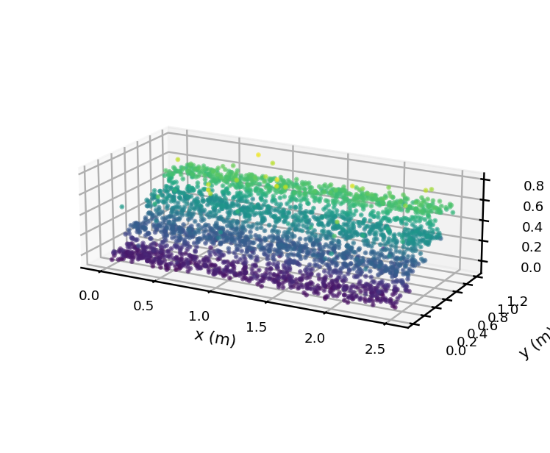
Motivation & Problem
1
Stairs are everywhere Stair-climbing robots constantly meet staircases in human-made environments.
2
Walkable vs. hazardous The robot must tell horizontal treads (safe to step on) from vertical risers and edges.
3
Point clouds are noisy LiDAR and depth cameras output 3D points with sensor noise and outliers.
Safety is critical A single mislabeled surface can make the robot slip or fall.
Raw point cloud: 4 steps + outliers (color = height)
4
Notes:
Precision on the walkable class matters most: a false positive can cause a fall.

Slide 4
Contributions
1
Controlled synthetic benchmark
A fully labeled 4-step staircase point cloud generated from explicit equations, with adjustable LiDAR noise and outliers.
2
Unified method comparison
Four classical segmentation methods evaluated under identical data, features, and metrics for a fair, reproducible comparison.
3
Noise & safety analysis
A systematic sensor-noise sensitivity study, framed around the walkable-class precision required for safe stair climbing.
Notes:
State the gap: most stair work jumps to a full system; we isolate the segmentation step on a controlled benchmark and quantify noise robustness with safety in mind.

Slide 5
Synthetic Data Generation
Tread — horizontal (i = 0…3)
x ~ Uniform(0, w)
y ~ Uniform(i·d, (i+1)·d)
z = i·h + εz , εz ~ N(0, 0.02²)
Riser — vertical (i = 1…3)
x ~ Uniform(0, w)
y = i·d + εy , εy ~ N(0, 0.02²)
z ~ Uniform((i−1)·h, i·h)
15,808 points
+ Isotropic LiDAR noise N(0, 0.005²) + 4% random outliers
10,400 tread · 4,800 riser · 608 other
Notes:
Width 2.5 m, tread depth 0.30 m, step height 0.18 m, 4 steps. Ground-truth labels enable quantitative evaluation. Riser i=0 skipped (below floor).

Slide 6
Methodology: From Points to Surfaces
1
4
›
›
Point cloud
Classify
2
›
3
Raw 3D points (x, y, z) from the sensor.
Tread, Riser, or Other per point.
Normal estimation
Geometry analysis
PCA on k=30 neighbors → nₚ = eigenvector of smallest eigenvalue.
Plane / orientation / cluster / height cues using |nz|.
Orientation key: |nz| → 1 horizontal (tread) |nz| → 0 vertical (riser)
Notes:
The vertical normal component is the shared feature across methods.

Slide 7
Four Segmentation Methods
1
1 · RANSAC Plane Fitting
Detects horizontal planes (|nz| > 0.9), then keeps only points whose local normal is also vertical.
2
2 · PCA + Normal Analysis
Classifies each point directly from |nz|: tread if > 0.85, riser if < 0.35, else edge.
3
3 · DBSCAN + Slope
Density clustering rejects outliers; valid points are labeled by their local slope.
4
4 · Height Histogram
Treads cluster at discrete heights; peaks in the z-histogram mark the step levels.

Slide 8
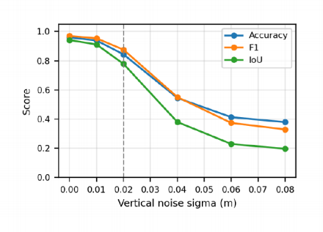
Results
Method | Acc | Prec | Rec | F1 | IoU
RANSAC + Normal | 0.836 | 0.947 | 0.795 | 0.864 | 0.761
PCA + Normal | 0.848 | 0.944 | 0.816 | 0.876 | 0.779
DBSCAN + Slope | 0.843 | 0.957 | 0.798 | 0.870 | 0.770
Height Histogram | 0.854 | 0.935 | 0.836 | 0.883 | 0.790
Notes:
Precision–recall trade-off: DBSCAN highest precision, Height Histogram best overall F1/IoU.

Slide 9
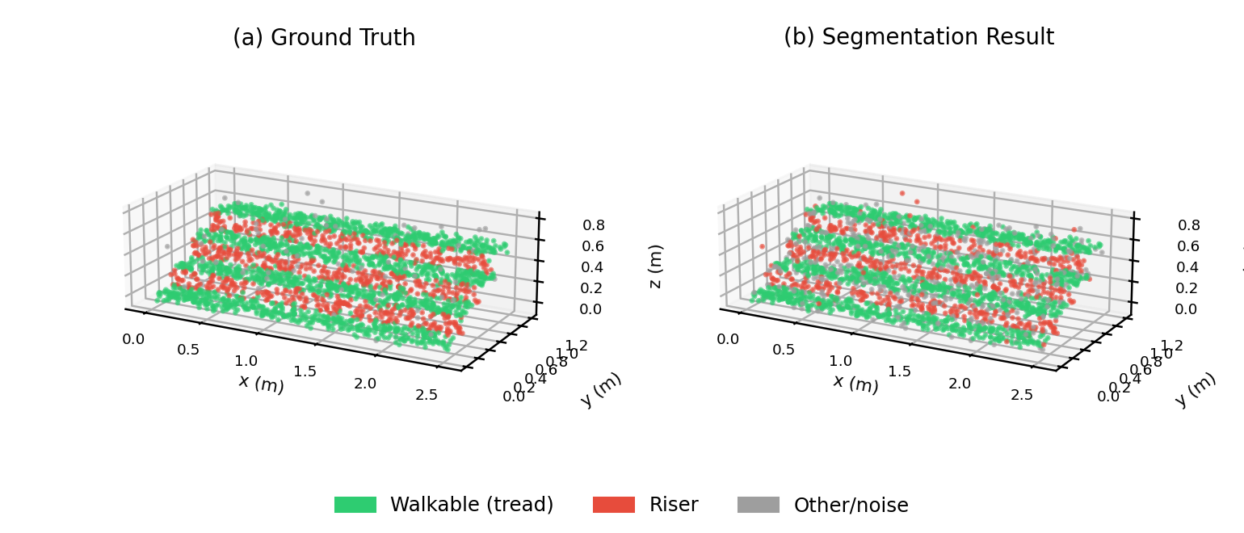
Segmentation Result vs Ground Truth
Takeaway: predicted walkable regions closely match ground truth; with precision > 0.93, almost everything marked green is truly a tread.
Notes:
Structure recovered cleanly; main errors are at edges and transition zones.

Slide 10
Implications
01
02
03
04
Precision over recall.
Noise-aware
Treat edges specially
Fuse, don't trust alone
A false positive can make the robot slip — target precision > 0.99 via edge filtering and safety margins.
thresholds. Use high-precision sensing or multi-scan temporal filtering; make |nz| thresholds adaptive.
The nosing is the most dangerous zone — add a dedicated edge class and a no-step margin.
. Adequate as a first perception layer, not a sole safety guarantee — fuse with IMU/camera.
Notes:
Argue that the metric to optimize for a robot is walkable-class precision, not overall accuracy.

Slide 11
CONCLUSION & FUTURE WORK
To summarise. We built a controlled, fully labelled synthetic staircase benchmark and compared four classical segmentation methods under identical conditions. The height histogram and normal analysis approaches deliver the best results, F1 of 0.883, precision above 0.93, IoU of 0.790. Noise is the decisive factor: performance degrades monotonically, which underscores the importance of sensor quality and preprocessing.
Future directions include defining a dedicated edge class, building noise-adaptive thresholds, applying smoothness-based region growing, exploring learning-based detectors, and most importantly, validating everything on real LiDAR data rather than synthetic data.
Notes:
Close on the contribution: a reproducible baseline + noise study; deployment needs safety margins and sensor fusion. Thank the audience.

