Slide 1

Example
Rima Al Ali

Slide 2
Suggested Use Case
Assumptions :
We have only the x dimension in the use case.
The movement in one direction (to front).
The leader, OffloadHelicopter and RescueHelicopter are fixed. (RescueHelicopter can go very slow to have a range for the outdated belief ).
The physical equation of the helicopter is the same as the car in this example.

Slide 3
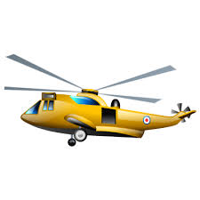

Suggested Use Case
connected
disconnected
Helicopter1 - 700
Helicopter2 - 1400
Leader
FireFighter
500

Slide 4
Suggested Use Case
connected
disconnected
Helicopter1 - 700
Helicopter2 - 1400
FireFighter
Leader
500

Slide 5
Suggested Use Case
connected
disconnected
?
Yes
(do nothing)
Helicopter1 - 700
Helicopter2 - 1400
Leader
500
FireFighter

Slide 6
Suggested Use Case
connected
No
If H1 nearest than H2
Then move H1
Else move H2
disconnected
?
Helicopter1 - 700
Helicopter2 - 1400
Leader
500
FireFighter

Slide 7
Suggested Use Case
connected
No
If H1 nearest than H2
Then move H1
Else move H2
disconnected
?
Helicopter1 - 700
Helicopter2 - 1000
Leader
500
FireFighter

Slide 8



Suggested Use Case
connected
No
If H1 nearest than H2
Then move H1
Else move H2
disconnected
?
$$α>β ?$$
Helicopter1 - 700
Helicopter2 - 1000
$$β$$
Leader
500
FireFighter
$$α$$

