Slide 1




Budget Buddy: Your Personal Finance Companion
Prepared By :-
Name :- Amipara Rimal
Roll No. :- 292
Enrollment No. :- 23002170210004
Branch :- IT

Slide 2
Project Outline
Purpose of the Project
ER Diagram
Use Case Diagram
Flow Chart
Functionalities
Usage Of Java
Usage Of Data Structure
Usage Of DBMS
Advantages
Disadvantages
Tools Use In project
Real Life Uses

Slide 3

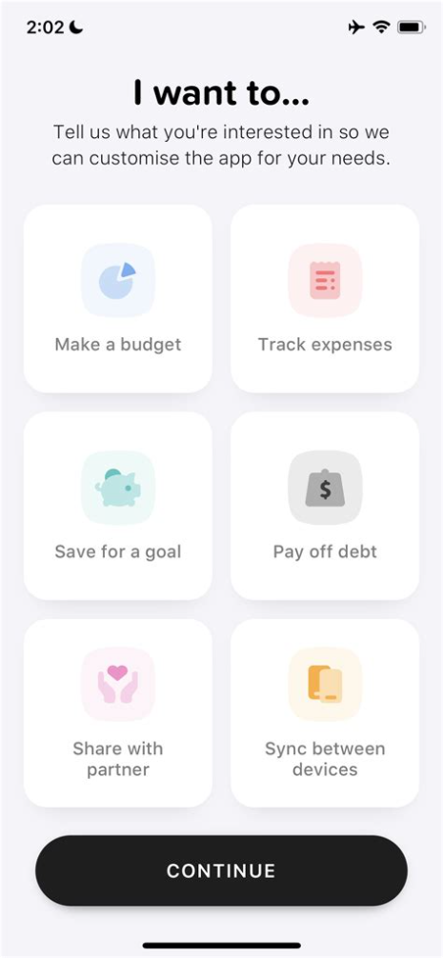
Purpose Of the Project
The purpose of the Budget Buddy project is to help users efficiently manage their finances by tracking income, expenses, and financial goals. It provides tools for users to log transactions, set savings goals, and view their financial history, making personal budgeting easier and more organized.

Slide 4
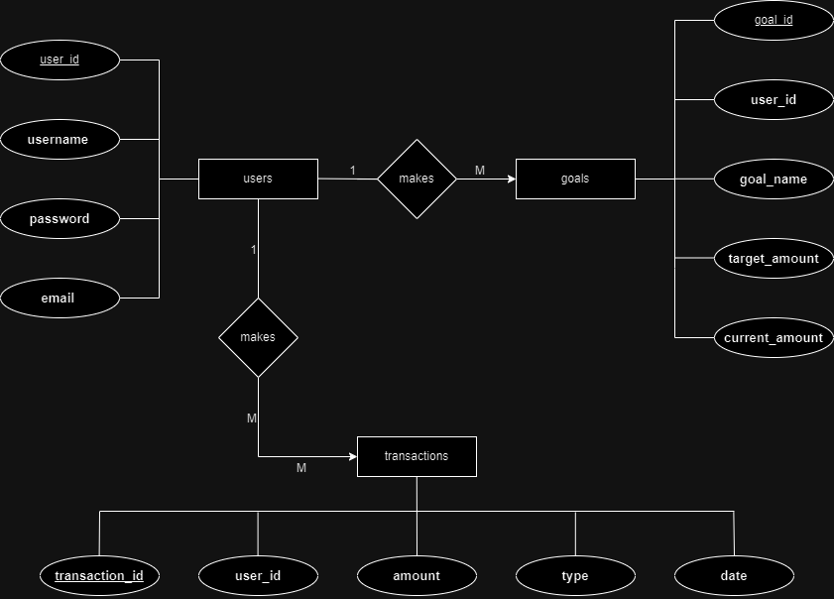

Slide 5
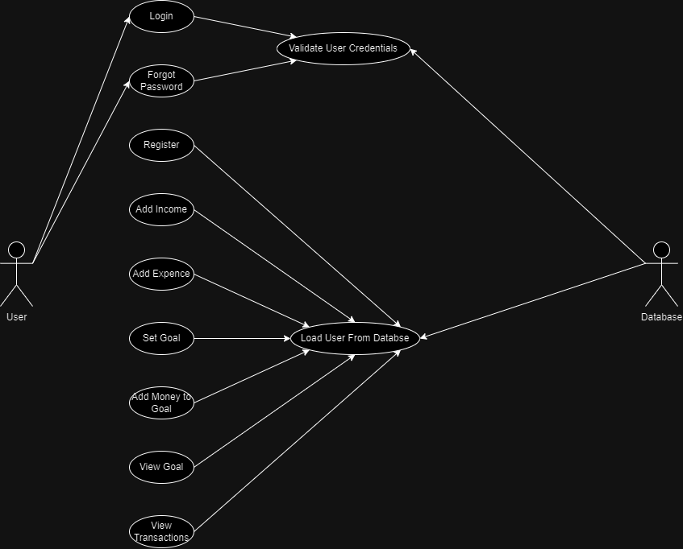

Slide 6
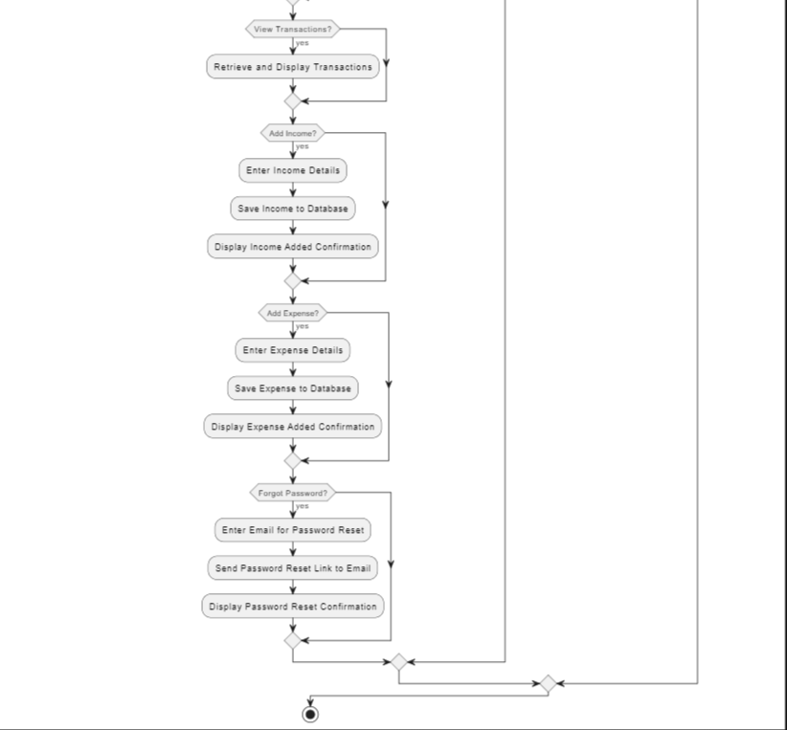
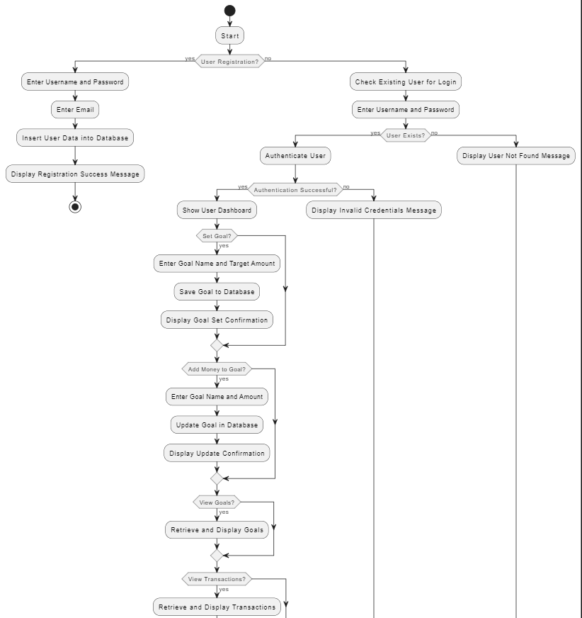

Slide 7
Functionalities
1
JAVA
Classes and Objects
Methods
Constructors
Interfaces
Exception Handling
2
Data Structure
Doubly Linked List (DLL)
3
DBMS
Insert, Update Operation
Prepared statement
Callable Statement
Procedures

Slide 8

Usage of Java
Classes :- Main, Login_Register, Income, Expense, DatabaseConnection, Transactions, Goal
Constructor :- Login_Register
Methods :- main(), loadUsersFromDatabase(), login(), resetPassword(), register(), addIncome(), addExpense(), viewTransactions(), setGoal(), addMoneyToGoal(), listOngoingGoals()
Interface :- IIncome, IExpense, interface ITransactions, IGoal
Exception Handling : Managing exceptions, particularly SQL exceptions, using try-catch.

Slide 9

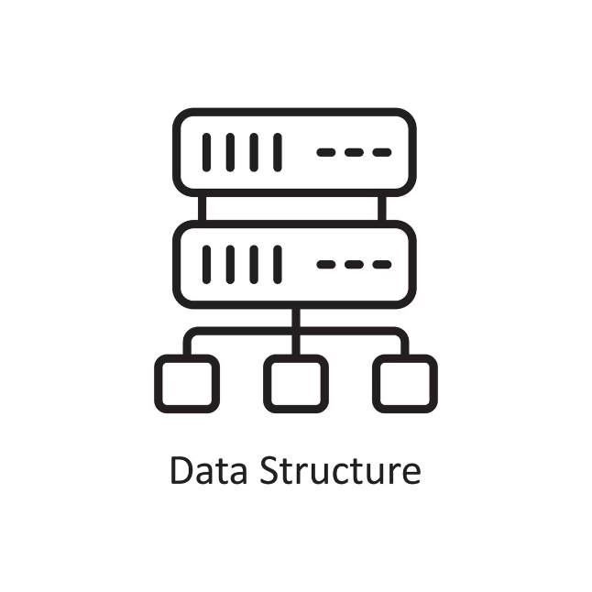
Usage of Data Structure
Doubly Linked list
Methods :- insertAtFirst(), insertAtLast(), insertAtLast(), display(), find()
Implementing a custom doubly linked list for managing user data and Transaction.

Slide 10

Usage of DBMS
SQL Queries: For retrieving, inserting, and updating data in tables like Users, Goals, and Transaction.
JDBC: Manages database connections and executes parameterized queries using Prepared Statement.
User Authentication: Validates user credentials against the database during login.
CRUD Operations: Supports creating, reading, and updating records in the database.
Connection Management: Ensures efficient handling of database resources.
The project also utilizes Stored Procedures for database operations, further enhancing the efficiency and modularity of SQL code execution. This integration supports complex queries and operations directly within the database, reducing client-side processing.

Slide 11
Advantages
Efficient Data Management: Custom linked lists enhance performance for user-related operations.
Secure Authentication: Parameterized queries prevent SQL injection.
Structured Database Interaction: Stored procedures improve efficiency and reduce client-side processing.
Modularity: Separate classes for different functionalities make the codebase easier to maintain and extend.
Real-Time Tracking: Users receive real-time updates on their financial goals.
Scalability: The design supports easy expansion with additional features.
Enhanced User Experience: Features like goal setting and forgot password improve usability.
Reusability: Custom data structures and components can be reused in future projects.

Slide 12
Disadvantages
Complexity: Custom data structures like linked lists can be more complex to implement and maintain compared to using built-in Java collections.
Database Dependency: Heavy reliance on the database means the system is vulnerable to issues like connection failures or SQL errors.
Scalability Challenges: While the design supports scalability, the use of custom structures could limit performance with large datasets compared to optimized built-in alternatives.
Maintenance Overhead: Managing custom code for linked lists and other structures may increase maintenance time and effort.
Limited Error Handling: The project might require more robust error handling, especially in database interactions, to ensure stability.
Learning Curve: Developers need a solid understanding of both DBMS concepts and custom data structures, which might be challenging for less experienced programmers.

Slide 13





Tools Used in Project
Java
VS Code
Used for developing the backend server logic and handling data processing.
Used for coding. And output Showing.
Xampp
SQL Database
Used for make database.
Used for storing and managing user data, transactions, and other financial information.

Slide 14

Real-life Uses:
Personal Finance Management: Helps individuals keep track of income and expenses.
Goal Setting: Allows users to set and monitor financial goals.
Transaction Tracking: Provides a history of financial transactions for better budgeting.
Financial Planning: Assists users in planning and achieving their financial objectives.

Slide 15
Thank You !
For Give your
Special Time

